Slide 1
Software Process

Slide 2
wall_dim = [0.0,2.4,0.0,1.5];

Slide 5

Wall Collision

Slide 7
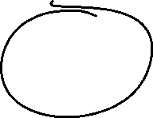




Slide 8
Load configuration file
TabFormDyn.py
def load_item_cfg(self,file):

Slide 9
plots_dir = "C:/_DJ/gPCDFP/inc";
tex_dir = "C:/_DJ/gPCDFP/inc";
tex_image_dir = "";
bond_profile = < Bonding Parameters FIle>.csv";
// rx ry rz vx, vy, vz
p0 = {rx=1.35;ry=1.0;rz=0.0;vx=1.0;vy=0.0;vz=0.0;radius=0.25;ptype=1;molar_mass=4.0026022;temp_vel=250,gas_const=8.3145,vap_temp=-268.9,attr_accel=0.045,rpls_accel=1.0,cmprs=1.0};
p1 = {rx=1.90;ry=1.0;rz=0.0;vx=-1.00;vy=0.0;vz=0.0;radius=0.25;ptype=1;molar_mass=4.0026022;temp_vel=250,gas_const=8.3145,vap_temp=-268.9,attr_accel=0.045,rpls_accel=1.0,cmprs=1.0};

Slide 10
rel_one = true;
wall_dim = [1.0,2.4,0.6,1.4];
walls = true;
sphere_facets = 15;
particle_range = [1,32];
particle_color = [1.0,0.0,0.0];
in_collison_factor = 0.11;
as_points = False;
vary_color = False;
dim = 2;

Slide 11
timer_interval = 100;
dt = 0.005;
start_time = 0.0;
end_time = 1.0;
xlim = [0.0,3.0];
ylim = [0.5,1.5];
plot_vectors = [true,false];
plot_commands =
[
"plt.ylabel('Time (s)')",
"plt.xlabel('Number particles, (N)')",
"fig.set_figwidth(10)",
"fig.set_figheight(8)",
"plt.rc('axes', labelsize=22)",
"plt.rc('xtick', labelsize=22)",
"plt.rc('ytick', labelsize=22)",
"plt.rc('legend', fontsize=22)",
];

Slide 12
description = "Two particles colliding horizontally";
select_particle = 0;
plt_vel_mag = [true,true];
plt_pvel_mag = [true,true];
plot_vectors = [true,true];
plot_pred_mom = [true,true];

Slide 14
Software Process
END

Slide 15

uint ArrayToIndex(uvec3 loc)
{
uint w = WIDTH;
uint h = HEIGHT;
uint indxLoc = loc.x + w * (loc.y + h * loc.z);
if(indxLoc > MaxLocation-1)
return npos;
else
return indxLoc;
}
The WIDTH and HEIGHT must be equal to the highest number cell location.
So, a particle located in the last cell<3,3,3> will have a HEIGHT,WIDTH of 4,4.
That is because the cell range is <0,0,0> to <3,3,3>

Slide 18
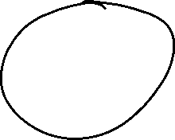
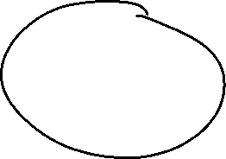

Slide 19
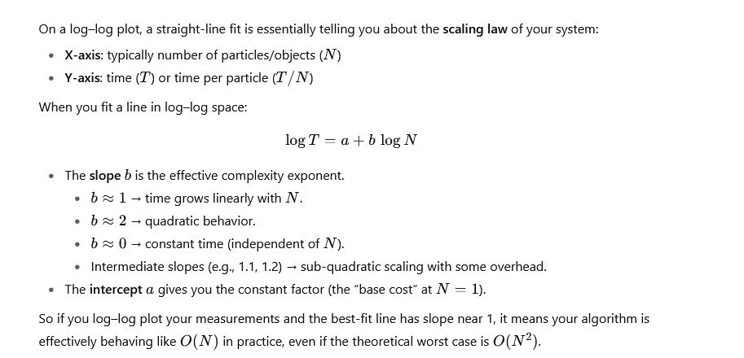

Slide 20
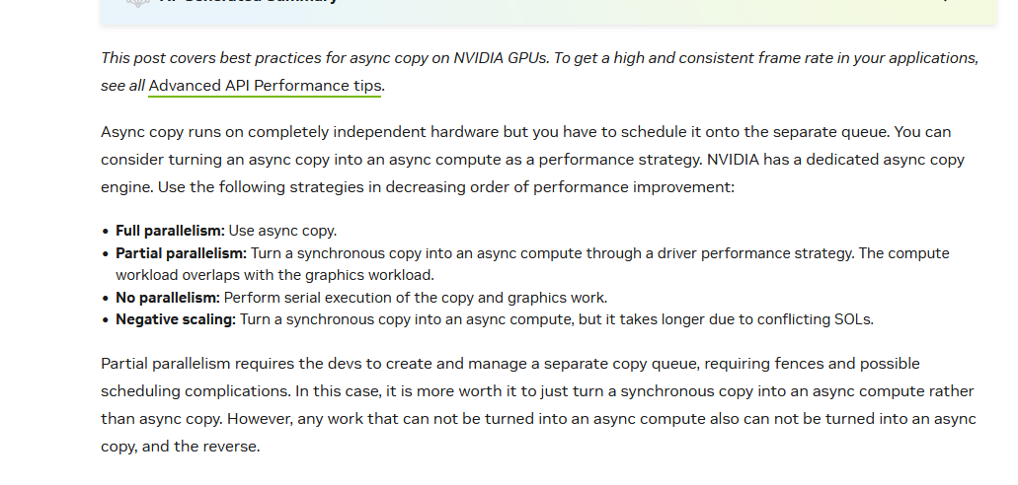

Slide 21
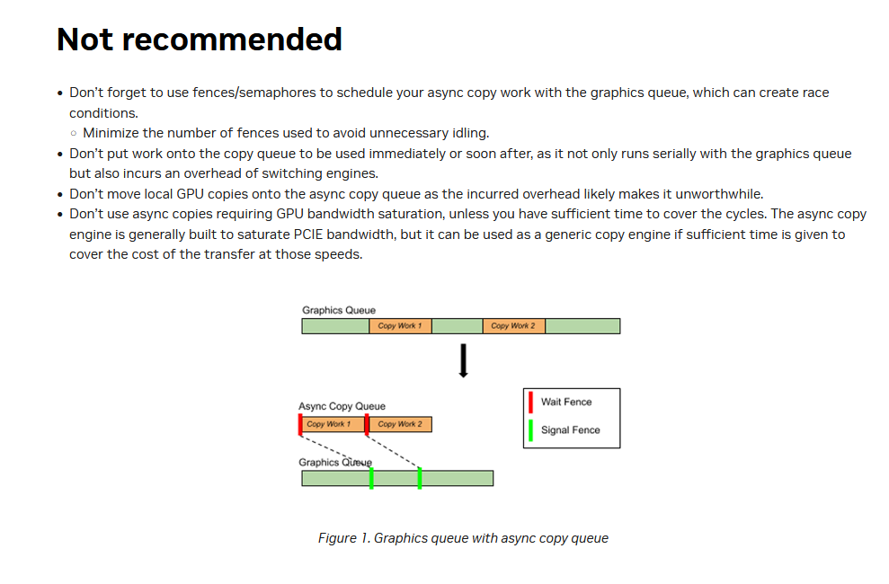

Slide 22
ivecA
360
ivecB

Slide 23
ivecA
Ovec
R1
ivecB

Slide 24

ivecA
Pvec
ivecB

Slide 27




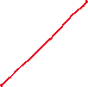





Slide 30
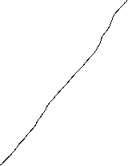
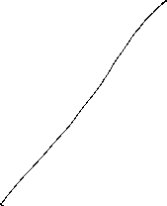
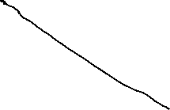
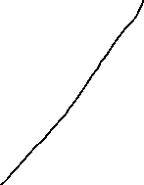
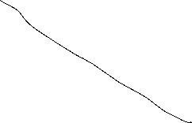
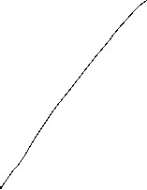

Slide 31




Slide 32
Steps:
Generate data sets
PQB,PQBR,PQBS
Run particleD.exe
Generates perfdataPQB.csv
Generates *.D.csv report files
Header
Run PQBTablePerfAllDiag.cfg
Generates perf
Runs in verification mode (cfg.mode)
Produces a repor of all unmatch parameters
Run ParticleR.exe
Generates *.D.csv report files

Slide 33
1,1

Slide 34
1,1

Slide 35
1,1

Slide 36
Nr = 2.0
C = 1.0/Nr
R = 0.2
D = C-2.0*R
S = D/2.0
x = 0.0;
y = 0.0;
for row = 0:Nr-1
for col = 0:Nr-1
x = 0.5 + S + R + col*(2*S+2*R);
y = 0.5 + S + R + row*(2*S+2*R);
fprintf("<%0.2f,%0.2f>\n",x,y)
end
end
Nr = 2
C = 0.5000
R = 0.2000
D = 0.1000
S = 0.0500
row:0,col:0<0.75,0.75>
row:0,col:1<1.25,0.75>
row:1,col:0<0.75,1.25>
row:1,col:1<1.25,1.25>

Slide 37
Cell and Lock array allocation and testing
In P Forge
Load config file
Generate paricle data and tst file
Select a bin file
Press Fill Cell Arry
Takes side length and adds one to it since the counter is <0,0,0> based
Allocates an cell array that is [(side_length+1)^3][(occupancy_list_size)]
Allocates a lock array that is [(side_length+1)^3]
In vulkan

Slide 38
Fill cell array
calculates cell array ise byts and len
calulates lock array bytes and len
Write cell array bytes to cfg(cell_ary_rpt_text = "cell_ary_rpt.txt“);

Slide 41
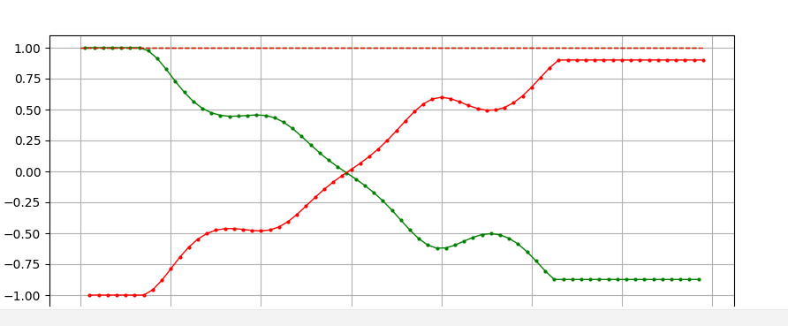
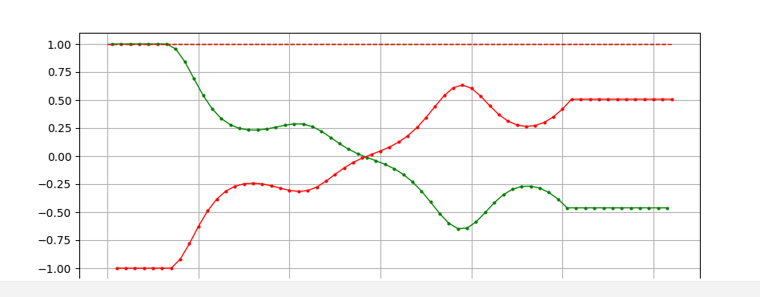
0.1

