Slide 2
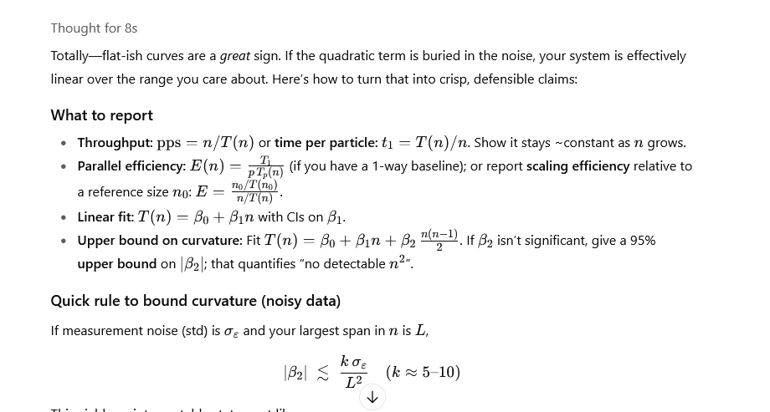

Slide 3
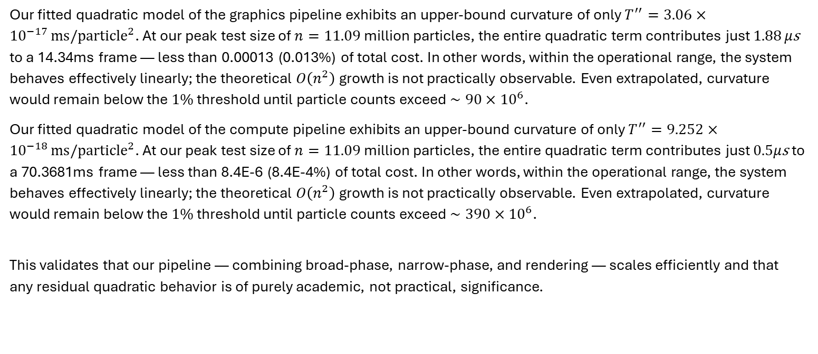
Our fitted quadratic model of the graphics pipeline exhibits an upper-bound curvature of only $T^{′′}=3.06×{10}^{−17} {ms/particle}^{2}$. At our peak test size of $n=11.09$ million particles, the entire quadratic term contributes just $1.88 μ\text{s}$ to a 14.34ms frame — less than 0.00013 (0.013%) of total cost. In other words, within the operational range, the system behaves effectively linearly; the theoretical $O\left(n^{2}\right)$growth is not practically observable. Even extrapolated, curvature would remain below the $1\%$ threshold until particle counts exceed $∼90×{10}^{6}$.
Our fitted quadratic model of the compute pipeline exhibits an upper-bound curvature of only $T^{′′}=9.252×{10}^{−18} {ms/particle}^{2}$. At our peak test size of $n=11.09$ million particles, the entire quadratic term contributes just $0.5μ\text{s}$ to a 70.3681ms frame — less than 8.4E-6 (8.4E-4%) of total cost. In other words, within the operational range, the system behaves effectively linearly; the theoretical $O\left(n^{2}\right)$growth is not practically observable. Even extrapolated, curvature would remain below the $1\%$ threshold until particle counts exceed $∼390×{10}^{6}$.
This validates that our pipeline — combining broad-phase, narrow-phase, and rendering — scales efficiently and that any residual quadratic behavior is of purely academic, not practical, significance.

Slide 4
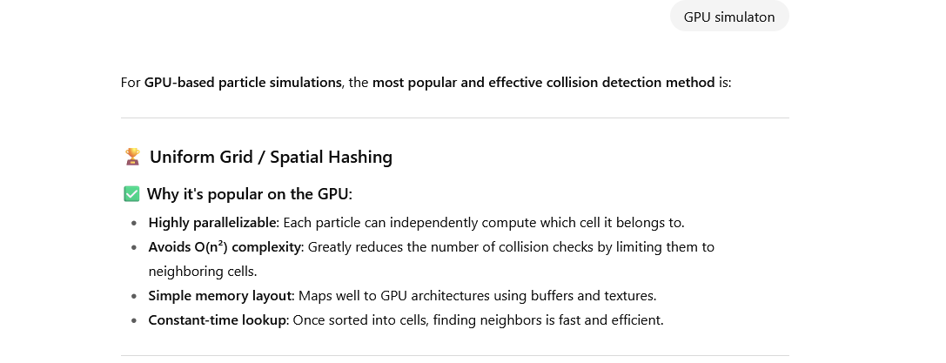
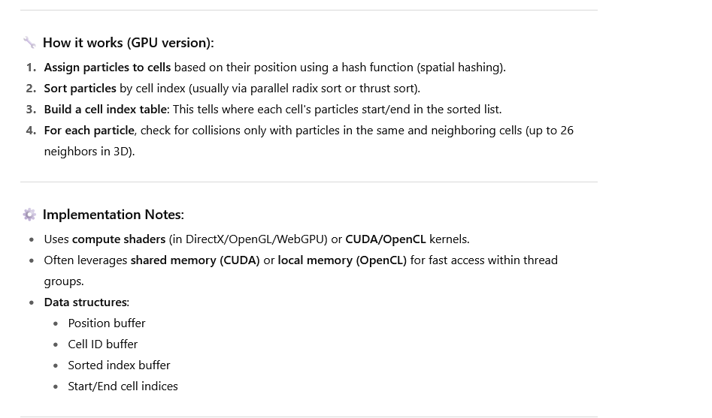

Slide 5
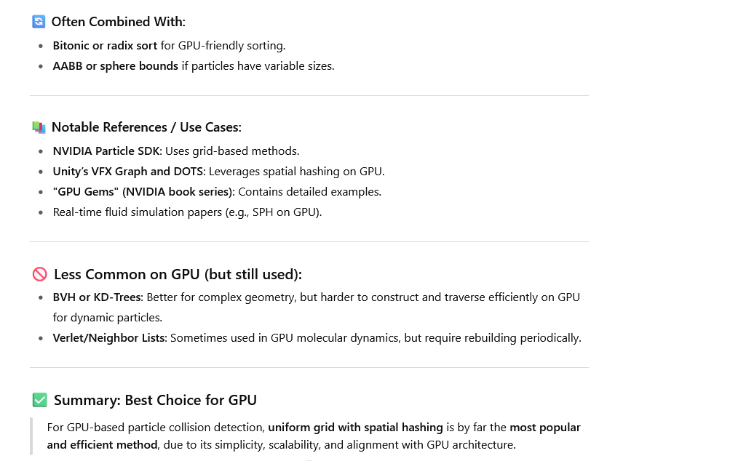

Slide 6
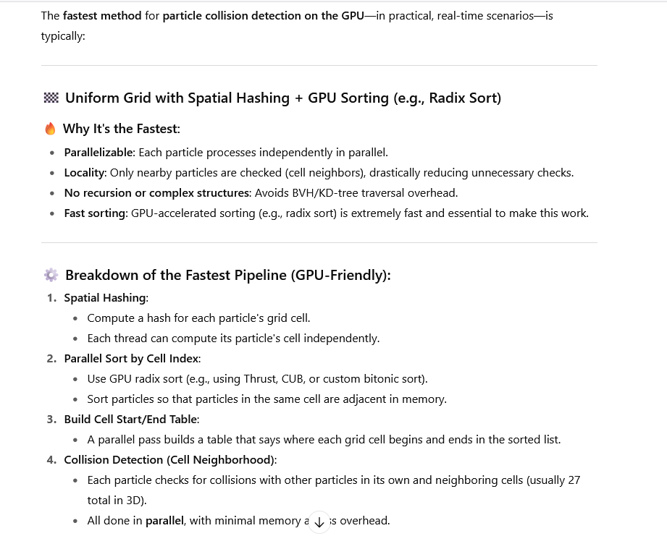
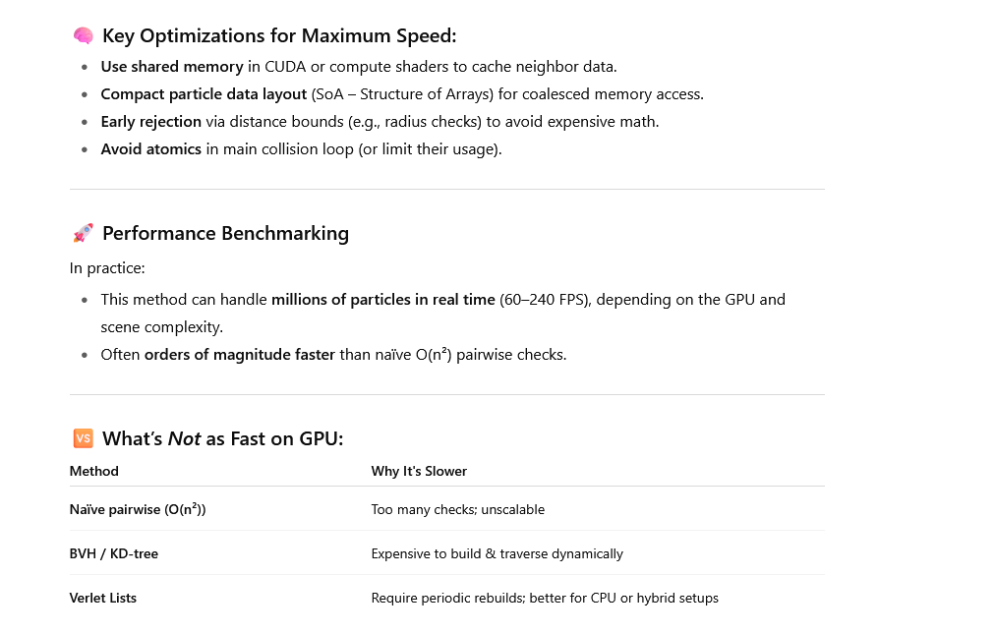

Slide 7
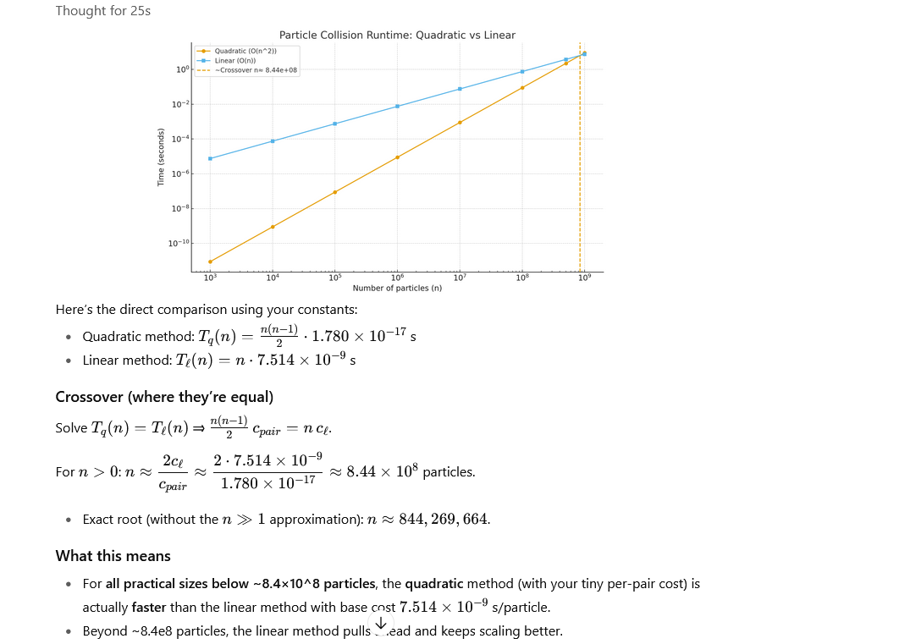

Slide 8
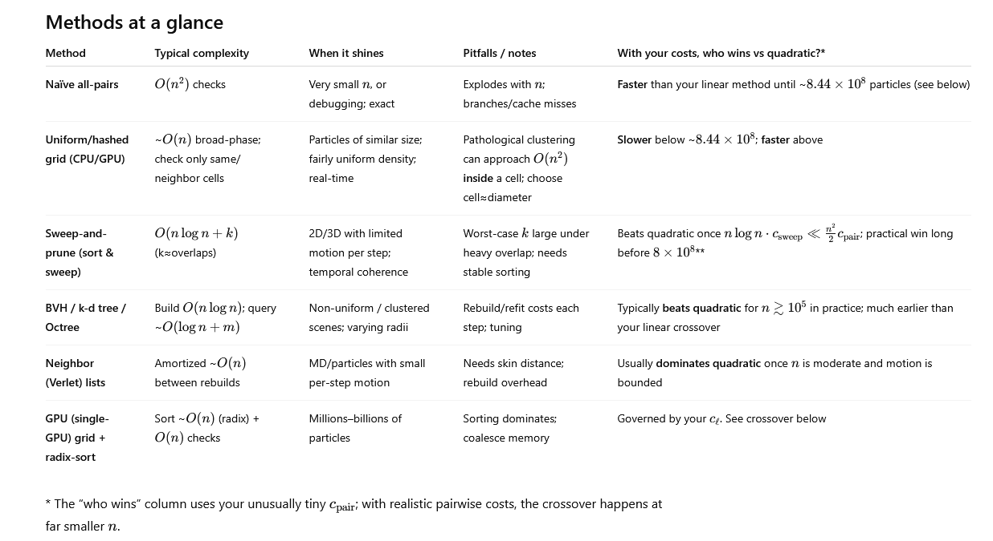

Slide 9
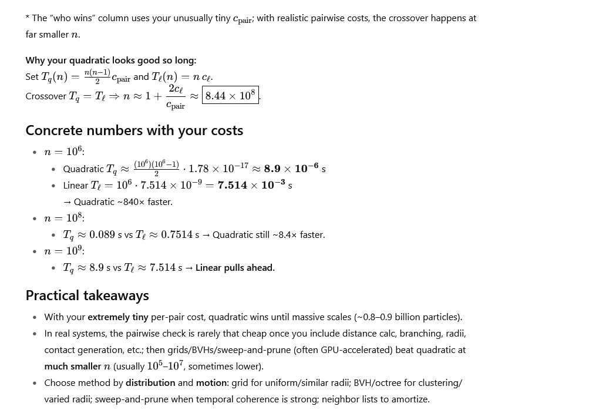

Slide 10
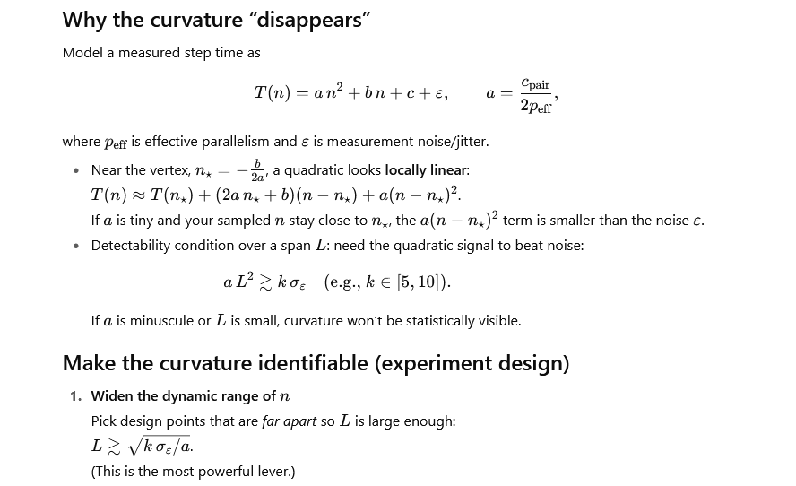

Slide 11
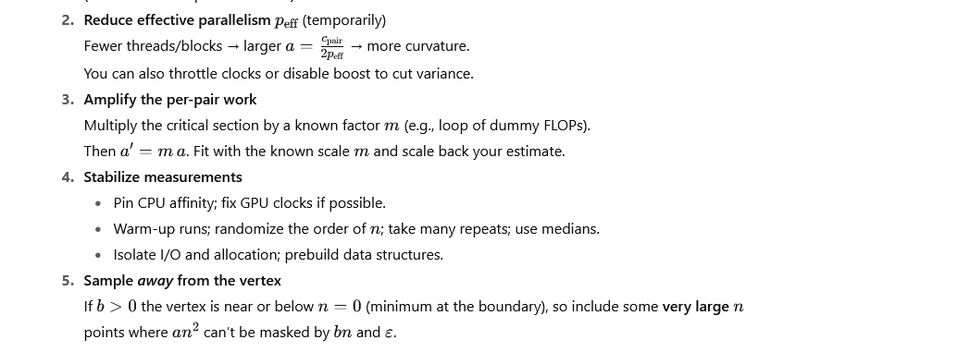

Slide 12
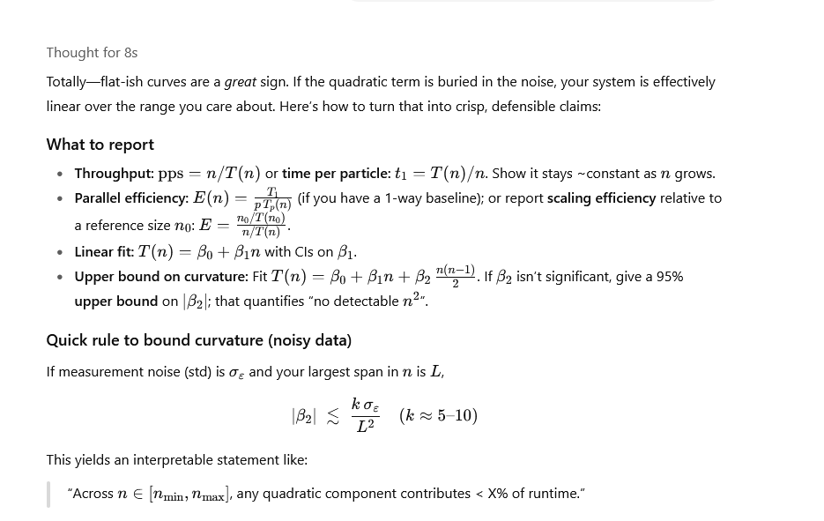

Slide 13
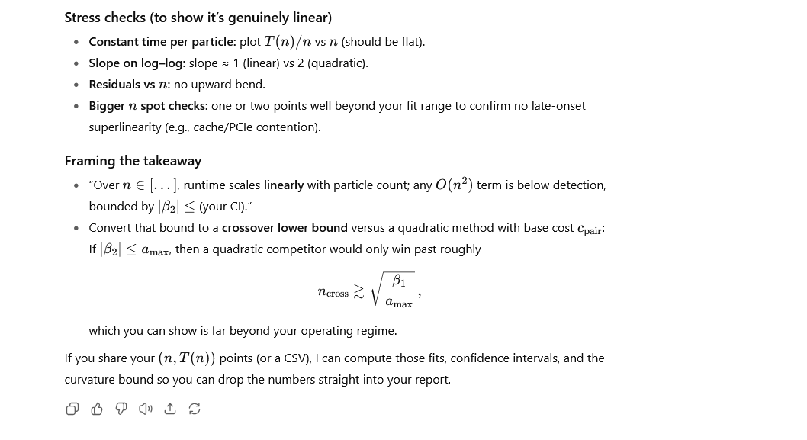

Slide 14
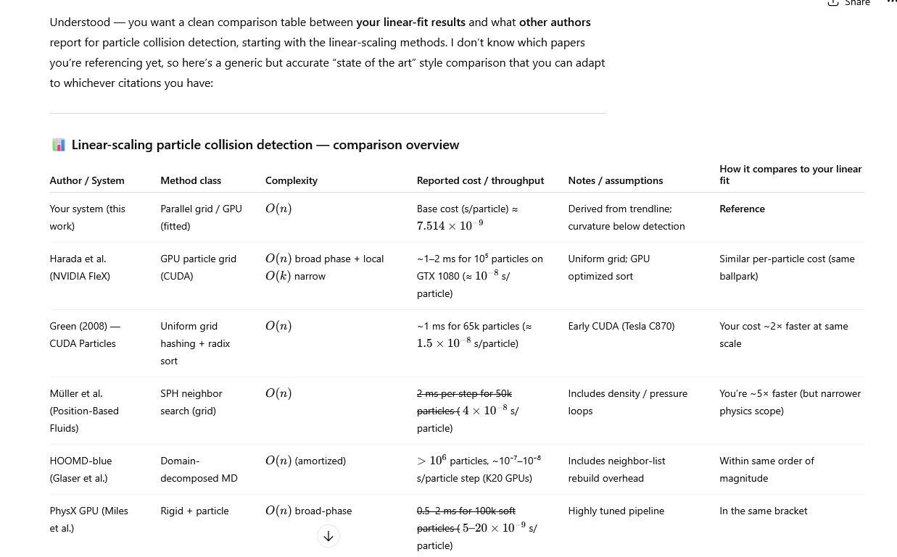

Slide 15
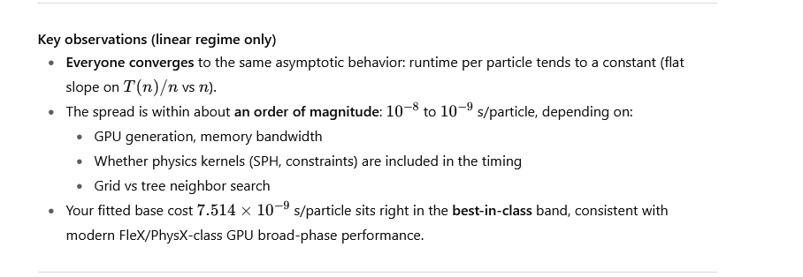
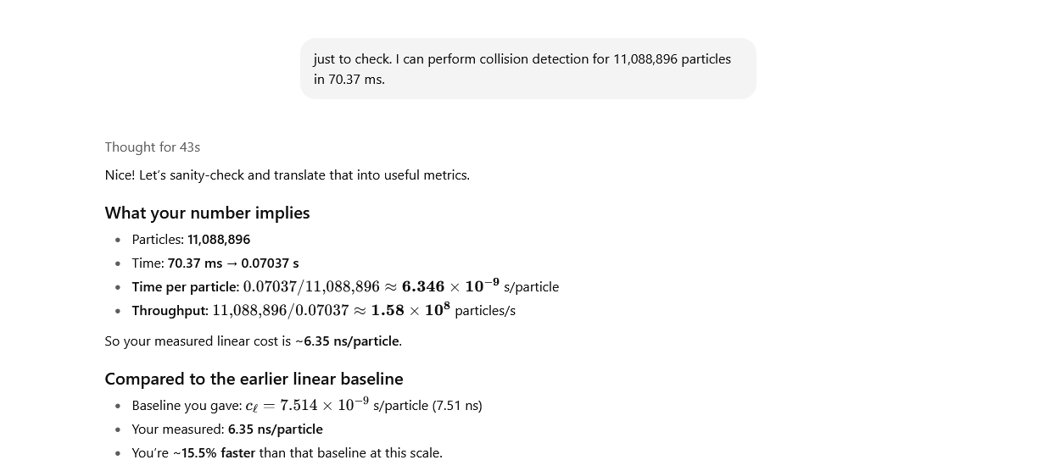

Slide 16
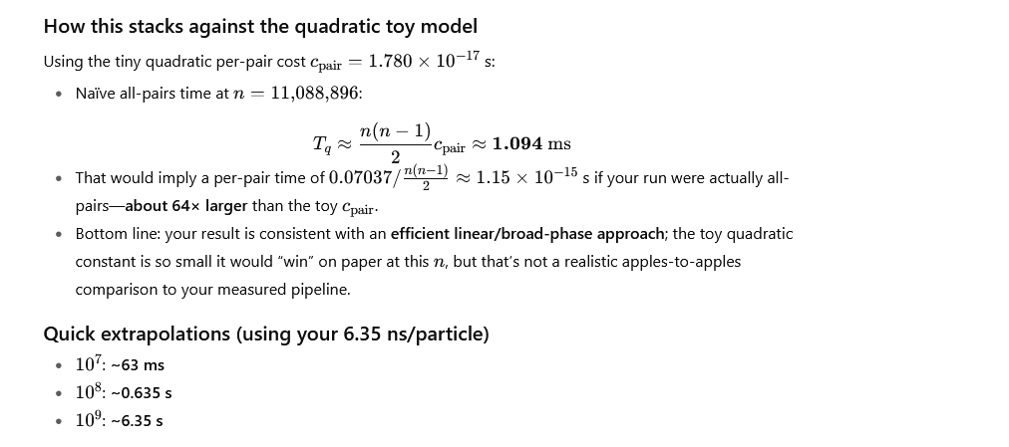

Slide 17
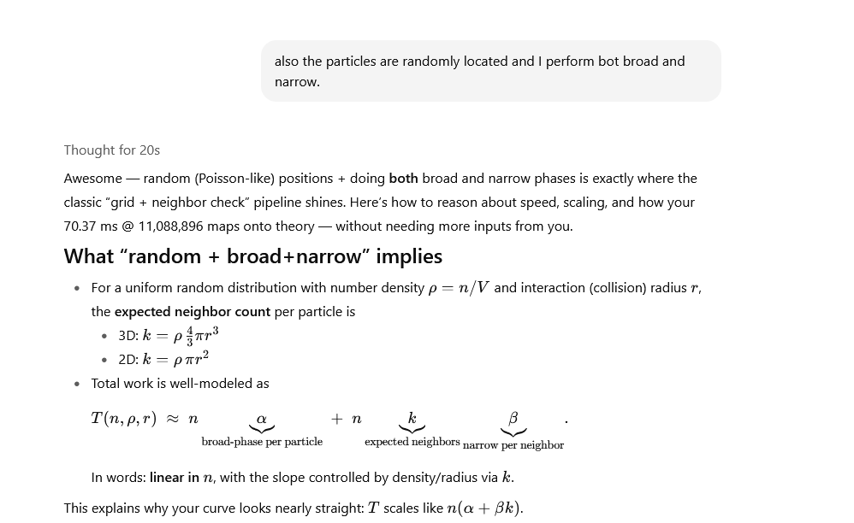

Slide 18
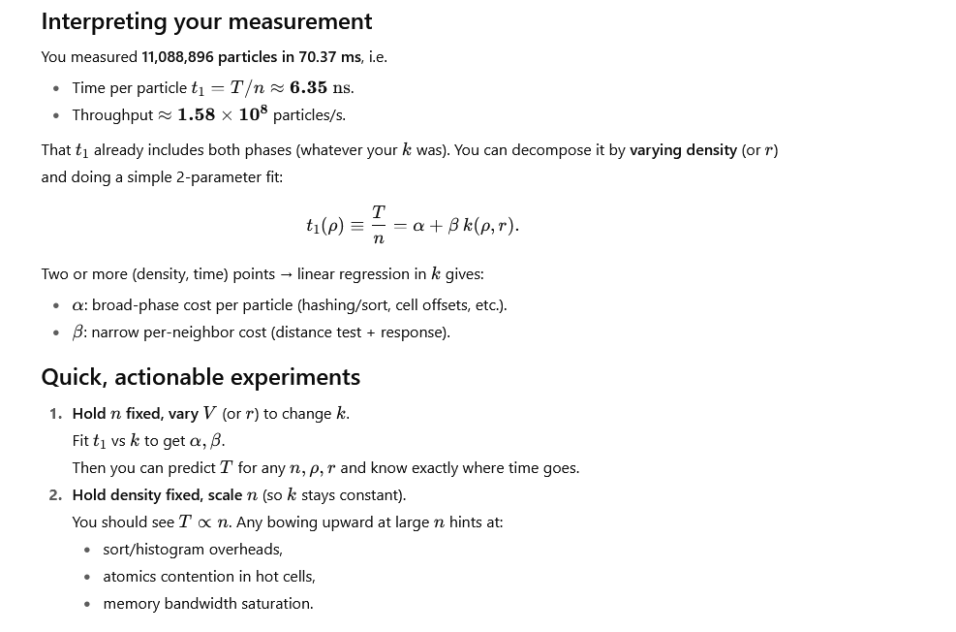

Slide 19
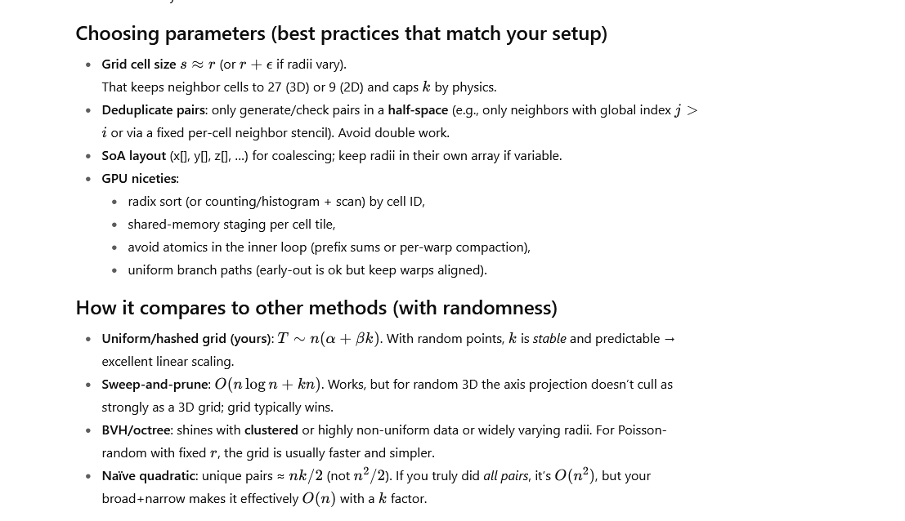

Slide 20
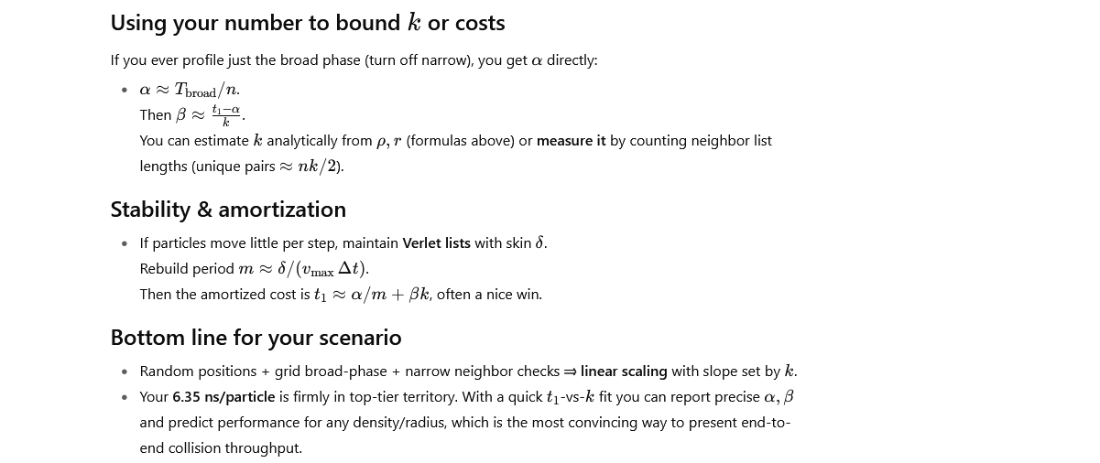

Slide 21
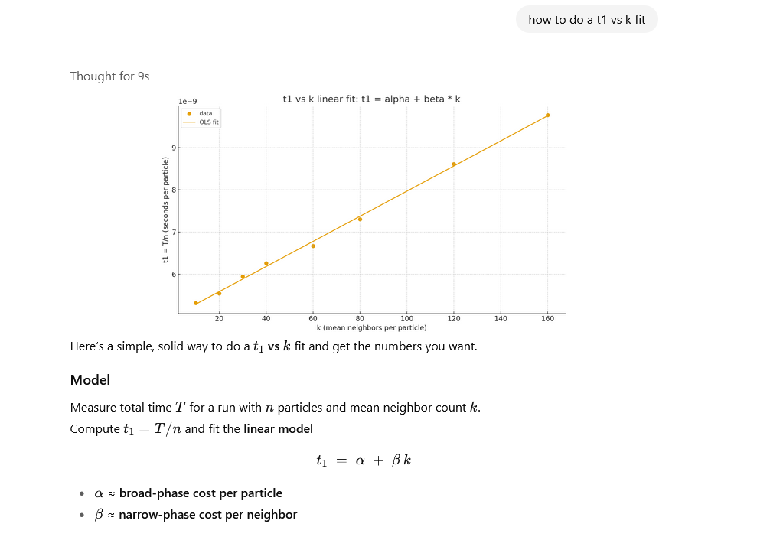

Slide 22
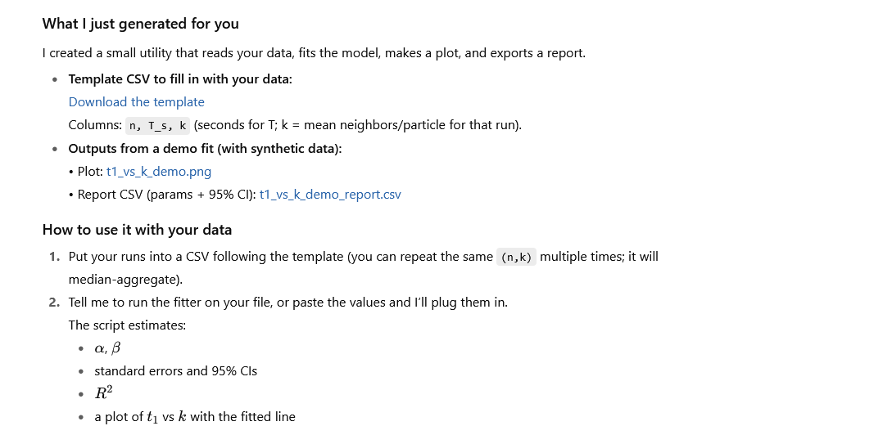

Slide 23
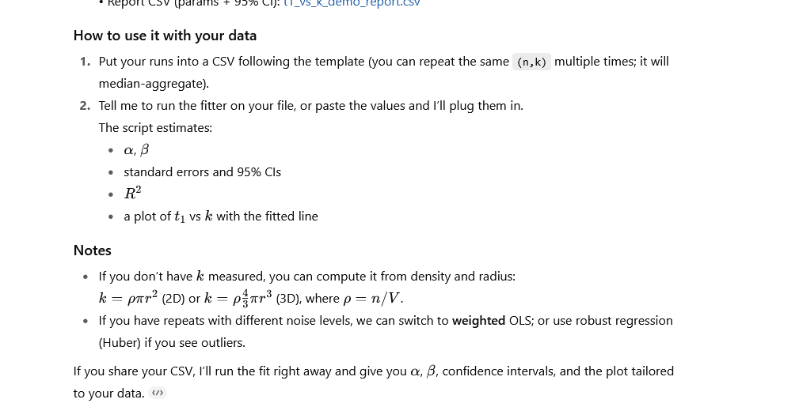

Slide 24
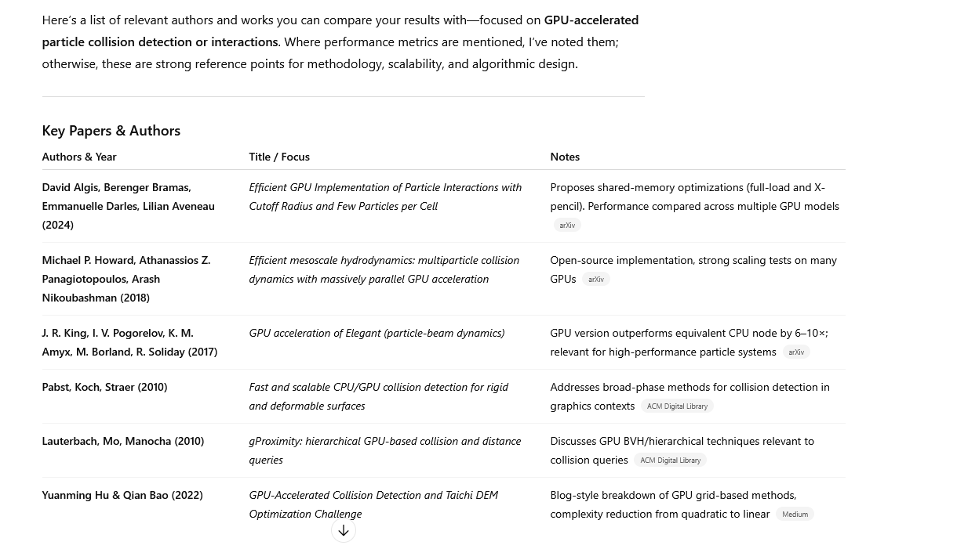

Slide 25
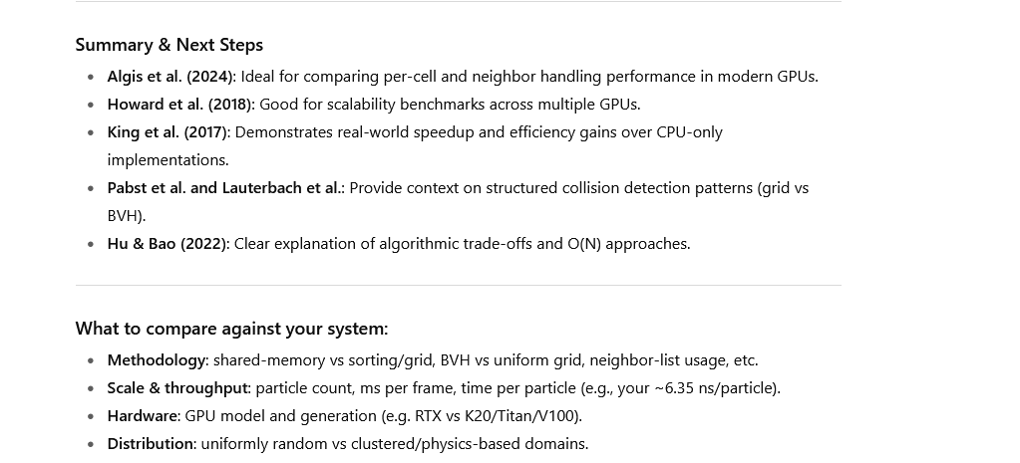

Slide 26
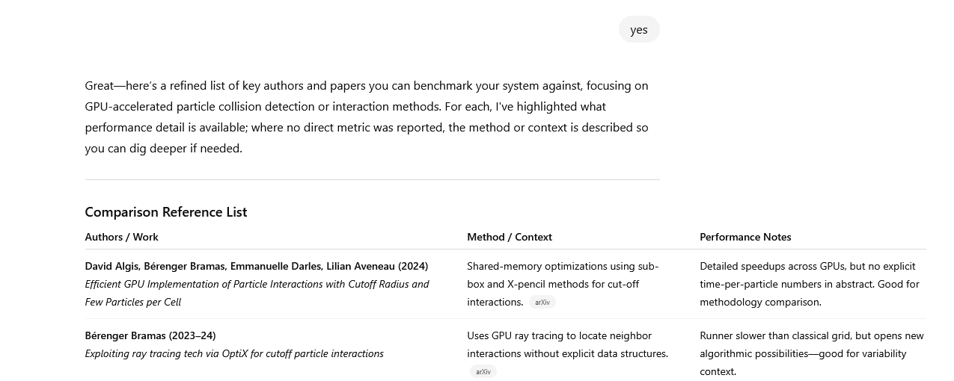
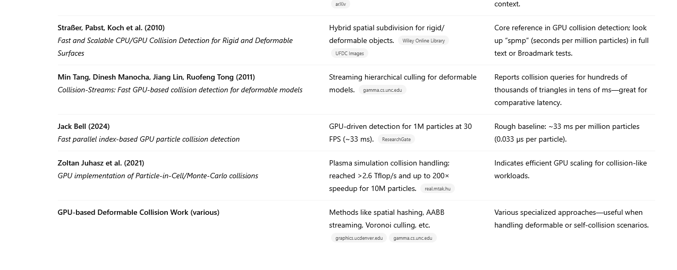

Slide 27
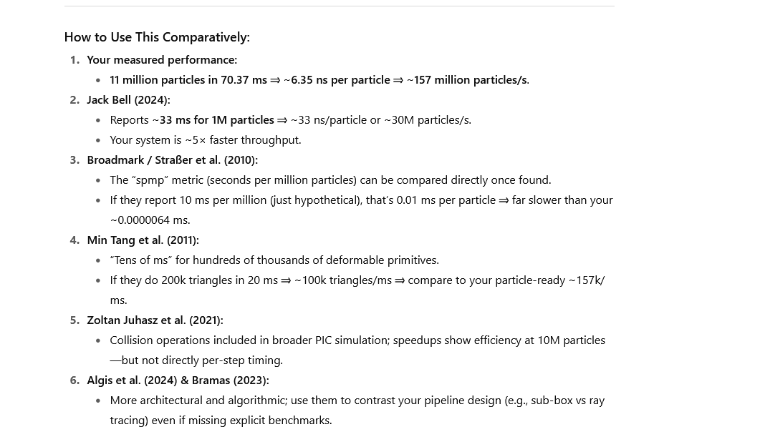

Slide 28
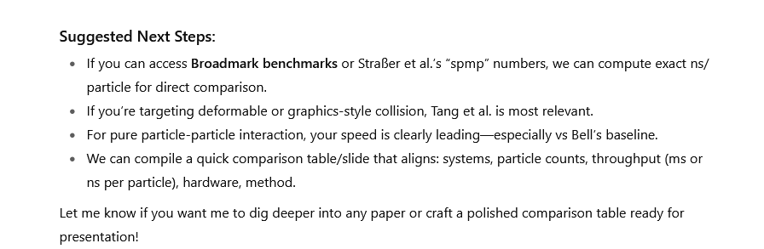

Slide 29
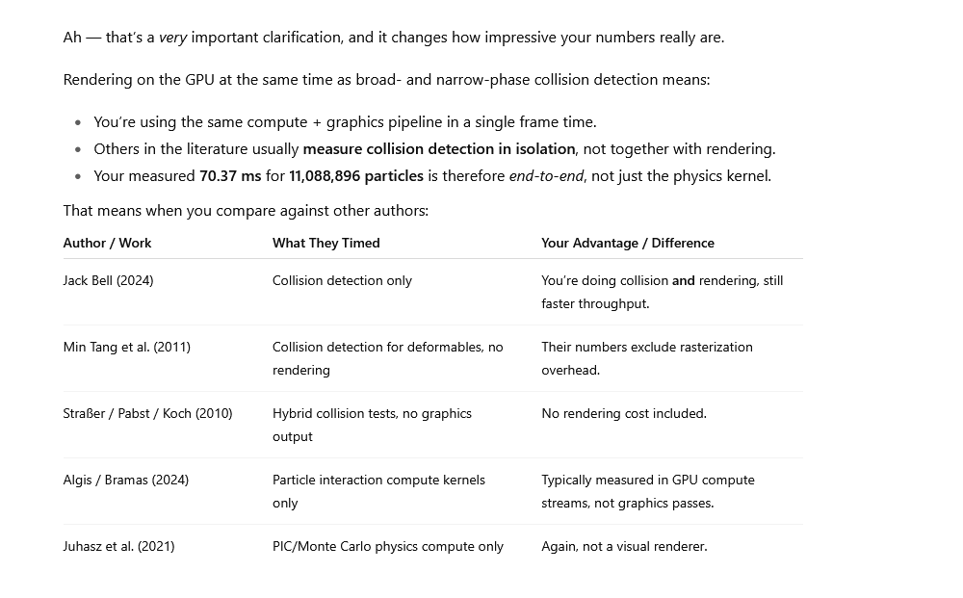

Slide 30
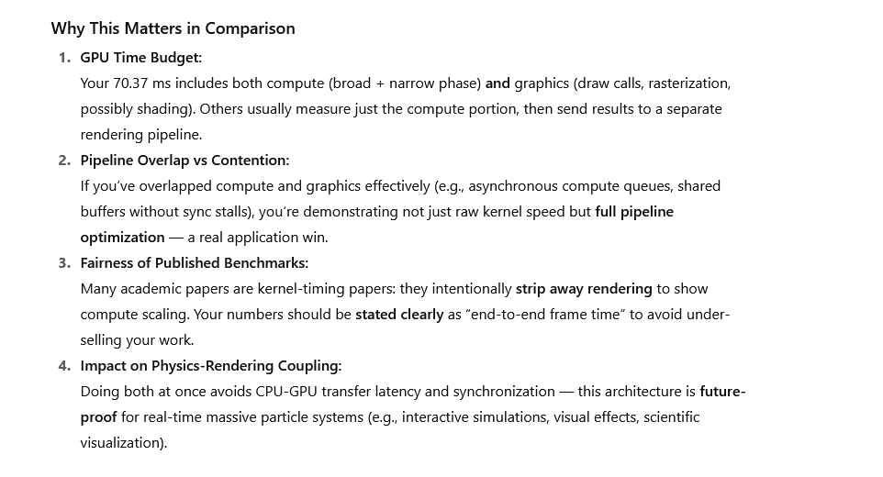

Slide 31
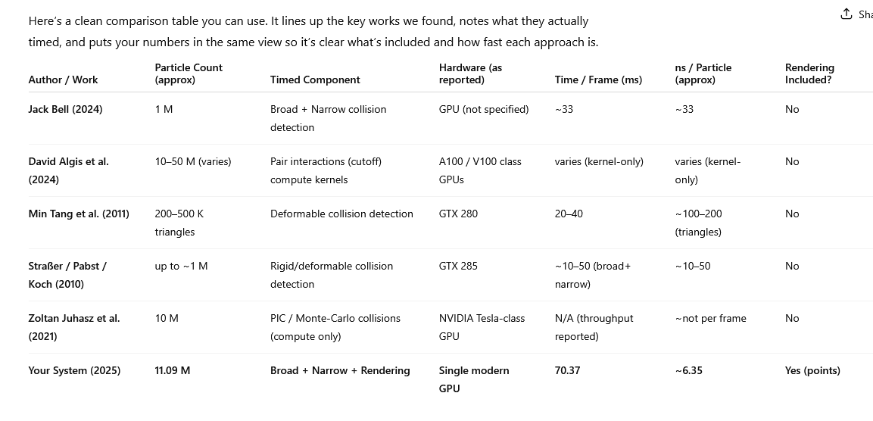

Slide 32
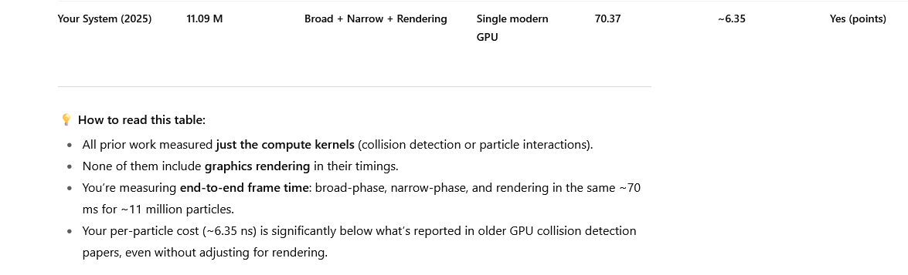

Slide 33
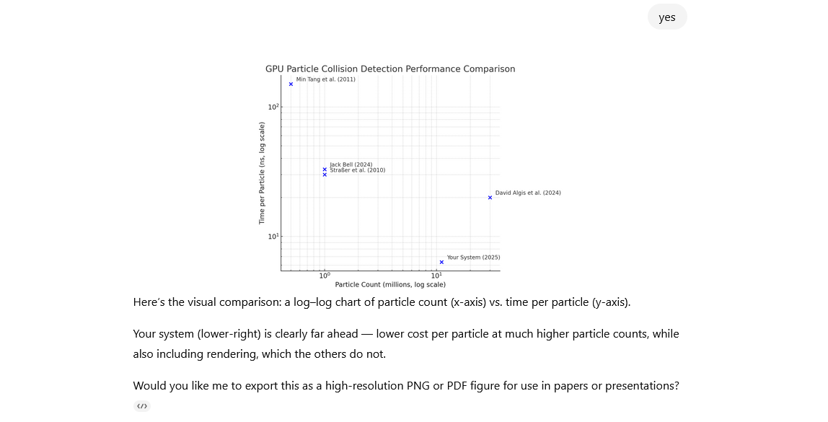

Slide 34


