Slide 1

ACHIEVEMENTS
INTEGRATED CHILD PROTECTION SCHEME
(ICPS)

Slide 2
INTEGRATED CHILD PROTECTION SCHEME
Comprehensive Centrally Sponsored Scheme
Creates a safety net of Service Delivery Structures at National, State & District level
Puts in place a cadre of trained personnel working exclusively on Child Protection
Provides a range of need based services for each child
Existing initiatives merged & new measures introduced, based on pre - defined and enhanced cost norms
2

Slide 3
STATUS OF EXPENDITURE

Slide 4
STATUTORY BODIES

Slide 5
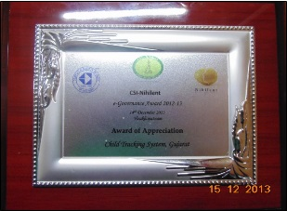
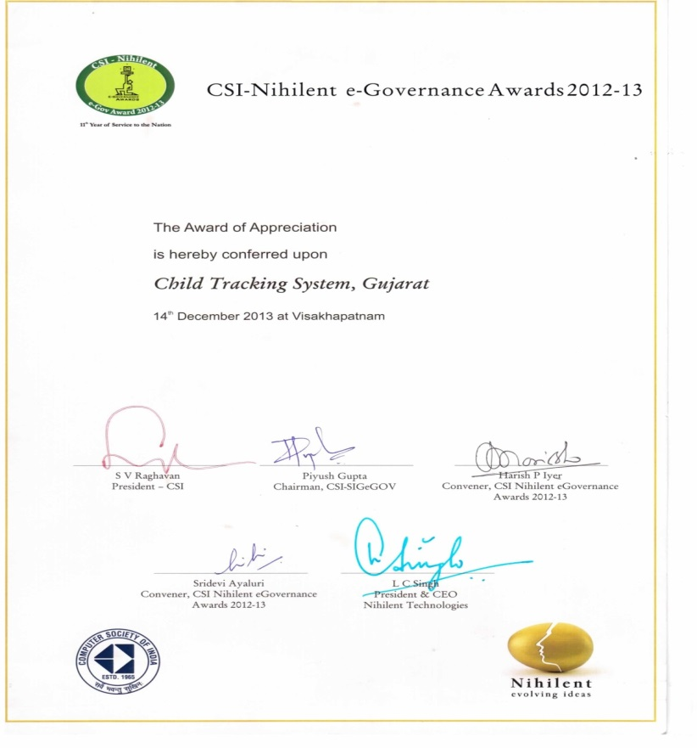
Award for implementing MIS for missing children: Trackchild
As Implementing Authority Social Justice and Empowerment Department, Gujarat State has received a National Award from Computer Society of India for “Award for Appreciation category” for year 2012-13 on 14th December 2013.

Slide 6
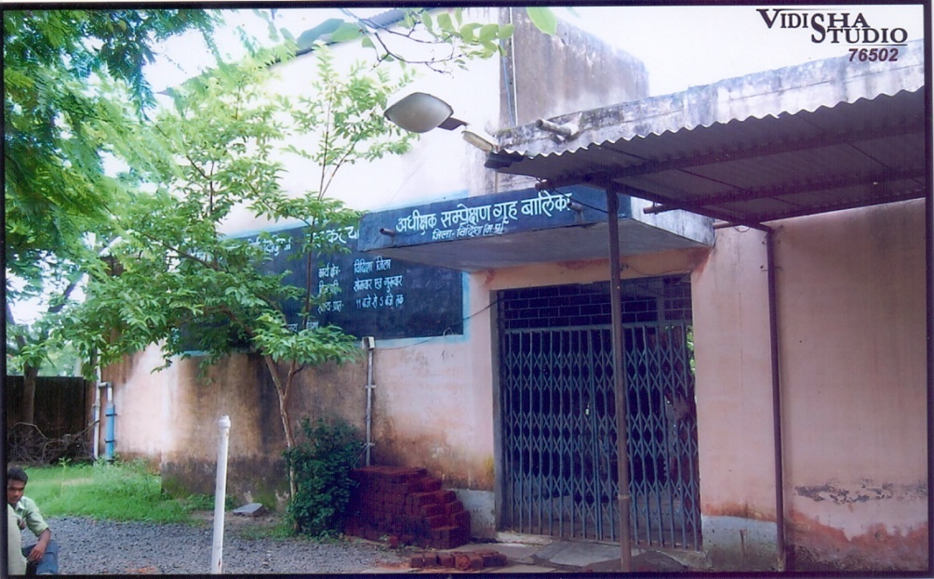
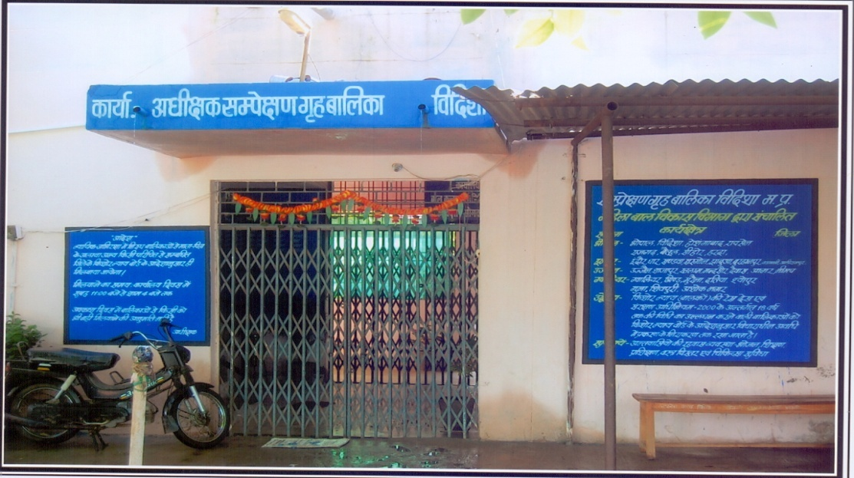
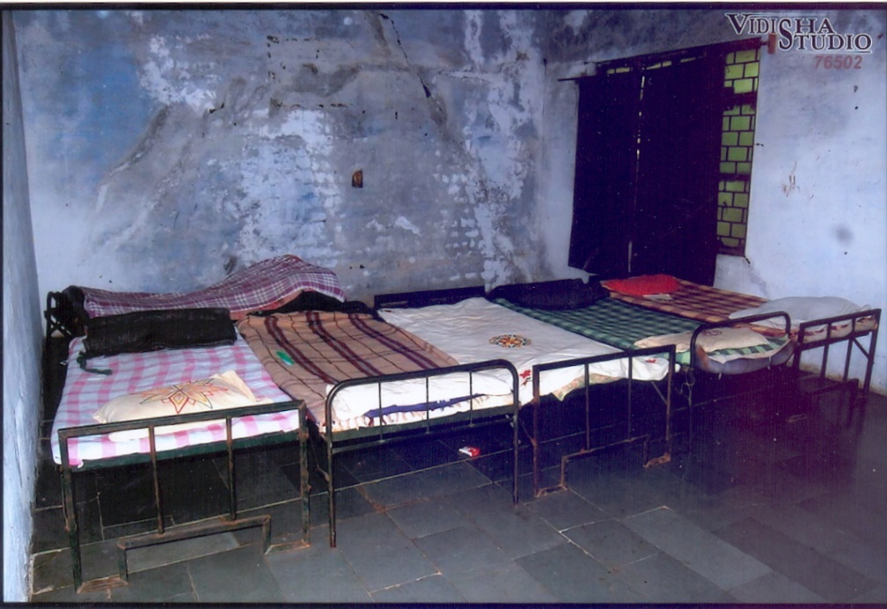
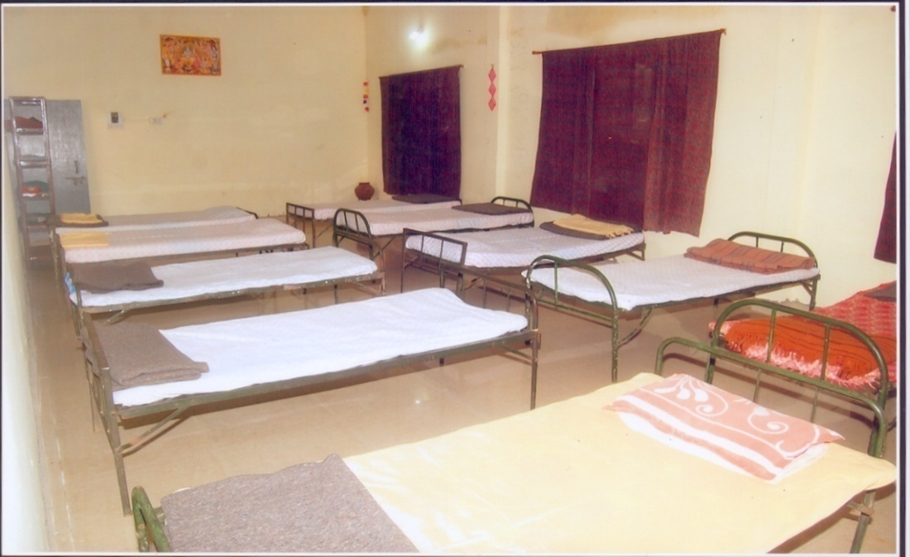
Upgraded Infrastructure of Homes
iwoZ fLFkfr
orZeku fLFkfr

Slide 7
SERVICE DELIVERY STRUCTURES
Structures set up at State & Districts
State Project Support Unit (SPSU): 31
State Child Protection Society (SCPS): 34
State Adoption Resource Agency (SARA): 31
District Child Protection Units (DCPU): 622
Central Project Support Unit (CPSU)

Slide 8
Care, Support & Rehabilitation Services Supported
1389 Homes of various kinds
261 community based safe spaces: as Open Shelters
289 Specialised Adoption Agencies (SAAs) for sponsorship, foster-care, adoption & aftercare)
282 ‘CHILDLINE’ locations through 554 partners for Emergency outreach services

