Slide 1
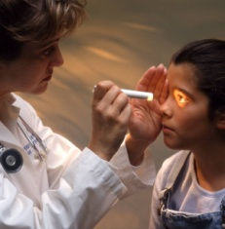
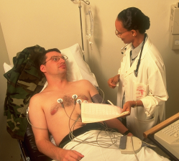
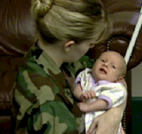
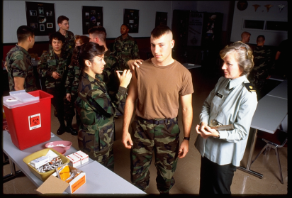
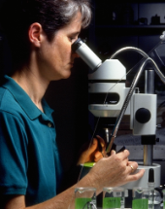
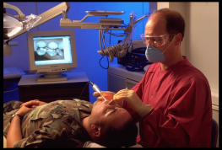
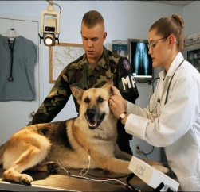
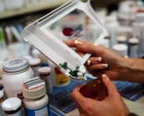

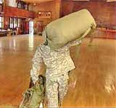
Fiscal Year 2015 in Direct Care – MEDCOM
Outpatient Care
19,094,904 Clinic Visits
Inpatient Care
389,721 Beds Occupied
128,568 Patients Discharged
Babies
16,436 Births
Vaccines
1,485,471 Immunizations
Laboratory
18,634,689 Lab Services
Dental
7,617,288 Services
RX
18,337,011 Prescriptions
Veterinary Services
557,371
Veterinary Outpatient Visits
$7.3 Billion of Food Inspected
154,866 Food Safety Visits
Personnel Deploying
2254 Soldiers & Civilians
Radiology
4,023,959
Rad Services
Notes:
Annual MEDCOM Numbers were derived by extracting data for specified time period.
--Inpatient Care (beds occupied and patients admitted) updated by:
Vernita Mahan, Health System Specialist Data Analysis Section, PASBA, 210-295-8922, DSN 421-8922
Source: M2, SIDR
--Dental procedures updated by: Vernita Mahan, Health System Specialist
Data Analysis Section, PASBA, 210-295-8922, DSN 421-8922. Source: M2, Dental Health Care Services Database
--Outpatient care visits and births updated by: Vernita Mahan, Health System Specialist
Data Analysis Section, PASBA, 210-295-8922, DSN 421-8922. Source: M2, CAPER
--Lab, Pharmacy, Radiology, Immunizations –
Source: RX = M2, PDTS; Rads = M2, Ancillary Radiology; Labs= M2, Ancillary Labs, Vaccines = M2, CAPER
Laboratory numbers represent ancillary laboratory services only
Pharmacy numbers represent outpatient prescriptions only
Immunizations extracted from M2 CAPER using CPT Codes that are related to vaccines, toxoids and immune globulins (ie immunizations). Source = CDC (http://www2a.cdc.gov/vaccines)
Updated by: Vernita Mahan, Health System Specialist. Data Analysis Section, PASBA, 210-295-8922, DSN 421-8922.
--Veterinary Services updated by: COL Lawrence, Program Manager, Technical, Veterinary Services Portfolio, Army Public Health Center
--Personnel Deployed updated by OTSG G-33 – Bobby Thacker, MEDCOM, San Antonio; Includes all global engagements: Kuwait, Afghanistan, Africa, Germany, Pacific, others.

Slide 2
Fiscal Year 2015 - Average Day in Direct Care – MEDCOM
Outpatient Care
52,279 Clinic Visits
Inpatient Care
1,067 Beds Occupied
352 Patients Discharged
Babies
45 Births
Vaccines
4,067 Immunizations
Laboratory
51,019 Lab Services
Dental
20,855 Services
RX
50,204 Prescriptions
Veterinary Services
1,533 Veterinary Outpatient Visits
$20.4 Million of Food Inspected
502 Food Safety Visits
Personnel Deploying
534 Soldiers & Civilians
Radiology
11,017 Rad Services
Notes:
Average Day in MEDCOM Numbers were derived by extracting data for specified time period and dividing by 365.25 to get to a daily average.
--Inpatient Care (beds occupied and patients admitted) updated by:
Vernita Mahan, Health System Specialist Data Analysis Section, PASBA, 210-295-8922, DSN 421-8922
Source: M2, SIDR
--Dental procedures updated by: Vernita Mahan, Health System Specialist
Data Analysis Section, PASBA, 210-295-8922, DSN 421-8922. Source: M2, Dental Health Care Services Database
--Outpatient care visits and births updated by: Vernita Mahan, Health System Specialist
Data Analysis Section, PASBA, 210-295-8922, DSN 421-8922. Source: M2, CAPER
--Lab, Pharmacy, Radiology, Immunizations –
Source: RX = M2, PDTS; Rads = M2, Ancillary Radiology; Labs= M2, Ancillary Labs, Vaccines = M2, CAPER
Laboratory numbers represent ancillary laboratory services only
Pharmacy numbers represent outpatient prescriptions only
Immunizations extracted from M2 CAPER using CPT Codes that are related to vaccines, toxoids and immune globulins (ie immunizations). Source = CDC (http://www2a.cdc.gov/vaccines)
Updated by: Vernita Mahan, Health System Specialist. Data Analysis Section, PASBA, 210-295-8922, DSN 421-8922.
--Veterinary Services updated by: COL Honadel, VC, Director, Veterinary Services Portfolio, Army Public Health Center
--Personnel Deployed updated by OTSG G-33 – Bobby Thacker, MEDCOM, San Antonio; Includes all global engagements: Kuwait, Afghanistan, Africa, Germany, Pacific, others.

