Slide 1
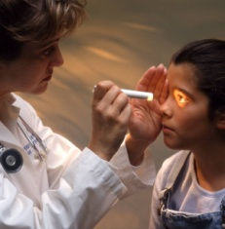
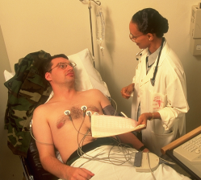
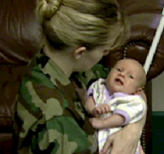
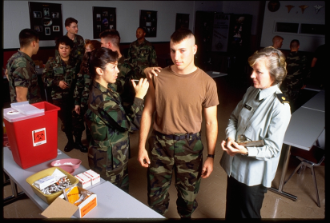
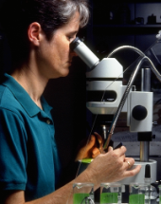
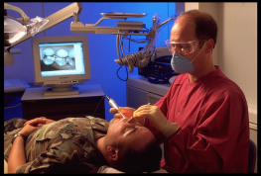
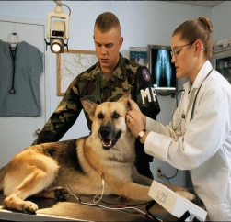
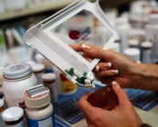

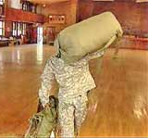
Fiscal Year 2016 in Direct Care – MEDCOM
Outpatient Care
19,312,927 Clinic Visits
Inpatient Care
387,316 Beds Occupied
124,533 Patients Discharged
Babies
22,051 Births
Vaccines
412,727 Immunizations
Laboratory
18,628,449 Lab Services
Dental
7,635,821 Services
RX
18,463,217 Prescriptions
Veterinary Services
557,371
Veterinary Outpatient Visits
$7.3 Billion of Food Inspected
154,866 Food Safety Visits
Personnel Deploying
2175 Soldiers & Civilians
Radiology
4,078,875
Rad Services
Notes:
Annual MEDCOM Numbers were derived by extracting data for specified time period.
--Inpatient Care (beds occupied and patients admitted) updated by:
Vernita Mahan, Health System Specialist Data Analysis Section, PASBA, 210-295-8922, DSN 421-8922
Source: M2, SIDR
--Dental procedures updated by: Vernita Mahan, Health System Specialist
Data Analysis Section, PASBA, 210-295-8922, DSN 421-8922. Source: M2, Dental Health Care Services Database
--Outpatient care visits and births updated by: Vernita Mahan, Health System Specialist
Data Analysis Section, PASBA, 210-295-8922, DSN 421-8922. Source: M2, CAPER
--Lab, Pharmacy, Radiology, Immunizations –
Source: RX = M2, PDTS; Rads = M2, Ancillary Radiology; Labs= M2, Ancillary Labs, Vaccines = M2, CAPER
Laboratory numbers represent ancillary laboratory services only
Pharmacy numbers represent outpatient prescriptions only
Immunizations extracted from M2 CAPER using CPT Codes that are related to vaccines, toxoids and immune globulins (ie immunizations). Source = CDC (http://www2a.cdc.gov/vaccines)
Updated by: Vernita Mahan, Health System Specialist. Data Analysis Section, PASBA, 210-295-8922, DSN 421-8922.
--Veterinary Services updated by: MAJ Mullaney, Veterinary Metrics Division Chief, Veterinary Services and Public Health Sanitation
--Personnel Deployed updated by OTSG G-33 – Bobby Thacker, MEDCOM, San Antonio; Includes all global engagements: Kuwait, Afghanistan, Africa, Germany, Pacific, others.

Slide 2
Average Day in Direct Care – MEDCOM
Outpatient Care
52,875 Clinic Visits
Inpatient Care
1,060 Beds Occupied
340 Patients Discharged
Babies
60 Births
Vaccines
1,129 Immunizations
Laboratory
51,001 Lab Services
Dental
20,905 Services
RX
50,549 Prescriptions
Veterinary Services
1,533 Veterinary Outpatient Visits
$20.4 Million of Food Inspected
502 Food Safety Visits
Personnel Deploying
6 Soldiers & Civilians
Radiology
11,167 Rad Services
Notes:
Average Day in MEDCOM Numbers were derived by extracting data for specified time period and dividing by 365.25 to get to a daily average.
--Inpatient Care (beds occupied and patients admitted) updated by:
Vernita Mahan, Health System Specialist Data Analysis Section, PASBA, 210-295-8922, DSN 421-8922
Source: M2, SIDR
--Dental procedures updated by: Vernita Mahan, Health System Specialist
Data Analysis Section, PASBA, 210-295-8922, DSN 421-8922. Source: M2, Dental Health Care Services Database
--Outpatient care visits and births updated by: Vernita Mahan, Health System Specialist
Data Analysis Section, PASBA, 210-295-8922, DSN 421-8922. Source: M2, CAPER
--Lab, Pharmacy, Radiology, Immunizations –
Source: RX = M2, PDTS; Rads = M2, Ancillary Radiology; Labs= M2, Ancillary Labs, Vaccines = M2, CAPER
Laboratory numbers represent ancillary laboratory services only
Pharmacy numbers represent outpatient prescriptions only
Immunizations extracted from M2 CAPER using CPT Codes that are related to vaccines, toxoids and immune globulins (ie immunizations). Source = CDC (http://www2a.cdc.gov/vaccines)
Updated by: Vernita Mahan, Health System Specialist. Data Analysis Section, PASBA, 210-295-8922, DSN 421-8922.
--Veterinary Services updated by: MAJ Mullaney, Veterinary Metrics Division Chief, Veterinary Services and Public Health Sanitation
--Personnel Deployed updated by OTSG G-33 – Bobby Thacker, MEDCOM, San Antonio; Includes all global engagements: Kuwait, Afghanistan, Africa, Germany, Pacific, others.

