Slide 1
Glaucoma Fundus Image Classification
Using Convolutional Neural Networks with
Image Preprocessing Strategies
Datasets & Methods • Deep Learning Models • Evaluation Results
15 Public Datasets | 11,031 Training Images | 5 CNN Models | 3 Preprocessing Methods
1

Slide 2
SECTION 1
Datasets &
Methods
Dataset sources • Preprocessing • CNN architectures • K-Fold • Evaluation metrics
2

Slide 3
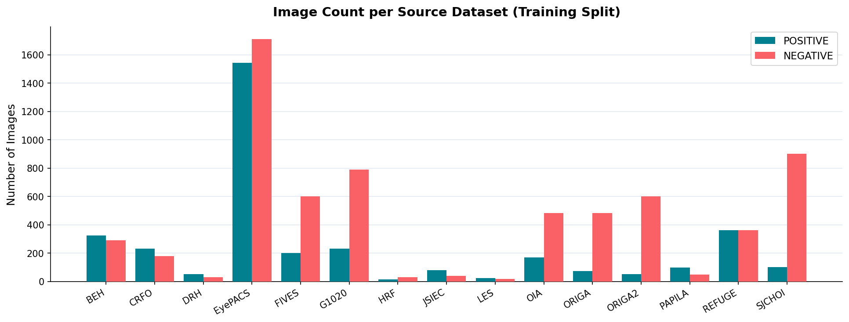
Dataset Overview
Combined from 15 publicly available fundus image databases
📊 11,031
Training Images
🔬 15
Source Datasets
⚖️ ~50/50
Class Balance
Train split (15 datasets) + separate Test split from RefA1
3

Slide 4
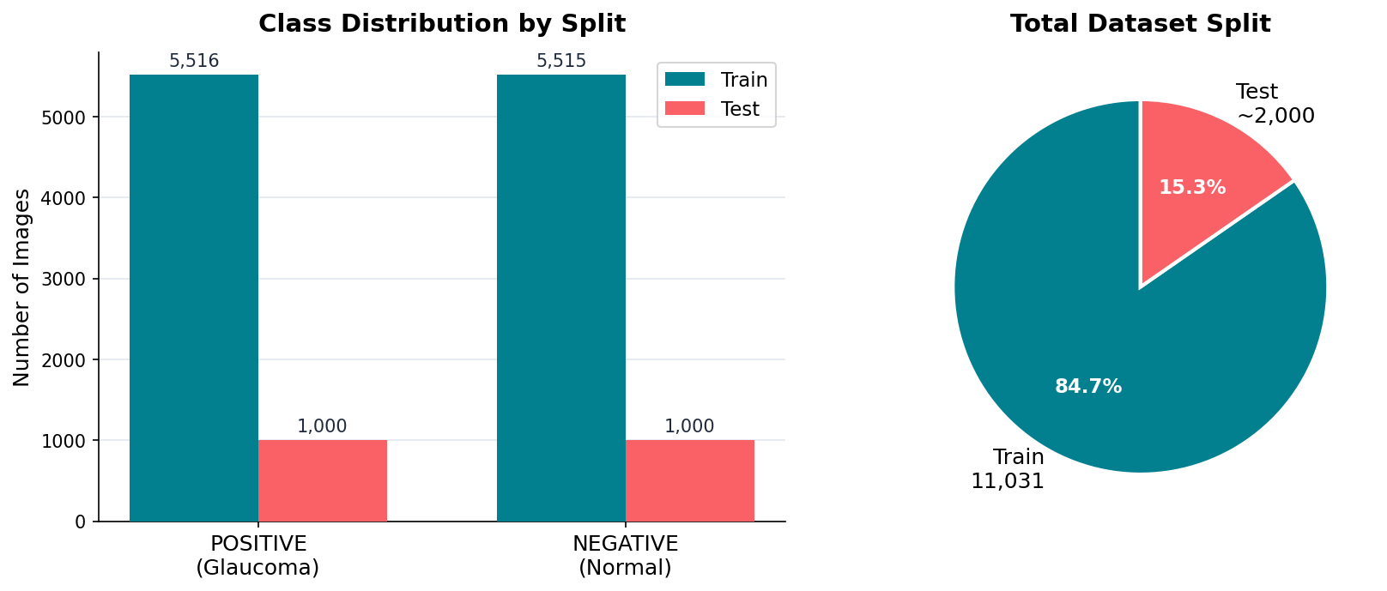
Data Distribution
Class balance and train/test split composition
✓ Dataset is already balanced (no oversampling required) • Augmentation: RandomFlip + RandomRotation(±20°) on training folds
4

Slide 5
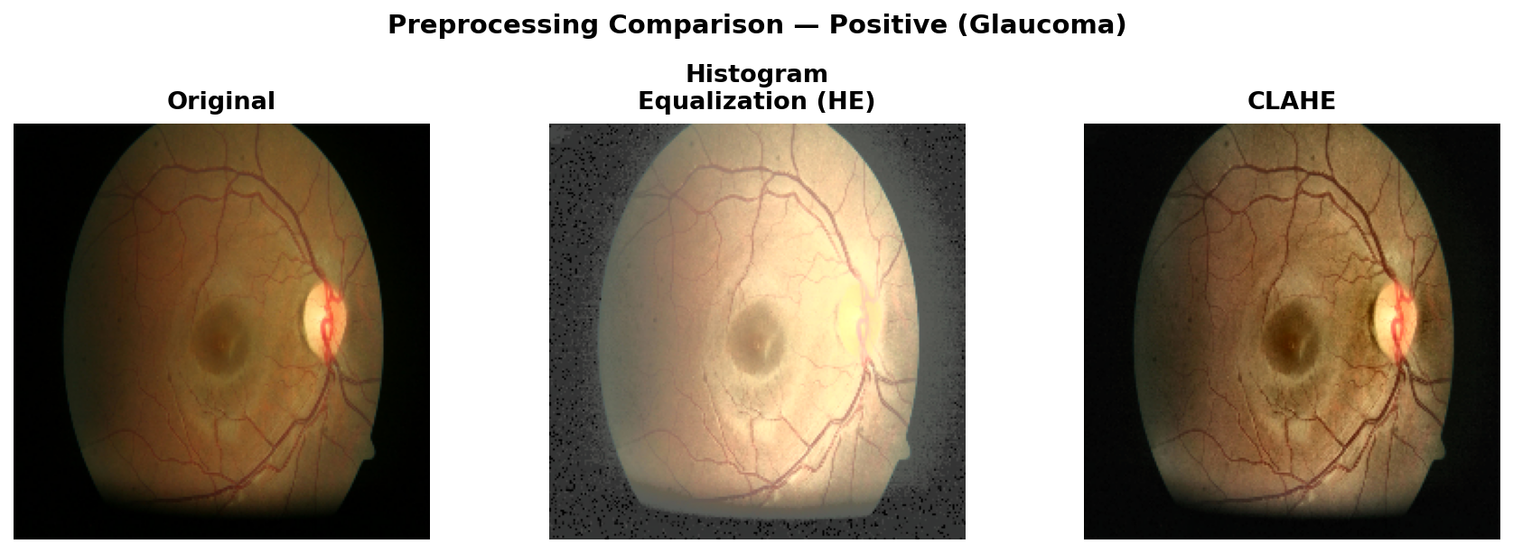
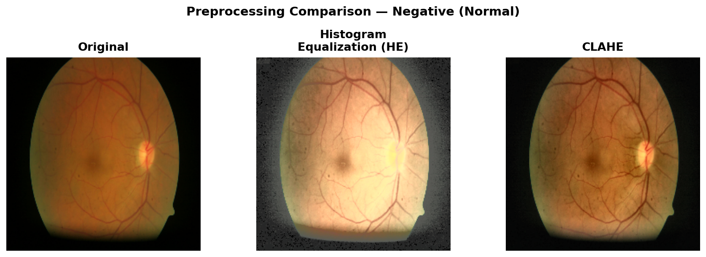
Image Preprocessing Methods
All images resized to 224×224 — three enhancement strategies evaluated
Original
Histogram
Equalization (HE)
CLAHE
Baseline — resize only.
No contrast enhancement.
Preserves natural fundus appearance.
Equalizes luminance channel (YUV).
Global contrast enhancement.
May over-amplify noise.
Contrast Limited Adaptive
Histogram Equalization.
Localized enhancement,
reduces over-amplification.
Glaucoma (POSITIVE) Sample:
Normal (NEGATIVE) Sample:
5

Slide 6
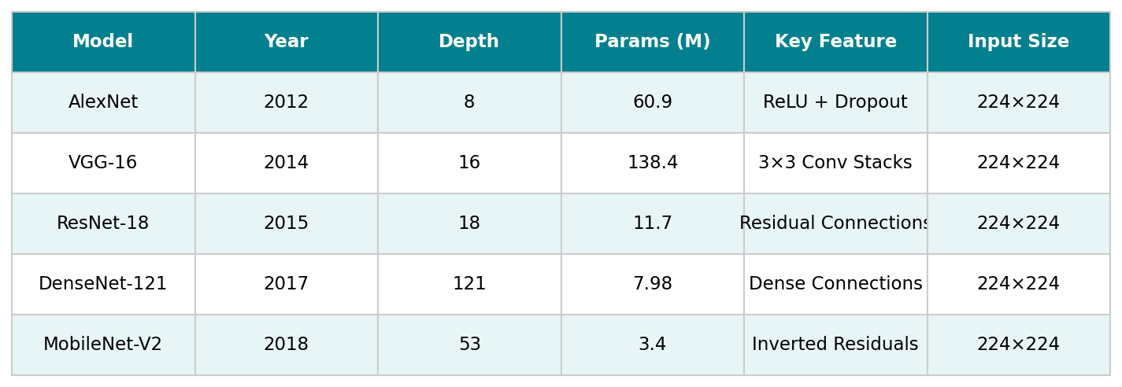
CNN Models
5 pre-trained ImageNet architectures with fine-tuned classification head (2 output classes)
Training Configuration
Optimizer:
Adam (lr = 1e-4)
Batch Size:
128
Loss:
Cross-Entropy
Input:
224×224 RGB
Epochs:
100 (early stopping)
Framework:
PyTorch 2.x
6

Slide 7
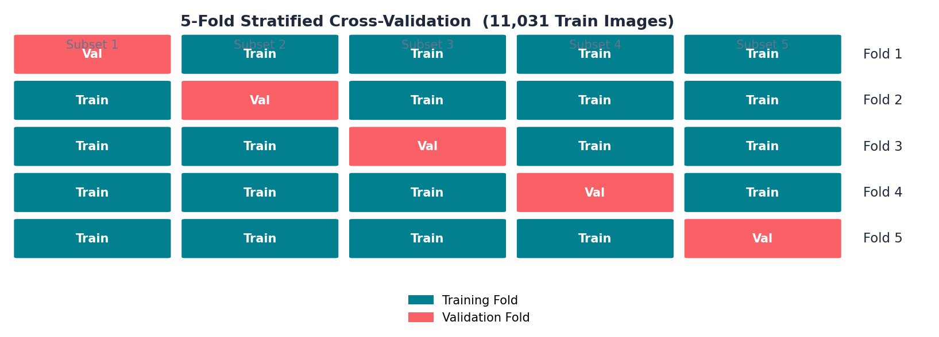
K-Fold Cross Validation
Stratified 5-Fold CV ensures balanced class distribution across all folds
5
8,824
2,207
11,031
Folds
Train per Fold
Validation per Fold
Total Train Images
7

Slide 8
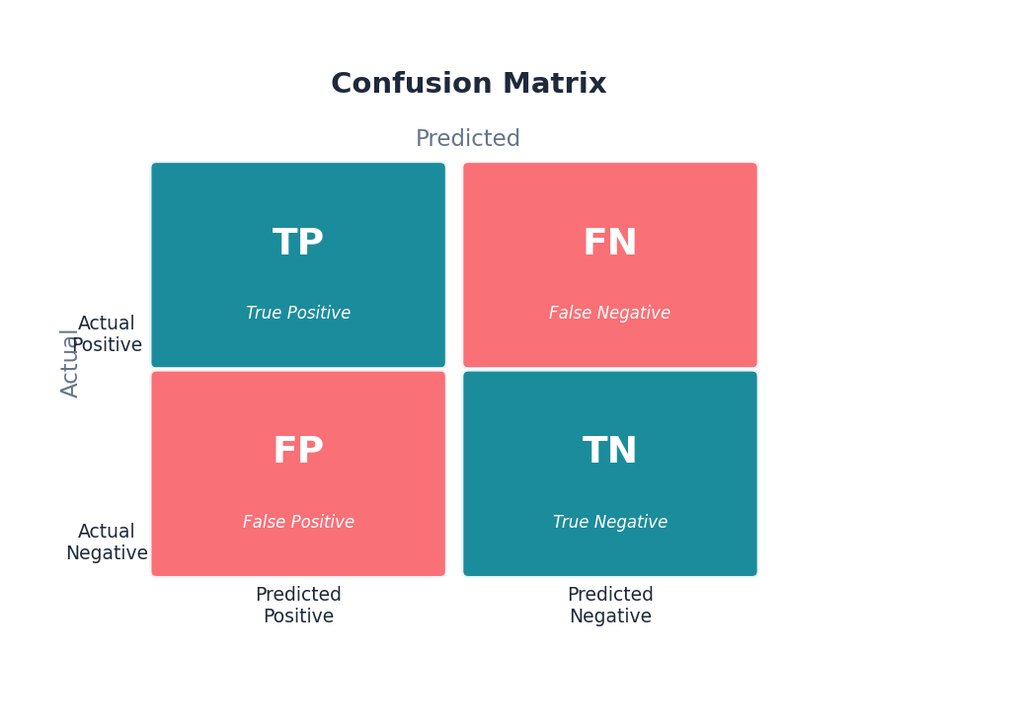
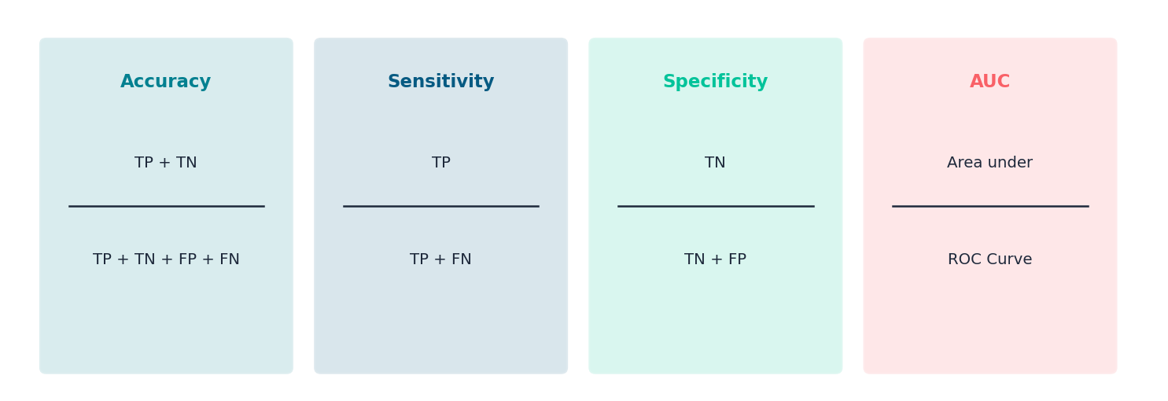
Evaluation Metrics
Comprehensive metrics for binary glaucoma classification assessment
Confusion Matrix
Performance Metrics
ROC Curve & AUC
• TPR (Sensitivity) vs FPR (1−Specificity) at all thresholds
• AUC = 1.0 → perfect classifier
• AUC = 0.5 → random classifier
8

Slide 9
SECTION 2
Results
Preprocessing effects • Model accuracy & AUC • Confusion matrices • ROC curves
9

Slide 10
Preprocessing: Visual Results
Effect of three enhancement methods on representative fundus images
Glaucoma (POSITIVE)
Normal (NEGATIVE)
10

Slide 11
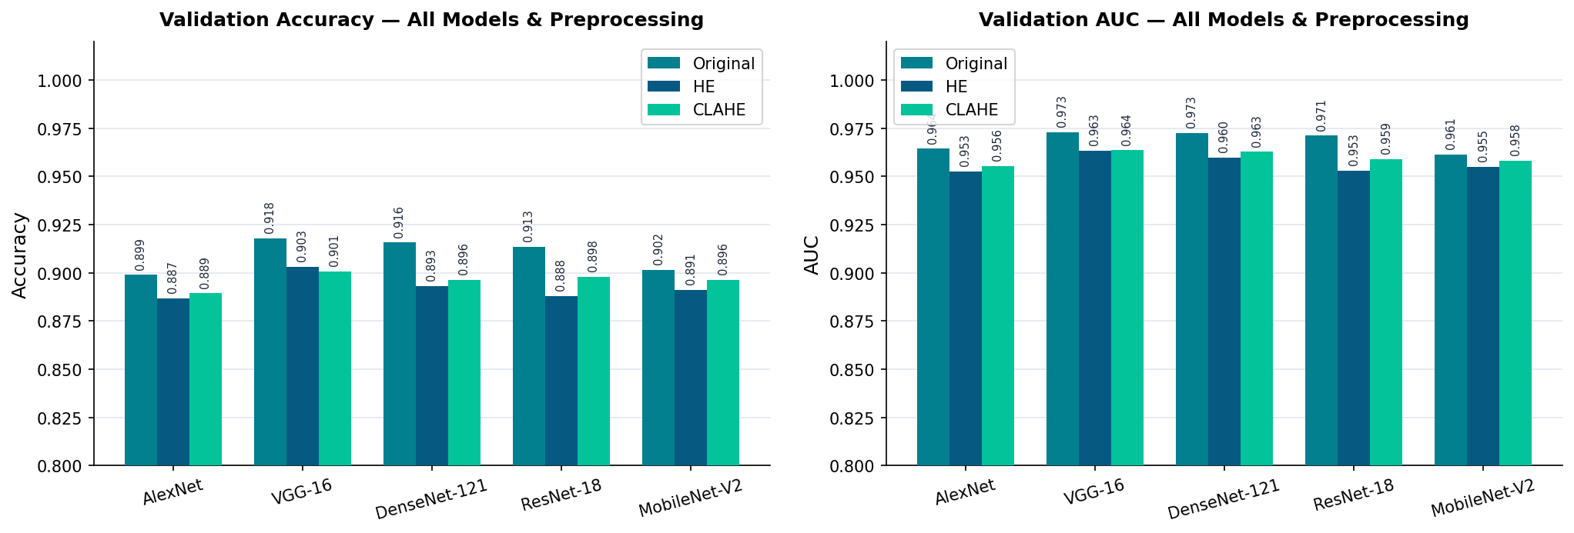
Model Performance Comparison
Validation Accuracy & AUC across all 5 models × 3 preprocessing methods (5-fold CV)
★ Best overall: VGG-16 with Original preprocessing — Accuracy 91.8%, AUC 0.973
11

Slide 12
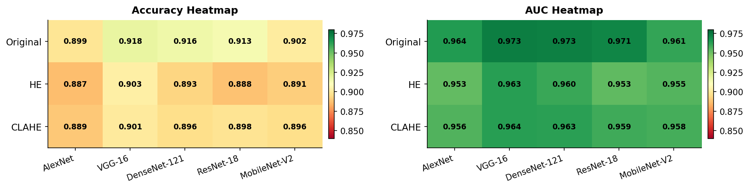
Performance Heatmap
Preprocessing × Model matrix — Accuracy (left) and AUC (right)
Key Observations:
• VGG-16 achieves top accuracy across all preprocessing variants (91.8% / 90.3% / 90.1%)
• All models perform strongly (88.6%–91.8%) — Original preprocessing consistently yields the best results
12

Slide 13
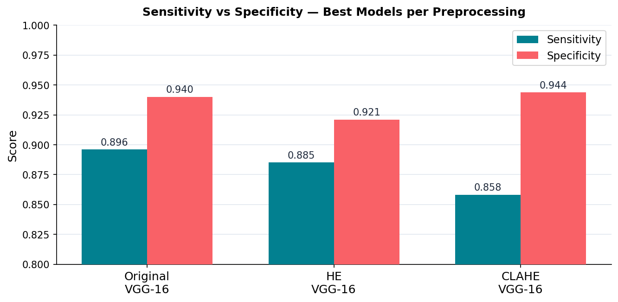
Sensitivity vs. Specificity — Best Models
VGG-16 results across all three preprocessing strategies
Clinical note: High Sensitivity critical for glaucoma screening (avoid missed diagnoses). CLAHE VGG-16 gives best Specificity (94.4%).
13

Slide 14
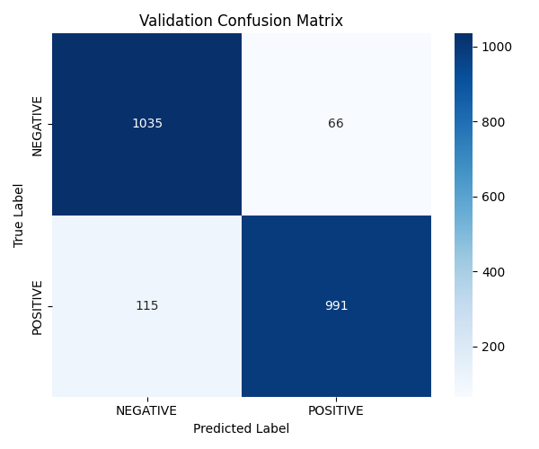
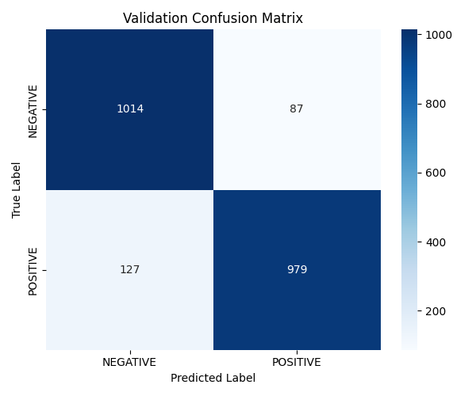

Confusion Matrices — VGG-16
Best model (VGG-16) evaluated across three preprocessing methods
Original (91.8% Acc)
HE (90.3% Acc)
CLAHE (90.1% Acc)
14

Slide 15
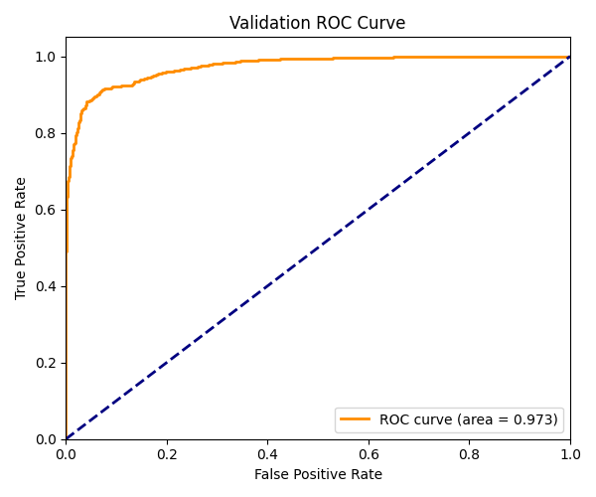
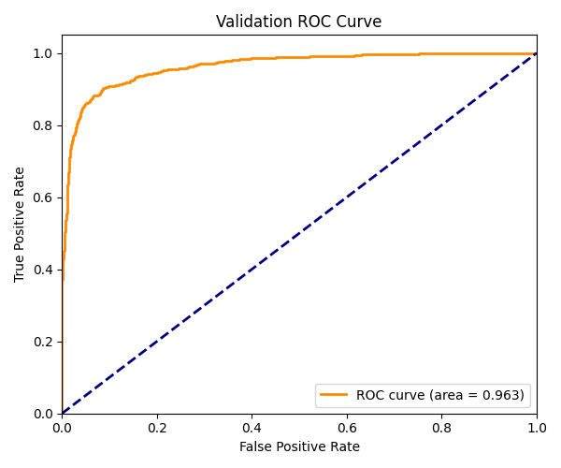
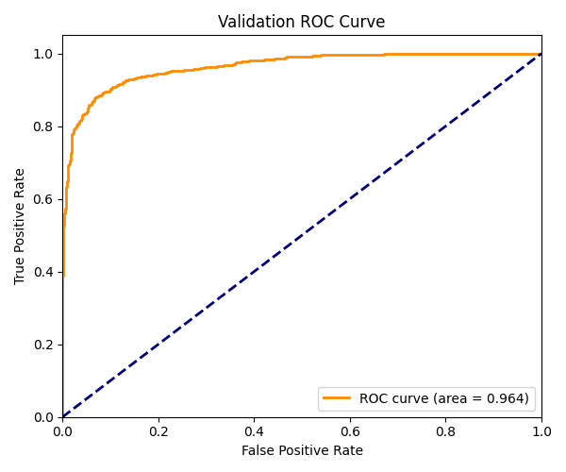
ROC Curves — VGG-16
Receiver Operating Characteristic curves — best model per preprocessing variant
Original (AUC 0.973)
HE (AUC 0.963)
CLAHE (AUC 0.964)
15

Slide 16
Results Summary
Preprocessing | Model | Accuracy | AUC | Sensitivity | Specificity
Original | AlexNet | 89.9% | 0.964 | 87.9% | 91.9%
Original | VGG-16 ★ | 91.8% | 0.973 | 89.6% | 94.0%
Original | DenseNet-121 | 91.6% | 0.973 | 92.4% | 90.7%
Original | ResNet-18 | 91.3% | 0.971 | 90.4% | 92.3%
Original | MobileNet-V2 | 90.2% | 0.961 | 86.3% | 94.1%
HE | AlexNet | 88.7% | 0.953 | 87.1% | 90.3%
HE | VGG-16 ★ | 90.3% | 0.963 | 88.5% | 92.1%
HE | DenseNet-121 | 89.3% | 0.960 | 86.3% | 92.4%
HE | ResNet-18 | 88.8% | 0.953 | 86.9% | 90.7%
HE | MobileNet-V2 | 89.1% | 0.955 | 85.4% | 92.8%
CLAHE | AlexNet | 88.9% | 0.956 | 86.7% | 91.2%
CLAHE | VGG-16 ★ | 90.1% | 0.964 | 85.8% | 94.4%
CLAHE | DenseNet-121 | 89.6% | 0.963 | 85.1% | 94.2%
CLAHE | ResNet-18 | 89.8% | 0.959 | 87.1% | 92.6%
CLAHE | MobileNet-V2 | 89.6% | 0.958 | 85.6% | 93.6%
16

Slide 17
Conclusions
🏆 Best Model:
VGG-16 with Original preprocessing achieves the highest accuracy (91.8%) and AUC (0.973)
🎨 Preprocessing Impact:
Original images outperform HE and CLAHE. CLAHE VGG-16 achieves best Specificity (94.4%) with slight accuracy trade-off
⚖️ Model Consistency:
All 5 models perform strongly (88.6%–91.8%) — no catastrophic failures; Run1 training generalises well across architectures
📈 AUC Consistency:
VGG-16 maintains AUC > 0.96 across all preprocessing variants — highly reliable for clinical screening
🔍 Future Work:
Ensemble methods, GAN-based augmentation, and explainability (Grad-CAM) for clinical adoption
Thank you
17

