Slide 1





Slide 2
Agenda
Introductions Name, department, research topic Fun thing you did over the summer
Acknowledgment
Class scheduling error availability
What data analysis platforms do you use? R background?
What is the most popular language? Which one should you use? Why learn R?
What is an interpreted language? Why does it matter?
Aim for this course working code versus readable code
Overview of all the modules Need input to make sure this is useful for you
Grading daily demos, participation, HWs, and exam
Challenges Objects GitHub

Slide 3
What is R?
Open-source, statistical programming language that data experts use.
The term “R” refers to - programming language and the software that interprets the scripts written using it.
RStudio - write your R scripts and interact with the R software.
RStudio needs R need to be installed on your computer to function correctly.
Reference: https://datacarpentry.org/R-ecology-lesson/00-before-we-start.html

Slide 4
Why R?
Does not involve lots of pointing and clicking, and that’s a good thing
R code is great for reproducibility
Interdisciplinary and extensible
Works on data of all shapes and sizes
Produces high-quality graphics
Has a large and welcoming community
Analyses conducted in R are transparent, easily shareable, and reproducible.
Reference: https://datacarpentry.org/R-ecology-lesson/00-before-we-start.html

Slide 5
Install R and check for updates
1. Download and install R
https://cran.r-project.org
2. Download and install R Studio GUI
https://www.rstudio.com/products/rstudio/

Slide 6
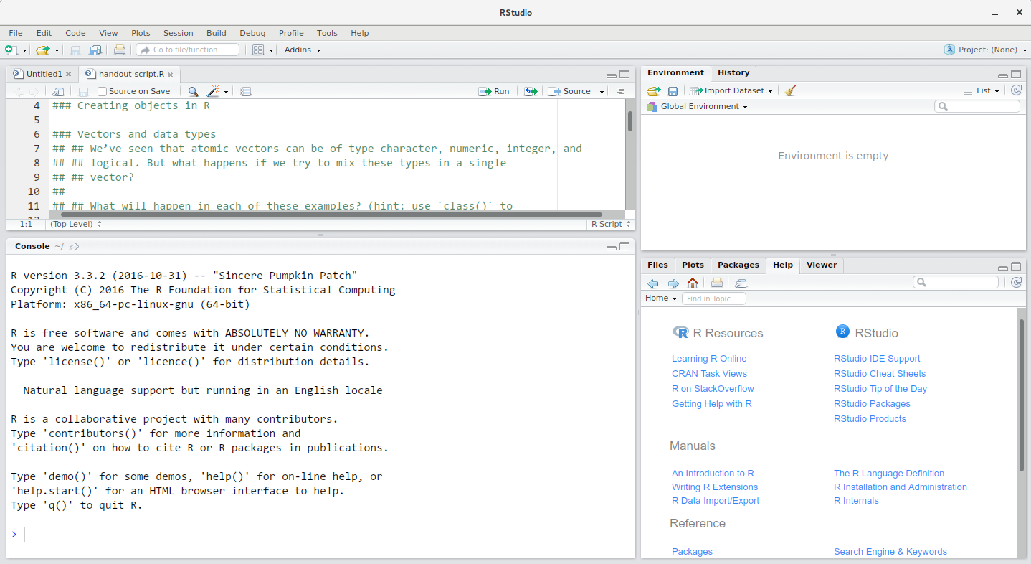
Structure of RStudio
Reference: https://datacarpentry.org/R-ecology-lesson/00-before-we-start.html

Slide 7
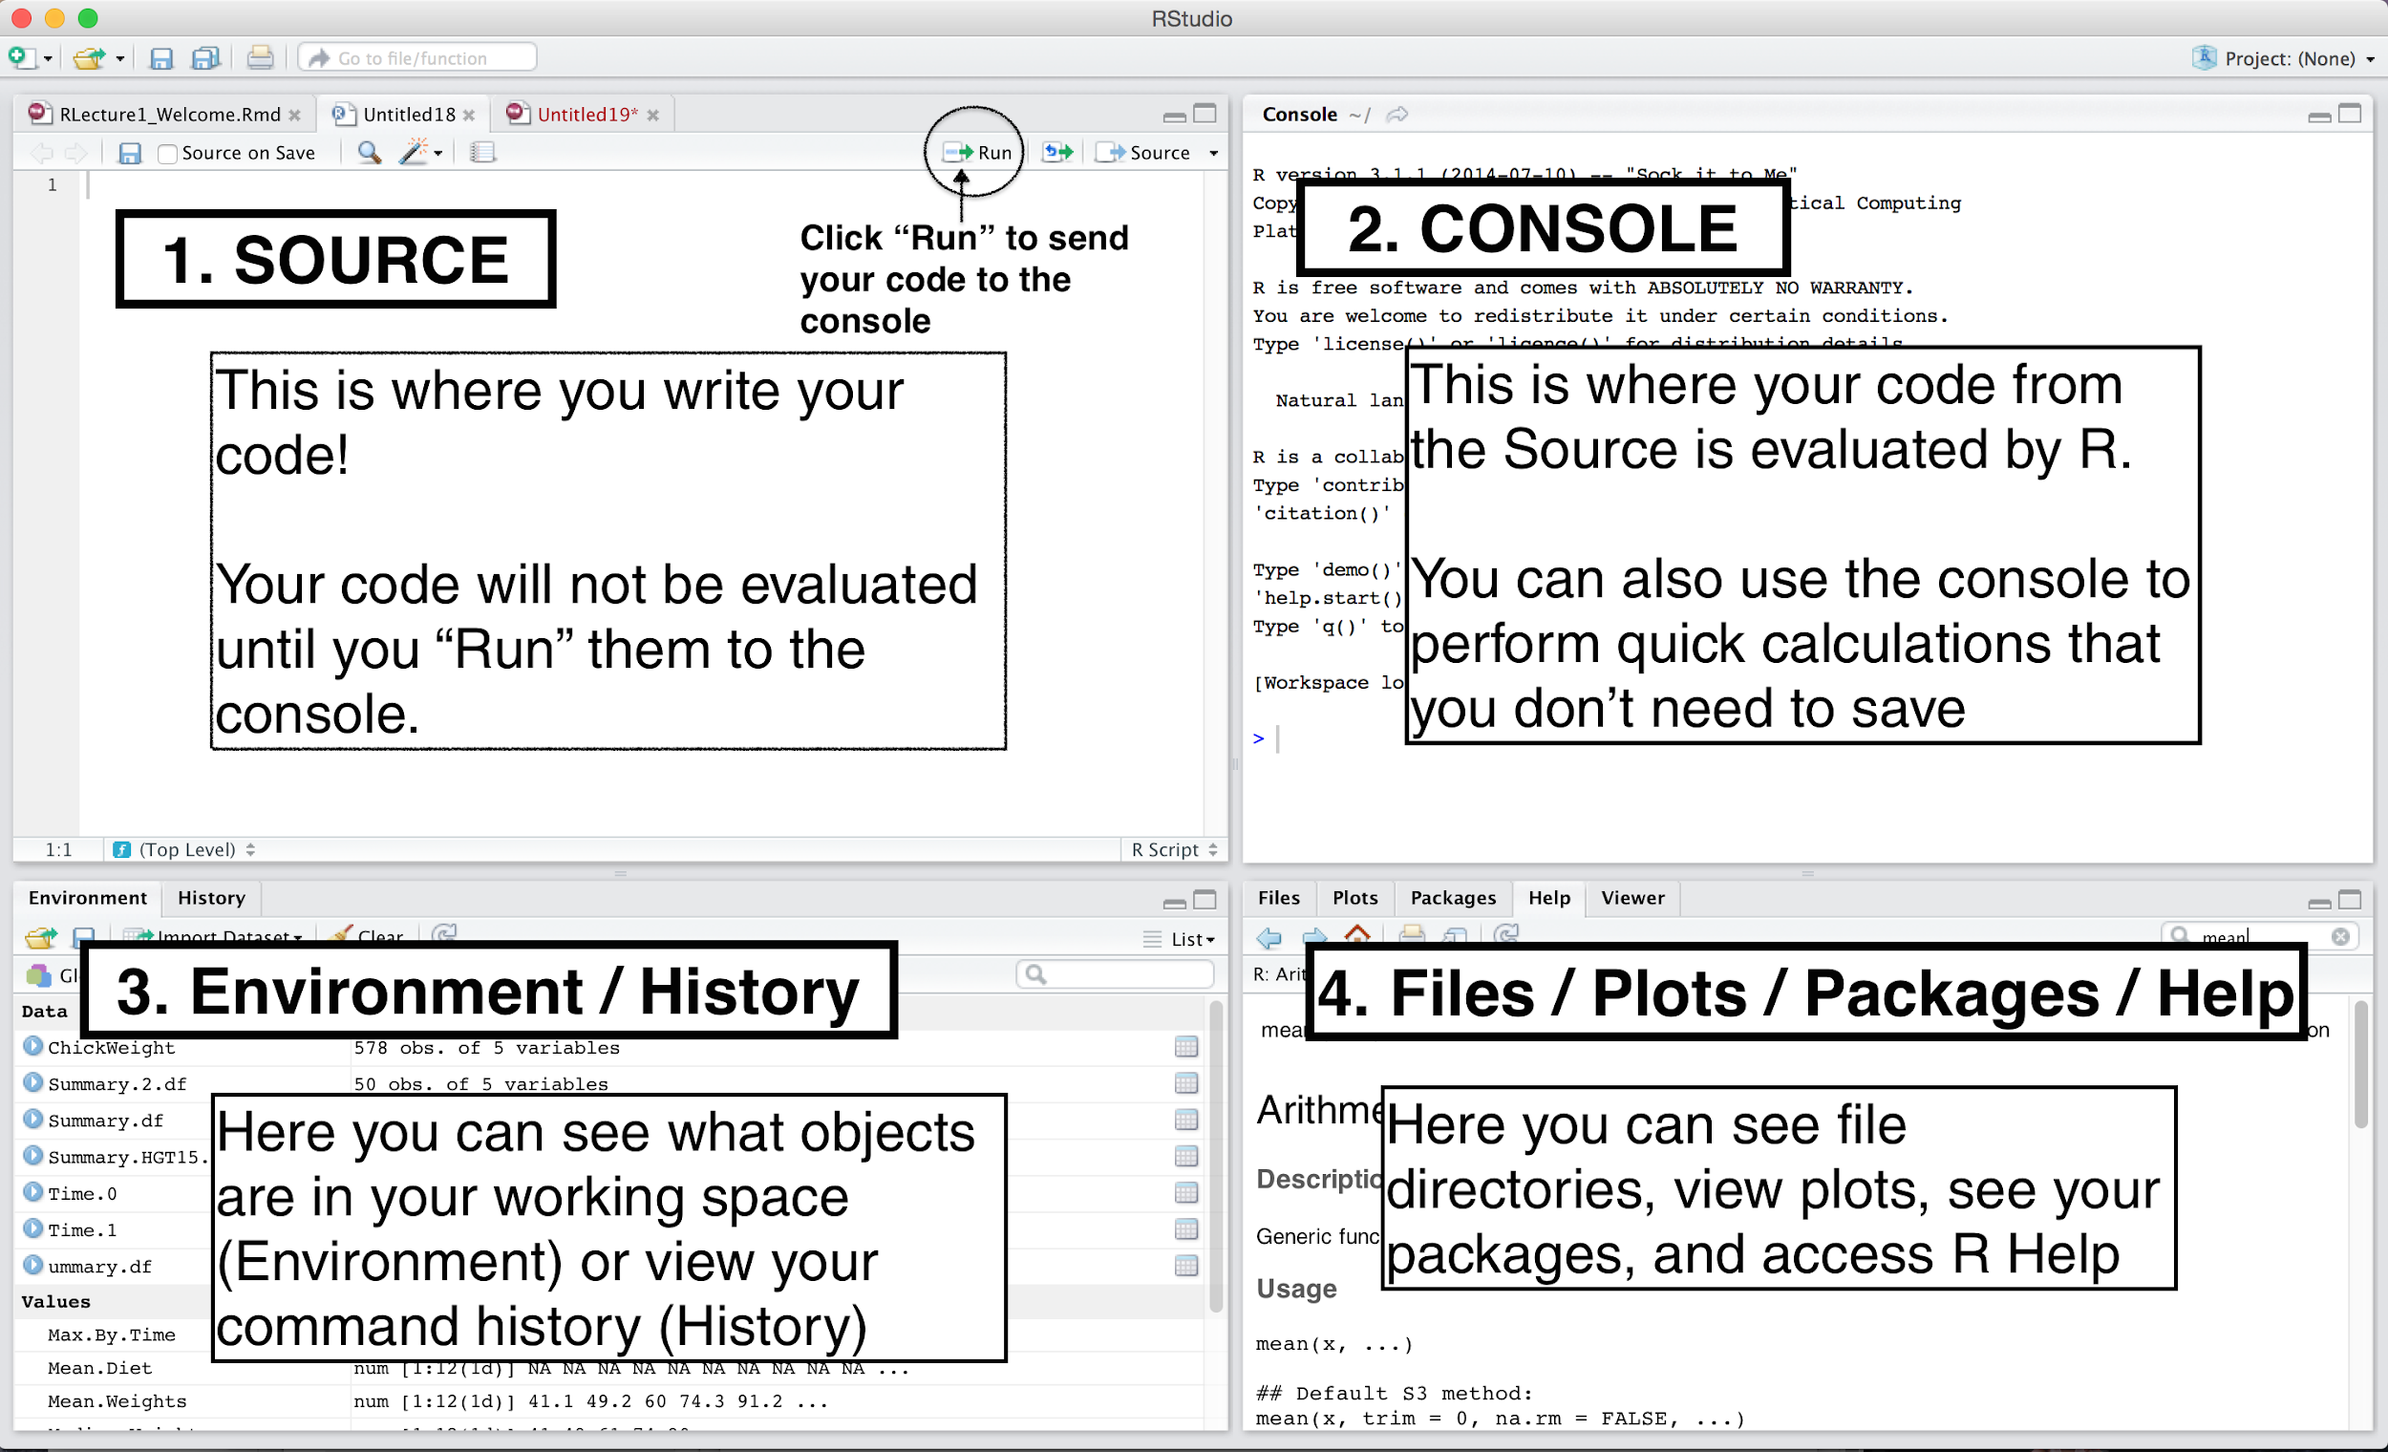
Structure of RStudio
Reference: https://datacarpentry.org/R-ecology-lesson/00-before-we-start.html

Slide 8
Structure of RStudio
Reference: https://datacarpentry.org/R-ecology-lesson/00-before-we-start.html

Slide 9
Structure of RStudio
Reference: https://datacarpentry.org/R-ecology-lesson/00-before-we-start.html

Slide 10
Structure of RStudio
Reference: https://datacarpentry.org/R-ecology-lesson/00-before-we-start.html

Slide 11
Getting started
Working directory keep a set of related data, analyses, and text self-contained in a single folder.
All of the scripts within this folder can then use relative paths to files.
Create a new project
Under the File menu, click on New project, choose New directory, then New project
Enter a name for this new folder (or “directory”) and choose a convenient location for it. This will be your working directory (e.g., ~/AFS505)
Click on Create project
Reference: https://datacarpentry.org/R-ecology-lesson/00-before-we-start.html

Slide 12
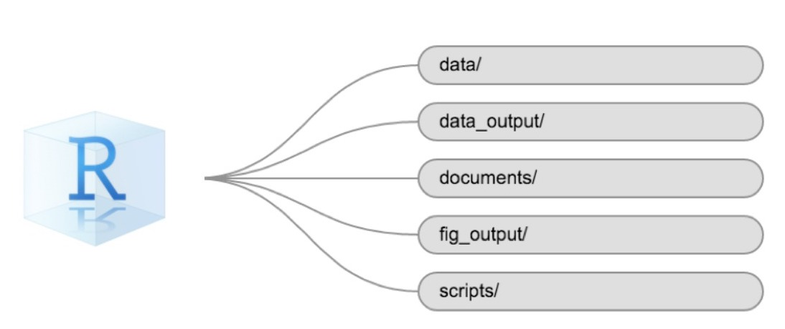
Organizing Working Directory
Reference: https://datacarpentry.org/R-ecology-lesson/00-before-we-start.html

Slide 13
Interacting with R
Using Console- directly type + Enter cannot be saved
Using Scripts- we need the codes to be reproducible and can be saved
Some frequently used shortcuts
Purpose | Windows | Mac
Execute code | Ctrl + Enter | Cmd + Return
Clear | Ctrl + L | Ctrl + L
Assignment operator <- | Alt + - | Option + -
Pipe %>% or |> | Ctrl + Shift + M | Cmd + Shift + M
Code chunk in Markdown | Ctrl + Alt + I | Command + Option + I
Reference: https://datacarpentry.org/R-ecology-lesson/00-before-we-start.html

Slide 14
R Markdown

Slide 15

What is R Markdown?
R Markdown provides an authoring framework for data science. You can use a single R Markdown file to both
save and execute code
generate high quality reports that can be shared with an audience
R Markdown documents are fully reproducible
They support dozens of output formats, like PDFs, Word files, slideshows, and more.
Reference: https://r4ds.had.co.nz/r-markdown.html

Slide 16
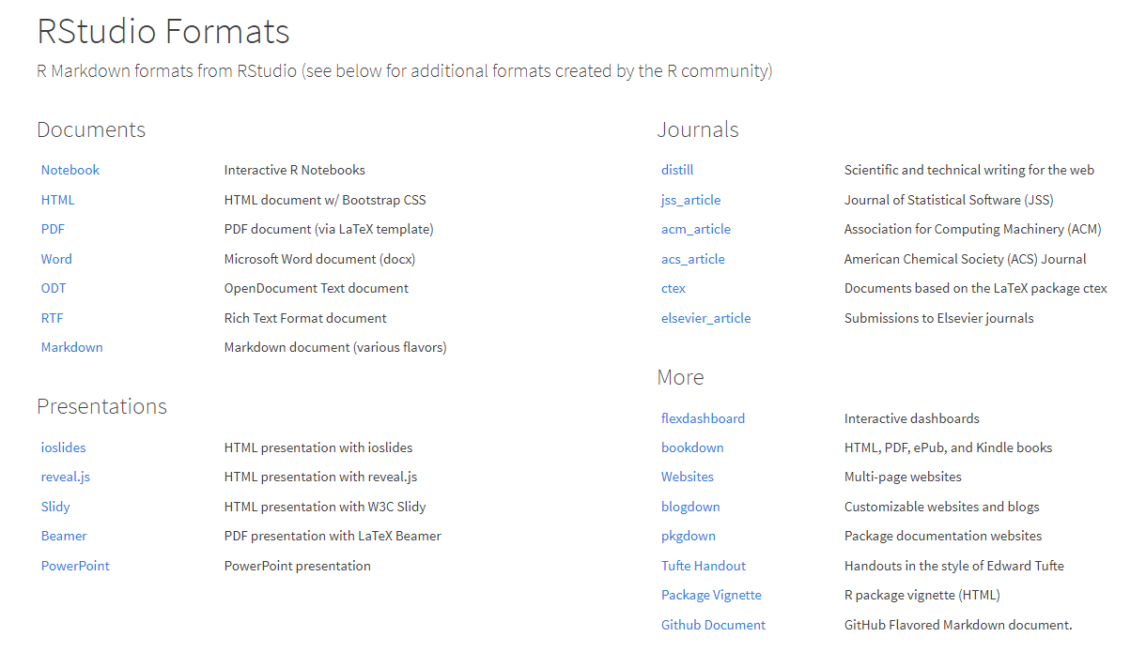
RStudio formats of the Markdown file
Reference: https://rmarkdown.rstudio.com/formats.html

Slide 17
Basic use of Markdown files
Communication with decision makers
conclusion is the key
R Markdown files
Use it like a modern lab notebook
Collaborate with data scientists interested in both code and conclusion
Reference: https://r4ds.had.co.nz/r-markdown.html

Slide 18

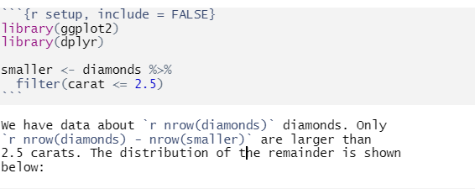
Structure of R Markdown document
YAML text specifying header | 2) Code chunk
3) Plain text
Reference: https://r4ds.had.co.nz/r-markdown.html

Slide 19
Jupyter Notebook

Slide 20
Jupyter is a free, open-source, interactive web tool known as a computational notebook
Use to combine software code, computational output, explanatory text and multimedia resources in a single document
Core programming languages Julia (Ju), Python (Py) and R
More than 2.5 million public Jupyter notebooks in September 2018, up from 200,000 or so in 2015

Slide 21
Language of choice:
Jupyter supports over 40 programming languages, including Python, R, Julia, and Scala.
Share notebooks
Notebooks can be shared with others using email, Dropbox, GitHub and the Jupyter Notebook Viewer.
Interactive output
Your code can produce rich, interactive output: HTML, images, videos, LaTeX

