Slide 1
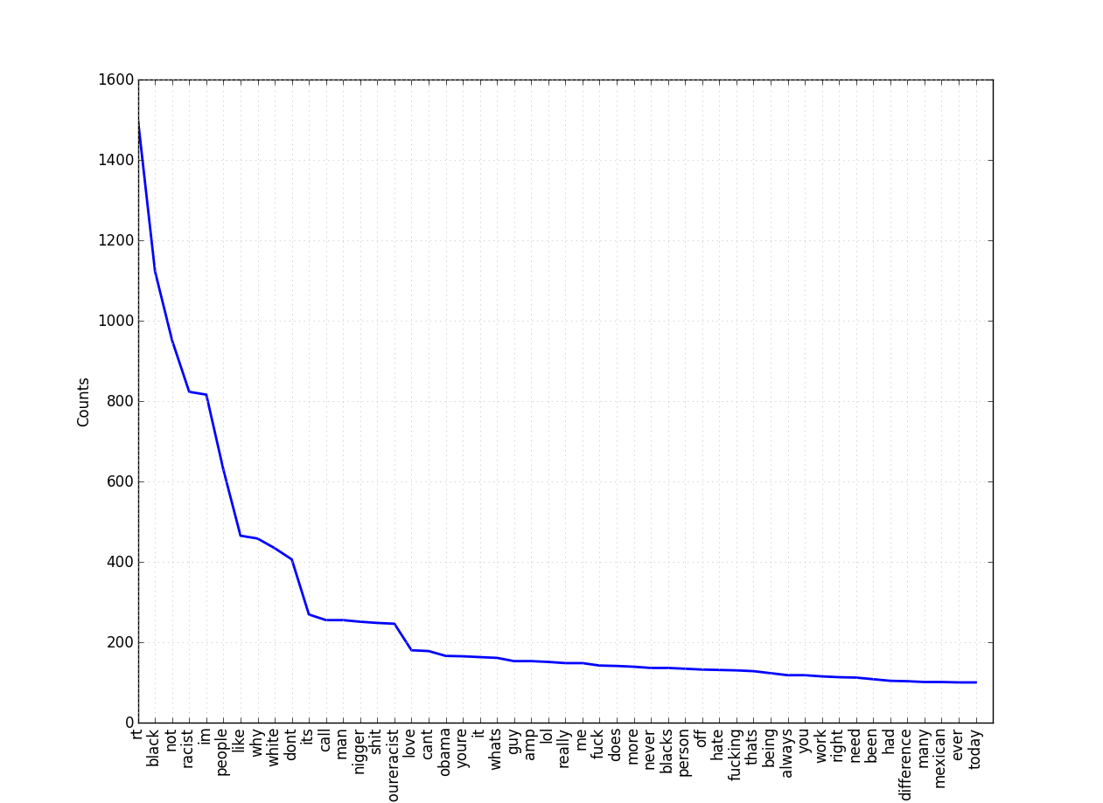
Detecting Racism in Tweets
Sean Noran, Fiete Botschen
- 15240 hand labeled tweets
- sources
twitter stream (~8 %)
racist jokes user (~ 87 %)
racist tweets retweeter (~ 50 %)
- classifiers:
NB, SVM, RF (similar results)
- features:
TF-IDF, BoW, word2vec
- data analysis:
Topic Modeling, feature extraction
Current state: generalizes not as good as we want. We hope to improve that quality.

