Slide 1
The new (or the first?) build system for Android
Gradle

Slide 2

About Me
Martin "Goddchen" Liersch (+Martin Liersch)
Freelance Android Developer
goddchen@gmail.com
https://github.com/Goddchen

Slide 3
Android Gradle Build System
What for?
Overview
Details
Examples
Android Studio
Hints

Slide 4
Android Tools Project Site
"We are working on a new build system to replace both the build system inside ADT and Ant."
http://tools.android.com/tech-docs/new-build-system

Slide 5
What should a build system be able to do?
Make it easy to reuse code and resources
Make it easy to create several variants of an application, either for multi-apk distribution or for different flavors of an application
Ease of extending and configuring the build

Slide 6
Elements
Product Flavors
Build Types
Build Variants
Flavor Groups
Sourcesets
Tests

Slide 7
Product Flavors
"A product flavor defines a customized version of the application build by the project."
"This new concept is designed to help when the differences are very, very minimum [...]"
What about library projects?
"Although different flavors could be very different applications, using Library Projects is a better use case for this, and the build system still supports this."
http://tools.android.com/tech-docs/new-build-system/build-system-concepts

Slide 8
Product Flavors - What can be customized?
minSdkVersion
targetSdkVersion
versionCode
versionName
package name (overrides value from manifest)
release signing info (keystore, key alias, passwords,...).
BuildConfig: Ability to provide custom Java code.
NDK ABI filter (Not implemented yet)
test info
package name for test app (optional, default is <base>.test)
InstrumentationTestRunner class (optional)
Additionally, Product Flavor can provide their own source code, resources and manifest.
http://tools.android.com/tech-docs/new-build-system/build-system-concepts

Slide 9
Build Types
"A build type allows configuration of how an application is packaged for debugging or release purpose."
"This concept is not meant to be used to create different versions of the same application. This is orthogonal to Product Flavor."
http://tools.android.com/tech-docs/new-build-system/build-system-concepts

Slide 10
Build Types - What can be customized?
manifest debuggable flag
native compilation debug flag
proguard enabled + specific rules (Not implemented yet)
debug signing flag (ie whether to use debug key or release key)
package name suffix (2)
Buildconfig
DEBUG flag. Set automatically based on the manifest debuggable flag.
Ability to provide custom Java code.
Types "Release" and "Debug" are automatically created and can be reconfigured
http://tools.android.com/tech-docs/new-build-system/build-system-concepts

Slide 11
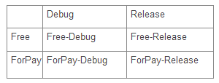
Build Variants
In short: the cross product of Build Type x Build Flavor
http://tools.android.com/tech-docs/new-build-system/build-system-concepts

Slide 12
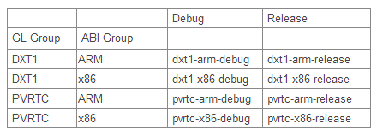
Flavor Groups
In short: Flavor groups provide several dimensions of flavors (eg 2 GL texture formats x 2 ABIs)
http://tools.android.com/tech-docs/new-build-system/build-system-concepts

Slide 13
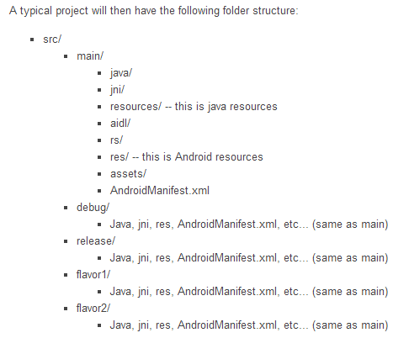
Sourcesets
Mapping of source types
Can be reconfigured
http://tools.android.com/tech-docs/new-build-system/build-system-concepts

Slide 14
Testing
Tests are no longer a separate project
They are now part of the main project
Tests go to "src/test" or "src/test<flavor>"
http://tools.android.com/tech-docs/new-build-system/build-system-concepts

Slide 15
Library Projects
Similar to regular project except:
There are no Product Flavor.
There are debug and release build types but they are used slightly differently.
Building a library project itself is always a "Debug" build
Packaging a library project in a distribution blob is always a "Release" build
http://tools.android.com/tech-docs/new-build-system/build-system-concepts

Slide 16
Groovy
http://groovy.codehaus.org/
The language used by Gradle
Great similarity to Java
"builds upon the strengths of Java but has additional power features inspired by languages like Python, Ruby and Smalltalk"

Slide 17

Gradle
http://gradle.org/
The actual build system, the core of everything
"Gradle is build automation evolved. Gradle can automate the building, testing, publishing, deployment and more of software packages or other types of projects"
"Gradle combines the power and flexibility of Ant with the dependency management and conventions of Maven into a more effective way to build."

Slide 18
Roadmap
0.7
NDK support
lint support (stretch)
Better Test support:
emma support
Define, create, start AVDs
Run tests on multiple AVDs
http://tools.android.com/tech-docs/new-build-system/roadmap

Slide 19
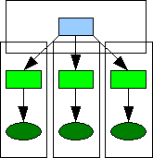
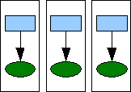
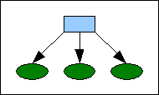
The new way...
Previously:
Worst: Multiple Android projects (with copied sources and resources)
Okay but still complex: Android library project + multiple Android Projects
Now:
One single Android project which contains:
Gradle config
Sources and resources for all build variants

Slide 20
Examples
Hello World
Product Flavors
Build Configs
Eclipse Compatibility (Custom Sourcesets)

Slide 21

Hello World Example

Slide 22
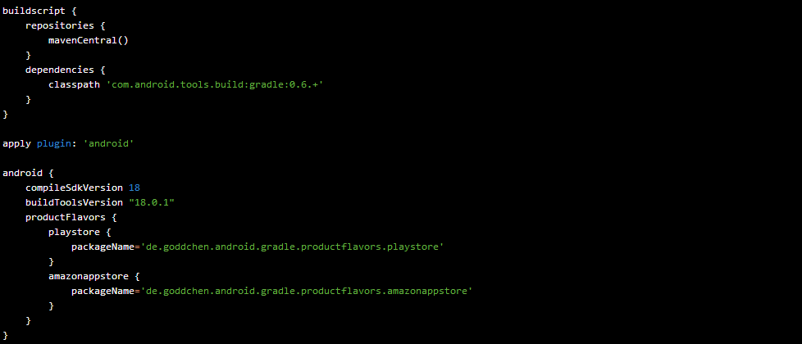
Product Flavors Example

Slide 23
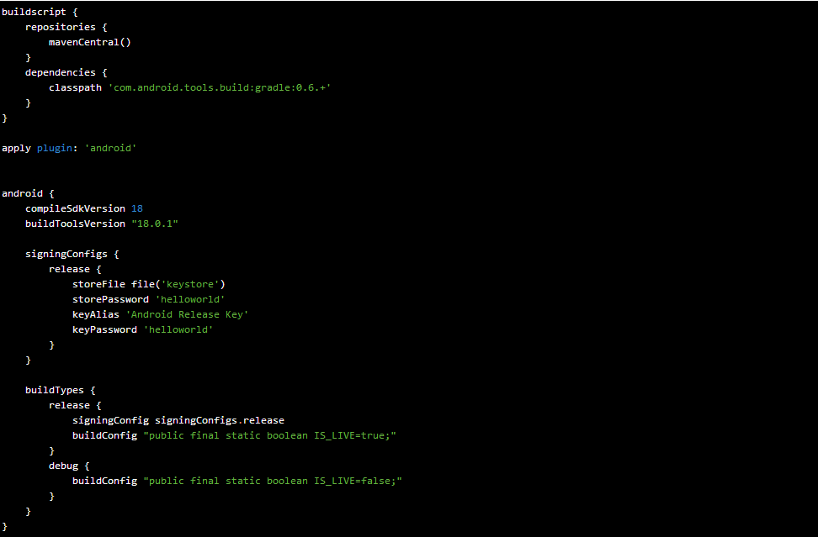
Build Configs Example

Slide 24
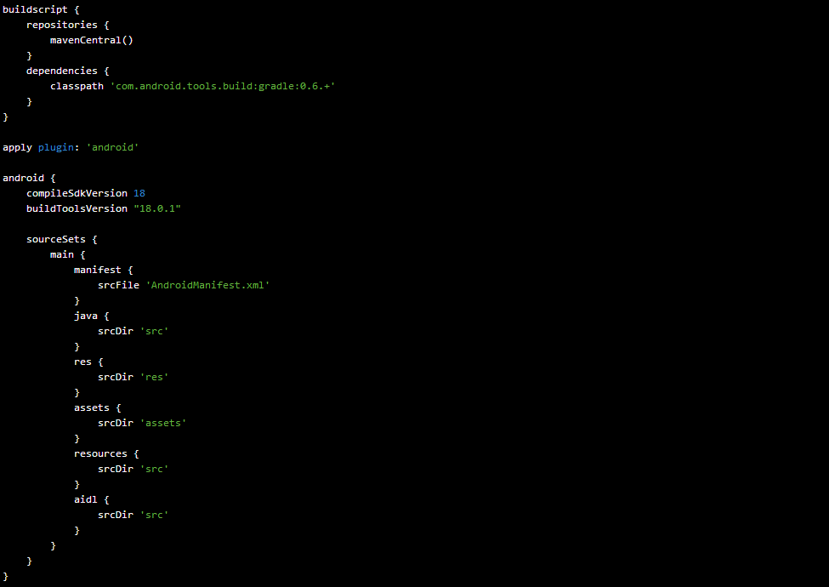
Eclipse Compatibility

Slide 25
Multi Project Build (Library Projects)
use the settings.gradle files to declare library projects
add library projects as "compile" dependency

Slide 26


Dependencies
Simply include any artifacts provided by mavenCentral()
Simple Jar dependencies
Libraries need to have the “aar” format!!!

Slide 27
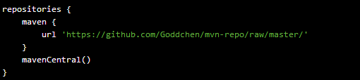
Library not available in mavenCentral as aar?
There is often the case that a library is no longer maintained or the maintainer simply doesn’t provide a aar artifact.
For that case, I have created a public maven repo hosted on GitHub and we are frequently adding aar artifacts of popular libraries

Slide 28
Android Studio
Introduced during Google I/O 2013
Full support for Gradle integration
http://developer.android.com/sdk/installing/studio.html

Slide 29
Migrating to Android Studio
Export an existing Eclipse project
Update your ADT plugin to the latest version
File -> Export -> Android -> -> Generate Gradle build files -> Finish
What you get are Gradle build files that you can import/open in Android Studio
Might need some manual tweaking depending on your project’s complexity

Slide 30
Importing into Android Studio
Select “Import Project”
Choose your build.gradle file
Android Studio should import the project :)

Slide 31
Android Studio
Does your colleagues still use Eclipse?
No problem!
Android Studio can even handle the Eclipse project structure
Before importing, you have to delete the .project and .classpath files

Slide 32
Hints
The latest version requires Gradle 1.8
It is wise to use the Gradle wrapper provided by Google
to be found in <android-sdk>\tools\templates\gradle\wrapper
Make sure to change this line: distributionUrl=http\://services.gradle.org/distributions/gradle-1.8-bin.zip

Slide 33
Hints
Things you might want to add to your .gitignore file:

Slide 34
Hints
Priority: AndroidManifest.xml -> build.gradle
When you haven't configured something in the Gradle build file, the data from the manifest is still used
Configuration that is done in the Gradle build file overrides the manifest data
Seems like the "libs/" folder is ignored. Add it as "compile" dependency with fileTree(...)

Slide 35
Hints
Of course, going the Eclipse-compatible way eliminates some of the benefits of the new build system (flavor specific res/java/...)
In multi project builds, if you get FileNotFoundExceptions during buildRelease/buildDebug you have to manually create the "<library>/build/libs" folder

Slide 36
Hints
Place your library projects as direct sub directories of your main project, everything else will get you in trouble
From my observations: Manifest merging is enabled by default

Slide 37
Hint
It can happen from time to time that (especially the Eclipse plugin) can leave a running Gradle job open (java process is still running). Never ever have 2 gradle jobs running at the same time, this will mess everything up and lead to very strange issues!

Slide 38
Hint
Once you converted your projects to Gradle managed projects and use the correct folder structure, Eclipse won't recognize your project as an Android project anymore. You have to do several things to be able to code in Eclipse again
Do a complete build with Gradle to generate all needed resources
Readd "src/main/java" and "build/sources/debug/" as sources
To import library project code, add "<libraryproject>/build/bundles/debug/classes.jar" to classpath
When you change anything in res, do a rebuild with gradle and refresh Eclipse
Add the "Android Classpath Container"

Slide 39
Hint
If you add Maven compile dependencies to the "android" tag, don't forget to add the repositories tag that includes "mavenCentral()" inside the "android" tag
Project dependencies seem to be resolved in an alphanumerical order

Slide 40
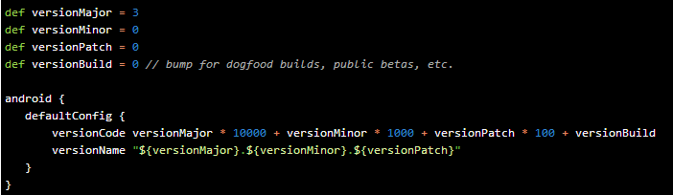
Hint
Better version management (+Jake Wharton)

Slide 41
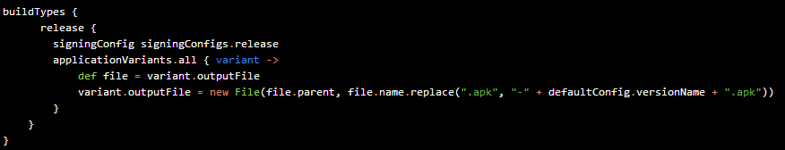
Hint
Version in release APK file (codaR0y on SO)

Slide 42
Hint
Including precompiled native code (.so files)
Zip the .so files under a folder named “lib” (e.g. /lib/armeabi/libnative.so)
Replace file extension with .jar
Place file in /libs folder
Gradle will extract this jar file when packaging your final APK :)

Slide 43
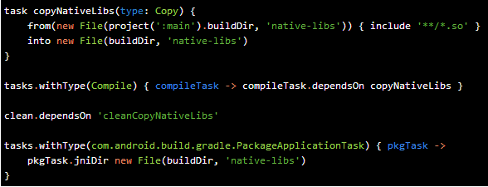
Hint
Including precompiled native code (.so files)

Slide 44
Resources
http://source.android.com/ (tools/build)
http://groups.google.com/group/adt-dev
http://tools.android.com/tech-docs/new-build-system
All the code samples are either from the "Android Tools Project Site", or the gradle-samples you can download there, or created by myself and available at https://github.com/Goddchen/Android-Gradle-Examples

Slide 45

Questions?

