Slide 1


The new build system for Android

Slide 2

Overview
Gradle basics
Gradle Plugins
Gradle and Studio
Demos
Gradle 与TV版
Resources

Slide 3
What’s Gradle?
Gradle is an open source build automation system.
Grade introduces DSL instead of the more traditional XML form of declaring the project configuration.
focused around Java, Groovy and Scala development and deployment, but more languages and project workflows are on the roadmap.
Gradle can automate the building, testing, publishing, deployment.
https://gradle.org
https://en.wikipedia.org/wiki/Gradle

Slide 4
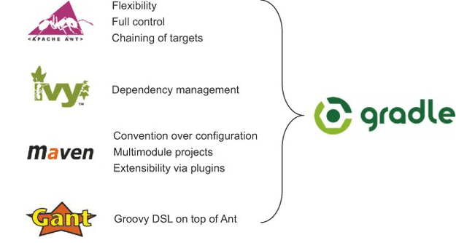
Why Gradle?
create custom build logic through plugins.
dependency management
Plugins can expose their own DSL and their own API for build files to use.
Gradle combines the best features from other build tools.
Why Gradle?
Why choose Gradle?

Slide 5
Installing Gradle
requires a Java JDK or JRE to be installed, version 6 or higher
Gradle ships with its own Groovy library, therefore Groovy does not need to be installed.
Any existing Groovy installation is ignored by Gradle.
Gradle uses whatever JDK it finds in your path
download （http://gradle.org/downloads）
unpacking
add GRADLE_HOME/bin to your PATH environment variable
Android Studio Project includes grade
gradle installation

Slide 6
Groovy
http://groovy-lang.org/
The language used by Gradle
Great similarity to Java
builds upon the strengths of Java but has additional power features inspired by languages like Python, Ruby and Smalltalk
http://learnxinyminutes.com/docs/groovy/

Slide 7
Build Script Basics
Project
What a project represents depends on what it is that you are doing with Gradle
Task
A task represents some atomic piece of work which a build performs.This might be compiling some classes, creating a JAR, generating Javadoc, or publishing some archives to a repository.
Plugin
A plugin is a mechanism by which we can extend the capabilities of Gradle .
http://rominirani.com/2014/07/28/gradle-tutorial-part-1-installation-setup/
https://gradle.org/docs/current/userguide/tutorial_using_tasks.html#N101A9

Slide 8
Demo
//defaultTasks 'buildTask'
task compileTask << {
System.out.println "compiling..."
}
task buildTask << {
//task buildTask (dependsOn:compileTask) << {
System.out.println "building..."
}
build.gradle
http://rominirani.com/2014/07/28/gradle-tutorial-part-1-installation-setup/

Slide 9
2.Gradle Plugin
Gradle plugin for Java
Gradle plugin for Android
for eclipse,idea,findbugs,c,cpp,oc,jetty……
https://gradle.org/docs/current/userguide/plugins.html
https://gradle.org/docs/current/userguide/standard_plugins.html

Slide 10
Gradle Plugin for Java
Source sets
Tasks
Project layout
Dependency management
···
http://gradle.org/docs/current/userguide/java_plugin.html

Slide 11
Demo
apply plugin: ‘java' // packaged with grade
archivesBaseName = "quote"
version = '1.0-FINAL'
repositories {
mavenCentral()
}
dependencies {
compile group: 'org.apache.commons', name: 'commons-lang3', version: '3.3.2'
testCompile group: 'junit', name: 'junit', version: '4.+'
}
build.gradle
http://rominirani.com/2014/07/28/gradle-tutorial-part-2-java-projects/

Slide 12
Gradle Plugin for Android
Published in May, 2013
1.0 Released in Dec, 2014
git clone https://android.googlesource.com/platform/prebuilts/gradle-plugin
http://tools.android.com/tech-docs/new-build-system/user-guide
https://www.youtube.com/watch?v=LCJAgPkpmR0
http://tools.android.com/build

Slide 13
Goals of the new build system
Make it easy to reuse code and resources
Make it easy to create several variants of an application, either for multi-apk distribution or for different flavors of an application
Make it easy to configure, extend and customize the build process
Good IDE integration
http://tools.android.com/tech-docs/new-build-system/user-guide

Slide 14
Android Plugin DSL Reference
defaultConfig{}
LintOptions
productFlavors{}
ProductFlavor
Blocks
buildTypes{}
BuildType
DSL types
signingConfigs{}
signingConfig
…{}
…
Android Plugin DSL Reference

Slide 15
signing Configs
configuration of how an application is signed
what can be customised?
keyAlias
keyPassword
storeFile
storePassword
storeType
hide key password
http://stackoverflow.com/questions/18328730/how-to-create-a-release-signed-apk-file-using-gradle

Slide 16
Product Flavors
A product flavor defines a customized version of the application build by the project. A single project can have different flavors which change the generated application
This new concept is designed to help when the differences are very, very minimum
Although different flavors could be very different applications, using Library Projects is a better use case for this, and the build system still supports this.
http://tools.android.com/tech-docs/new-build-system/build-system-concepts

Slide 17
What can be customised by Product Flavor?
minSdkVersion
targetSdkVersion
versionCode
versionName
package name (overrides value from manifest)
release signing info (keystore, key alias, passwords,…)
BuildConfig: Ability to provide custom Java code
NDK ABI filter (Not implemented yet)
Additionally, Product Flavor can provide their own source code, resources and manifest.
http://tools.android.com/tech-docs/new-build-system/build-system-concepts

Slide 18
Build Types
A build type allows configuration of how an application is packaged for debugging or release purpose.
This concept is not meant to be used to create different versions of the same application. This is orthogonal to Product Flavor.
http://tools.android.com/tech-docs/new-build-system/build-system-concepts

Slide 19
What can be customised by Build Types?
manifest debuggable flag
native compilation debug flag
proguard enabled + specific rules
debug signing flag (ie whether to use debug key or release key)
package name suffix (2)
Buildconfig
DEBUG flag. Set automatically based on the manifest debuggable flag.
Ability to provide custom Java code.
Types "Release" and "Debug" are automatically created and can be reconfigured
http://tools.android.com/tech-docs/new-build-system/build-system-concepts

Slide 20
Build Variants
Build Type + Product Flavor = Build Variant
 | type1 | type2
flavor1 | flavor1-type1 | flavor1-type2
flavor2 | flavor2-type1 | flavor2-type2
http://tools.android.com/tech-docs/new-build-system/build-system-concepts

Slide 21
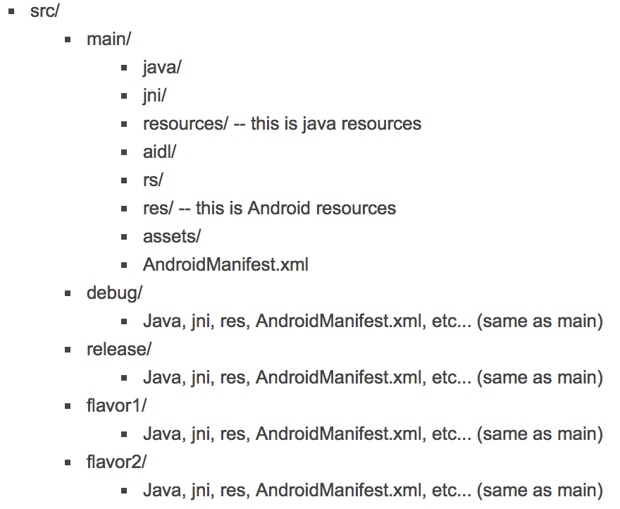
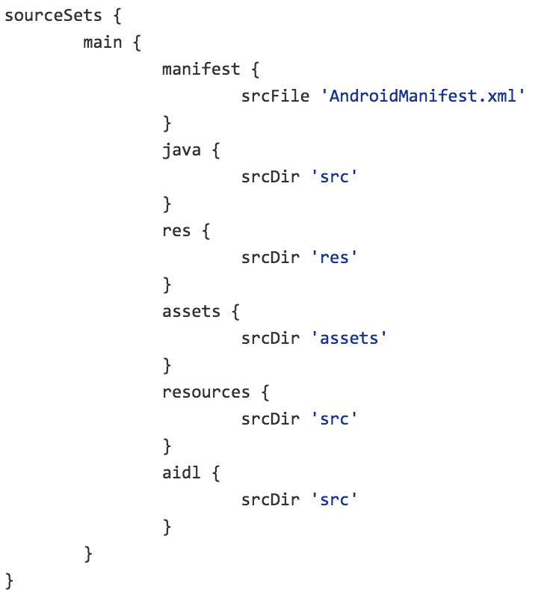
Sourcesets
remap src structure
eclipse compatibility
http://tools.android.com/tech-docs/new-build-system/build-system-concepts

Slide 22
Dependencies
Simply include any artifacts provided by mavenCentral()
…
dependencies {
compile fileTree(dir: 'libs', include: ['*.jar'])
compile 'com.android.support:appcompat-v7:21.0.2'
compile 'com.jpardogo.flabbylistview:library:+'
compile 'com.jpardogo.googleprogressbar:library:+'
compile 'com.mcxiaoke.volley:library:1.0.+'
compile 'com.umeng.analytics:analytics:5.2.4'
}
…
build.gradle

Slide 23
Dependencies
指定你自己的仓库地址
…
repositories {
maven {
url "http://repo.mycompany.com/repo"
}
}
…
build.gradle
常见的maven仓库
http://search.maven.org （mavenCentral()）
https://bintray.com/bintray/jcenter (jcenter())
http://maven.oschina.net/home.html
( maven{ url 'http://maven.oschina.net/content/groups/public/'} )

Slide 24
Multi Project Build (Library Projects)
use the settings.gradle files to declare library projects
add library projects as "compile" dependency
自定义library project位置
…
include ':letvCore'
include ':loginLib'
include ':letv'
project(':letvCore').projectDir = new File(rootDir, "../librarys/letvCore")
project(':loginLib').projectDir = new File(rootDir, "../librarys/loginLib")
…
settings.gradle
http://tools.android.com/tech-docs/new-build-system/build-system-concepts

Slide 25
Demo
如何通过一套代码开发不同功能的apk
git clone https://github.com/ghuiii/gradledemo.git

Slide 26
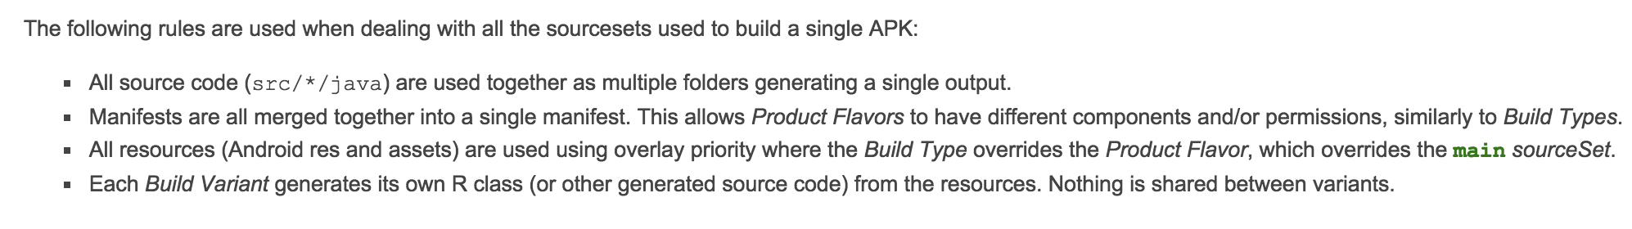
代码合并规则
图片、音频、 XML 类型的 Drawable 等资源文件，将会进行文件级的覆盖
字符串、颜色值、整型等资源以及 AndroidManifest.xml ，将会进行元素级的覆盖
代码资源，同一个类， buildTypes 、 productFlavors 、 main 中只能存在一次，否则会有类重复的错误
覆盖等级为：buildTypes > productFlavors > main
http://ask.android-studio.org/?/article/30

Slide 27
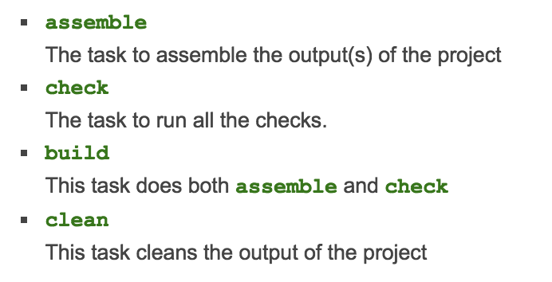
Gradle plugin for android 常见task
http://tools.android.com/tech-docs/new-build-system/user-guide#TOC-Build-Tasks

Slide 28
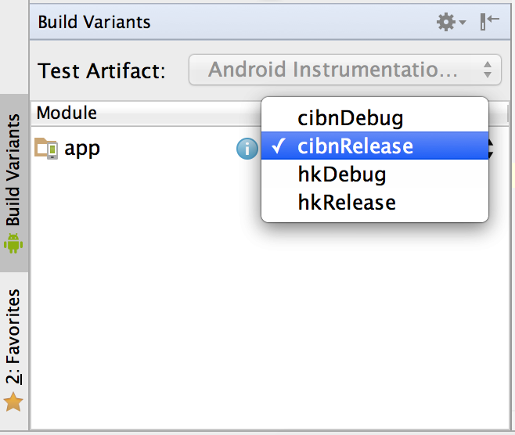
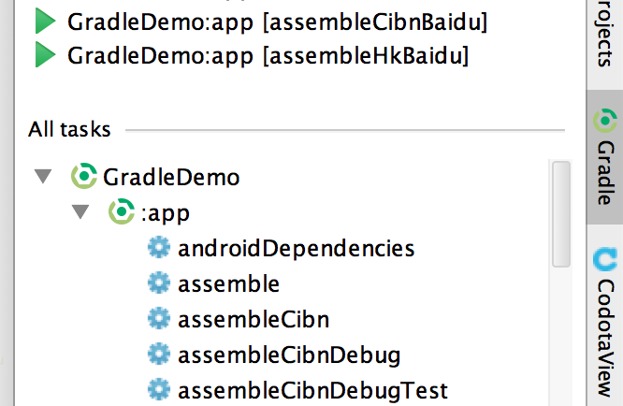
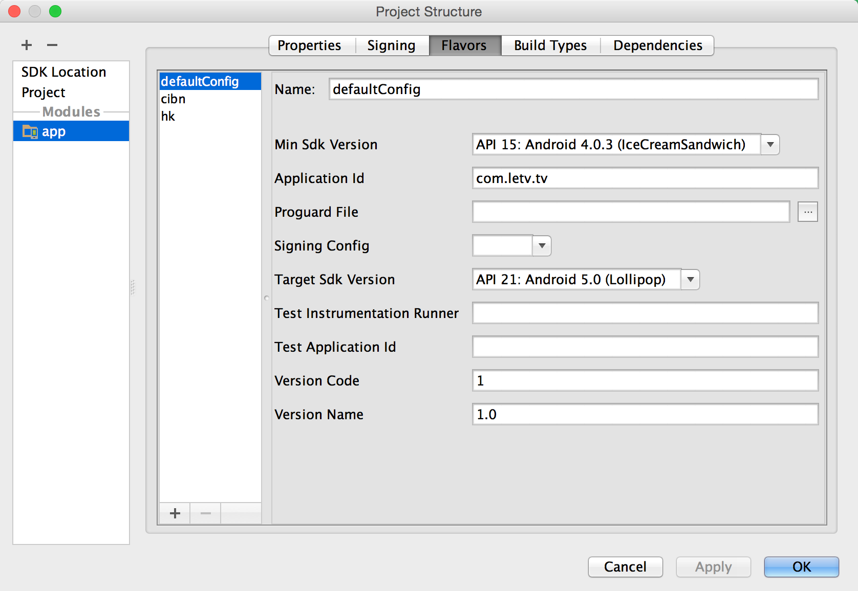
Studio&Gradle
Good IDE integration
The IDE doesn’t do a build anymore
Building and Running from Android Studio
Building and Running from Command Line
http://developer.android.com/tools/building/index.html

Slide 29
Gradle 与 tv版

Slide 30
从maven仓库获取依赖的好处
将主工程与依赖隔离开，方便对依赖的管理，它们之间只是通过一条gradle语句建立联系
依赖不再会进入主工程的代码仓库
在本地不会存在依赖的重复副本（依赖只会缓存一份到本地）

Slide 31
Resources
http://gradle.org/docs/current/userguide/userguide.html
http://rominirani.com/2014/07/28/gradle-tutorial-series-an-overview/
http://avatarqing.github.io/Gradle-Plugin-User-Guide-Chinese-Verision/introduction/README.html
http://developer.android.com/sdk/installing/studio-build.html
http://apdr.qiniudn.com/index.html

Slide 32
Thanks

