Slide 1
Gradle
王凌翔

Slide 2
Revolution
"We are working on a new build system to replace both the build system inside ADT(Eclipse) and Ant."
http://tools.android.com/tech-docs/new-build-system

Slide 3
Android Gradle Build System
What is Gradle?
Why Gradle?
How to use Gradle?
Examples
Hints
Resources
Q.A

Slide 4
What is Gradle?
Gradle is an open source build automation system.
Grade introduces DSL instead of the more traditional XML form of declaring the project configuration.
focused around Java, Groovy and Scala development and deployment, but more languages and project workflows are on the roadmap.
Gradle can automate the building, testing, publishing, deployment.
https://github.com/gradle/gradle
https://gradle.org/
https://en.wikipedia.org/wiki/Gradle

Slide 5
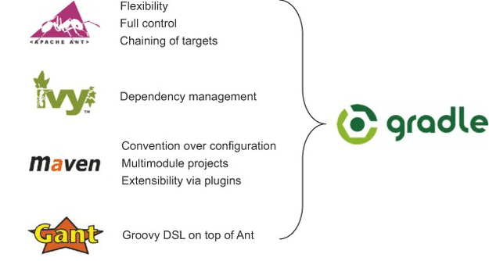
Why Gradle?
Make it easy to reuse code and resources
Make it easy to create several variants of an application, either for multi-apk distribution or for different flavors of an application
Make it easy to configure, extend and customize the build process
Good IDE integration
http://gradle.org/whygradle/
http://www.drdobbs.com/jvm/why-build-your-java-projects-with-gradle/240168608

Slide 6
How to use Gradle?
requires a Java JDK or JRE to be installed, version 6 or higher
Gradle ships with its own Groovy library, therefore Groovy does not need to be installed.
Any existing Groovy installation is ignored by Gradle.
Gradle uses whatever JDK it finds in your path
download （http://gradle.org/downloads）
unpacking
add GRADLE_HOME/bin to your PATH environment variable
If you don‘t want to do Automation Build , Android Studio is enough
Android Studio Project includes Gradle plugin for Android
https://docs.gradle.org/current/userguide/installation.html
Notes:
Building and Running from Android Studio
Building and Running from Command Line

Slide 7
Elements
Product Flavors
Build Types
Build Variants
Flavor Groups
Sourcesets
Tests

Slide 8
Product Flavors
"A product flavor defines a customized version of the application build by the project."
"This new concept is designed to help when the differences are very, very minimum [...]"
http://tools.android.com/tech-docs/new-build-system/build-system-concepts

Slide 9
Library Projects
Similar to regular project except:
There are no Product Flavor.
There are debug and release build types but they are used slightly differently.
Building a library project itself is always a "Debug" build
Packaging a library project in a distribution blob is always a "Release" build
http://tools.android.com/tech-docs/new-build-system/build-system-concepts

Slide 10
Product Flavors - What can be customized?
minSdkVersion
targetSdkVersion
versionCode
versionName
package name (overrides value from manifest)
release signing info (keystore, key alias, passwords,...).
BuildConfig: Ability to provide custom Java code.
test info
package name for test app (optional, default is <base>.test)
InstrumentationTestRunner class (optional)
Additionally, Product Flavor can provide their own source code, resources and manifest.
http://tools.android.com/tech-docs/new-build-system/build-system-concepts

Slide 11
Build Types
"A build type allows configuration of how an application is packaged for debugging or release purpose."
"This concept is not meant to be used to create different versions of the same application. This is orthogonal to Product Flavor."
http://tools.android.com/tech-docs/new-build-system/build-system-concepts

Slide 12
Build Types - What can be customized?
manifest debuggable flag
native compilation debug flag
proguard enabled + specific rules
debug signing flag (ie whether to use debug key or release key)
package name suffix (2)
Buildconfig
DEBUG flag. Set automatically based on the manifest debuggable flag.
Ability to provide custom Java code.
Types "Release" and "Debug" are automatically created and can be reconfigured
http://tools.android.com/tech-docs/new-build-system/build-system-concepts

Slide 13
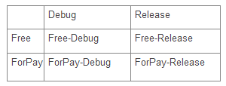
Build Variants
In short: the cross product of Build Type x Build Flavor
http://tools.android.com/tech-docs/new-build-system/build-system-concepts

Slide 14
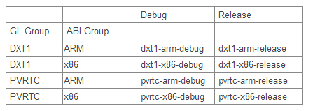
Flavor Groups
In short: Flavor groups provide several dimensions of flavors (eg 2 GL texture formats x 2 ABIs)
http://tools.android.com/tech-docs/new-build-system/user-guide#TOC-Multi-flavor-variants

Slide 15
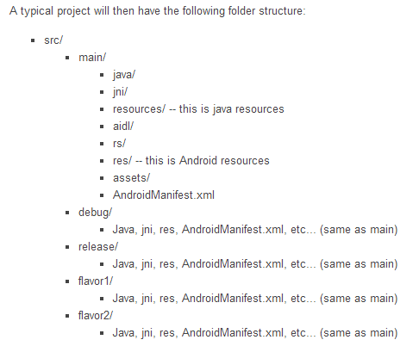
Sourcesets
Mapping of source types
Can be reconfigured
http://tools.android.com/tech-docs/new-build-system/build-system-concepts

Slide 16
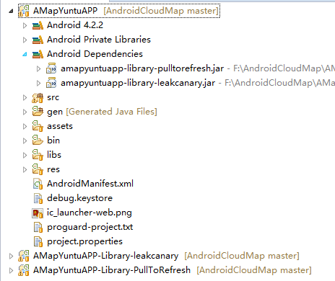
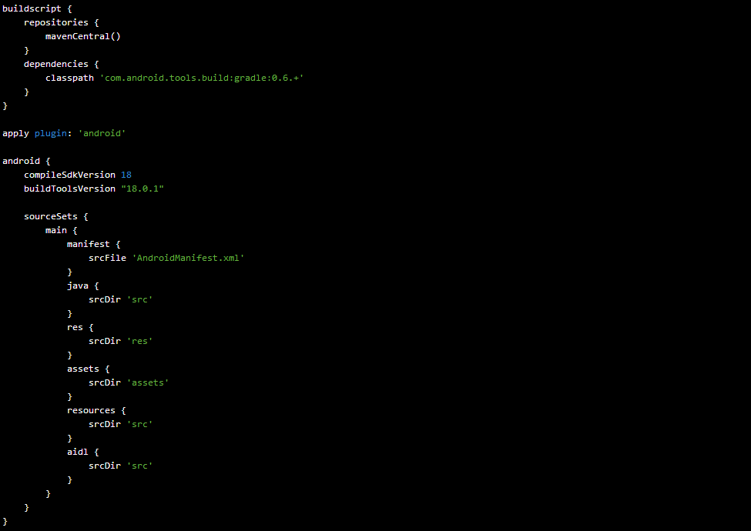
Eclipse Compatibility

Slide 17
Testing
Tests are no longer a separate project
They are now part of the main project
Tests go to "src/test" or "src/test<flavor>"
http://tools.android.com/tech-docs/new-build-system/build-system-concepts

Slide 18
Groovy
http://groovy.codehaus.org/
The language used by Gradle
Great similarity to Java
"builds upon the strengths of Java but has additional power features inspired by languages like Python, Ruby and Smalltalk"

Slide 19
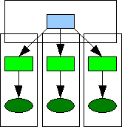
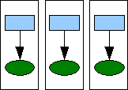
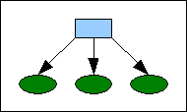
The new way...
Previously:
Worst: Multiple Android projects (with copied sources and resources)
Okay but still complex: Android library project + multiple Android Projects
Now:
One single Android project which contains:
Gradle config
Sources and resources for all build variants

Slide 20
resource-merging
We just mentioned:
Sources and resources for all build variants
Priority Order
The priority order is the following:
BuildType -> Flavor -> main -> Dependencies.
This means that if a resource is declared in both the Build Type and in main, the one from Build Type will be selected.
http://tools.android.com/tech-docs/new-build-system/resource-merging

Slide 21
Examples
如何从Eclipse工程转到Android Studio工程
如何理解Build Type，给release版本签名，设置BuildConfig
如何添加引用，From:.jar,maven repo,project
如何通过一套代码开发不同功能的apk

Slide 22
Hints
Multi Project Build (Library Projects)
Dependencies
Benefits of using maven repositories
Customizing Maven Repos
Work with Eclipse fans
.gitignore
AndroidManifest.xml & build.gradle
Better version management
Version control for releasing .apk

Slide 23
Multi Project Build (Library Projects)
use the settings.gradle files to declare library projects
add library projects as "compile" dependency in build.gradle of App project

Slide 24


Dependencies
Simply include any artifacts provided by maven repos
Simple Jar dependencies
Libraries need to have the “aar” format!!!
Useful maven repos at:
./useful maven repos/Maven Repositories.html

Slide 25
Benefits of using maven repositories
Relationship between project and dependencies is just one line of code
Dependencies won’t be included in the Developing folder
Just one piece of dependency lib stored in your computer
C:\Users\[username]\.gradle\caches\modules-2\files-2.1

Slide 26
Customizing Maven Repos
Default:
...
buildscript {
repositories {
jcentral()
}
}
...
Or:
repositories {
maven{ url ‘${MAVEN_REPO_URL}'}
}
http://maven.oschina.net/content/groups/public/
Your own maven repo url

Slide 27
Work with Eclipse fans
Does your colleagues still use Eclipse?
No problem!
Android Studio can even handle the Eclipse project structure
Before importing, you have to delete the .project and .classpath files
Not Recommed
Of course, going the Eclipse-compatible way eliminates some of the benefits of the new build system (flavor specific res/java/...)

Slide 28
.gitignore
Things you might want to add to your .gitignore file:
Awesome .gitignore file here：
./推荐的.gitignore/.gitignore

Slide 29
AndroidManifest.xml & build.gradle
Priority: AndroidManifest.xml -> build.gradle
When you haven't configured something in the Gradle build file, the data from the manifest is still used
Configuration that is done in the Gradle build file overrides the manifest data
Seems like the "libs/" folder is ignored. Add it as "compile" dependency with fileTree(...)

Slide 30
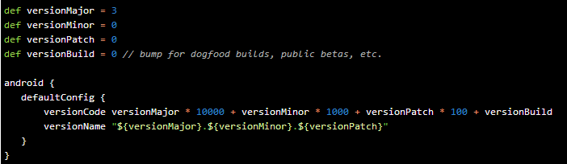
Better version management
Better version management (+Jake Wharton)

Slide 31
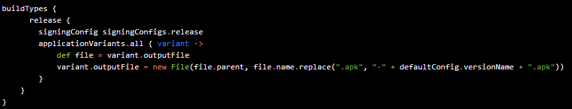
Version control for releasing .apk
Version in release APK file (codaR0y on SO)

Slide 32
Resources
http://source.android.com/ (tools/build)
http://groups.google.com/group/adt-dev
http://tools.android.com/tech-docs/new-build-system
All the code samples are either from the "Android Tools Project Site", or the gradle-samples you can download there, or created by myself and available at https://github.com/Goddchen/Android-Gradle-Examples

Slide 33

Questions?

Slide 34
Thanks
Bye Bye

