Slide 1
Engine High Level Layering
Clients
Engine Extensions
SWIG wrappers
Engine Core
External Libraries

Slide 2
Engine Language Partitioning
Clients
C++, script
Engine Extensions
script
SWIG wrappers
C++, script
Engine Core
C++
External Libraries
C++, script

Slide 3
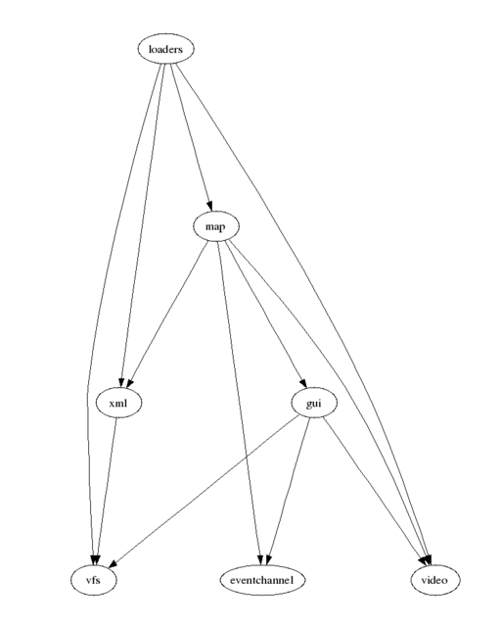
Engine Core

Slide 4
0-1
Module
design
*
Module
description
1
*
Module
proposal
Module
proposal
Module
proposal
1
1
Module
ideas

Slide 5
Games
Engine Utilities
Editor
Engine tests
Engine Core
Engine Extensions
SWIG wrappers

Slide 6
Controller
Loaders
Model
View
Gui
XML
Audio
Path finding
Event Channel
Video
VFS
Util

