Slide 1
Management of Herbivorous Mites of Rose with Predatory Mites and Systemic Acquired Resistance
Austin Fife, Gary Knox, Xavier Martini, Mathews Paret
What is my main takeaway? - Spirotetramat (Kontos) works, other combos do not

Slide 2
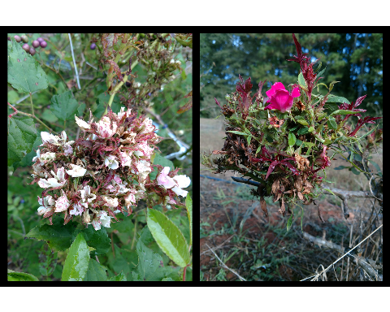
Rose Rosette Disease continues to kill our roses
Typical symptoms of Rose Rosette Disease (RRD), caused by Rose Rosette Virus: clusters of deformed flowers known as rosettes/witches’ brooms, increased thorniness, elongated shoots, reddened leaves and stems. RRD ultimately kills the rose host.

Slide 3
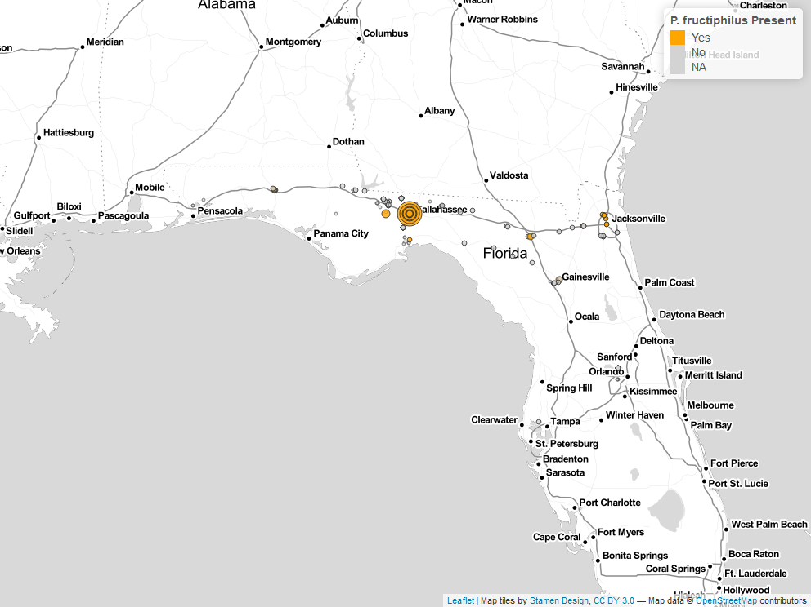
P. fructiphilius are moving southwards into Florida
P. fructiphilus mites recovered during surveys of roses in Florida, 2017-2021.

Slide 4
- Check out Monterrosa et al. (2021)

Slide 5
Plant defenses slow the progress of RRD infection
Monterrosa, A., F. B. Iriarte, M. L. Paret, and S. V. Joseph. 2021. Effects of relative humidity on the vector of rose rosette disease, Phyllocoptes fructiphilus (eriophyidae), and incidence of disease symptoms. 104, DOI:10.1653/024.104.0305.

