Slide 1
Management of herbivorous mites of rose with predatory mites and Systemic Acquired Resistance
Austin Fife, Gary Knox, Xavier Martini, Mathews Paret

Slide 2
Phyllocoptes fructiphilus Keifer (Trombidiformes: Eriophyidae)
Feeds on plants in the genus Rosa
Vector for Rose Rosette Virus (RRV)

Slide 3
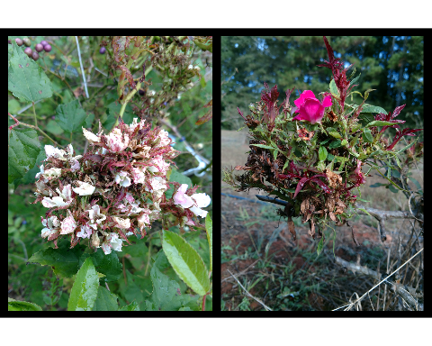
RRD Symptoms
Typical symptoms of Rose Rosette Disease (RRD), caused by Rose Rosette Virus: clusters of deformed flowers known as rosettes/witches’ brooms, increased thorniness, elongated shoots, reddened leaves and stems. RRD ultimately kills the rose host.

Slide 4
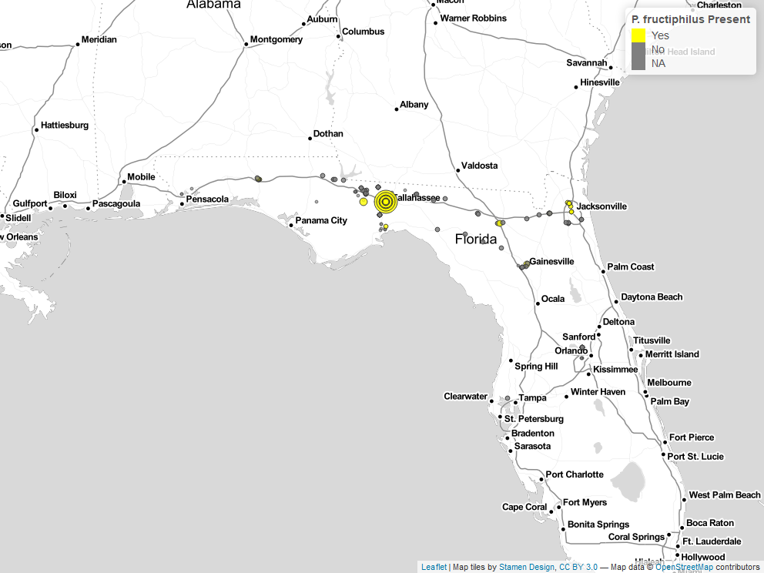
P. fructiphilius in Florida
mites recovered during surveys of roses in Florida, 2017-2021.

Slide 5
- Possibility of introducing RRD from areas where the disease had become established, including the neighboring states of Georgia and Alabama (Solo 2018, Solo et al. 2020).

Slide 6
Integrating Pest Management
P. fructiphilus is hard to control Illustration of the typical location of on roses. are difficult to manage with pesticides due to the protection offered by the sepals.

Slide 7
Phytoseids an option for control?
Small species may be able to find and feed on P. fructiphilus
Amblyseius swirskii Athias-Henriot (Mesostigmata: Phytoseiidae) mites were attracted towards roses which were infected with RRD
Too large!
Model organism

Slide 8
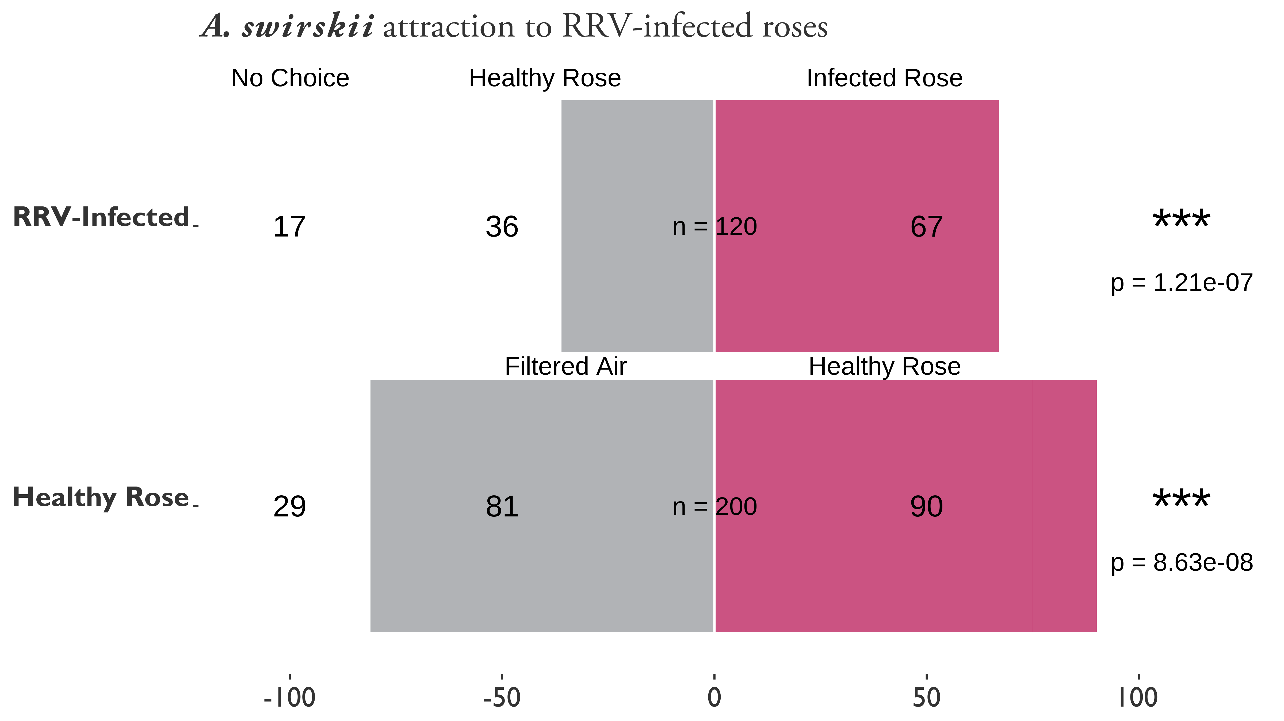
What caused the attraction to infected roses?
attraction to healthy and Rose Rosette Virus-infected Pink Double Knock Out® roses. Asterisks represent significant differences as calculated by $χ^{2}$ contingency table tests for given probabilities. N.S. = not significant. RRV-infected vs Healthy Rose: $χ^{2}=9.33$, $df=1$, $α=0.05$, $p−value=0.002$. Filtered Air vs Healthy Rose: $χ^{2}=0.47$, df $=$ 1, $α=0.05$, $p−value=0.4913$.

Slide 9
- Low levels of MeSA from RRV-infected roses - MeSA attractive to some many predatory mites

Slide 10
MeSA and SAR
MeSA increases when a plant is attacked by herbivores or pathogens, derivative of Salicylic Acid
Systemic Acquired Resistance (SAR), protects distant tissues
Hypersensitive Response
Enduring resistance
Pathogen resistance: fungi, bacteria and viral pathogens

Slide 11
SAR-induction
Induce SAR before RRV infection
acibenzolar-S-methyl (ASM), benzothiadiazole
ASM used to protect plants from fungal infection
Chitinase activity in roses (Suo and Leung 2001)
Hypersensitive response and SAR interferes with the ability of eriophyoid mites to feed or grow on induced plants (Bronner et al. 1991, Westphal et al. 1991, 1992).

Slide 12
How does SAR-induction affect predators?
Predatory mites may still be harmed via direct and indirect effects of SAR-induction Pappas et al. (2017)

Slide 13
Design: ASM Trials
12 weeks, from August to October
Griffin and Athens, GA
low and high pest pressure
Plants inoculated with canes from nearby RRD-infected roses
Inoculated 1st and 5th weeks of the experiment
48 Pink Double Knock Out® Roses 1 gallon buckets

Slide 14
Treatments: ASM
acibenzolar-S-methyl, ASM (Actigard50WG)
Two rates: 50 / (Half rate) and 100 / (High rate)
Goal: observe the effects of inducing Systemic Acquired Resistance (SAR) on P. fructiphilus
Griffin had two controls:
Kontos (Spirotetramat), label rate (negative control)
Water (positive control)
Athens had untreated roses and water as negative controls

Slide 15
Data Collection: ASM
Subset of samples weekly
Each rose plant has been sampled three times.
Rose/rosebud cuttings ~10 cm
Samples in 50 mL centrifuge tubes
Washing methods of Monfreda et al. (2007)
Counted eriophyoid mites

Slide 16
Design: IPM Trials
August to October simultaneously in Griffin, GA and Athens, GA. The Athens site will be given 96 Pink Double Knock Out® Roses (Star Roses and Plants, West Grove, PA, USA), while Griffin will use 54 roses due to the smaller plot area available. Bare root roses will be planted 2 months before the trials begin to allow new flush to form. Rose planting media and environmental conditions will be the same as previously described.

Slide 17
Treatments - IPM
ASM (Actigard 50WG) and SP2700, (Ninja, SePro)
A. swirskii 2 mini sachets with hooks sachets per rose
ASM + A. swirskii
Kontos - spirotetramat acaricide as a negative control
Water - a positive control
12 weeks, mites applied on the 1st, 5th and 9th week
Two blocks, 10 plots, 12 roses/plot w/buffer, six roses treated

Slide 18
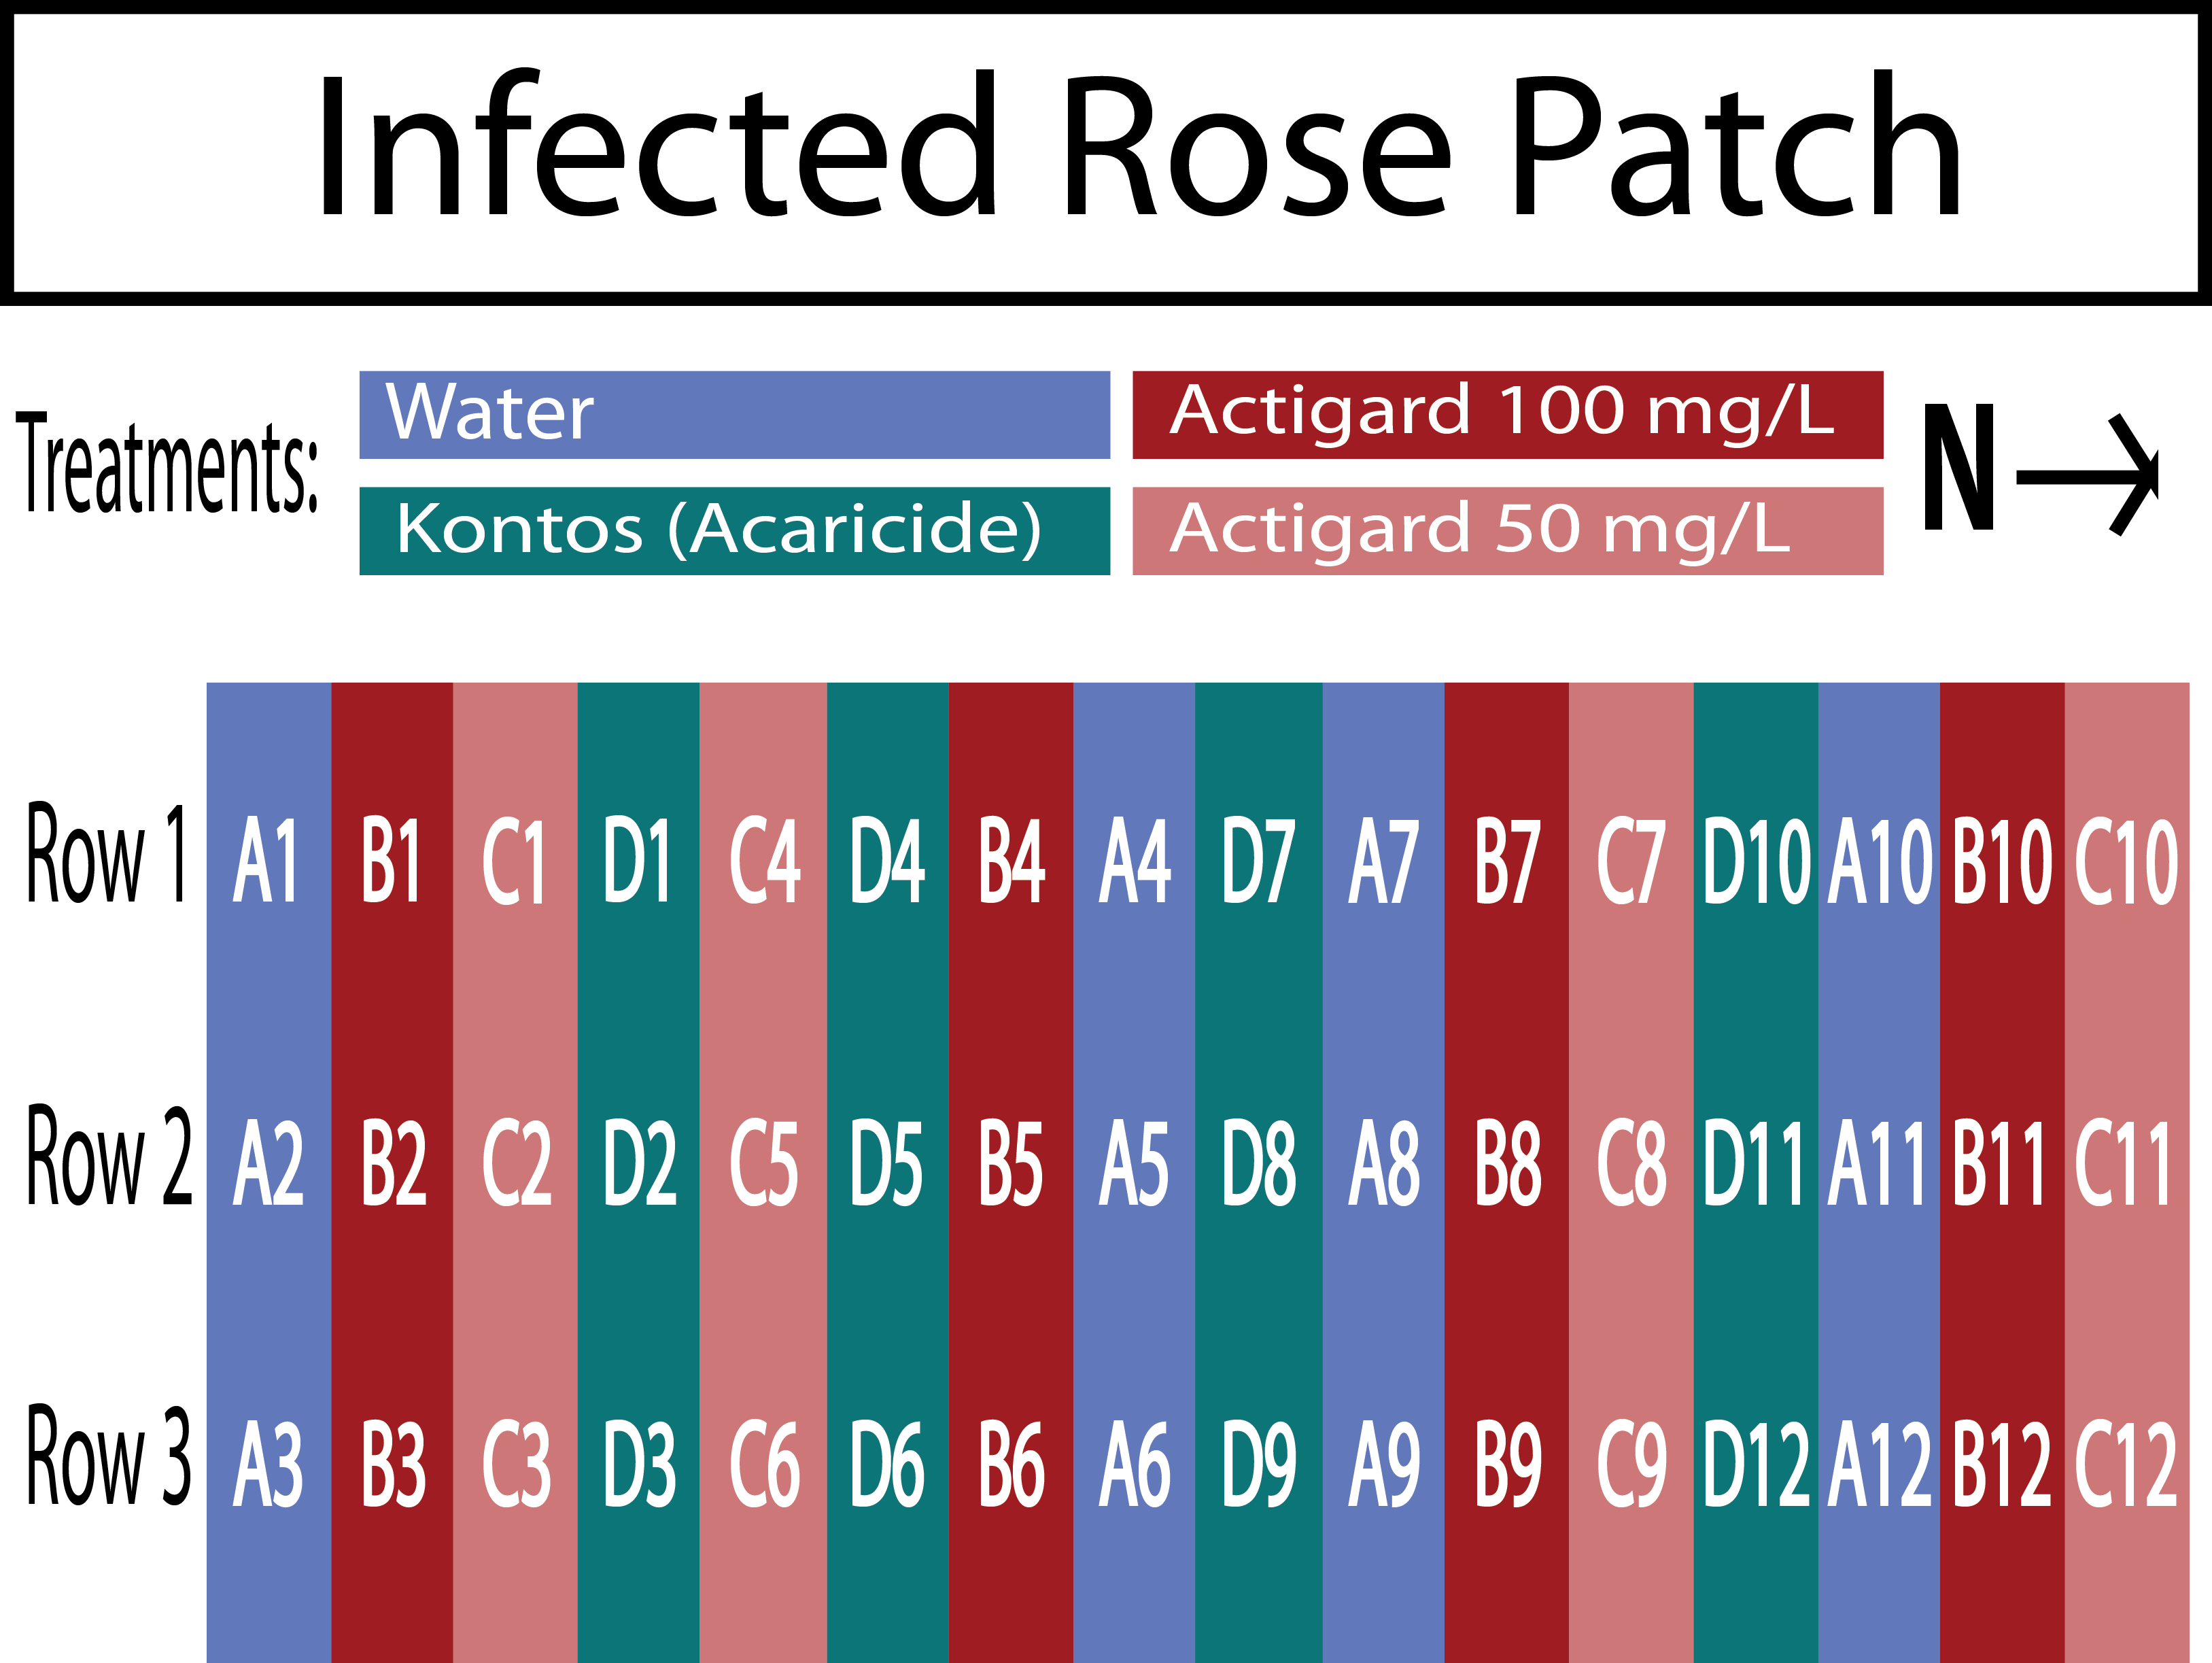
Plot Design - 2018
Field design for testing the potential of Acibenzolar-S-Methyl to reduce populations of by inducing Systemic Acquired Resistance in Pink Double Knock Out® roses. Trials were conducted for three months from September to December 2019 in Griffin, GA. Four treatments were applied weekly fo 12 weeks: Blue = Water Red = Actigard50WG 100 /L (High rate), Pink = Actigard50WG /L (Half rate) Turquoise = Kontos (Label rate). Flower cuttings were be taken weekly to record numbers.

Slide 19
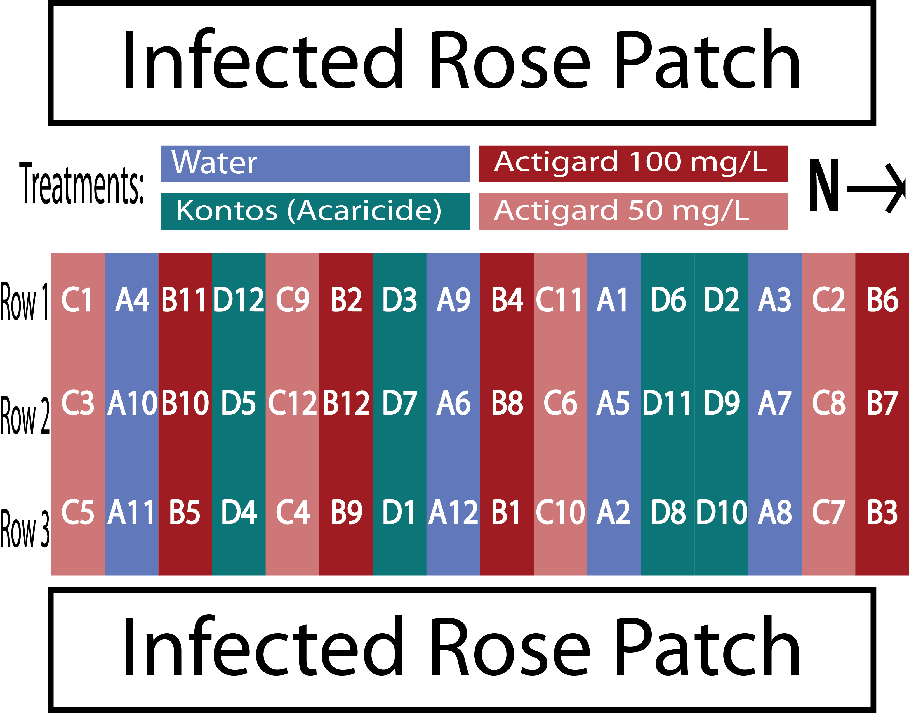
Plot Design - 2019
Field design for testing the potential of Acibenzolar-S-Methyl to reduce populations of by inducing Systemic Acquired Resistance in Pink Double Knock Out® roses. Trials were conducted for three months from September to December 2019 in Griffin, GA. Four treatments were applied weekly fo 12 weeks: Blue = Water Red = Actigard50WG 100 /L (High rate), Pink = Actigard50WG 100 /L (Half rate) Turquoise = Kontos (Label rate). Flower cuttings were be taken weekly to record numbers.

Slide 20
Data Collection: IPM
Cuttings taken weekly from six treated roses
Three flowers (buds if no flowers present)
~18 flowers/buds per bottle for each plot
Bottles with 95% EtOH
Sieves to separate mites from the plant tissues.
Plant tissues dried ~48 hrs at 50 °C, weighed
A. swirskii applied on the 1st, 5th and 9th week

Slide 21
Treatments: IPM
Water - Control
Actigard - 100 mg/L
Ninja - label rate
Kontos - label rate
A. swirskii (one sachet per rose treated)
A. swirskii + Ninja (one sachet per rose treated, label rate)

Slide 22
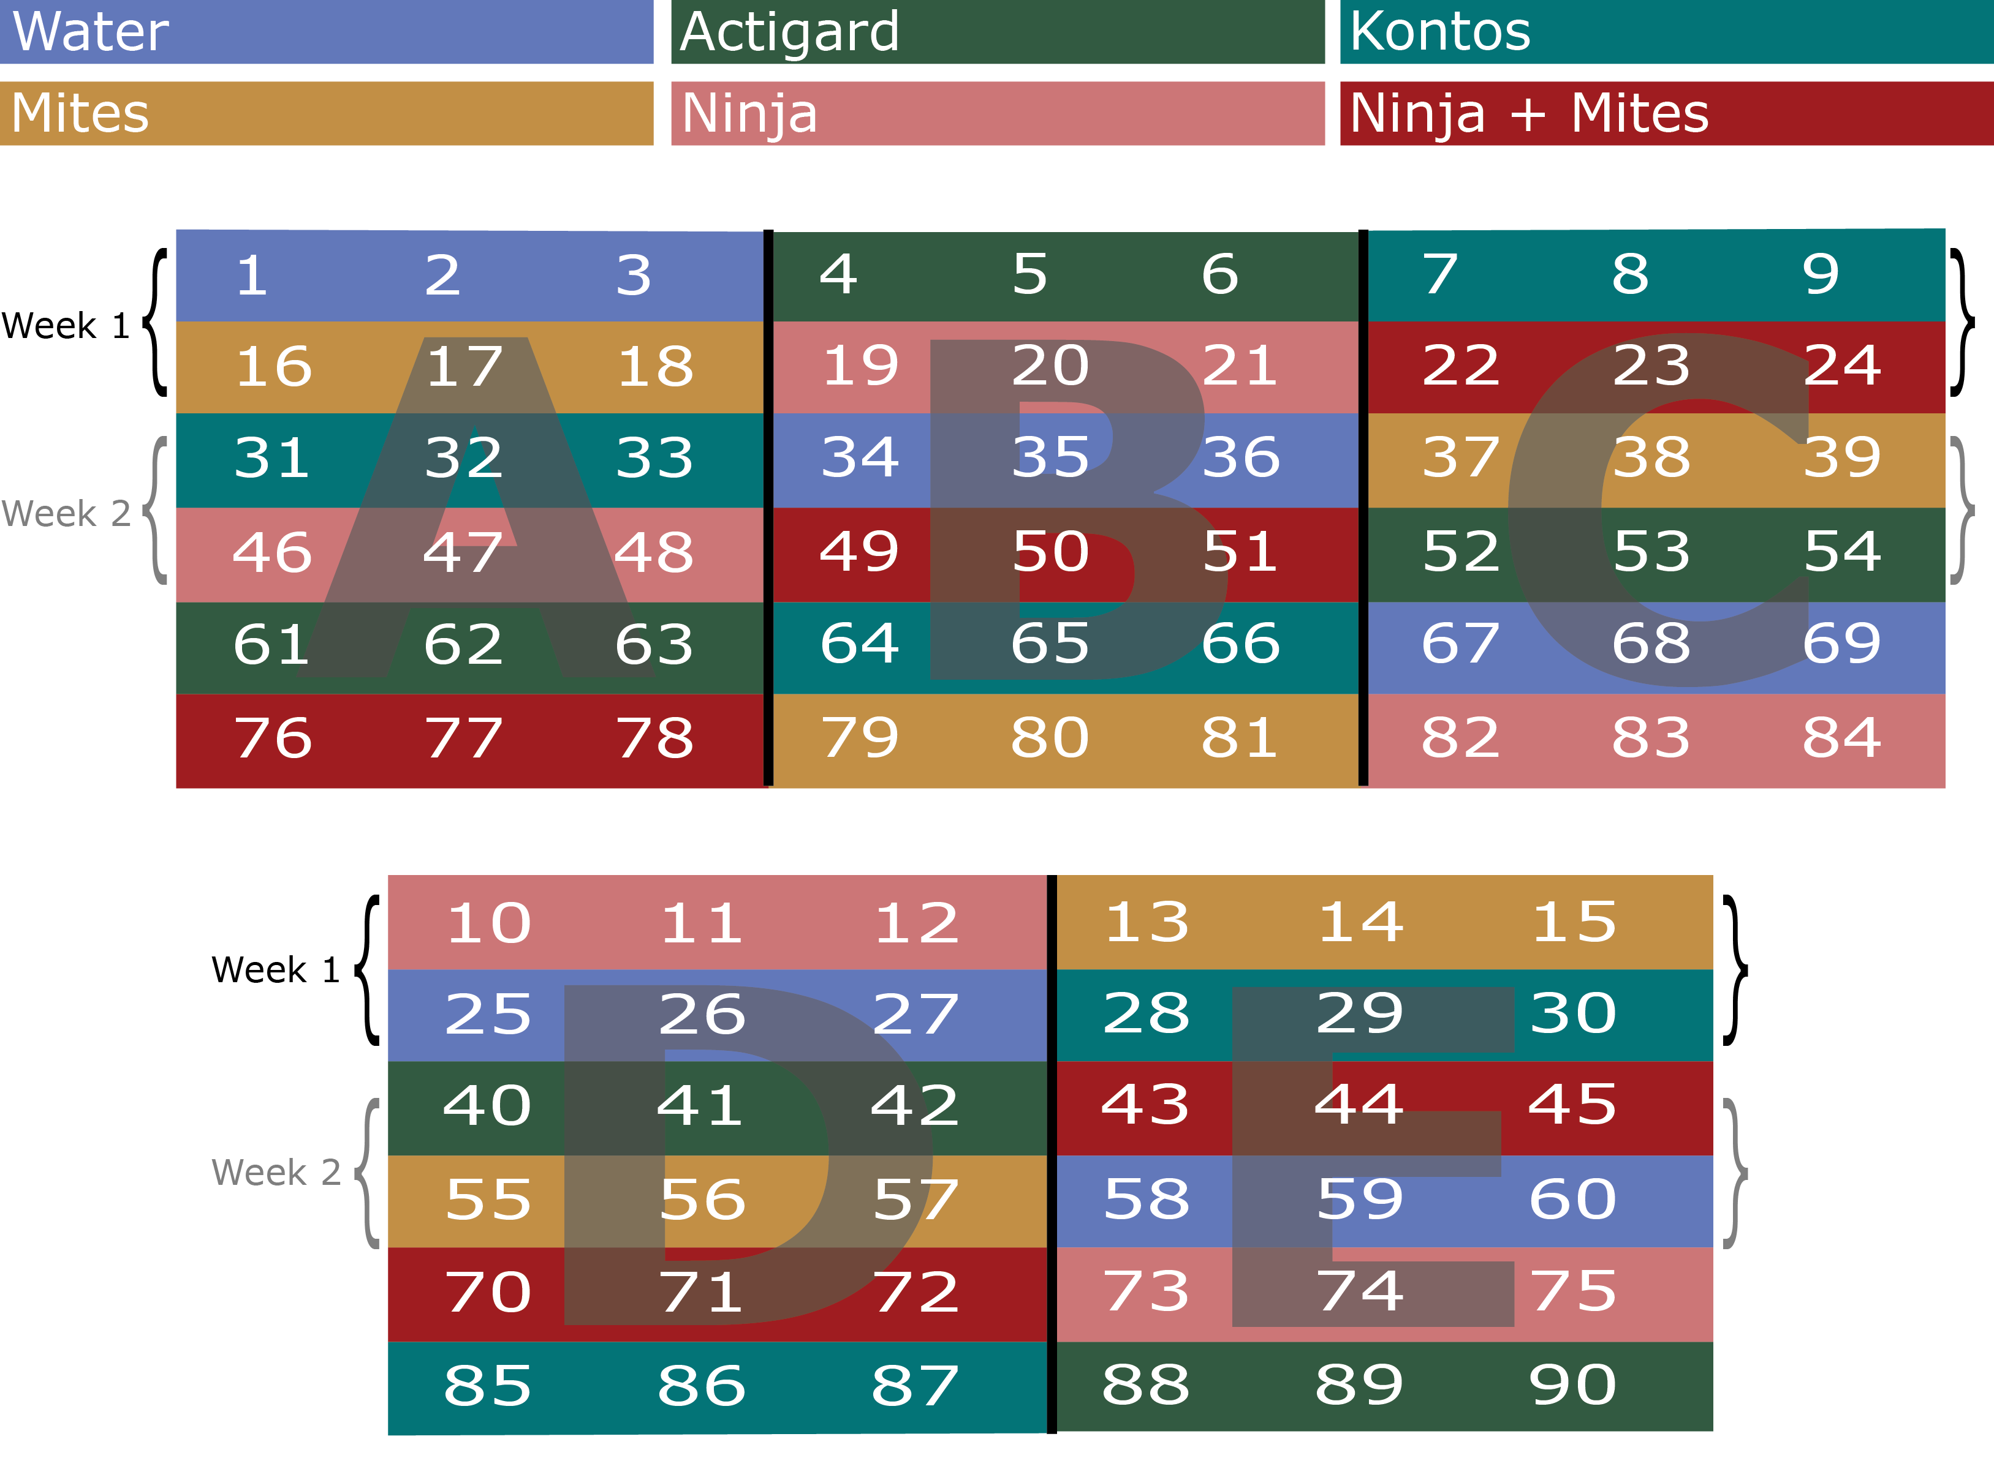
Plot Design: IPM - Athens
Field design for Integrated Pest Management trials on Pink Double Knock Out® roses to control in Athens, GA with five treatments. W = Water A = Actigard50WG, K = Kontos, M = predatory mite sachets, N = SP2700 (Trade name: Ninja, SePro), + = + Ninja combined treatments. All products were applied at their label rates for 12 weeks. Flower cuttings were taken weekly to record numbers.

Slide 23
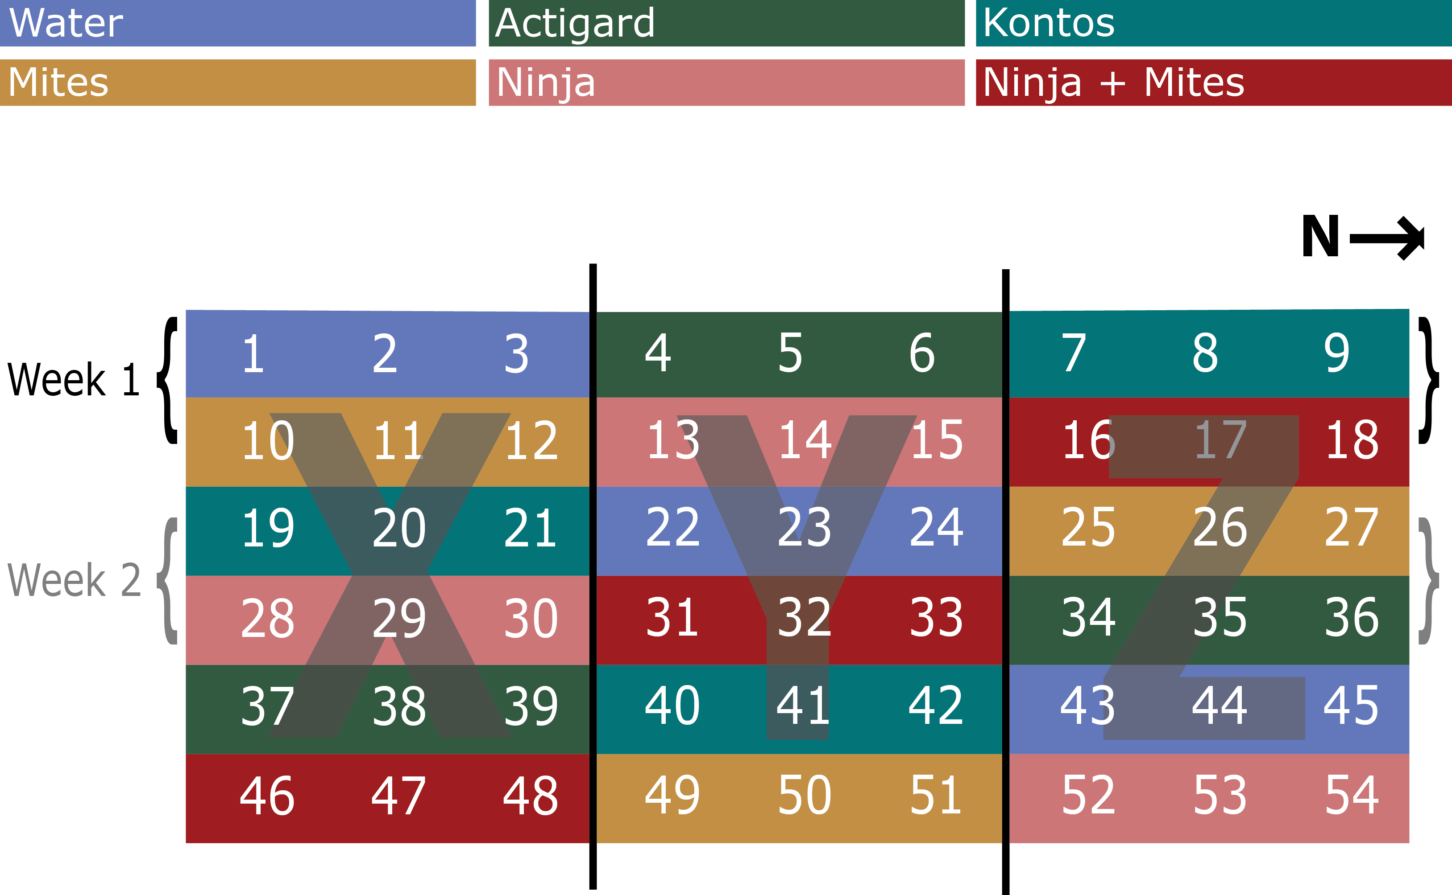
Plot Design: IPM - Griffin
Field design for Integrated Pest Management trials on Pink Double Knock Out® roses to control in Griffin, GA with five treatments. W = Water A = Actigard50WG, K = Kontos, M = predatory mite sachets, N = SP2700 (Trade name: Ninja, SePro), + = + Ninja combined treatments. All products were applied at their label rates for 12 weeks. Flower cuttings were taken weekly to record numbers.

Slide 24
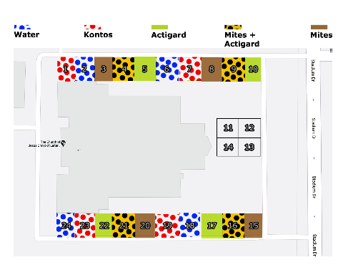
Plot Design: IPM - Tallahassee
Field design for Integrated Pest Management trials on Pink Double Knock Out® roses to control in Tallahassee, FL with five treatments: Water, Actigard50WG, Kontos, predatory mite sachets, and + Actigard combined treatments. All products were applied at their label rates for 12 weeks. Flower cuttings were taken weekly to record numbers.

Slide 25
Results
Combining predatory mites with a SAR-inducer was as effective as the miticide alone, and controlled herbivorous mite populations more than either SAR-induction or predatory mites alone

Slide 26
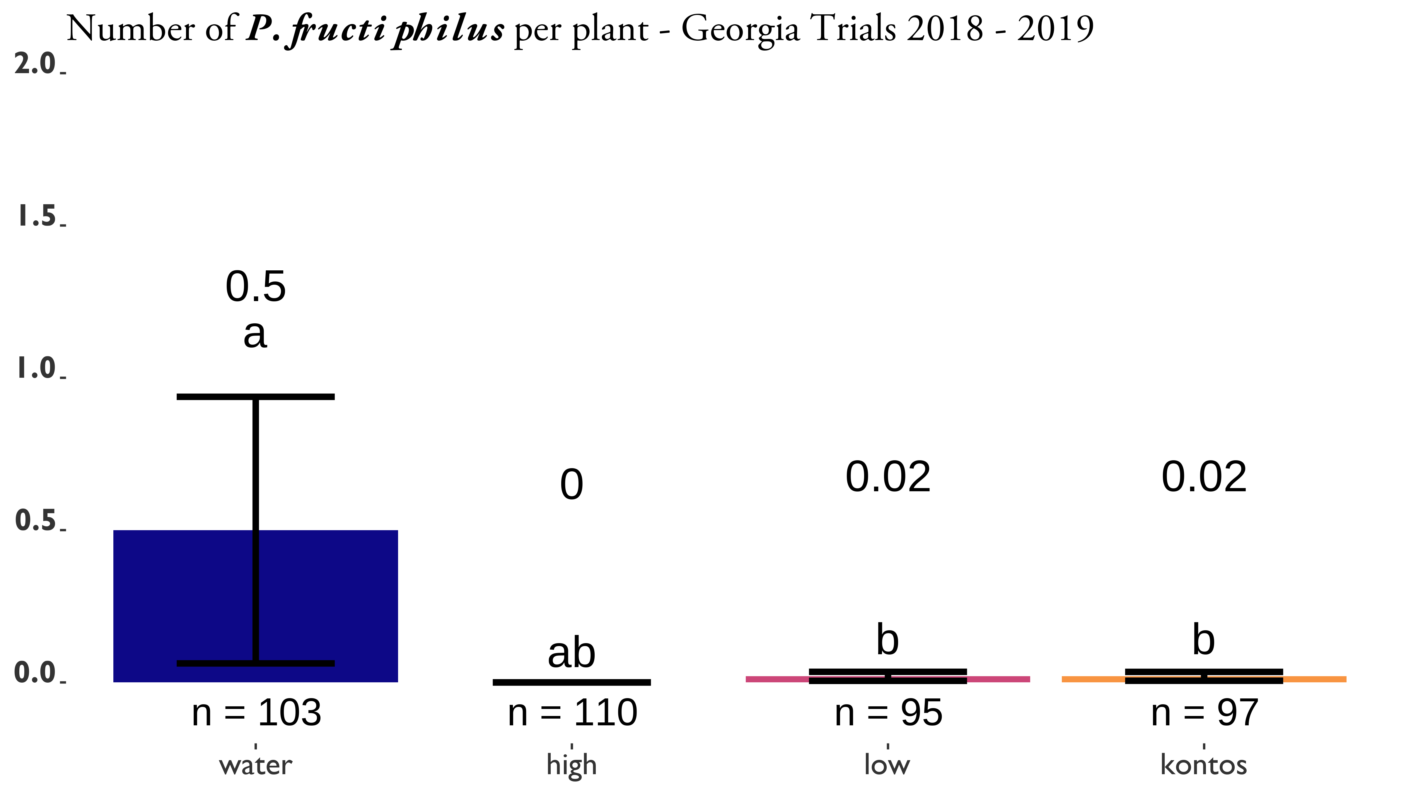
SAR-induction trials on Pink Double Knock Out® roses to control in Athens and Griffin, GA. Statistical significance was determined using Tukey contrasts for multiple Comparisons of means. Groups which share letters are not statistically different from one another. $α=0.05$. water = Water Control, High = 100 / Actigard® 50WG (Syngenta, Greensboro, NC, USA) acibenzolar-S-methyl (ASM), low = 50 / Actigard® 50WG (Syngenta, Greensboro, NC, USA) acibenzolar-S-methyl (ASM), kontos = Kontos® Miticide Insecticide - Spirotetramat (Bayer Corporation, Whippany, New Jersey, USA), untreated = No treatment. All products were applied for 12 weeks. Flower cuttings were taken weekly to record the numbers of herbivorous mites.

Slide 27
ASM Trial: Athens 2018

Slide 28
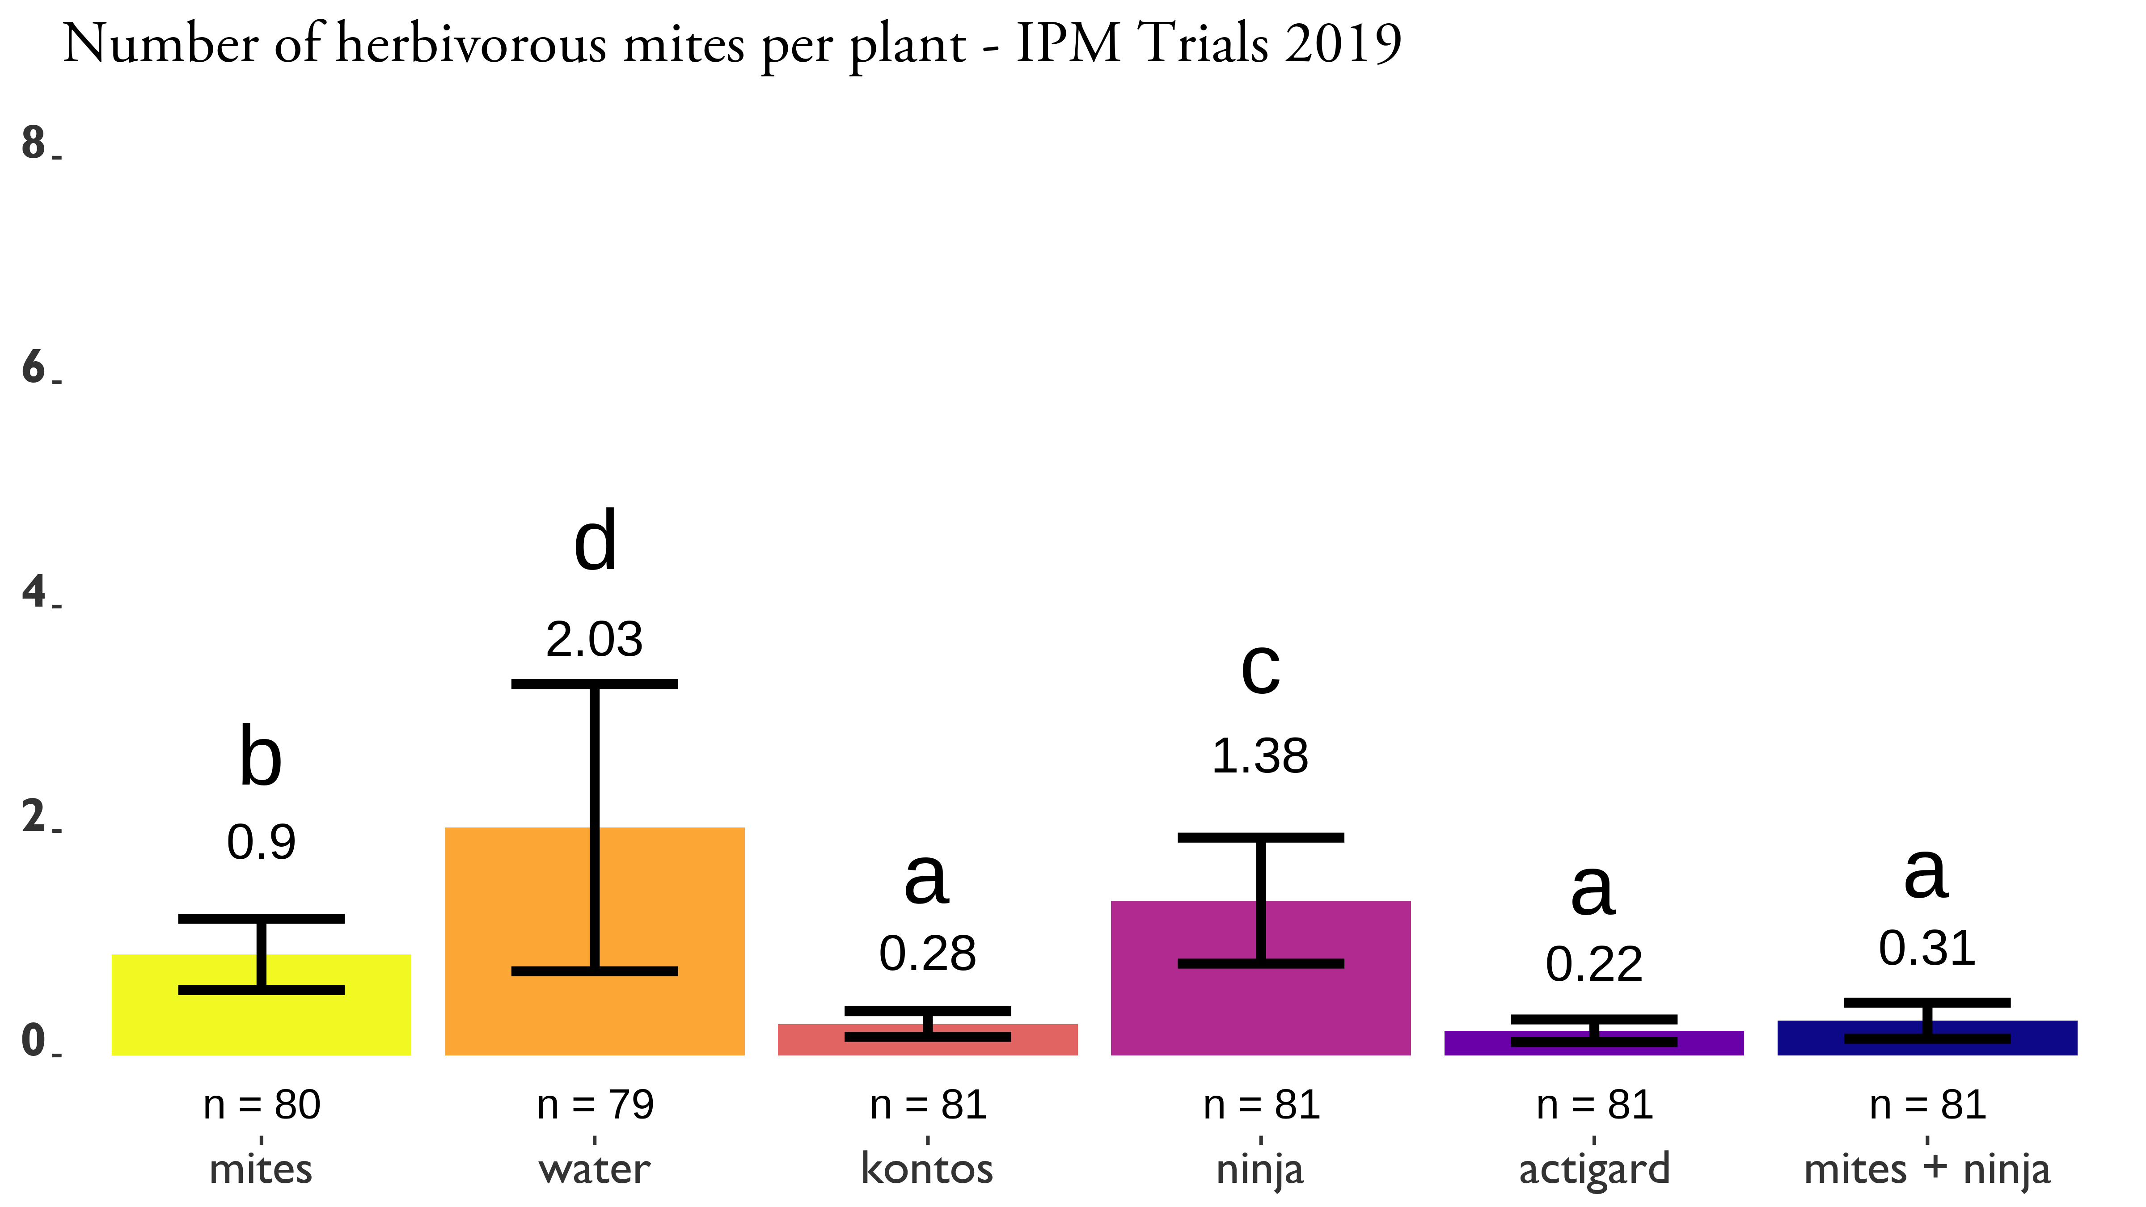
IPM Trials
Integrated Pest Management trials on Pink Double Knock Out® roses to control in Athens and Griffin, GA with five treatments. Statistical significance was determined using Tukey contrasts for multiple Comparisons of means. Groups which share letters are not statistically different from one another. $α=0.05$. water = Water Control, actigard = Actigard® 50WG (Syngenta, Greensboro, NC, USA) acibenzolar-S-methyl (ASM), kontos = Kontos® Miticide Insecticide - Spirotetramat (Bayer Corporation, Whippany, New Jersey, USA), mites = predatory mite mini sachets on hooks (Ambly-S, Arbico Organics, Oro Valley, AZ, USA), ninja = SP2700 (Trade name: Ninja, SePro, Carmel, IN, USA), mites + ninja = + Ninja combined treatments. All products were applied at their label rates for 12 weeks. Flower cuttings were taken weekly to record the numbers of herbivorous mites.

Slide 29
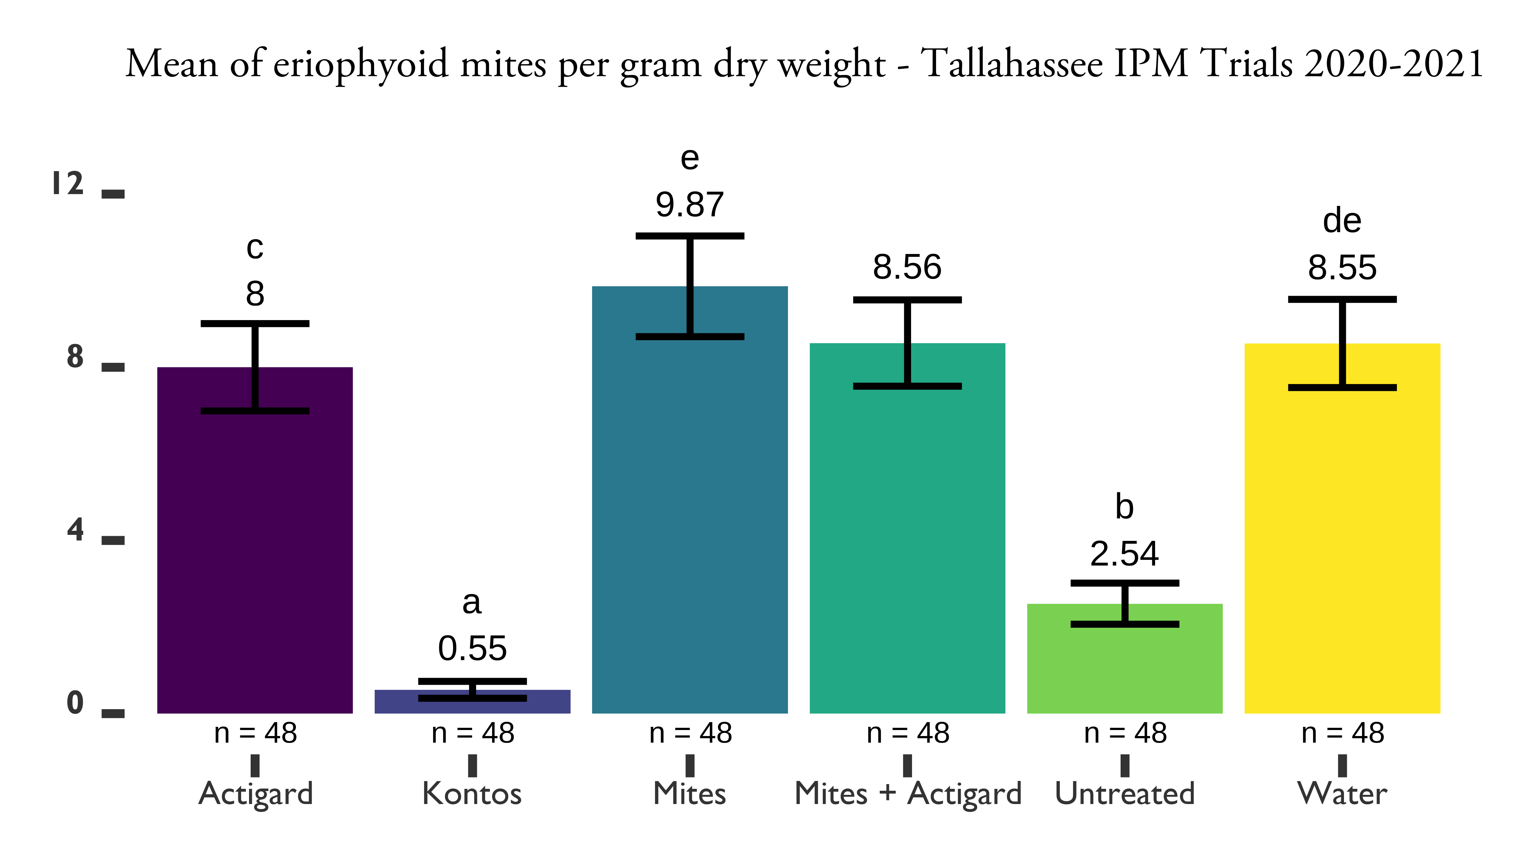
IPM Trial: Tallahassee 2021
Integrated Pest Management trials on Pink Double Knock Out® roses to control in Tallahassee, FL with five treatments. Statistical significance was determined using Tukey contrasts for multiple Comparisons of means. Groups which share letters are not statistically different from one another. $α=0.05$. Water = Water Control, Actigard = Actigard® 50WG (Syngenta, Greensboro, NC, USA) acibenzolar-S-methyl (ASM), Kontos = Kontos® Miticide Insecticide - Spirotetramat (Bayer Corporation, Whippany, New Jersey, USA), Mites = predatory mite mini sachets on hooks (Ambly-S, Arbico Organics, Oro Valley, AZ, USA), Mites + Actigard = + Actigard combined treatments. Untreated = No treatment. All products were applied at their label rates for 12 weeks. Flower cuttings were taken weekly to record the numbers of and other herbivorous mites.

Slide 30
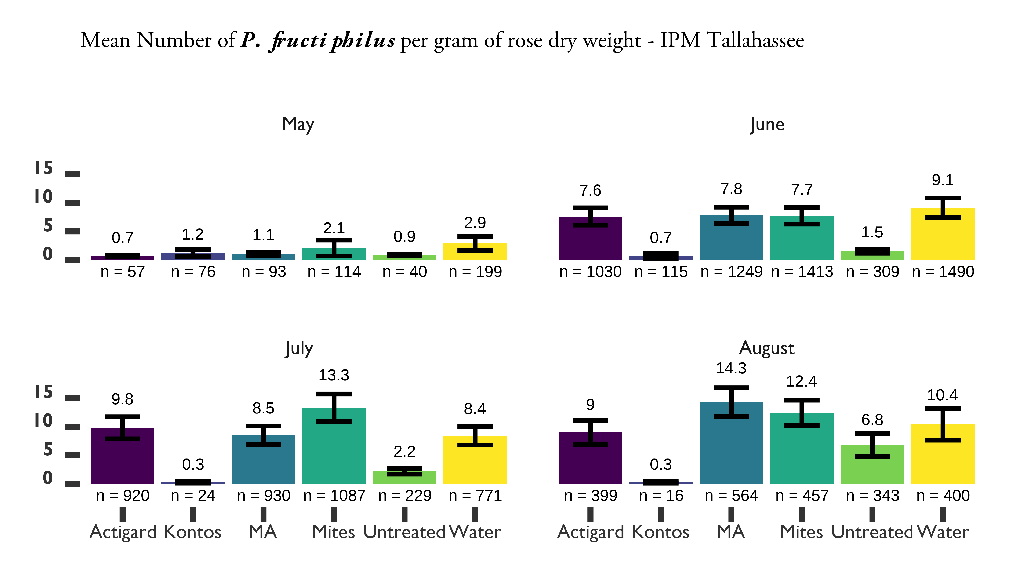
IPM Trial: Tallahassee 2021 - week
Integrated Pest Management trials on Pink Double Knock Out® roses to control in Tallahassee, FL with five treatments. Water = Water Control, Actigard = Actigard® 50WG (Syngenta, Greensboro, NC, USA) acibenzolar-S-methyl (ASM), Kontos = Kontos® Miticide Insecticide - Spirotetramat (Bayer Corporation, Whippany, New Jersey, USA), Mites = predatory mite mini sachets on hooks (Ambly-S, Arbico Organics, Oro Valley, AZ, USA), MA = + Actigard combined treatments. Untreated = No treatment. All products were applied at their label rates for 12 weeks. Flower cuttings were taken weekly to record the numbers of and other herbivorous mites.

Slide 31
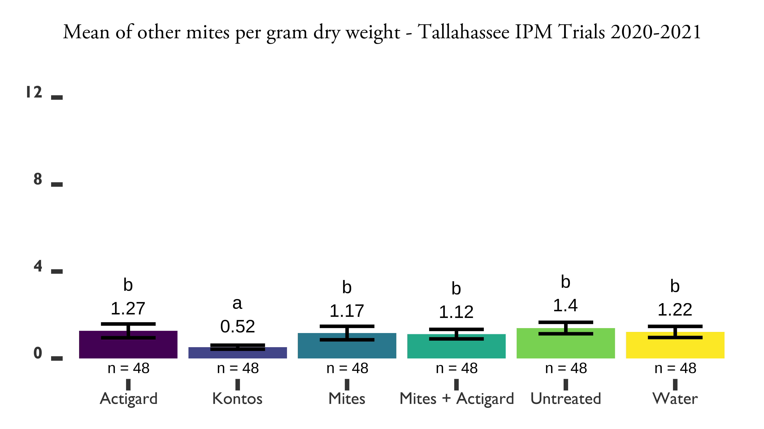
IPM Trial: Tallahassee 2021 - other
Integrated Pest Management trials on Pink Double Knock Out® roses to control in Tallahassee, FL with five treatments. Statistical significance was determined using Tukey contrasts for multiple Comparisons of means. Groups which share letters are not statistically different from one another. $α=0.05$. Water = Water Control, Actigard = Actigard® 50WG (Syngenta, Greensboro, NC, USA) acibenzolar-S-methyl (ASM), Kontos = Kontos® Miticide Insecticide - Spirotetramat (Bayer Corporation, Whippany, New Jersey, USA), Mites = predatory mite mini sachets on hooks (Ambly-S, Arbico Organics, Oro Valley, AZ, USA), Mites + Actigard = + Actigard combined treatments. Untreated = No treatment. All products were applied at their label rates for 12 weeks. Flower cuttings were taken weekly to record the numbers of and other herbivorous mites.

Slide 32
Discussion
Our results suggest that SAR-induced plant defenses have the potential to manage populations of P. fructiphilus and other herbivorous mites, especially when integrating SAR-induction with predatory mites.

Slide 33
References
Ataide, L. M. S., M. L. Pappas, B. C. J. Schimmel, A. Lopez-Orenes, J. M. Alba, M. V. A. Duarte, A. Pallini, R. C. Schuurink, and M. R. Kant. 2016. Induced plant-defenses suppress herbivore reproduction but also constrain predation of their offspring. Plant Science. 252: 300–310, DOI:10.1016/j.plantsci.2016.08.004.
Bronner, R., E. Westphal, and F. Dreger. 1991. Pathogenesis-related proteins in Solanum dulcamara L. Resistant to the gall mite Aceria cladophthirus (Nalepa)(syn Eriophyes cladophthirus Nal.). Physiological and molecular plant pathology.
Monfreda, R., G. Nuzzaci, and E. De Lillo. 2007. Detection, extraction, and collection of eriophyoid mites. Zootaxa. 1662: 35–43.
Pappas, M. L., C. Broekgaarden, G. D. Broufas, M. R. Kant, G. J. Messelink, A. Steppuhn, F. Wäckers, and N. M. van Dam. 2017. Induced plant defences in biological control of arthropod pests: A double-edged sword. Pest Management Science. 73: 1780–1788, DOI:10.1002/ps.4587.
Solo, K. M. 2018. Rose eriophyid mites: An ecological study of Phyllocoptes fructiphilus Keifer (Acari: Eriophyidea), vector of Rose rosette virus, and its relationship with Rosa species (Master’s thesis).
Solo, K. M., S. B. Collins, M. K. Shires, R. Ochoa, G. R. Bauchan, L. G. Schneider, A. Henn, J. C. Jacobi, J. L. Williams-Woodward, M. R. Hajimorad, F. A. Hale, J. B. Wilkerson, A. S. Windham, K. L. Ong, M. L. Paret, X. Martini, D. H. Byrne, and M. T. Windham. 2020. A survey of Rose rosette virus and eriophyid mites associated with roses in the southeastern United States. HortScience. 1–7, DOI:10.21273/hortsci14653-20.
Suo, Y., and D. W. M. Leung. 2001. Elevation of extracellular ,3-glucanase and chitinase activities in rose in response to treatment with acibenzolar-S-methyl and infection by D. rosae. Journal of Plant Physiology. 158: 971–976, DOI:10.1078/0176-1617-00300.
Westphal, E., F. Dreger, and R. Bronner. 1991. Induced resistance in Solanum dulcamara triggered by the gall mite Aceria cladophthirus (Acari: Eriophyoidea). Experimental & Applied Acarology. 12: 111–118, DOI:10.1007/bf01204404.
Westphal, E., M. J. Perrot-Minnot, S. Kreiter, and J. Gutierrez. 1992. Hypersensitive reaction of Solanum dulcamara to the gall mite Aceria cladophthirus causes an increased susceptibility to Tetranychus urticae. Experimental & Applied Acarology. 15: 15–26, DOI:10.1007/bf01193964.

