Slide 1
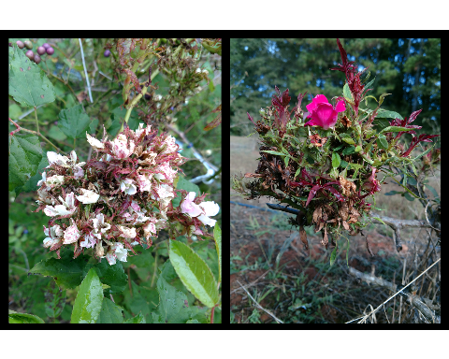
Motivation: Exploring Methods to Control Rose Rosette Disease
Typical symptoms of Rose Rosette Disease (RRD), caused by Rose Rosette Virus: clusters of deformed flowers known as rosettes/witches’ brooms, increased thorniness, elongated shoots, reddened leaves and stems. RRD ultimately kills the rose host.

Slide 2
Austin Fife, Gary Knox, Xavier Martini, Mathews Paret

Slide 3
Orientation Slide:

Slide 4
Hypothesis: Can SAR Reduce Populations of P. fructiphilus?

Slide 5
Hypothesis: Will SAR Kill Predatory Mites?

Slide 6
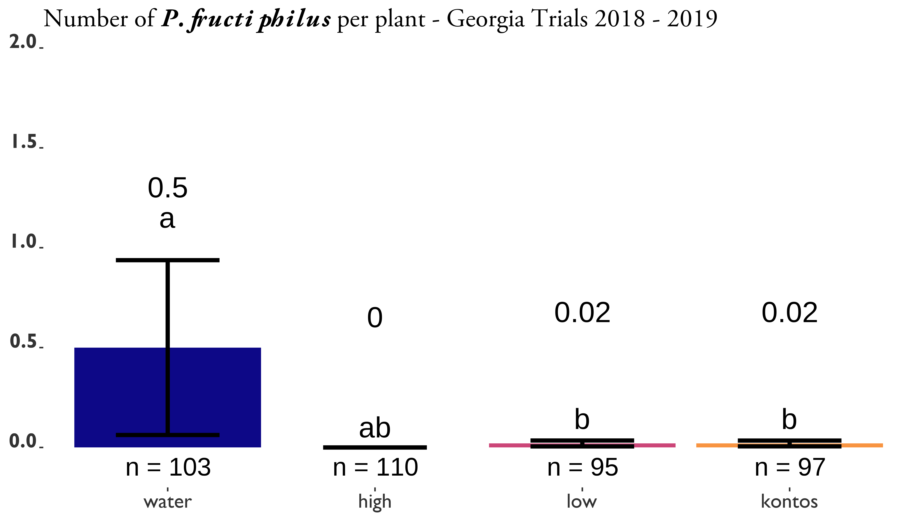
Results: Inducing SAR with Acibenzolar-S-Methyl seemed to work…
SAR-induction trials on Pink Double Knock Out® roses to control in Athens and Griffin, GA. Statistical significance was determined using Tukey contrasts for multiple Comparisons of means. Groups which share letters are not statistically different from one another. $α=0.05$. water = Water Control, High = 100 / Actigard® 50WG (Syngenta, Greensboro, NC, USA) acibenzolar-S-methyl (ASM), low = 50 / Actigard® 50WG (Syngenta, Greensboro, NC, USA) acibenzolar-S-methyl (ASM), kontos = Kontos® Miticide Insecticide - Spirotetramat (Bayer Corporation, Whippany, New Jersey, USA), untreated = No treatment. All products were applied for 12 weeks. Flower cuttings were taken weekly to record the numbers of herbivorous mites.

Slide 7
Results: So

