Slide 1





Decision making algorithms for
Autopilot cars
By Yanxi (fifi) Feng

Slide 2


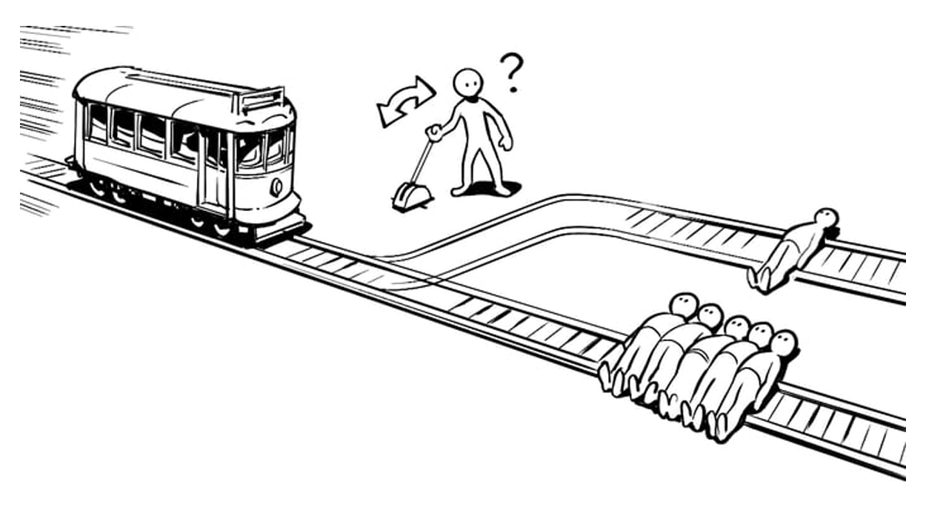

Figure 1.: One trolley problem
Trolley problem

Slide 3
Explore ethical dilemmas, the stakeholders involved, and the balancing act between passenger and pedestrian safety, also car company

Slide 4


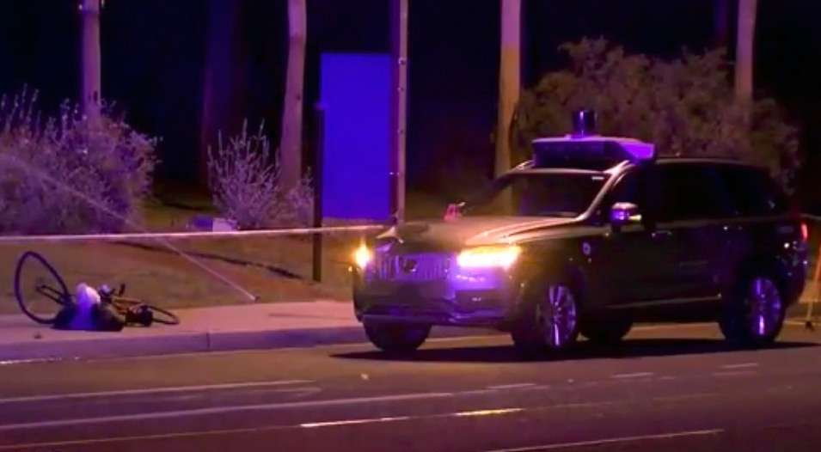
Uber self-driving car test driver pleads guilty to endangerment in pedestrian death case
In March 2018, a self-driving Uber car in Arizona hit and killed a pedestrian, despite having an operator onboard. The car's software noticed the pedestrian but mistakenly ignored the detection, leading to a fatal accident. This incident underscores the ethical challenges in programming autonomous vehicles, particularly the need to balance passenger comfort with pedestrian safety.
Figure 2. :an investigator works at the scene of a fatal accident involving a self driving Uber car in Tempe

Slide 5



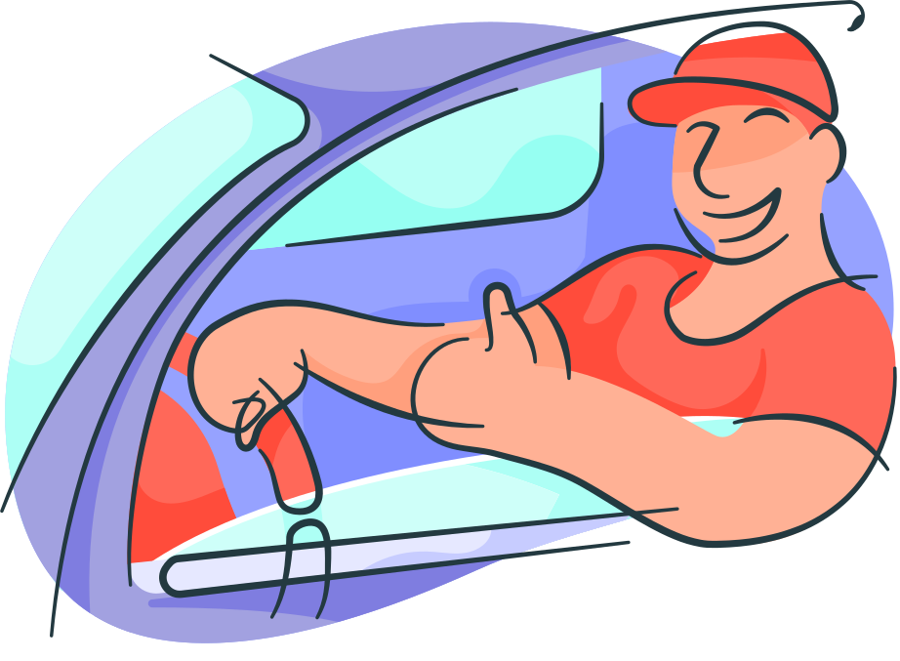
Main point 1
Algorithmic Decisions Favoring Vehicle Passengers
AWESOME

Slide 6


Ethical Lenses:
Emphasize that while passenger safety is maximized, pedestrians are at greater risk. Consumers will be more willing to buy this car, and the company’s interest will also increase

Slide 7

Main point 2
Algorithmic decision making aimed at saving more lives
OOPS

Slide 8
Ethical Lenses:
this approach might sometimes put passengers at risk to save more lives overall. And intent on public safety and how it might enhance the ethical standing of the companies and engineers involved.

Slide 9
Recommendation:
Consider both the safety of passengers and pedestrians, finding a middle ground.
Find some examples from some current companies to support this recommendation

Slide 10
Conclusion
Car companies and engineers need to balance individual rights with public safety, consider the safety of passengers and pedestrians, and find a middle ground.

Slide 11
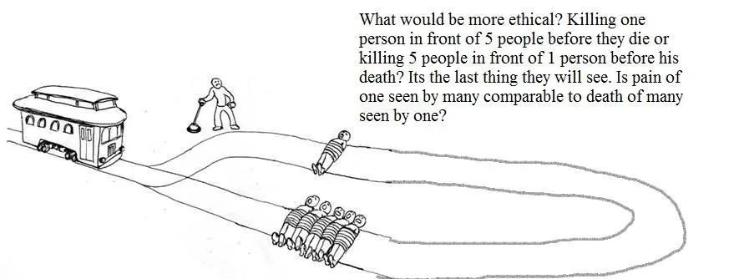
THANK
YOU!
By Yanxi (fifi) Feng
[1] R. Riess,” Uber self-driving car test driver pleads guilty to endangerment in pedestrian death case”, CNN Business, Sat July 29, 2023[Online]
Available:https://www.cnn.com/2023/07/29/business/uber-self-driving-car-death-guilty/index.htm
[2]S.Malik,”How Do Autonomous Vehicles Decide?”,MDPI,September 3 2022[Online]Available:https://www.mdpi.com/1424-8220/23/1/317
[3]S.Li,”Planning and Decision-making for Connected Autonomous Vehicles at Road Intersections: A Review”,SpringerOpen,December 11 2021[Online]Available:https://cjme.springeropen.com/articles/10.1186/s10033-021-00639-3
[4]K.BURKE,”How Do Self-Driving Cars Make Decisions?”,nvidia,May 7, 2019[Online] Available: https://blogs.nvidia.com/blog/self-driving-cars-make-decisions
[5]S.Ravindra,”The Machine Learning Algorithms Used in Self-Driving Cars”,kdnuggets,[Online]Available:https://www.kdnuggets.com/2017/06/machine-learning-algorithms-used-self-driving-cars.html
Figure1.:”Would you push the Fat Man off the Bridge?”,https://shikharsachdev.com/trolley-problem/
Figure2:”Backup driver in 1st death by fully autonomous car pleads guilty to endangerment”,https://krcrtv.com/news/nation-world

