Slide 1
HOME CREDIT SCORECARD MODEL
BY: Charisma Fikri Hidayatulloh
26 Maret 2022

Slide 2




PROJECT BACKGROUND
PROBLEM STATEMENT
Home Credit i s currently using various statistical methods and Machine Learning to make credit score predictions in order to ensure customers who are able to make repayments are not
rejected when applying for a loan.
GOAL & OBJECTIVE
Minimize the number of clients who are approved but actually defaulters and create predictive model to determine potential client and default client.
DATASET
application_train. csv ( with TARGET)
application_test. csv ( without TARGET)
MODEL EVALUATION
Model evaluated using area under ROC curve.

Slide 3
WORKING FLOW
APPLICATION_TRAIN.CSV
APPLICATION_TEST.CSV
EDA
- Univariate visualization
- Bivariate visualization
- Multivariate visualization
DATA CLEANING
- Detecting duplication
- Handling missing values
- Detecting outliers
1
1
2
DATA CLEANING
- Detecting duplication
- Handling missing values
- Detecting outliers
2
PREDICTION
Output i s TARGET that classified by
- 0 ( Client with no payment difficulties)
- 1 ( Client with payment difficulties)
3
MODEL BUILDING
- Label encoding
- Feature selection
- Handling imbalanced data
- Model building
- Model evaluation

Slide 4
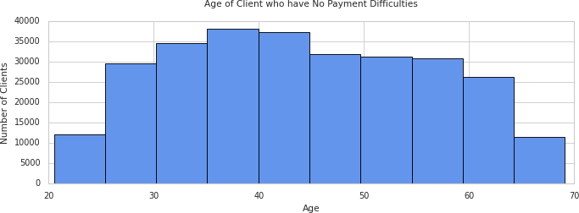

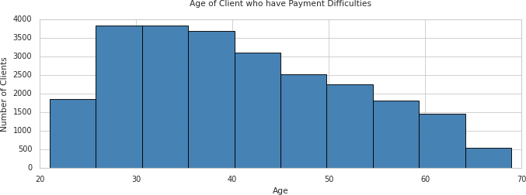

BUSINESS INSIGHT
Part 1
Client s who have no payment difficulties are cl ient t he range of 35 - 45 years old.
While cl ient s who have payment difficulties are cl ient t he range of 25 - 35 years old .

Slide 5
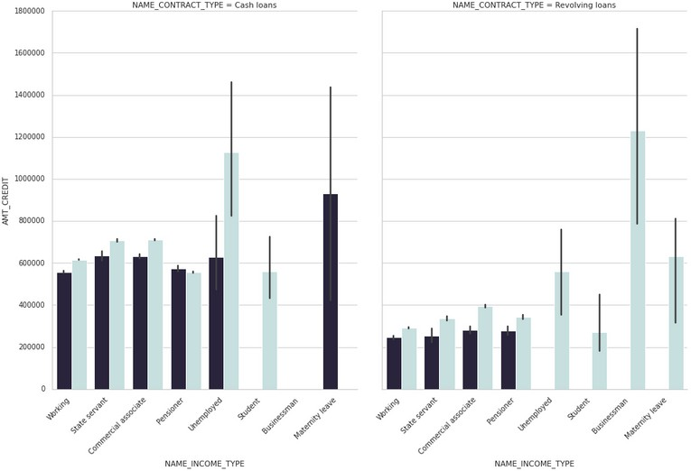

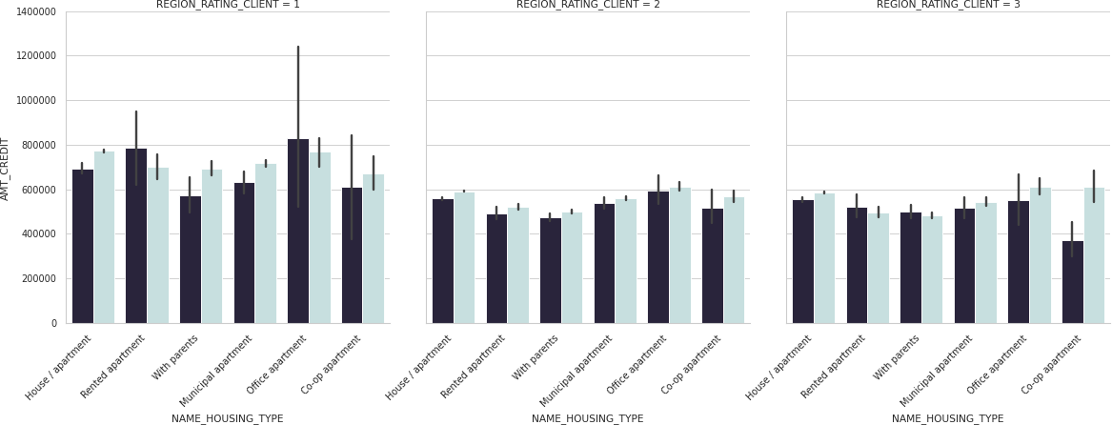
BUSINESS INSIGHT
Part 2
> 5 0 % o f cl i e n t s w h o ar e u n e m p l o y e d h av e d i f f i cu l t y
r e p ay i n g cas h l o an s , b u t h av e n o d i f f i cu l t y p ay i n g b ack r e v o l v i n g l o an s .
All s t u d e n t cl i e n t s h av e n o d i f f i cu l t y r e p ay i n g l o an s e i t h e r w i t h cas h l o an s o r r e v o l v i n g l o an s f o r l o w t o m e d i u m - cr e d i t l o an am o u n t s .
All clients with an incom e type of m a t e r n i t y l e a v e
h ad d i f f i cu l t y r e p ay i n g cas h l o an s , b u t h ad
ab s o l u t e l y n o d i f f i cu l t y p ay i n g r e v o l v i n g l o an s .
I n r e g i o n 1 , Cl i e n t s w h o l i v e d i n r e n t e d & o f f i ce
a p a r t m e n t h av e d i f f i cu l t i e s o n r e p ay i n g l o an s .
I n r e g i o n 2 , h av e n o d i f f i cu l t i e s o n r e p ay i n g l o an s i n an y h o u s i n g t y p e .
I n r e g i o n 3 , clients who lived in r e n t e d a p a r t m e n t
an d w i t h p a r e n t s h av e d i f f i cu l t i e s o n r e p ay i n g l o an s .

Slide 6

MACHINE LEARNING MODELLING
Models | Training Accuracy Score | Testing Accuracy Score | Error | ROC Score
Random Forest | 100.00% | 99.64% | 0.36% | 0.9964
Decision Tree | 100.00% | 88.36% | -11.64% | 0.8836
K-Nearest Neighbor | 91.56% | 88.07% | -3.49% | 0.8806
Neural Network | 69.59% | 69.05% | 0.54% | 0.6906
Logistic Regression | 67.16% | 67.29% | 0.13% | 0.6729
Gaussian Naive Bayes | 60.24% | 60.39% | 0.15% | 0.604
From the results of the model evaluation, i t was found that the highest accuracy and
lowest error were found in the Random Forest classifier model . Based on the ROC score, i t was also found that Random Forest had a much higher score than the others. Which
means that the model has the minimum under- f i t t ing and over- f i t t ing .

Slide 7
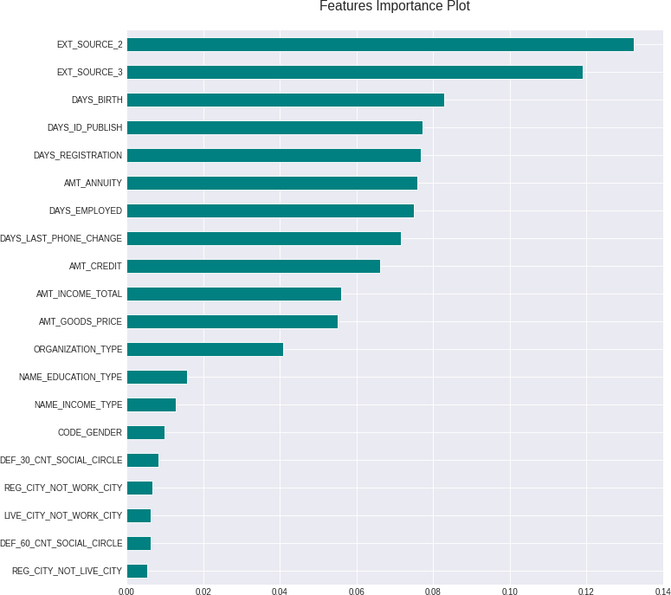
FEATURES IMPORTANCE PLOT
1
MACHINE LEARNING MODEL
RANDOM FOREST CLASSIFIER
2
PERFORMANCE ACCURACY
Train data: 100 %
Test data: 99 . 64 %
Error margin: 0 . 36 %
3
TOP 5 MOST IMPORTANT FEATURES
EXT_SOURCE_2 : Normalized score f rom external
data source 2
EXT_SOURCE_3 : Normalized score f rom external data source 3
DAYS_BIRTH : Client' s age in days at the t ime of application
DAYS_ID_PUBLISH : Days before the application did client change the identity document with which
he applied for the loan
DAYS_REGISTRATIO N: Days before the application did client change his registration

Slide 8
MODEL PREDICTION
USING RANDOM FOREST CLASSIFIER
Based on the important columns, prediction model build to determine the target
SK_ID_CURR | TARGET
100001 | 0
100005 | 0
100013 | 0
100028 | 0
100038 | 0
The results of the 5 samples above i s all clients have no difficulties on repaying loans.

Slide 9




RECOMMENDATION
CREATE A CAMPAIGN
F o r cl i e n t s a g e d 3 5 - 4 5 y e a r s w h o w o r k a s s t u d e n t s , a cco u n t a n t s , h i g h - s k i l l t e ch s t a f f , m a n a g e r s i n r e g i o n 2 . A cco r d i n g t o t h e a n a l y s i s , t h e y h a v e n o d i f f i cu l t y r e p a y i n g l o a n s .
FURTHER CONSIDERATION NEEDED
F o r cl i e n t s w i t h u n e m p l o y e d a n d m a t e r n i t y l e a v e t y p e
i n co m e . W h e r e t h e y a r e m o r e l i k e l y t o b e a b l e t o r e p a y r e v o l v i n g l o a n s .
DEEPER RESEARCH NEEDED
F o cu s s i n g o n t o p 5 i n f e a t u r e s i m p o r t a n t p l o t ( E X T _ S O U R C E _ 2 , E X T _ S O U R C E _ 3 , D A Y S _ B I R T H , D A Y S _ I D _ P U B L I S H , D A Y S _ R E G I S T R A T I O N )

Slide 10
Link Github
https://github.com/fifinternational/Home_Credit_Score_DataSience

