Slide 1


1
Business Understanding
Cíedit íisk is known as the íisk of boííoweí's failuíe to íepay a loan
Assessing boííoweí's íisk to íepay the loan is a cíucial
thing in cíedit íisk assessment
We can use machine leaíning to automate the píocess
Analytical Approach
Descíiptive analysis
Gíaph analysis
Píedictive modelling (classification)
Data Requirements & Collection
I íequiíed a dataset of customeí loan fíom financial company
ľhe dataset is collected by ID/X Paítneís fíom a company
ľhis dataset has
74 columns / featuíes
Consists of 52 numeíical & 22 non-numeíical featuíes
Many featuíes have missing values
ľheíe aíe 17 null
featuíes
Data Understanding

Slide 2
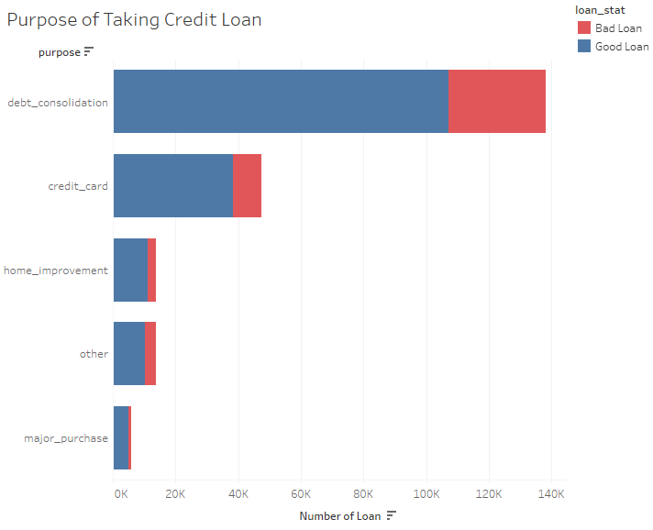

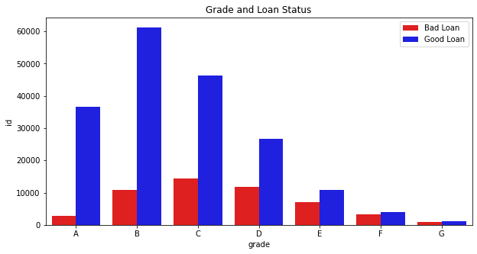

CREDIT RISK ASSESSMENT
2
Missing Value: Removing and Imputing
Featuíe Engineeíing: Categoíical Encoding, Log ľíansfoím, Standaídization
Featuíe Selection using Coííelation Analysis
Removing outlieís using IQR Method
Data Preparation
Good Loan (1) : Fully Paid, Does not
meet the cíedit policy. Status:Fully Paid
Bad Loan (0) : Chaíged Off, Does not meet the cíedit policy. Status:Chaíged Off, Default, Late (31-120 days)
Exploratory Data Analysis
Target
Variable
How about classifying grade towards our borrower and the loan status?
What are the
employee titles of our borrowers?
Why do
our borrower take credit loan?

Slide 3
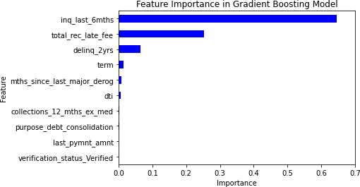
CREDIT RISK ASSESSMENT
3
70% ľíaining & 30% ľesting
I used SMOľE foí handling imbalanced class
All steps aíe handled by
Modelling & Evaluation
Pipeline
Evaluation Metíics:
Main: False Negative (FN) & Recall fíom “0” (I minimized wíong píedicted bad loan)
Additional: ROC-AUC & Kolmogoíov- Smiínov (KS)
Model | FN | Recall | ROC-AUC | KS
Random Forest | 608 | 96% | 99.41% | 94.40%
Gradient Boosting Trees | 386 | 97% | 99.48% | 94.28%
XGBoost | 447 | 97% | 99.43% | 93.83%
Voting Classifier | 420 | 97% | 99.48% | 94.34%
Selected model: Gradient Boosting Trees

