Slide 1

第9章
使用电话网和有线电视网进行数据传输
Copyright © The McGraw-Hill Companies, Inc. Permission required for reproduction or display.

Slide 2
9-1 TELEPHONE NETWORK
Telephone networks use circuit switching. The telephone network had its beginnings in the late 1800s. The entire network, which is referred to as the plain old telephone system (POTS), was originally an analog system using analog signals to transmit voice.
Topics discussed in this section:
Major Components
LATAs Signaling
Services Provided by Telephone Networks

Slide 3
Figure 9.1 A telephone system

Slide 4

Note
Intra-LATA services are provided by local exchange carriers. Since 1996, there are two
types of LECs: incumbent local exchange carriers and competitive local exchange carriers.

Slide 5
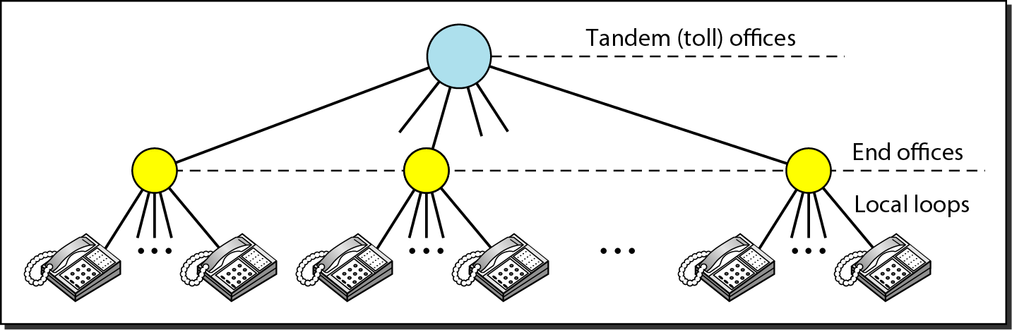
Figure 9.2 Switching offices in a LATA

Slide 6
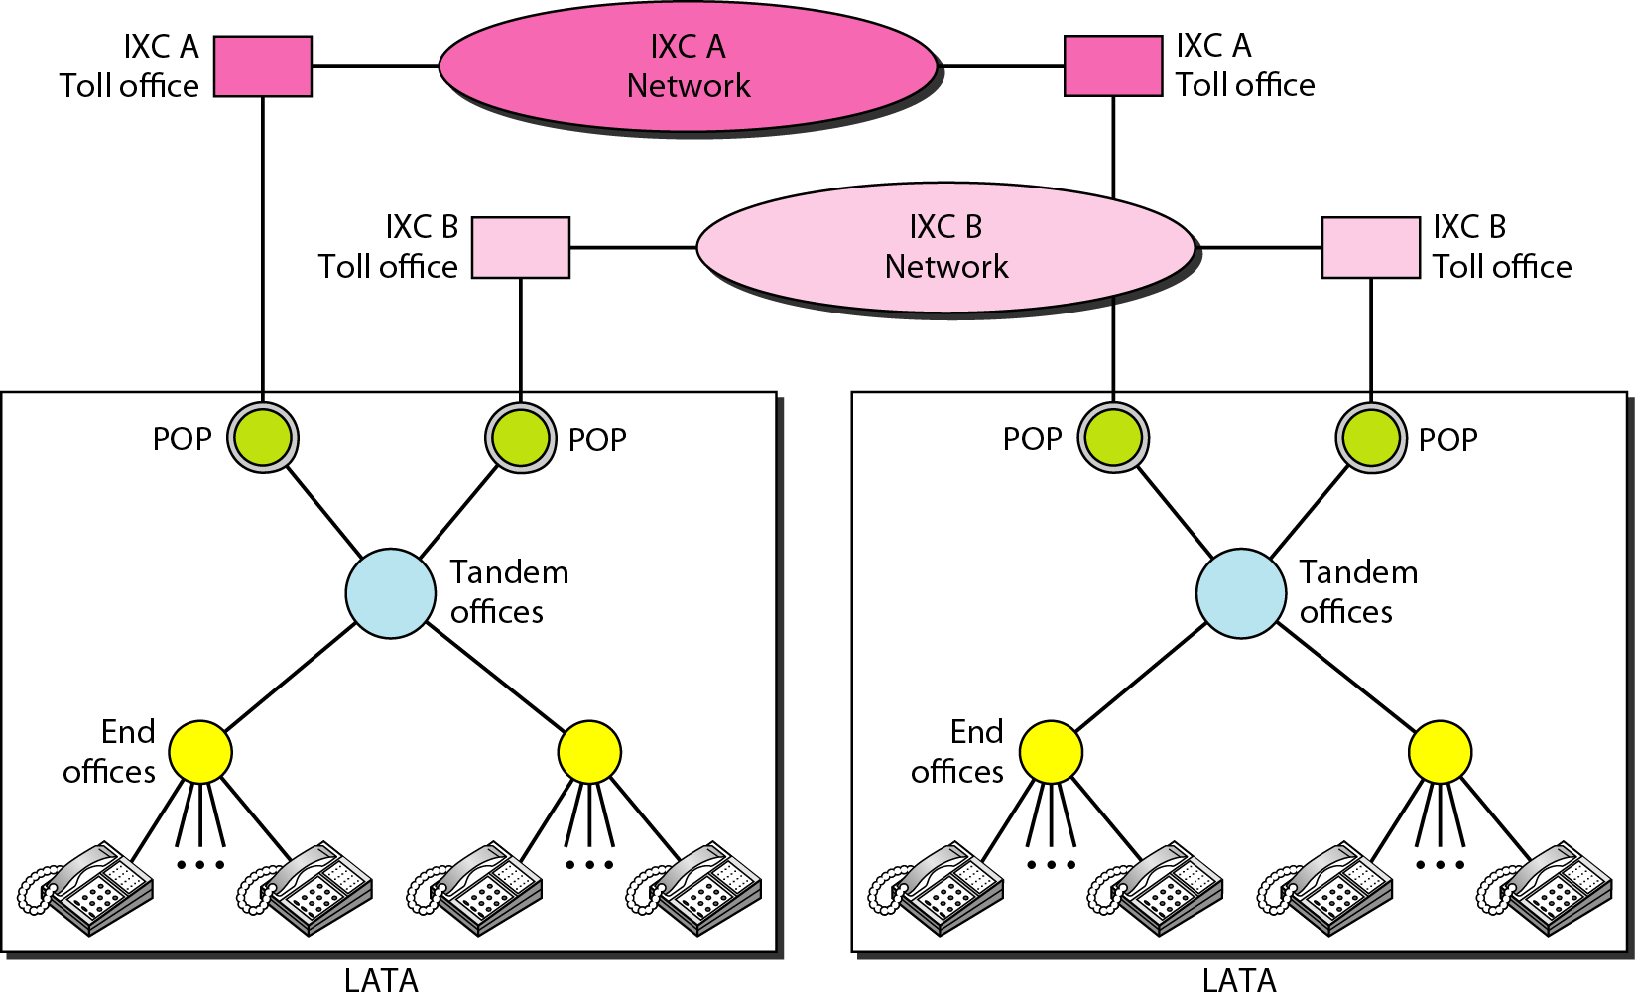
Figure 9.3 Point of presences (POPs)

Slide 7
Note
The tasks of data transfer and signaling are separated in modern telephone networks: data transfer is done by one network, signaling by another.

Slide 8
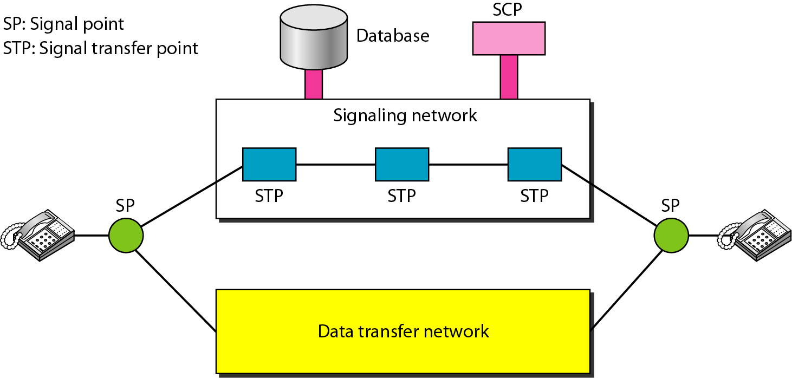
Figure 9.4 Data transfer and signaling networks

Slide 9
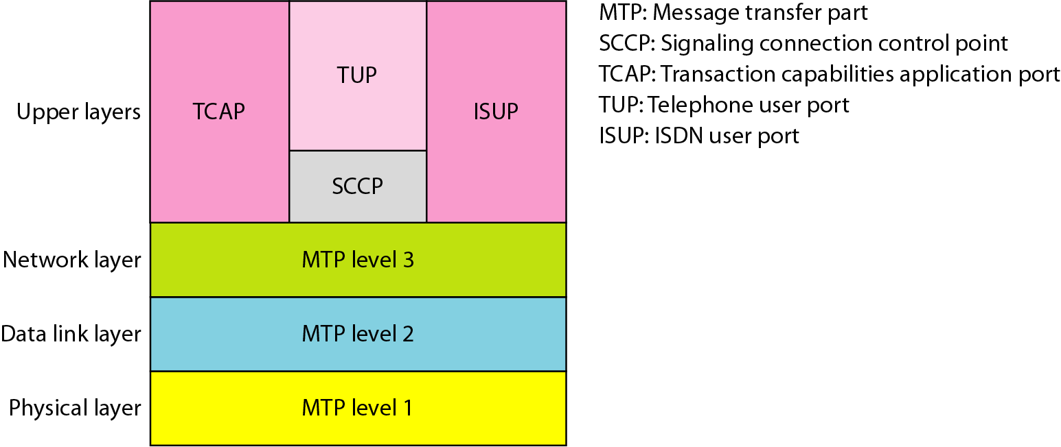
Figure 9.5 Layers in SS7

Slide 10
9-2 电话调制解调器
传统的电话线路可以传送频率范围是300~3300Hz的信号，提供给信号的带宽是3000Hz。整个频率范围用于传输语音，在不丢失可识别性的情况下，有一些干扰和失真是可以接受的。
本节讨论的主题:
调制解调器标准

Slide 11
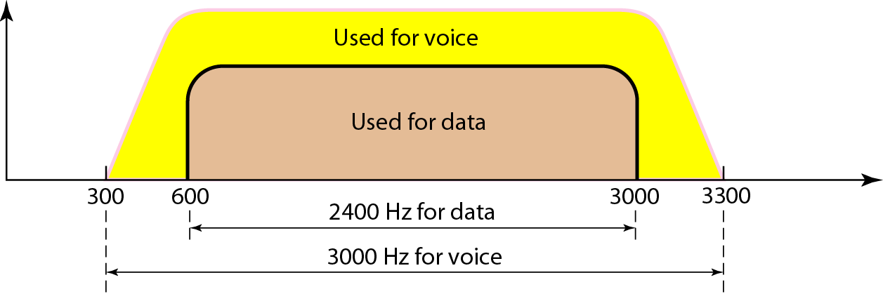
图 9.6 电话线路带宽

Slide 12
Note
调制解调器
代表调制器/解调器。

Slide 13
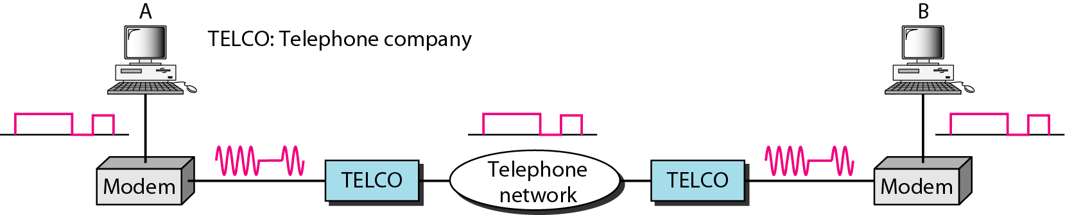
图 9.7 调制器/解调器
TELCO：电话公司

Slide 14
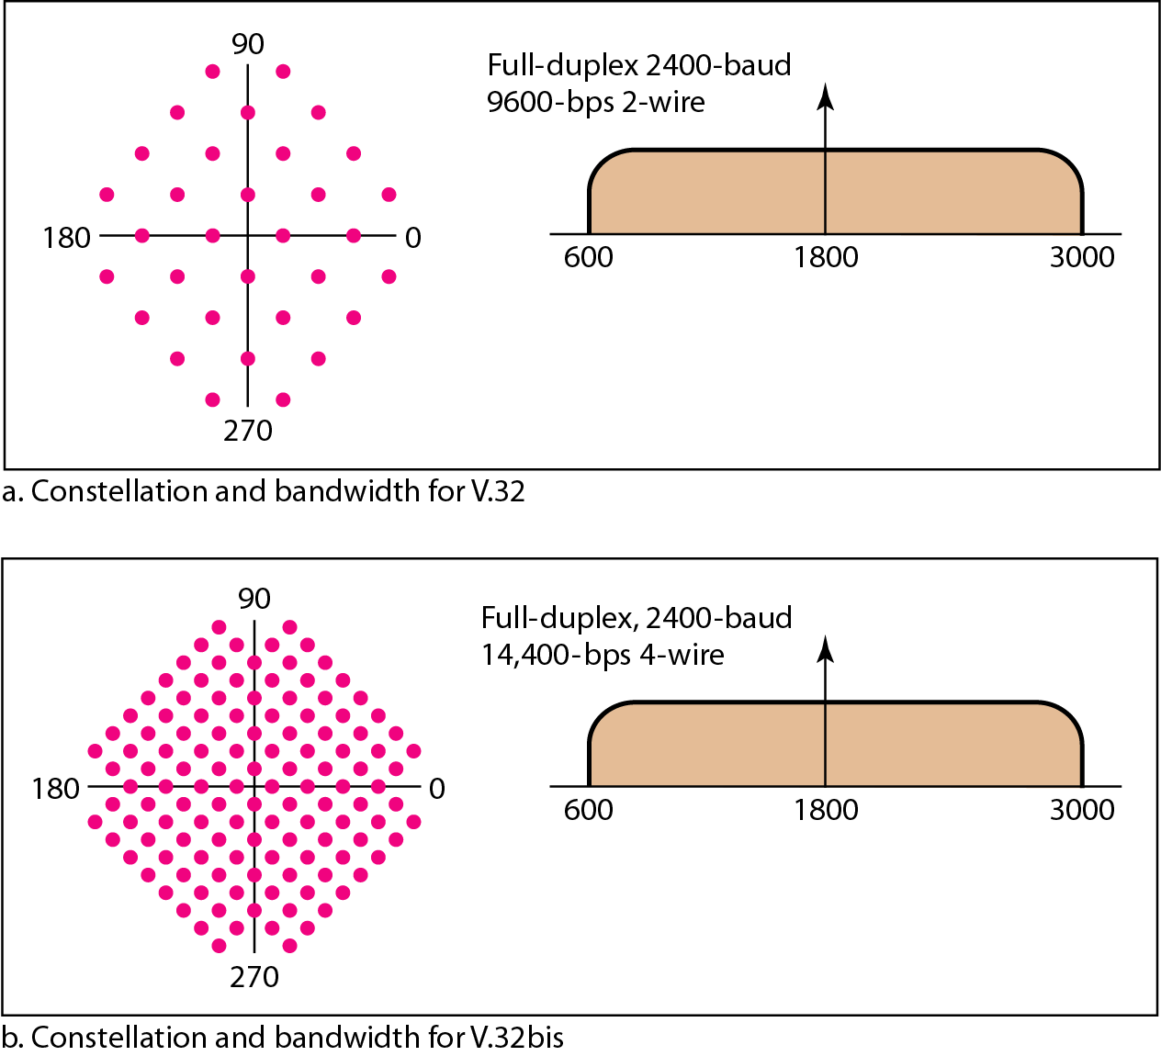
图 9.8 V.32和V.32bis星座图和带宽
全双工2400波特9600bps两路
Log₂32 = 5
其中4bit数据，1bit冗余校验位。
2400*4=9600bps
a.V.32星座图和带宽
全双工2400波特14400bps四路
Log₂64 = 6
2400*6=14400bps
b.V.32bis星座图和带宽

Slide 15
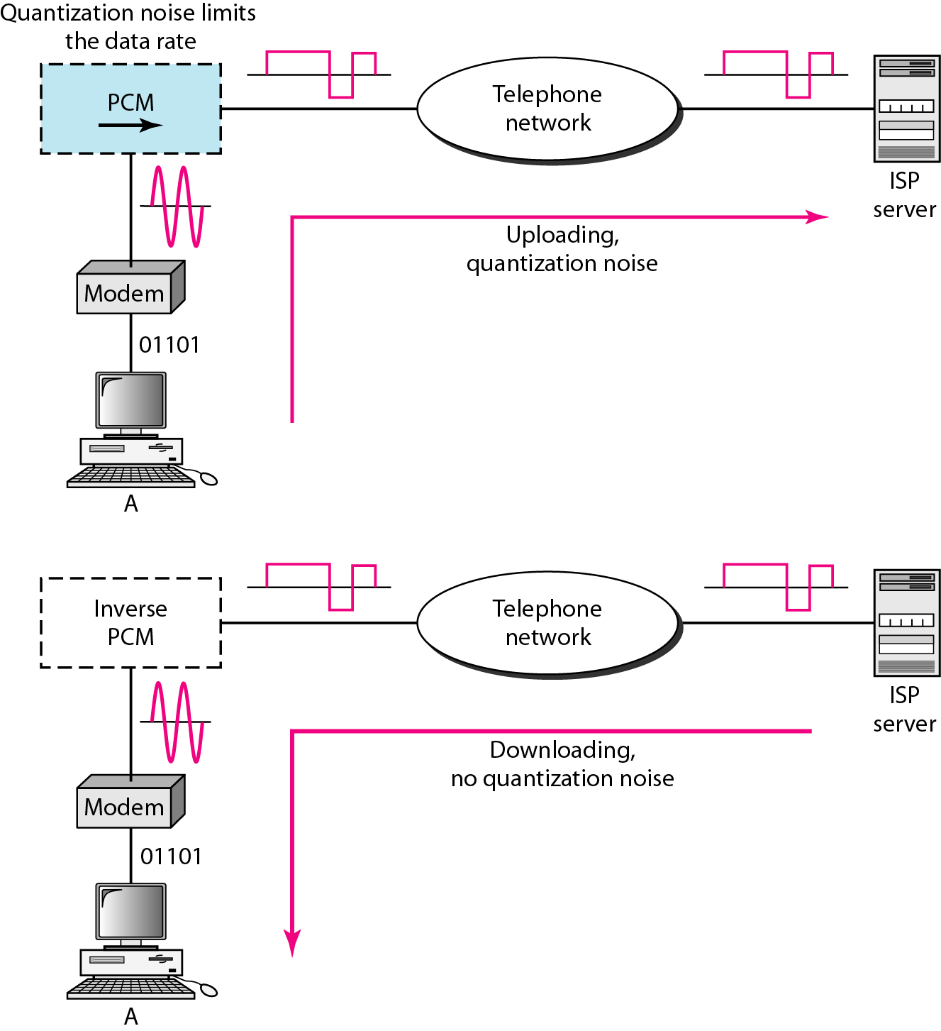
图 9.9 56K调制解调器
采样噪声限制数据速率
上传受香农公式约束，33.6kbps;
上传，量化噪声
反向PCM
下载不受噪声影响，可达56kbps;
下载，无量化噪声

Slide 16
9-3 数字用户线路
在传统调制解调器到达其最高数据速率以后，电话公司开发出了另一种技术——数字用户线路(digital subscriber line，DSL)技术来提供对因特网的高速访问。DSL技术是在现有本地回路上支持高速数字通信的最有前途的技术之一。
本节讨论的主题:
非对称数字用户线路(ADSL)
通用的ADSL(ADSL Lite)
高速数字用户线路(HDSL)
对称数字用户线路(SDSL) 甚高速数字用户线路(VDSL)

Slide 17
Note
ADSL下行速率比上行速率高，所以称为“非对称”，是专门针对住宅用户而设计的，它不适合于商业应用。

Slide 18
Note
现有的本地回路的双绞线能够处理的带宽可以高达1.1 MHz，但是电话公司安装在本地交换局的滤波器将带宽限制在4kHz（对于语音电话够用了，而且容易多路复用），如果拆除掉滤波器，则全部1.1MHz带宽可用。

Slide 19
Note
1.1MHz是理论带宽，诸多因素会影响信号质量，所以ADSL被设计为一种自适应技术，系统使用的数据速率依据本地回路的线路状况而定。

Slide 20
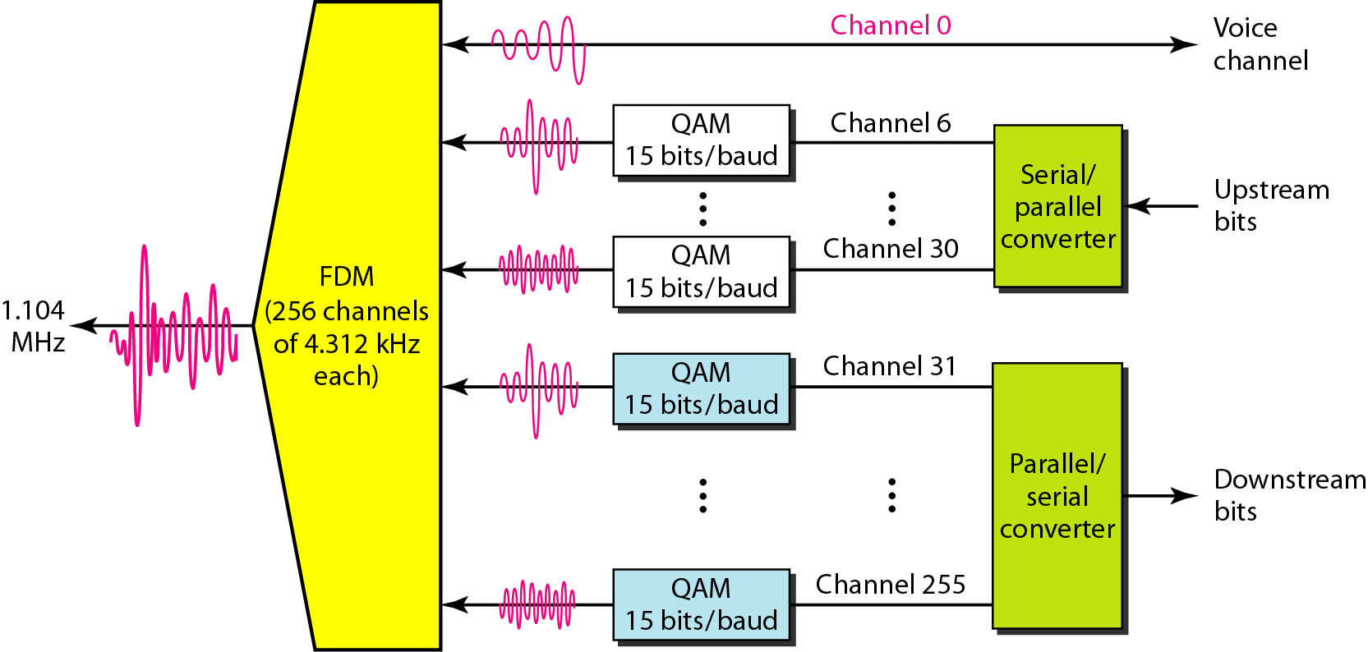
图 9.10 离散多音频技术（DMT）
语音通道
上行位
下行位
将QAM和FDM结合在一起。
下行共224个通道，理论可达224*4000(每个通道带宽)*15(QAM)=13.4Mbps，但实际在8Mbps以下。

Slide 21
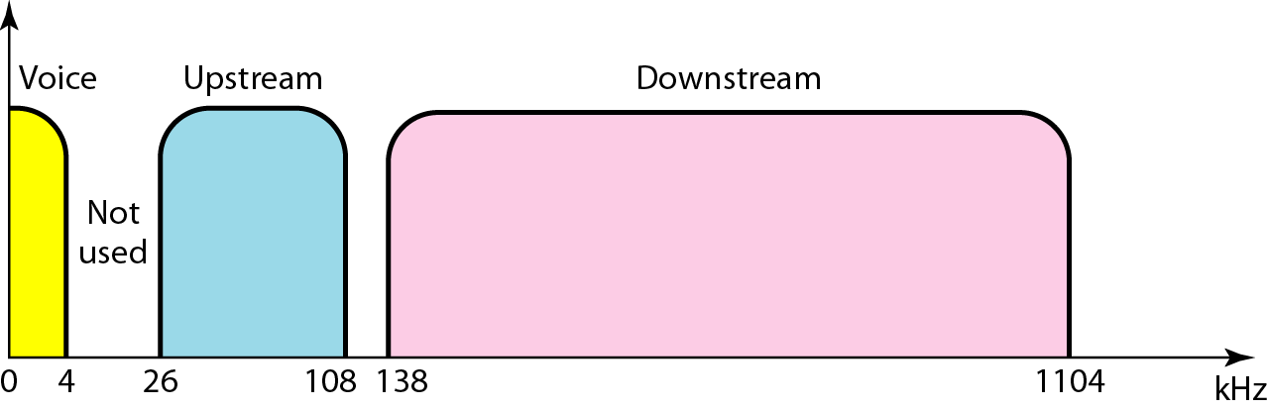
图 9.11 ADSL中带宽划分
上行数据流
下行数据流

Slide 22
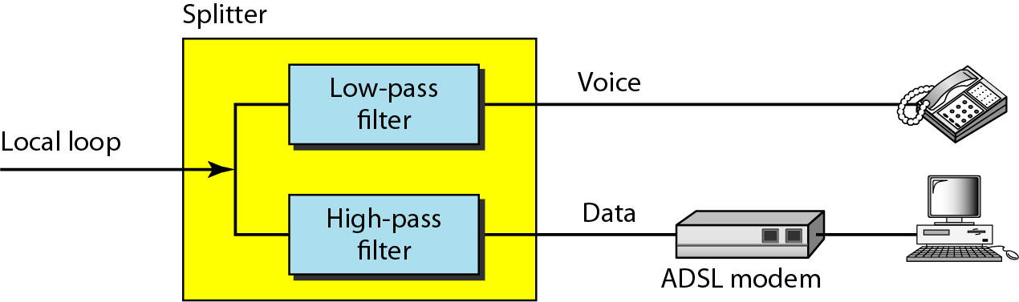
图 9.12 ADSL调制解调器
分配器
低通 滤波器
本地回路
高通 滤波器

Slide 23
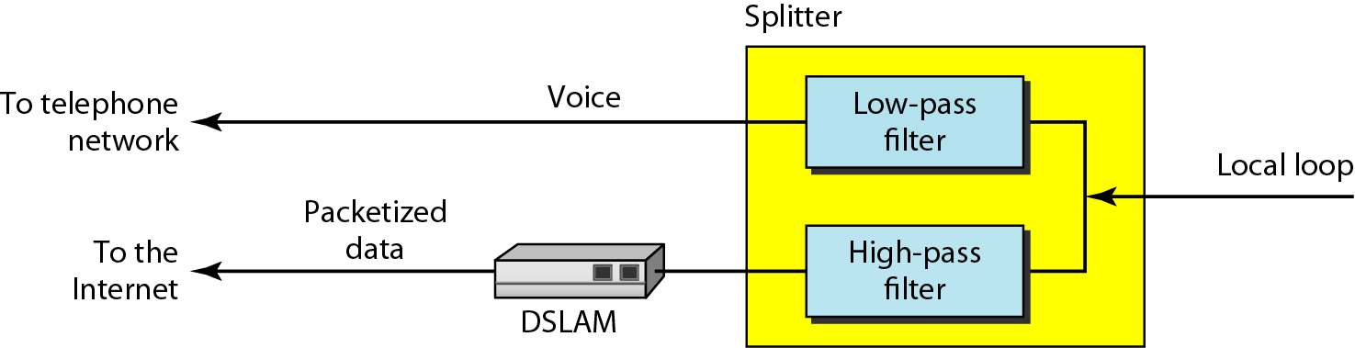
图 9.13 DSLAM
分配器
到电话网络
低通滤波器
本地回路
分组的 数据
到因特网
高通滤波器
DSLAM数字用户线路接入复用器

Slide 24
表 9.1 DSL技术总结
技术 | 下行速率 | 上行速率 | 距离（ft） | 双绞线对 | 线路代码
ADSL | 1.5~6.1Mbps | 16~640kbps | 12000 | 1 | DMT
ADSL Lite | 1.5Mbps | 500kbps | 18000 | 1 | DMT
HDSL | 1.5~2.0Mbps | 1.5~2.0Mbps | 12000 | 2 | 2B1Q
SDSL | 768kbps | 768kbps | 12000 | 1 | 2B1Q
VDSL | 25~55Mbps | 3.2Mbps | 3000~10000 | 1 | DMT

Slide 25
9-4 CABLE TV NETWORKS
The cable TV network started as a video service provider, but it has moved to the business of Internet access. In this section, we discuss cable TV networks per se; in Section 9.5 we discuss how this network can be used to provide high-speed access to the Internet.
Topics discussed in this section:
Traditional Cable Networks
Hybrid Fiber-Coaxial (HFC) Network

Slide 26
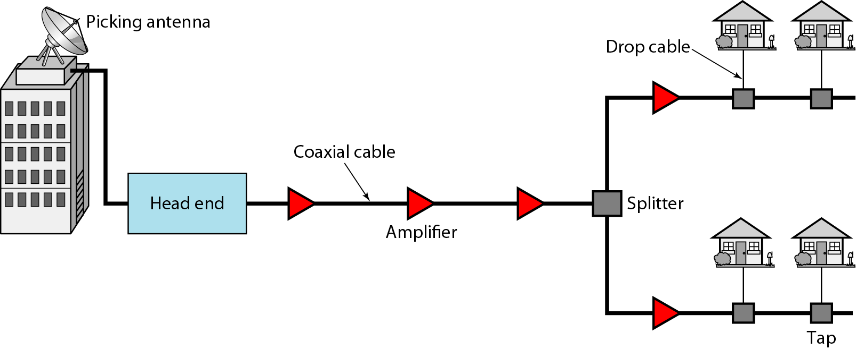
Figure 9.14 Traditional cable TV network

Slide 27
Note
Communication in the traditional cable TV network is unidirectional.

Slide 28
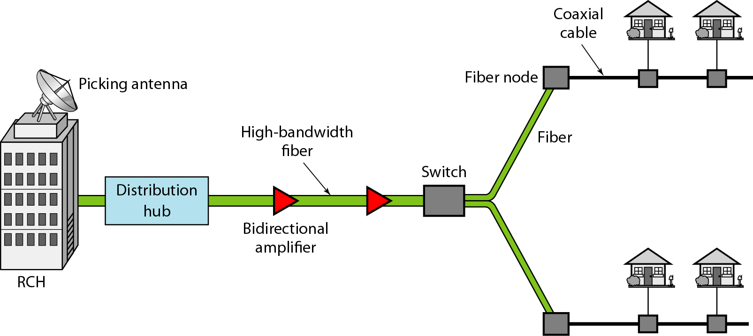
Figure 9.15 Hybrid fiber-coaxial (HFC) network

Slide 29
Note
Communication in an HFC cable TV network can be bidirectional.

Slide 30
9-5 CABLE TV FOR DATA TRANSFER
Cable companies are now competing with telephone companies for the residential customer who wants high-speed data transfer. In this section, we briefly discuss this technology.
Topics discussed in this section:
Bandwidth
Sharing CM and CMTS
Data Transmission Schemes: DOCSIS

Slide 31
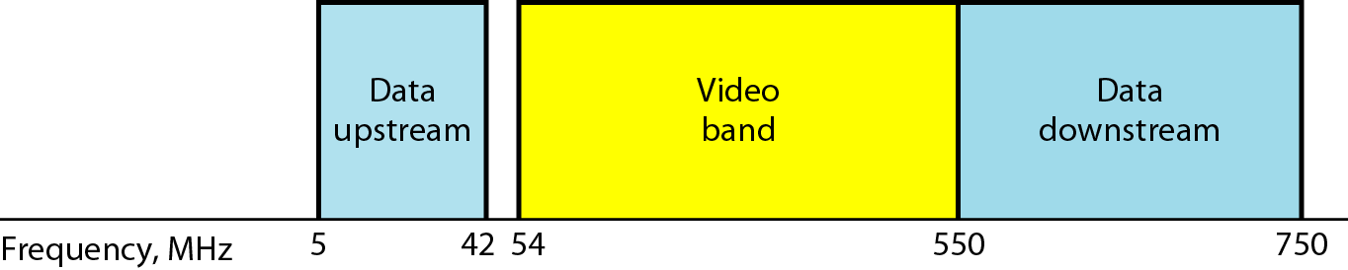
Figure 9.16 Division of coaxial cable band by CATV

Slide 32
Note
Downstream data are modulated using the 64-QAM modulation technique.

Slide 33
Note
The theoretical downstream data rate is 30 Mbps.

Slide 34
Note
Upstream data are modulated using the QPSK modulation technique.

Slide 35
Note
The theoretical upstream data rate is 12 Mbps.

Slide 36
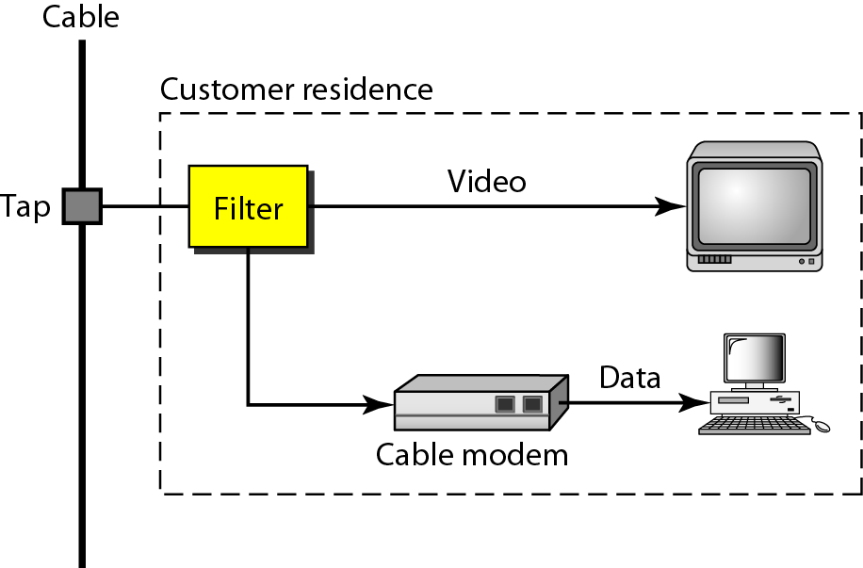
Figure 9.17 Cable modem (CM)

Slide 37
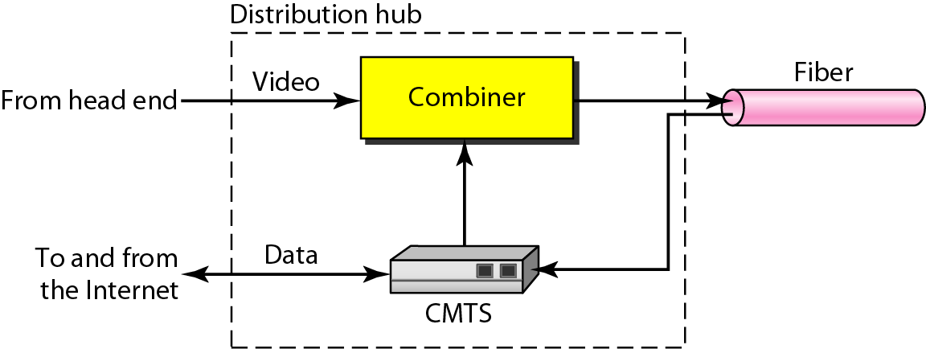
Figure 9.18 Cable modem transmission system (CMTS)

