Slide 1

Chapter 10
Error Detection and Correction
检错与纠错

Slide 2

Note
数据在出传输额过程中可能遭到破坏，一些应用程序也需要进行检错和纠错。

Slide 3
10-1 INTRODUCTION
首先讨论差错检测和差错纠正的相关问题
Topics discussed in this section:
Types of Errors 差错类型 Redundancy 冗余 Detection Versus Correction 检错和纠错 Forward Error Correction Versus Retransmission 前向纠错和重传 Coding 编码
Modular Arithmetic 模运算

Slide 4
Note
在单比特差错中，数据单位中仅有一比特发生变化。

Slide 5
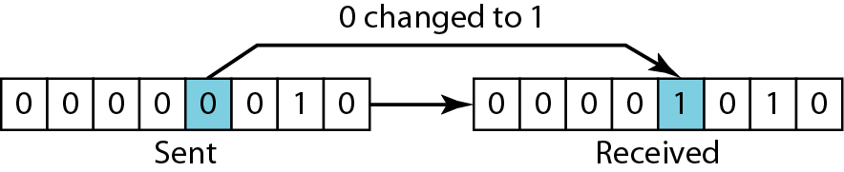
Figure 10.1 Single-bit error
单bit差错在串行数据传输中很少出现，比如1Mbps的数据速率，每一bit的持续时间仅仅是1μs，噪声也必须只有1μs，但一般噪声都比这个时间长。

Slide 6
Note
一个突发差错意味着数据单元中两位或多位发生变化。

Slide 7
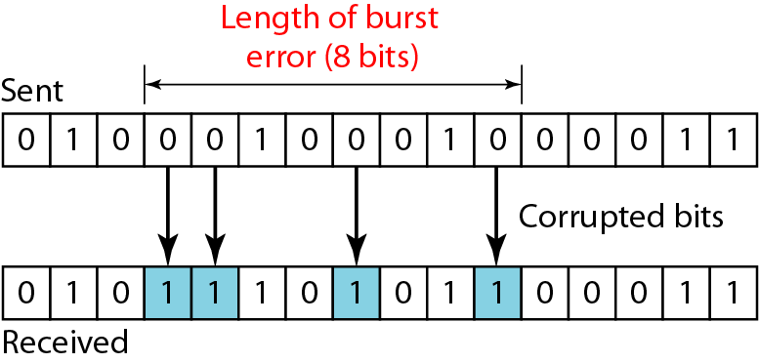
Figure 10.2 Burst error of length 8
突发性错误的长度按从第一个出错位到最后一个出错位长度计算，其间某些位可能未产生错误。

Slide 8
Note
为了检测或纠正错误，我们需要发送除了数据外的额外（冗余）位，这是核心思想。
有两种纠错方法：
向前纠错：接收方通过冗余位纠错报文；
重传纠错：接收检测出错误，通过请求重传来纠错。

Slide 9
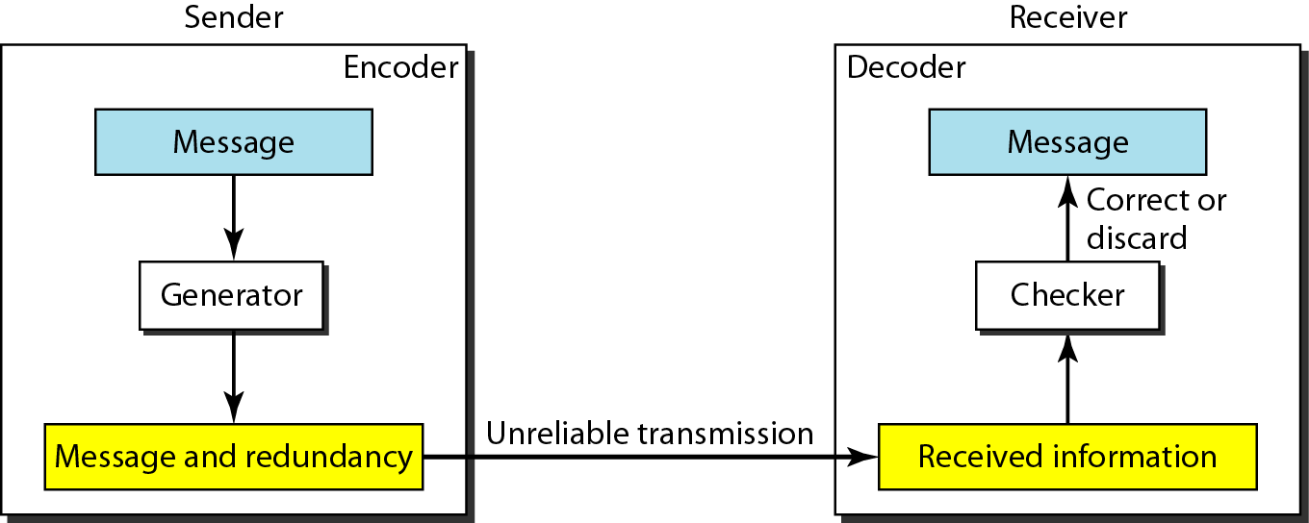
Figure 10.3 编码器和译码器的结构
通过各种编码方案实现冗余。

Slide 10
Note
编码方案分为两大类：块编码和卷积编码。本课程，我们主要介绍块编码。

Slide 11
Note
模运算的概念
在模N运算中，只使用0到N-1的整数

Slide 12
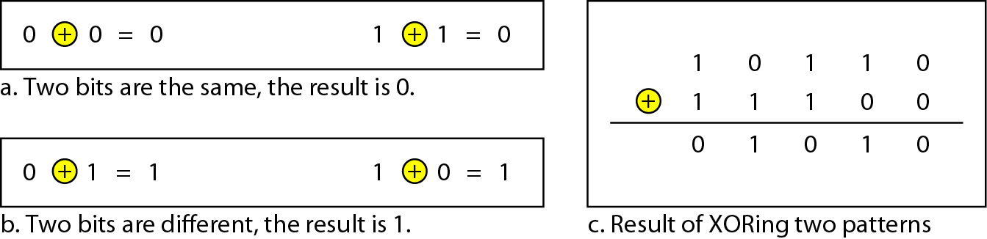
Figure 10.4 模2运算和异或运算关系

Slide 13
10-2 BLOCK CODING 块编码
在块编码中，我们把报文划分成块，每块k位，称数据字（dataword），并增加r个冗余位使其长度变为n=k+r，形成n位块称为码字（codeword）。
Topics discussed in this section:
Error Detection 检错 Error Correction 纠错 Hamming Distance 汉明距离
Minimum Hamming Distance 最小汉明距离

Slide 14
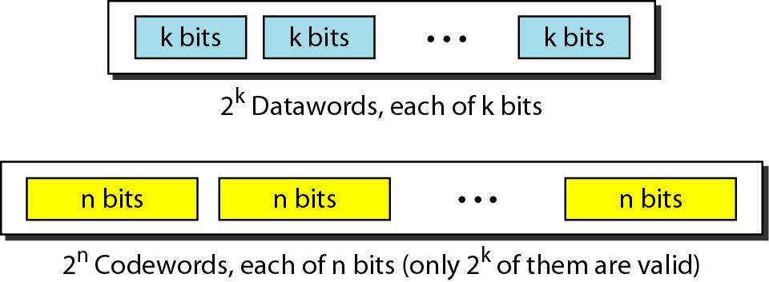
Figure 10.5 数据字和码字
k位就有2^{k}种情况；
n位同理；
n比k大，所以2^{n}- 2^{k}个码子是无效或非法码。

Slide 15
Example 10.1
第四章讨论的4B/5B码就是这种编码的一个好例子。我们可以看到，由于k=4，n=5，则数据字有2^{k} = 16 个，码字有2^{n} = 32 个。我们从32个码字里精心挑选16个码字用于报文传输。其余16个不用。

Slide 16
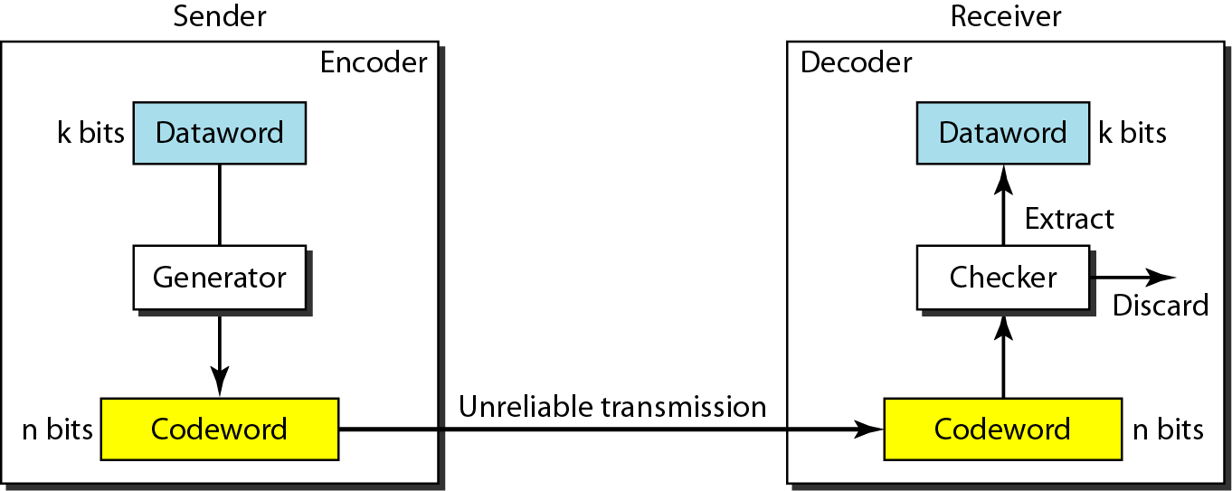
Figure 10.6 块编码的差错检测过程

Slide 17
Note
满足以下两个条件，接收方就能检测错误：
1.接收方有有效码子的列表；
2.原来的码子已经改变成无效的码子；

Slide 18
Note
检错码是为某些类型的差错而设计的，因此只能检测这些类型的差错；其它类型的差错就无法检测到。

Slide 19
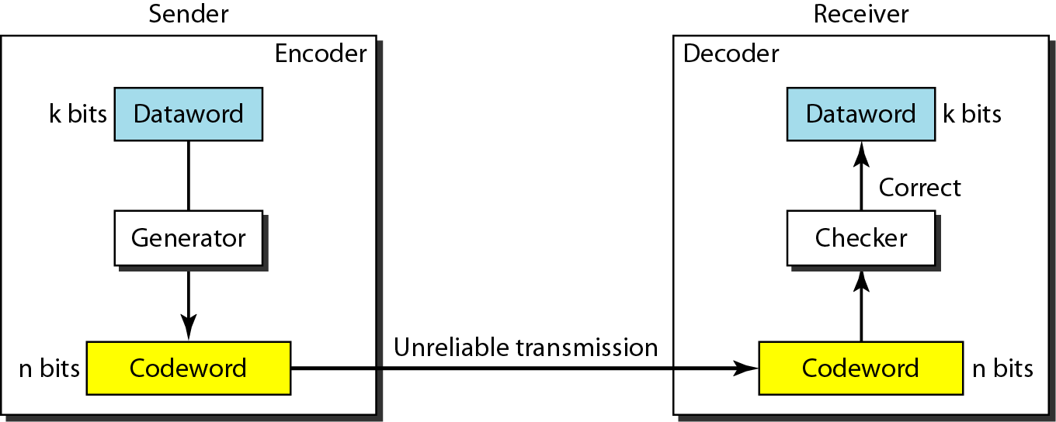
Figure 10.7 纠错码的编码器和译码器的结构

Slide 20
Note
1.纠错更复杂，需要比检测更多的冗余位。
2.两个字（codeword）的汉明距离是：对应位不同的数量。
3.如果对两个字进行异或并计算结果中1的个数，就能算出汉明距离。

Slide 21
Example 10.4
用异或计算汉明距离
Let us find the Hamming distance between two pairs of words.
1. The Hamming distance d(000, 011) is 2 because
2. The Hamming distance d(10101, 11110) is 3 because

Slide 22
Note
最小汉明距离是一组字中所有可能对的最小汉明距离。

Slide 23
Example 10.5
求表10.1编码方案的最小汉明距离。
Solution
We first find all Hamming distances.
The d_{min} in this case is 2.

Slide 24
Example 10.6
求表10.2编码方案的最小汉明距离。
Solution
We first find all the Hamming distances.
The d_{min} in this case is 3.

Slide 25
Note
为了保证检测出最多s个错误，块编码中最小汉明距离一定是d_{min} = s + 1。

Slide 26
Example 10.7
表10.1第一个编码方案的最小汉明距离为2，所以只能检单比特错误。
表10.2第二个编码方案的最小汉明距离为3，所以最多能检两比特差错。

Slide 27
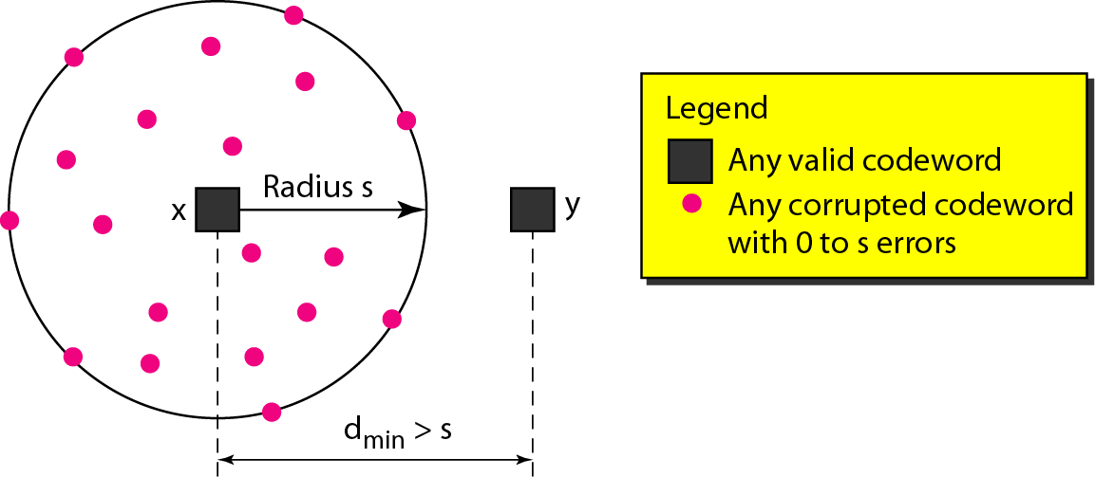
Figure 10.8 检错码的d_{min} 几何意义

Slide 28
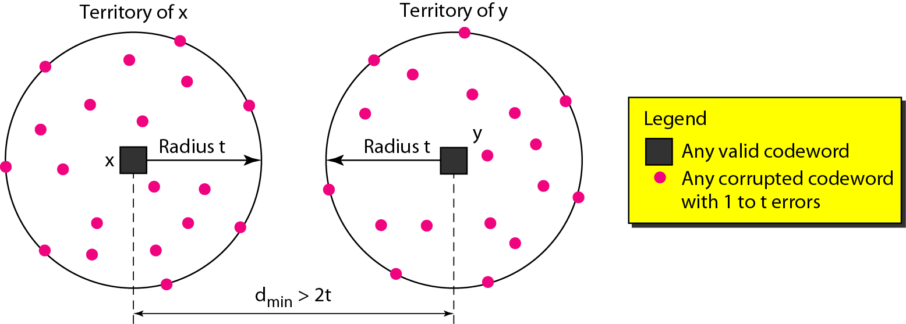
Figure 10.9 纠错码d_{min}几何意义

Slide 29
Note
为了保证最多能纠正t个差错，块码中最小汉明距离是d_{min} = 2t + 1。

Slide 30
10-3 LINEAR BLOCK CODES
当前，几乎所有使用的块码都属于一个称为线性块编码的子集。在线性块码中，任两个有效码字的异或（即模2加）生成另一个有效码字。
Topics discussed in this section:
Minimum Distance for Linear Block Codes 线性块码的最小距离 Some Linear Block Codes 一些线性块编码

Slide 31
Note
在线性块码中，任两个有效码字的异或（即模2加）生成另一个有效码字。

Slide 32
Note
奇偶校验码是n = k + 1，使得码字中1的总数为偶数个，且 d_{min} = 2的单比特检错码。

Slide 33
Table 10.3 Simple parity-check code C(5, 4) 简单的奇偶校验码

Slide 34
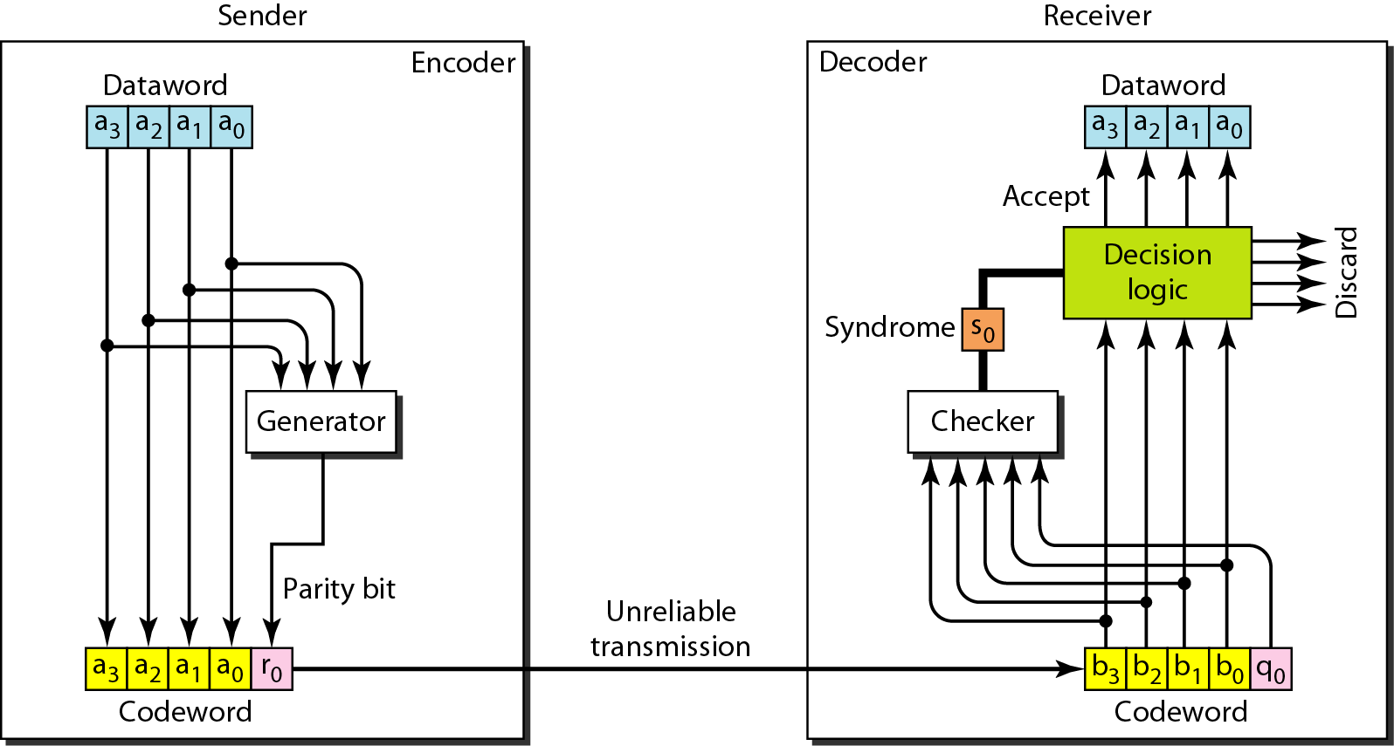
Figure 10.10 奇偶校验码的编码器和译码器 （模2加运算）
a0+a1+a2+a3=r0 q0+a0+a1+a2+a3=s0

Slide 35
Note
简单奇偶校验码能检出奇数个差错。

Slide 36
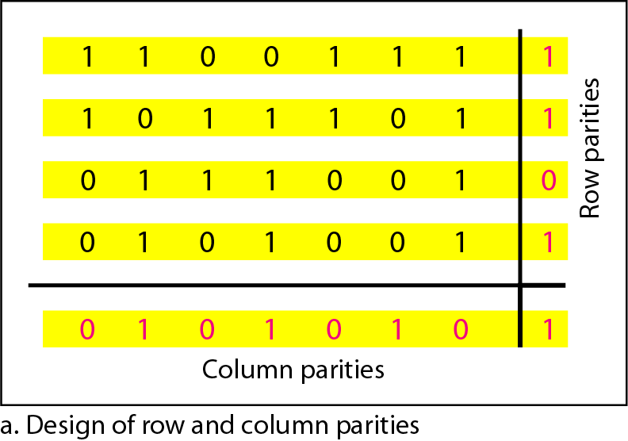
Figure 10.11 两维奇偶校验码

Slide 37
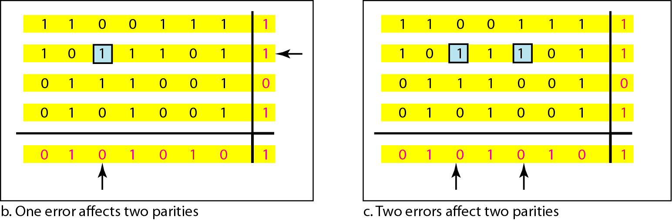
Figure 10.11 Two-dimensional parity-check code

Slide 38
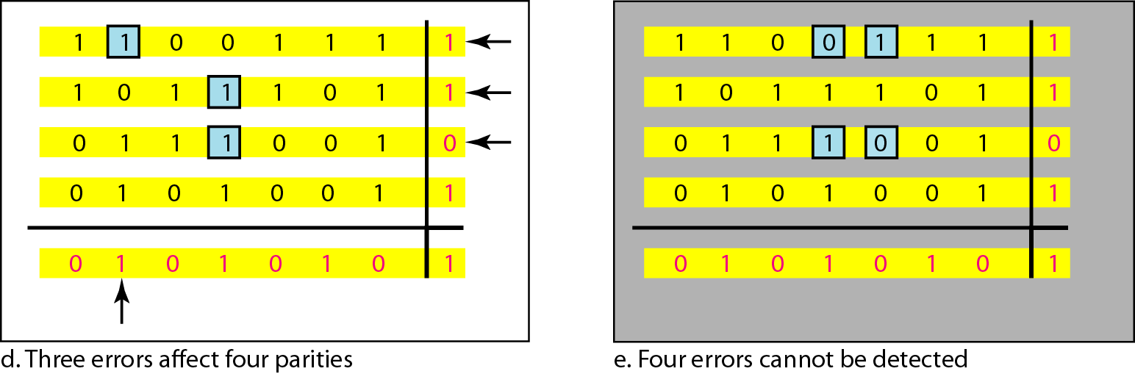
Figure 10.11 Two-dimensional parity-check code
d_{min} = s + 1;
s=3, so,d_{min} = 4

Slide 39
Note
All Hamming codes discussed in this book have d_{min} = 3.
本书只讨论汉明距离为3的最小的汉明码，这样能检出2位差错，和纠正1位差错。
The relationship between m and n in these codes is n = 2^m − 1
汉明距离m与码字长n和数据字长k的关系为n = 2^m − 1, k=n-m,r=n-k

Slide 40
Table 10.4 Hamming code C(7, 4)

Slide 41
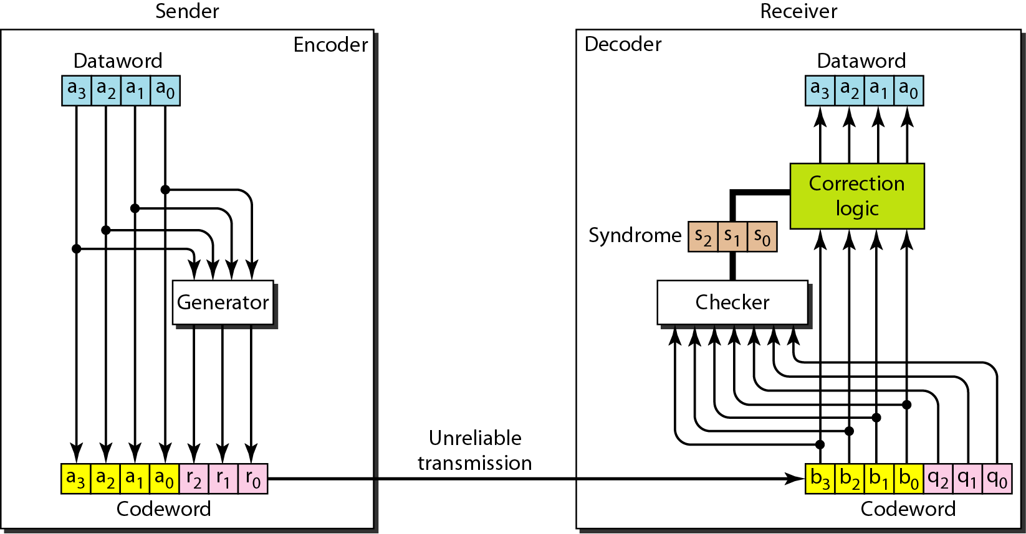
Figure 10.12 The structure of the encoder and decoder for a Hamming code
汉明码的编码器和解码器的结构 （冗余位也是模2运算，见书）

Slide 42
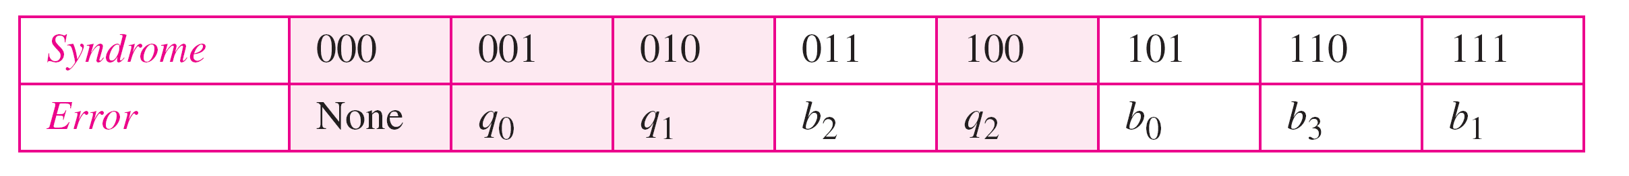
Table 10.5 Logical decision made by the correction logic analyzer
译码器的纠错逻辑分析器的逻辑判定

Slide 43
Example 10.13
Let us trace the path of three datawords from the sender to the destination:
跟踪3个数据字从发送端到目的端的路径，见书P185
1. The dataword 0100 becomes the codeword 0100011. The codeword 0100011 is received. The syndrome is 000, the final dataword is 0100.
2. The dataword 0111 becomes the codeword 0111001. The syndrome is 011. After flipping b₂ (changing the 1 to 0), the final dataword is 0111.
3. The dataword 1101 becomes the codeword 1101000. The syndrome is 101. After flipping b₀, we get 0000, the wrong dataword. This shows that our code cannot correct two errors.

Slide 44
Example 10.14
We need a dataword of at least 7 bits. Calculate values of k and n that satisfy this requirement.
若数据字至少为7比特，计算n，k，r。
Solution
We need to make k = n − m greater than or equal to 7, or 2^m − 1 − m ≥ 7.
1. If we set m = 3, the result is n = 23 − 1 and k = 7 − 3, or 4, which is not acceptable.
2. If we set m = 4, then n = 24 − 1 = 15 and k = 15 − 4 = 11, which satisfies the condition. So the code is
C(15, 11)

Slide 45
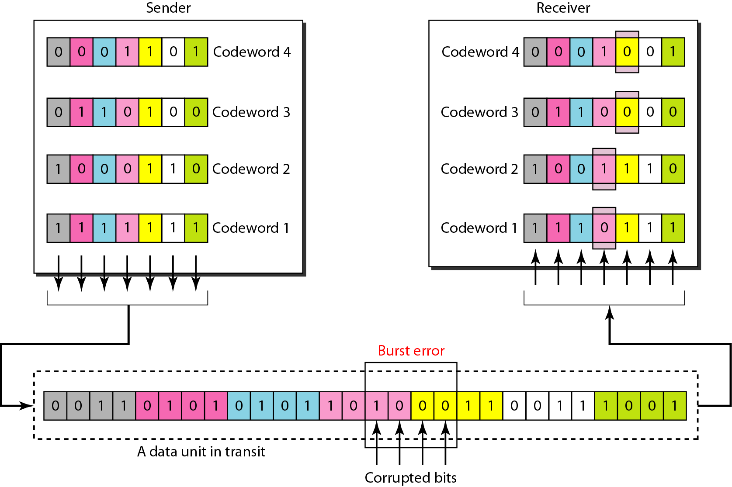
Figure 10.13 Burst error correction using Hamming code
使用交织编码技术的汉明码，提高突发错误能力

Slide 46
10-4 CYCLIC CODES 循环码
循环码是有一个附加性质的特殊的线性块码。这个性质是如果码字循环移位，结果还是另一个循环码字。例如，1011000是一个码子，循环左移，那么0110001也是码子。
Topics discussed in this section:
Cyclic Redundancy Check 循环冗余校验码 Hardware Implementation 硬件实现 Polynomials 多项式 Cyclic Code Analysis 循环码性能分析
Advantages of Cyclic Codes 循环码的优点 Other Cyclic Codes 其它循环码

Slide 47
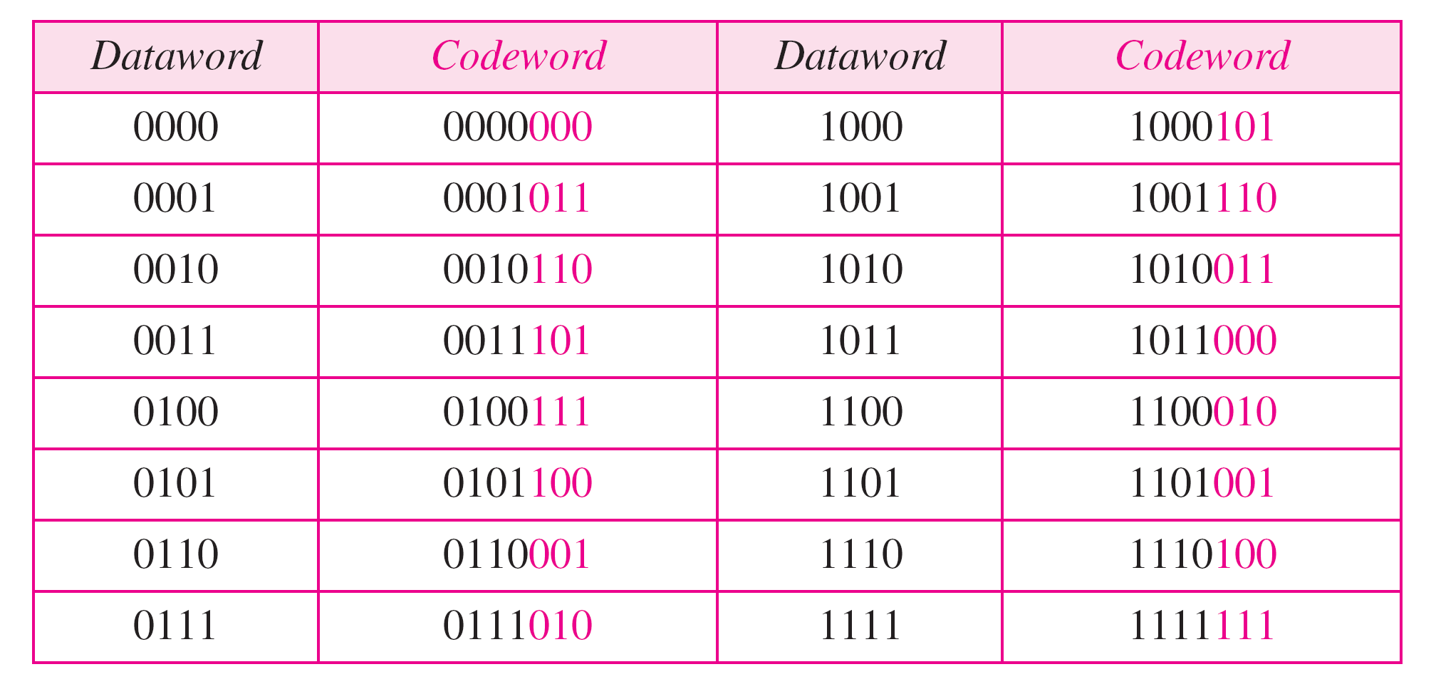
Table 10.6 A CRC code with C(7, 4) 循环冗余校验码简称CRC

Slide 48
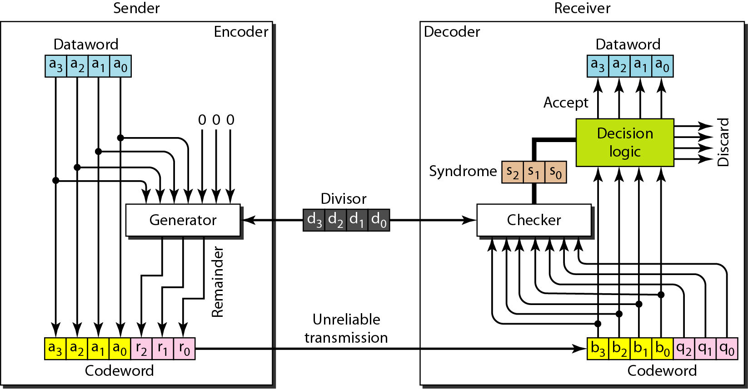
Figure 10.14 CRC encoder and decoder
数据字k=4位，码子n=7位,数据字右边加上n-k=3个位零，除数是n-k+1=4位，双方提前协商好的。

Slide 49
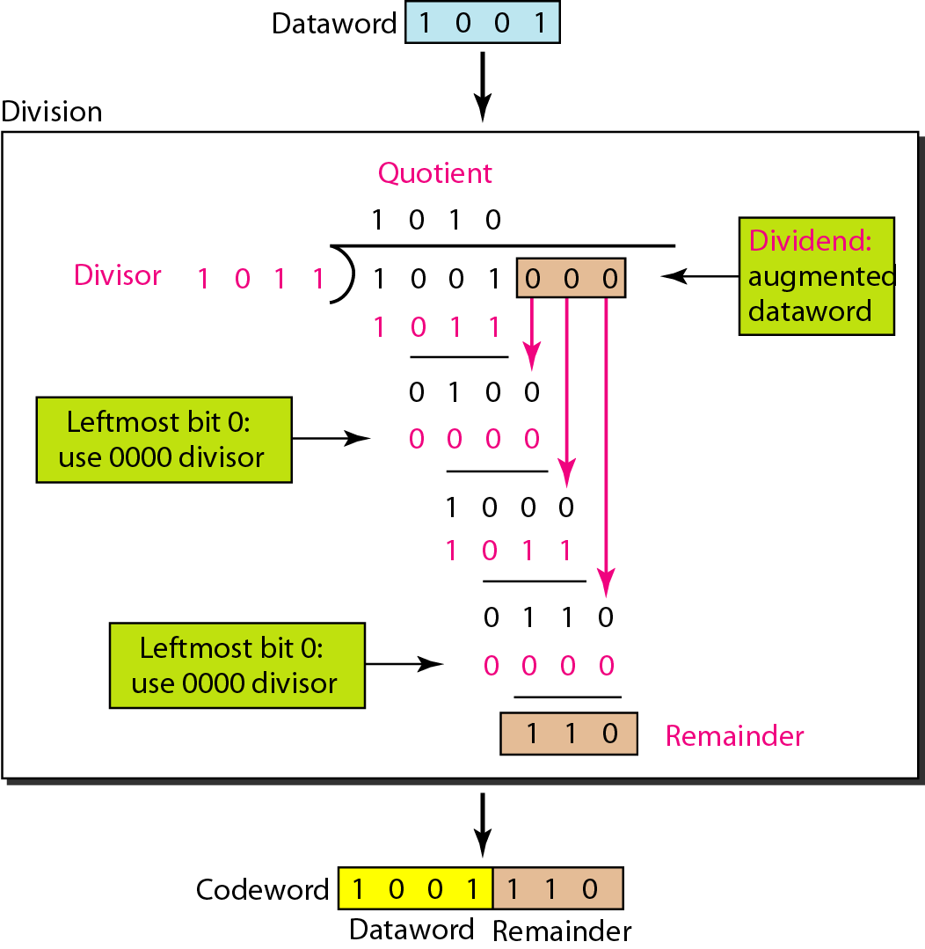
Figure 10.15 Division in CRC encoder CRC编码器中的除法（模2运算）
1.模2除法也等同于异或；
2.如果被除数最左边的位是0，这一步就不能用正常的除数，而需要使用全0的除数；

Slide 50
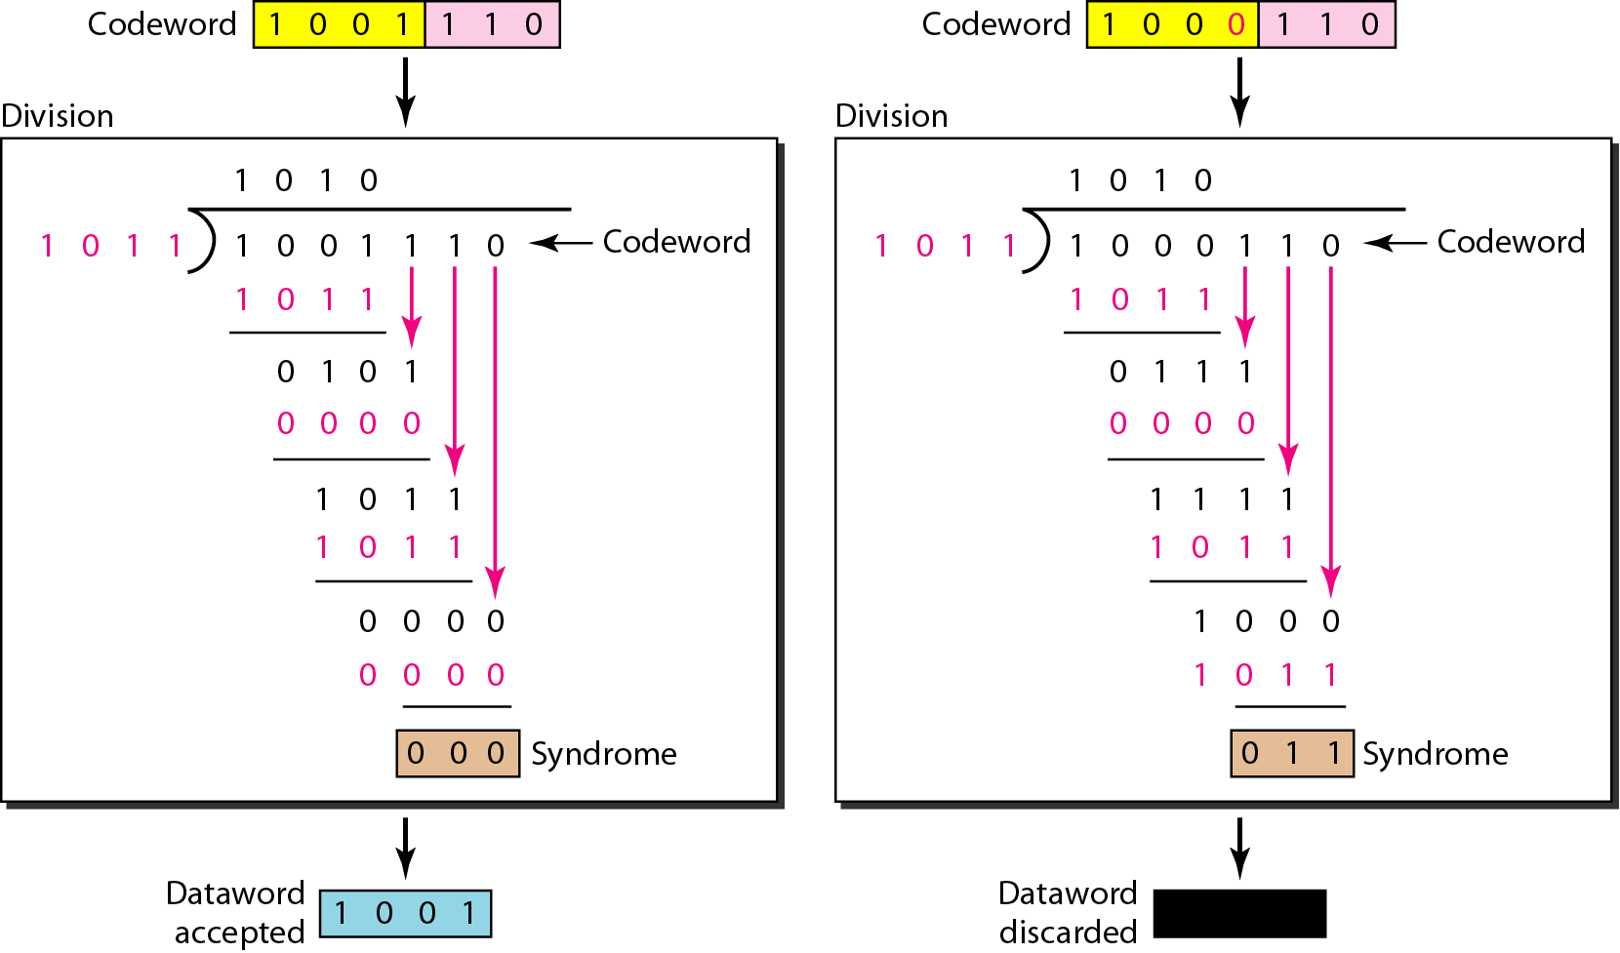
Figure 10.16 CRC的译码器中的除法（除尽和除不尽）

Slide 51
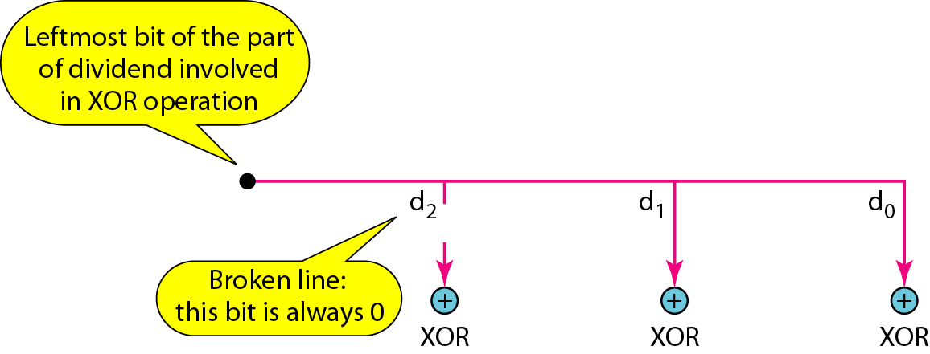
Figure 10.17 Hardwired design of the divisor in CRC
CRC的硬件实现不做要求，选讲

Slide 52
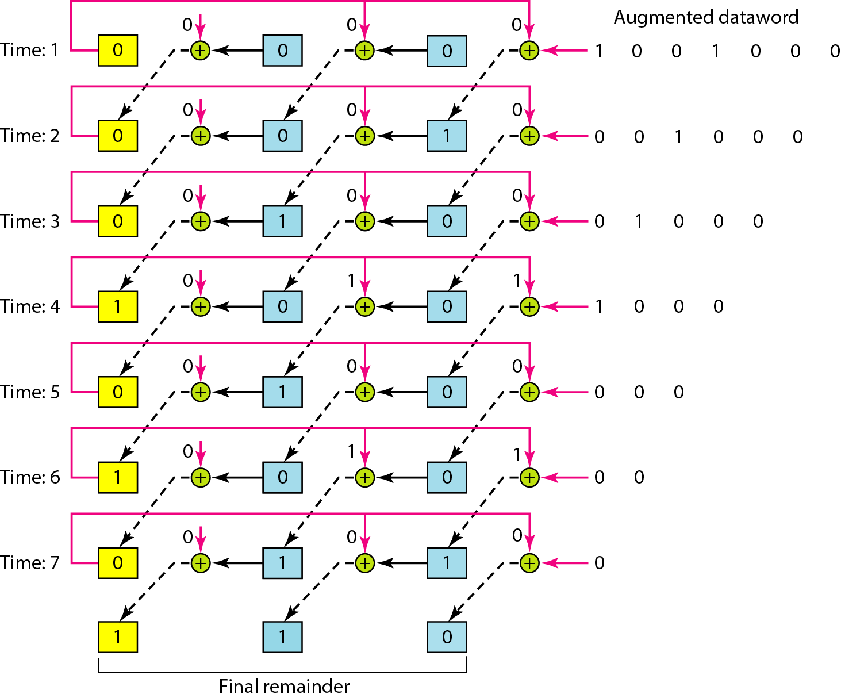
Figure 10.18 Simulation of division in CRC encoder
CRC的硬件实现不做要求，选讲

Slide 53
Figure 10.19 The CRC encoder design using shift registers
CRC的硬件实现不做要求，选讲

Slide 54
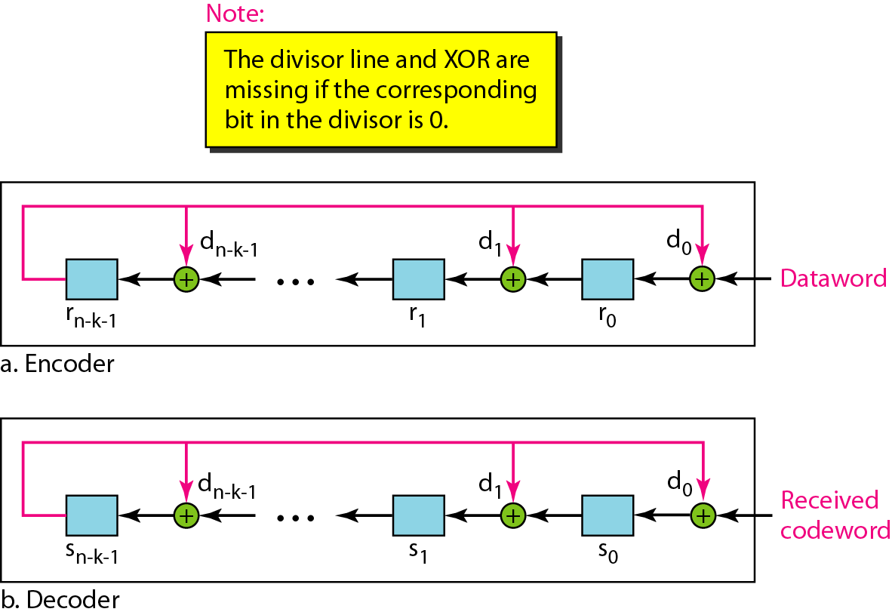
Figure 10.20 General design of encoder and decoder of a CRC code
CRC的硬件实现不做要求，选讲

Slide 55
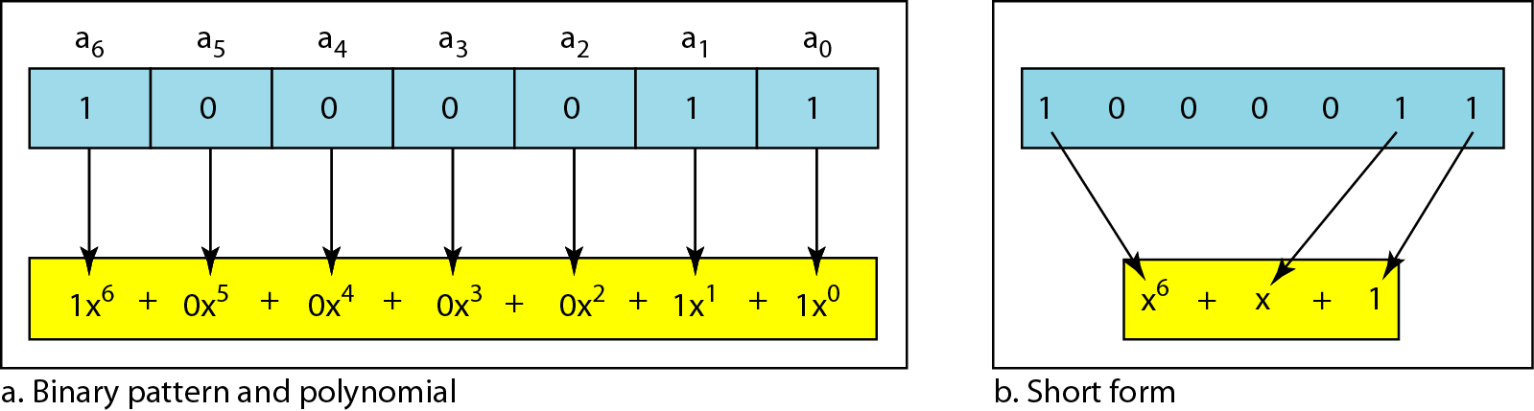
Figure 10.21 A polynomial to represent a binary word
循环冗余校验码可以用多项式表示

Slide 56
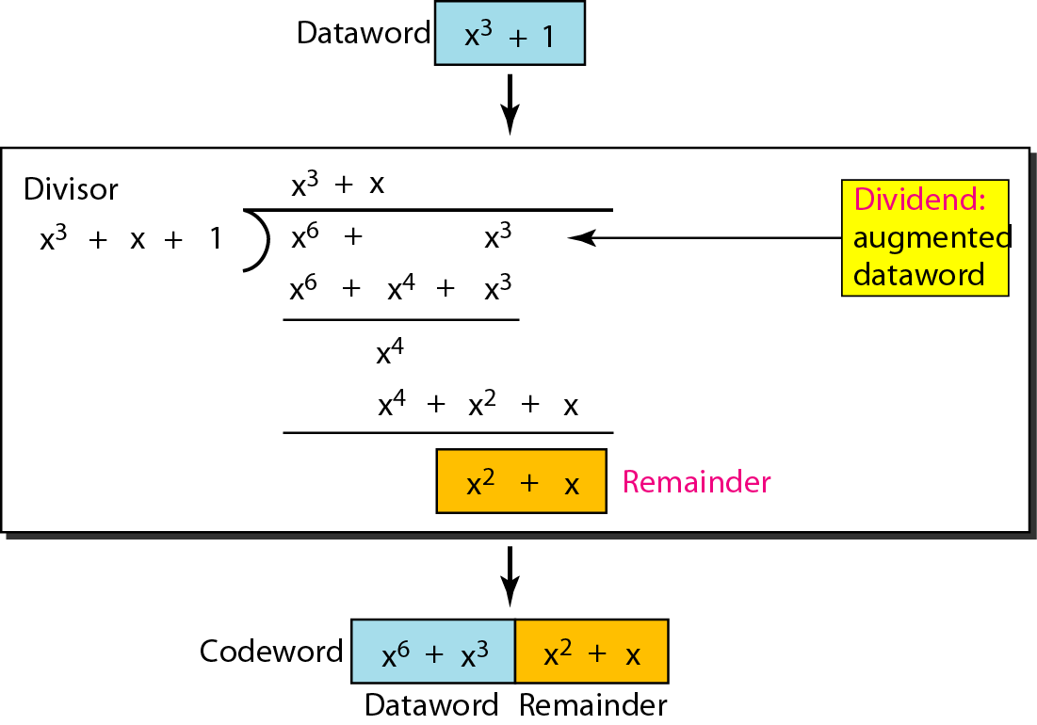
Figure 10.22 CRC division using polynomials
这样，CRC除法就变成多项式除法

Slide 57
Note
循环码的除数通常称为生成多项式，简称生成子（生成器）

Slide 58
Note
CRC性能分析
In a cyclic code,
If s(x) ≠ 0, one or more bits is corrupted.
If s(x) = 0, either
a. No bit is corrupted. or
b. Some bits are corrupted, but the decoder failed to detect them.
CRC中，校正子S(x) ≠ 0说明有差错；=0说明无差错或者有差错但译码器无法检测出(超出检错能力)。

Slide 59
Note
In a cyclic code, those e(x) errors that are divisible by g(x) are not caught.
循环码中，有些可以被生成多项式g(x)整除的差错无法被捕捉到。(发生的概率极小)

Slide 60
Note
If the generator has more than one term and the coefficient of x⁰ is 1, all single errors can be caught.
若生成多项式至少有两项，且x⁰ 的系数是1，则所有单比特错误都可以检出。

Slide 61
Example 10.15
下面三个生成多项式的纠错能力如何？
Which of the following g(x) values guarantees that a single-bit error is caught? For each case, what is the error that cannot be caught?
a. x + 1 b. x³ c. 1
Solution
a. No x^{i} can be divisible by x + 1. Any single-bit error can be caught.
b. If i is equal to or greater than 3, x^{i} is divisible by g(x). All single-bit errors in positions 1 to 3 are caught.
c. All values of i make x^{i} divisible by g(x). No single-bit error can be caught. This g(x) is useless.

Slide 62
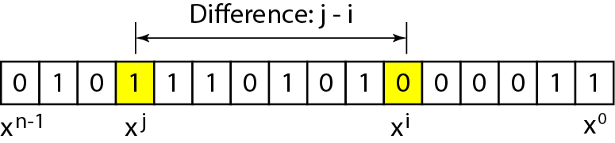
Figure 10.23 Representation of two isolated single-bit errors using polynomials
使用多项式表示的两个独立的单比特差错

Slide 63
Note
If a generator cannot divide x^{t} + 1 (t between 0 and n – 1),
then all isolated double errors can be detected.
若生成多项式不能整除x^{t} + 1 ，那么所有独立的双比特错误都能被检测到。

Slide 64
Example 10.16
下面几个生成多项式对独立的双比特差错能力如何
Find the status of the following generators related to two isolated, single-bit errors.
a. x + 1 b. x⁴ + 1 c. x⁷ + x⁶ + 1 d. x¹⁵ + x¹⁴ + 1
Solution
a. This is a very poor choice for a generator. Any two errors next to each other cannot be detected.
b. This generator cannot detect two errors that are four positions apart.
c. This is a good choice for this purpose.
d. This polynomial cannot divide x^{t} + 1 if t is less than 32,768. A codeword with two isolated errors up to 32,768 bits apart can be detected by this generator.

Slide 65
Note
A generator that contains a factor of x + 1 can detect all odd-numbered errors.
包含x+1因子的生成多项式能检测到所有奇数个比特错误。

Slide 66
Note
❏ All burst errors with L ≤ r will be detected.
❏ All burst errors with L = r + 1 will be detected with probability 1 – (1/2)^{r–1}.
❏ All burst errors with L > r + 1 will be detected with probability 1 – (1/2)^{r}.
生成多项式纠突发错误的能力

Slide 67
Example 10.17
下面的生成多项式纠突发错误的能力如何
Find the suitability of the following generators in relation to burst errors of different lengths.
a. x⁶ + 1 b. x¹⁸ + x⁷ + x + 1 c. x³² + x²³ + x⁷ + 1
Solution
a. This generator can detect all burst errors with a length less than or equal to 6 bits; 3 out of 100 burst errors with length 7 will slip by; 16 out of 1000 burst errors of length 8 or more will slip by.

Slide 68
Example 10.17 (continued)
b. This generator can detect all burst errors with a length less than or equal to 18 bits; 8 out of 1 million burst errors with length 19 will slip by; 4 out of 1 million burst errors of length 20 or more will slip by.
c. This generator can detect all burst errors with a length less than or equal to 32 bits; 5 out of 10 billion burst errors with length 33 will slip by; 3 out of 10 billion burst errors of length 34 or more will slip by.

Slide 69
Note
生成多项式检错能力总结：
A good polynomial generator needs to have the following characteristics:
1. It should have at least two terms. 两项
2. The coefficient of the term x⁰ should be 1. 即x⁰系数一定不为0
3. It should not divide x^{t} + 1, for t between 2 and n − 1. 没有因子x^{t} + 1
4. It should have the factor x + 1.待讨论?
5. 一定是一个素的生成多项式。（新加的）

Slide 70
Table 10.7 Standard polynomials 一些常用的标准生成多项式

Slide 71
10-5 CHECKSUM 校验和与反码
最后讨论的一个检错方法称为校验和；校验和在Internet中被许多不属于数据链路层的协议使用；校验和也是基于冗余的概念。
Topics discussed in this section:
Idea 概念 One’s Complement 反码 Internet Checksum 因特网中的校验和

Slide 72
Example 10.18
1.将要发送的数字为：(7, 11, 12, 0, 6）；
2.实际发送的数字为：(7, 11, 12, 0, 6, 36）；
3.其中，36是发送数字的和；接收方将5个数字相加并与36比较，如果两者相同接收方就认为没错，否则，认为发送错误。36，就是校验和的概念。

Slide 73
Example 10.19
We can make the job of the receiver easier if we send the negative (complement) of the sum, called the checksum. In this case, we send (7, 11, 12, 0, 6, −36). The receiver can add all the numbers received (including the checksum). If the result is 0, it assumes no error; otherwise, there is an error.
也可以发送和的反码，这样接收器处理更简单些。

Slide 74
Note
因特网校验和的步骤： (发送方)
Sender site:
1. The message is divided into 16-bit words.
2. The value of the checksum word is set to 0.
3. All words including the checksum are added using one’s complement addition.
(使用反码运算相加)
4. The sum is complemented and becomes the checksum. (累加和求反码变成校验和)
5. The checksum is sent with the data.

Slide 75
Note
因特网校验和的步骤： (接收方)
Receiver site:
1. The message (including checksum) is divided into 16-bit words.
2. All words are added using one’s complement addition. (使用反码运算相加)
3. The sum is complemented and becomes the new checksum. (求反码变成新校验和)
4. If the value of checksum is 0, the message is accepted; otherwise, it is rejected.

Slide 76
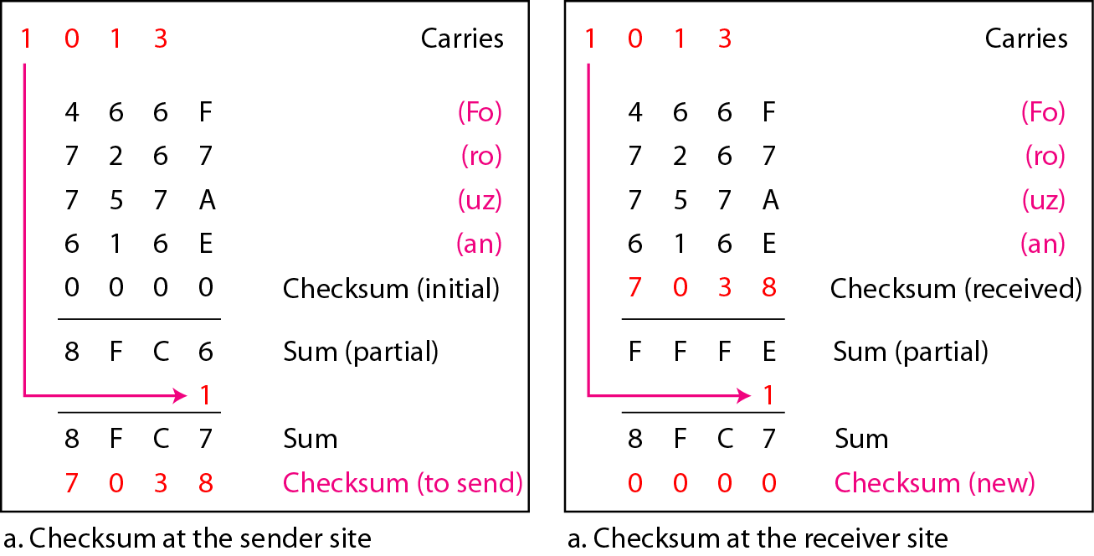
Figure 10.25 Example 10.23 注意分段，进位，和反码等相关的操作
(注意: 图右下角有错)

Slide 77
本章作业：
1，4，7，8，
15，16，18，23，24，26，27，28，30，32

