Slide 1
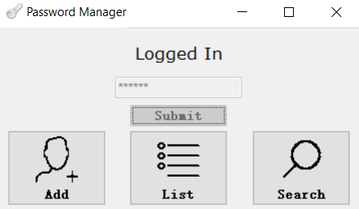
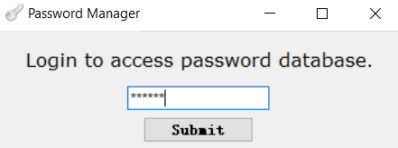
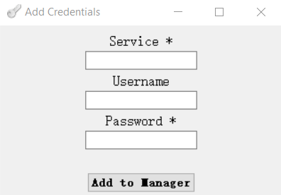
5002 Final Project Presentation
Password Manager Master
Instructor: Sarita Singh
Ruotian Zhang
Zhiliang Yu
2023 Fall CS Align

Slide 2

Vigenere cipher (simple one)
- encode

Slide 3
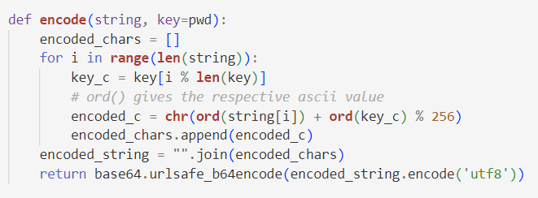
Vigenere cipher (simple one)
- encode

Slide 4
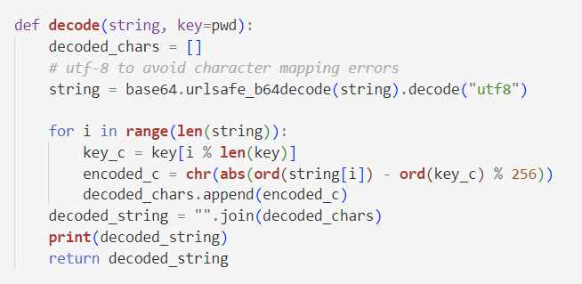
Vigenere cipher (simple one)
- decode

Slide 5
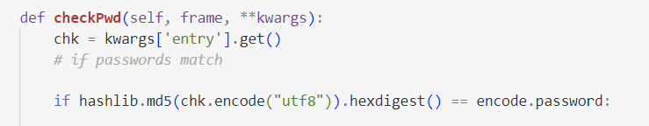
Vigenere cipher (simple one)
- match

Slide 6
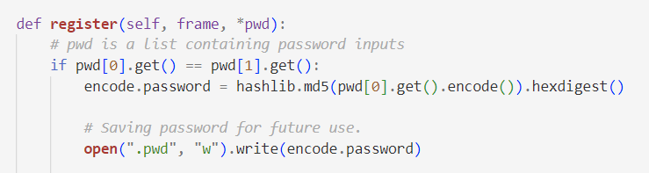
Vigenere cipher (simple one)
- match

Slide 7

RSA Encryption
- encode

Slide 8
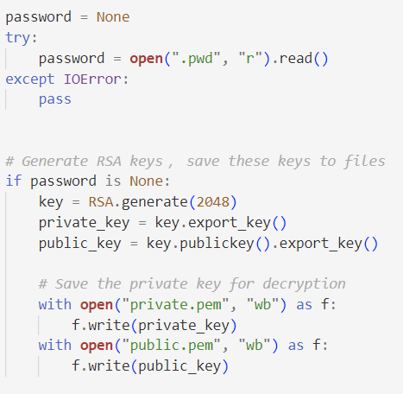
RSA Encryption
- encode

Slide 9
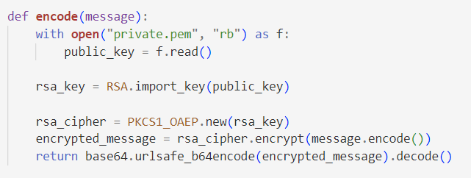
RSA Encryption
- encode

Slide 10
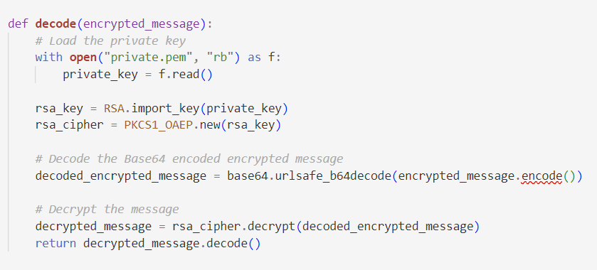
RSA Encryption

Slide 11
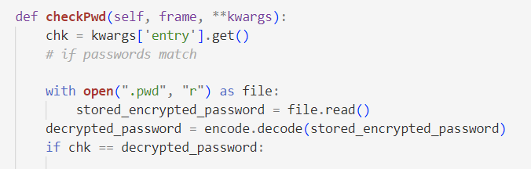
RSA Encryption
- match

Slide 12
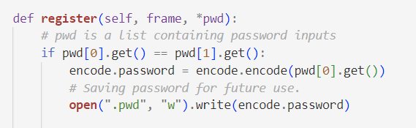
RSA Encryption
- match

Slide 13
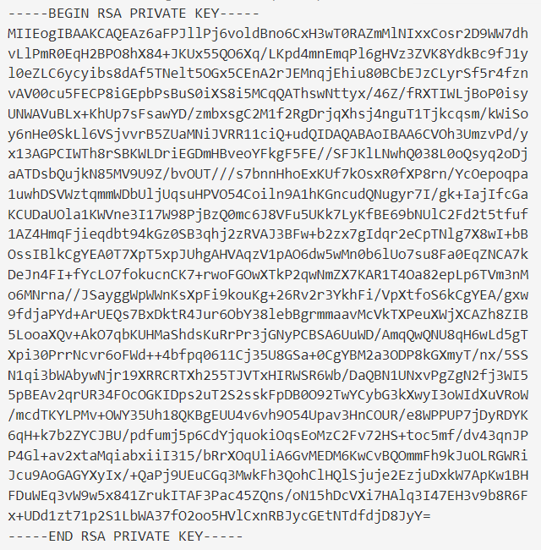
RSA Encryption
- keys

Slide 14
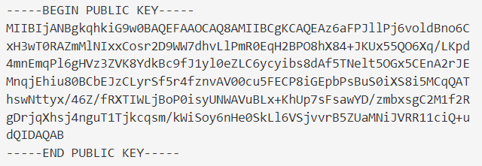
RSA Encryption
- keys

Slide 15
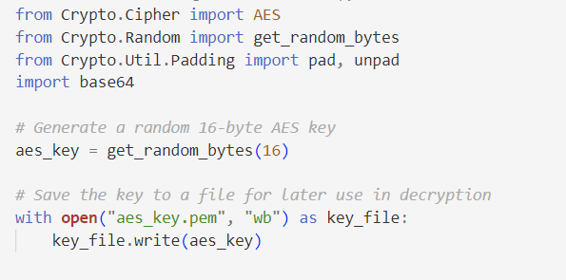
AES Encryption

Slide 16
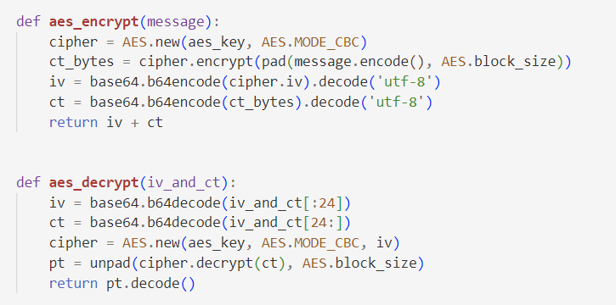
AES Encryption

Slide 17
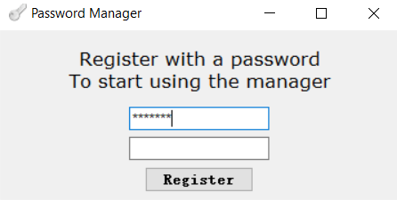
Work Flow

Slide 18
Work Flow

Slide 19
Work Flow

Slide 20
Work Flow

Slide 21
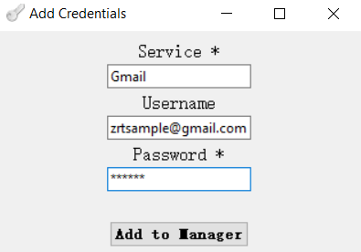
Work Flow

Slide 22
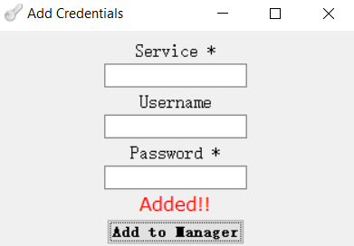
Work Flow

Slide 23
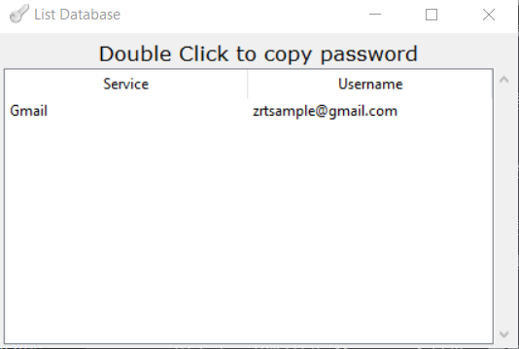
Work Flow

Slide 24
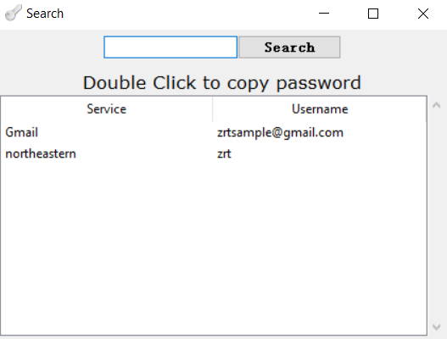
Work Flow

Slide 25
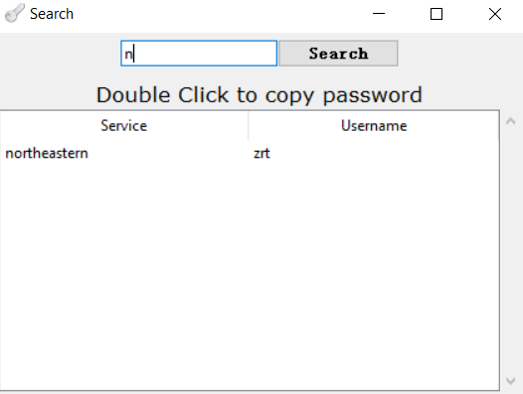
Work Flow

