Slide 1
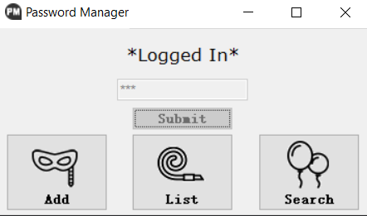
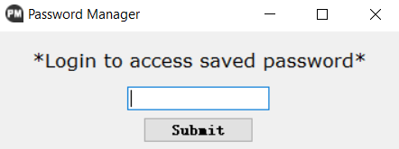
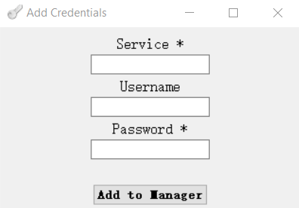
5002 Final Project Presentation
Password Manager Master
Instructor: Sarita Singh
Ruotian Zhang
Zhiliang Yu
2023 Fall CS Align

Slide 2
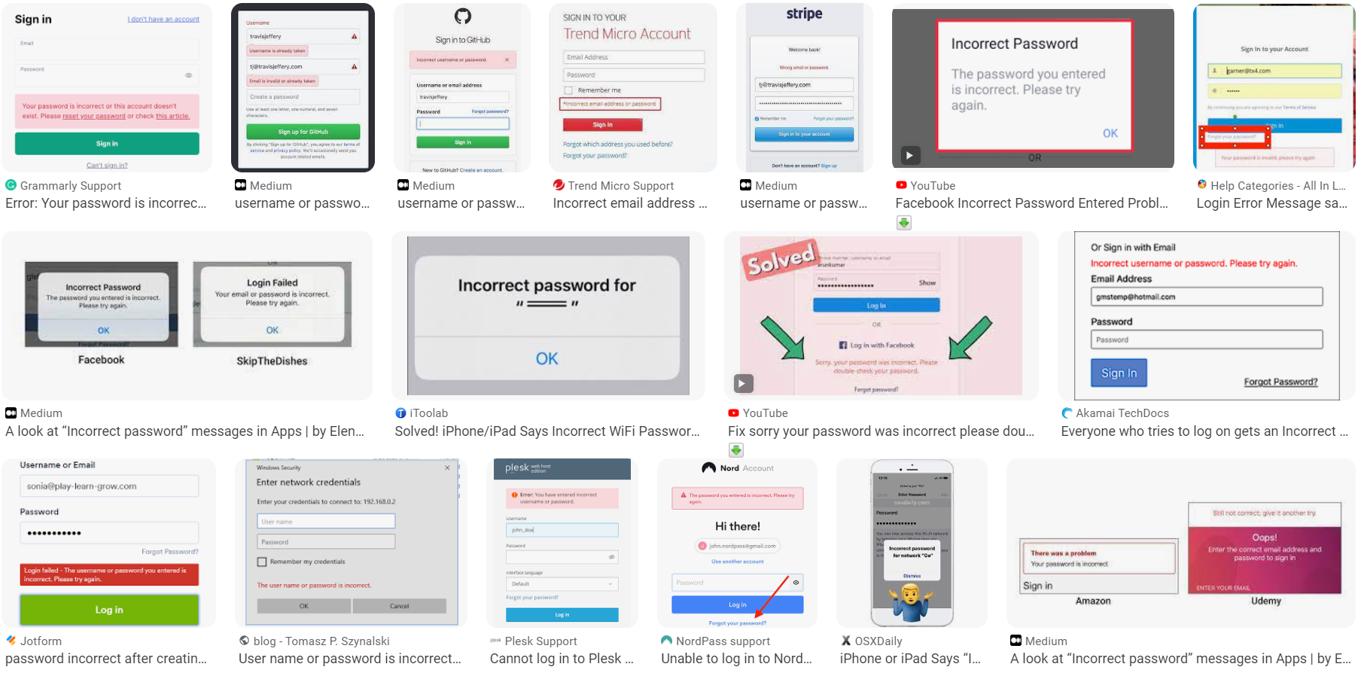
!!!!!!!!!!!!!!!!!!!!!!!!!!!! PASSWORD INCORRECT !!!!!!!!!!!!!!!!!!!!!!!!!!!!!!!!!!!!!!!!!!!

Slide 3
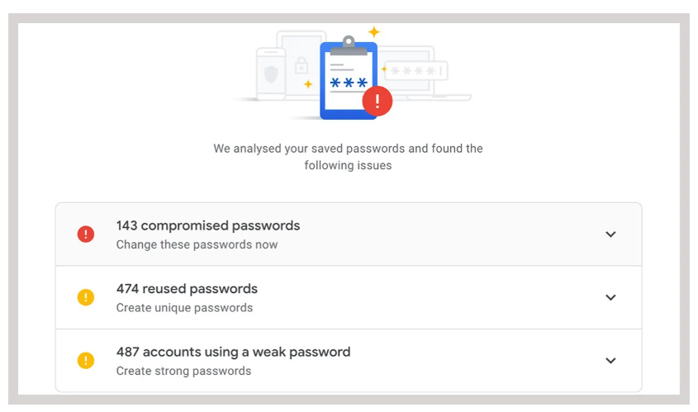
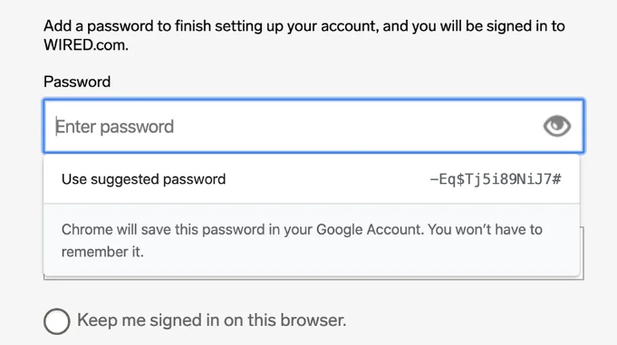

Slide 4
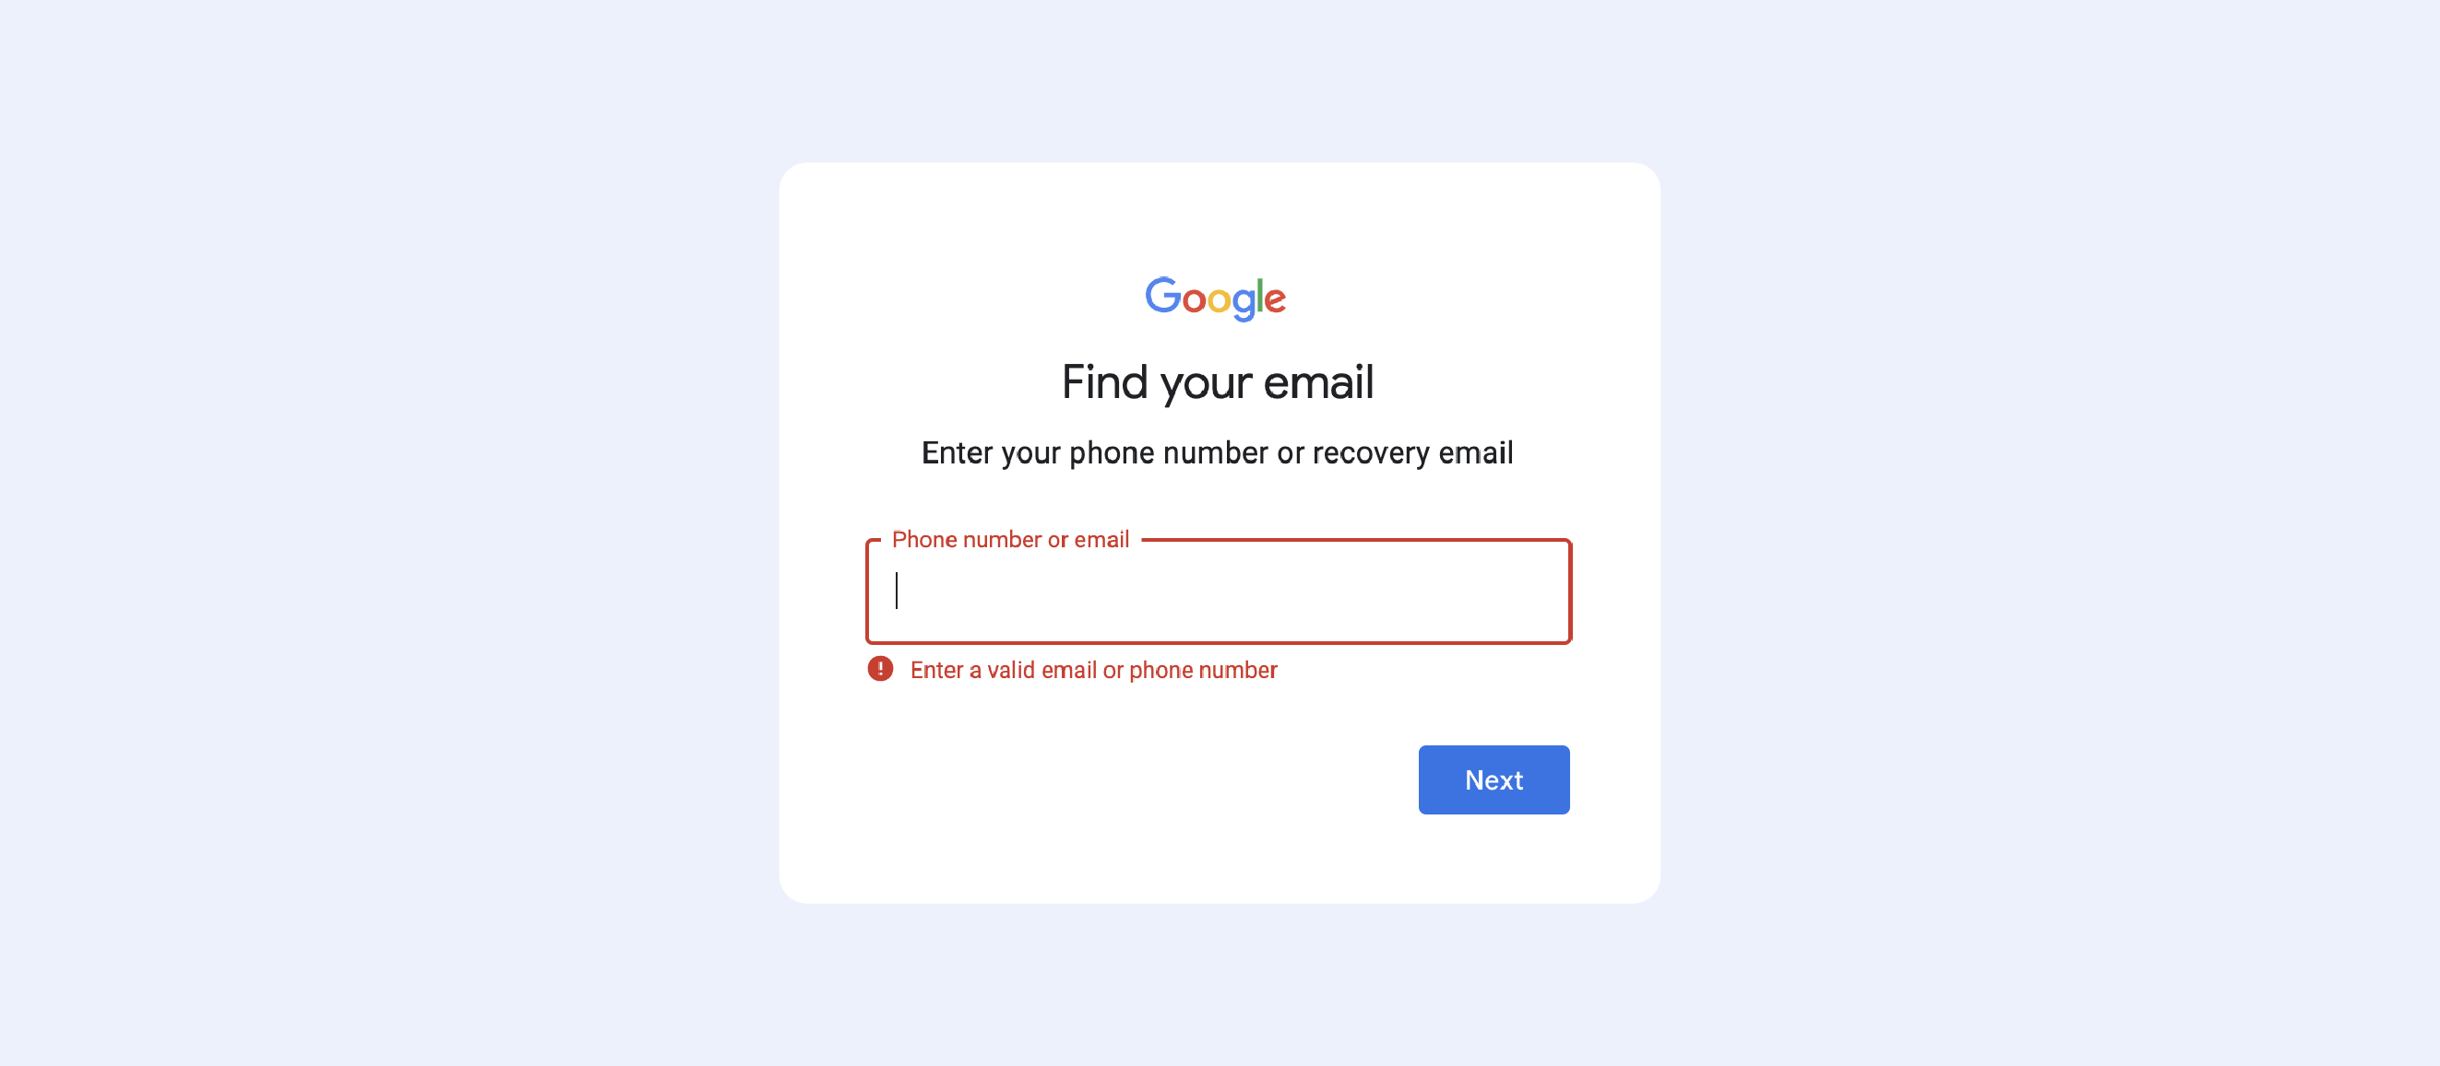

Slide 5
AIM
A program that can help people manage password
With the knowledge about cryptography we learnt in 5002

Slide 6
STRUCTURE
ADD
MANAGER
ENCRYPT
LIST
SEARCH

Slide 7
STRUCTURE
ADD
ENCRYPT
MANAGER
LIST
Vigenere Cipher
RSA Encryption
SEARCH
AES Encryption

Slide 8
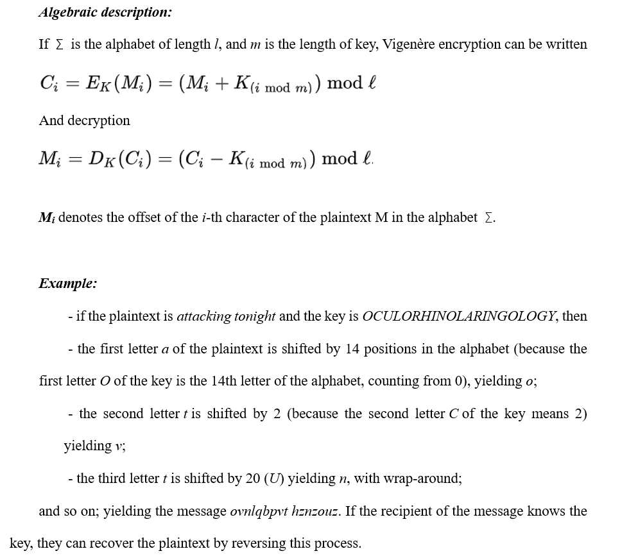
Vigenere cipher

Slide 9

Vigenere cipher (simple one)
- encode

Slide 10
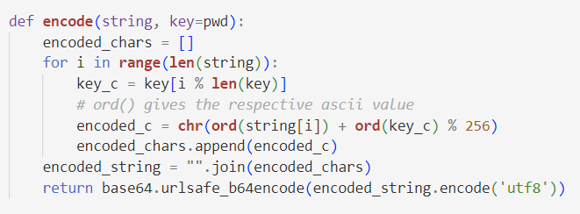
Vigenere cipher (simple one)
- encode

Slide 11
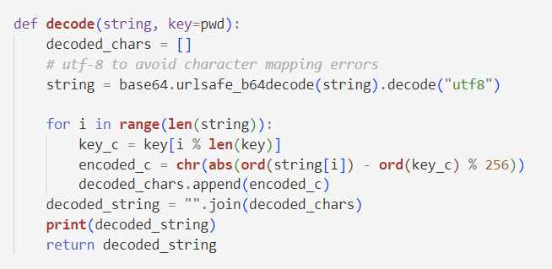
Vigenere cipher (simple one)
- decode

Slide 12
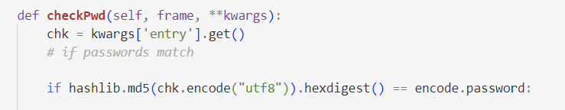
Vigenere cipher (simple one)
- match

Slide 13
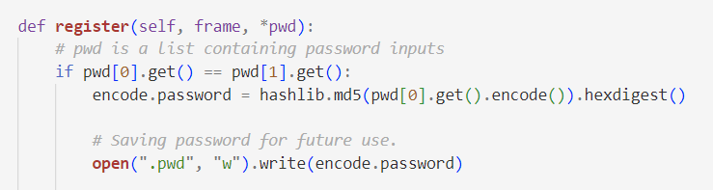
Vigenere cipher (simple one)
- match

Slide 14


RSA Encryption

Slide 15
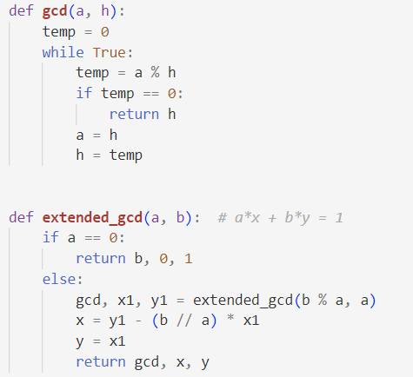
RSA Encryption (Demo)

Slide 16
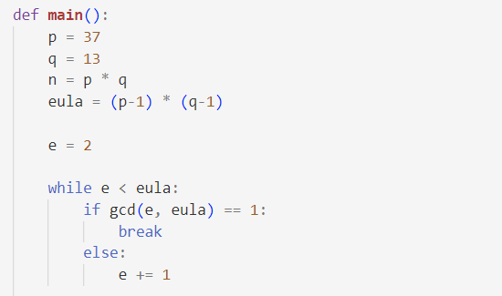
RSA Encryption (Demo)

Slide 17
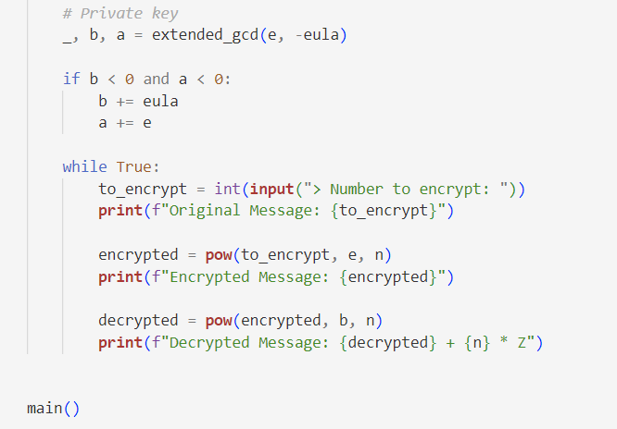
RSA Encryption (Demo)

Slide 18
RSA Encryption (Demo)
Problem
They need to be big enough to handle various kinds of passwords

Slide 19

RSA Encryption
- encode

Slide 20
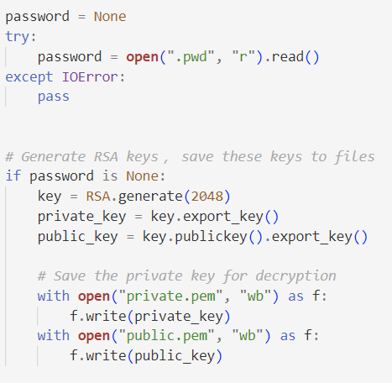
RSA Encryption
- encode

Slide 21
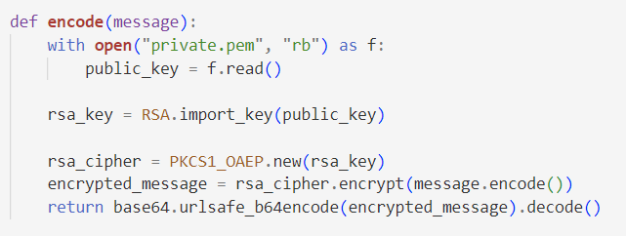
RSA Encryption
- encode

Slide 22
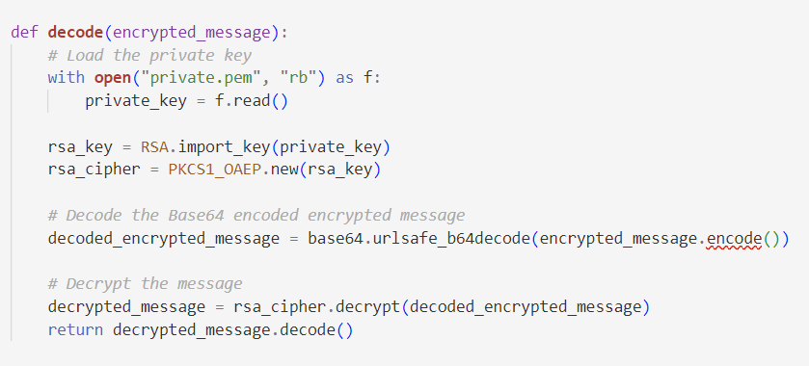
RSA Encryption

Slide 23
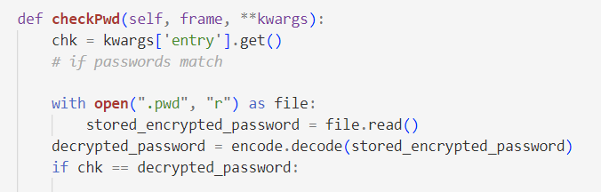
RSA Encryption
- match

Slide 24
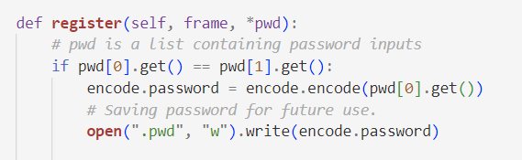
RSA Encryption
- match

Slide 25
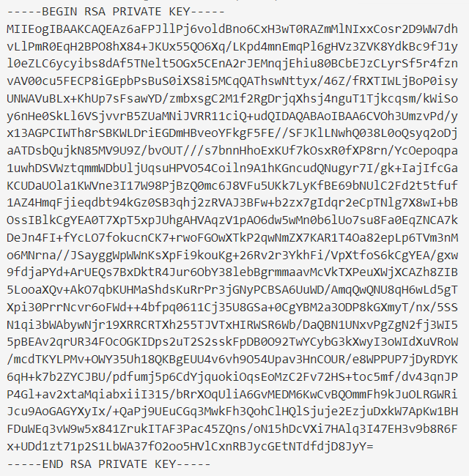
RSA Encryption
- keys

Slide 26
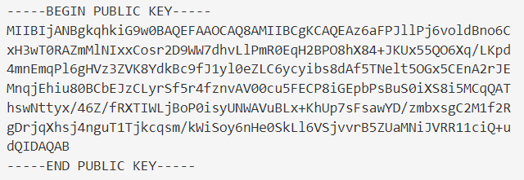
RSA Encryption
- keys

Slide 27
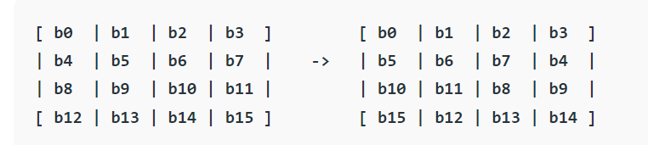
AES Encryption

Slide 28
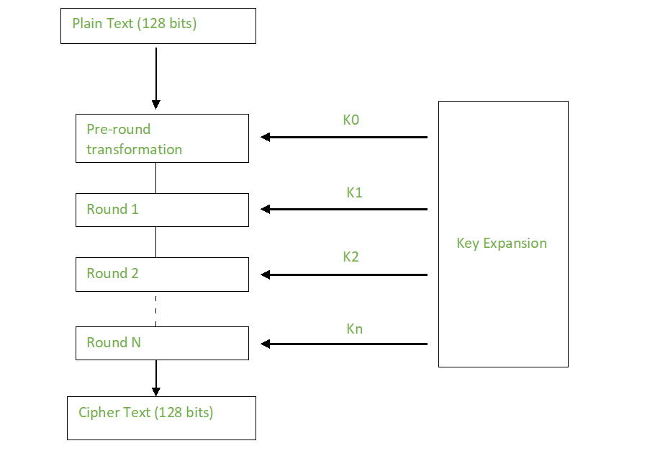
AES Encryption

Slide 29
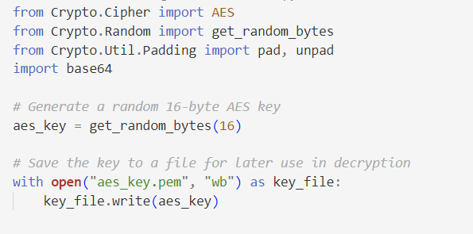
AES Encryption

Slide 30
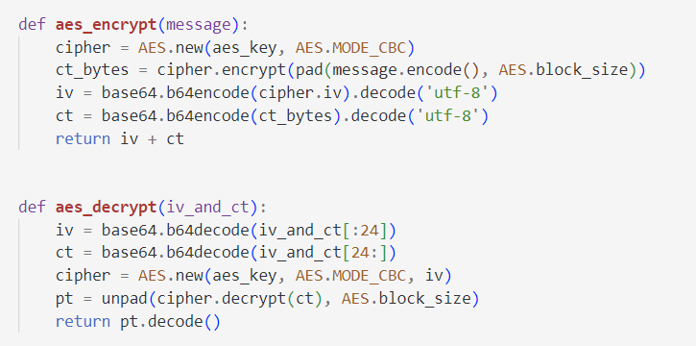
AES Encryption

Slide 31
STRUCTURE
ADD
MANAGER
ENCRYPT
LIST
SEARCH

Slide 32
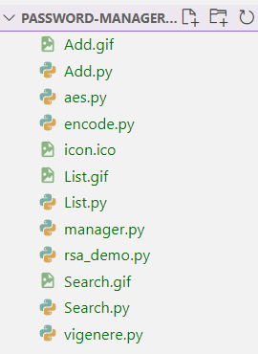
STRUCTURE
ADD
MANAGER
ENCRYPT
LIST
SEARCH

Slide 33
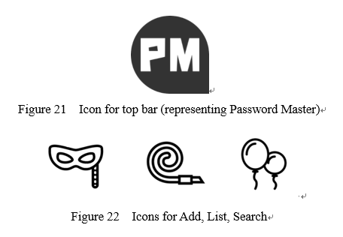
Tools
Tkinter – For GUI use, a library in Python, with a versatile set of tools for creating intuitive and user-friendly interfaces, allowing to organize distinct windows for functionalities such as log in, add, list, and search.
Photoshop, Illustrator – For simple Icon design

Slide 34
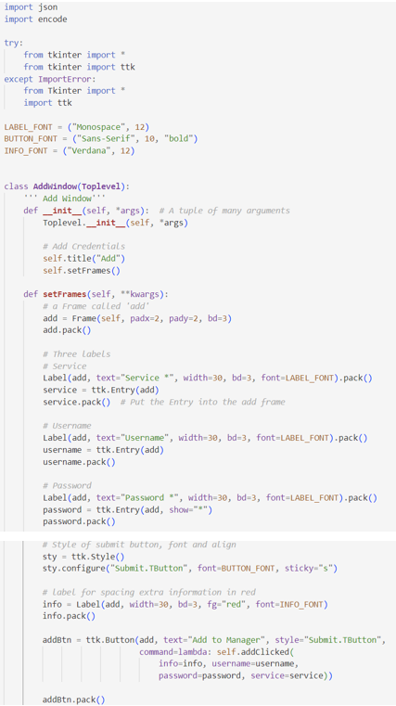
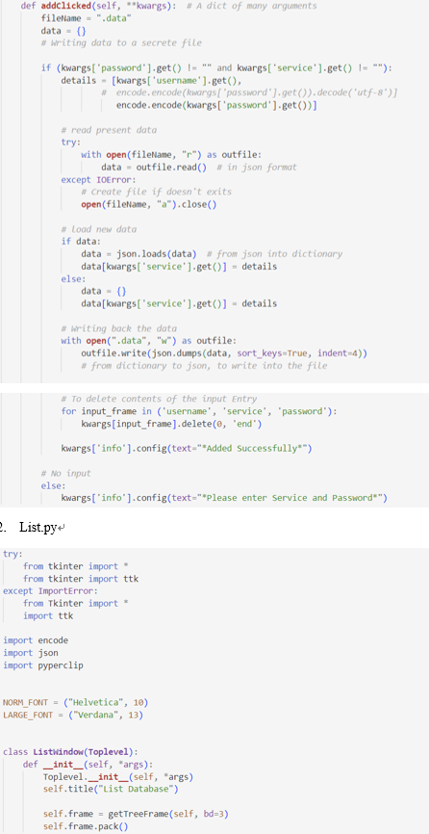
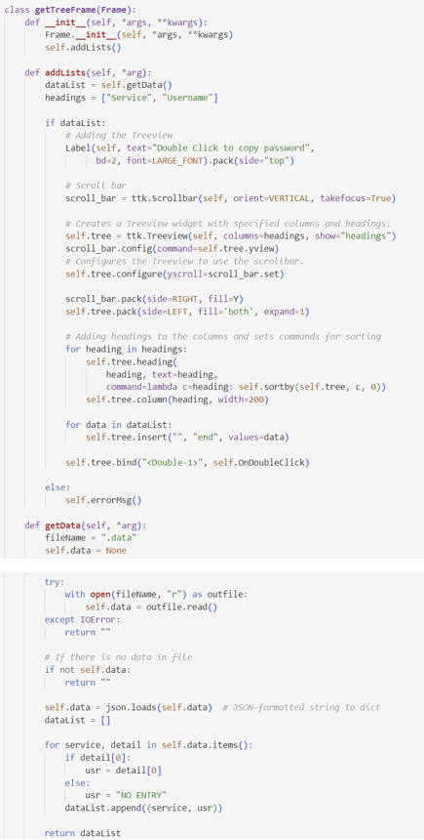

Slide 35
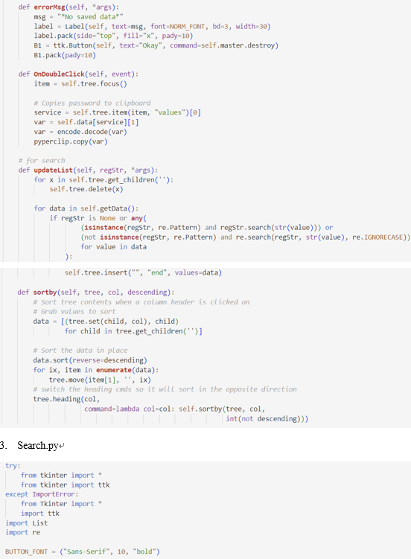
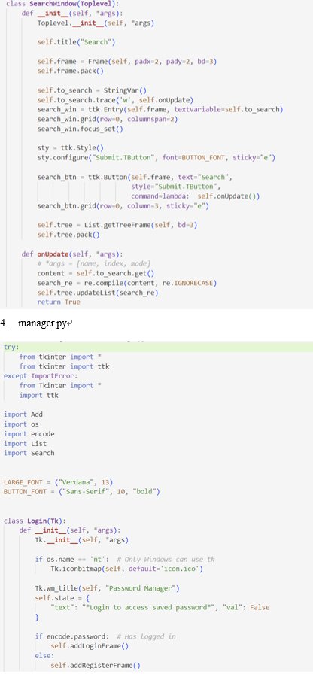
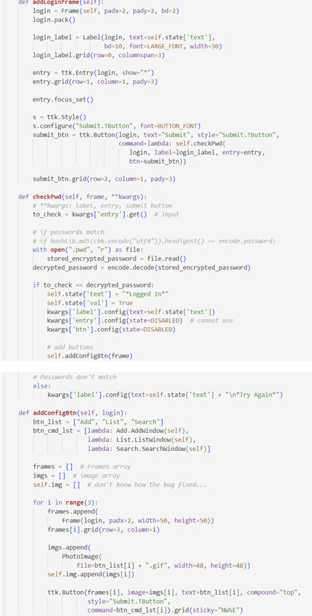

Slide 36
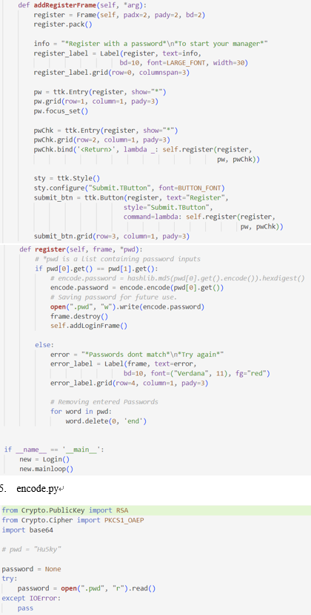
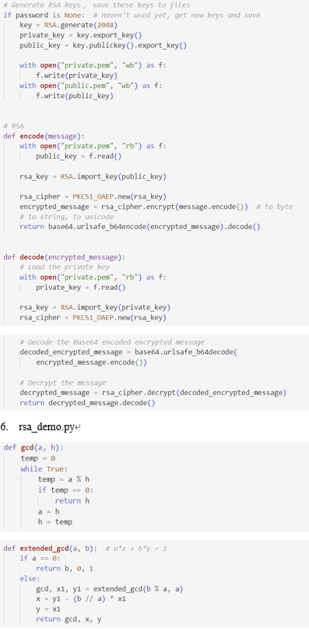
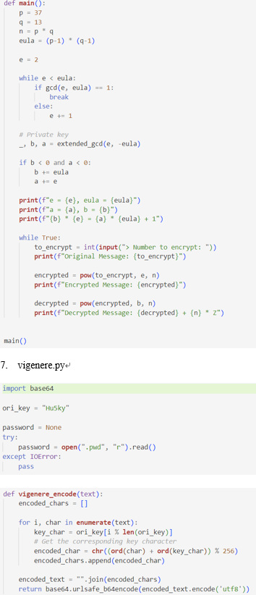
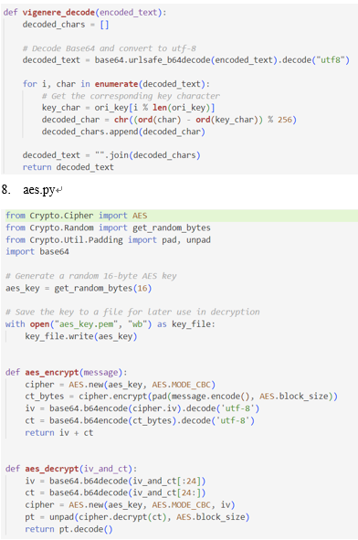

Slide 37
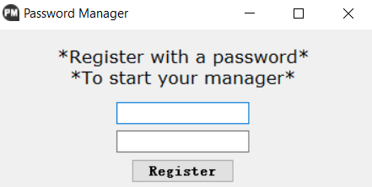
Work Flow

Slide 38
Work Flow

Slide 39
Work Flow

Slide 40
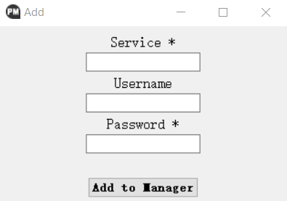
Work Flow

Slide 41
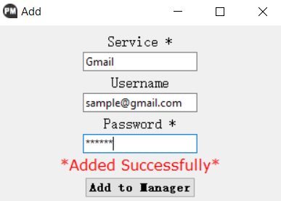
Work Flow

Slide 42
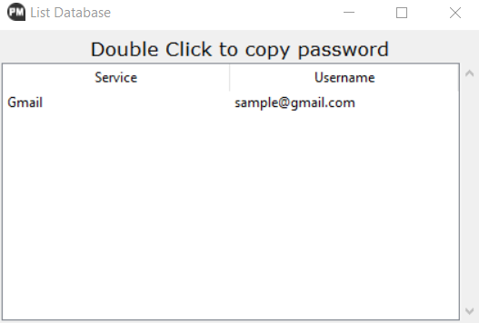
Work Flow

Slide 43
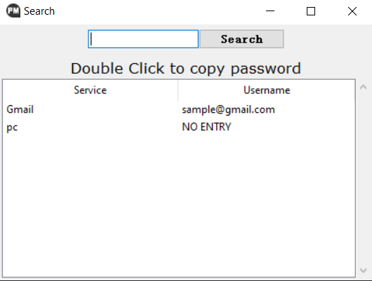
Work Flow

Slide 44
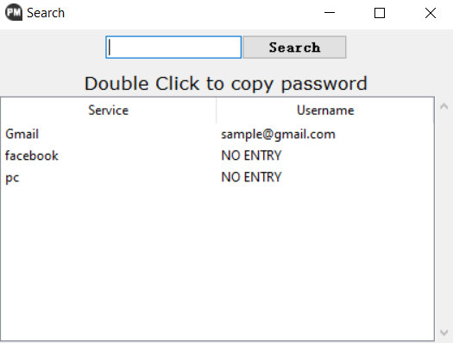
Work Flow

Slide 45

Work Flow

Slide 46
RESULT
We successfully build a password manager that can work properly :D
ADD
MANAGER
ENCRYPT
LIST
SEARCH

Slide 47
reference
Vigenère Cipher Concept: https://en.wikipedia.org/wiki/Vigen%C3%A8re_cipher
Vigenère Cipher: https://www.geeksforgeeks.org/vigenere-cipher/
RSA Algorithm Cryptography Concept: https://en.wikipedia.org/wiki/RSA_(cryptosystem)
RSA Algorithm Cryptography: https://www.geeksforgeeks.org/rsa-algorithm-cryptography/
AES Algorithm Cryptography Concept: https://en.wikipedia.org/wiki/Advanced_Encryption_Standard
AES Algorithm Cryptography: https://www.geeksforgeeks.org/advanced-encryption-standard-aes/
Password Manager structure:
https://github.com/ashutoshkrris/Password-Manager-using-Tkinter
https://github.com/mukkachaitanya/Password-Manager/tree/master
8. Tkinter Usage: http://stupidpythonideas.blogspot.in/2013/12/tkinter-validation.html
9. Tkinter Usage, binding a key to a button: http://stackoverflow.com/questions/11456631/how-to-capture-events-on-tkinter-child-widgets

Slide 48
5002 Final Project Presentation
Thank you!
Ruotian Zhang
Zhiliang Yu
2023 Fall CS Align

