Slide 1
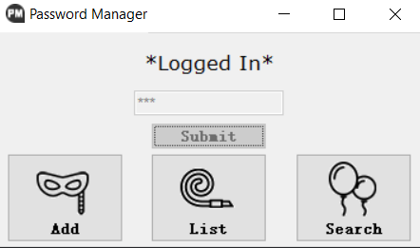
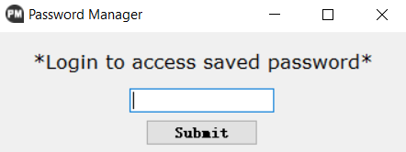
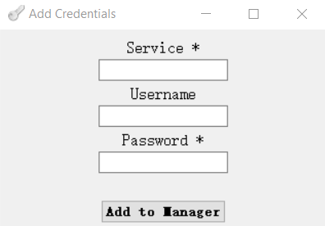
5002 Final Project Presentation
Password Manager Master
Instructor: Sarita Singh
Ruotian Zhang
Zhiliang Yu
2023 Fall CS Align

Slide 2
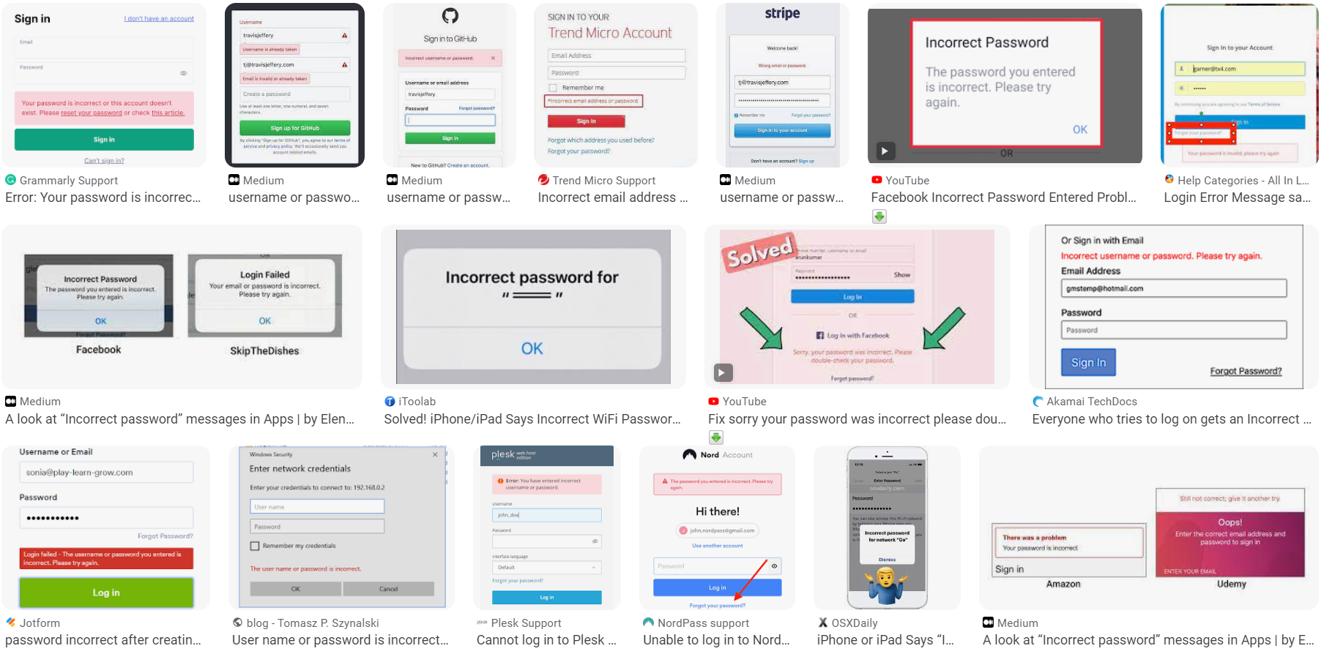
!!!!!!!!!!!!!!!!!!!!!!!!!!!! PASSWORD INCORRECT !!!!!!!!!!!!!!!!!!!!!!!!!!!!!!!!!!!!!!!!!!!

Slide 3
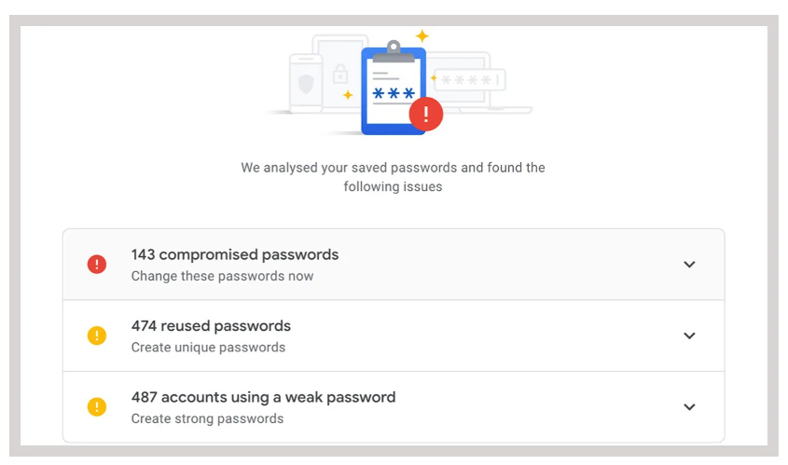
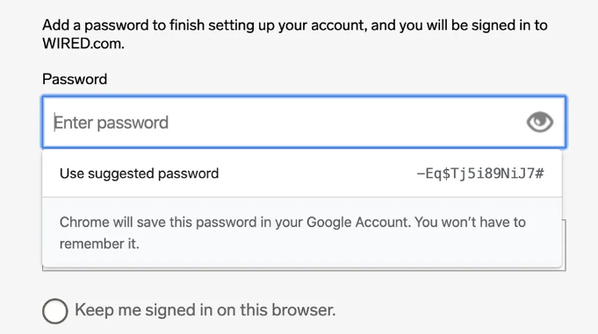

Slide 4
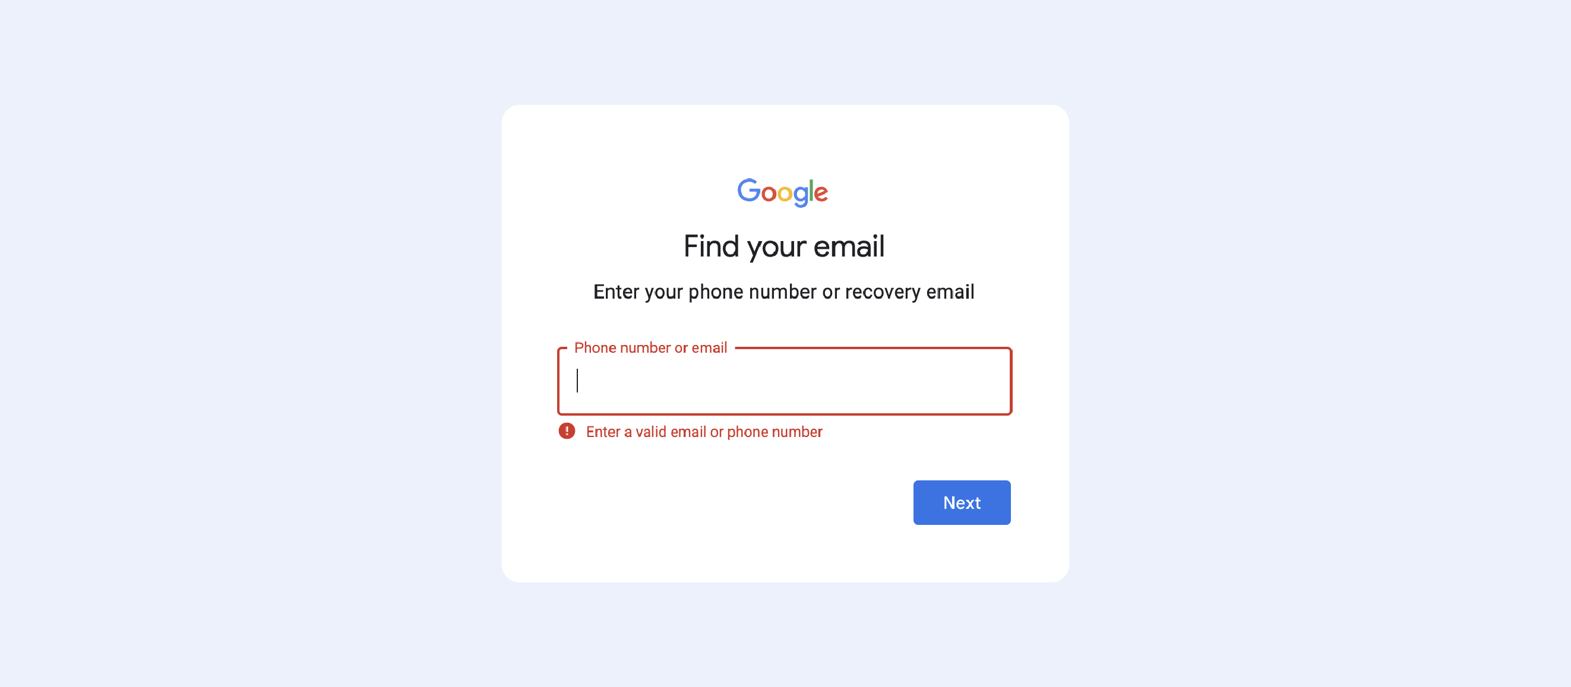

Slide 5
AIM
A program that can help people manage password
With the knowledge about cryptography we learnt in 5002

Slide 6
STRUCTURE
ADD
MANAGER
ENCRYPT
LIST
SEARCH

Slide 7
STRUCTURE
ADD
ENCRYPT
MANAGER
LIST
Vigenere Cipher
RSA Encryption
SEARCH
AES Encryption

Slide 8
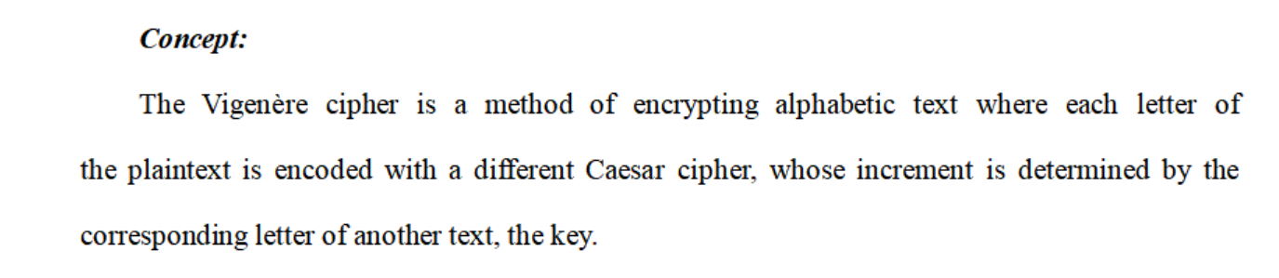
Vigenere cipher

Slide 9
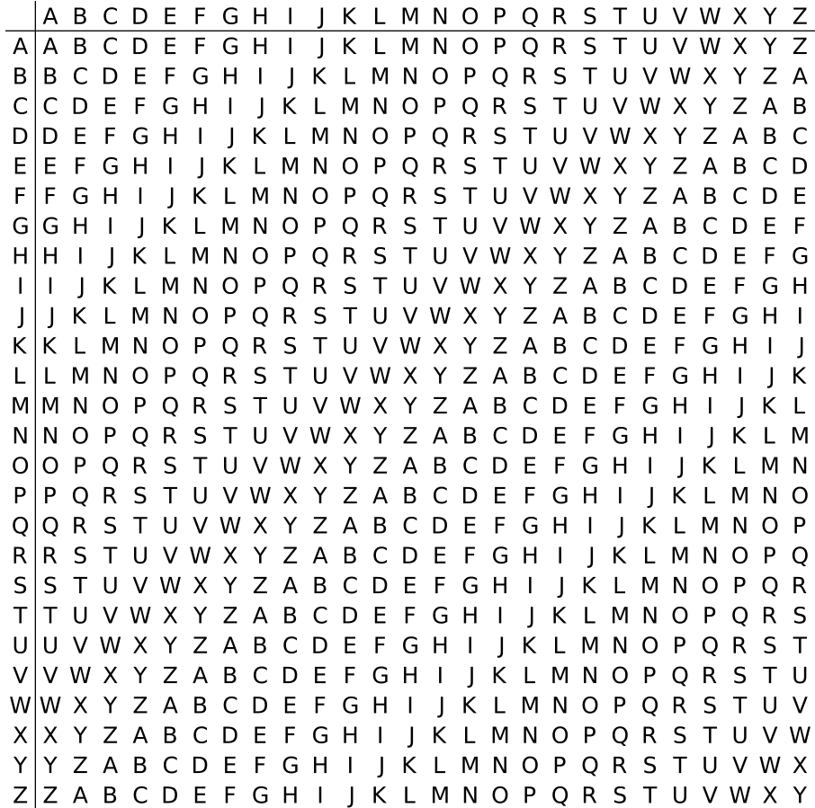
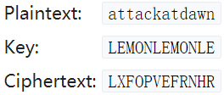
Vigenere cipher
Plaintext:
Key:

Slide 10
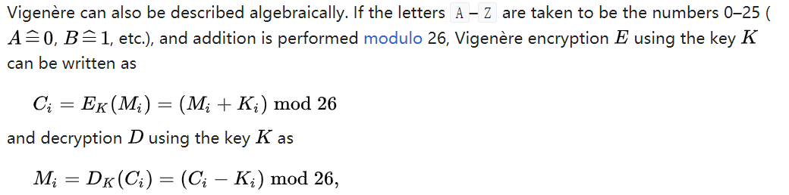
Vigenere cipher

Slide 11

Vigenere cipher (simple one)
- encode
Notes:
At first, we set as original key to use it for encryption and decryption, and obviously it generates from husky.

Slide 12
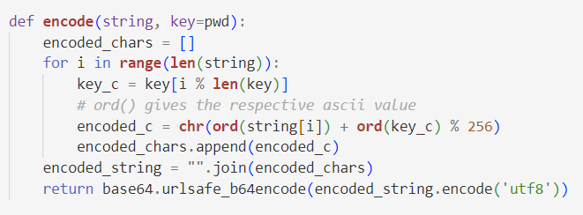
Vigenere cipher (simple one)
- encode
Notes:
And in the encrypt part, it takes a plain text input, which is the password the user typed in. It go through every character in the input string, and add the ascii value of the original key, which is husky, to the asci value of every character we want to encode, and finally transfer the modified ascii value back into character.
One thing to notice is the last step. when dealing with text data in Python, it's often stored as Unicode characters. By encoding the text into bytes using UTF-8 and then applying Base64 encoding, it ensures that the input is a binary representation of the text, and make sure these text won’t have issues or be misinterpreted, and to get a range of consistent output.

Slide 13
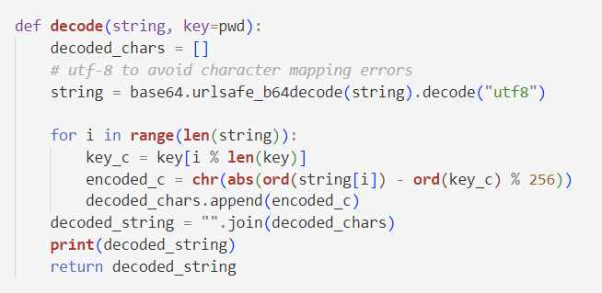
Vigenere cipher (simple one)
- decode
Notes:
So the decrypt is basically an inverse of the encryption after transfer the string into bytes, quite straightforward

Slide 14
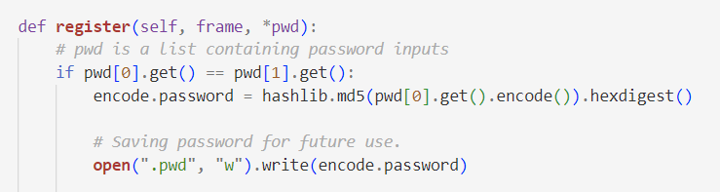
Vigenere cipher (simple one)
- match
Notes:
When the user use this program for the first time, they need to set a personal password. If they type in the same password for two times, then we save it into a file named .pwd. The hash we use in the program is for security reasons, to avoid storing plaintext directly, making it difficult (in theory) for an attacker to reverse the process and obtain the original password.

Slide 15
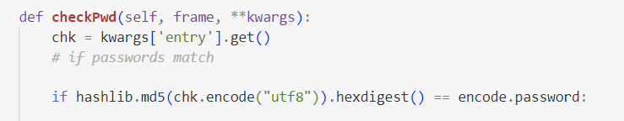
Vigenere cipher (simple one)
- match
Notes:
At last, if it is not the first time the user open this program, we compare if the user typed the right password. If they match, then the user can visit the database they saved before.

Slide 16
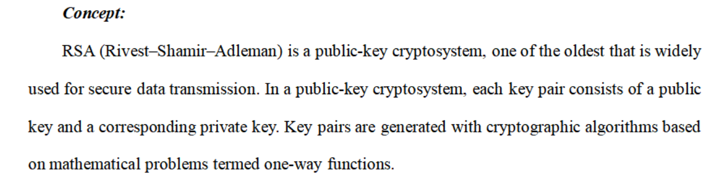
RSA Encryption

Slide 17


p
q
RSA Encryption
n = pq
Key generation
φ(n)=(p−1)(q−1)
integer e such that 1 < e < φ(n) and gcd(e, φ(n)) = 1
Key distribution
de ≡ 1 mod φ(n)
Encryption
Public key (n, e)
Private key (n, d)
Decryption

Slide 18
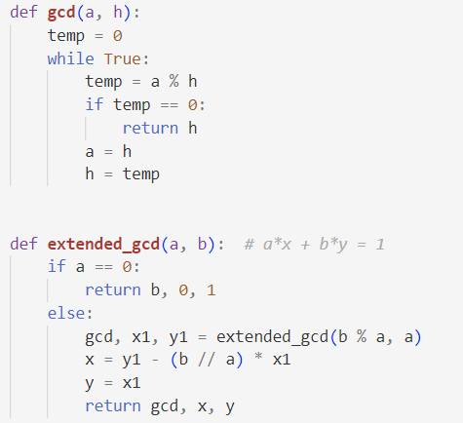
RSA Encryption (Demo)
Notes:
We first write a demo to implement the rsa algorithm. We wirte some functions to get the gcd,

Slide 19
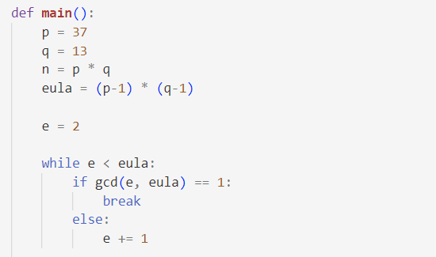
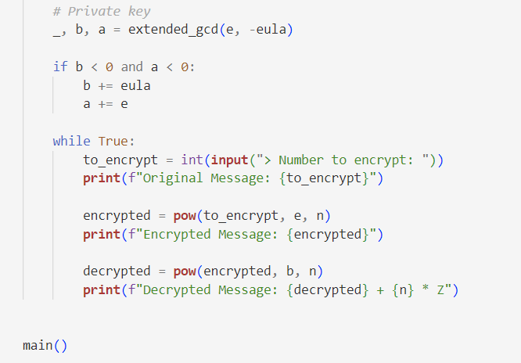
RSA Encryption (Demo)
Notes:
And a simple process as we’ve introduced before to make it possible to accomplish the encrypt and decrypt process.

Slide 20
RSA Encryption (Demo)
Problem
They need to be big enough to handle various kinds of passwords
Notes:
But the problem is only if we give big enough numbers can we handle complicated enough or even just normal passwords.

Slide 21

RSA Encryption
- encode
Notes:
So eventually, we choose the python library for formal use

Slide 22
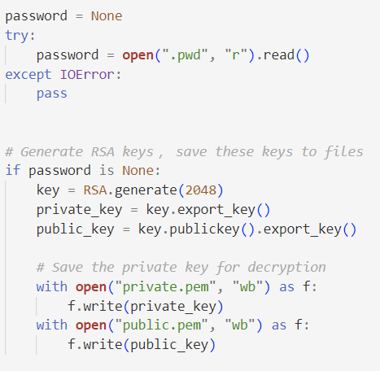
RSA Encryption
- encode
Notes:
If is the first time the user open the program, it will generate a public key and a private key first and save it to files for future use.

Slide 23
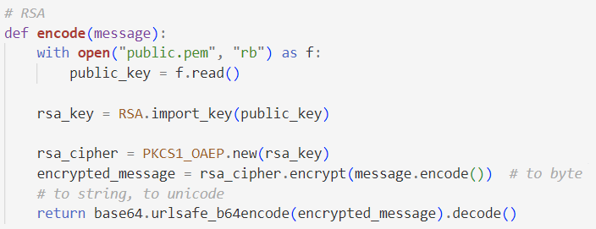
RSA Encryption
- encode
Notes:
And then the implemented encrypt function will encrypt the password for us.

Slide 24
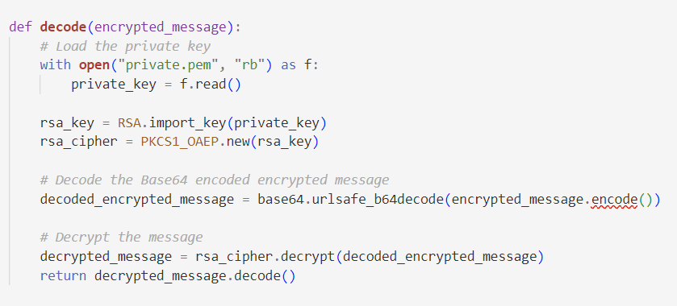
RSA Encryption
Notes:
And decrypt in the same way

Slide 25
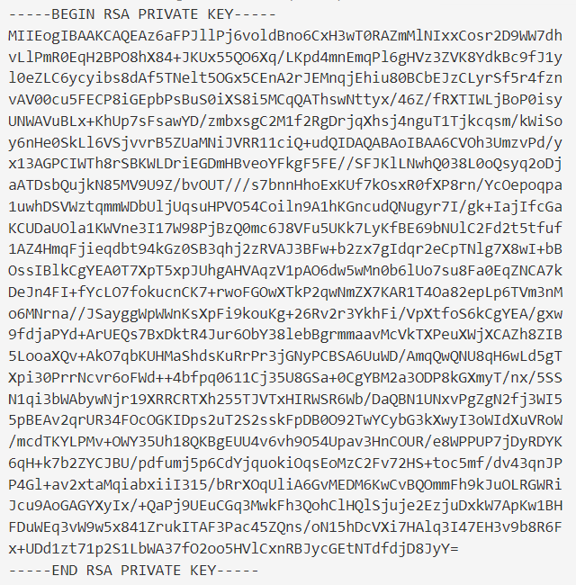
RSA Encryption
- keys
Notes:
The keys we stored in the files are like this

Slide 26
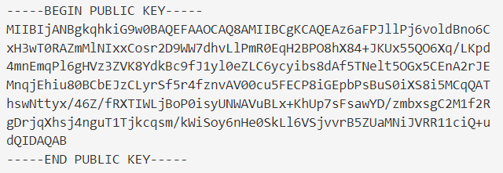
RSA Encryption
- keys
Notes:
But one tricky thing is, it might be unsafe to just store them in the file when the file can be easily accessed, so it actually can be improved in future.

Slide 27
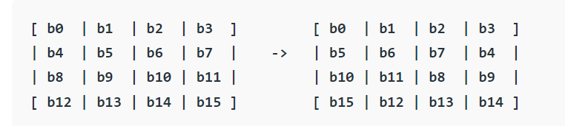
AES Encryption

Slide 28
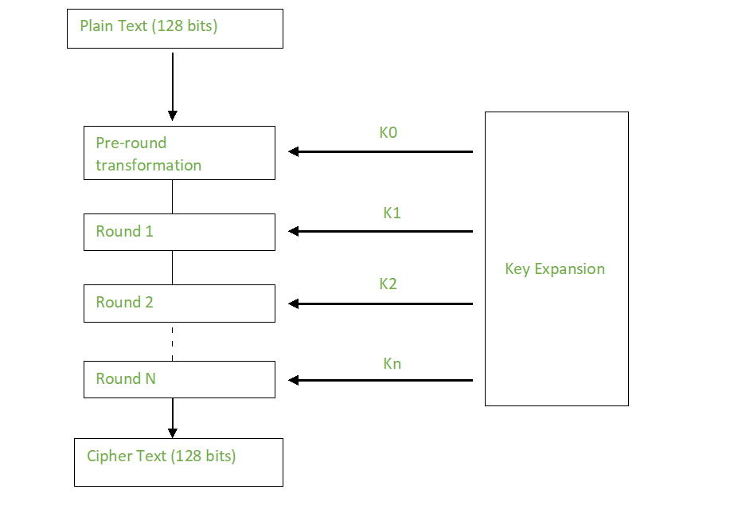
AES Encryption

Slide 29
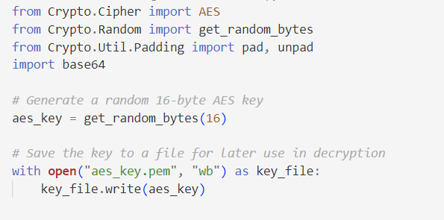
AES Encryption

Slide 30
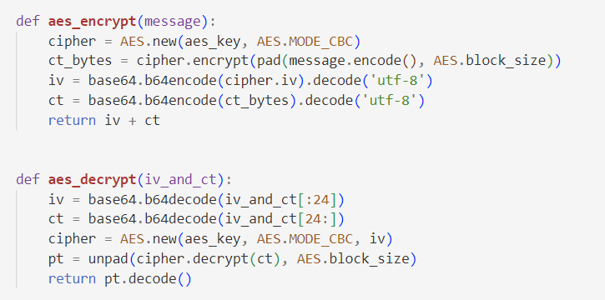
AES Encryption
Notes:
we initializes an AES cipher in Cipher Block Chaining (CBC) mode.
The message is padded to ensure its length is a multiple of the block size.
The padded message is then encrypted using the AES cipher, producing cipher text bytes.

Slide 31
STRUCTURE
ADD
MANAGER
ENCRYPT
LIST
SEARCH
Notes:
So the above is basically encryption part of our program, which is also the main and most important part. And then we will briefly introduce other parts to show how the whole manager works.

Slide 32
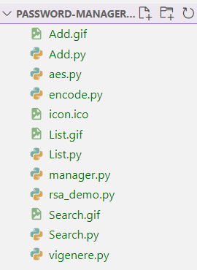
STRUCTURE
ADD
MANAGER
ENCRYPT
LIST
SEARCH
Notes:
We use other class like add, list search to implement these main functions,

Slide 33
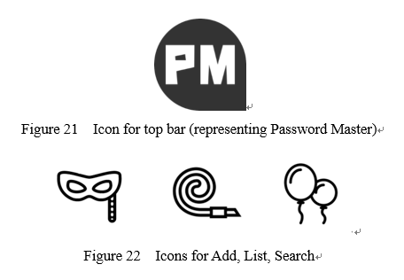
Tools
Tkinter – For GUI use, a library in Python, with a versatile set of tools for creating intuitive and user-friendly interfaces, allowing to organize distinct windows for functionalities such as log in, add, list, and search.
Photoshop, Illustrator – For simple Icon design
Notes:
And the tool we use , firstly is the Tkinter library, which can provide us with graphic interface, but only useful for windows. And also we use some graphic design software like photoshop to make our application more interesting.

Slide 34
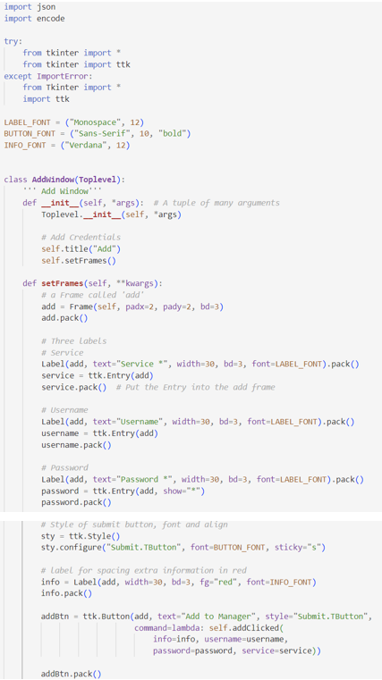
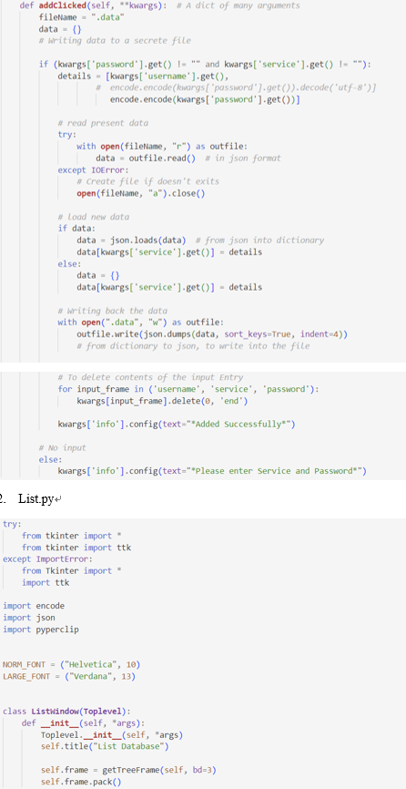
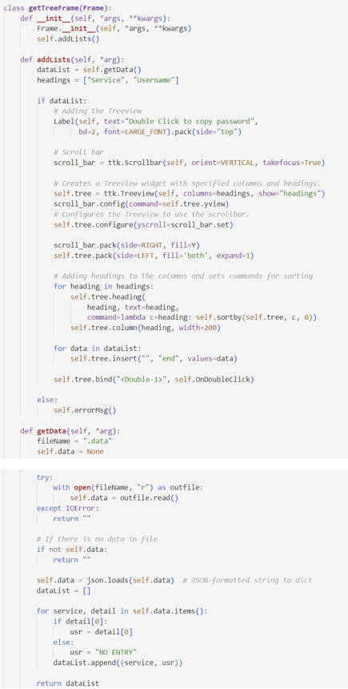

Slide 35
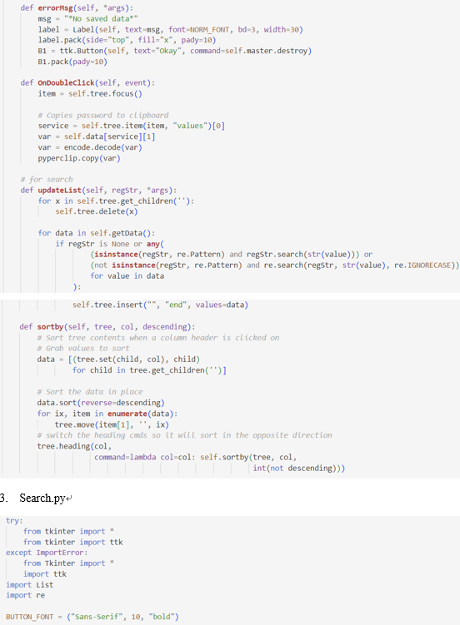
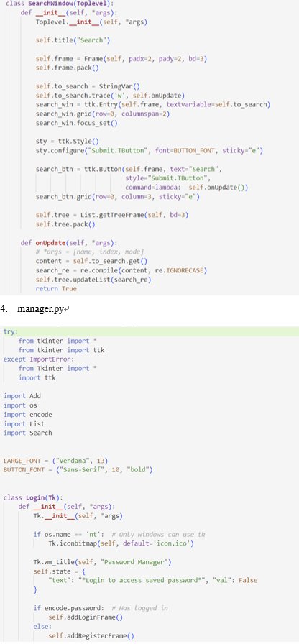
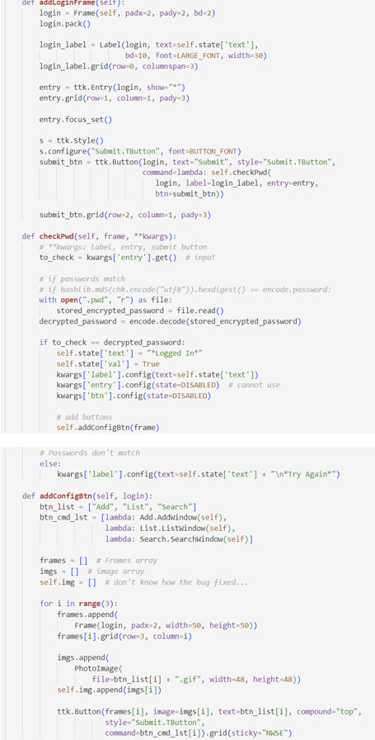

Slide 36
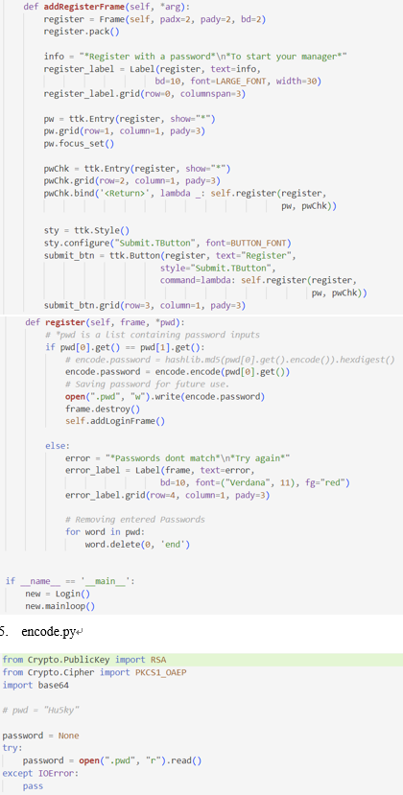
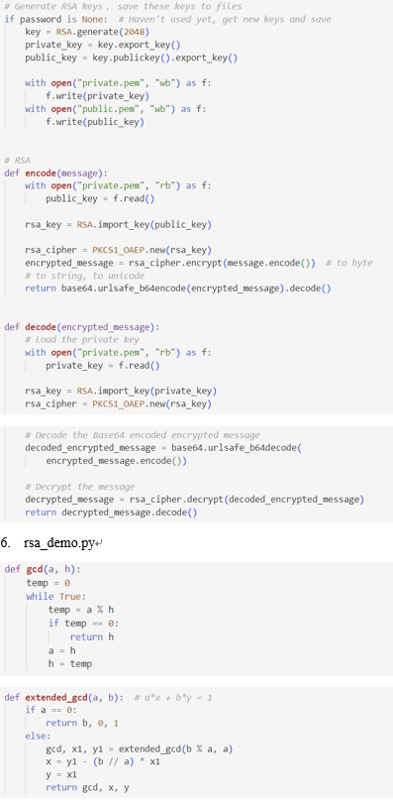
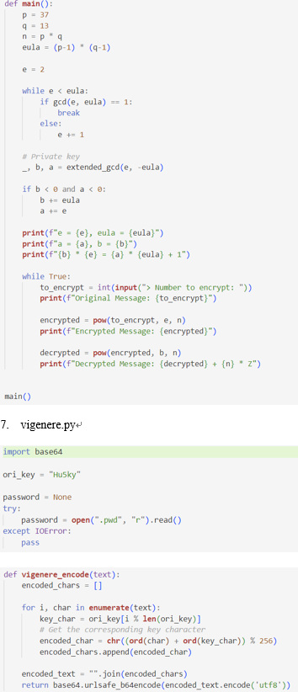
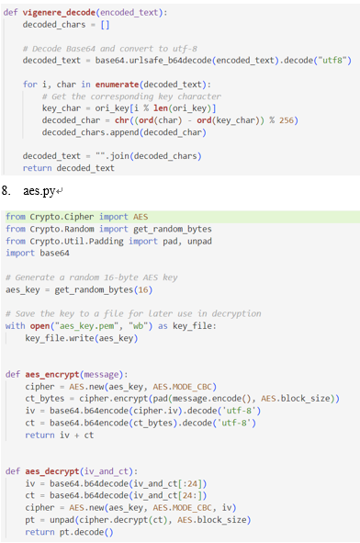

Slide 37
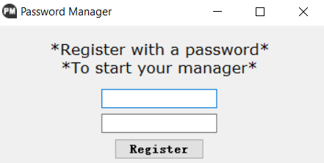
Work Flow

Slide 38
Work Flow

Slide 39
Work Flow

Slide 40
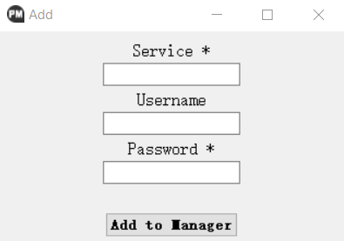
Work Flow

Slide 41
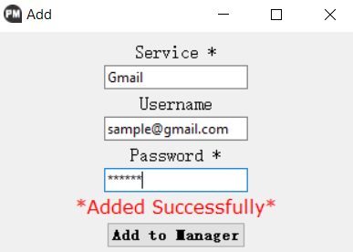
Work Flow

Slide 42
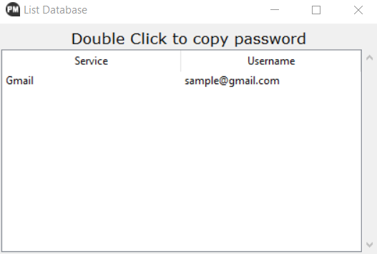
Work Flow

Slide 43
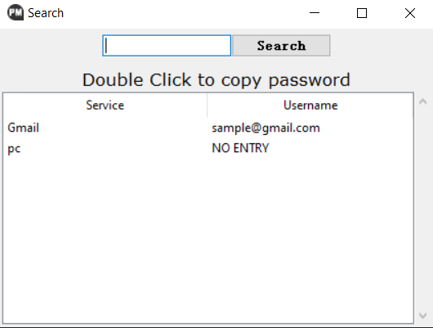
Work Flow

Slide 44
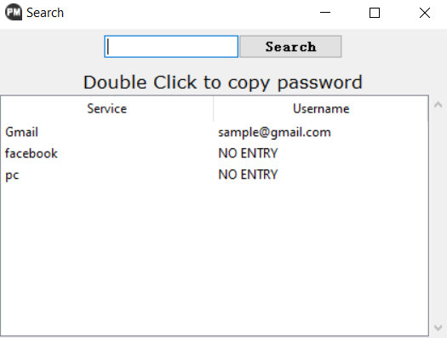
Work Flow

Slide 45

Work Flow

Slide 46
RESULT
We successfully build a password manager that can work properly :D
ADD
MANAGER
ENCRYPT
LIST
SEARCH

Slide 47
RESULT
Weakness and Limitation
Have not figure out how to keep the keys safe in files;
Other convenient functions. E.g. autofill, auto-generate, security level….

Slide 48
reference
Vigenère Cipher Concept: https://en.wikipedia.org/wiki/Vigen%C3%A8re_cipher
Vigenère Cipher: https://www.geeksforgeeks.org/vigenere-cipher/
RSA Algorithm Cryptography Concept: https://en.wikipedia.org/wiki/RSA_(cryptosystem)
RSA Algorithm Cryptography: https://www.geeksforgeeks.org/rsa-algorithm-cryptography/
AES Algorithm Cryptography Concept: https://en.wikipedia.org/wiki/Advanced_Encryption_Standard
AES Algorithm Cryptography: https://www.geeksforgeeks.org/advanced-encryption-standard-aes/
Password Manager structure:
https://github.com/ashutoshkrris/Password-Manager-using-Tkinter
https://github.com/mukkachaitanya/Password-Manager/tree/master
8. Tkinter Usage: http://stupidpythonideas.blogspot.in/2013/12/tkinter-validation.html
9. Tkinter Usage, binding a key to a button: http://stackoverflow.com/questions/11456631/how-to-capture-events-on-tkinter-child-widgets

Slide 49
5002 Final Project Presentation
Thank you!
Ruotian Zhang
Zhiliang Yu
2023 Fall CS Align

