Slide 1
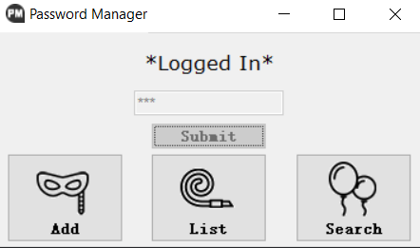
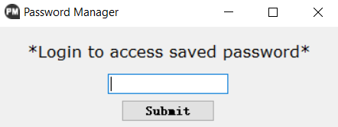
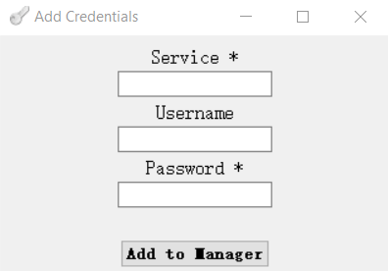
5002 Final Project Presentation
Password Manager Master
Instructor: Sarita Singh
Ruotian Zhang
Zhiliang Yu
2023 Fall CS Align

Slide 2
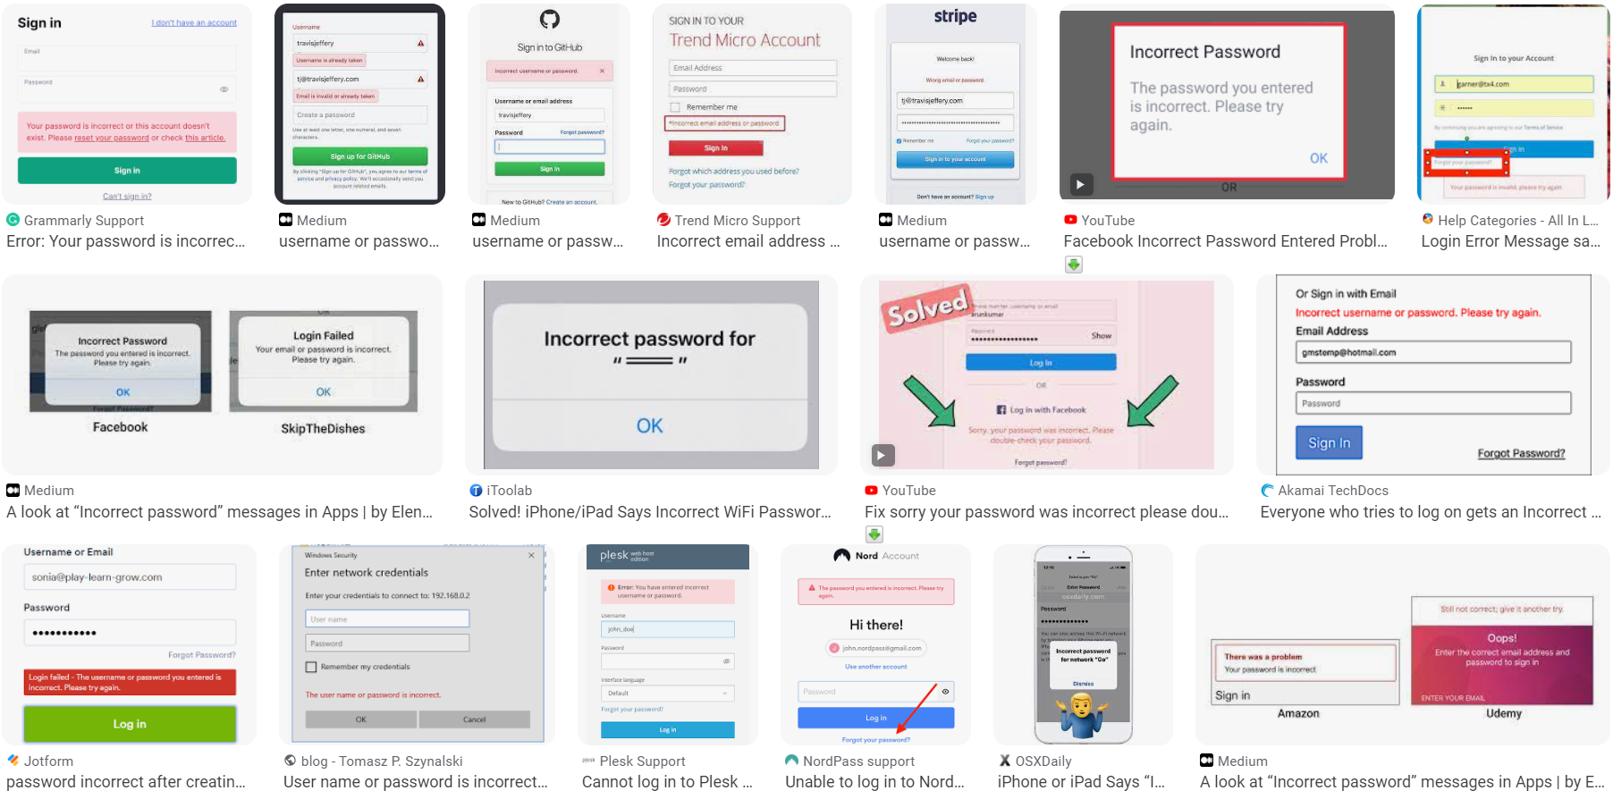
!!!!!!!!!!!!!!!!!!!!!!!!!!!! PASSWORD INCORRECT !!!!!!!!!!!!!!!!!!!!!!!!!!!!!!!!!!!!!!!!!!!

Slide 3
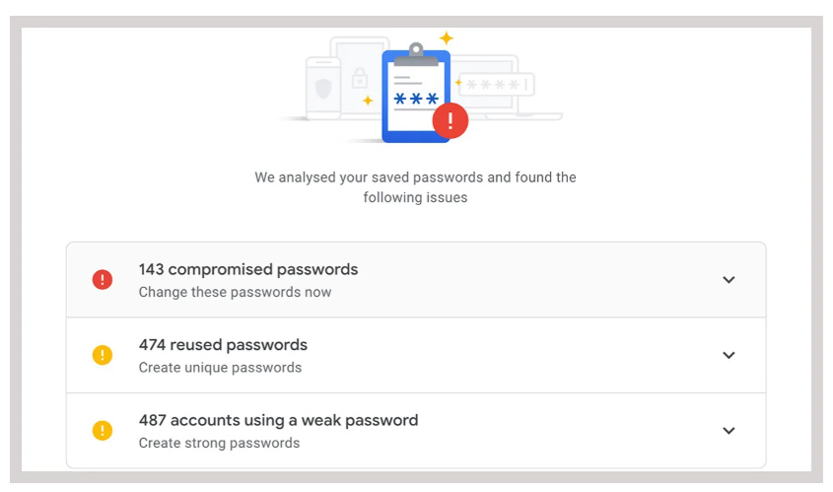
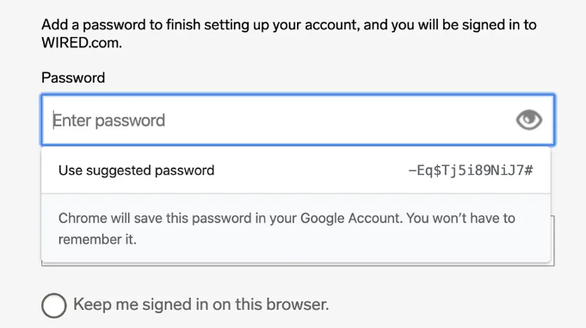

Slide 4
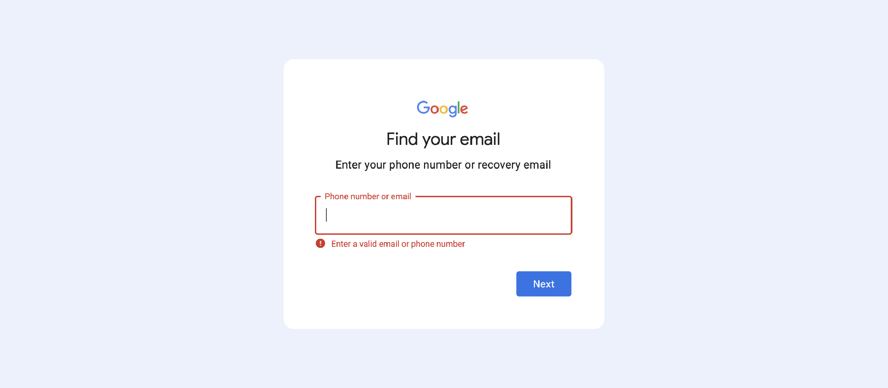

Slide 5
AIM
A program that can help people manage password
With the knowledge about cryptography we learnt in 5002

Slide 6
STRUCTURE
ADD
MANAGER
ENCRYPT
LIST
SEARCH

Slide 7
STRUCTURE
ADD
ENCRYPT
MANAGER
LIST
Vigenere Cipher
RSA Encryption
SEARCH
AES Encryption

Slide 8
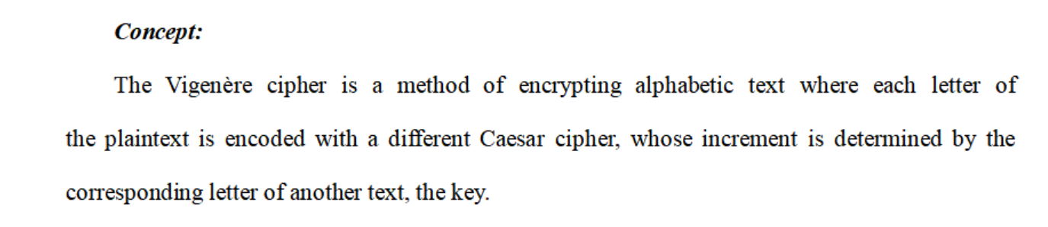
Vigenere cipher

Slide 9
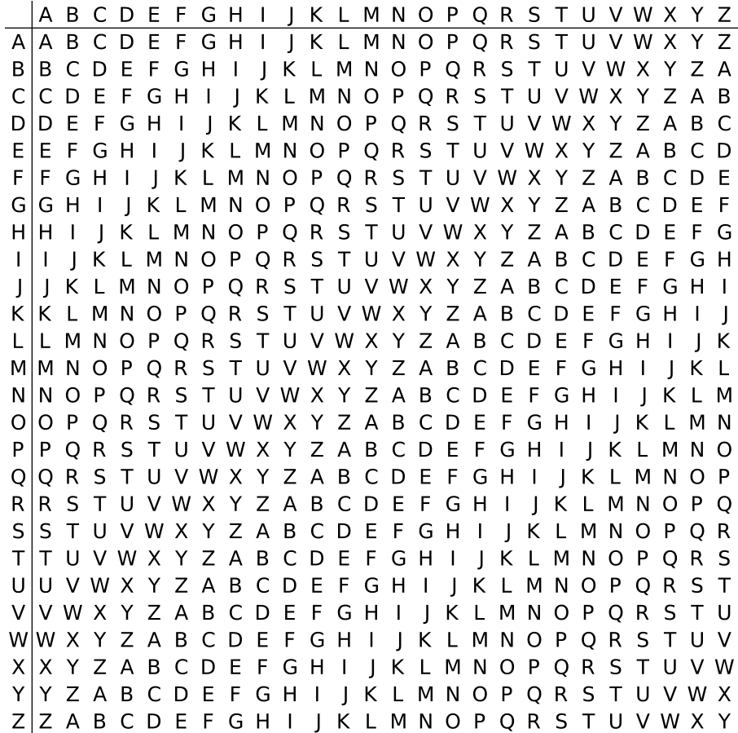
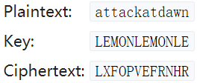
Vigenere cipher
Plaintext:
Key:

Slide 10
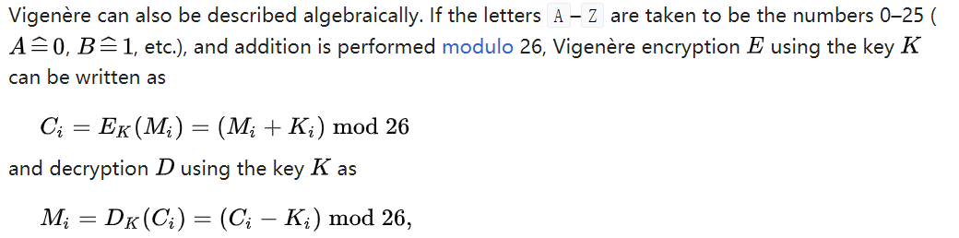
Vigenere cipher

Slide 11

Vigenere cipher (simple one)
- encode
Notes:
To use it in our program, At first, we set an original key to use it for encryption and decryption, and obviously it generates from husky.

Slide 12
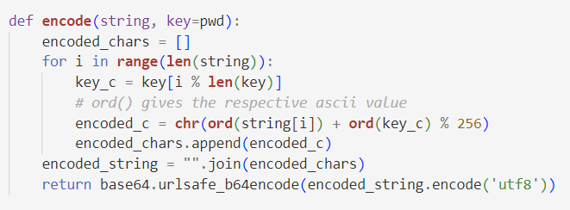
Vigenere cipher (simple one)
- encode
Notes:
And in the encrypt part, it takes a plain text input, which is the password the user typed in. It go through every character in the input string, and add the ascii value of the original key, which is husky, to the ascii value of every character we want to encode, and finally transfer the modified ascii value back into character.

Slide 13
Vigenere cipher (simple one)
- encode
Notes:
One thing to notice is the last step. when dealing with text data in Python, it's often stored as Unicode characters. By encoding the text into bytes using UTF-8 and then applying Base64 encoding, it ensures that the input is a binary representation of the text, and make sure these text won’t have issues or be misinterpreted, and to get a range of consistent output.

Slide 14
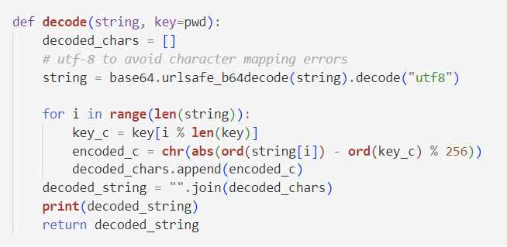
Vigenere cipher (simple one)
- decode
Notes:
So the decrypt part is basically an inverse of the encryption after transfer the string into bytes, quite straightforward

Slide 15
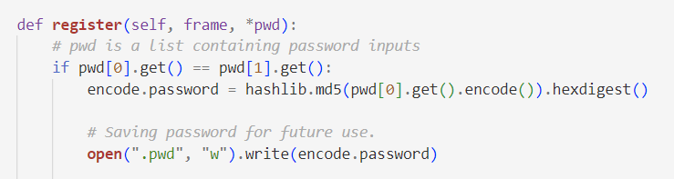
Vigenere cipher (simple one)
- match
Notes:
When the user use this program for the first time, they need to set a personal password, and we save it into a file named .pwd. The hash we use in the program is for security reasons, to avoid storing plaintext directly, making it for maybe an attacker to reverse the process and obtain the original password.

Slide 16
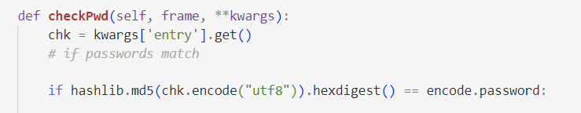
Vigenere cipher (simple one)
- match
Notes:
At last, if it is not the first time the user open this program, we compare if the user typed the right password. If they match, then the user can visit the database they saved before. These are the Vigenere cipher part, which is a quite simple one and we originally implemented it just for test.

Slide 17
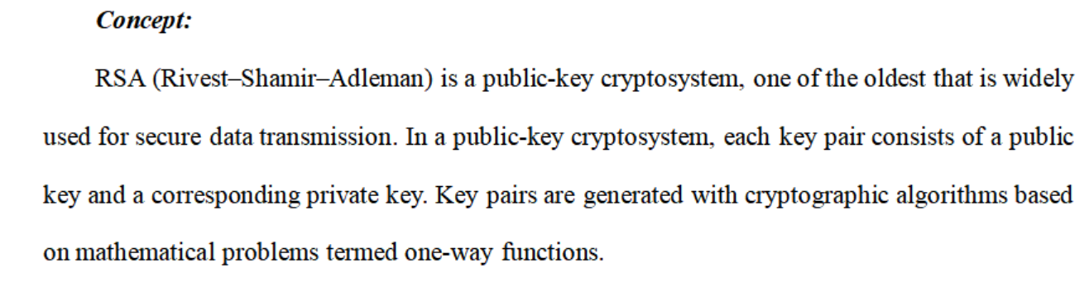
RSA Encryption

Slide 18


p
q
RSA Encryption
n = pq
Key generation
φ(n)=(p−1)(q−1)
integer e such that 1 < e < φ(n) and gcd(e, φ(n)) = 1
Key distribution
de ≡ 1 mod φ(n)
Encryption
Public key (n, e)
Private key (n, d)
Decryption

Slide 19
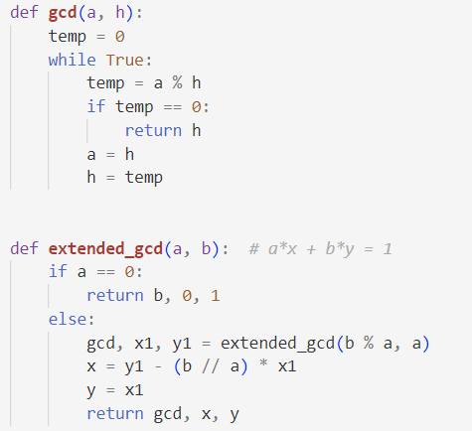
RSA Encryption (Demo)
Notes:
In our program, We first write a demo to implement the rsa algorithm. We write some functions to get the gcd,

Slide 20
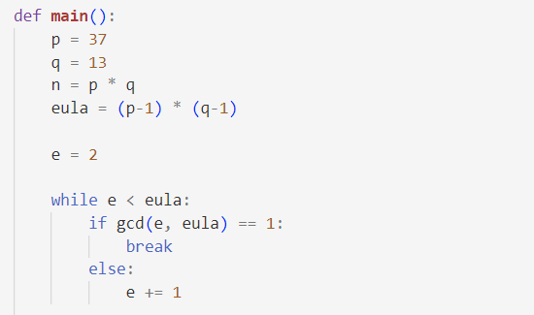
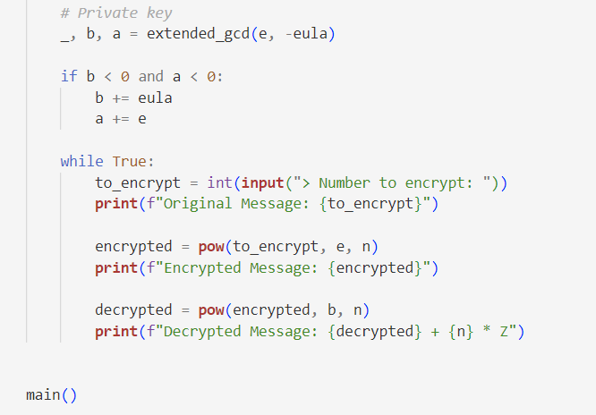
RSA Encryption (Demo)
Notes:
And a simple process as we’ve introduced before to make it possible to accomplish the encrypt and decrypt process.

Slide 21
RSA Encryption (Demo)
Problem
They need to be big enough to handle various kinds of passwords
Notes:
But the problem is that, only if we give big enough numbers can we handle complicated enough or even just normal passwords.

Slide 22

RSA Encryption
- encode
Notes:
So eventually, we choose the python library for formal use

Slide 23
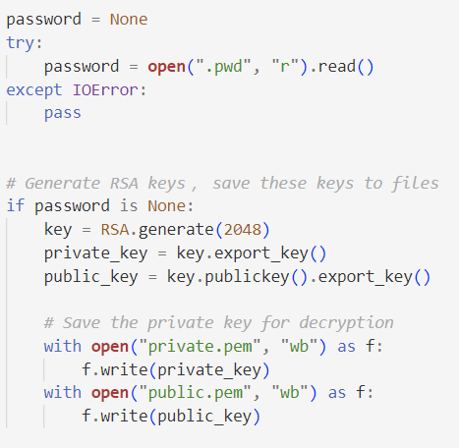
RSA Encryption
- encode
Notes:
If is the first time the user open the program, it will generate a public key and a private key first and save it to files for future use.

Slide 24
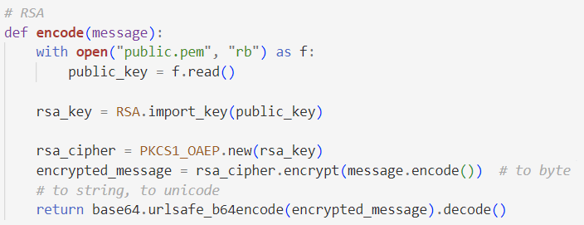
RSA Encryption
- encode
Notes:
And then the implemented encrypt function will encrypt the password for us.

Slide 25
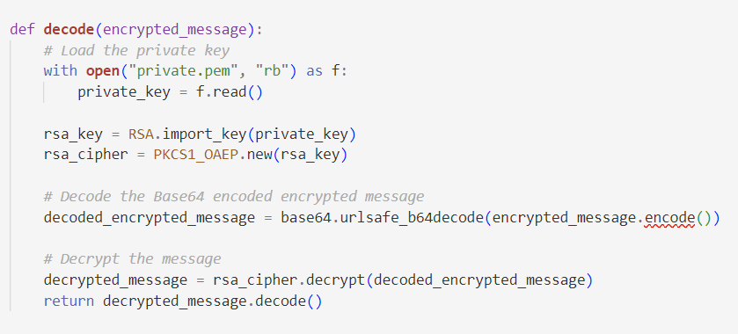
RSA Encryption
Notes:
And decrypt in the same way

Slide 26
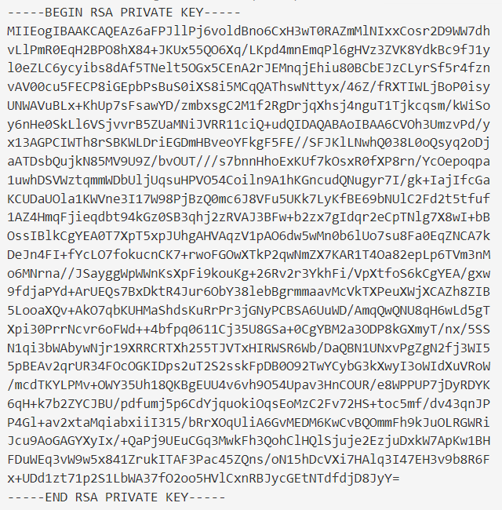
RSA Encryption
- keys
Notes:
The keys we stored in the files are like this

Slide 27
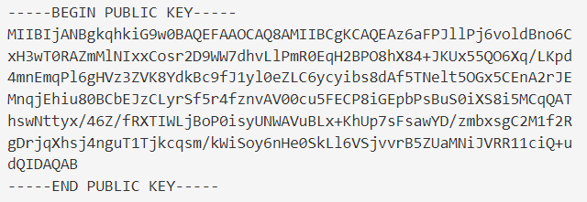
RSA Encryption
- keys
Notes:
But one tricky thing is, it might be unsafe to just store them in the files when the files can be easily accessed, so it actually can be improved in future.

Slide 28
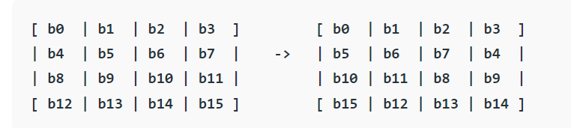
AES Encryption

Slide 29
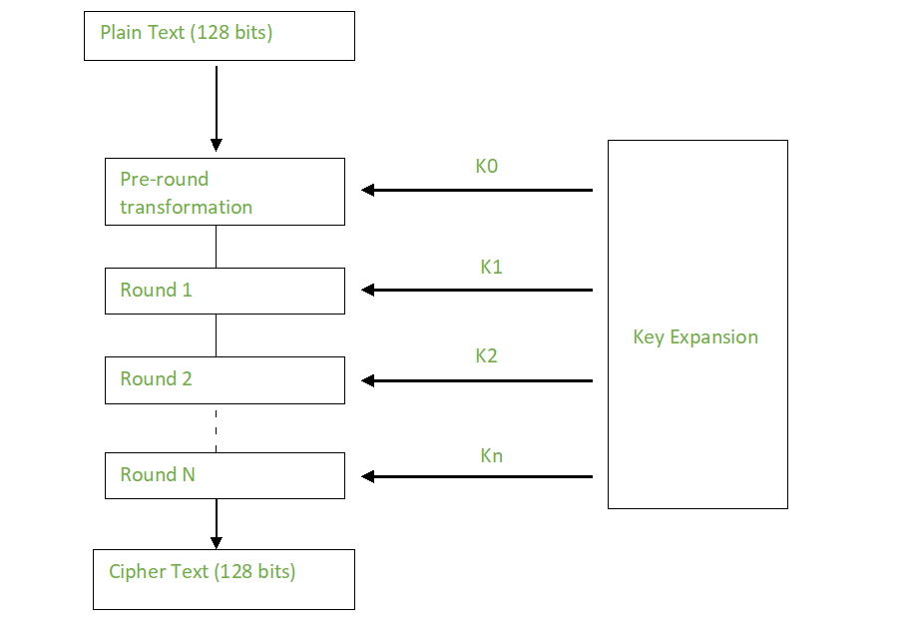
AES Encryption

Slide 30
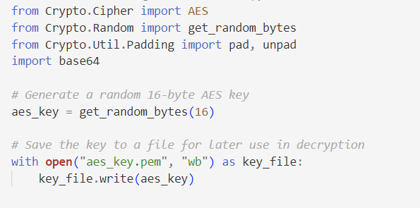
AES Encryption

Slide 31
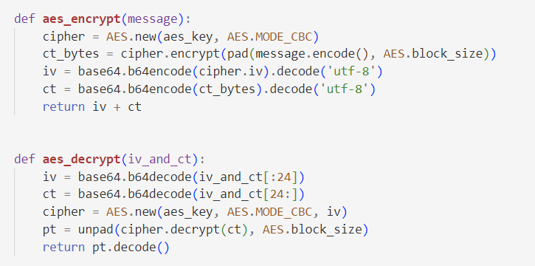
AES Encryption
Notes:
In our implementation, we initializes an AES cipher and
The message is padded to ensure its length is a multiple of the block size.
The padded message is then encrypted using the AES cipher, producing cipher text bytes.

Slide 32
Vigenere cipher
RSA Encryption
AES Encryption
Notes:
So in these three encryption algorithm, we choose the RSA as our final implementation, considering its security and complexity

Slide 33
STRUCTURE
ADD
MANAGER
ENCRYPT
LIST
SEARCH
Notes:
So the above is basically encryption part of our program, which is also the main and most important part. And then we will briefly introduce other parts to show how the whole manager works.

Slide 34
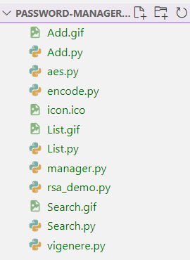
STRUCTURE
ADD
MANAGER
ENCRYPT
LIST
SEARCH
Notes:
We use other class like add, list, and search to implement these main functions,

Slide 35
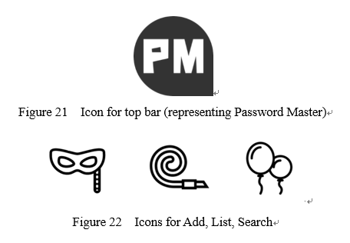
Tools
Tkinter – For GUI use, a library in Python, with a versatile set of tools for creating intuitive and user-friendly interfaces, allowing to organize distinct windows for functionalities such as log in, add, list, and search.
Photoshop, Illustrator – For simple Icon design
Notes:
And the tool we use , firstly is the Tkinter library, which can provide us with graphic interface, but only useful for windows. And also we use some graphic design software like photoshop to make our application more interesting.

Slide 36
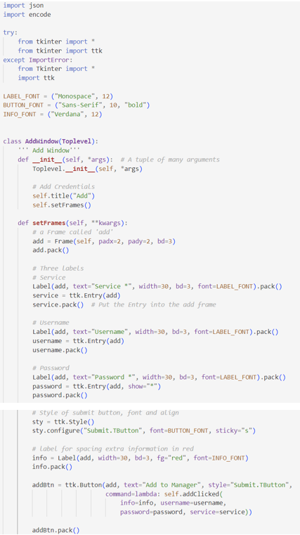
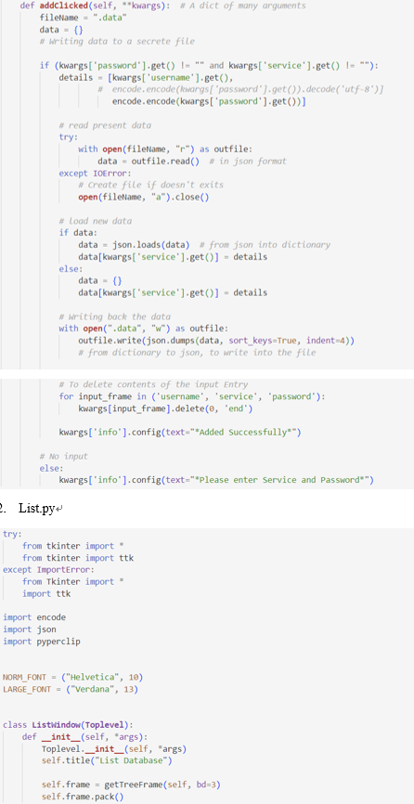
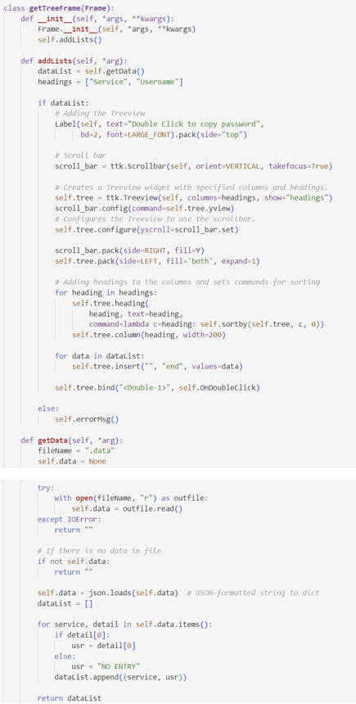
Notes:
And these are code for other parts and we won’t go into detail of them

Slide 37
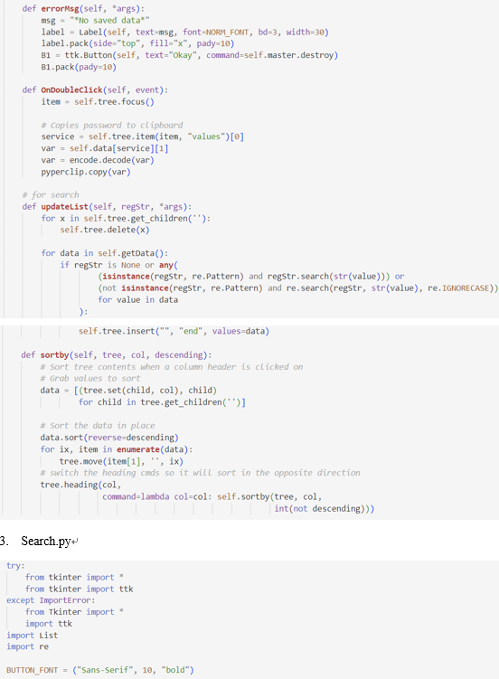
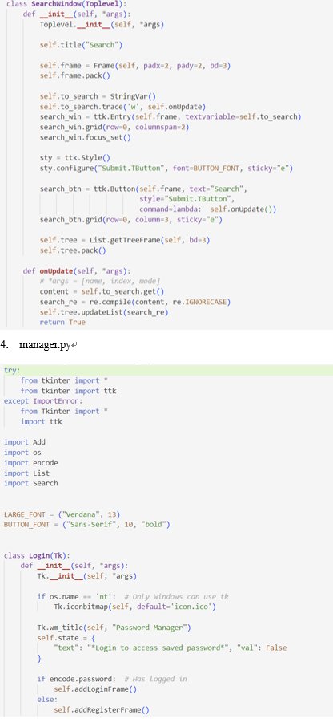
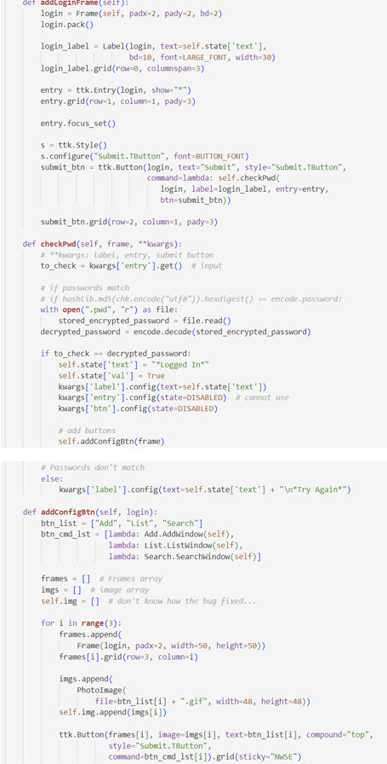
Notes:
And these are code for other parts and we won’t go into detail of them

Slide 38
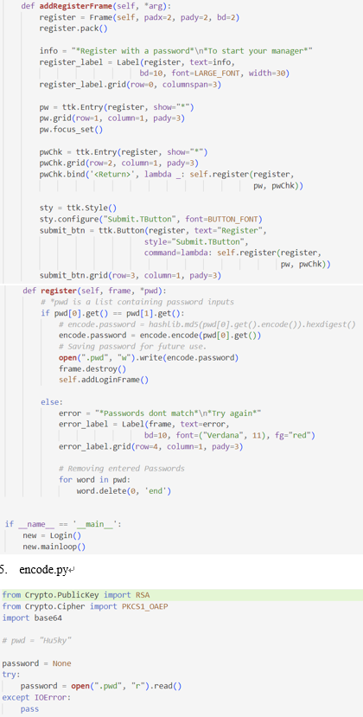
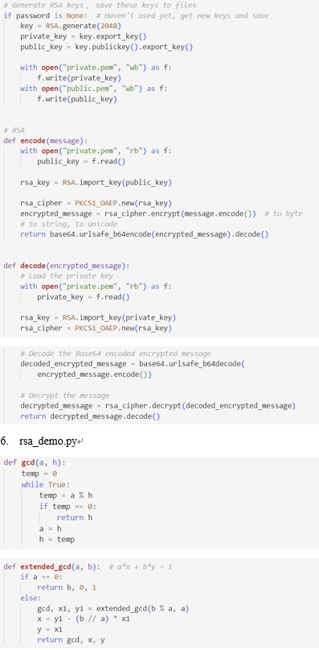
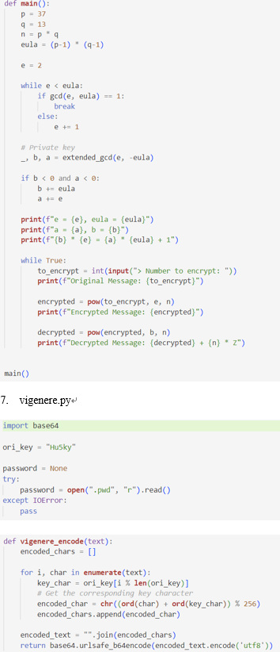
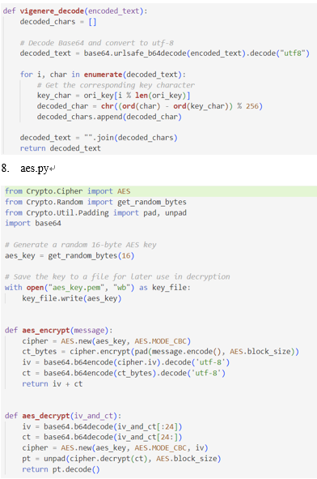
Notes:
And these are code for other parts and we won’t go into detail of them

Slide 39
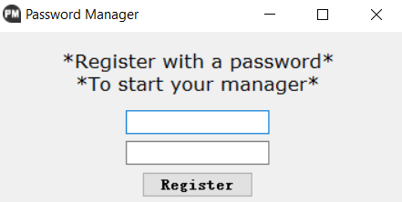
Work Flow
Notes:
Now we are gonna show how it really works

Slide 40
Work Flow

Slide 41
Work Flow

Slide 42
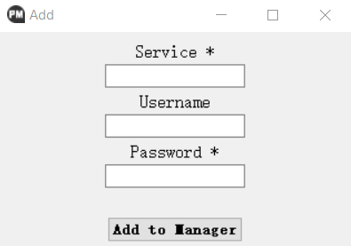
Work Flow

Slide 43
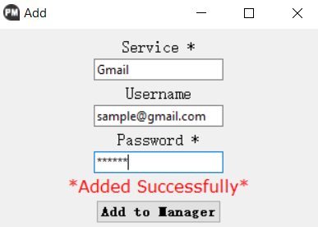
Work Flow

Slide 44
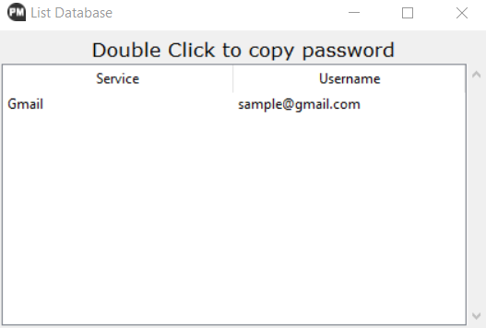
Work Flow

Slide 45
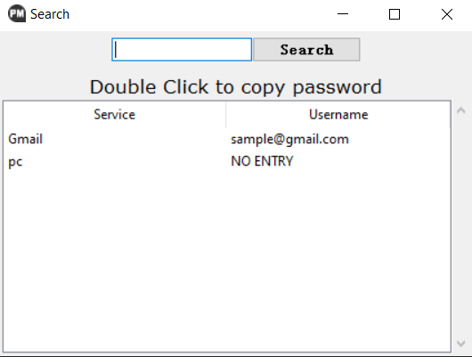
Work Flow

Slide 46
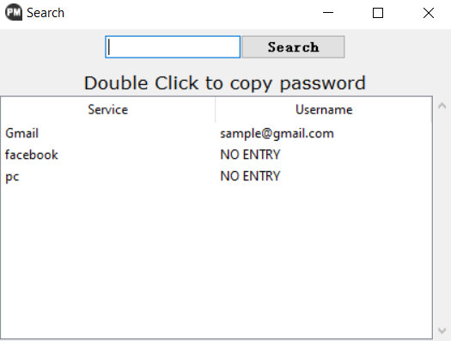
Work Flow

Slide 47

Work Flow

Slide 48
RESULT
We successfully build a password manager that can work properly :D
ADD
MANAGER
ENCRYPT
LIST
SEARCH
Notes:
The result, as you can see, we build a program that can indeed manage our passwords, at least there is no bug and it works properly

Slide 49
RESULT
Weakness and Limitation
Have not figure out how to keep the keys safe in files;
Other convenient functions. E.g. autofill, auto-generate, security level….
Notes:
And for the weakness, of course there are a lot, like for now we are not protecting our key files, which can be easily accessed; and also there are a lot of convenient function that we can add to it. So it has a large room to be improved

Slide 50
reference
Vigenère Cipher Concept: https://en.wikipedia.org/wiki/Vigen%C3%A8re_cipher
Vigenère Cipher: https://www.geeksforgeeks.org/vigenere-cipher/
RSA Algorithm Cryptography Concept: https://en.wikipedia.org/wiki/RSA_(cryptosystem)
RSA Algorithm Cryptography: https://www.geeksforgeeks.org/rsa-algorithm-cryptography/
AES Algorithm Cryptography Concept: https://en.wikipedia.org/wiki/Advanced_Encryption_Standard
AES Algorithm Cryptography: https://www.geeksforgeeks.org/advanced-encryption-standard-aes/
Password Manager structure:
https://github.com/ashutoshkrris/Password-Manager-using-Tkinter
https://github.com/mukkachaitanya/Password-Manager/tree/master
8. Tkinter Usage: http://stupidpythonideas.blogspot.in/2013/12/tkinter-validation.html
9. Tkinter Usage, binding a key to a button: http://stackoverflow.com/questions/11456631/how-to-capture-events-on-tkinter-child-widgets
Notes:
At last is our references

Slide 51
5002 Final Project Presentation
Thank you!
Ruotian Zhang
Zhiliang Yu
2023 Fall CS Align
Notes:
Thank you all for listening.

