Slide 1


Interactive Learning Exercise for Children With Autism
A Train Game
Jacob Karstensen Wortmann
Nicklas Andersen
Jesper Riemer Andersen
Simon Reedtz Olesen

Slide 2
Agenda
GIRAF
Game Design
OpenGL ES
Game Implementation
Conclusion
demonstration
Department of computer science
AALBORG UNIVERSITy

Slide 3
GIRAF
Simon Reedtz Olesen

Slide 4
The GIRAF project
Vision
Agile development
Scrum
Weekly meetings
Committees
Redmine
GIT
continuous integration
Department of computer science
AALBORG UNIVERSITy

Slide 5
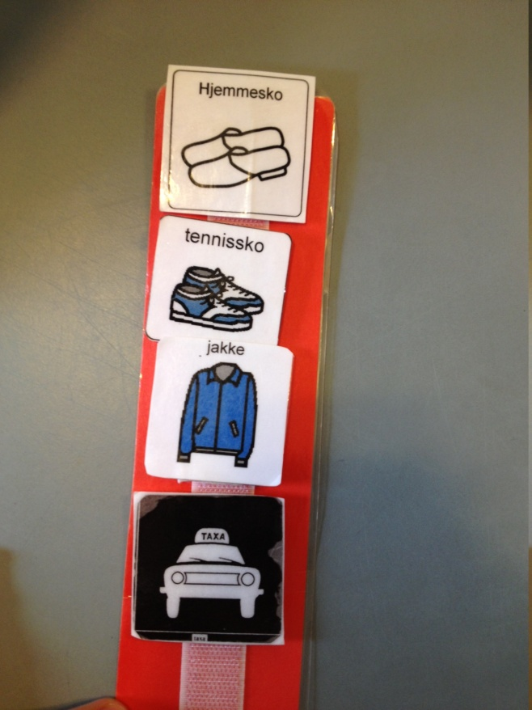
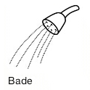
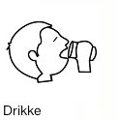

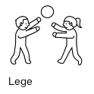
Pictograms
Department of computer science
AALBORG UNIVERSITy

Slide 6
Train
Problem Statement:
“In what ways can we aid the pedagogues in their work with children with autism, by digitalizing a physical exercise onto an android tablet?”
Department of computer science
AALBORG UNIVERSITy

Slide 7
Game Design
Nicklas Andersen

Slide 8
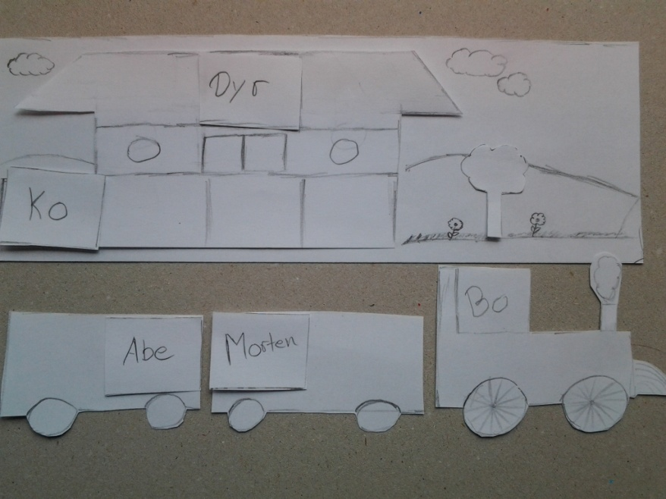
Train design
Idea
Tove Søby
Prototype
Department of computer science
AALBORG UNIVERSITy

Slide 9
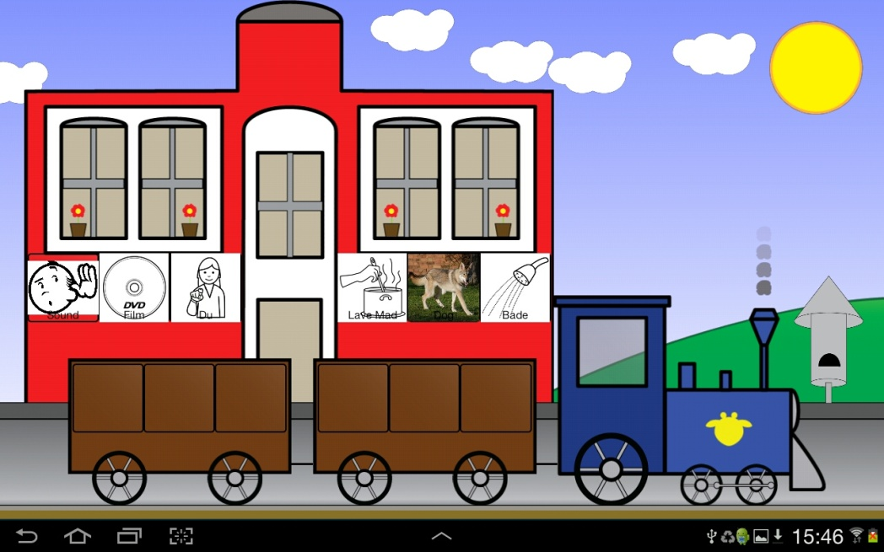
Prototype
Department of computer science
AALBORG UNIVERSITy

Slide 10
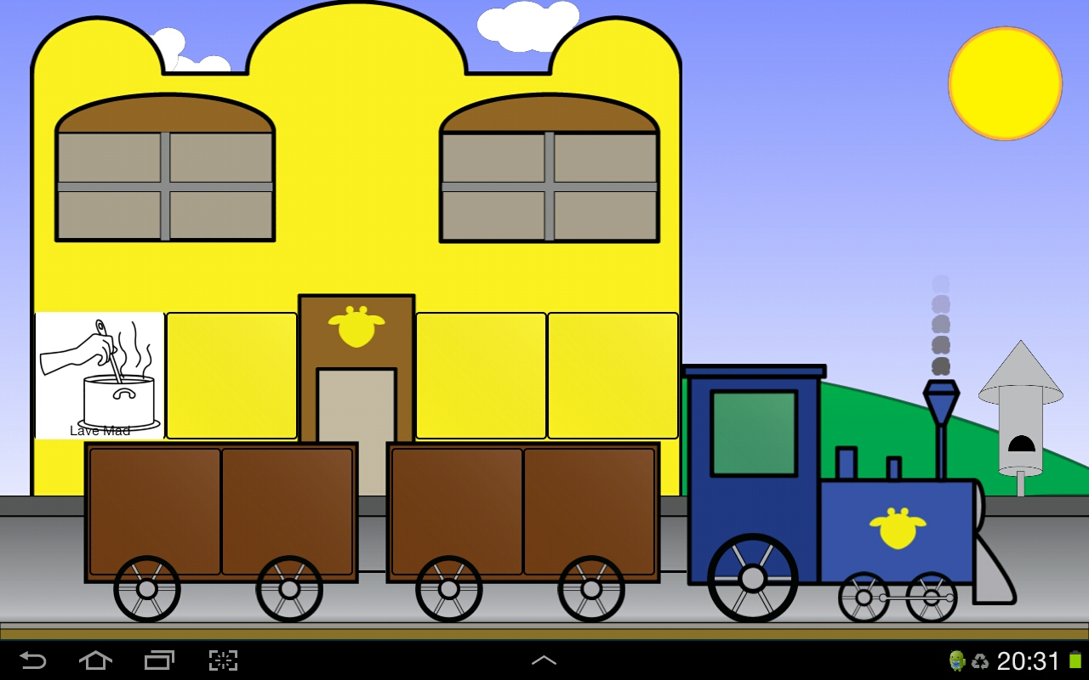
Screenshots: Part 1
Department of computer science
AALBORG UNIVERSITy

Slide 11
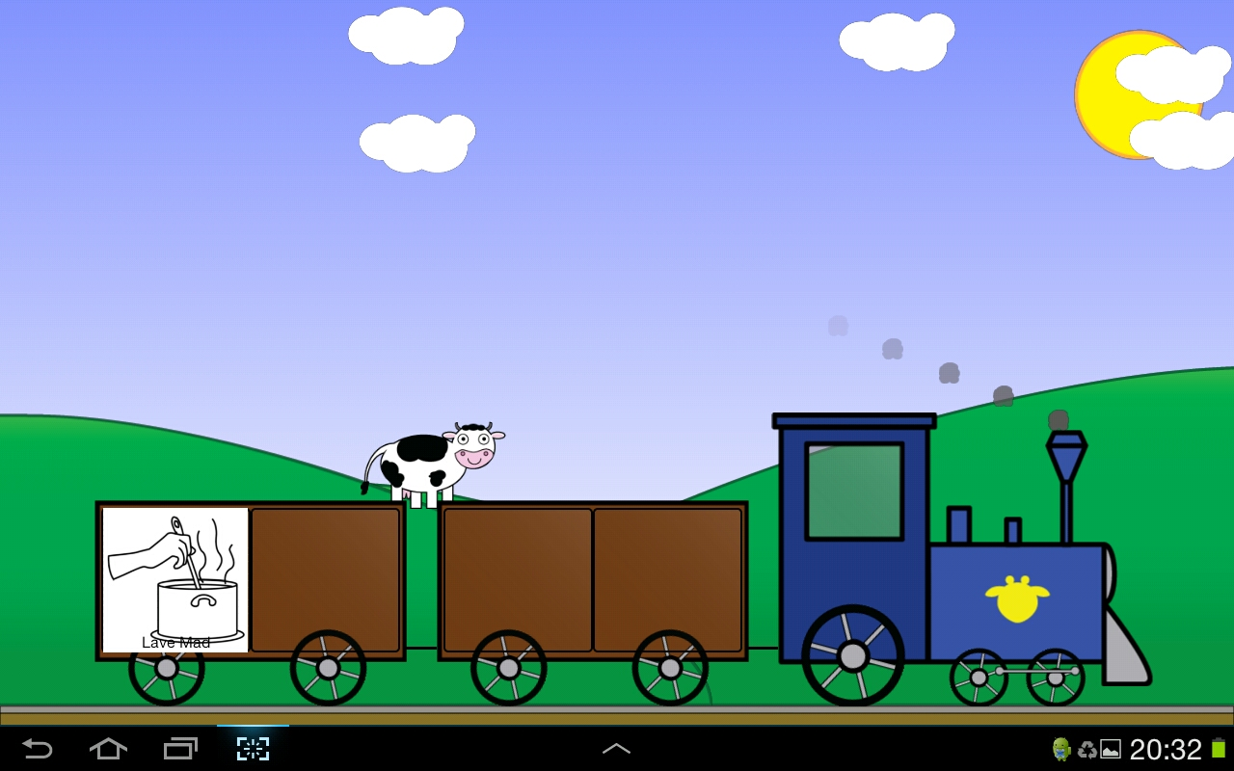
Screenshots: Part 2
Department of computer science
AALBORG UNIVERSITy

Slide 12
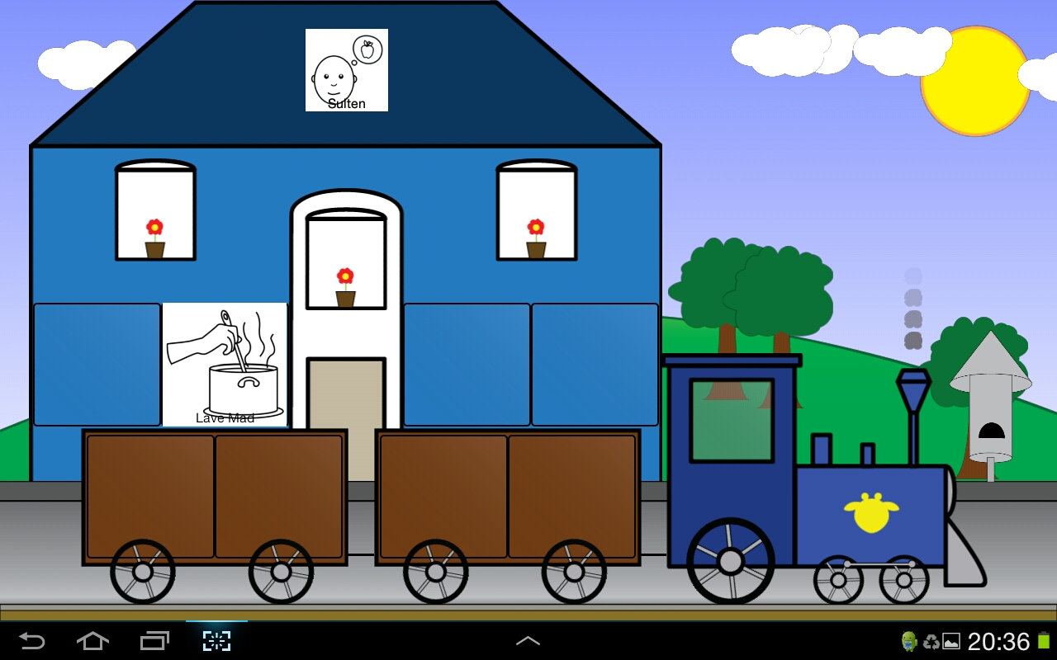
Screenshots: Part 3
Department of computer science
AALBORG UNIVERSITy

Slide 13
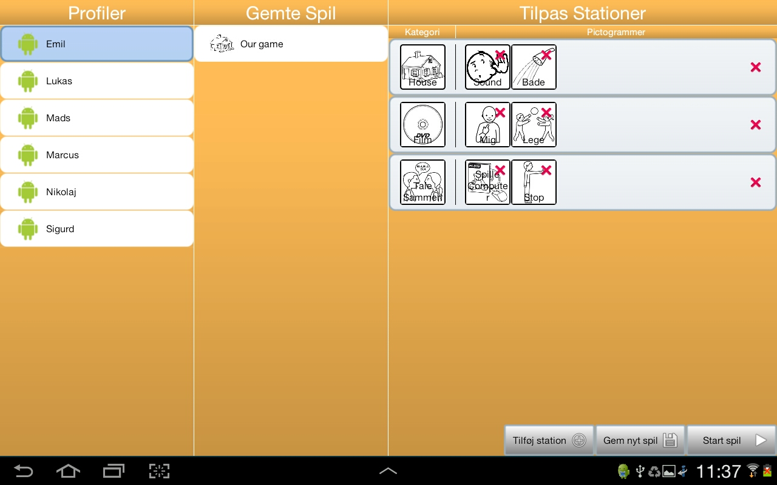
Game Customization
Department of computer science
AALBORG UNIVERSITy

Slide 14
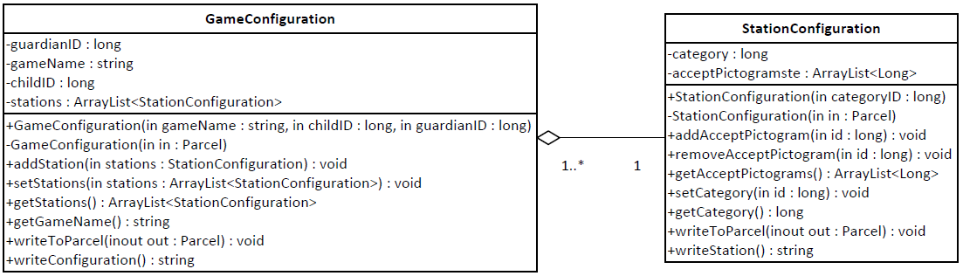
configurations
Game Configurations
Station Configurations
FORMAT:
gameID,guardianID,childID,gameName;category,pictogram,pictogram;category,pictogram\n
Department of computer science
AALBORG UNIVERSITy

Slide 15
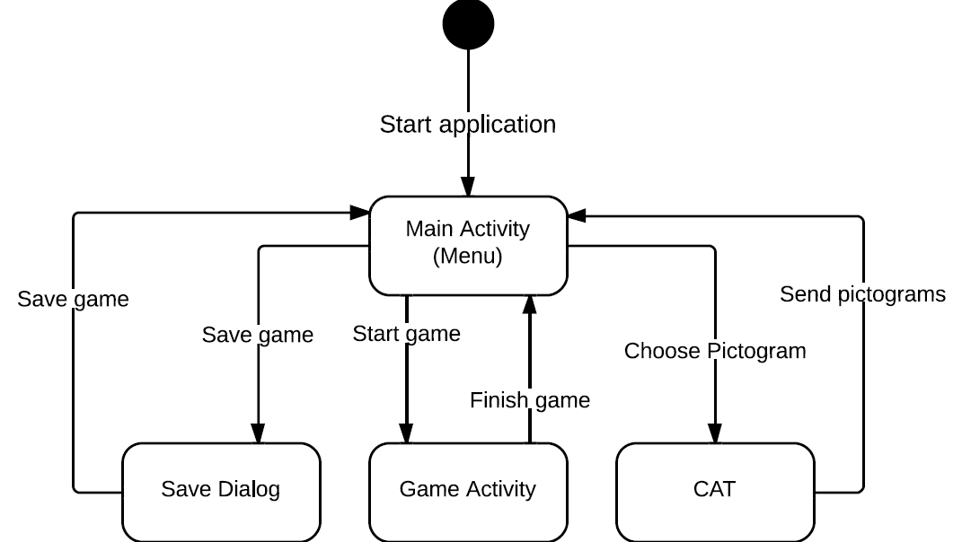
Activity Flow
Department of computer science
AALBORG UNIVERSITy

Slide 16
OpenGL ES
Jesper Riemer Andersen

Slide 17
OpenGL ES
OpenGL ES vs Surface View
OpenGL ES
Version 1.x
Department of computer science
AALBORG UNIVERSITy

Slide 18
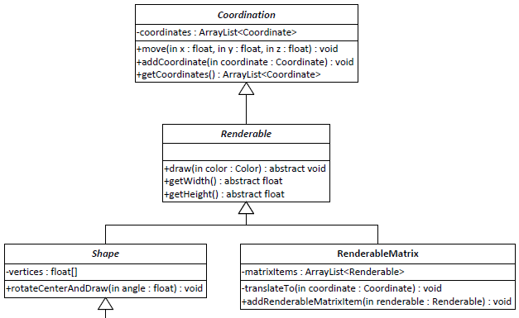
Renderables
Department of computer science
AALBORG UNIVERSITy

Slide 19
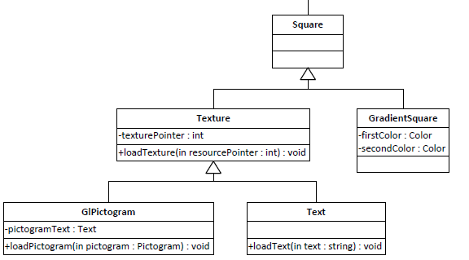
Renderables Continued
Max Texture Size
Department of computer science
AALBORG UNIVERSITy

Slide 20
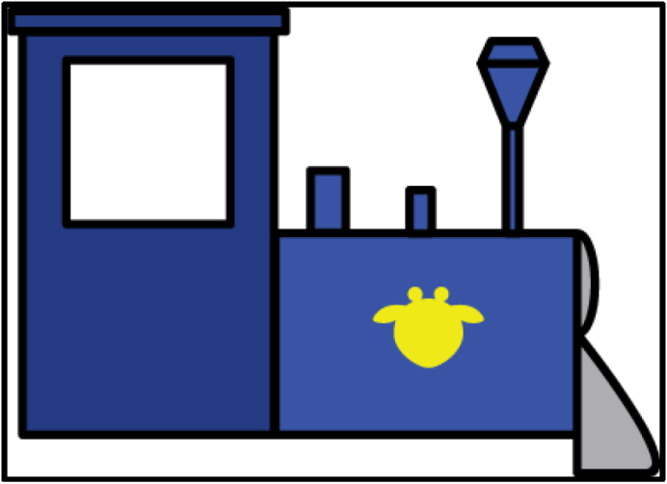
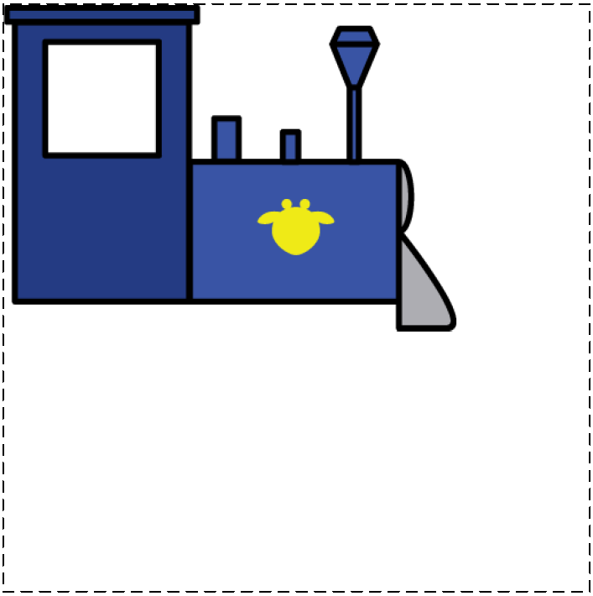
Power-of-two conversion: Part 1
Original
Converted
Texture: 396 x 284
Square: 396 x 284
512 x 512
Department of computer science
AALBORG UNIVERSITy

Slide 21

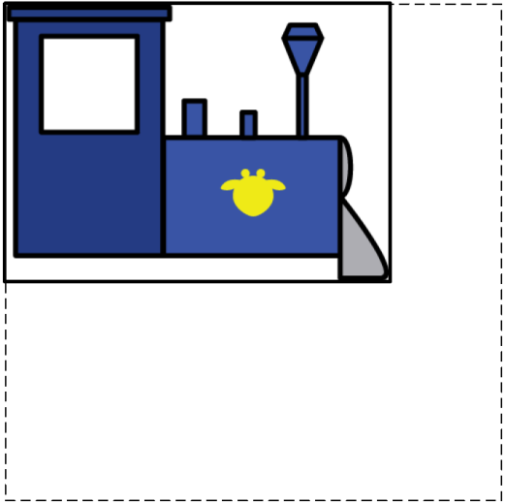
Power-of-two conversion: Part 2
Clamped
Result
Texture: 512 x 512
Square: 396 x 284
Texture: 512 x 512
Square: 396 x 284
Department of computer science
AALBORG UNIVERSITy

Slide 22

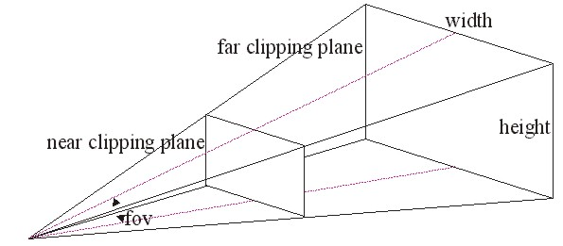
Frustum
THREE-DIMENSIONAL SPACE
MATRIX STACK
Department of computer science
AALBORG UNIVERSITy

Slide 23

Frustum
THREE-DIMENSIONAL SPACE
MATRIX STACK
Department of computer science
AALBORG UNIVERSITy

Slide 24
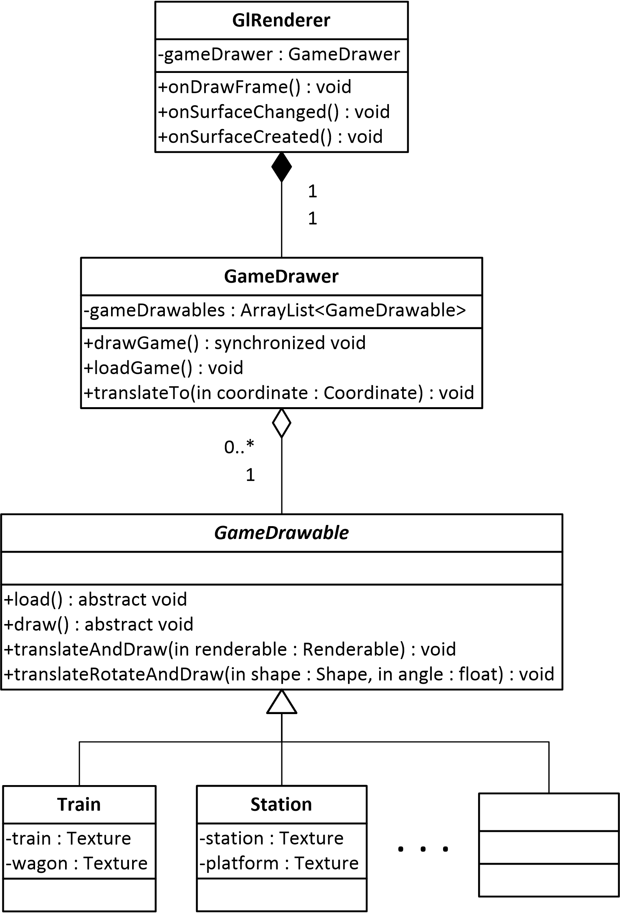
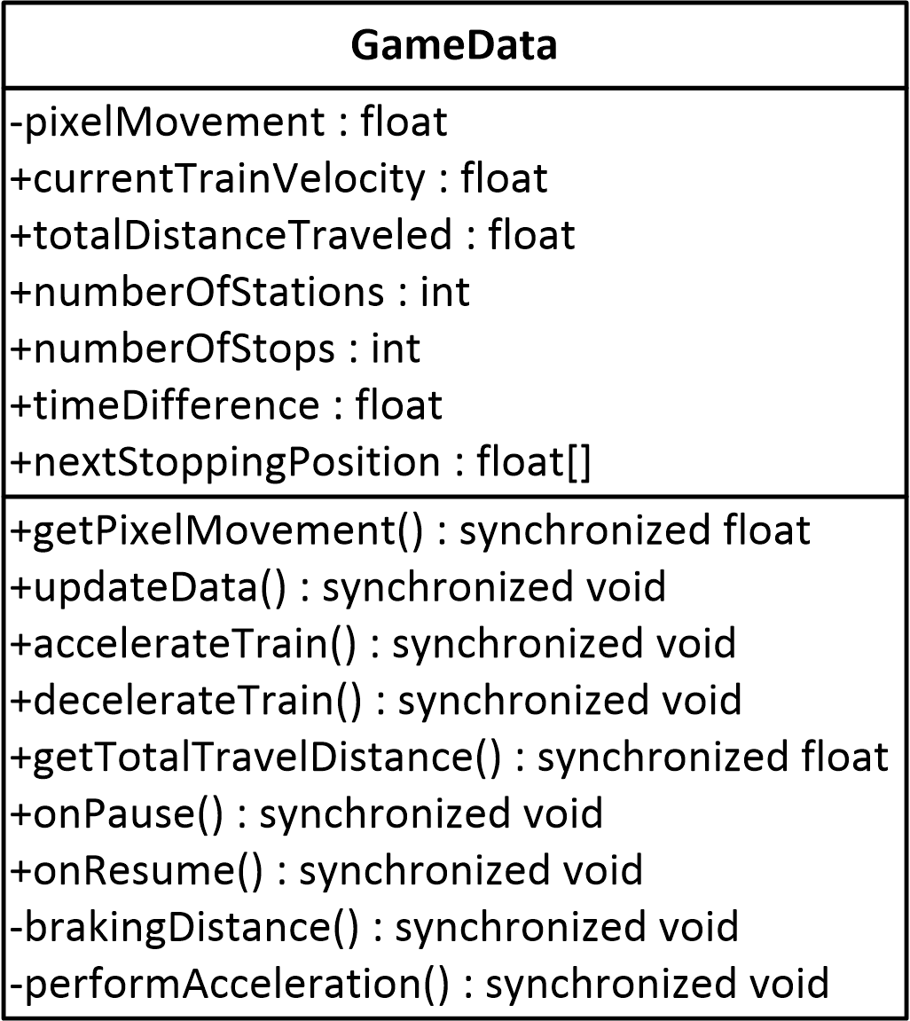
Rendering
ANDROID OPENGL ES
android.opengl.GLSurfaceView
android.opengl.GLSurfaceView.Renderer
Department of computer science
AALBORG UNIVERSITy

Slide 25
Game Implementation
Jacob Karstensen Wortmann

Slide 26
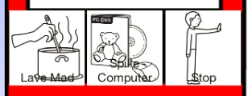
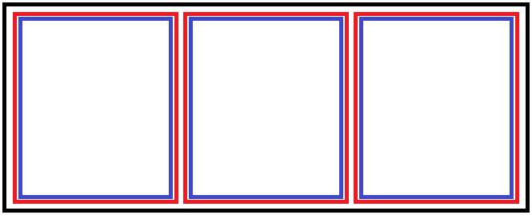
Drag and drop
Touch listener
Drag listener
Department of computer science
AALBORG UNIVERSITy

Slide 27
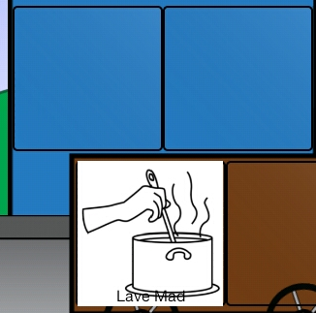
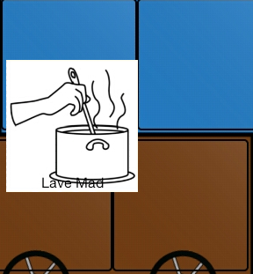
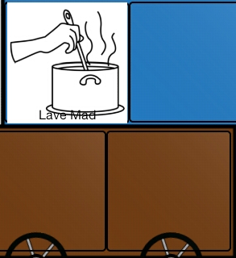
Drag events
Events
ACTION_DRAG_START
ACTION_DROP
ACTION_DRAG_ENDED
Department of computer science
AALBORG UNIVERSITy

Slide 28
Game Drawables
Trains and wagons
Wheels
Train Smoke
Station
Random sequence
Game Background
Hills
Trees
Cows
Clouds
Department of computer science
AALBORG UNIVERSITy

Slide 29
Conclusion
Jacob Karstensen Wortmann

Slide 30
Conclusion
Problem statement
Customization
Managing games
Easy to start
“In what ways can we aid the pedagogues in their work with children with autism, by digitalizing a physical exercise onto an android tablet?”
Department of computer science
AALBORG UNIVERSITy

Slide 31
Demonstration
Simon Reedtz Olesen

