Slide 1


Interactive Learning Exercise for Children With Autism
A Train Game
Jacob Karstensen Wortmann
Nicklas Andersen
Jesper Riemer Andersen
Simon Reedtz Olesen

Slide 2
GIRAF
Game Design
OpenGL ES
Implementation
Conclusion
demonstration
Agenda
GIRAF
Game Design
OpenGL ES
Implementation
Conclusion
demonstration
Department of computer science
AALBORG UNIVERSITy

Slide 3
GIRAF
Simon Reedtz Olesen

Slide 4
GIRAF
Game Design
OpenGL ES
Implementation
Conclusion
demonstration
The GIRAF project
Vision
Agile development
Scrum
Weekly meetings
Committees
Redmine
GIT
continuous integration
Department of computer science
AALBORG UNIVERSITy

Slide 5
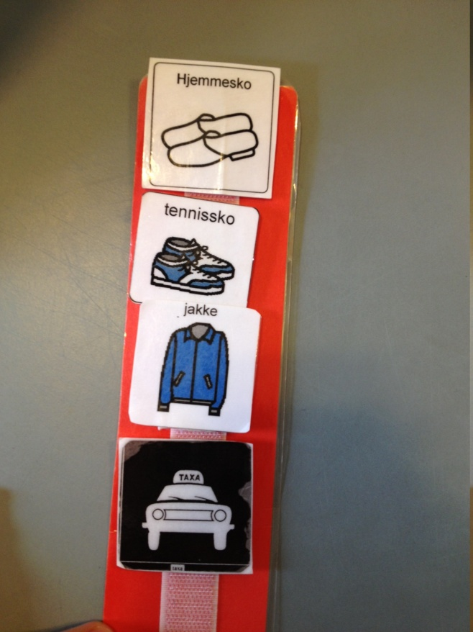
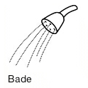
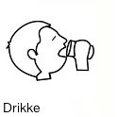

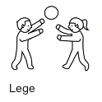
GIRAF
Game Design
OpenGL ES
Implementation
Conclusion
demonstration
Pictograms
Figure 3.1: Page 26
Department of computer science
AALBORG UNIVERSITy

Slide 6
GIRAF
Game Design
OpenGL ES
Implementation
Conclusion
demonstration
Train
Problem Statement:
“In what ways can we aid the pedagogues in their work with children with autism, by digitalizing a physical exercise onto an android tablet?”
Department of computer science
AALBORG UNIVERSITy

Slide 7
Game Design
Nicklas Andersen

Slide 8
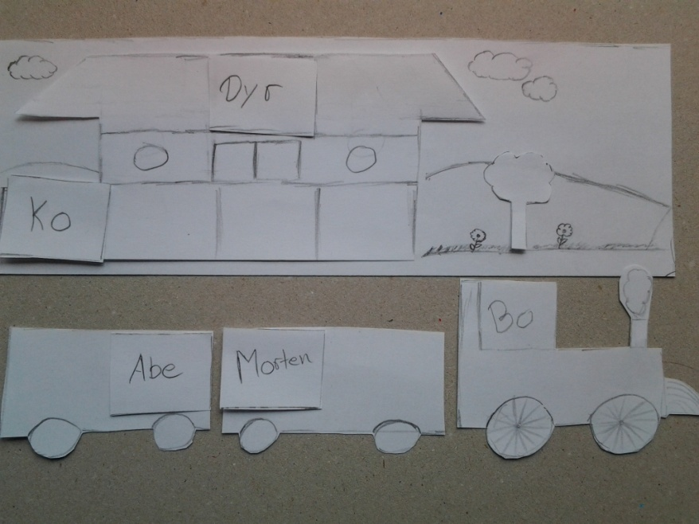
GIRAF
Game Design
OpenGL ES
Implementation
Conclusion
demonstration
Train design
Idea
Tove Søby
Prototype
Figure 7.1: Page 52
Department of computer science
AALBORG UNIVERSITy

Slide 9
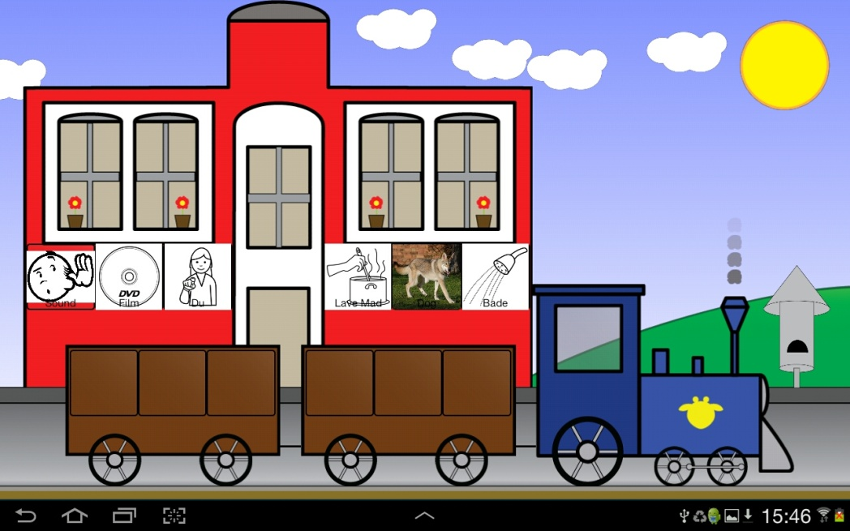
GIRAF
Game Design
OpenGL ES
Implementation
Conclusion
demonstration
Prototype
Figure 7.1: Page 52
Figure 7.2: Page 53
Department of computer science
AALBORG UNIVERSITy

Slide 10
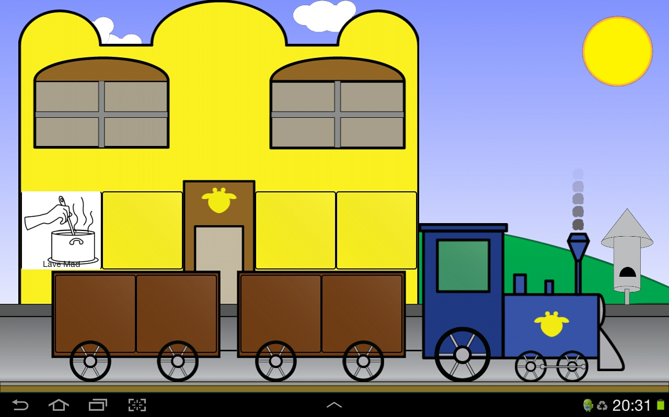
GIRAF
Game Design
OpenGL ES
Implementation
Conclusion
demonstration
Screenshots: Part 1
Department of computer science
AALBORG UNIVERSITy

Slide 11
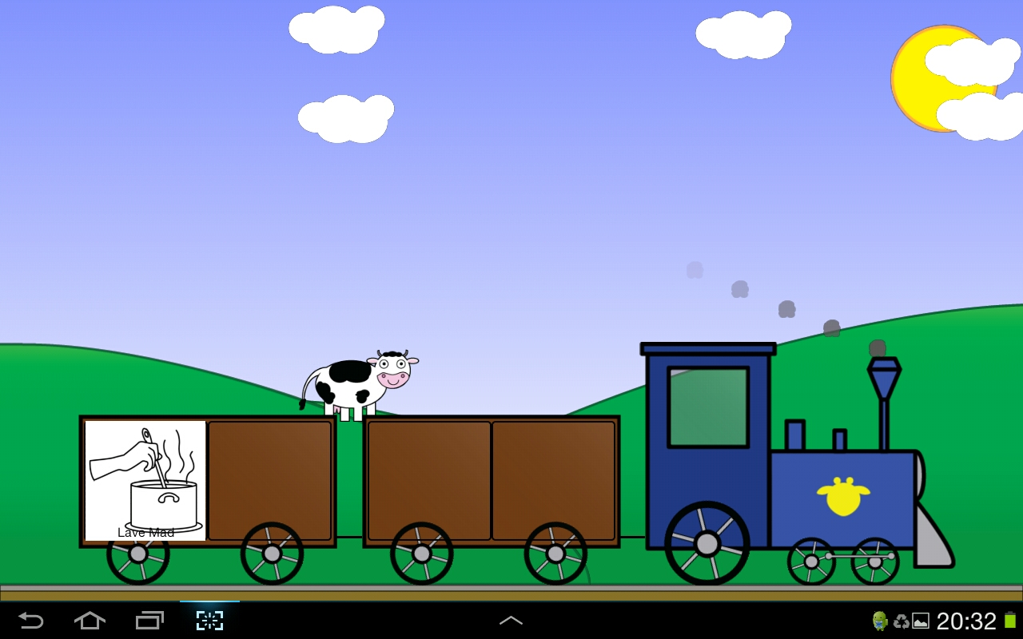
GIRAF
Game Design
OpenGL ES
Implementation
Conclusion
demonstration
Screenshots: Part 2
Department of computer science
AALBORG UNIVERSITy

Slide 12
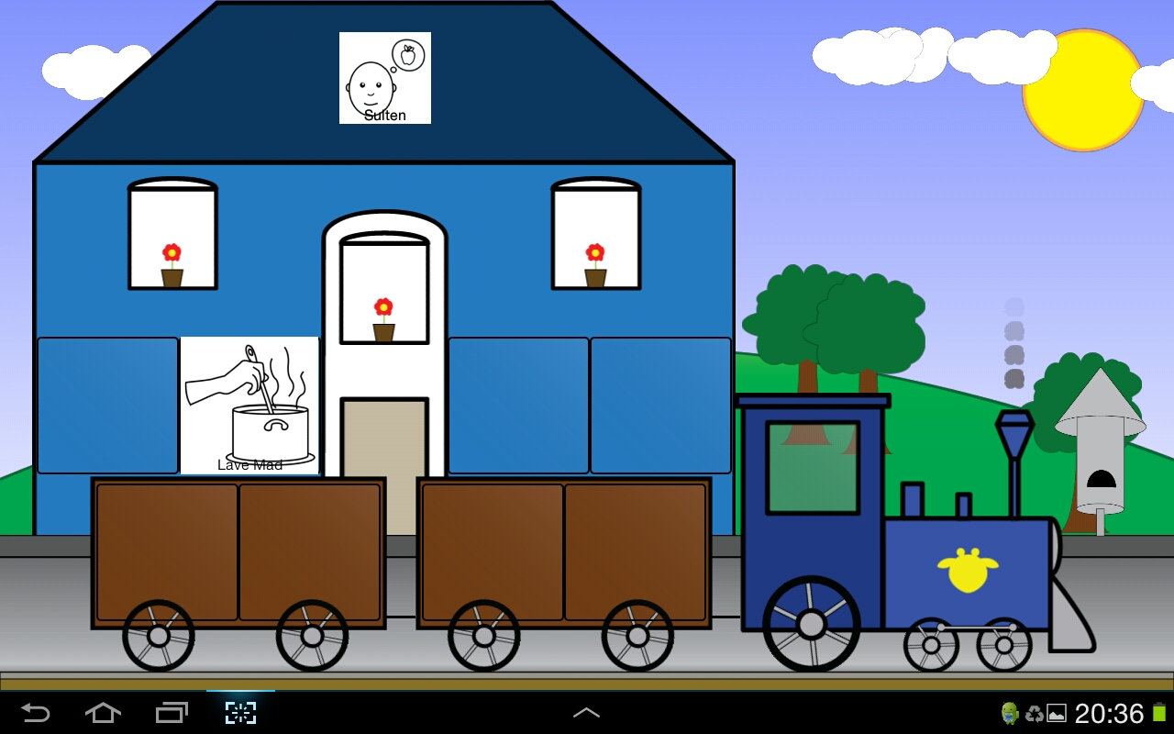
GIRAF
Game Design
OpenGL ES
Implementation
Conclusion
demonstration
Screenshots: Part 3
Department of computer science
AALBORG UNIVERSITy

Slide 13
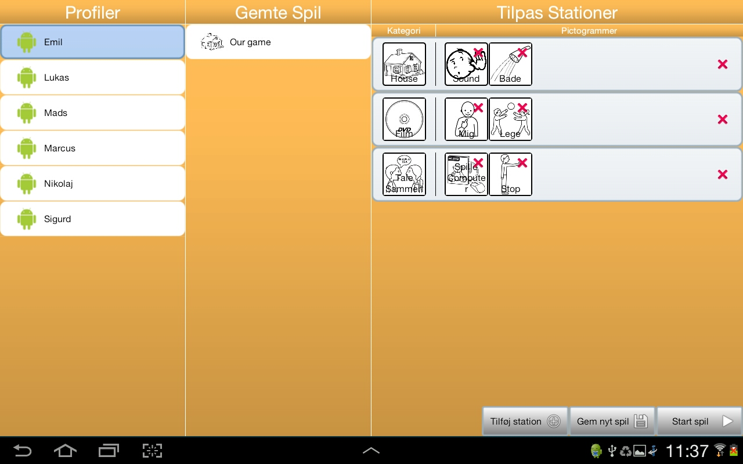
GIRAF
Game Design
OpenGL ES
Implementation
Conclusion
demonstration
Game Customization
Figure 7.12: Page 59
Department of computer science
AALBORG UNIVERSITy

Slide 14
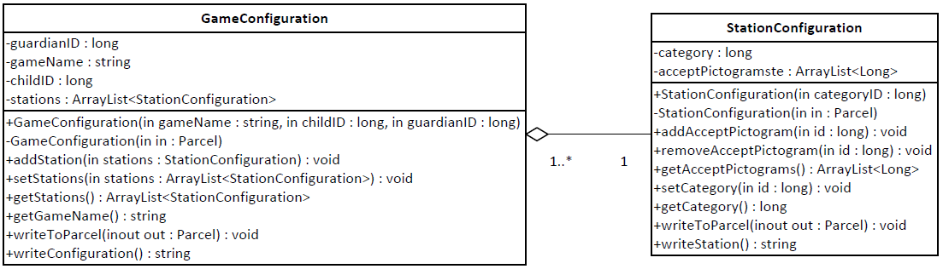
GIRAF
Game Design
OpenGL ES
Implementation
Conclusion
demonstration
configurations
Game Configurations
Station Configurations
Figure 7.4: Page 54
Department of computer science
AALBORG UNIVERSITy

Slide 15
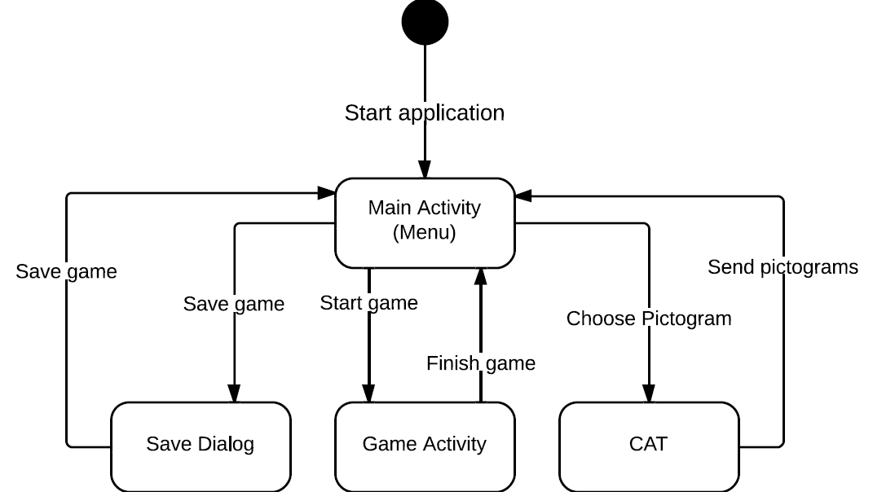
GIRAF
Game Design
OpenGL ES
Implementation
Conclusion
demonstration
Activity Flow
Figure 7.13: Page 59
Department of computer science
AALBORG UNIVERSITy

Slide 16
OpenGL ES
Jesper Riemer Andersen

Slide 17
GIRAF
Game Design
OpenGL ES
Implementation
Conclusion
demonstration
OpenGL ES
OpenGL ES vs Surface View
OpenGL ES
Version 1.x
Department of computer science
AALBORG UNIVERSITy

Slide 18
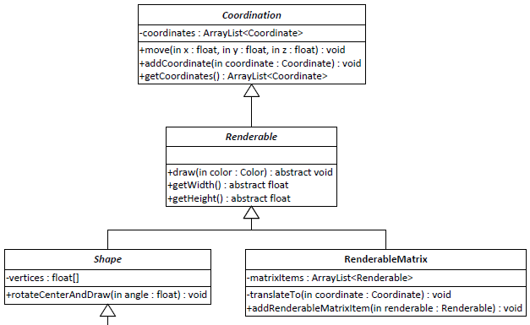
GIRAF
Game Design
OpenGL ES
Implementation
Conclusion
demonstration
Renderables
Figure 6.1: Page 40
Department of computer science
AALBORG UNIVERSITy

Slide 19
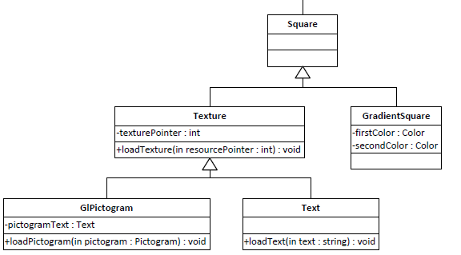
GIRAF
Game Design
OpenGL ES
Implementation
Conclusion
demonstration
Renderables Continued
Max Texture Size
Figure 6.1: Page 40
Department of computer science
AALBORG UNIVERSITy

Slide 20
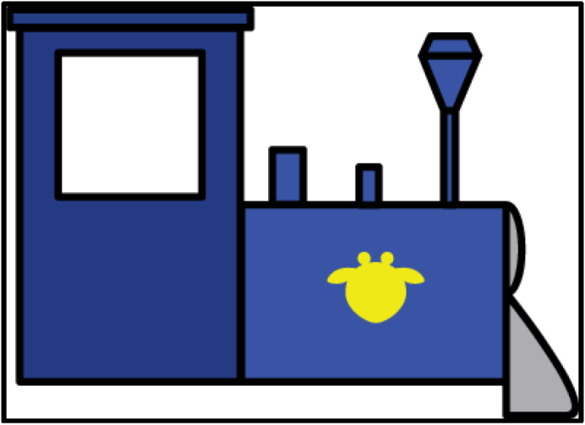

GIRAF
Game Design
OpenGL ES
Implementation
Conclusion
demonstration
Power-of-two: Part 1
Original
Converted
Figure 6.2: Page 42
Texture: 396 x 284
Square: 396 x 284
Figure 6.3: Page 42
512 x 512
Department of computer science
AALBORG UNIVERSITy

Slide 21
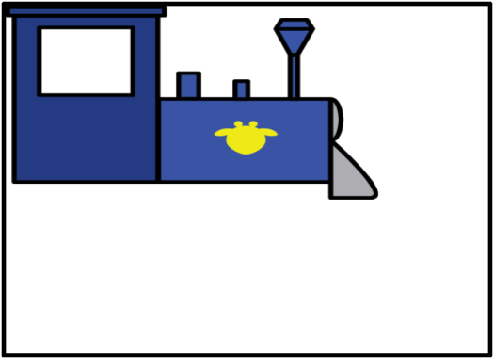
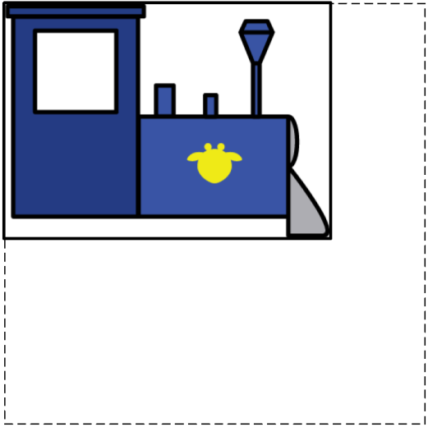
GIRAF
Game Design
OpenGL ES
Implementation
Conclusion
demonstration
Power-of-two: Part 2
Clamped
Result
Figure 6.4: Page 43
Texture: 512 x 512
Square: 396 x 284
Figure 6.5: Page 43
Texture: 512 x 512
Square: 396 x 284
Department of computer science
AALBORG UNIVERSITy

Slide 22

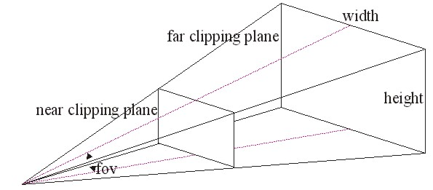
GIRAF
Game Design
OpenGL ES
Implementation
Conclusion
demonstration
Frustum
THREE-DIMENSIONAL SPACE
MATRIX STACK
Figure 6.7: Page 46
Department of computer science
AALBORG UNIVERSITy

Slide 23

GIRAF
Game Design
OpenGL ES
Implementation
Conclusion
demonstration
Frustum
THREE-DIMENSIONAL SPACE
MATRIX STACK
Figure 6.7: Page 46
Department of computer science
AALBORG UNIVERSITy

Slide 24
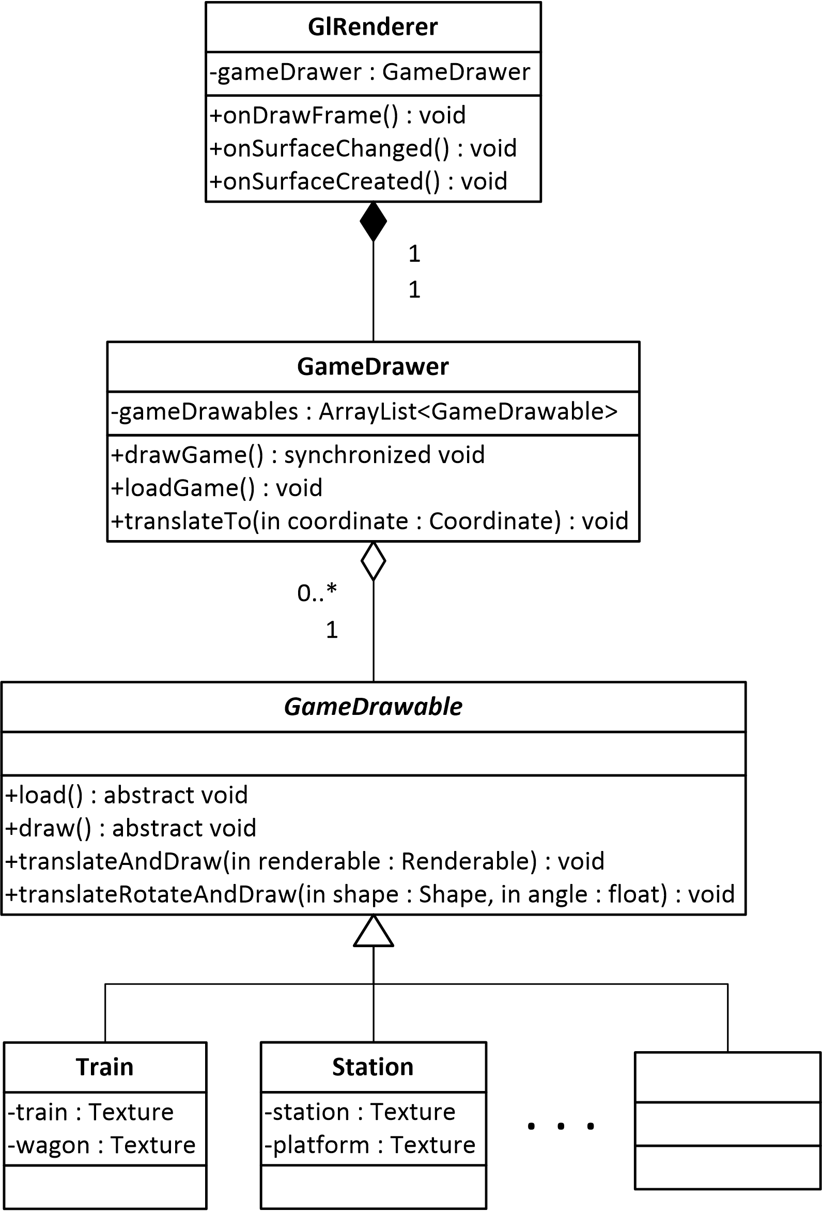
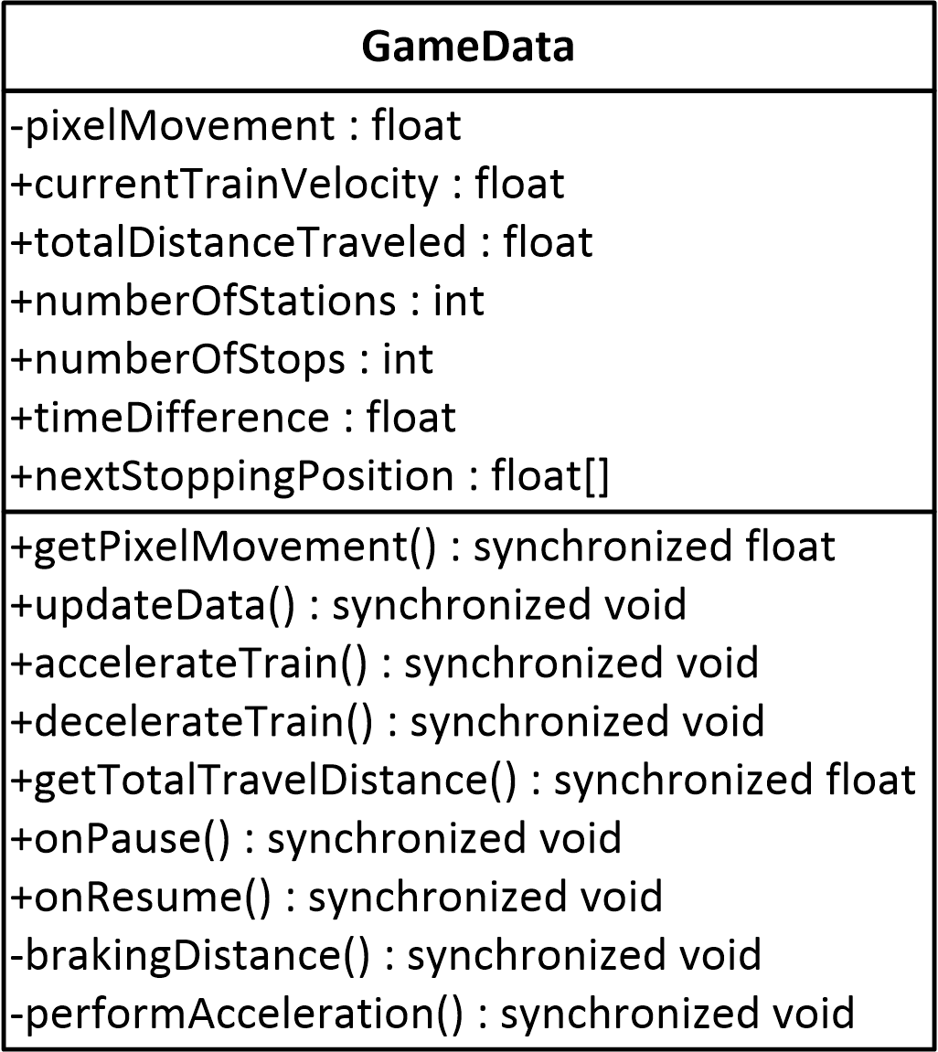
Rendering
ANDROID OPENGL ES
android.opengl.GLSurfaceView
android.opengl.GLSurfaceView.Renderer
Figure 6.6: Page 44
Department of computer science
AALBORG UNIVERSITy

Slide 25
Implementation
Jacob Karstensen Wortmann

Slide 26
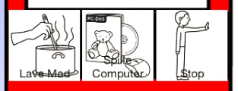
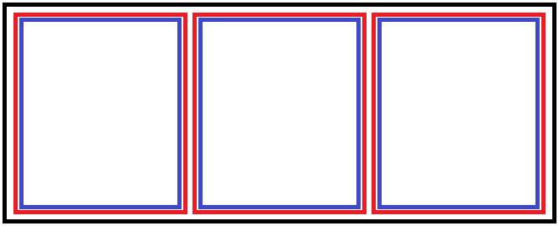
GIRAF
Game Design
OpenGL ES
Implementation
Conclusion
demonstration
Drag and drop
Touch listener
Drag listener
Figure 9.1: Page 65
Department of computer science
AALBORG UNIVERSITy

Slide 27
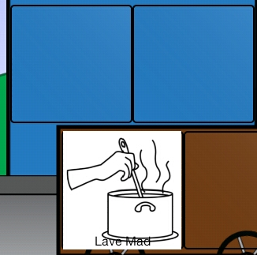
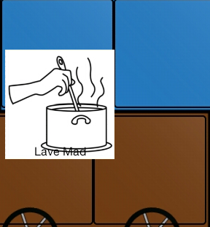
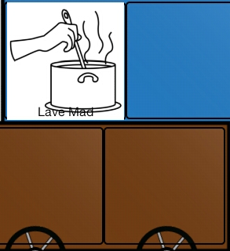
GIRAF
Game Design
OpenGL ES
Implementation
Conclusion
demonstration
Drag events
Events
ACTION_DRAG_START
ACTION_DROP
ACTION_DRAG_ENDED
Department of computer science
AALBORG UNIVERSITy

Slide 28
GIRAF
Game Design
OpenGL ES
Implementation
Conclusion
demonstration
Game Drawables
Trains and wagons
Wheels
Train Smoke
Station
Random sequence
Game Background
Hills
Trees
Cows
Clouds
Department of computer science
AALBORG UNIVERSITy

Slide 29
Conclusion
Jacob Karstensen Wortmann

Slide 30
GIRAF
Game Design
OpenGL ES
Implementation
Conclusion
demonstration
Conclusion
Problem statement
Customization
Managing games
Easy to start
“In what ways can we aid the pedagogues in their work with children with autism, by digitalizing a physical exercise onto an android tablet?”
Department of computer science
AALBORG UNIVERSITy

Slide 31
Demonstration
Simon Reedtz Olesen

