Slide 1
Identification of hand mudras for Indian classical dance forms
Presented by:
Varshanjali Sayyaparaju 201030097
Prateek Goel 201001067
Aditya Singh 201002055

Slide 2
Problem Statement
Given an image depicting a hand mudra for an Indian classical dance form, identify the mudra and provide a short description explaining its significance.
References
J.C. Terrillon, M.N. Shirazi, H. Fukumachi, and S. Akamatsu, “Comparative performance of different skin chrominance models and chrominance spaces for the automatic detection of human faces in color images”, Proceedings of the Fourth IEEE International Conference on Automatic Face and Gesture Recognition, March 2000, IEEE Computer Society, pp 54-61.
Singh, Devendra. "Human Face Detection by Using Skin Color Segmentation, Face Features and Regions Properties." Http://research.ijcaonline.org/volume38/number9/pxc3876881.pdf. N.p., n.d. Web.
Asamyukta - Single Hand Gestures- Dances of India-Angika Abhinaya." Asamyukta - Single Hand Gestures- Dances of India. N.p., n.d. Web. 31 Oct. 2012. http://www.webindia123.com/dances/abhinaya/angika_bhinaya/asamyukta.htm

Slide 3

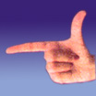

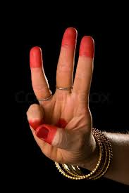
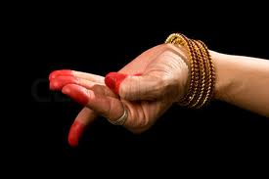
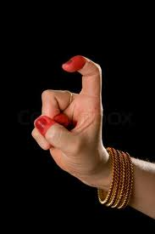
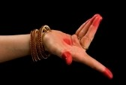
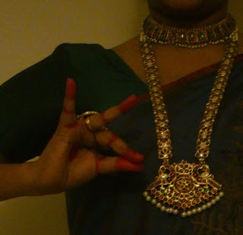
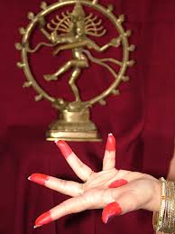
Datasets
Type I
Type II
Type III

Slide 4
Image Processing Pipeline
Preprocessing
Hand Segmentation
Skin detection
K-means clustering
Boundary Extraction
Neighbourhood processing
Morphological processing
Fingertip Detection
K-Curvature
Postprocessing

Slide 5
Hand Segmentation
Skin detection : YCbCr, HSV and RGB planes
K-means clustering
Challenges :
For Type II dataset, removal of mehendi.
For Type III dataset, additional objects in the background with similar color values are detected.

Slide 6
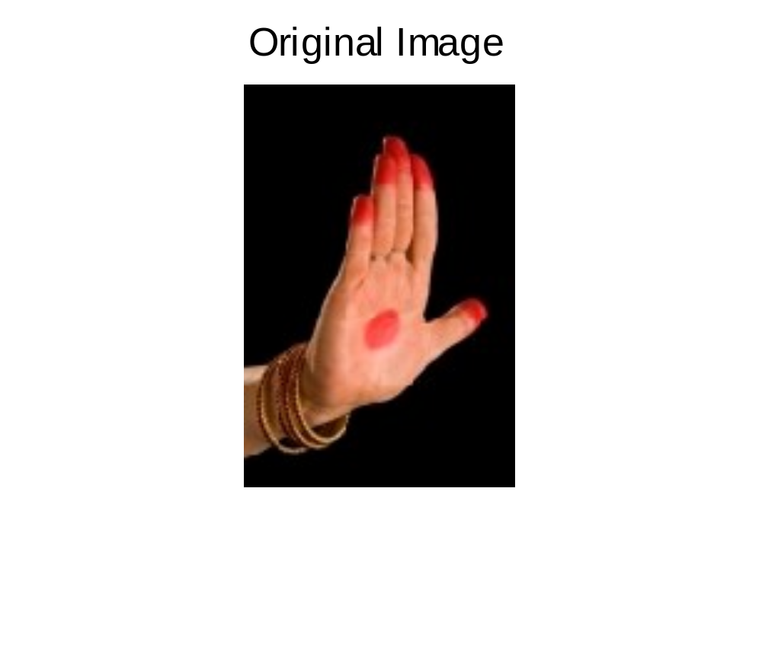
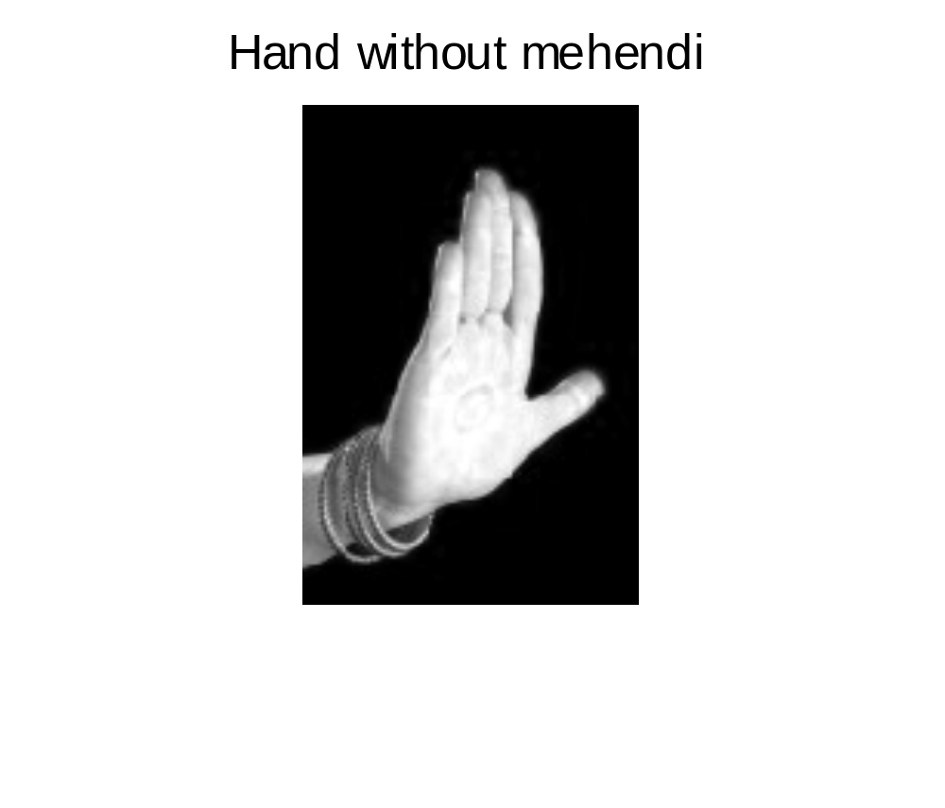
Hand Segmentation : Challenges
Type II dataset : Removal of mehendi

Slide 7
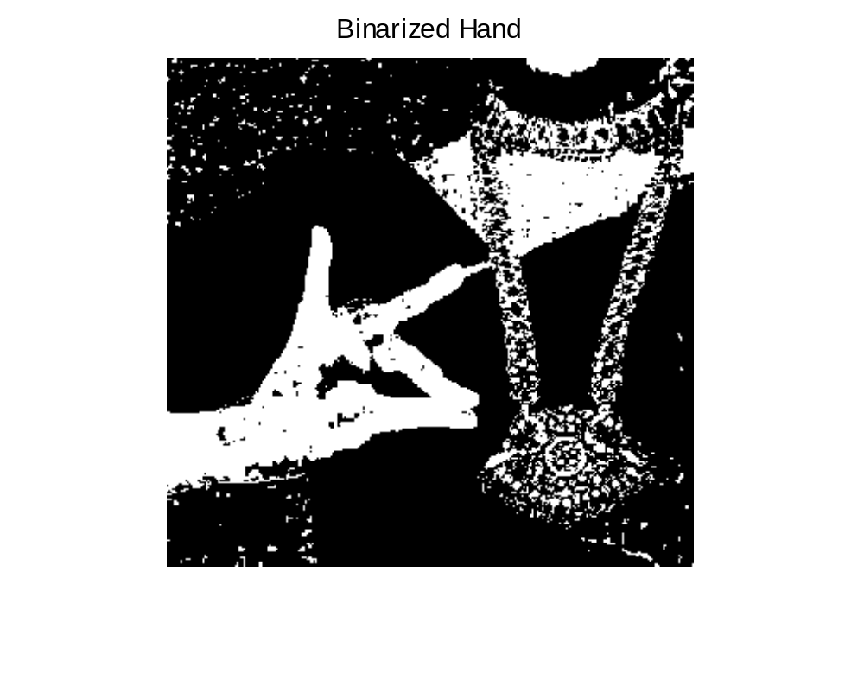
Hand Segmentation : Challenges
Type III dataset : Undesired objects detected

Slide 8
Boundary Extraction
Neighbourhood processing
Challenges :
For both Type II and Type III dataset, bangles distort the boundary.
For Type III dataset, background objects to be removed.

Slide 9
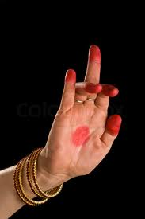
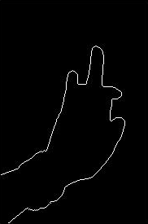
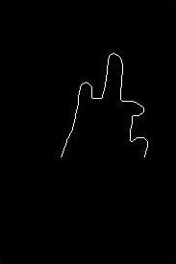
Boundary Extraction : Challenges
Bangles cause boundary distortion

Slide 10
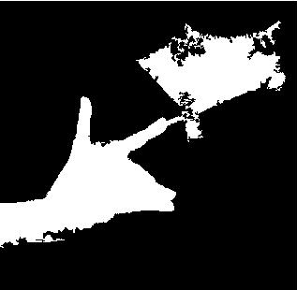
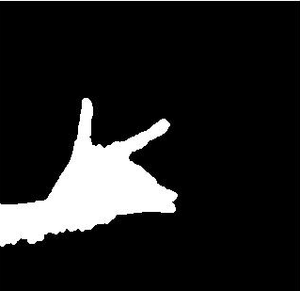
Boundary Extraction : Challenges
Undesired object removal

Slide 11



Fingertip Detection
K – Curvature
Type I

Slide 12

Type II

Slide 13

Type III

Slide 14
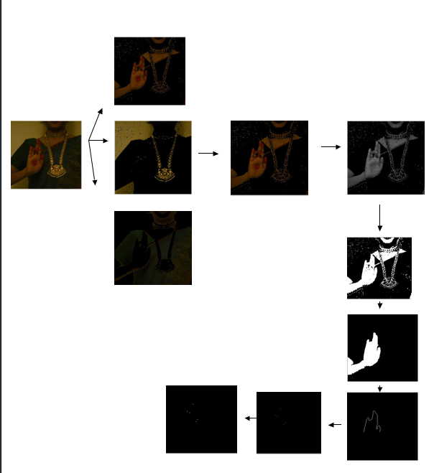
Overall Process:

Slide 15
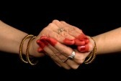

Two hands

Slide 16
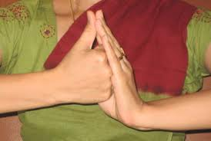
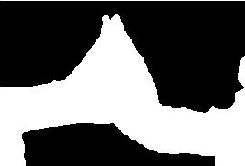
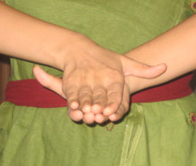

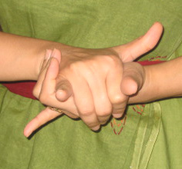


Slide 17
Further work
Proper two hand segmentation with discernible hands.
More embellishments
Identification of best approach for recognition
Work Division
Phase 1 :
Varsha : Dataset Identification, basic thresholding, Skin detection
Prateek : Fingertip Detection (Distance metrics)
Aditya : Boundary Extraction (Morphological Operations)
Phase 2:
Varsha : Dataset Identification, K-means clustering, two hands – edge detection and Watershed transform
Prateek : Fingertip detection (K-curvature), Type II dataset challenges
Aditya : Boundary Extraction (Neighbourhood processing), Type III dataset challenges

Slide 18
Thank You!

