Slide 1

Travel Diary
Ying Wang
Shaobin Ding
Congrui Xu
Tong Liu

Slide 2


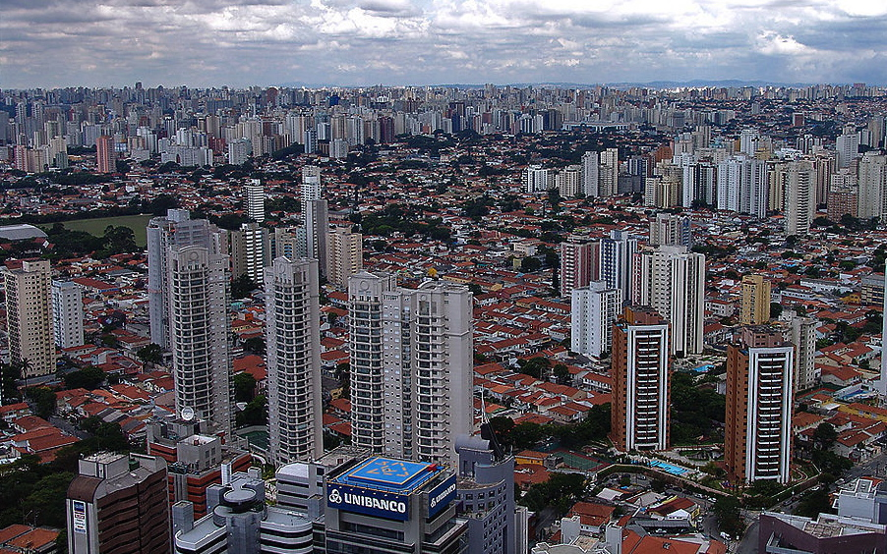
Introdution （Cont..）
long term heavy load
Humdrum living environmet

Slide 3
Introdution （Cont..）
Trip-trip aims at helping people to:
Keep minute of life
Relax yourself
Make friends during trip
Ideal website for you!

Slide 4

Functions(Cont...)
Basic:
Account management
Add friends or groups
Basic search
Share information
Comments

Slide 5
Functions(Cont...)
Advanced:
Rank
Recommendation
Chat
Advanced search

Slide 6
Graphic expression

Slide 7

Website Hierarchy(basic)
Register
Welcome Page
Login
Profile
Scenery Page
Personal Page
Activity
Search
experience
Specific Scenery
location
food
expense
accommodation

Slide 8
Website Hierarchy(Advanced)
Register
Welcome Page
Login
Profile
Scenery Page
Personal Page
Chat
Plan
Activity
access
Recommendation
Rank
Advanced Search
Search
Rate
experience
Specific Scenery
CTR
location
food
expense
accommodation

Slide 9
Milestone
1. Design Main pages of website
2. Gather contents to enrich database
3. login function and friends function.
(Design database for user information)
4. Design personal page
5. Design database for travel blog function
6. Comment function, thumb up or thumb down
7. UI beautification
8. Advanced Features
9. Testing

Slide 10
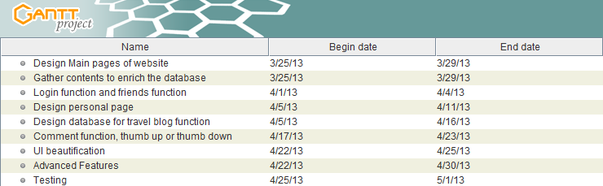
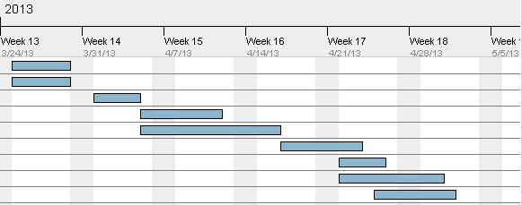
Gannt Chart

Slide 11
Work Division
Ying Wang
User interface design and implementation.
Gather information for the contents and enrich the database.
Congrui Xu
Login function and friends function.
Testing
Tong Liu
Design and maintain the database for user imformation
Design databse for travel blog and photos
Shaobin Ding
Progaming for main page and personal pages
Design the structure of travel blog
Comment function

Slide 12
Work Division
Ying Wang
User interface design and implementation.
Gather information for the contents and enrich the database.
Congrui Xu
Login function and friends function.
Testing
Tong Liu
Design and maintain the database for user imformation
Design databse for travel blog and photos
Shaobin Ding
Progaming for main page and personal pages
Design the structure of travel blog
Comment function

Slide 13
Risk Analysis
1 Trip plan function
2 Recommendation function
3 Dynamic news update

Slide 14

Thank you!

