Slide 1
Panel desk
Quick check of atom distance and angle
Save/load session state
Expression selection: for domain, or superlattice
Group modifier and rename them
Replicate: slice + replicate for transformation of system’s coordinate
Slice # visualize plane
Color coding: for domain wall visualization, or polarization pattern
Histogram: for phase determination
Adjust view
Displacement vector: structure optimization, or defect induced structural distortion
Data source: file name, automatch, color
Compute properties: “Transparency” 0.5
Create bonds: for visualization
Rendering setting: resolution, background transparent
Pro option:
Time averaging
Python scripting
Others:
Dislocation analysis
Common neighbor analysis → dislocation
Generating trajectory line
→ diffusion

Slide 2
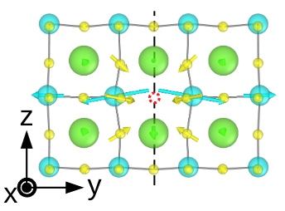
Slice
Create bonds
Displacement vector
Compute property + Trasparency

