Slide 1
Survey of Deep Learning Accelerator
2017/11/09 Yi Li

Slide 2
Outline
Background
Overview/Products
Implementation/Strategy

Slide 3
Outline
Background
Overview/Products
Implementation/Strategy

Slide 4
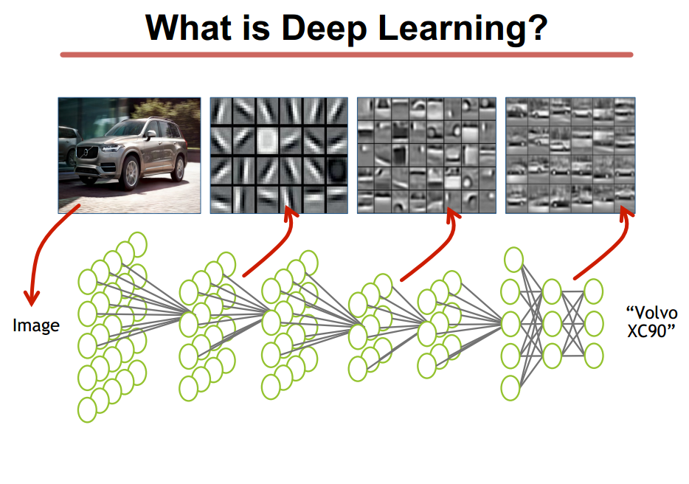
Background

Slide 5
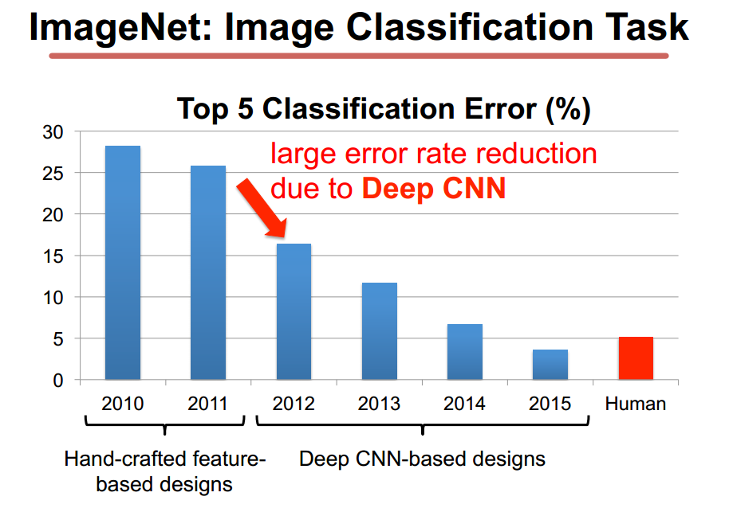
Background

Slide 6
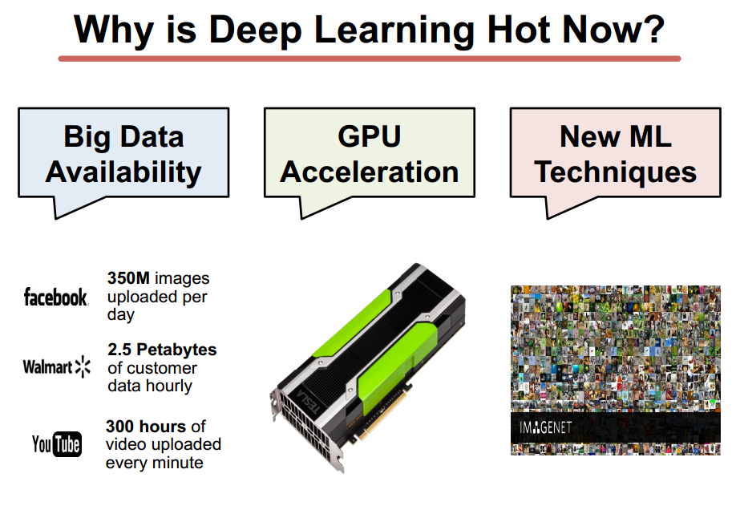
Background

Slide 7
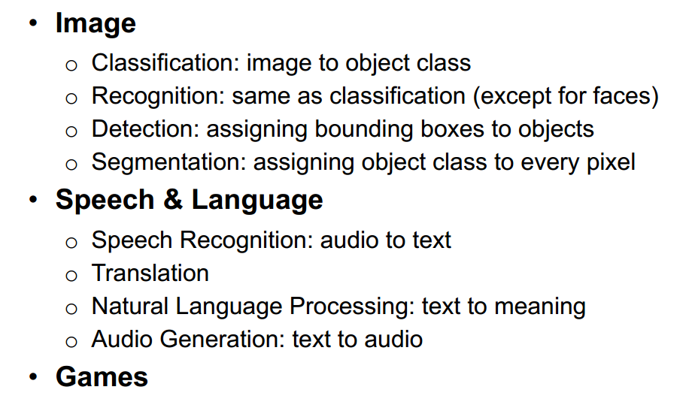
Background

Slide 8
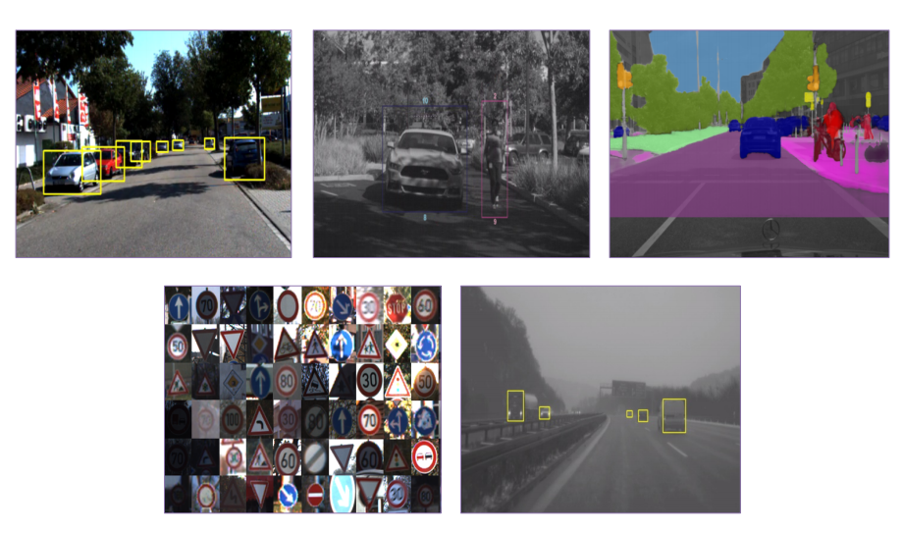
Background

Slide 9
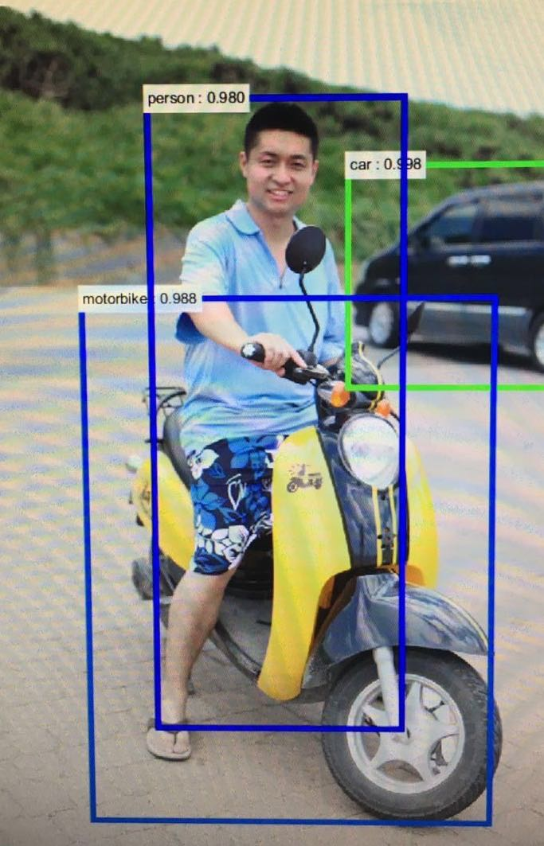
Background

Slide 10
Outline
Background
Overview/Products
Implementation/Strategy

Slide 11
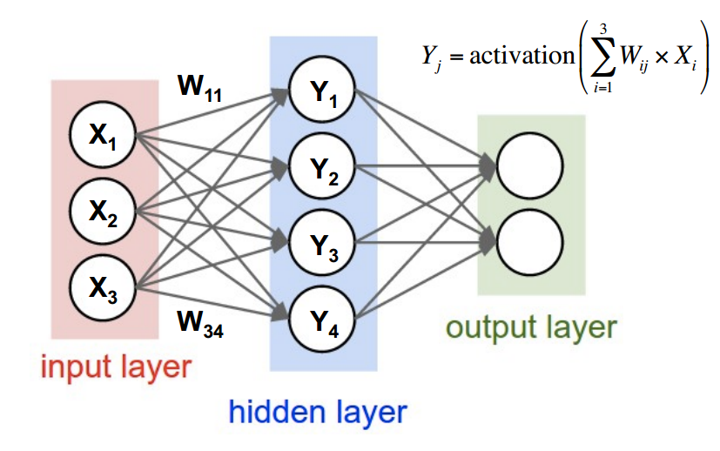
Overview

Slide 12
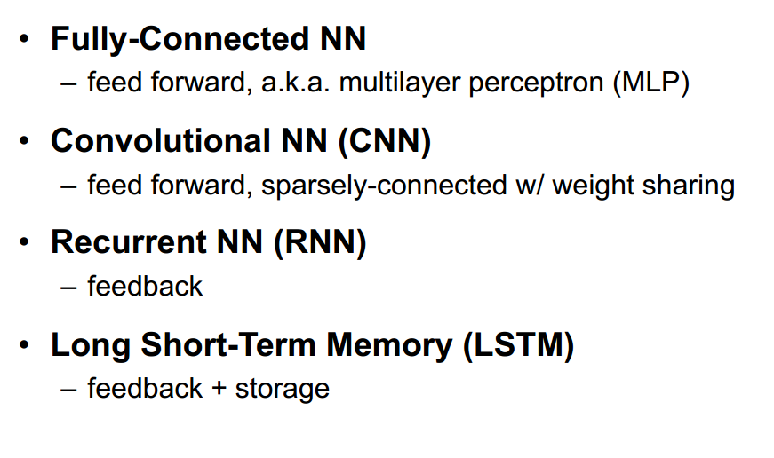
Overview

Slide 13
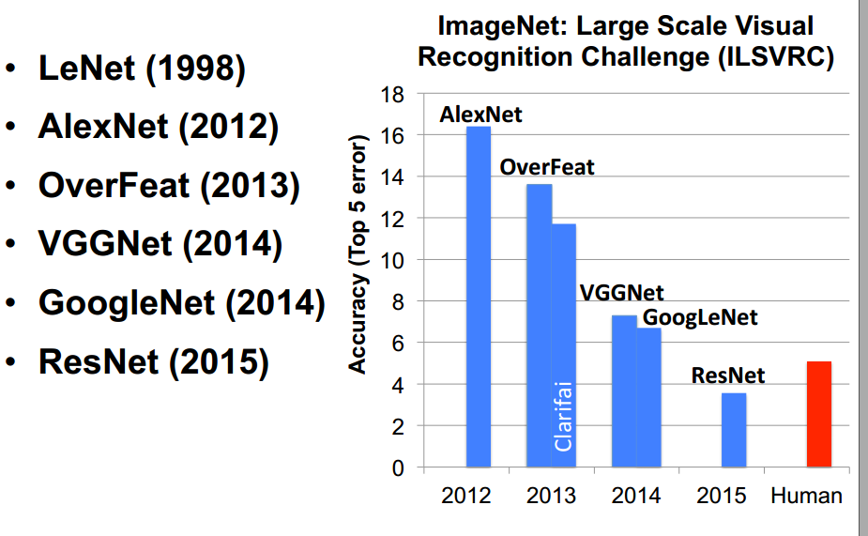
Overview

Slide 14
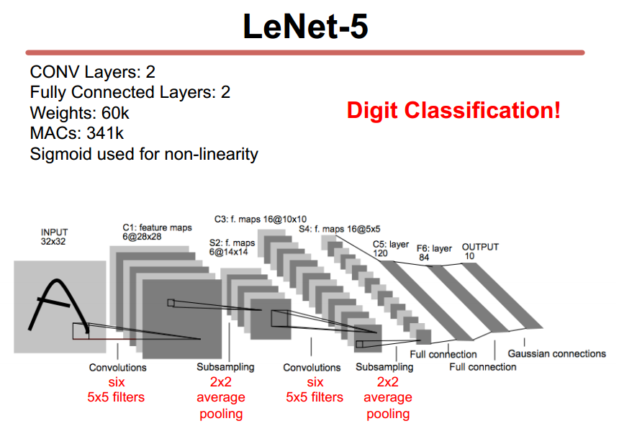
Overview/Products

Slide 15
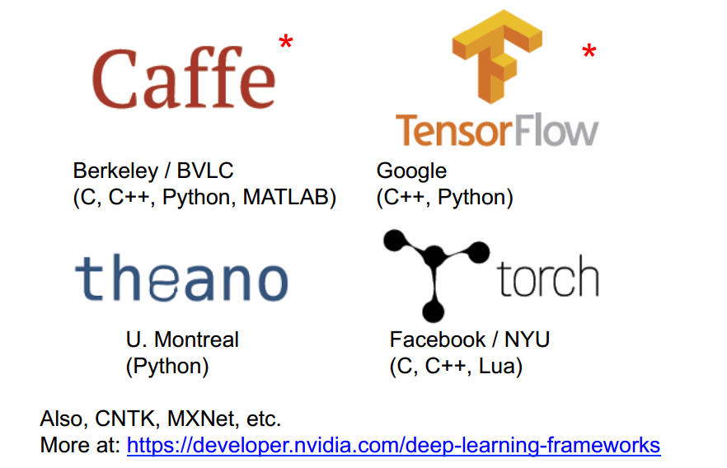
Overview/Products

Slide 16
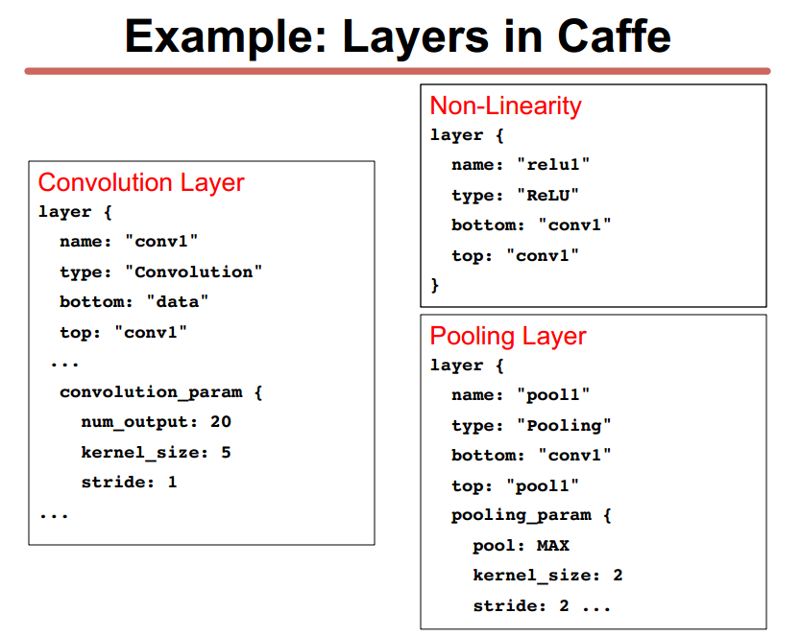
Overview/Products

Slide 17
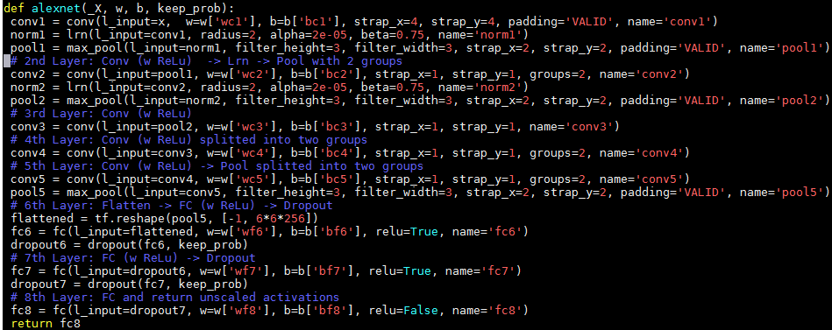
Overview/Products
Tensorflow

Slide 18
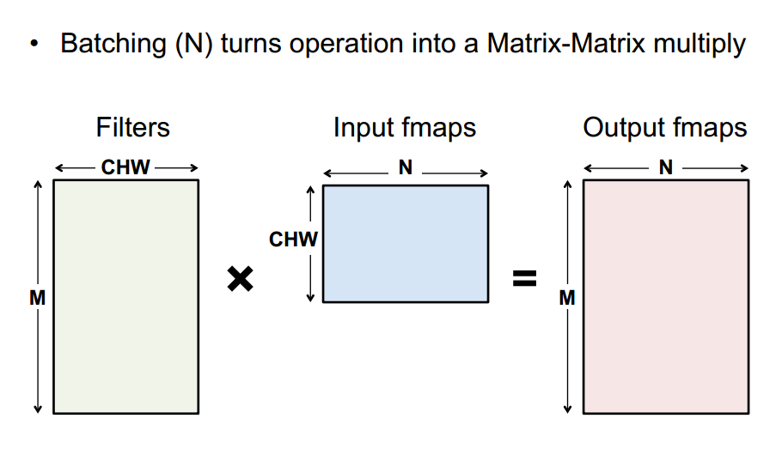
Overview

Slide 19
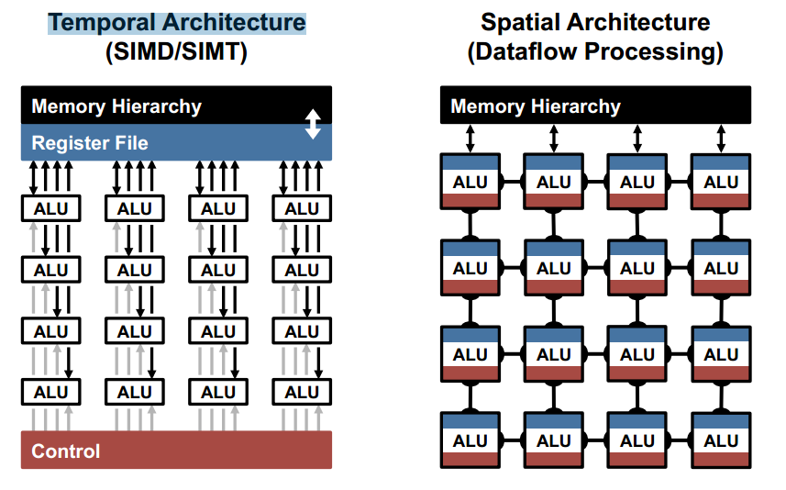
Products

Slide 20
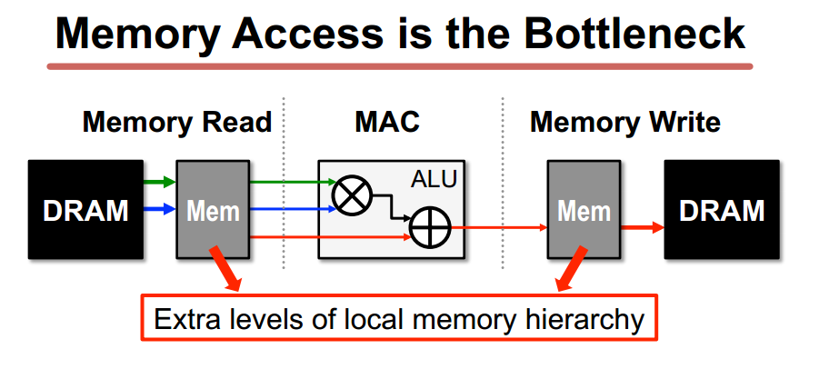
Products

Slide 21
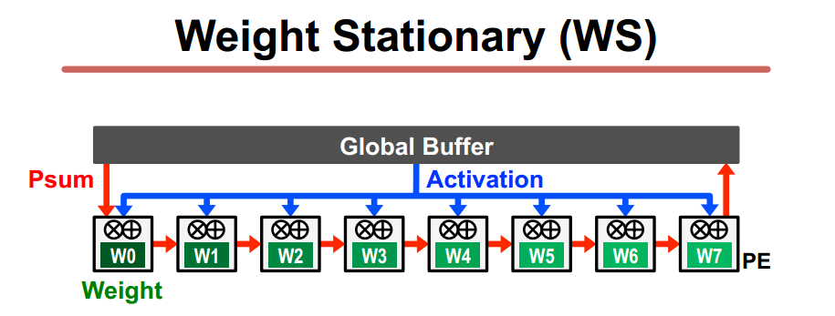
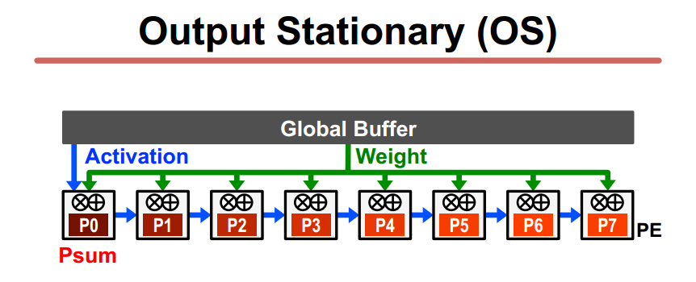
Products

Slide 22
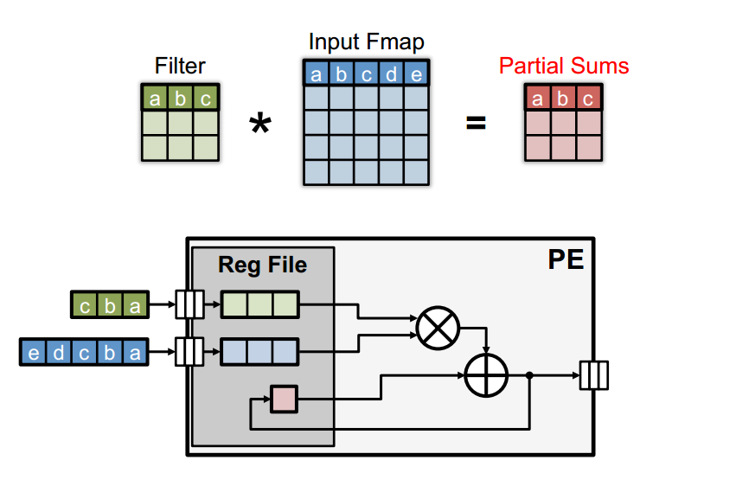
Products

Slide 23
Products
Cambricon
Deephi

Slide 24
Products
Cambricon
DianNao/DaDianNao/ShiDianNao/PuDiannao
Diannao
16b multiply-accumulators with buffers optimized for DNNs– All data stored in off-chip DRAM
DaDiannao
for FC layers – up to 12M parameters in on-chip EDRAM
ShiDiannao
Sensors connect DLA. for conv layers – up to 64K parameters on chip PuDianNao
Instruction. loop tilling tech, accelerate 7 algorithms such as KNN/k-Mean/DNN/SVM

Slide 25
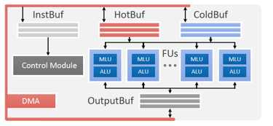
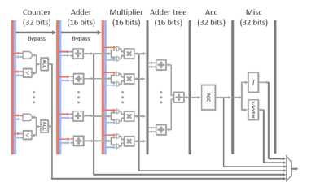

Products
PuDianNao
loop tilling tech, accelerate 7 algorithms such as KNN/k-Mean/DNN/SVM et. al

Slide 26
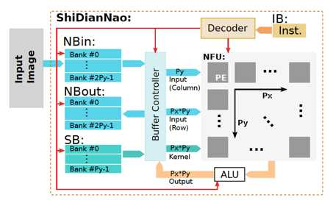
Products
ShiDianNao

Slide 27
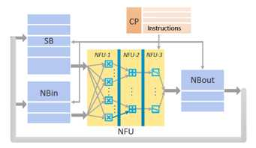
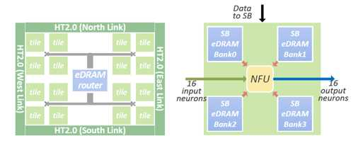
Products
DaDianNao

Slide 28
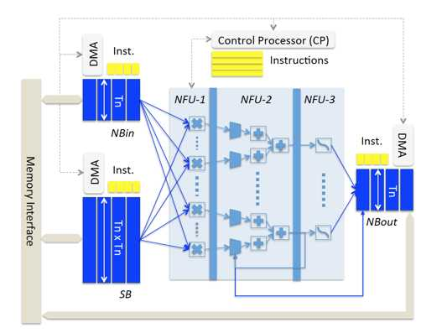
Products
DianNao

Slide 29
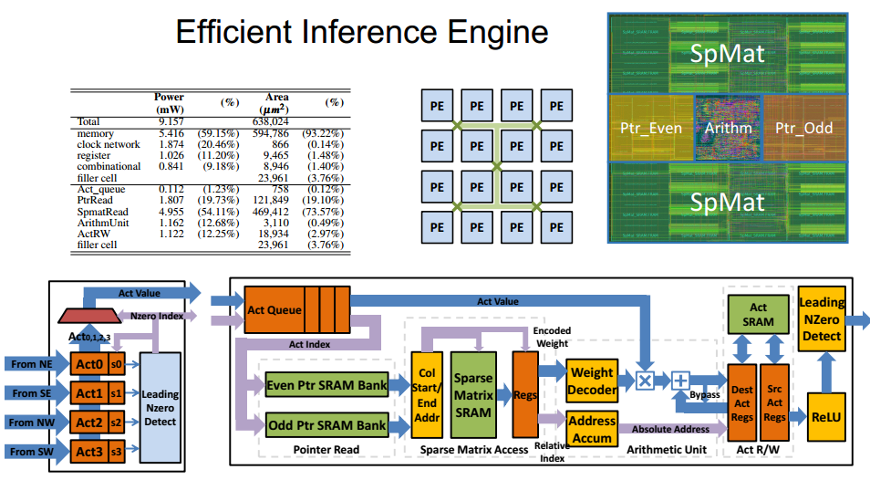
Products
DeepHi

Slide 30
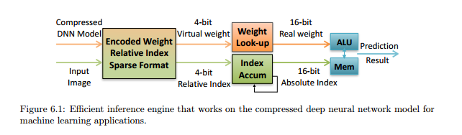
Products
DeepHi

Slide 31
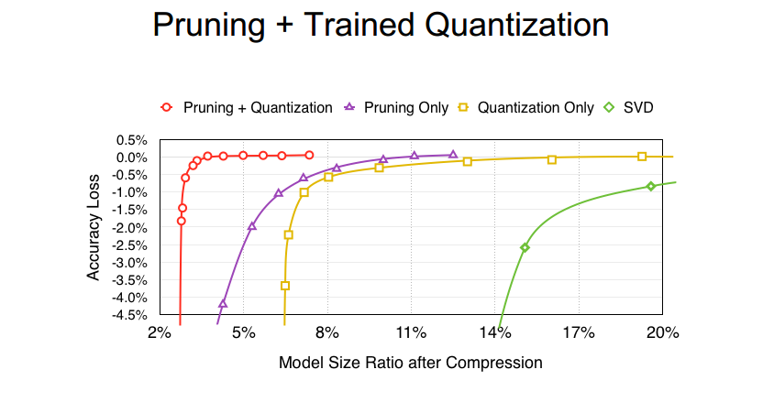
Products
DeepHi EIE

Slide 32
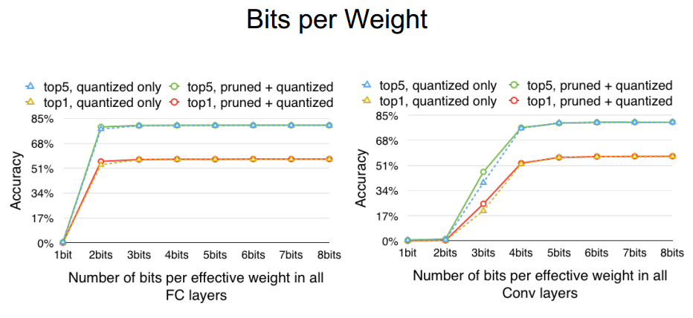
Products
DeepHi EIE

Slide 33
Products
ASIC
Mobileye Cambricon（寒武纪科技) Wave Computing Horizon Robotics（地平线机器人） Cerebras Systems Nervana Movidius Mediatek（联发科） NXP Netradyne ChipIntelli（启英泰伦） IntelliFusion（云天励飞
Neuromorphic
IBM HRL Laboratories Numenta Knupath Brain corp General Vision Demiurge Technologies AG
Westwell lab（西井科技）
Brainchip
Saffron
IP/DSP
CEVA Kneron（耐能人工智能） Synopsys Cadence
FPGA
TeraDeep DeephiTech（深鉴科技） Microsoft Auviz Systems Xilinx Altera Baidu（百度）
GPU/CPU/TPU
Nvidia AMD Qualcomm Intel Google

Slide 34
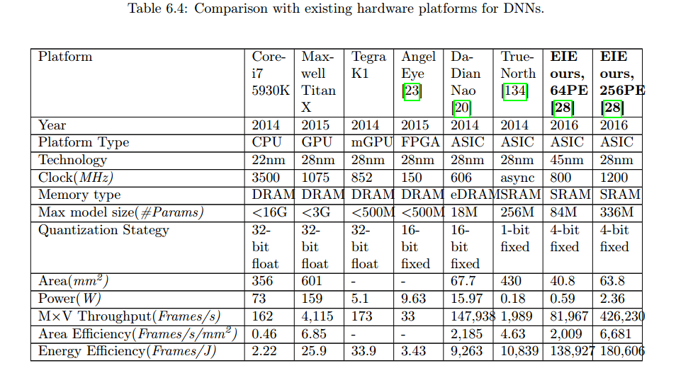
Products

Slide 35
Outline
Background
Overview/Products
Implementation/Strategy

Slide 36
Implementation/Strategy
1) Target/Spec
2）Architecture
3）Quantization
4）Sparsity
5）Compiler/Generator
6）Mem

Slide 37
Implementation/Strategy
Target/Spec
Function: Train/inference
Algorithm: CNN/RNN/KNN/
Operation: conv/fc/pooling/relu/fire

Slide 38
Implementation/Strategy
2) Architecture
Temporal/Spacial achitecture
data static
weight static

Slide 39
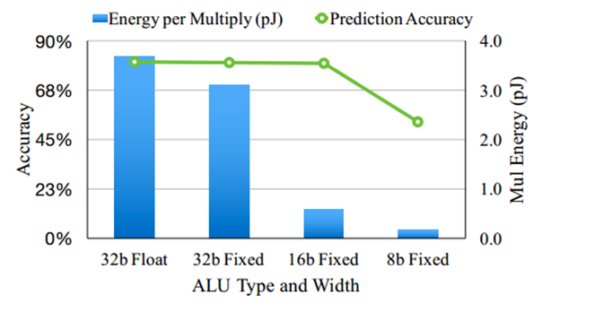
Implementation/Strategy
3) Quantization

Slide 40
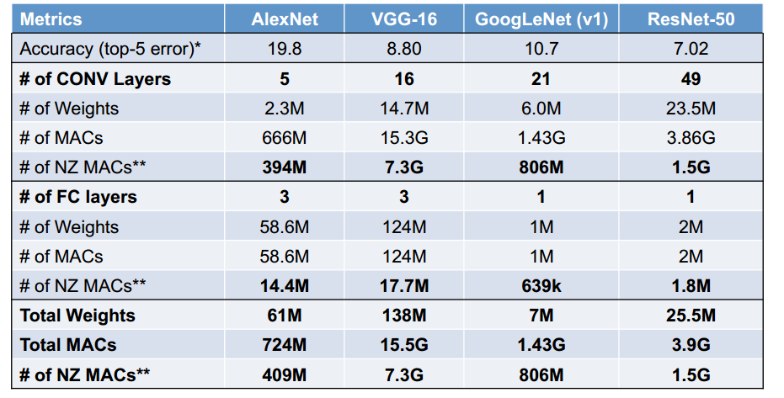
Implementation/Strategy
4) Sparsity

Slide 41
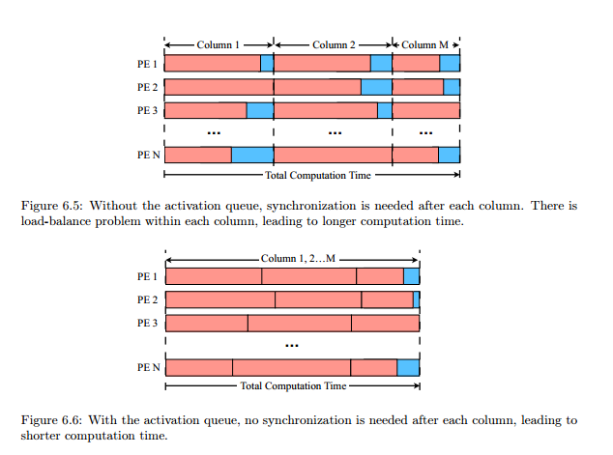
Implementation/Strategy
4) Sparsity

Slide 42
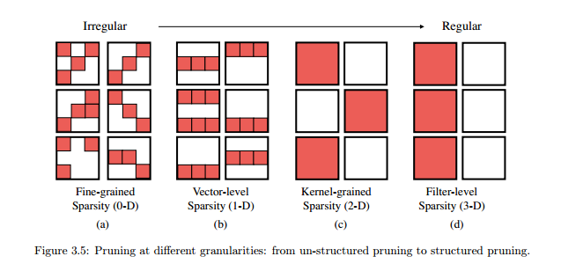
Implementation/Strategy
4) Sparsity

Slide 43
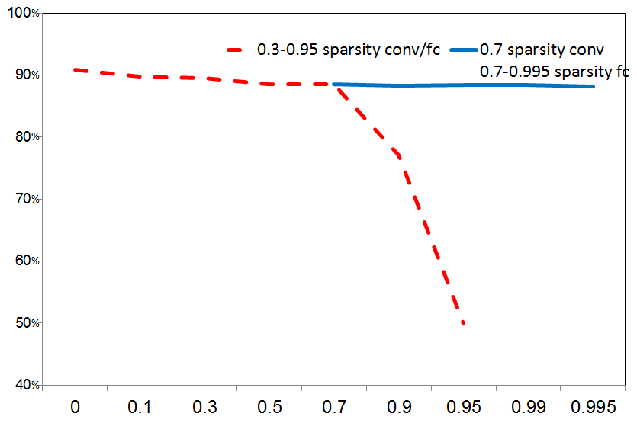
Implementation/Strategy
4) Sparsity
Alexnet pruning at Imagenet2012 by tensorflow
Compression ratio 61:1
MACs reduced to 27.4%

Slide 44
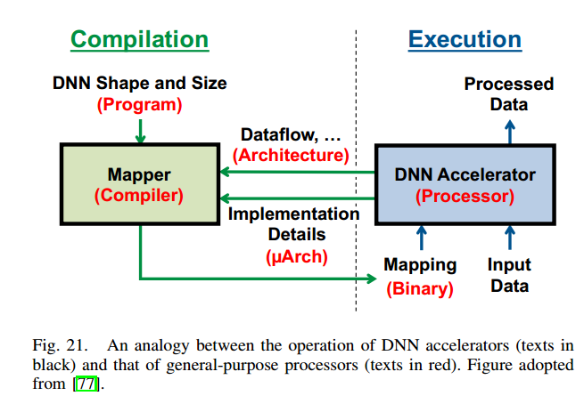
Implementation/Strategy
5) Compiler/Generator

Slide 45
Implementation/Strategy
6) Mem
Memory size
High density memory

Slide 46
Implementation/Strategy
Thank You!
Q & A

