Slide 1

DLA hardware
Yi Li
2017/11/9

Slide 2
Outline
NVDLA data/weight implementation on MAC interface
NVDLA data/weight datapath through CBUF
MAC size/Buffer size
Energy efficiency for DLA
Compiler/Generator/Parser

Slide 3
Outline
NVDLA data/weight implementation on MAC interface
NVDLA data/weight datapath through CBUF
MAC size/Buffer size
Energy efficiency for DLA
Compiler/Generator/Parser

Slide 4
data/weight implement
case | Input channel | Output channel | Kernel size_x | Kernel Size_y | Feature Size_x | Feature Size_y
Google conv2 3x3 | 64 | 192 | 3 | 3 | 19 | 19
Alexnet conv5 5x5 | 192 | 256 | 3 | 3 | 13 | 13

Slide 5
data/weight implement
9 cycle
16 feature data
0 | 0 | 0 | 0 | 0 | 0 | 0 | 0 | 0 | 0 | 0 | 0 | 0 | 0 | 0 | 0 | 0 | 0 | 0 | 0 | 0
0 | 1d1 | 231 | 51 | 0 | 0 | 0 | 0 | 0 | 0 | 0 | 0 | 0 | 65 | bc | 30 | 0 | 7c | 0 | 0 | 0
0 | 5b | 0 | 22 | 0 | e8 | cc | 17f | 13f | 17e | 1fb | 2a9 | 255 | 273 | 26a | 358 | 2ce | 334 | 447 | 3c9 | 0
0 | 272 | 36c | 395 | 372 | 3f6 | 3dc | 3cf | 39e | 38c | 39d | 3a4 | 29a | 34a | 3ca | 3d5 | 3b9 | 280 | 83a | 8e3 | 0
0 | 0 | 0 | 0 | 0 | 0 | 0 | 0 | 0 | 0 |  |  |  |  |  |  |  |  |  |  | 0
0 |  |  |  |  |  |  |  |  |  |  |  |  |  |  |  |  |  |  |  | 0
0 |  |  |  |  |  |  |  |  |  |  |  |  |  |  |  |  |  |  |  | 0
0 |  |  |  |  |  |  |  |  |  |  |  |  |  |  |  |  |  |  |  | 0

Slide 6
data/weight implement
9 cycle
16 feature data
0 | 0 | 0 | 0 | 0 | 0 | 0 | 0 | 0 | 0 | 0 | 0 | 0 | 0 | 0 | 0 | 0 | 0 | 0 | 0 | 0
0 | 1d1 | 231 | 51 | 0 | 0 | 0 | 0 | 0 | 0 | 0 | 0 | 0 | 65 | bc | 30 | 0 | 7c | 0 | 0 | 0
0 | 5b | 0 | 22 | 0 | e8 | cc | 17f | 13f | 17e | 1fb | 2a9 | 255 | 273 | 26a | 358 | 2ce | 334 | 447 | 3c9 | 0
0 | 272 | 36c | 395 | 372 | 3f6 | 3dc | 3cf | 39e | 38c | 39d | 3a4 | 29a | 34a | 3ca | 3d5 | 3b9 | 280 | 83a | 8e3 | 0
0 | 0 | 0 | 0 | 0 | 0 | 0 | 0 | 0 | 0 |  |  |  |  |  |  |  |  |  |  | 0
0 |  |  |  |  |  |  |  |  |  |  |  |  |  |  |  |  |  |  |  | 0
0 |  |  |  |  |  |  |  |  |  |  |  |  |  |  |  |  |  |  |  | 0
0 |  |  |  |  |  |  |  |  |  |  |  |  |  |  |  |  |  |  |  | 0

Slide 7
data/weight implement
9 cycle
16 feature data
0 | 0 | 0 | 0 | 0 | 0 | 0 | 0 | 0 | 0 | 0 | 0 | 0 | 0 | 0 | 0 | 0 | 0 | 0 | 0 | 0
0 | 1d1 | 231 | 51 | 0 | 0 | 0 | 0 | 0 | 0 | 0 | 0 | 0 | 65 | bc | 30 | 0 | 7c | 0 | 0 | 0
0 | 5b | 0 | 22 | 0 | e8 | cc | 17f | 13f | 17e | 1fb | 2a9 | 255 | 273 | 26a | 358 | 2ce | 334 | 447 | 3c9 | 0
0 | 272 | 36c | 395 | 372 | 3f6 | 3dc | 3cf | 39e | 38c | 39d | 3a4 | 29a | 34a | 3ca | 3d5 | 3b9 | 280 | 83a | 8e3 | 0
0 | 0 | 0 | 0 | 0 | 0 | 0 | 0 | 0 | 0 |  |  |  |  |  |  |  |  |  |  | 0
0 |  |  |  |  |  |  |  |  |  |  |  |  |  |  |  |  |  |  |  | 0
0 |  |  |  |  |  |  |  |  |  |  |  |  |  |  |  |  |  |  |  | 0
0 |  |  |  |  |  |  |  |  |  |  |  |  |  |  |  |  |  |  |  | 0

Slide 8
data/weight implement
9 cycle
16 feature data
0 | 0 | 0 | 0 | 0 | 0 | 0 | 0 | 0 | 0 | 0 | 0 | 0 | 0 | 0 | 0 | 0 | 0 | 0 | 0 | 0
0 | 1d1 | 231 | 51 | 0 | 0 | 0 | 0 | 0 | 0 | 0 | 0 | 0 | 65 | bc | 30 | 0 | 7c | 0 | 0 | 0
0 | 5b | 0 | 22 | 0 | e8 | cc | 17f | 13f | 17e | 1fb | 2a9 | 255 | 273 | 26a | 358 | 2ce | 334 | 447 | 3c9 | 0
0 | 272 | 36c | 395 | 372 | 3f6 | 3dc | 3cf | 39e | 38c | 39d | 3a4 | 29a | 34a | 3ca | 3d5 | 3b9 | 280 | 83a | 8e3 | 0
0 | 0 | 0 | 0 | 0 | 0 | 0 | 0 | 0 | 0 |  |  |  |  |  |  |  |  |  |  | 0
0 |  |  |  |  |  |  |  |  |  |  |  |  |  |  |  |  |  |  |  | 0
0 |  |  |  |  |  |  |  |  |  |  |  |  |  |  |  |  |  |  |  | 0
0 |  |  |  |  |  |  |  |  |  |  |  |  |  |  |  |  |  |  |  | 0

Slide 9
data/weight implement
case | Input channel | Output channel | Kernel size_x | Kernel Size_y | Feature Size_x | Feature Size_y
Google conv2 3x3 | 64 | 192 | 3 | 3 | 19 | 19
12
21
1
9
9
16
25
weight
data
clk

Slide 10
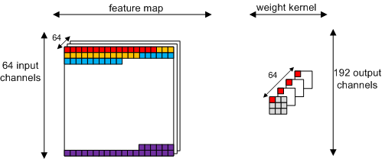
data/weight implement
case | Input channel | Output channel | Kernel size_x | Kernel Size_y | Feature Size_x | Feature Size_y
Google conv2 3x3 | 64 | 192 | 3 | 3 | 19 | 19
Notes:
智能无人机
根据艾媒咨询发布的《2016年中国无人机行业研究报告》的数据，到2019年，中国消费类无人机市场规模将超高240亿。
预计在十三五期间，国内农业植保无人机整机和服务年均市场需求300亿左右
其他的工业无人机领域，如，安防、电力巡线、石油管线巡检、风力和太阳能发电厂巡检、气象、勘测资源、检灾、测绘等领域，预计到2025年国内有超过300亿的市场规模
根据美国FAA预测，美国民用无人机保有量有望从2016年的190万台增长至2020年的430万台，而商用无人机的保有量预计从现在的60万部增长至270万台，而所有类型无人机加起来到2020年，美国境内将会拥有超过700万台。
智能安防
预计仅2020年全球新装机智能摄像头就在1亿路以上，市场规模在1000亿美元以上。
智能家庭机器人
2016年全球家用机器人市场规模为80亿美金，预计到2025年，年市场复合增长率将超30%；
VR/AR内容制作
根据Manatt Digital Media发布的2015 Q2 AR/VR报告：到2020年，预计虚拟现实和增强现实的市场规模将达到1,500亿美元。
无人驾驶汽车
预计2018年左右，无人驾驶汽车将实现规模上路，而其创造的市场价值将在2025年前达到420亿美元；

Slide 11
data/weight implement
case | Input channel | Output channel | Kernel size_x | Kernel Size_y | Feature Size_x | Feature Size_y
Alexnet conv5 5x5 | 192 | 256 | 3 | 3 | 13 | 13
16
9
1
54
54
16
25
weight
data
clk

Slide 12
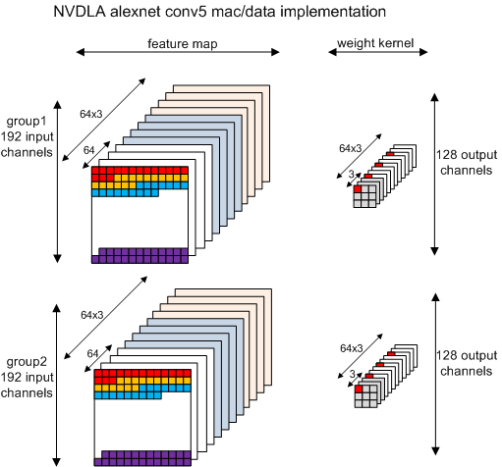
data/weight implement

Slide 13
data/weight implement
Summary
12
21
1
9
9
16
25
weight
data
clk
16: 1)weight load timing, 2)last stripe total_data%16+1
9 : 1)weight kernel size, 2) weight kernel size * input_channel/64, 3)accumulation
21(1) : 1)total_data/16, 3) reload weight
12 : output_channel/16

Slide 14
Outline
NVDLA data/weight implementation on MAC interface
NVDLA data/weight datapath through CBUF
MAC size/Buffer size
Energy efficiency for DLA
Compiler/Generator/Parser

Slide 15
datapath through CBUF
c1 for high bit
c0 for low bit
c1
c0
Data access
b0-b14
b0
256x512bit
256x512bit
b1
256x512bit
256x512bit
Weight access
b1-b15
b14
256x512bit
256x512bit
Wmb access
b15
b15
256x512bit
256x512bit

Slide 16
datapath through CBUF
case | Input channel | Output channel | Kernel size_x | Kernel Size_y | Feature Size_x | Feature Size_y
Google conv2 3x3 | 64 | 192 | 3 | 3 | 19 | 19
Data ：64*19*19*16bit / （256 * 1024bit）= 1.4 actually using 2 bank
Weight：64*192*3*3*16bit / （256 * 1024bit）= 6.75 actually using 3 bank
case | Input channel | Output channel | Kernel size_x | Kernel Size_y | Feature Size_x | Feature Size_y
Alexnet conv5 5x5 | 192 | 256 | 3 | 3 | 13 | 13
Data ：192*13*13*16bit / （256 * 1024bit）= 1.98 actually using 2 bank
Weight：192*256*3*3*16bit / （256 * 1024bit）= 27 actually using full 15 bank
Weight requires reload operation to CBUF

Slide 17
Outline
NVDLA data/weight implementation on MAC interface
NVDLA data/weight datapath through CBUF
MAC size/Buffer Size
Energy efficiency for DLA
Compiler/Generator/Parser

Slide 18
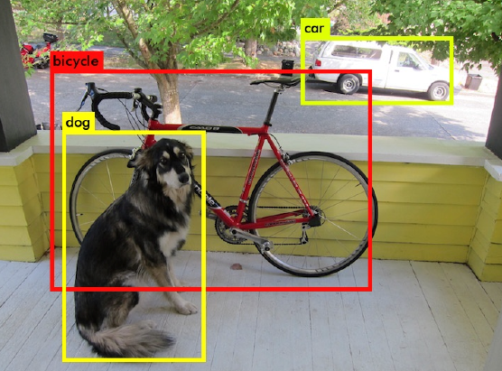
MAC size/Buffer Size
Yolo v2 34.90Billion Flops 16bits
Real-time requirements: 30 frames, total 1047x10e9 MACs/cycle
600MHz frequency, need 1745 MACs with 16bits, assume 2048MACs
Estimated Peak Performance:
1bits: 16x16x2048x600MHz = 307Tops,
2bit: 76.8Tops,
4bit: 19.2Tops,
8bit: 4.8Tops
16bit:1.2Tops
#ops = 1mac = 1mul + 1add

Slide 19
MAC size/Buffer Size
YOLO v2
 | filter num | filter_size_x | filter_size_y | feature map x | feature map y
conv1 | 32 | 3 | 3 | 224 | 224
maxpooling
conv2 | 64 | 3 | 3 | 112 | 112
maxpooling
conv3 | 128 | 3 | 3 | 56 | 56
conv4 | 64 | 1 | 1 | 56 | 56
conv5 | 128 | 3 | 3 | 56 | 56
maxpooling
conv6 | 256 | 3 | 3 | 28 | 28
conv7 | 128 | 1 | 1 | 28 | 28
conv8 | 256 | 3 | 3 | 28 | 28
maxpooling
conv9 | 512 | 3 | 3 | 14 | 14
conv10 | 256 | 1 | 1 | 14 | 14
conv11 | 512 | 3 | 3 | 14 | 14
conv12 | 256 | 1 | 1 | 14 | 14
conv13 | 512 | 3 | 3 | 14 | 14
maxpooling
conv14 | 1024 | 3 | 3 | 7 | 7
conv15 | 512 | 1 | 1 | 7 | 7
conv16 | 1024 | 3 | 3 | 7 | 7
conv17 | 512 | 1 | 1 | 7 | 7
conv18 | 1024 | 3 | 3 | 7 | 7
conv19 | 1000 | 1 | 1 | 7 | 7
avgpoool
softmax
Input channel 32/64
Output channel 16
Width 2/4/8/16
Accumulation Num 16/32

Slide 20
MAC size/Buffer Size
tiny yolo
MACs | Bandwidth (bits) | input | output | Ndata_x | Ndata_y | Nw_x | Nw_y | Tmac | Tbandwidth | Tmac/Tbandwidth
2048 | 32 | 3 | 16 | 224 | 224 | 3 | 3 | 1.1E+04 | 2.5E+04 | 0.41827
2048 | 32 | 16 | 32 | 112 | 112 | 3 | 3 | 2.8E+04 | 8.6E+03 | 3.29104
2048 | 32 | 32 | 64 | 56 | 56 | 3 | 3 | 2.8E+04 | 1.1E+04 | 2.61721
2048 | 32 | 64 | 128 | 56 | 56 | 3 | 3 | 1.1E+05 | 3.8E+04 | 2.93755
2048 | 32 | 128 | 256 | 14 | 14 | 3 | 3 | 2.8E+04 | 1.5E+05 | 0.19128
2048 | 32 | 256 | 512 | 14 | 14 | 3 | 3 | 1.1E+05 | 5.9E+05 | 0.19137
2048 | 32 | 512 | 1024 | 7 | 7 | 3 | 3 | 1.1E+05 | 2.4E+06 | 0.04785
2048 | 32 | 1024 | 1024 | 7 | 7 | 3 | 3 | 2.3E+05 | 4.7E+06 | 0.04785
2048 | 32 | 1024 | 125 | 7 | 7 | 1 | 1 | 3.1E+03 | 6.4E+04 | 0.04783
T_{bandwidth} = (Ndata + Ninput_channel * Noutput_channel * Nx * Ny) * 16bit/32bit
T_{mac} = (Ninput_channel * Noutput_channel * Ndata * Nx * Ny)/2048bit
T_{mac} / T_{bandwidth} >1 : 1)using tile, divide output channel , 2)tile size depends on buffer size
T_{mac} / T_{bandwidth} <1 : 1)increase bandwith 2)increase inner buffer

Slide 21
Outline
NVDLA data/weight implementation on MAC interface
NVDLA data/weight datapath through CBUF
MAC size/Buffer Size
Energy efficiency for DLA
Compiler/Generator/Parser

Slide 22
Energy efficiency
 | MAC | Process | Area (mm2) | Freq (MHz) | Voltage (V) | EE
ISSCC2016 | 128 (16bit) | 65nm | 3.5x3.5 | 100-250 | 0.82-1.17
ISSCC2017 | 1024 (16bit) | 65nm | 4x4 | 5-100 | 0.46-0.8 | 2.11nJ/cycle (0.8V) 0.485TMAC/W 1.06nJ/cyclle(0.46V) 0.966TMAC/W
ISSCC2016 | 512(16bit) | 65nm | 4X4 | 125 | 1 | 0.71TMAC/W
ISSCC2017 | 768(16bit) | 65nm | 4X4 | 50-200 | 0.77-1.1 | 2.1TOPS/W @ 0.77V 1.0TOPS/W @ 1.1V #not sure TOPS meanings,usually 1MAC = 2OPS in paper
ISSCC2017 | 256(16bit) | 28nm | 1.29x1.45 | 200 | 1 | 10TOPS/W 4bit 0.26TOPS/W 16bit #not sure TOPS meanings,usually 1MAC = 2OPS in paper

Slide 23
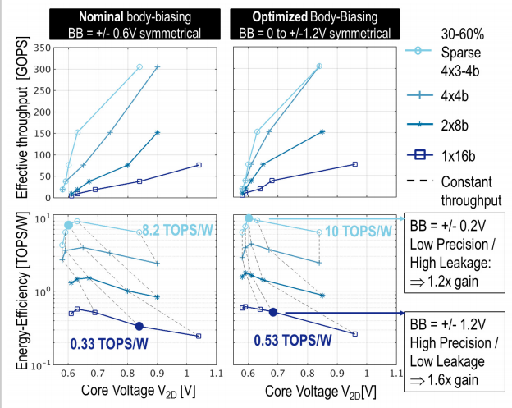
Energy efficiency

Slide 24
Outline
NVDLA data/weight implementation on MAC interface
NVDLA data/weight datapath through CBUF
MAC size/Buffer Size
Energy efficiency for DLA
Compiler/Generator/Parser

Slide 25
Compiler/Generator/Parser
Hardware Task
Filling padding
Processing zero value
Supporting multi-precision MAC operation
Convolution operation by sliding window
Non-linear computation
DMA/Bus Bridge/Ping-Pong Buffer
Compiler/Generator/Parser Task
1) Read standard CNN net definition file and extract key word
2) Transfer standard feature/weight to DLA-prefer format
3) Auto divide tile for loading
4) Generate software/register code for automatically implementing CNN on DLA

Slide 26
THANKS ! Q & A

