Slide 1



NVDLA Introduction
Cong Liu
09/11/2007

Slide 2
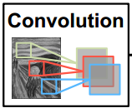
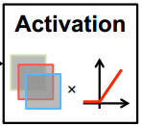
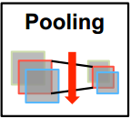
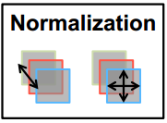
Mathematical Operations in DL
Convolutions
Activations
Pooling
Normalization
Notes:
Sigmoid ReLU
Max min average
线性函数归一化、0均值标准化

Slide 3
NVDLA Hardware
Convolution Core
Optimized high-performance convolution engine.
Single Data Processor（SDP）
Single-point lookup engine for activation functions.
Planar Data Processor （PDP）
Planar averaging engine for pooling.
Channel Data Processor（CDP）
Multi-channel averaging engine for advanced normalization functions.
Dedicated Memory and Data Reshape Engines
Memory-to-memory transformation acceleration for tensor reshape and copy operations.
Notes:
many different sizes，sparse weight compression，Winograd convolution ，Batch convolution， internal RAM
linear and non-linear，lookup table
different pool group sizes，maximum-pooling, minimum-pooling, and average-pooling
local response normalization (LRN) function，operates on channel dimensions, as opposed to the spatial dimensions

Slide 4
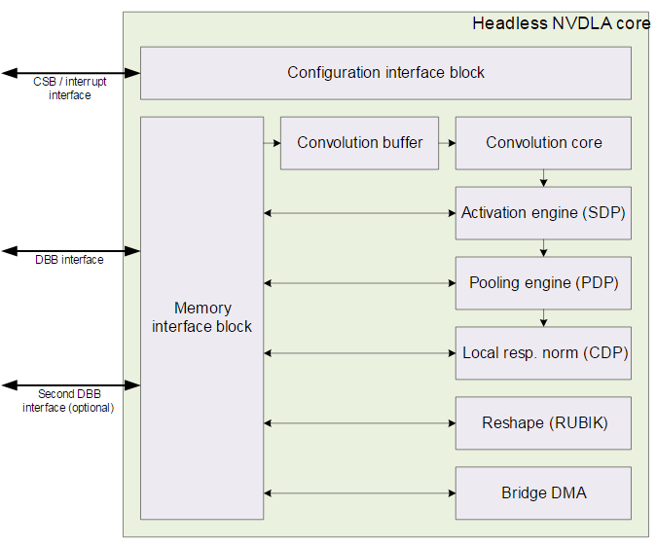
NVDLA Hardware
CEI flow
command-excute-interrupt
Mode
Independent
Fused
Connection
Configuration Space Bus (CSB) interface
Interrupt interface（1bit）
Data Backbone (DBB) interface
Notes:
Double buffer configuration register，“active command”
FIFO
CSB 32bit DBB configurable

Slide 5
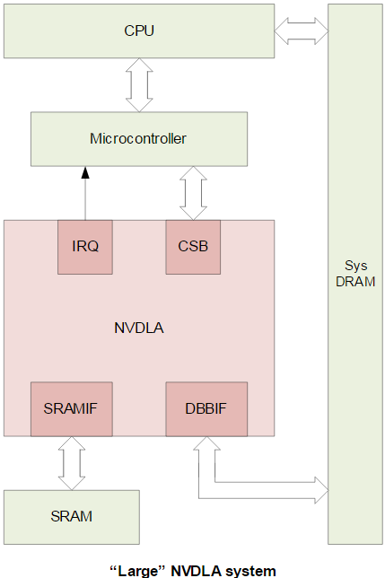
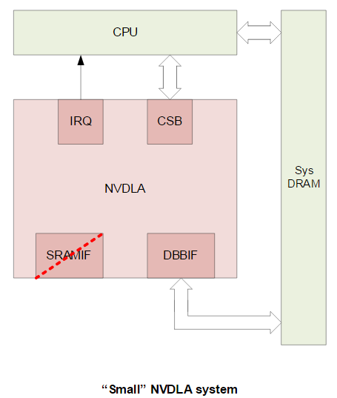
NVDLA Systems
Headless
Headed
Notes:
fine-grained
coarse-grained

Slide 6
Configurability
Data types
Input image memory formats
Weight compression
Winograd convolution
Batched convolution
Convolution buffer size
MAC array size
Second memory interface
Non-linear activation functions
Activation engine size
Bridge DMA engine
Data reshape engine
Pooling engine presence
Pooling engine size
Local response normalization engine presence
Local response normalization engine size
Memory interface bit width
Memory read latency tolerance

Slide 7
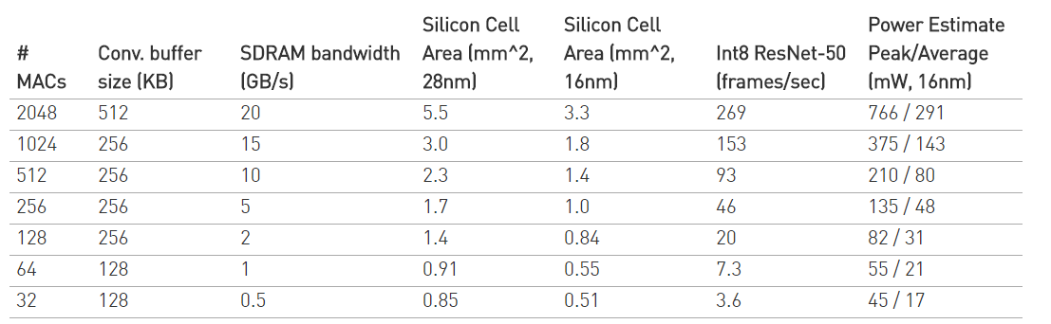
Implementation

Slide 8
Simulation
Configuration
nv_large：2048 INT8 MAC
nv_small：64 INT8 MAC
Test Case
sanity0
basic register write and compare read-back value
sanity1
memory copy test using bdma (dbb to dbb), test ends using register polling
sanity2
sanity1 waiting on interrupts instead of register polling
sanity3
convolution test, test ends using register polling and compares output mem region to determine passing
sanity3_cvsram
convolution test, uses cvsram path instead of dbb, test ends using register polling and compares output mem region to determine passing
conv_8x8_fc_int16
pdp_max_pooling_int16
sdp_relu_int16
googlenet_conv2_3x3_int16
cc_alexnet_conv5_relu5_int16_dtest_cvsram

