Slide 1
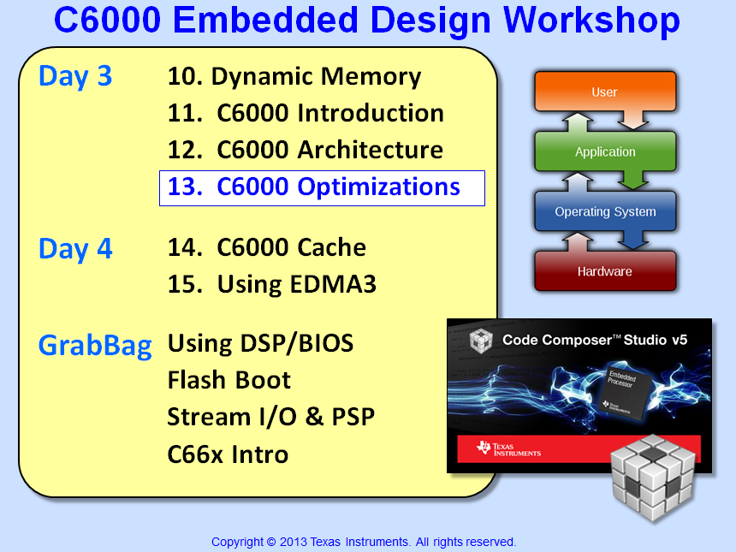

Slide 2


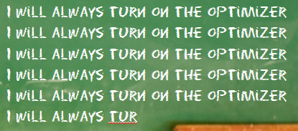

Slide 3
Objectives
Describe how to configure and use the various compiler/optimizer options
Discuss the key techniques to increase performance or reduce code size
Demonstrate how to use optimized libraries
Overview key system optimizations
Lab 13 – Use FIR algo on audio data, optimize using the compiler, benchmark

Slide 4
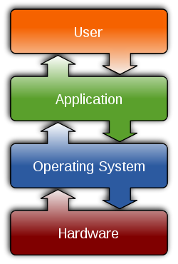
Outline
Introduction
C Compiler & Optimizer
Data Types & Alignment
Restrict Mem Dependencies
Access Hardware Features
Give Compiler MORE info
Use Optimized Libraries
System Optimizations
Quiz + Lab

Slide 5

What Does “Optimal” Mean ?
Every user will have a different definition of “optimal”:
“When my processing keeps up with my I/O (real-time) …”
“When my algo achieves theoretical minimum…”
“When I’ve worked on it for 2 weeks straight, it is FAST ENOUGH…”
“When my boss says GOOD ENOUGH…”
“After I have applied all known (by me) optimization techniques, I guess this is as good as it gets…”
What is implied by that last statement?
Notes:
The point here is that everyone has a different definition of “optimal” or “best in class” or “good enough”. The goal here is NOT to give the ultimate definition that everyone must adhere to. It is simply to say “everyone is different”, but let’s spend some time given you the best info we can so that you have a great tool set to work with in terms of optimization techniques.
What is implied by the last statement is “if you don’t know many techniques, well, you have handcuffed yourself”. The more you know, the more tricks you have to apply.

Slide 6
Know Your Goal and Your Limits…
count
for (i = 0; i < count; i++){ Y += coeff[i] * x[i]; }
Y = Σ coeff_{i} * x_{i}
i = 1
Goals:
A typical goal of any system’s algo is to meet real-time
You might also want to approach or achieve “CPU Min” in order to maximize #channels processed
CPU Min (the “limit”):
The minimum # cycles the algo takes based on architectural limits (e.g. data size, #loads, math operations required)
Real-time vs. CPU Min
Often, meeting real-time only requires setting a few compiler options (easy)
However, achieving “CPU Min” often requires extensive knowledge of the architecture (harder, requires more time)

Slide 7
Optimization – Intro
Optimization is:
Continuous process of refinement in which code being optimized executes faster and takes fewer cycles, until a specific objective is achieved (real-time execution).
When is it “fast enough”? Depends on user’s definition.
Compiler’s personality? Paranoid. Will ALWAYS make decisions to give you the RIGHT answer vs. the best optimization (unless told otherwise)
Bottom Line:
Learn as many optimization techniques as possible – try them all (if necessary)
This is the GOAL of this chapter…
Keep in mind: mileage may vary (highly system/arch dependent)
So, let’s jump right in…

Slide 8
Outline
Introduction
C Compiler & Optimizer
“Debug” vs. “Optimized”
Build Configurations
Size Optimizations
File & Function-Specific Opts
Coding Guidelines
Data Types & Alignment
Restrict Mem Dependencies
Access Hardware Features
Give Compiler MORE info
Use Optimized Libraries
System Optimizations
Quiz + Lab

Slide 9
Outline
Introduction
C Compiler & Optimizer
“Debug” vs. “Optimized”
Build Configurations
Size Optimizations
File & Function-Specific Opts
Coding Guidelines
Data Types & Alignment
Restrict Mem Dependencies
Access Hardware Features
Give Compiler MORE info
Use Optimized Libraries
System Optimizations
Quiz + Lab

Slide 10
“Debug” vs. “Optimized” – Benchmarks
FIR
for (j = 0; j < nr; j++) {
sum = 0;
for (i = 0; i < nh; i++)
sum += x[i + j] * h[i];
r[j] = sum >> 15;
}
Dot Product
for (i = 0; i < count; i++){ Y += coeff[i] * x[i]; }
Benchmarks:
Algo FIR (256, 64) DOTP (256-term)
Debug (no opt, –g) 817K 4109
“Opt” (-o3, no –g) 18K 42
Add’l pragmas 7K 42
(DSPLib) 7K 42
CPU Min 4096 42
Debug – get your code LOGICALLY correct first (no optimization)
“Opt” – increase performance using compiler options (easier)
“CPU Min” – it depends. Could require extensive time…

Slide 11
“Debug” vs. “Optimized” – Environments
“Debug” (–g, NO opt): Get Code Logically Correct
Provides the best “debug” environment with full symbolic support, no “code motion”, easy to single step
Code is NOT optimized – i.e. very poor performance
Create test vectors on FUNCTION boundaries (use same vectors as Opt Env)
“Opt” (–o3, –g ): Increase Performance
Higher levels of “opt” results in code motion – functions become “black boxes” (hence the use of FXN vectors)
Optimizer can find “errors” in your code (use volatile)
Highly optimized code (can reach “CPU Min” w/some algos)
Each level of optimization increases optimizer’s “scope”…

Slide 12
Levels of Optimization
FILE1.C
{
{
}
{
. . .
}
}
{
. . .
}
-o0, -o1 -o2 -o3 -pm -o3
LOCAL
single block
FUNCTION
across
blocks
FILE
across
functions
PROGRAM
across files
Increasing levels of opt:
↑ scope, code motion
↑ build times
↓ visibility
FILE2.C
{
. . .
}

Slide 13
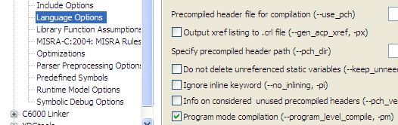
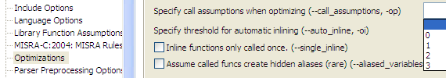
Program Level Optimization (-pm)
Using –pm
Right-click on your Project and select:
Build Options…
Throttling –pm with –op_{n}
-pm is critical in compiling for maximum performance (requires use of –o3)
-pm creates a temp.c file which includes all C source files, thus giving the optimizer a program-level optimization context
-op_{n} describes a program's external references (-op2 means NO ext’l refs) (-op is what “throttles” –pm …)
Be careful with –op2 (no ext’l refs). BIOS scheduler calls are “external” to C
Notes:
“External reference” means that a function or global is OUTSIDE the scope of what the compiler can see.
-op0: External function and external global references exist (least aggressive)
-op1: External data (global) references exist, but no ext’l fxn refs
-op2: NONE – no external data or function references (MOST AGGRESSIVE)
-op3: Ext’l fxn refs, but no ext’l data refs

Slide 14
Outline
Introduction
C Compiler & Optimizer
“Debug” vs. “Optimized”
Build Configurations
Size Optimizations
File & Function-Specific Opts
Coding Guidelines
Data Types & Alignment
Restrict Mem Dependencies
Access Hardware Features
Give Compiler MORE info
Use Optimized Libraries
System Optimizations
Quiz + Lab

Slide 15

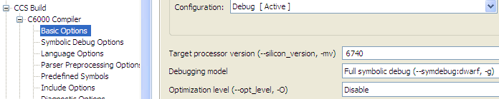
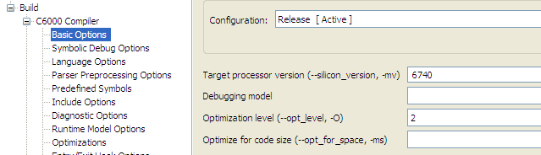
Two Default Configurations
For new projects, CCS always creates two default build configurations:
“Debug” Options (OK for “Debug” Environment)
“Release” Options (Ok for “first step” optimization)
–o3, NO –g
Note: these are simply “sets” or “containers” for build options. If you set a path in one, it does NOT copy itself to the other (e.g. includes). Also, you can make your own!

Slide 16
Outline
Introduction
C Compiler & Optimizer
“Debug” vs. “Optimized”
Build Configurations
Size Optimizations
File & Function-Specific Opts
Coding Guidelines
Data Types & Alignment
Restrict Mem Dependencies
Access Hardware Features
Give Compiler MORE info
Use Optimized Libraries
System Optimizations
Quiz + Lab

Slide 17
Minimizing Space Option (-ms)
The table shows the basic strategy employed by compiler and Asm-Opt when using the –ms options.
% denotes how much you “care” about each:
-ms level | Performance | Code Size
none | 100% | 0
-ms0 | 90 | 10
-ms1 | 60 | 40
-ms2 | 20 | 80
-ms3 | 0 | 100%
Any –ms will invoke compressed opcodes (16 bit)
User must use the optimizer (-o) with –ms for the greatest effect. Suggestion: use on “init” code.

Slide 18
Additional Code Space Options
Use program level optimization (-pm)
Try -mh to reduce prolog/epilog code
Use –oi0 to disable auto-inlining
Inlining inserts a copy of a function into a C file rather than calling (i.e. branching) to it
Auto-inlining is a compiler feature whereas small functions are automatically inlined
Auto-inlining is enabled for small functions by –o3
The –oisize sets the size of functions to be automatcially inlined
size = function size * # of times inlined
Use –on1 or –on2 to report size
Force function inlining with inline keyword
inline void func(void);

Slide 19
Outline
Introduction
C Compiler & Optimizer
“Debug” vs. “Optimized”
Build Configurations
Size Optimizations
File & Function-Specific Opts
Coding Guidelines
Data Types & Alignment
Restrict Mem Dependencies
Access Hardware Features
Give Compiler MORE info
Use Optimized Libraries
System Optimizations
Quiz + Lab

Slide 20
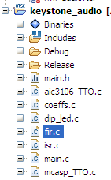
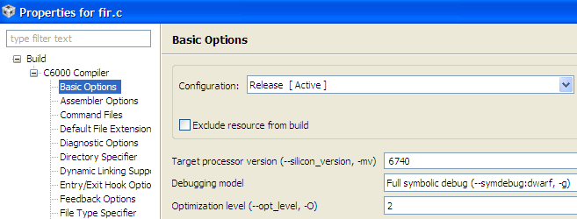
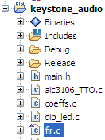
File Specific Options
Right-click on file and select “Build Options”
Apply settings and click OK.
Little triangle  on file denotes file-specific options applied
Can also use FUNCTION-specific options via a pragma:
#pragma FUNCTION_OPTIONS();
Note: most used are -o, -ms

Slide 21
Outline
Introduction
C Compiler & Optimizer
“Debug” vs. “Optimized”
Build Configurations
Size Optimizations
File & Function-Specific Opts
Coding Guidelines
Data Types & Alignment
Restrict Mem Dependencies
Access Hardware Features
Give Compiler MORE info
Use Optimized Libraries
System Optimizations
Quiz + Lab

Slide 22
Programming the ‘C6000
Source
Efficiency*
Effort
Compiler
Optimizer
C
C ++
80 - 100%
Low
Assembly
Optimizer
Linear ASM
95 - 100%
Med
Hand
Optimize
ASM
100%
High
T TO
Technical Training
Organization
Notes:
The key points here are: (1) you have three options to generate code; (2) each option is independent of the other (three different types of input files: C, serial assembly, ASM); (3) Assuming that hand-coded asm provides 100% efficiency (as good as you can get performance wise), the C compiler and linear assembler trade off performance with coding effort; (4) 80% is VERY high for a C compiler - therefore, many people choose to use C as the majority means to write code for the C6x.
Some people might ask “so where did you get these numbers?” The tools group ran many popular algorithms through each tool. Sometimes the C compiler actually beat hand-coded asm, but other times it did not. On average, the compiler produced code that was 80% the efficiency of hand-optimized asm. Currently, this benchmark is for LOOPs ONLY. If you have more operating-system-like code (decision trees, bit testing, branches, etc), the efficiency will be lower because the decisions are more serial and the processor cannot make the best use of all 8 functional units as well as w/loops. The priority at the start was to make loops efficient and then begin working on serial, o/s-type code.
I also tell them that they will be exploring each option throughout the workshop and be able to benchmark code using each method.

Slide 23
Basic C Coding Guidelines
In order for the compiler to create the most efficient code, it is best to follow these guidelines:
1. Use Minimum Complexity Code
If a human can’t understand and read it easily, neither can the compiler
Break up larger “logic” into smaller loops/pieces
2. No function calls in tight loops
The compiler cannot create a pipelined loop with fxn calls present
3. Keep loops relatively small
Helps compiler generate tighter, more efficient pipelined loops
4. Create test vectors at FUNCTION boundaries
When optimization is turned on, it is nearly impossible to single-step inside fxns
5. Look at the assembly file – SPLOOP ?
If curious, look at the disassembly. Was SPLOOP/LDDW used or not? Why?
Assembly optimizer generates comments as to what happened in the loop and why
Use –mw (verbose pipeline info), -os (interlist), -k (keep .asm file) to see all info

Slide 24
Outline
Introduction
C Compiler & Optimizer
Data Types & Alignment
C6000 Data Types
Data Alignment
Recent Changes: EABI, C66x
Restrict Mem Dependencies
Access Hardware Features
Give Compiler MORE info
Use Optimized Libraries
System Optimizations
Quiz + Lab

Slide 25
Outline
Introduction
C Compiler & Optimizer
Data Types & Alignment
C6000 Data Types
Data Alignment
Recent Changes: EABI, C66x
Restrict Mem Dependencies
Access Hardware Features
Give Compiler MORE info
Use Optimized Libraries
System Optimizations
Quiz + Lab

Slide 26
‘C6000 C Data Types
Type | Bits | Representation
char | 8 | ASCII
short | 16 | Binary, 2's complement
int | 32 | Binary, 2's complement
long | 40* | Binary, 2's complement
long long | 64 | Binary, 2's complement
float | 32 | IEEE 32-bit
double | 64 | IEEE 64-bit
long double | 64 | IEEE 64-bit
pointers | 32 | Binary
* long type is 32-bit for EABI (ELF)
Device ALWAYS accesses data on aligned boundaries
Notes:
We cover this here for lack of any better place to do this in the workshop.
Here’s the key points to get across during this foil …
1. int is 32-bits. Use int or unsigned int for loop counters to avoid unnecessary sign extension
2. Use shorts for integer multiplication inputs since this makes the most efficient use of the 16 x 16-bit integer multipliers.
3. On ‘C67x devices, 32-bit float operations are performed in hardware. The ‘C6000 supports IEEE 32-bit floating-point math.
4. long operands are 40-bits in length:
-- This implementation choice was made since the ‘C6000 has hardware support for 40-bit arithmetic.
-- Ordinarily used to provide headroom in integer operations.
-- Provides 8-bit “carry bit”.
-- Avoid coding longs and ints as the same size. (common practice on some processors)
5. double precision floating-point hardware supports IEEE 64-bit floating-point math.
6. pointer’s can reach the entire length of the memory map, all 32-bits.

Slide 27
Outline
Introduction
C Compiler & Optimizer
Data Types & Alignment
C6000 Data Types
Data Alignment
Recent Changes: EABI, C66x
Restrict Mem Dependencies
Access Hardware Features
Give Compiler MORE info
Use Optimized Libraries
System Optimizations
Quiz + Lab

Slide 28
Data Alignment in Memory
DataType.C
char z = 1;
short x = 7;
int y;
double w;
void main (void)
{
y = child(x, 5);
}
Byte (LDB) Boundaries
0
z
1
2
3
4
5
6
7
8
Hint: all single data items are aligned on “type” boundaries…
9
Notes:
Hidden slide for Word Doc only.

Slide 29
Data Alignment in Memory
DataType.C
char z = 1;
short x = 7;
int y;
double w;
void main (void)
{
y = child(x, 5);
}
Byte (LDB) Boundaries
0
z
1
2
3
4
5
6
7
8
Hint: all single data items are aligned on “type” boundaries…
9

Slide 30
Data Alignment in Memory
DataType.C
char z = 1;
short x = 7;
int y;
double w;
void main (void)
{
y = child(x, 5);
}
Short (LDH) Boundaries
0
z
2
x
x
4
6
8
Hint: all single data items are aligned on “type” boundaries…

Slide 31
Data Alignment in Memory
DataType.C
char z = 1;
short x = 7;
int y;
double w;
void main (void)
{
y = child(x, 5);
}
Int/Float (LDW)
0
z
x
x
4
y
y
y
y
8
Hint: all single data items are aligned on “type” boundaries…
.
.
.

Slide 32
Data Alignment in Memory
DataType.C
char z = 1;
short x = 7;
int y;
double w;
void main (void)
{
y = child(x, 5);
}
Double (LDDW)
7
y
8
w
w
w
w
C
w
w
w
F
w
The top of Arrays are always aligned on larger type boundaries
32-bit boundary for C62x & C67x
64-bit boundary for C64x, C64x+ & C674x
128-bit boundary for C66x
.
.
.

Slide 33
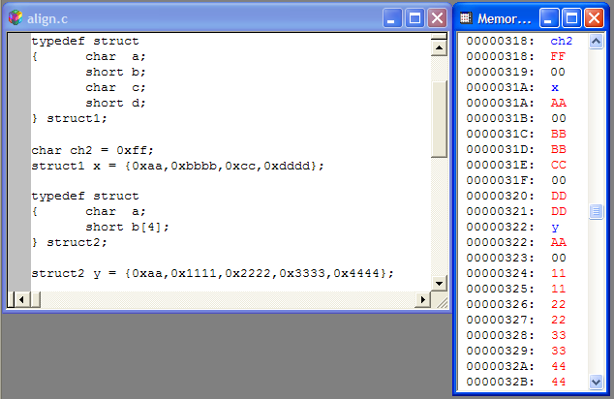
Alignment of Structures
Structures are aligned to the largest type they contain
For data space efficiency, start with larger types first to minimize holes
Arrays within structures are only aligned to their typesize
Aligning arrays within structs...

Slide 34
Forcing Alignment within Structures
While arrays are aligned to 32 or 64-bit boundaries, arrays within structures are not, which might affect optimization.
Here are a couple ideas to force arrays to 8-byte alignment:
1. Use dummy variable to force alignment
typedef struct ex1_t{
short b; long long dummy1;
short a[40];
} ex1;
2. Use unions
typedef union algn_t{
short a2[80];
long long a8[10];
};
typedef struct ex2_t{
short b; algn_t a3;
} ex2;
How can we force alignments of scalars or structs?

Slide 35
Forcing Alignment
#pragma DATA_ALIGN(x, 4)
short z;
short x;
Data Align pragma can align to any 2^{n} boundary
0
z
z
x
They would have been placed here ...
x
4
x
but pragma forces them to next 4 byte (int) boundary
x
8

Slide 36
Outline
Introduction
C Compiler & Optimizer
Data Types & Alignment
C6000 Data Types
Data Alignment
Recent Changes: EABI, C66x
Restrict Mem Dependencies
Access Hardware Features
Give Compiler MORE info
Use Optimized Libraries
System Optimizations
Quiz + Lab

Slide 37
EABI : ELF ABI
Starting with v7.2.0 the C6000 Code Gen Tools (CGT) will begin shipping two versions of the Linker:
COFF: Binary file-format used by TI tools for over a decade
ELF: New binary file-format which provides additional features like dynamic/relocatable linking
You can choose either format
v7.3.x default may become ELF (prior to this, choose ELF for new features)
Continue using COFF for projects already in progress using “--abi=coffabi” compiler option (support will continue for a long time)
Formats are not compatible
Your program’s binary files (.obj, .lib) must all be built with the same format
If building libraries used for multiple projects, we recommend building two libraries – one with each format
Migration Issues
EABI long’s are 32 bits; new TI type (__int40_t) created to support 40 data
COFF adds a leading underscore to symbol names, but the EABI does not
See: http://processors.wiki.ti.com/index.php/C6000_EABI_Migration

Slide 38
C66x : New __float2_t Type
Recommendations on the use/non-use of the "double" type
In order to better support packed data compiler optimizations in the future, the use of the type "double" for *packed data* is now discouraged and its support may be discontinued in the future. ("double" support is NOT going away!)
Changes do NOT break compatibility with older code (source files or object files).
Recommendations:
long long: Should be used for 64-bit packed integer data
double: Should only be used for double-precision floating point values.
__float2_t: Holds two floats; use instead of double for holding two floats.
Intrinsics (intrinsics are discussed more chapter 9):
There are new __float2_t manipulation intrinsics (see below) that should be used to create and manipulate objects of type __float2_t.
C66 intrinsics with packed float data are now declared using __float2_t instead of double.
When using any intrinsic that involves __float2_t, c6x.h must be included.
Certain intrinsics that used double to store fixed-point packed data have been deprecated. They will still be supported in the near future, but their descriptions will be removed from the compiler user's guide (spru187). Use the long long versions instead. Deprecated: _mpy2, _mpyhi, _mpyli, _mpysu4, _mpyu4, and _smpy2.

Slide 39
C66x : 128-bit
C66x adds 128-bit data type
Needed for certain SIMD operations on C6600 (i.e. quad-16x16 multiplies)
New container type for storing 128-bits of data: __x128_t
Objects of this type are aligned to a 128-bit boundary in memory
Compiler provided header file defines new type: c6x.h
This type may be used only when compiling for C66x (-mv6600), available starting CGT v7.2
Compiler loads __x128_t object into four registers (a register quad)
The following operations are supported:
Declarations: local, global, pointer, array, member of a struct, class, or union
Assign a __x128_t object to another __x128_t object
Pass to function – or use as return value (Pass by value)
Use 128-bit intrinsics to set and extract contents (see list below)

Slide 40
128-bit Type : Supported / Not-Supported
The following operations are supported:
Declarations: local, global, pointer, array, member of a struct, class, or union
Assign a __x128_t object to another __x128_t object
Pass to function – or use as return value (Pass by value)
Use 128-bit intrinsics to set and extract contents (see list below)
The following operations are not supported:
Native-type operations, such as +, -, *, etc
Cast an object to a __x128_t type
Access the elements of a __x128_t using array or struct notation
Pass a __x128_t object to I/O functions like printf. Instead, extract the values from the __x128_t object by using appropriate intrinsics.

Slide 41
10min Brain Break?

Slide 42
Outline
Introduction
C Compiler & Optimizer
Data Types & Alignment
Restrict Mem Dependencies
Access Hardware Features
Give Compiler MORE info
Use Optimized Libraries
System Optimizations
Quiz + Lab

Slide 43
What is Aliasing?
int x;
int *p;
main()
{
p = &x;
x = 5;
*p = 8;
}
One memory location, two ways to access it:
x and *p
Note: This is a very simple alias example. The compiler doesn't have any problem disambiguating an alias condition like this.

Slide 44
Aliasing?
void fcn(*in, *out)
{
LDW *in++, A0 ADD A0, 4, A1 STW A1, *out++
}
in
a
in + 4
b
out
c
out₀
Intent: no aliasing (ASM code?)
*in and *out point to different memory locations
Reads are not the problem, WRITES are. *out COULD point anywhere
Compiler is paranoid – it assumes aliasing unless told otherwise. ASM code is the key (pipelining)
Use restrict keyword (more soon…)
d
out₁
e
out₂
...
...
Notes:
If *in could equal *out, then they could point to the same memory location. This is called an alias. Generated “pipelined” ASM code won’t work.

Slide 45
Aliasing?
What happens if the function is called like this?
fcn(*myVector, *myVector+1)
void fcn(*in, *out)
{
LDW *in++, A0 ADD A0, 4, A1 STW A1, *out++
}
in
a
Definitely Aliased pointers
*in and *out could point to the same address
But how does the compiler know?
If you tell the compiler there is no aliasing, this code will break (LDs in software pipelined loop)
One solution is to “restrict” the writes - *out (see next slide…)
in + 4
b
c
d
e
...
Notes:
If *in could equal *out, then they could point to the same memory location. This is called an alias.

Slide 46
Alias Solutions
Compiler solves most aliasing on its own.
If in doubt, the result will be correct even if the most optimal method won’t be used
Program Level Optimization (–pm –o3)
Provide compiler visibility to entire program
No Bad Aliasing Option (–mt)
Tell the compiler that no bad aliases exist in entire project
See Compiler User's Guide for definition of “bad”
Previous weighted vector summation example performance was increased by 5x (by using –mt)
“Restrict” Keyword (ANSI C)
Similar to –mt, but on a array-level basis
void fcn(short * in, short * restrict out)
Along with these suggestions, we highly recommend you check out:
TMS320C6000 Programmer’s Guide
TMS320C6000 Optimizing C Compiler User’s Guide

Slide 47
Outline
Introduction
C Compiler & Optimizer
Data Types & Alignment
Restrict Mem Dependencies
Access Hardware Features
Give Compiler MORE info
Use Optimized Libraries
System Optimizations
Quiz + Lab

Slide 48
Comparing the Coding Methods
C Code
y = a * b;
C Code Using Intrinsics
y = _mpyh (a, b);
In-Line Assembly
asm (“ MPYH A0, A1, A2”);
Intrinsics...
Can use C variable names instead of register names
Are compatible with the C environment
Adhere to C’s function call syntax
Do NOT use in-line assembly !
Assembly Code
MPYH A0, A1, A2

Slide 49
Intrinsics - Examples
Think of intrinsic functions as a specialized function library written by TI
#include <c6x.h> has prototypes for all the intrinsic functions
Intrinsics are great for accessing the hardware functionality which is unsupported by the C language
To run your C code on another compiler, download intrinsic C-source:
spra616.zip
Example:
Intrinsics
_add2( )
_clr ( )
_ext/u ( )
_lmbd ( )
_mpy ( )
_mpyh ( )
_mpylh ( )
_mpyhl ( )
_nassert ( )
_norm ( )
_sadd ( )
_set ( )
_smpy ( )
_smpyh ( )
_sshl ( )
_ssub ( )
_subc ( )
_sub2 ( )
_sat ( )
int x, y, z; z = _lmbd(x, y);
Refer to C Compiler User’s Guide for more information

Slide 50
Outline
Introduction
C Compiler & Optimizer
Data Types & Alignment
Restrict Mem Dependencies
Access Hardware Features
Give Compiler MORE info
Use Optimized Libraries
System Optimizations
Quiz + Lab

Slide 51
Provide Compiler with More Insight
✓
Program Level Optimization: -pm –op2 -o3
#pragma DATA_ALIGN (var, byte align)
#pragma UNROLL(# of times to unroll);
#pragma MUST_ITERATE(min, max, %factor);
Use volatile keyword
Set MAX interrupt threshold
Use _nassert() to tell optimizer about pointer alignment
✓
Like –pm, #pragmas are an easy way to pass more information to the compiler
The compiler uses this information to create “better” code
#pragmas are ignored by other C compilers if they are not supported

Slide 52
3. UNROLL(# of times to unroll)
#pragma UNROLL(2);
for(i = 0; i < count ; i++) {
sum += a[i] * x[i];
}
Tells the compiler to unroll the for() loop twice
The compiler will generate extra code to handle the case that count is odd
The #pragma must come right before the for() loop
UNROLL(1) tells the compiler not to unroll a loop

Slide 53
4. MUST_ITERATE(min, max, %factor)
#pragma UNROLL(2);
#pragma MUST_ITERATE(10, 100, 2);
for(i = 0; i < count ; i++) {
sum += a[i] * x[i];
}
Gives the compiler information about the trip (loop) count
In the code above, we are promising that:
count >= 10, count <= 100, and count % 2 == 0
If you break your promise, you might break your code
MIN helps with code size and software pipelining
MULT allows for efficient loop unrolling (and “odd” cases)
The #pragma must come right before the for() loop

Slide 54
5. Use Volatile Keyword
If a variable changes OUTSIDE the optimizer’s scope, it will remove/delete the variable and any associated code.
For example, let’s say *ctrl points to an EMIF address:
int *ctrl;
while (*ctrl == 0);
Use volatile keyword to tell compiler to “leave it alone”:
volatile int *ctrl;
while (*ctrl == 0);

Slide 55
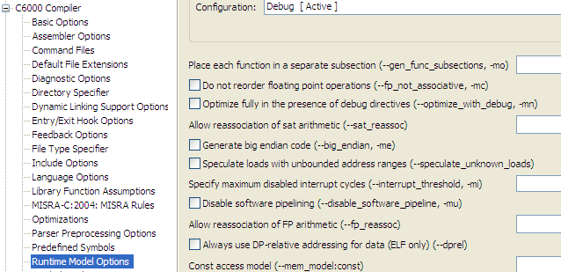
6. Set MAX Interrupt Threshold
Loops using SPLOOP buffer are interruptible. However, loops that do not meet the criteria for SPLOOP are NOT generally interruptible
Use the –mi option to set the MAX #cycles that interrupts are disabled (n = 1000 is a good starting number)
This option does NOT comprehend slow memory cycles or stalls
#pragma FUNC_INTERRUPT_THRESHOLD(func, threshold);

Slide 56
-mi Details
-mi0
Compiler’s code is not interruptible
User must guarantee no interrupts will occur
-mi1
Compiler uses single assignment and never produces a loop less than 6 cycles
-mi1000 (or any number > 1)
Tells the compiler your system must be able to see interrupts every 1000 cycles
When not using –mi (compiler’s default)
Compiler will software pipeline (when using –o2 or –o3)
Interrupts are disabled for s/w pipelined loops
Notes:
Be aware that the compiler is unaware of issues such as memory wait-states, etc.
Using –mi, the compiler only counts instruction cycles

Slide 57
MUST_ITERATE Example
int dot_prod(short *a, Short *b, int n)
{
int i, sum = 0;
#pragma MUST_ITERATE ( ,512)
for (i = 0; i < n; i++)
sum += a[i] * b[i];
return sum;
}
Provided:
If interrupt threshold was set at 1000 cycles (-mi 1000),
Assuming this can compile as a single-cycle loop,
And 512 = max# for Loop count (per MUST_ITERATE pragma).
Result:
The compiler knows a 1-cycle kernel will execute no more than 512 times which is less than the 1000 cycle interrupt disable option (–mi1000)
Uninterruptible loop works fine
Verdict:
3072 cycle loop (512 x 6) can become a 512 cycle loop

Slide 58
7. _nassert()
_nassert((ptr & 0x7) == 0 );
Generates no code, evaluated at compile time
Tells the optimizer that the expression declared with the ‘assert’ function is true
Above example declares that ptr is aligned on an 8-byte boundary (i.e. the lowest 3-bits of the address in ptr are 000b)
In the next lab, _nassert() is used to tell the compiler that “history” pointer is aligned on an 8-byte boundary

Slide 59
Outline
Introduction
C Compiler & Optimizer
Data Types & Alignment
Restrict Mem Dependencies
Access Hardware Features
Give Compiler MORE info
Use Optimized Libraries
System Optimizations
Quiz + Lab

Slide 60
DSPLIB
Adaptive filtering | Math
DSP_firlms2 | DSP_dotp_sqr
Correlation | DSP_dotprod
DSP_autocor | DSP_maxval
FFT | DSP_maxidx
DSP_bitrev_cplx | DSP_minval
DSP_radix 2 | DSP_mul32
DSP_r4fft | DSP_neg32
DSP_fft | DSP_recip16
DSP_fft16x16r | DSP_vecsumsq
DSP_fft16x16t | DSP_w_vec
DSP_fft16x32 | Matrix
DSP_fft32x32 | DSP_mat_mul
DSP_fft32x32s | DSP_mat_trans
DSP_ifft16x32 | Miscellaneous
DSP_ifft32x32 | DSP_bexp
Filters & convolution | DSP_blk_eswap16
DSP_fir_cplx | DSP_blk_eswap32
DSP_fir_gen | DSP_blk_eswap64
DSP_fir_r4 | DSP_blk_move
DSP_fir_r8 | DSP_fltoq15
DSP_fir_sym | DSP_minerror
DSP_iir | DSP_q15tofl
Optimized DSP Function Library for C programmers using C62x/C67x and C64x devices
These routines are typically used in computationally intensive real-time applications where optimal execution speed is critical.
By using these routines, you can achieve execution speeds considerably faster than equivalent code written in standard ANSI C language. And these ready-to-use functions can significantly shorten your development time.
The DSP library features:
C-callable
Hand-coded assembly-optimized
Tested against C model and existing run-time-support functions

Slide 61
IMGLIB
Compression / Decompression | Picture Filtering / Format Conversions
IMG_fdct_8x8 | IMG_conv_3x3
IMG_idct_8x8 | IMG_corr_3x3
IMG_idct_8x8_12q4 | IMG_corr_gen
IMG_mad_8x8 | IMG_errdif_bin
IMG_mad_16x16 | IMG_median_3x3
IMG_mpeg2_vld_intra | IMG_pix_expand
IMG_mpeg2_vld_inter | IMG_pix_sat
IMG_quantize | IMG_yc_demux_be16
IMG_sad_8x8 | IMG_yc_demux_le16
IMG_sad_16x16 | IMG_ycbcr422_rgb565
IMG_wave_horz | Image Analysis
IMG_wave_vert | IMG_boundary
 | IMG_dilate_bin
 | IMG_erode_bin
 | IMG_histogram
 | IMG_perimeter
 | IMG_sobel
 | IMG_thr_gt2max
 | IMG_thr_gt2thr
 | IMG_thr_le2min
 | IMG_thr_le2thr
Optimized Image Function Library for C programmers using C62x/C67x and C64x devices
The Image library features:
C-callable
C and linear assembly src code
Tested against C model

Slide 62
FastRTS (C67x)
Optimized floating-point math function library for C programmers using TMS320C67x devices
Includes all floating-point math routines currently in existing C6000 run-time-support libraries
The FastRTS library features:
C-callable
Hand-coded assembly-optimized
Tested against C model and existing run-time-support functions
Single Precision | Double Precision
atanf | atan
atan2f | atan2
cosf | cos
expf | exp
exp2f | exp2
exp10f | exp10
logf | log
log2f | log2
log10f | log10
powf | pow
recipf | recip
rsqrtf | rsqrt
sinf | sin
FastRTS must be installed per directions in its Users Guide (SPRU100a.PDF)

Slide 63
FastRTS (C62x/C64x)
Optimized floating-point math function library for C programmers enhances floating-point performance on C62x and C64x fixed-point devices
The FastRTS library features:
C-callable
Hand-coded assembly-optimized
Tested against C model and existing run-time-support functions
Single Precision | Double Precision | Others
_addf | _addd | _cvtdf
_divf | _divd | _cvtfd
_fixfi | _fixdi
_fixfli | _fixdli
_fixfu | _fixdu
_fixful | _fixdul
_fltif | _fltid
_fltlif | _fltlid
_fltuf | _fltud
_fltulf | _fltuld
_mpyf | _mpyd
recipf | recip
_subf | _subd
FastRTS must be installed per directions in its Users Guide (SPRU653.PDF)

Slide 64
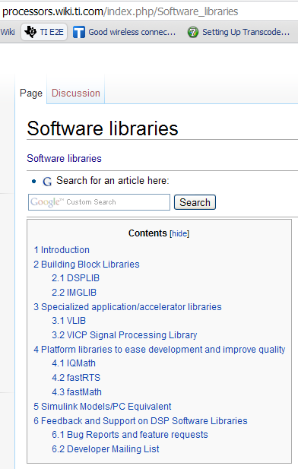
Download and Support
Download via TI Wiki
Source code available
Includes doc folders which contain useful API guides
Other docs:
SPRU565 – DSP API User Guide
SPRU023 – Imaging API UG
SPRU100 – FastRTS Math API UG
SPRA885 – DSPLIB app note
SPRA886 – IMGLIB app note

Slide 65
Outline
Introduction
C Compiler & Optimizer
Data Types & Alignment
Restrict Mem Dependencies
Access Hardware Features
Give Compiler MORE info
Use Optimized Libraries
System Optimizations
BIOS Libraries
Optimizing Memory Placement
Use EDMA
Use Cache
System Opt (SCR)
Quiz + Lab

Slide 66
Outline
Introduction
C Compiler & Optimizer
Data Types & Alignment
Restrict Mem Dependencies
Access Hardware Features
Give Compiler MORE info
Use Optimized Libraries
System Optimizations
BIOS Libraries
Optimizing Memory Placement
Use EDMA
Use Cache
System Opt (SCR)
Quiz + Lab

Slide 67

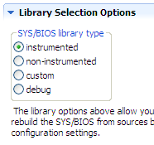
BIOS Library Types
Instrumented – all logs and assert checking enabled. Use: dev’t, debug, OK to deploy.
Non-Instrumented – NO logs or assert checking. Use: if not meeting real-time with instrumented ver
Custom – uses the app’s .cfg to rebuild BIOS according to those settings
Debug – Use: stepping into and debugging BIOS itself – not generally useful for customers
Start Here

Slide 68
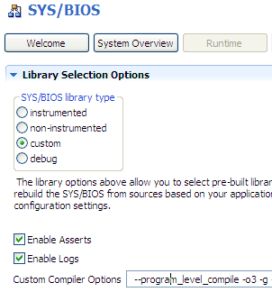
Using “Custom”
Compiles BIOS C Source Code along with your project. Can customize compiler options and perform source-level debug of BIOS
Uncheck Enable boxes to remove Assert/Log
Build error generated if you try to use a feature not supported by non/instrumented options

Slide 69
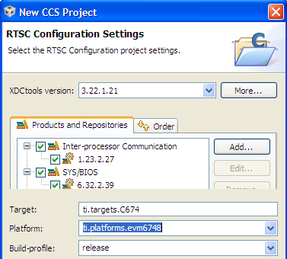
Build-profile Options
For pure SYS/BIOS apps, release and debug profiles are the same – both provide same set of libraries for linking your app
If the user installs other packages (e.g. Codec Engine) and they contain debug and release versions, this selection can be used to choose between those libraries.
“release” profile is the default – recommended for SYS/BIOS apps
Reference: BIOS User’s Guide Appendix E (Minimizing the Application Footprint)

Slide 70
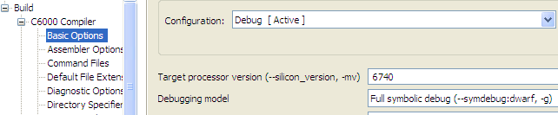
Build Configurations (C Compiler)
“Debug” and “Release” profiles specified here have NO impact on the BIOS library selection or BIOS performance
These settings are ONLY used for the application .c files and libraries built with CCS.

Slide 71
Outline
Introduction
C Compiler & Optimizer
Data Types & Alignment
Restrict Mem Dependencies
Access Hardware Features
Give Compiler MORE info
Use Optimized Libraries
System Optimizations
BIOS Libraries
Optimizing Memory Placement
Use EDMA
Use Cache
System Opt (SCR)
Quiz + Lab

Slide 72
Custom Placement of Data and Code
Problem #1: have three arrays, two have to be linked into L1D and one can be linked to DDR2. How do you “split” the .far section??
.far
L1D
rcvPing
rcvPing
DDR2
rcvPong
SlowBuf
rcvPong
SlowBuf
Problem #2: have two fxns, one has to be linked into L1P and the other can be linked to DDR2. How do you “split” the .text section??
.text
filter
L1P
DDR2
filter
SlowCode
SlowCode
Notes:
When you create a custom section, you must use a userlinker.cmd file and link in (-l, that’s a minus L) the linker command file generated by the cdb. This user linker command file will contain just a SECTIONS directive and the memory area you specify can be set up in the .cdb file and Mem Manager.

Slide 73
Making Custom Sections
Create custom data section using:
#pragma DATA_SECTION (rcvPing, “.far:rcvBuff”);
int rcvPing[32];
#pragma DATA_SECTION (rcvPong, “.far:rcvBuff”);
int rcvPong[32];
rcvPing is the name of the buffer
“.far: rcvBuff” is the name of the custom section
Create custom code section using:
#pragma CODE_SECTION(filter, “.text:_filter”);
void filter(*rcvPing, *coeffs, …){…
How do we link these custom sections?
Notes:
When you create a custom section, you must use a userlinker.cmd file and link in (-l, that’s a minus L) the linker command file generated by the cdb. This user linker command file will contain just a SECTIONS directive and the memory area you specify can be set up in the .cdb file and Mem Manager.

Slide 74
Linking Custom Sections
“Build”
audio_appcfg.cmd
app.cfg
Linker
MEMORY { … }
SECTIONS { … }
.map
SECTIONS
{ .far:rcvBuff: > FAST_RAM
.text:_filter: > FAST_RAM
}
userlinker.cmd
app.out
Create your own linker.cmd file for custom sections
CCS projects can have multiple linker CMD files
Results of the linker are written to the .map file
“.far:” used in case linker.cmd forgets to link custom section
–mo creates subsection for every fxn (great for libraries)
–w warns if unexpected section encountered
Notes:
Do not modify appcfg.cmd – your changes will be overwritten during “Build” (or “Rebuild”)

Slide 75
Outline
Introduction
C Compiler & Optimizer
Data Types & Alignment
Restrict Mem Dependencies
Access Hardware Features
Give Compiler MORE info
Use Optimized Libraries
System Optimizations
BIOS Libraries
Optimizing Memory Placement
Use EDMA
Use Cache
System Opt (SCR)
Quiz + Lab

Slide 76
Using EDMA
External Memory
Internal RAM
Program
0x8000
func1
func2
func3
CPU
EDMA
EMIF
Program the EDMA to automatically transfer data/code from one location to another.
Operation is performed WITHOUT CPU intervention
All details covered in a later chapter…

Slide 77
Multiple DMA’s : EDMA3 and QDMA
VPSS
EDMA3
(System DMA)
C64x+ DSP
L1P
L1D
DMA
(sync)
QDMA
(async)
Master Periph
L2
DMA
Enhanced DMA (version 3)
DMA to/from peripherals
Can be sync’d to peripheral events
Handles up to 64 events
QDMA
Quick DMA
DMA between memory
Async – must be started by CPU
4-8 channels available
Both Share (number depends upon specific device)
128-256 Parameter RAM sets (PARAMs)
64 transfer complete flags
2-4 Pending transfer queues
Notes:
DM6437 – 128 PSETS, 8 QDMA channels, 3 Queues, 64 TCCs
DM6446 – 128/8/2/64
6455 – 256/4/4/64

Slide 78
Multiple DMA’s : Master Periphs & C64x+ IDMA
VPSS
EDMA3
(System DMA)
C64x+ DSP
Front End (capture)
Back End (display)
L1P
L1D
DMA
(sync)
QDMA
(async)
Master Periph’s
USB  ATA
Ethernet
VLYNQ
IDMA
L2
Master Peripherals
VPSS (and other master periph’s) include their own DMA functionality
USB, ATA, Ethernet, VLYNQ share bus access to SCR
IDMA
Built into all C64x+ DSPs
Performs moves between internal memory blocks and/or config bus
Don’t confuse with iDMA API
Notes:  Both ARM and DSP can access the EDMA3  Only DSP can access hardware IDMA

Slide 79
Outline
Introduction
C Compiler & Optimizer
Data Types & Alignment
Restrict Mem Dependencies
Access Hardware Features
Give Compiler MORE info
Use Optimized Libraries
System Optimizations
BIOS Libraries
Optimizing Memory Placement
Use EDMA
Use Cache
System Opt (SCR)
Quiz + Lab

Slide 80
Using Cache Memory
DDR2
Cache
0x8000
Program
func1
func2
func3
CPU
Cache H/W
mDDR
Cache hardware automatically transfers code/data to internal memory, as needed
Addresses in the Memory Map are associated with locations in cache
Cache locations do not have their own addresses
Note: we have an entire chapter dedicated to cache later on…
Notes:
When using the internal memory as memory-mapped RAM, you can either copy all your tasks (or at least the critical ones) into internal memory and execute as needed.
Some systems even “overlay” tasks, that is, they have the DMA copy in new programs threads (routines) while executing others. In this way they can be available as they’re needed. This is often done when the entire program code cannot fit on chip all-at-once.
Of course, if it seems like all your DMA bandwidth is spent copying program code into the internal program memory, you could instead enable the cache. Why? Because this is exactly what a cache is for. It automatically stores program code into internal memory as it is used. Then it’ll be available on-chip whenever it’s needed again. Since most DSP code consists of many loops, this is a great solution.
The cache keeps track of what’s in internal memory and when it runs out of internal memory, it dumps the oldest stuff. AND, it does all this without using any of your DMA channels. Cool!

Slide 81
Outline
Introduction
C Compiler & Optimizer
Data Types & Alignment
Restrict Mem Dependencies
Access Hardware Features
Give Compiler MORE info
Use Optimized Libraries
System Optimizations
BIOS Libraries
Optimizing Memory Placement
Use EDMA
Use Cache
System Opt (SCR)
Quiz + Lab

Slide 82
System Architecture – SCR
SCR – Switched Central Resource
Masters initiate accesses to/from slaves via the SCR
Most Masters (requestors) and Slaves (resources) have their own port to SCR
Lower bandwidth masters (HPI, PCIe, etc) share a port
There is a default priority (0 to 7) to SCR resources that can be modified:
Switched Central Resource
“Masters”
“Slaves”
SRIO
C64 Mem
DDR2
CPU
EMIF64
TC0
TCP
TC1
CC
SCR
VCP
TC2
SRIO, HOST (PCI/HPI), EMAC
TC0, TC1, TC2, TC3
CPU accesses (cache misses)
Priority Register: MSTPRI
TC3
PCI66
PCIe
McBSP
HPI
Utopia
EMAC
Note: refer to your specific datasheet for register names…
Notes:
If masters of the same priority access the same resource, they will share that resource in a round-robin fashion.

Slide 83
Outline
Introduction
C Compiler & Optimizer
Data Types & Alignment
Restrict Mem Dependencies
Access Hardware Features
Give Compiler MORE info
Use Optimized Libraries
System Optimizations
Quiz + Lab

Slide 84
Chapter Quiz
How do you turn ON the optimizer ?
Why is there such a performance delta between “Debug” and “Opt” ?
Name 4 compiler techniques to increase performance besides -o?
Why is data alignment important?
What is the purpose of the –mi option?
What is the BEST feedback mechanism to test compiler’s efficiency?

Slide 85
Chapter Quiz
How do you turn ON the optimizer ?
Why is there such a performance delta between “Debug” and “Opt” ?
Name 4 compiler techniques to increase performance besides -o?
Why is data alignment important?
What is the purpose of the –mi option?
What is the BEST feedback mechanism to test compiler’s efficiency?
Project -> Properties, use –o2 or –o3 for best performance
Debug allows for single-step (NOPs), “Opt” fills delay slots optimally
Data alignment, MUST_ITERATE, restrict, –mi, intrinsics, _nassert()
Performance. The CPU can only perform 1 non-aligned LD per cycle
To specify the max # cycles a loop will go “dark” responding to INTs
Benchmarks, then LOOK AT THE ASSEMBLY FILE. Look for LDDW & SPLOOP

Slide 86
Lab 13 – FIR Algo & Buffer Management
Lab 13 uses a double-buffered (PING/PONG) channel-sorted (L/R) buffering scheme.
A FIR algorithm requires “history” to be preserved over calls to the algo.
FIR_process() must first copy the history, then process the data
rcvPingL.hist
PING
hist
Processing of the last data blk (PONG) starts from the top of hist down thru data for DATA_SIZE items.
This leaves the last ORDER-1 data items NOT processed.
Therefore, user must copy the history of the last processed buffer (PONG) to the new buffer (PING), then filter.
Repeat the process…
rcvPingL.data
data
rcvPongL.hist
PONG
hist
rcvPongL.data
data

Slide 87
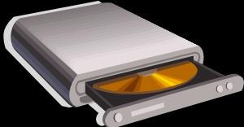

Lab 13 – FIR Audio – Optimizations Galore
McASP
Hwi
Task
SR12
rcvBufs
ADC
isrAudio
Semaphore_post()
FIR
AIC3106
Audio Codec
SR11
xmtBufs
isrAudio
DAC
LED
Part A – Determine goal/CPU Min Apply Compiler Options
Part B – Code Tuning (pragmas)
Part C – Optimize for Space
Part D – Use DSPLib
Clk1
Tick
250ms
Time = 75min
Note: this lab uses NEW i2c code for LED_toggle() – 4 new files (i2c/led)

Slide 88


Slide 89
Linear Assembly
_dotp: .cproc pm, pn, count
.reg m, n, prod, sum
zero sum
loop:
ldh *pm++, m ldh *pn++, n mpy m, n, prod add prod, sum, sum
sub count, 1, count [count] b loop
.return sum
.endproc
Linear assembly abstracts the user from having to learn how to software pipeline C64x+ assembly code (NO NOPs, functional units, parallel bars, register specifications req’d)
This linear assembly routine performs this function:
int dotp ( short *a, short *x, int count )
Can specify arguments (pm, pn, count), variables (m, n, prod, sum), return values (sum)
.cproc/.endproc are assembly directives that specify the start/end of the procedure
Reference: SPRU187, Chapter 4
Notes:
.cproc makes this routine C-callabe. Pm, pn, count are incoming parameters. .reg specifies which values go into registers.
Highly recommend using INTRINSICS vs. linear assembly. You have MORE control over the results and the compiler LOVES consuming intrinsics (you’re speaking the native langauge of the device).
OLD INFO

Slide 90
IDMA – “Internal” DMA
C64x+ IDMA – Performs background data movement or peripheral programming WITHOUT using EDMA bandwidth/resources or SCR (internal to GEM megamodule).
Channel 0 (IDMA0 – Hi Priority)
Performs rapid programming of peripheral configuration registers
Avoids unnecessary wait states through CFG bus vs. traditional use of the CPU copying config structures from L2 to the peripheral registers
Typically used when new config structures are needed quickly. A copy of the structures can be stored in L1D/L2 and then transferred during run-time.
PERIPH
L1D
Cfg
IDMA0
L2
Channel 1 (IDMA1 – Lo Priority)
Rapid block transfers between L1P, L1D, L2
L1P
L1D
L2
Notes:
If there are two IDMA transfers, IDMA0 will have higher priority – there is no way to change this.

Slide 91
IDMA0 – Programming Details
IDMA0 operates on a block of 32 contiguous 32-bit registers (both src/dst blocks must be aligned on a 32-word boundary). Optionally generate CPU interrupt if needed.
User provides: Src, Dst, Count and “mask” (Reference: SPRU871)
L1D/L2
Periph Cfg
Src
0
Dst
0
Count = # of 32-register blocks to xfr (up to 16)
Mask = 32-bit mask determines WHICH registers to transfer (“0” = xfr, “1” = NO xfr)
. .
. .
31
31
32-bits
32-bits
Example Transfer using MASK (not all regs typically need to be programmed):
User must write to IDMA0 registers in the following order (COUNT written – triggers transfer):
IDMA0_MASK = 0x573FEA8C; //set mask for 13 regs above
IDMA0_SOURCE = reg_ptr; //set src addr in L1D/L2
IDMA0_DEST = MMR_ADDRESS; //set dst addr to config location
IDMA0_COUNT = 0; //set mask for 1 block of 32 registers

Slide 92
IDMA1 – Programming Details
IDMA1 is optimized for LINEAR burst transfers between L1P, L1D and L2
Src
1
Dst
1
2
2
3
3
Cannot access CFG port registers (only used for internal memory transfers)
User provides: Src, Dst, Count (Reference: SPRU871)
All src/dest addresses increment linearly throughout the transfer
IDMA1_COUNT = #bytes to transfer
Example:
IDMA1_SOURCE = outBuffFast; //set src addr in L1D
IDMA1_DEST = outBuff; //set dst addr to L2
IDMA1_COUNT = 7 << IDMA_PRI_SHIFT | //PRI low vs. cache/EDMA
1 << IDMA_INT_SHIFT | //interrupt CPU on completion
buffsize; //set count to buffer size (bytes)

Slide 93
Outline
MainHighlight
MainNormal
SubHighlight
SubNormal

