Slide 1
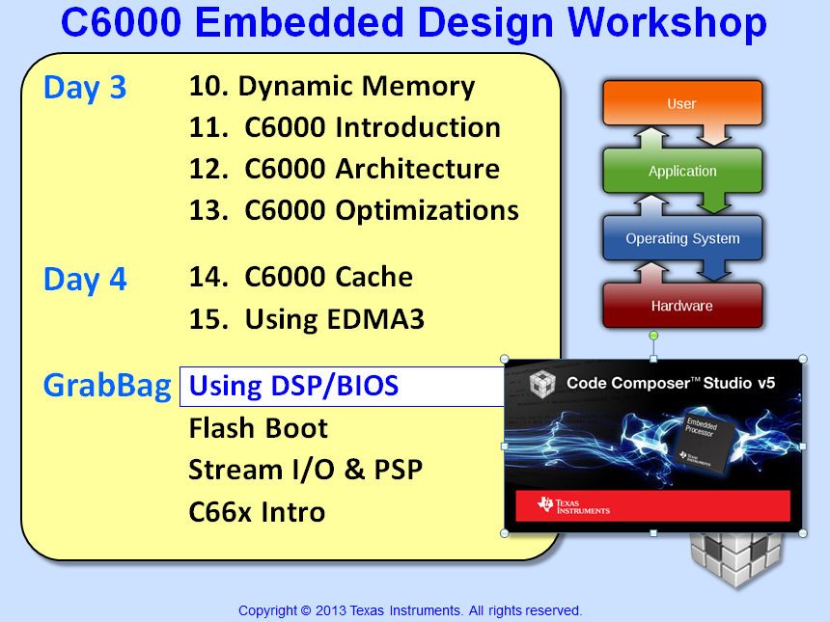

Slide 2
Objectives
Grab bag chapter assumes students have already been through Intro to SYS/BIOS
Describe how to create a new BIOS project
Learn how to configure BIOS using TCF files
Lab 16a – Create and debug a simple DSP/BIOS application

Slide 3
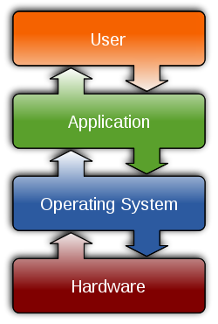

Outline
Overview
Threads & Scheduling
Real-Time Analysis Tools
BIOS Configuration (.tcf)
Creating a BIOS Project
Memory Mgmt Using .tcf…
Lab 13a

Slide 4
DSP/BIOS Environment
User Code
DSP/BIOS Library
#include <log.h>
func1 { LOG_printf(...); }
#include <sem.h>
func2 { SEM_post(…); }
HWI SWI TSK IDL SIO PIP
SEM MBX QUE HST CLK LOG
STS TRC PRD ATM BUF GBL
LCK DIO GIO PWRM MSGQ
API
Module names are DIFFERENT
Therefore, API names are DIFFERENT
DSP/BIOS is a library that contains modules with a particular interface and data structures
Application Program Interfaces (API) define the interactions (methods) with a module and data structures (objects)
Objects - are structures that define the state of a component
Pointers to objects are called handles
Object based programming offers:
Better encapsulation and abstraction
Multiple instance ability
pointer
handle
structure….
element1
element2
…
object

Slide 5
Outline
Overview
Threads & Scheduling
Real-Time Analysis Tools
BIOS Configuration (.tcf)
Creating a BIOS Project
Memory Mgmt Using .tcf…
Lab 13a

Slide 6
DSP/BIOS Thread Types
HWI
Hardware Interrupts
Implements ‘urgent’ part of real-time event
Hardware interrupt triggers ISRs to run
Priorities set by hardware
Module names are DIFFERENT
Same implicit “group” priorities
Fewer SWI/TSK priority levels
SWI
Software Interrupts
Performs HWI ‘follow-up’ activity
‘posted’ by software
PRDs (periodic functions) are prioritized as SWIs
14 priority levels
Priority
TSK
Tasks
Runs programs concurrently under separate contexts
Usually enabled to run by posting a ‘semaphore’ (a task signaling mechanism)
15 priority levels
IDL
Background
Multiple IDL functions
Runs as an infinite loop (like traditional while(1) loop)
Single priority level
Notes:
Using PRDs in a TSK-based video system is not really recommended because PRDs will ALWAYS have a higher priority than TSKs because PRDs are prioritized as SWIs.

Slide 7
SWIs and TSKs
SWI_post(&swiObj);
SEM_post(&semObj)
SWI
TSK
start
API Names are different
Same behavior of threads
SEM_pend
Pause
“run to
completion”
(blocked state)
start
end
end
Similar to hardware interrupt, but triggered when posted
All SWI's share system software stack
Unblocking triggers execution
Each TSK has its own stack, which allows them to pause (i.e. block)
Topology: prologue, loop, epilogue…

Slide 8
DSP/BIOS: Priority-Based Scheduling
HWI 1
HWI 2
SWI 3
SWI 2
SWI 1
MAIN
IDL
post3
rtn
SWI_post(&swi_name);
post2
rtn
post1
rtn
PRI
int1
rtn
Must “return” from main() to
start DSP/BIOS Scheduler
rtn
rtn
int2

Slide 9
Outline
Overview
Threads & Scheduling
Real-Time Analysis Tools
BIOS Configuration (.tcf)
Creating a BIOS Project
Memory Mgmt Using .tcf…
Lab 13a

Slide 10
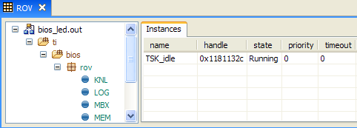
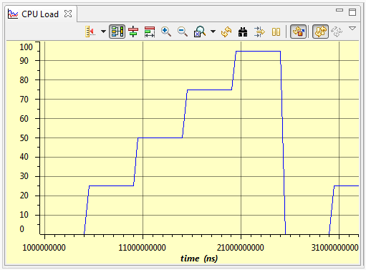
Built-in Real-Time Analysis Tools
Gather data on target (3-10 CPU cycles)
Send data during BIOS IDL (100s of non-critical cycles)
Format data on host (1000s of host PC cycles)
Data gathering does NOT stop target CPU
ROV works the same.
RTA using RTDX – flaky – not supported any longer
RTA stop mode – just ok.
RunTime Obj View (ROV)
Halt to see results
Displays stats about all threads in system
CPU Load Graph
Analyze time NOT spent in IDL

Slide 11
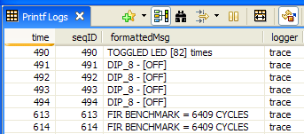
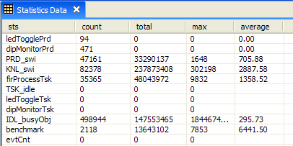
Built-in Real-Time Analysis Tools
Printf LOGs
Printf LOGs work well
STS is GREAT – not available in SYS/BIOS.
Send Dbg Msgs to PC
Data displayed during runtime
Deterministic, low DSP cycle count
WAY more efficient than traditional printf()
LOG_printf (&trace, “Toggle time = %d”, time);
Statistics (STS)
Gather benchmarks during runtime
Set “start/end” points in code (more later…)

Slide 12
Outline
Overview
Threads & Scheduling
Real-Time Analysis Tools
BIOS Configuration (.tcf)
Creating a BIOS Project
Memory Mgmt Using .tcf…
Lab 13a

Slide 13
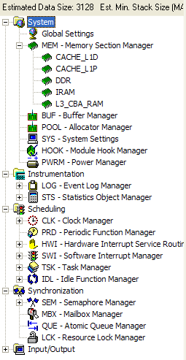
Textual Config File (TCF) Contents
System Config
Clock & Cache
BIOS Clk freq, cache settings
MEM
Memory Areas (origin, length, …)
Stack/heap sizes
BIOS Config
Instrumentation
LOG and Statistics (STS) Objects
Scheduling
CLK objects (tick rate)
PRD, HWI, SWI, TSK, IDL fxns
Biggest difference – Config
DSP/BIOS uses TCF vs. CFG
Synchronization
Semaphores (SEM)
The GUI creates a TCF script…

Slide 14
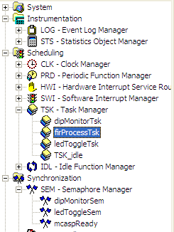
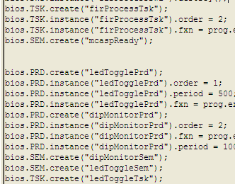
GUI Creates TCF Script…
To create a TCF file, we first need a new BIOS project…

Slide 15
Outline
Overview
Threads & Scheduling
Real-Time Analysis Tools
BIOS Configuration (.tcf)
Creating a BIOS Project
Memory Mgmt Using .tcf…
Lab 13a

Slide 16

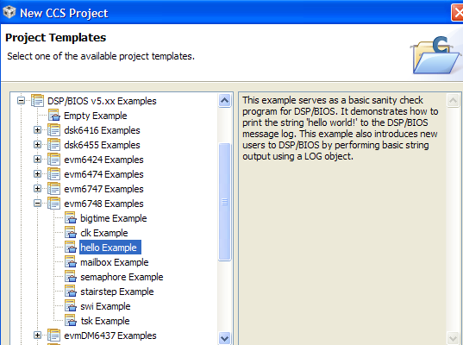
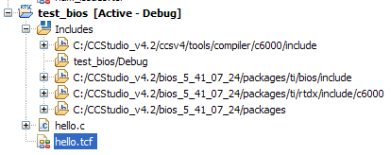
Creating a New BIOS Project (1)
You have two options:
Start with a standard EVM6748 BIOS Example
Done For You…
CGT/BIOS include paths added
TCF file with proper memory map added
Modifications…
Delete unused source files
[Optional] – Rename TCF file to match project name (explorer)

Slide 17
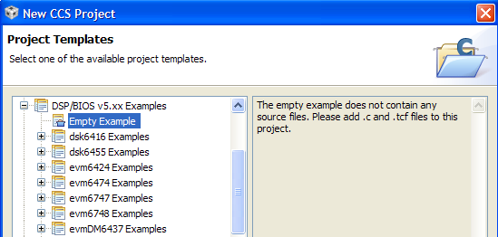
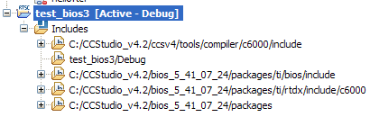
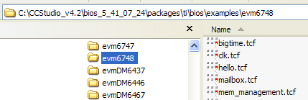
Creating a New BIOS Project (2)
You have two options:
☑
Start with a standard EVM6748 BIOS Example
Use an EMPTY example and add a TCF file to it
Done For You…
CGT/BIOS include paths added
TCF file NOT ADDED
Modifications…
ADD TCF file to your project:
File → New …(next…)
BIOS Examples
Elsewhere…

Slide 18
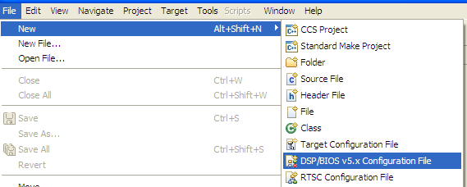
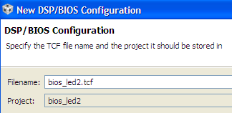
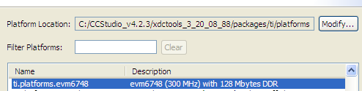
Adding a New TCF File to Your Project
You have several options – however the easiest way is simply to:
1
Select: File → New → DSP/BIOS v5.x Config File
2
Give the new file a name:
3
Pick the proper platform (e.g. evm6748)
Platform file sets up…
Clock settings
Memory Map & Cache settings
The TCF file does some work for us…

Slide 19

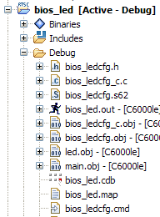
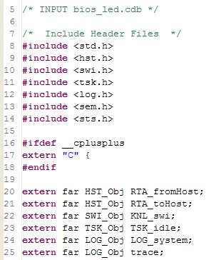
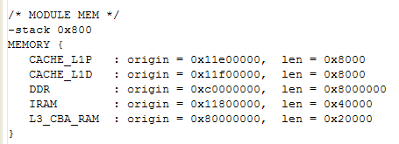
TCF Generates Key Files…
file.tcf file generates (when saved) two very important files:
filecfg.h: header file for all BIOS libraries (must #include in project)
filecfg.cmd: linker.cmd file for your project (add to project)
Other files…
Covered later
filecfg.h
filecfg.cmd

Slide 20
Outline
Overview
Threads & Scheduling
Real-Time Analysis Tools
BIOS Configuration (.tcf)
Creating a BIOS Project
Memory Mgmt Using .tcf…
Lab 13a

Slide 21
Remember ?
Memory Segments
Sections
1180_0000
256K IRAM
.text
.bss
.far
.cinit
.cio
.stack
6400_0000
4MB FLASH
C000_0000
512MB DDR2
How do you define the memory segments (e.g. IRAM, FLASH, DDR2) ?
How do you place the sections into these memory segments ?
How do we accomplish this with a .tcf file ?

Slide 22
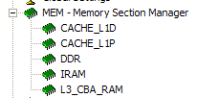
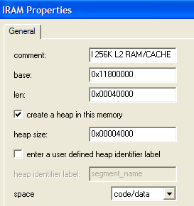
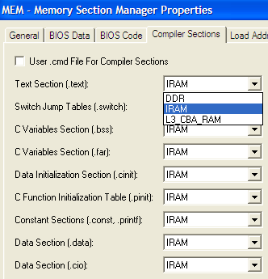
MEM – Memory Section Manager
Similar to a linker.cmd file, the .tcf defines two pieces:
Memory Segments: name, base, len
Sections: name, which segment to link to
Note: seed file has default mem settings
Memory Segments
Sections
Right-click on name, select Properties
Right-click on MEM and select Properties
MEM Mgmt – WAY easier using TCF
SYS/BIOS has some “catching up” to do…

Slide 23
Outline
Overview
Threads & Scheduling
Real-Time Analysis Tools
BIOS Configuration (.tcf)
Creating a BIOS Project
Memory Mgmt Using .tcf…
Lab 13a

Slide 24
Lab 16a – Intro to DSP/BIOS
main.c
Procedure
main() {
init_BSL();
init_LED();
…
return;
}
Create a new BIOS project (empty)
Add files (main.c, led.c)
Link BSL library
Add a new BIOS TCF file (mem map, scheduler, .cmd)
Create IDL object
Build, “Play”, Debug
Scheduler
HWI
while(1) {}
SWI
led.c
while() loop replaced by IDL
IDL
ledToggle() {
toggle(LED_1);
delay(500ms);
}
Time: 45min

Slide 25


Slide 26
DSP/BIOS – TI’s Real-Time O/S
Code Composer Studio
DSP/BIOS is:
DSP/BIOS APIs
Library of essential application services
Pre-emptive scheduler to manage threads, memory, I/O, timers
Hardware (peripheral) abstraction
CONFIG (.cdb)
SRC
DSP/BIOS Modules
Benefits:
Build
Provides an interactive config tool
Consumes minimal MIPs, memory
Supports specialized DSP drivers
Integrates real-time analysis tools
Executable Output
VISUALIZE (RTA)
.
.
.
User’s Application
Debug
DSP/BIOS Kernel Interface
Emulation
RTDX
Capture
Threads
H/W
Host PC
JTAG
Target Hardware
Notes:
This is DSP BIOS in one slide – feel free to elaborate on any one topic. Also, make sure you highlight the fact that BIOS is SCALABLE – you can use a few pieces and not pay the data/performance penalty for ALL of BIOS. If someone asks specifically about what the “overhead” is for different processors, point them to the BIOS Benchmarks App Note – SPRA900x.pdf.

Slide 27
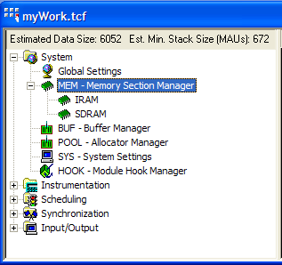
Files Generated by the Config Tool
myWork.tcf Textual configuration script file
myWorkcfg.cmd Linker command file
myWorkcfg_c.c C file to s/u BIOS obj’s, etc
myWorkcfg.s## ASM init file for series ## DSP
myWorkcfg.h## Header file for above
myWork.cdb I/F to GCONF display
myWorkcfg.h header file for config inclusions

Slide 28
Polling vs Interrupt (Event) Driven
Polling:
- Overhead of repeated checking
- Wastes MIPS, Watts
- Doesn’t allow other threads to run in the mean time
Interrupts:
+ No checking – launch on event
+ no wasted time or power
+ Allows other threads to run independently
+ Represent response to priority events
- Small number of interrupt sources to post ISRs
“Software” Interrupts and Semaphore posting
+ Allows interrupt/event launch of threads beyond ISRs
+ BIOS HWI & SWI are both posted to run, like an ISR
+ BIOS tasks (TSK) can be synchronized via SEMaphores
+ Improved Modularity

Slide 29
System Design Options and Tradeoffs
Dynamic vs Static
Static systems – are smaller and faster code solutions, simpler to create and manage
Dynamic systems – allow blocks of RAM to be ‘borrowed’ from heap when needed, and returned afterward for reuse by subsequent requestors; add the create & delete phases
MIPS vs Mbytes – system designer can often trade one for the other to optimize performance and cost
Number of Buffers : Latency (input to output time) vs flexibility (improved ability to tolerate preemption)
What is speed? MIPS vs TTM (Time To Market)
Faster DSP processing rates offer performance that exceeds minimum requirements of many systems
More sophisticated features can be employed to simplify coding effort, improve speed of coding and time to market
Cost: Device vs TTM
Price of DSP HW and development should be weighed against the value of time to market
create
initialize
run
I
P
O
shutdown
delete

Slide 30
Outline
MainHighlight
MainNormal
SubHighlight
SubNormal

