Slide 1
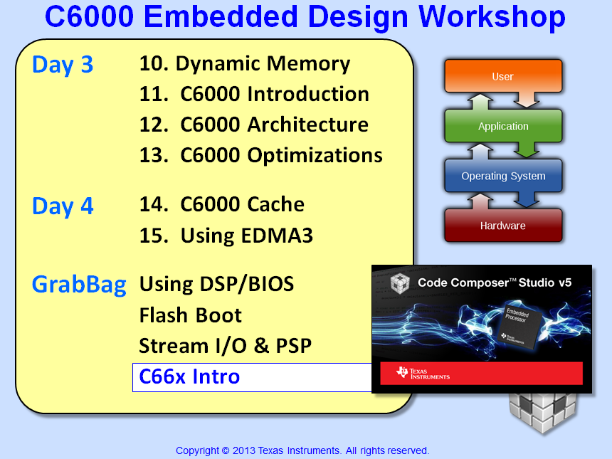

Slide 2
Objectives
Describe the basic architecture of the C66x family of devices
Provide an overview of each device subsystem
Describe the basic features of the Multicore Software Development Kit (MCSDK)

Slide 3
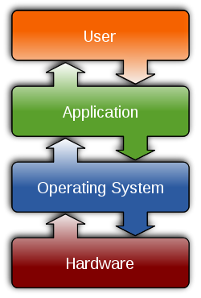

Outline
C66x Family Overview
C6000 Roadmap
C667x Architecture Overview
C665x Low-Power Devices
MCSDK Overview

Slide 4
Outline
C66x Family Overview
C6000 Roadmap
C667x Architecture Overview
C665x Low-Power Devices
MCSDK Overview

Slide 5
Enhanced DSP core
100% upward object code compatible
4x performance improvement for multiply operation
32 16-bit MACs
Improved support for complex arithmetic and matrix computation
C66x ISA
Performance improvement
100% upward object code compatible with C64x, C64x+, C67x and c67x+
Best of fixed-point and floating-point architecture for better system performance and faster time-to-market.
2x registers
Enhanced floating-point add capabilities
SPLOOP and 16-bit instructions for smaller code size
Flexible level one memory architecture
iDMA for rapid data transfers between local memories
C674x
C64x+
C67x+
IEEE 754 Native Instructions for SP & DP
Advanced VLIW architecture
C67x
Advanced fixed-point instructions
Four 16-bit or eight 8-bit MACs
Two-level cache
C64x
FLOATING-POINT VALUE
FIXED-POINT VALUE
Notes:
5

Slide 6
Outline
C66x Family Overview
C6000 Roadmap
C667x Architecture Overview
C665x Low-Power Devices
MCSDK Overview

Slide 7
CorePac
Memory Subsystem
Application-Specific
CorePac
64-bit
DDR3 EMIF
MSM SRAM
Coprocessors
1 to 8 C66x CorePac DSP Cores operating at up to 1.25 GHz
Fixed/Floating-pt operations
Code compatible with other C64x+ and C67x+ devices
L1 Memory
Partition as Cache or RAM
32KB L1P/D per core
Dedicated L2 Memory
Partition as Cache or RAM
512 KB to 1 MB per core
Direct connection to memory subsystem
MSMC
C66x™
CorePac
L1P
L1D
L2
1 to 8 Cores @ up to 1.25 GHz
HyperLink
TeraNet
Multicore Navigator
Common and App-specific I/O
Network Coprocessor

Slide 8
Memory Subsystem
Memory Subsystem
Application-Specific
CorePac
64-bit
DDR3 EMIF
MSM SRAM
Coprocessors
Memory Subsystem
MSMC
Multicore Shared Memory (MSM SRAM)
2 to 4MB (Program or Data)
Available to all cores
Multicore Shared Mem (MSMC)
Arbitrates access to shared memory and DDR3 EMIF
Provides CorePac access to coprocessors and I//O
Provides address extension to 64G (36 bits)
DDR3 External Memory Interface (EMIF) – 8GB
Support for 16/32/64-bit modes
Specified at up to 1600 MT/s
C66x™
CorePac
L1P
L1D
L2
1 to 8 Cores @ up to 1.25 GHz
HyperLink
TeraNet
Multicore Navigator
Common and App-specific I/O
Network Coprocessor

Slide 9
Multicore Navigator
Memory Subsystem
Application-Specific
CorePac
64-bit
DDR3 EMIF
MSM SRAM
Coprocessors
Memory Subsystem
MSMC
Multicore Navigator
Provides seamless inter-core communications (msgs and data) between cores, IP, and peripherals. “Fire and forget”
Low-overhead processing and routing of packet traffic to/from cores and I/O
Supports dynamic load optimization
Consists of a Queue Manager Subsystem (QMSS) and multiple, dedicated Packet DMA engines
C66x™
CorePac
L1P
L1D
L2
1 to 8 Cores @ up to 1.25 GHz
HyperLink
TeraNet
Multicore Navigator
Queue Manager
Packet DMA
Common and App-specific I/O
Network Coprocessor

Slide 10
Multicore Navigator Architecture

Slide 11
Network Coprocessor
Memory Subsystem
Application-Specific
CorePac
64-bit
DDR3 EMIF
MSM SRAM
Coprocessors
Memory Subsystem
MSMC
Multicore Navigator
Network Coprocessor
Provides H/W accelerators to perform L2, L3, L4 processing and encryption (often done in S/W)
Packet Accelerator (PA)
8K multi-in/out HW queues
Single IP address option
UDP/TCP checksum and CRCs
Quality of Service (QoS) support
Multi-cast to multiple queues
Security Accelerator (SA)
HW encryption, decryption and authentication
Supports protocols: IPsec ESP, IPsec AH, SRTP, 3GPP
C66x™
CorePac
L1P
L1D
L2
1 to 8 Cores @ up to 1.25 GHz
HyperLink
TeraNet
Multicore Navigator
t
e
h
n
c
SA
r
t
h
e
i
c
h
w
t
t
S
i
E
w
S
PA
I
I
Common and App-specific I/O
M
x2
Network Coprocessor
G
S

Slide 12
External Interfaces
Memory Subsystem
Application-Specific
CorePac
64-bit
DDR3 EMIF
MSM SRAM
Coprocessors
Memory Subsystem
MSMC
Multicore Navigator
Network Coprocessor
External Interfaces
C66x™
2x SGMII ports – support 10/100/1000 Ethernet
4x SRIO lanes for inter-DSP xfrs
SPI for boot operations
UART for development/test
2x PCIe at 5Gbps
I2C for EPROM at 400 Kbps
GPIO
App-specific interfaces
CorePac
L1P
L1D
L2
1 to 8 Cores @ up to 1.25 GHz
HyperLink
TeraNet
Multicore Navigator
x2
x4
t
T
e
h
C
R
I
n
c
P
r
Application
Specific I/O
e
Application
Specific I/O
t
GPIO
2
I
A
S
O
e
i
I
C
U
I
h
w
P
R
t
S
S
E
I
I
M
x2
Network Coprocessor
Common and App-specific I/O
G
S

Slide 13
TeraNet Switch Fabric
Memory Subsystem
Application-Specific
CorePac
64-bit
DDR3 EMIF
MSM SRAM
Coprocessors
Memory Subsystem
MSMC
Multicore Navigator
Network Coprocessor
External Interfaces
C66x™
TeraNet Switch Fabric
CorePac
Non-blocking switch fabric that enables fast and contention-free data movement
Can configure/manage traffic queues and priorities of xfrs while minimizing core involvement
High-bandwidth transfers between cores, subsystems, peripherals and memory
L1P
L1D
L2
1 to 8 Cores @ up to 1.25 GHz
HyperLink
TeraNet
Multicore Navigator
Common and App-specific I/O
Network Coprocessor

Slide 14
TeraNet Data Connections
HyperLink
S
MSMC
DDR3
S
M
CPUCLK/2
256bit TeraNet
Shared L2
S
HyperLink
DDR3
M
S
S
S
S
M
TPCC
16ch QDMA
TC0
M
EDMA_0
TC1
M
Facilitates high-bandwidth communication links between DSP cores, subsystems, peripherals, and memories.
Supports parallel orthogonal communication links
XMC
S
L2 0-3
M
SRIO
S
Core
M
M
S
Core
M
M
S
Core
M
Network
Coprocessor
M
SRIO
TPCC
64ch
QDMA
TC2
M
S
TC3
M
S
TPCC
64ch
QDMA
TC6
M
TCP3e_W/R
TC4
M
TC5
TC7
M
M
TC8
M
TC9
M
S
EDMA_1,2
TCP3d
S
CPUCLK/3
128bit TeraNet
TCP3d
TAC_BE
TAC_FE
S
M
RAC_FE
RAC_BE0,1
S
M
RAC_FE
RAC_BE0,1
S
M
FFTC / PktDMA
M
FFTC / PktDMA
M
VCP2 (x4)
S
VCP2 (x4)
S
VCP2 (x4)
AIF / PktDMA
S
M
VCP2 (x4)
S
QMSS
M
QMSS
PCIe
S
M
S
PCIe
DebugSS
M
Notes:
CPT see physical addresses. In MSMC, one CPT per bank.

Slide 15
Diagnostic Enhancements
Memory Subsystem
Application-Specific
CorePac
64-bit
DDR3 EMIF
MSM SRAM
Coprocessors
Memory Subsystem
MSMC
Multicore Navigator
Debug & Trace
Network Coprocessor
External Interfaces
C66x™
TeraNet Switch Fabric
CorePac
Diagnostic Enhancements
L1P
L1D
L2
Embedded Trace Buffers (ETB) enhance CorePac’s diagnostic capabilities
CP Monitor provides diagnostics on TeraNet data traffic
Automatic statistics collection and exporting (non-intrusive)
Can monitor individual events
Monitor all memory transactions
Configure triggers to determine when data is collected
1 to 8 Cores @ up to 1.25 GHz
HyperLink
TeraNet
Multicore Navigator
Common and App-specific I/O
Network Coprocessor

Slide 16
HyperLink Bus
Memory Subsystem
Application-Specific
CorePac
64-bit
DDR3 EMIF
MSM SRAM
Coprocessors
Memory Subsystem
MSMC
Multicore Navigator
Network Coprocessor
External Interfaces
C66x™
TeraNet Switch Fabric
CorePac
Diagnostic Enhancements
L1P
L1D
HyperLink Bus
L2
Expands the TeraNet Bus to external devices
Supports 4 lanes with up to 12.5Gbaud per lane
1 to 8 Cores @ up to 1.25 GHz
HyperLink
TeraNet
Multicore Navigator
Common and App-specific I/O
Network Coprocessor

Slide 17
Miscellaneous Elements
Memory Subsystem
Application-Specific
CorePac
64-bit
DDR3 EMIF
MSM SRAM
Coprocessors
Memory Subsystem
MSMC
Multicore Navigator
Network Coprocessor
Boot ROM
External Interfaces
HW Sem
C66x™
TeraNet Switch Fabric
Power
CorePac
Diagnostic Enhancements
Mgmt
PLL
L1P
L1D
HyperLink Bus
x3
L2
Miscellaneous
EDMA
x3
1 to 8 Cores @ up to 1.25 GHz
Boot ROM
HW Semaphore provides atomic access to shared resources
Power Management
PLL1 (Corepacs), PLL2 (DDR3), PLL3 (Packet Acceleration)
Three EDMA Controllers
16 64-bit Timers
Inter-Processor Communication (IPC) Registers
HyperLink
TeraNet
Multicore Navigator
Common and App-specific I/O
Network Coprocessor

Slide 18
App-Specific: Wireless Applications
Memory Subsystem
C6670
Coprocessors
CorePac
64-bit
DDR3 EMIF
MSM SRAM
Memory Subsystem
MSMC
RSA
Multicore Navigator
VCP2
Network Coprocessor
x4
External Interfaces
C66x™
TCP3d
x2
TeraNet Switch Fabric
CorePac
TCP3e
Diagnostic Enhancements
L1P
L1D
FFTC
HyperLink Bus
L2
x2
Miscellaneous
1 to 8 Cores @ up to 1.25 GHz
BCP
Application-Specific
HyperLink
TeraNet
Wireless Applications
Multicore Navigator
Wireless-specific Coprocessors
2x FFT Coprocessor (FFTC)
Turbo Dec/Enc (TCP3D/3E)
4x Viterbi Coprocessor (VCP2)
Bit-rate Coprocessor (BCP)
2x Rake Search Accel (RSA)
Wireless-specific Interfaces
6x Antenna Interface (AIF2)
AIF2 x6
Common and App-specific I/O
Network Coprocessor

Slide 19
App-Specific: General Purpose
Memory Subsystem
Application-Specific
CorePac
64-bit
DDR3 EMIF
MSM SRAM
Coprocessors
Memory Subsystem
MSMC
Multicore Navigator
Network Coprocessor
External Interfaces
C66x™
TeraNet Switch Fabric
CorePac
Diagnostic Enhancements
L1P
L1D
HyperLink Bus
L2
Miscellaneous
1 to 8 Cores @ up to 1.25 GHz
Wireless Applications
HyperLink
TeraNet
General Purpose Applications
Multicore Navigator
2x Telecom Serial Port (TSIP)
EMIF 16 (EMIF-A):
Connects memory up to 256MB
Three modes:
Synchronized SRAM
NAND Flash
NOR Flash
EMIF 16
TSIP x2
Common and App-specific I/O
Network Coprocessor

Slide 20
Keystone Device Architecture
Memory Subsystem
Application-Specific
CorePac
64-bit
DDR3 EMIF
MSM SRAM
Coprocessors
Memory Subsystem
MSMC
Multicore Navigator
Debug & Trace
Network Coprocessor
Boot ROM
External Interfaces
Semaphore
C66x™
TeraNet Switch Fabric
Power
CorePac
Diagnostic Enhancements
Management
PLL
L1P
L1D
HyperLink Bus
x3
L2
Miscellaneous
EDMA
Wireless Applications
x3
1 to 8 Cores @ up to 1.25 GHz
HyperLink
TeraNet
General Purpose Applications
Multicore Navigator
Queue
Packet
Manager
DMA
x2
x4
t
T
e
h
C
R
I
n
c
e
P
Application
Specific I/O
O
r
t
h
Security
Application
Specific I/O
GPIO
2
I
A
S
e
i
c
I
C
U
I
h
w
t
Accelerator
P
R
t
S
i
S
E
w
S
Packet
I
Accelerator
I
M
x2
Network Coprocessor
G
S

Slide 21
Outline
C66x Family Overview
C6000 Roadmap
C667x Architecture Overview
C665x Low-Power Devices
MCSDK Overview

Slide 22
Keystone C6655/57 – Device Features
Memory Subsystem
C6655/57
C6655/57 Low-Power Devices
1MB
32-Bit
MSM
DDR3 EMIF
SRAM
C66x CorePac
C6655 (1 core) @ 1/1.25 GHz
C6657 (2 cores) @ 0.85, 1.0 or 1.25 GHz
Memory Subsystem
1MB Local L2 per core
MSMC , 32-bit DDR3 I/F
Hardware Coprocessors
TCP3d, VCP2
Multicore Navigator
Interfaces
2x McBSP, SPI, I2C, UPP, UART
1x 10/100/1000 SGMII port
Hyperlink, 4x SRIO, 2x PCIe
EMIF 16, GPIO
Debug and Trace (ETB/STB)
MSMC
Debug & Trace
Boot ROM
2nd core, C6657 only
Semaphore
Timers
C66x™
Security /
CorePac
Key Manager
Coprocessors
Power
Management
32KB L1
32KB L1
TCP3d
PLL
P-Cache
D-Cache
x2
1024KB L2 Cache
VCP2
x2
EDMA
1 or 2 Cores @ up to 1.25 GHz
HyperLink
TeraNet
Multicore Navigator
Queue
Packet
Manager
DMA
6
x2
x2
x2
x4
1
O
P
T
I
P
Ethernet
F
I
P
S
O
MAC
I
P
I²C
R
P
e
I
M
G
U
A
S
B
I
E
U
c
C
R
M
P
S
SGMII

Slide 23
Keystone C6654 – Power Optimized
Memory Subsystem
C6654
C6654 – Power Optimized
32-Bit
MSMC
DDR3 EMIF
C66x CorePac
C6654 (1 core) @ 850 MHz
Memory Subsystem
1MB Local L2
MSMC , 32-bit DDR3 I/F
Multicore Navigator
Interfaces
2x McBSP, SPI, I2C, UPP, UART
1x 10/100/1000 SGMII port
EMIF 16, GPIO
Debug and Trace (ETB/STB)
Debug & Trace
Boot ROM
Semaphore
Timers
C66x™
Security /
CorePac
Key Manager
Power
Management
32KB L1
32KB L1
PLL
P-Cache
D-Cache
x2
1024KB L2 Cache
EDMA
1 Core @ 850 MHz
TeraNet
Multicore Navigator
Queue
Packet
Manager
DMA
6
x2
x2
x2
1
O
P
T
I
P
Ethernet
F
I
P
S
MAC
I
P
I²C
R
P
e
M
G
U
A
S
B
I
E
U
c
C
M
P
SGMII

Slide 24
Keystone C665x – Comparisons
HW Feature | C6654 | C6655 | C6657
CorePac Frequency (GHz) | 0.85 | 1 @ 1.0, 1.25 | 2 @ 0.85, 1.0, 1.25
Multicore Shared Mem (MSM) | No | 1MB SRAM
DDR3 Maximum Data Rate | 1066 | 1333
Serial Rapid I/O (SRIO) Lanes | No | 4x
HyperLink | No | Yes
Viterbi CoProcessor (VCP) | No | 2x
Turbo Decoder (TCP3d) | No | Yes

Slide 25
For More Information
For more information, refer to the C66x Getting Started page to locate the data manual for your KeyStone device.
View the complete C66x Multicore SOC Online Training for KeyStone Devices, including details on the individual modules.
For questions regarding topics covered in this training, visit the support forums at the TI E2E Community website.
Notes:
NEW

Slide 26
Outline
C66x Family Overview
MCSDK Overview
What is the MCSDK ?
Software Architecture
For More Info…

Slide 27
Outline
C66x Family Overview
MCSDK Overview
What is the MCSDK ?
Software Architecture
For More Info…

Slide 28
What is MCSDK?
The Multicore Software Development Kit (MCSDK) provides the core foundational building blocks for customers to quickly start developing embedded applications on TI high performance multicore DSPs.
Uses the SYS/BIOS or Linux real-time operating system
Accelerates customer time to market by focusing on ease of use and performance
Provides multicore programming methodologies
Available for free on the TI website bundled in one installer, all the software in the MCSDK is in source form along with pre-built libraries

Slide 29
Software Development Ecosystem Multicore Performance, Single-core Simplicity
Eclipse
Code
Composer
StudioTM
Third
Party
Plug-Ins
Editor
PolyCore
CodeGen
OpenMP
ENEA
Optima
Multicore Software Development Kit
Profiler
3L
Debugger
Critical
Blue
Remote
Debug
Multicore System
Analyzer
Visualization
Host Computer
Target Board
XDS 560 V2
XDS 560 Trace

Slide 30
MCSDK Variants
Name | Release | DSP | ARM | OS | Notes
BIOS-MCSDK | 1.x, 2.x | x | NA | SYS/BIOS | DSP-only SOC running SYS/BIOS real-time operating system
Linux-MCSDK | 1.x, 2.x | x | NA | Linux on DSP | DSP-only SOC running Linux real-time operating system

Slide 31
Outline
C66x Family Overview
MCSDK Overview
What is the MCSDK ?
Software Architecture
For More Info…

Slide 32

Migrating Development Platform
TI Demo Application on TI Evaluation Platform
TI Demo Application on Customer Platform
Customer Application on Customer Platform
Customer App on Next Generation TI SOC Platform
Demo Application
Demo Application
Customer Application
Customer Application
Tools
(UIA)
EDMA, Etc
Tools
(UIA)
EDMA, Etc
Tools
(UIA)
EDMA, Etc
Tools
(UIA)
EDMA, Etc
Network
Dev Kit
Network
Dev Kit
Network
Dev Kit
Network
Dev Kit
LLD
IPC
TI Platform
LLD
IPC
Customer Platform
LLD
IPC
Customer Platform
LLD
IPC
Next Gen TI Platform
CSL
CSL
CSL
CSL
No modifications required
Software may be different, but API remain the same (CSL, LLD, etc.)
May be used “as is” or customer can implement value-add modifications
Needs to be modified or replaced with customer version

Slide 33
BIOS-MCSDK Software
Demonstration Applications
HUA/OOB
IO Bmarks
Image
Processing
Software Framework Components
Communication Protocols
SYS/BIOS
RTOS
Interprocessor
Communication
Instrumentation
(MCSA)
TCP/IP
Networking
(NDK)
Algorithm Libraries
Platform/EVM Software
DSPLIB
IMGLIB
MATHLIB
Platform
Library
Transports - IPC - NDK
Low-Level Drivers (LLDs)
Resource
Manager
POST
EDMA3
PA
SRIO
FFTC
TSIP
OSAL
Bootloader
PCIe
QMSS
CPPI
HyperLink
…
Chip Support Library (CSL)
Hardware

Slide 34
Interprocessor Communication (IPC)
Device 1
Device 2
IPC Transports | Task to Task | Core to Core | Device to Device
Shared Memory | x | x
Navigator/QMSS | x | x
SRIO | x | x | x
PCIe | x | x | x
HyperLink | x | x | x
Core 1
Core 2
Core 1
Core 2
BIOS
Process 1
Process 2
BIOS
Process 1
Process 2
BIOS
Process 1
Process 2
BIOS
Process 1
Process 2
IPC
IPC
IPC
IPC
SoC Hardware and Peripherals
SoC Hardware and Peripherals
Device 1
Core 1
Core 2
Core 3
Core N
Linux
Process 1
Process 2
BIOS
Process 1
Process 2
BIOS
Process 1
Process 2
BIOS
Process 1
Process 2
SysLink
IPC
IPC
IPC
SoC Hardware and Peripherals

Slide 35
MessagQ – Message Queue
+ any number of messages can be passed
+ message can be anything desired (beginning with MessageQ_header)
+ message notification is user specified (e.g. semaphore, polling, etc.)
+ API unchanged even when going trans-processor !
Example:
Thread 1
Thread 2
...
MessageQ_get(msg,q2);
…
…
…
…
Blocked until flag (semaphore) posted (or timeout)
Wait for message to be posted
…
…
…
…
MessageQ_put(q2,msg);
…
Post msg into queue
Post semaphore
Unblock blocked thread
QUE
Notes:
MSGQ_get cannot be done in an HWI. Instructor – going from SEM and QUE to MBX, then SCOM, then MSGQ is an evolutionary process. MBX, because it makes copies of the messages is slower and more cumbersome (but ok for short msgs – not that much overhead). For video systems, SCOM (an RF5 module) is preferred due to its higher performance and being able to pass ptrs to data buffers. MSGQ is the latest and “greatest” QUE/SEM API providing the user with lots of flexibility (esp the capability of talking between a DSP and GPP, e.g. OMAP). So, for many video systems, SCOM is the right choice. For others, that need the flexibility of MSGQ – then use it.

Slide 36
MessageQ: Overview
Messaging protocol allows clients to send messages to a named Message Queue located on any processor in the system
Message Queue can have: single reader, multiple writers
Writer 1
Message Queue object
Reader
Writer n
So, the MessageQ object is associated with the READER…
Notes:
Multiple writer, Single reader
MSGQ_get is blocking APIs – useful for synchronization
Check Programmer Guide -

Slide 37
MessageQ Concepts (1/4)
MessageQ
READER
“myQ”
MsgQ_create( “myQ”, &hQ, ... );
MsgQ_get( hQ, &msg, ... );
MsgQ transactions begin with listener opening a MsgQ (single reader, multi-talker)
Listener’s attempt to get a message results in a block (when semaphore specified), since no messages are in the queue yet

Slide 38
MessageQ Concepts (2/4)
MSGQ
WRITER
READER
MsgQ_open(“myQ”, &hQ, .. );
MsgQ_alloc( poolid, &msg, .. );
msg->myMsg = …;
MsgQ_put( msg, hQ );
“myQ”
MsgQ_create( “myQ”, &hQ, ... );
MsgQ_get( hQ, &msg, ... );
MyMsgqMsg
MSGQ_Header
myMsg
POOL
typedef struct MyMsgqMsg {
MsgQ_MsgHeader header;
...
} MyMsg;
Talker begins by locating the MsgQ opened by the listener
Talker gets a message block from a pool and fills it as desired
Talker puts the message into the MsgQ

Slide 39
MessageQ Concepts (3/4)
MSGQ
WRITER
READER
MsgQ_open(“myQ”, &hQ, .. );
MsgQ_alloc( poolid, &msg, .. );
msg->myMsg = …;
MsgQ_put( msg, hQ );
“myQ”
MsgQ_create( “myQ”, &hQ, ... );
MsgQ_get( hQ, &msg, ... );
eval( msg->myMsg );
MsgQ_free( msg );
MyMsgqMsg
MsgQ_Header
myMsg
POOL
Once talker puts message to MsgQ, listener is unblocked
Listener can now read/evaluate received message
Listener frees message back to pool

Slide 40
MessageQ Concepts (4/4)
MSGQ
WRITER
READER
MsgQ_open(“myQ”, &hQ, .. );
MsgQ_alloc( poolid, &msg, .. );
msg->myMsg = …;
MsgQ_put( msg, hQ );
`
“myQ”
MsgQ_create( “myQ”, &hQ, ... );
MsgQ_get( hQ, &msg, ... );
eval( msg->myMsg );
MsgQ_free( msg );
MyMsgqMsg
MsgQ_Header
myMsg
POOL
MsgQ APIs
POOL0
. . .
POOLN
Transports
Msg Pool
Msg Pool
The message object manages queuing of messages passed
An allocator mechanism is for getting buffers; standard = POOL
A transport mechanism can be specified for trans-processor MsgQ (transport = SRIO or DSPLNK)

Slide 41
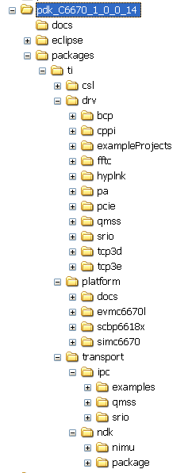
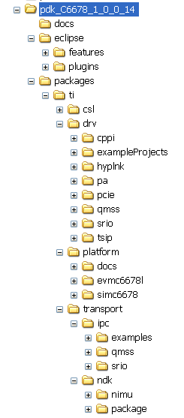
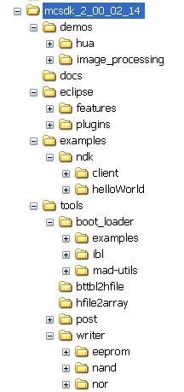
Packaging (BIOS-MCSDK)

Slide 42
Outline
C66x Family Overview
MCSDK Overview
What is the MCSDK ?
Software Architecture
For More Info…

Slide 43
Linux/BIOS MCSDK C66x Lite EVM Details
EVM Flash Contents
DVD Contents
EEPROM
128 KB
NOR
16 MB
NAND
64 MB
POST
BIOS MCSDK
“Out of Box” Demo
Linux MCSDK
Demo
Factory default recovery
EEPROM: POST, IBL
NOR: BIOS MCSDK Demo
NAND: Linux MCSDK Demo
EEPROM/Flash writers
CCS 5.0
IDE
C667x EVM GEL/XML files
BIOS MCSDK 2.0
Source/binary packages
Linux MCSDK 2.0
Source/binary packages
IBL
Online Collateral
TMS320C667x processor website http://focus.ti.com/docs/prod/folders/print/tms320c6678.html http://focus.ti.com/docs/prod/folders/print/tms320c6670.html
MCSDK website for updates http://focus.ti.com/docs/toolsw/folders/print/bioslinuxmcsdk.html
CCS v5 http://processors.wiki.ti.com/index.php/Category:Code_Composer_Studio_v5
Developer’s website Linux: http://linux-c6x.org/
BIOS: http://processors.wiki.ti.com/index.php/BIOS_MCSDK_2.0_User_Guide
Notes:
43

Slide 44
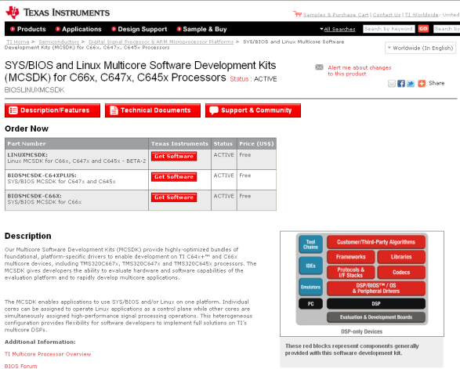
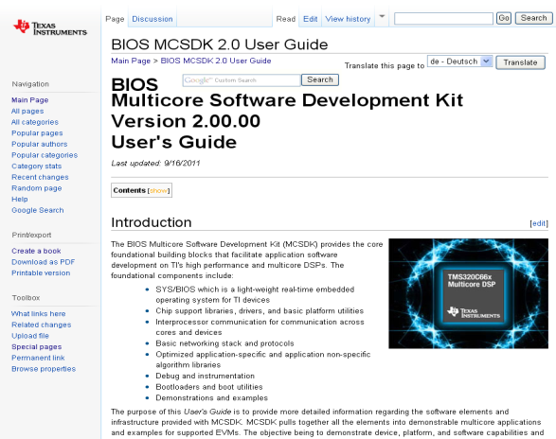
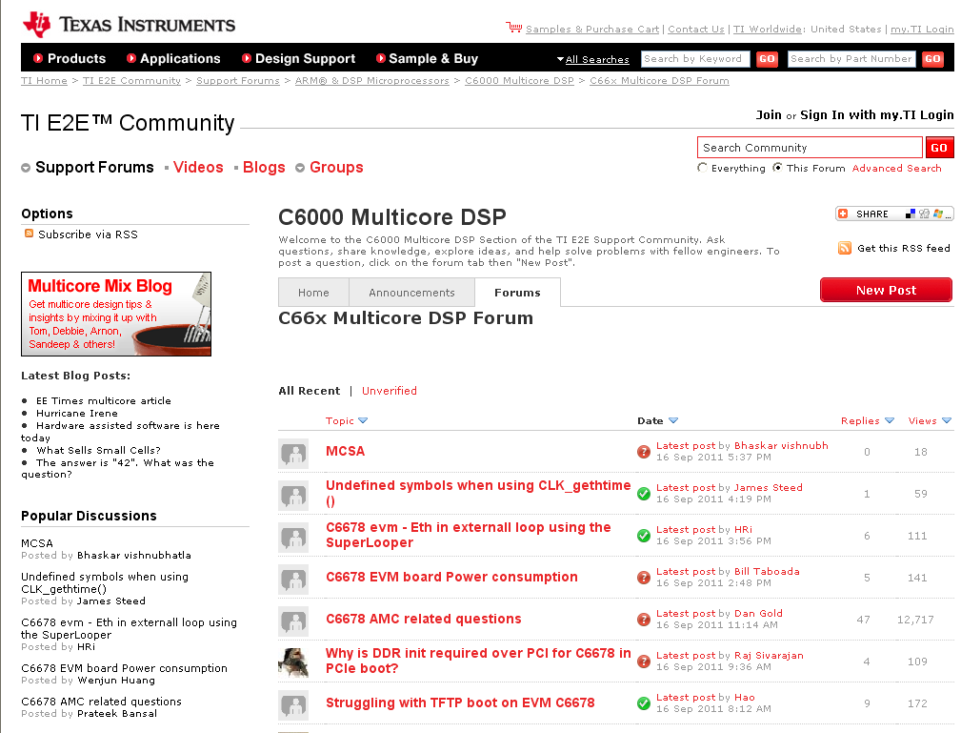
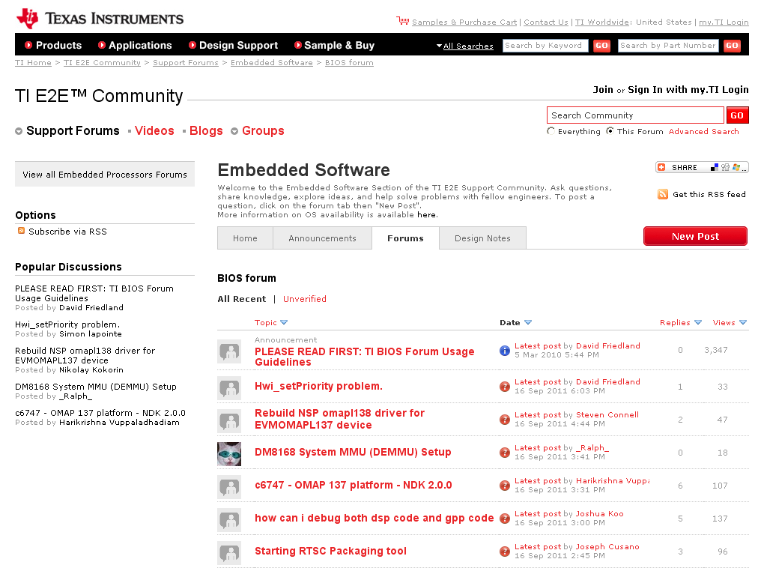
For More Information
Download MCSDK software:
http://focus.ti.com/docs/toolsw/folders/print/bioslinuxmcsdk.html
Refer to the MCSDK User’s Guide:
http://processors.wiki.ti.com/index.php/BIOS_MCSDK_2.0_User_Guide
Download Software
User’s Guide
For questions regarding topics covered in this training, visit the following e2e support forums:
http://e2e.ti.com/support/dsp/c6000_multi-core_dsps/f/639.aspx
http://e2e.ti.com/support/embedded/f/355.aspx
Software Forums

Slide 45


Slide 46
TMS320C674x Architecture - Overview
TMS320C6748
Performance & Memory
128K L3
EDMA3
4-32x PLL
Up to 456MHz
256K L2 (cache/SRAM)
32K L1P/D Cache/SRAM
16-bit DDR2-266
16-bit EMIF (NAND Flash)
16-bit EMIF
128
32KB L1P Cache/SRAM
DDR2 mDDR
256K
L2
256
McASP
Communications
Switched Central Resource (SCR)
64-Channel EDMA 3.0
10/100 EMAC
USB 1.1 & 2.0
SATA
MMC/SD
EMAC
HPI
Power/Packaging
USB
128
SATA
13x13mm nPBGA & 16x16mm PBGA
Pin-to-pin compatible w/OMAP L138 (+ARM9), 361-pin pkg
Dynamic voltage/freq scaling
Total Power < 420mW
128
Timers
128
128
I2C, SPI, UART
LCD, PWM, eCAP
32KB L1D Cache/SRAM
uPP
Notes:
mDDR – mobile DDR

Slide 47
Outline
MainHighlight
MainNormal
SubHighlight
SubNormal

