Slide 1

Code Composer Studio
TM
Overview

Slide 2
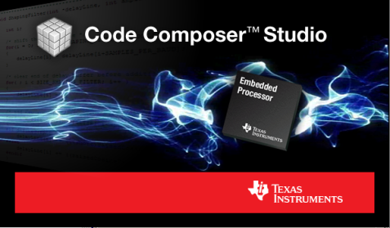
Code Composer Studio
What is Code Composer Studio?
Integrated development environment for TI’s embedded processors supporting all Microcontrollers and Processors in a single environment
A suite of tools including a debugger, compiler, editor…
Based on the Eclipse open source software framework
Eclipse is widely used by many development environments
Offers a rich set of code development tools
TI contributes changes directly to the open source community
Extended by TI to support device capabilities
Integrate additional tools & functionality
OS application development tools (Linux, Android…)
Code analysis, source control…

Slide 3




User interface makes development intuitive and easy
Simplified user interface
shows features as needed
Resource Explorer
facilitates use of example code
Development tools
for Windows and Linux operating systems
Eclipse open source framework
enables customization via latest plug-ins
SYS/BIOS Kernel
included with royalty free high performance TI-RTOS
Training Material
explains how to get the most out of features

Slide 4
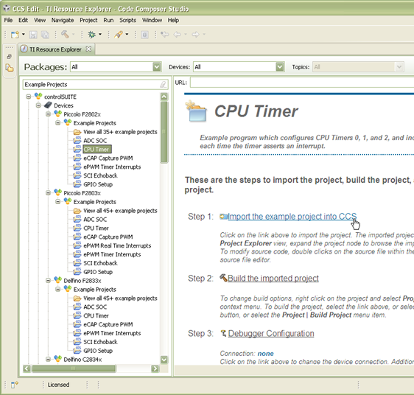
Resource Explorer
Easily access a broad selection of software packages including:
controlSUITE
MSP430ware
TivaWare
TI-RTOS
Guides you step by step through using examples
Browse resources:
Documentation
Videos

Slide 5
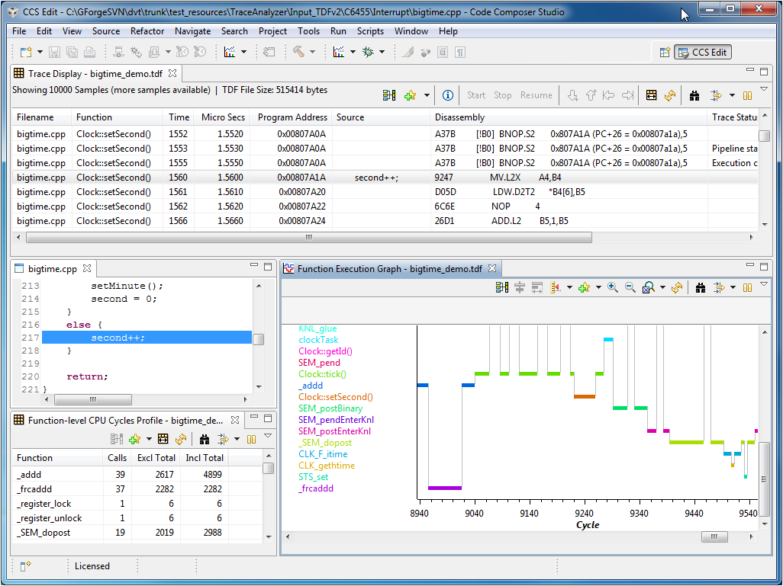
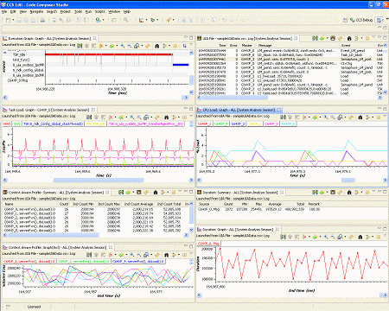
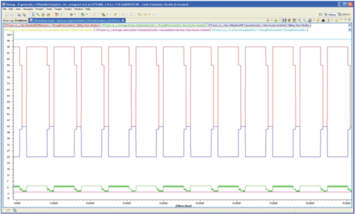
Analyzer Suite
Trace Analyzer
System Analyzer
STM Statistics Analyzer
DSP CPU Trace via pins or Embedded Trace Buffer (ETB)
ARM CPU Trace via ETB
Program, data and event tracing
Trace based profiling and analysis
Correlate information from multiple sources (Linux, RTOS, trace)
For BIOS applications view task execution, CPU & thread load, OS object status…
System Trace Module (STM)
Understand and identify application hotspots and performance bottlenecks
Bandwidth and latency analysis
Interconnect and traffic monitoring

Slide 6
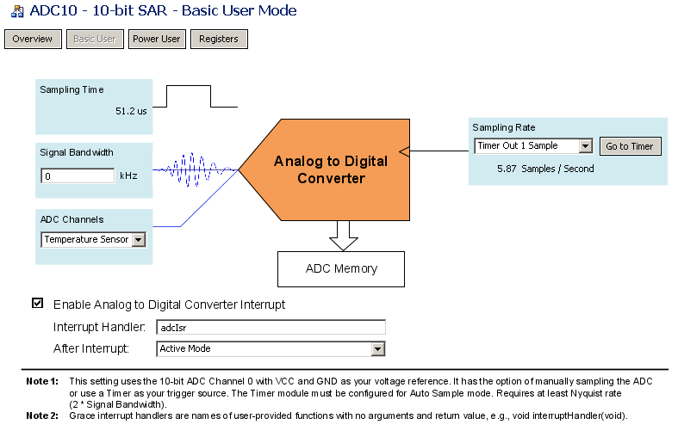

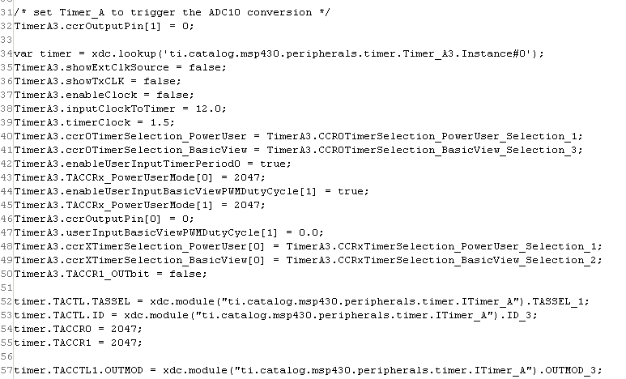
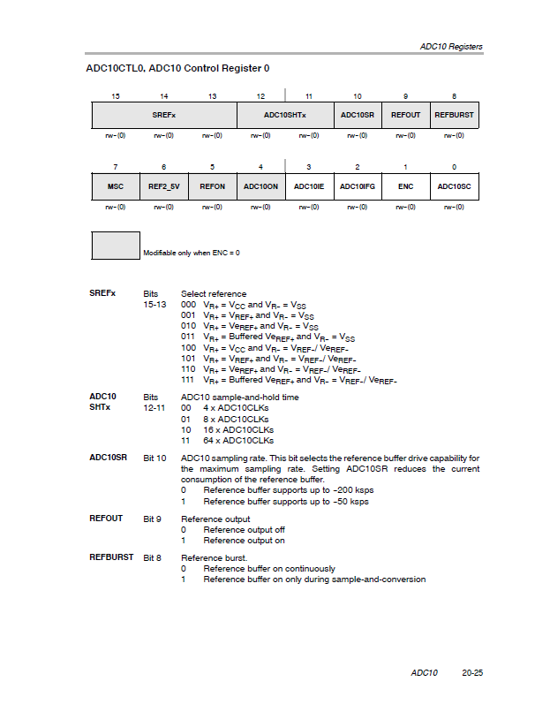
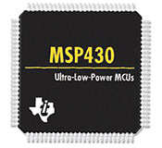
Meet Grace
Layers of Abstraction
Graphical User Interface for enabling and configuring MSP430 peripherals.
Visually configure MSP430 peripherals. Enable and configure ADCs, DACs, timers, clocks, serial communication modules and more, by navigating buttons, drop-down menus, and text fields.
Grace Graphical User Interface
Generate code that is inserted directly into your Code Composer Studio project.
This code can be debugged and downloaded to your MSP430 device just like traditionally created code!
Generates C code
Helpful popups and tooltips are based on MSP430 documentation.
Spend less time flipping through pages of datasheets and user guides, and learn as you go!
Configures Low-level
Register Settings
Grace is seamlessly integrated into the development environment
Grace supports all F2xx and G2xx Value Line microcontrollers, as well as MSP430’s most popular hardware kits, including the LaunchPad, the eZ430-F2013 and eZ430-RF2500.
Supports MSP430F2xx/ G2xx MCUs
www.ti.com/grace
Notes:
Back

Slide 7
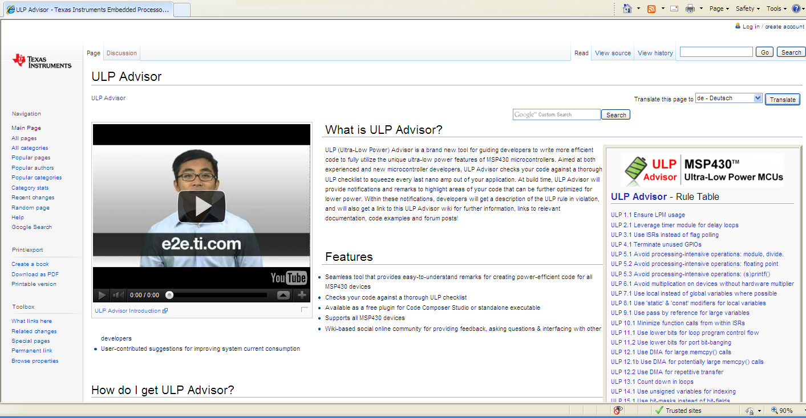
ULP (Ultra-Low Power) Advisor
Guides developers on how to write code that fully utilizes the unique Ultra Low Power features of MSP430 devices
First true software-based teaching tool in the industry for enabling developers to always write code with Ultra-Low Power in mind
Offers unique and not-easily-discovered ULP tips and tricks
Developers will understand where they can improve their code line-by-line for ULP performance
www.ti.com/ulpadvisor

Slide 8
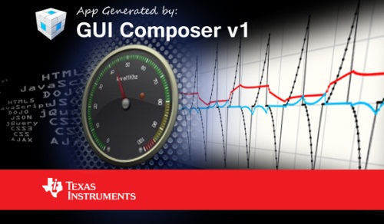
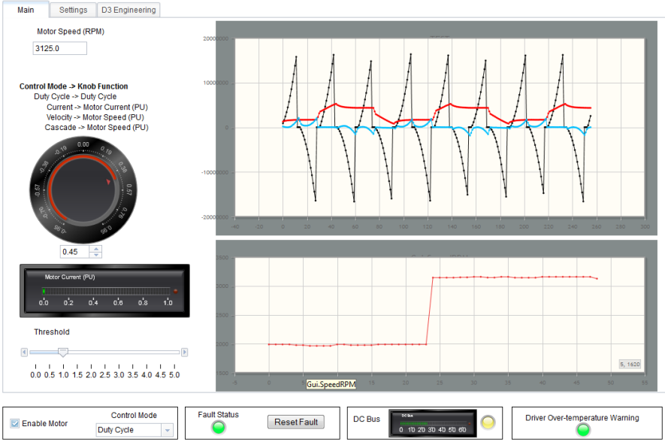
GUI Composer
GUI Composer provides a ‘simple’ framework to build and deliver ‘rich’ GUI based host applications for embedded systems
Connect widgets (dials, meters, graphs) to target variables.
The GUI is powered by HTML5 technology
Off-the-shelf HTML5 widgets
Developers have complete control of GUI if they dive into the html code

Slide 9
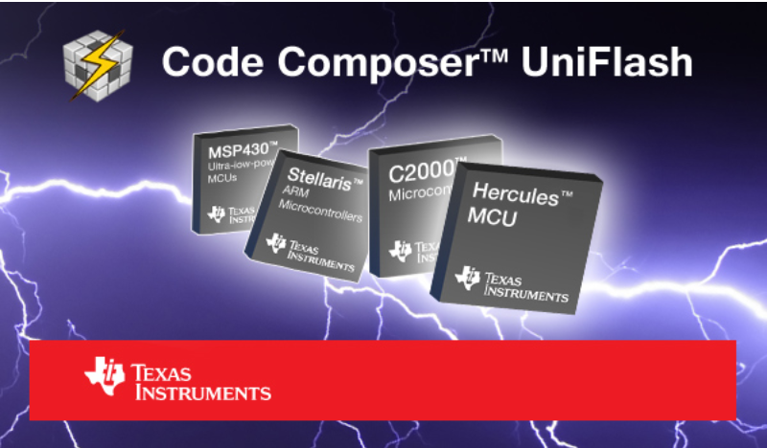
Code Composer UniFlash
Standalone Flash tool
GUI or command line operation
Supports MCU devices with onchip flash:
MSP430, C28x, Hercules, Tiva and Stellaris
Free

Slide 10
Code Composer Studio Pricing
Free options:
90 day evaluation (can be extended for an additional 90 days)
Code Size Limited (16KB) – MSP430 Only
Tied to hardware
XDS100 debug probes
Development kits with onboard emulation (excluding MSP430)
Professional tools:
Node locked licenses (tied to a specific PC)
$445 download version, $495 for DVD version
Floating licenses (shared by multiple users/PCs)
Starting at $795 for 1 seat
Available in 1, 3, 5, 10, 25 and 50 seat configurations
More information available at: www.ti.com/ccstudio

Slide 11
Code Composer Studio Subscription
What is subscription?
Subscription determines if you will receive major upgrades for free
Purchased in 1 year increments, the first year is included with CCS
What is a major upgrade?
Represents a change in the major version number: CCSv5, CCSv6, CCSv7…
How are major upgrades received?
Users will active subscription will receive an activation code that will enable them to generate a license file for the new version
The new version can be downloaded from the CCS download site
For users of free licenses you just download the new tools and activate a new free license
How can I check my subscription?
Go to www.ti.com/myregisteredsoftware
More information available at: http://www.ti.com/tool/ccssub

Slide 12
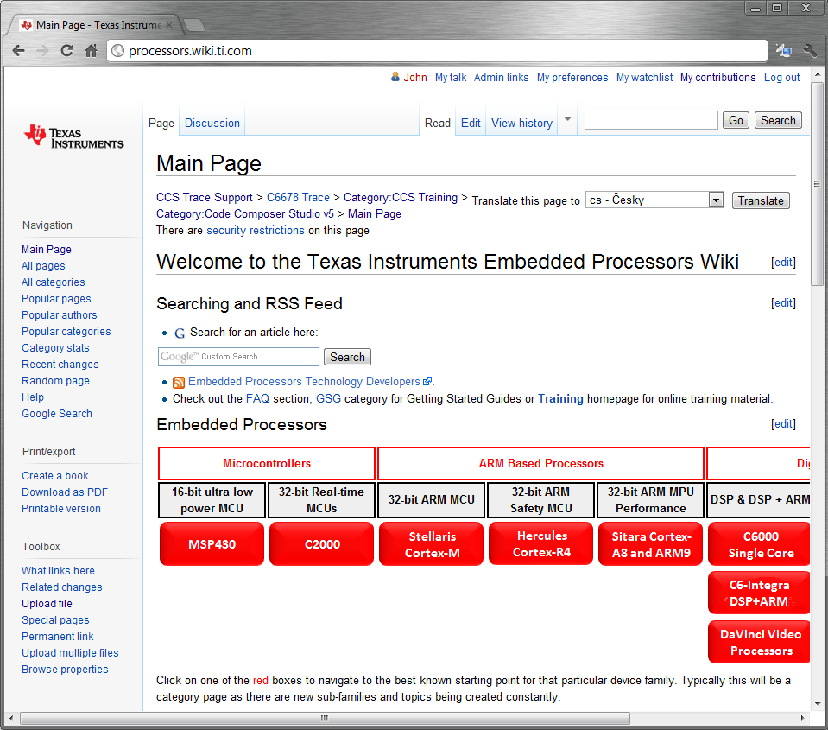
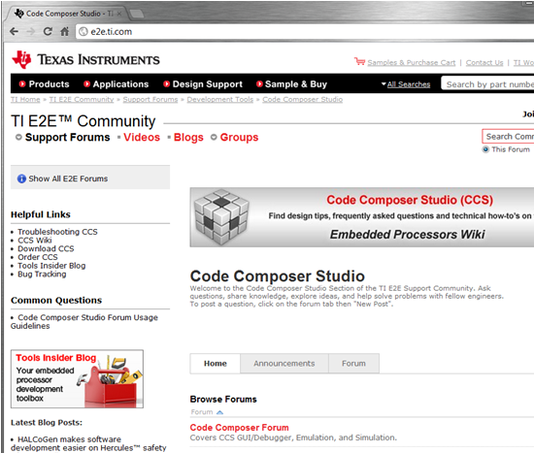
Support
Embedded Processors Wiki provides in depth information on using tools, software and devices
Ask questions and get support via the E2E community. Forums for Code Composer Studio, Compilers, BIOS and devices.
Learn about new software and tools via the Tools Insider Blog.
Check the status of bugs or enhancement requests.

Slide 13
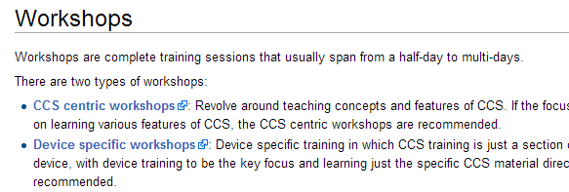
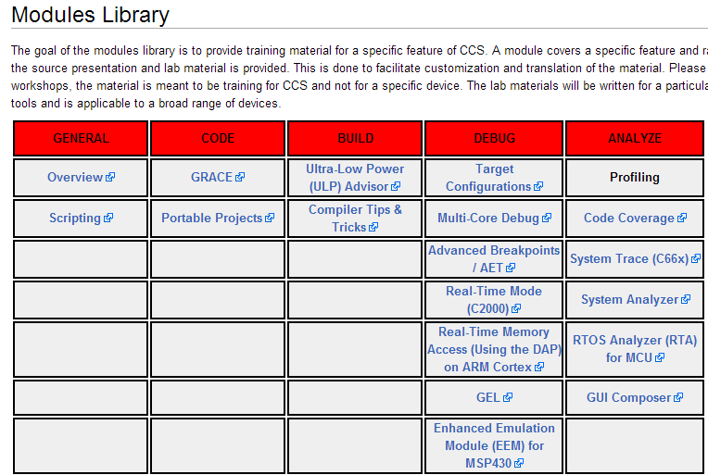
Training Material
Hands-on Workshops
Step by step instructions
Use low cost development kits
Video Training
Feature demonstrations
Modules Library
Collection of training material for specific features
http://processors.wiki.ti.com/index.php/Category:CCS_Training

Slide 14
Why use Code Composer Studio?
Code development environment
eases and speeds design and troubleshooting.
simplifies project management.
manages status and information from multiple cores.
aids control of compiler & SYS/BIOS™ sw kernel foundation.
enables the automation of common tasks.
automatically manages tool updates.
Advanced GUI framework
Multi-processor debugging
Flexible project environment
Debug server scripting interface
Update manager tool

