Slide 1



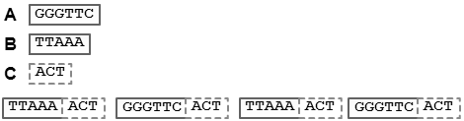
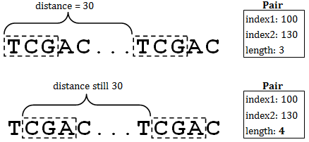
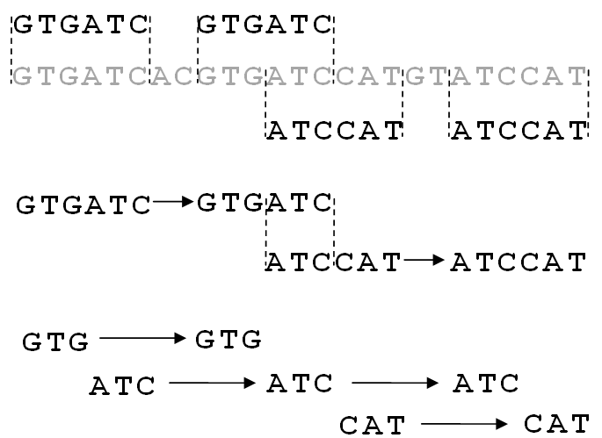
SCANER
Nathan Figueroa¹, Xiaolin Liu^{1,2} and John E. Karro^{1,2,3}
Departments of ¹Computer Science, ²Microbiology, and ³Statistics
Miami University, Oxford Ohio, USA
Sequential Chaining and Analysis of New Elementary Repeats
Problem: De Novo Repeat Identification
Want to identify repeats in a sequence without the use of known repeats ℓ - the minimum length for a substring to be considered significant Elementary repeat⁴ – substring greater than ℓ and not exclusive to a longer repeat Maximal repeat - substring both greater than ℓ and maximal in length, occurring a significant number of times in the query sequence Difficult to identify efficiently due to large input size and repeat deterioration O(n²) is too slow and exact-matching is too rigid
Elementary repeat
Maximal repeat
Proposed Solution: Tabulate ℓ-mers with Spaced Seeds
Let ℓ-mer denote a substring of length ℓ Tabulation of ℓ-mer occurrences in a sequence similar to approach taken by popular de novo tool RepeatScout⁵. Rather than tabulating exact ℓ-mers, add wildcards to pattern matching to create spaced seeds, as done by PatternHunter⁶ in BLAST.
For ℓ = 5, spaced seed = 1101011 where 1 = match, 0 = wildcard
GG*A*AG
==
GG*A*AG
…ATCCTTGTCATGATCAAGGCAGACCACACGTCCCAGAGAGCCCAGCTCCATGATGGGAGAGCAGGGCATAGCGGCTGTG…
Find Maximal Pairs via Distance
Rather than recording occurrences, we record the distance since the last matching ℓ-mer When two or more pairs of matching ℓ-mer seeds occur over the same distance in tandem, we combine the two into a maximal pair (see illustration at right). The resulting output is the set of all maximal repeats occurring sequentially
Split Maximal Pairs into Chains of Elementary Repeats
Elementary repeats will be absorbed by the larger maximal pairs By noting where maximal pairs overlap, we can find the elementary repeats Let every node n denote a repeat’s start and end coordinates From now on, let each maximal pair be considered a chain of 2 nodes We proceed as follows: If there exists a chain, c₁ = (r₁, r₂) and c₂ = (r₃, r₄) and the suffix of r₂ overlaps the prefix of r₃, we split the chains on the intersection of their overlap and merge the intersecting regions together. We end up with three chains of the fragments: c₁= (r_{1, prefix}, r_{2,prefix}), c₂= (r_{1,ntersection}, r_{2,intersection,} r_{3,intersection}) and c₃= (r_{2,suffix}, r_{3,suffix}). (See illustration at left.) Note that c₁ could have ended up with its suffix instead of its prefix if instead the suffix of r₃ overlapped the prefix of r₂. We start by sorting all nodes, then split and merge all overlapping chains from first to last.
Results
We used well-annotated genomes and searched for selected representative families of repeats. We preserved all regions marked by RepeatMasker as containing these families, and shuffled the interim sequence to remove unknown repeats that might otherwise be regarded as false positives. RepeatScout is run with parameters set to default. Runtimes include time taken by RepeatMasker⁷ to find RepeatScout seed locations.
 | C. Elegans ChrI - SINE1_CE CELE45 LINE2B_CE LINE2G_CE - 15,072,423 bp |  |  |  | Human Chr22 - AluSx MIRb L1MB5 L1MC1 - 49,691,432 bp
Seed / Method | Time (s) | False Positives | Mean MSP | Mean Ancestor Coverage | Time (s) | False Positives | Mean MSP | Mean Ancestor Coverage
111111111111111111111111 | 26.93 | 0.001245099 | 0.505 | 0.771 | 93.48 | 0.108815916 | 0.542 | 0.739
1111101111111001111111011111 | 28.87 | 0.000367438 | 0.595 | 0.782 | 111.52 | 0.098448046 | 0.724 | 0.752
11011011011011011011011011011011 | 29.88 | 0.19106363 | 0.431 | 0.53 | 132.01 | 0.18350619 | 0.71 | 0.696
110010010... 010 x 12 ...010010011 | 43.63 | 0.7804096 | 0.6 | 0.331 | 206 | 0.25300387 | 0.526 | 0.751
RepeatScout | 1070.06 | 0.011351637 | 0.249 | 0.944 | 2436.48 | 0.19688854 | 0.459 | 0.806
 | C. Elegans ChrX - HAT1_CE PALTTTAAA2 CELE14B LINE2C_CE - 17,718,866 bp |  |  |  | Mouse Chr19 - B1F1 PB1 L1_Mm L1_Mus3 - 61,431,566 bp
 | Time (s) | False Positives | Mean MSP | Mean Ancestor Coverage | Time (s) | False Positives | Mean MSP | Mean Ancestor Coverage
111111111111111111111111 | 35.29 | 0.000587725 | 0.217 | 0.636 | 134.66 | 0.91384715 | 0.309 | 0.232
1111101111111001111111011111 | 40.07 | 0.001088812 | 0.312 | 0.498 | 161.9 | 0.8686861 | 0.418 | 0.322
11011011011011011011011011011011 | 39.41 | 0.054841343 | 0.477 | 0.41 | 171.36 | 0.86637384 | 0.397 | 0.279
110010010... 010 x 12 ...010010011 | 46.57 | 0.50505066 | 0.35 | 0.455 | 201.03 | 0.862343 | 0.424 | 0.375
RepeatScout | 1332.8 | 0.5017984 | 0.25 | 0.978 | 4184.46 | 0.48790565 | 0.512 | 0.549
⁴Zheng, Jie, and Stefano Lonardi. "Discovery of repetitive patterns in DNA with accurate boundaries." Bioinformatics and Bioengineering, 2005. BIBE 2005. Fifth IEEE Symposium on. IEEE, 2005. | ⁶Price, Alkes L., Neil C. Jones, and Pavel A. Pevzner. "De novo identification of repeat families in large genomes." Bioinformatics 21.suppl 1 (2005): i351-i358.
⁵J. T. M. L. Bin Ma, “PatternHunter: faster and more sensitive homology search,” Bioinformatics, 2001. | ⁷Smit, AFA, Hubley, R & Green, P. RepeatMasker Open-3.0. 1996-2010 <http://www.repeatmasker.org>.

