Slide 1



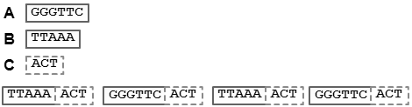
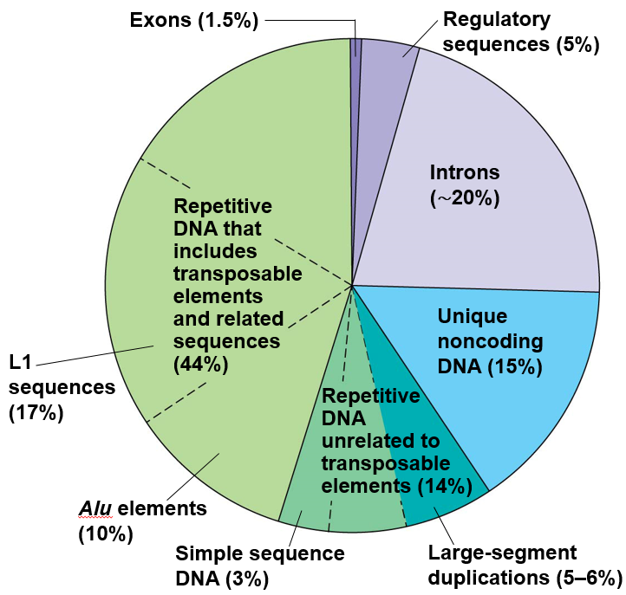
RAIDER
Charlotte Schaeffer¹, Nathan Figueroa¹, Xiaolin Liu^{1,2} and John E. Karro^{1,2,3}
Departments of ¹Computer Science, ²Microbiology, and ³Statistics
Miami University, Oxford Ohio, USA
Rapid Ab Initio Detection of Elementary Repeats
De Novo Repeat Identification
Repeats are a significant portion of eukaryotic genomes - For breakdown of human genome, see pie chart⁴ RepeatMasker is a library based tool for identifying repeats De novo – identify repeats without the use of known repeats Many approaches have scalability/generalizability issues
Elementary repeat
Elementary Repeat⁵
An elementary repeat is a subsequence that: - meets minimum length and frequency requirements - does not contain a repeat of higher frequency - is maximal (not contained within a longer repeat)
Maximal
elementary repeat
RAIDER⁶: a linear search for repeated l-mers
Construct a hash table mapping each distinct l-mer to the locations it was seen, similar to approach taken by RepeatScout⁷
CTTCAGAATA…CTTCAGAATA…CTTCAGTACA
l = 5, f = 2
CTTCAGAATA…CTTCAGAATA…CTTCAGTACA
Search for repeated l-mers
CTTCA:1
TTCAG:1
TCAGA:1
CTTCAGAATA…CTTCAGAATA…CTTCAGTACA
Check if the l-mer can be merged into an existing family
To be part of family, must be within l of last lmer added
Only need to look at the last l families seen
If cannot merge, create new family with this l-mer
CTTCA:2
TTCAG:1
TCAGA:1
…
CTTCAGAATA…CTTCAGAATA…CTTCAGTACA
CTTCA:2
TTCAG:2
TCAGA:1
…
CTTCAGAATA…CTTCAGAATA…CTTCAGTACA
Merge overlapping l-mers together as encountered
CTTCA:2
TTCAG:2
TCAGA:2
…
Break merges apart when elementary repeat definition is violated
CTTCAGAATA…CTTCAGAATA…CTTCAGTACA
Break merged l-mers apart as needed
CTTCAGAATA…CTTCAGAATA…CTTCAGTACA
l = 5, f = 2, s = 1*1*1
Augmentation: Spaced Seeds
Spaced seed- pattern describing required matching between two strings - Used successfully by PatternHunter⁸ in BLAST - String of 1’s and *’s, where *’s represent “wildcard” positions l-mers q and t match WRT seed s of length l if q_{i}=t_{i} for each 1 position i in s Allows for some mismatched bases in elementary repeat instances
CTTCAGAATA…CTTCAGAATA…CTTCAGTACA
CTTCAGAATA…CTTCAGAATA…CTTCAGTACA
CTTCAGAATA…CTTCAGAATA…CTTCAGTACA
CTTCAGAATA…CTTCAGAATA…CTTCAGTACA
CTTCAGAATA…CTTCAGAATA…CTTCAGTACA
Results
We used well-annotated genomes and searched for repeats, comparing results with those in RepBase to determine bases that were correctly or incorrectly identified as repeats. RepeatScout is run with parameters set to default. Runtimes include time taken by RepeatMasker⁹ to find RepeatScout seed locations.
 | C. Elegans ChrI - 15,072,423 bp
Seed / Method | Time (s) | True Positives | True Negatives
111111111111111111111111 | 3632 | 0.27573 | 0.84774
11111011111110011111111011111 | 3650 | 0.35049 | 0.82401
11101101101001100111 | 14426 | 0.39361 | 0.78065
11110100101001101111 | 14403 | 0.41674 | 0.78163
11110010101001100111 | 18049 | 0.42555 | 0.77728
RepeatScout | 28853 | 0.55450 | 0.85224
 | Human Chr22 - 49,691,432 bp
Seed / Method | Time (s) | True Positives | True Negatives
111111111111111111111111 | 10849 | 0.42979 | 0.52446
11111011111110011111111011111 | 14409 | 0.45121 | 0.51482
11101101101001100111 | 18043 | 0.49493 | 0.39744
11110100101001101111 | 21637 | 0.49044 | 0.56207
11110010101001100111 | 28833 | 0.49299 | 0.61368
RepeatScout | 39610 | 0.63881 | 0.7118
⁴Reece, Jane B., Lisa A. Urry, Michael L. Cain, Steven A. Wasserman, Peter V. Minorsky, and Robert B. Jackson. “Genomes and their evolution.” Campbell Biology. 10th ed. USA: Pearson Education, 2013. 444. Print. | ⁶Figueroa, Nathaniel, et al. "RAIDER: Rapid Ab Initio Detection of Elementary Repeats." Advances in Bioinformatics and Computational Biology. Springer International Publishing, 2013. 170-180. | ⁸Price, Alkes L., Neil C. Jones, and Pavel A. Pevzner. "De novo identification of repeat families in large genomes." Bioinformatics 21.suppl 1 (2005): i351-i358.
⁵Zheng, Jie, and Stefano Lonardi. "Discovery of repetitive patterns in DNA with accurate boundaries." Bioinformatics and Bioengineering, 2005. BIBE 2005. Fifth IEEE Symposium on. IEEE, 2005. 105-112. | ⁷Ma, Bin, John Tromp, and Ming Li. “PatternHunter: faster and more sensitive homology search.” Bioinformatics. 18.3 (2002) 440-445. | ⁹Smit, Arian FA, Robert Hubley, and Phil Green. "RepeatMasker Open-3.0." (1996): 1996.

