Slide 1



JDBC
Java Database Connectivity

Slide 2
What’s JDBC?
JDBC-ODBC Bridge Driver
JDBC stands for Java Database Connectivity. JDBC is a Java API to connect and execute the query with the database. It is a part of JavaSE (Java Standard Edition). JDBC API uses JDBC drivers to connect with the database. There are four types of JDBC drivers:
Native Driver
Network Protocol Driver
Thin Driver

Slide 3
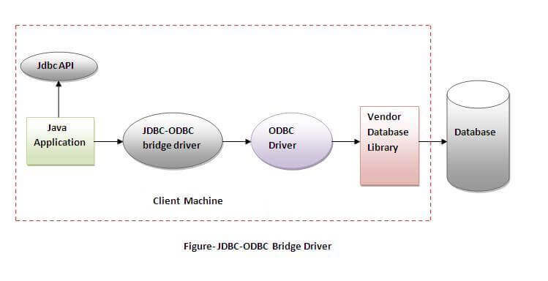
JDBC-ODBC bridge driver
The JDBC-ODBC bridge driver uses ODBC driver to connect to the database. The JDBC-ODBC bridge driver converts JDBC method calls into the ODBC function calls. This is now discouraged because of thin driver.
Advantages:
easy to use.
can be easily connected to any database.
Disadvantages:
Performance degraded because JDBC method call is converted into the ODBC function calls.
The ODBC driver needs to be installed on the client machine.
In Java 8, the JDBC-ODBC Bridge has been removed.

Slide 4
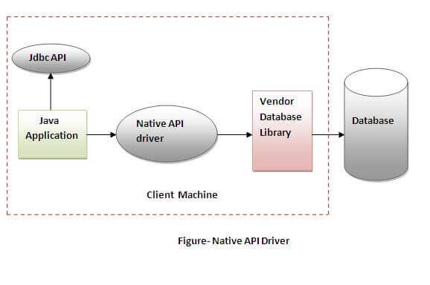
Native-API driver
The Native API driver uses the client-side libraries of the database. The driver converts JDBC method calls into native calls of the database API. It is not written entirely in java.
Advantage:
performance upgraded than JDBC-ODBC bridge driver.
Disadvantage:
The Native driver needs to be installed on the each client machine.
The Vendor client library needs to be installed on client machine.

Slide 5
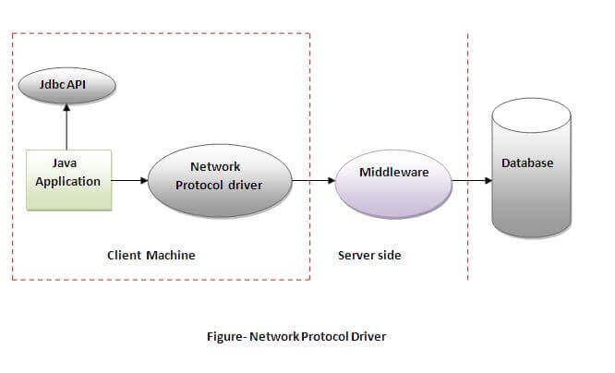
Network Protocol driver
The Network Protocol driver uses middleware (application server) that converts JDBC calls directly or indirectly into the vendor-specific database protocol. It is fully written in java.
Advantage:
No client side library is required because of application server that can perform many tasks like auditing, load balancing, logging etc.
Disadvantages:
Network support is required on client machine.
Requires database-specific coding to be done in the middle tier.
Maintenance of Network Protocol driver becomes costly because it requires database-specific coding to be done in the middle tier.

Slide 6
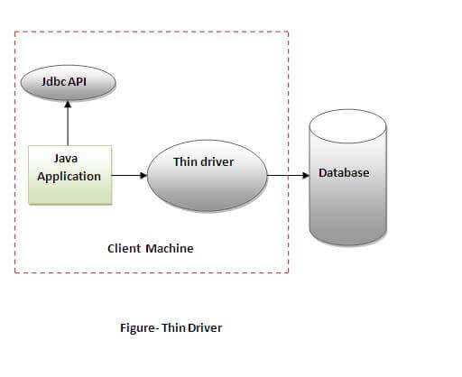
Thin driver
The thin driver converts JDBC calls directly into the vendor-specific database protocol. That is why it is known as thin driver. It is fully written in Java language.
Advantage:
Better performance than all other drivers.
No software is required at client side or server side.
Disadvantage:
Drivers depend on the Database.

Slide 7
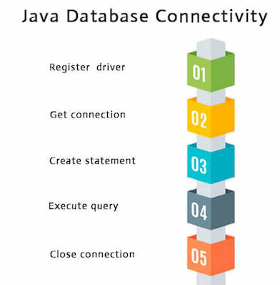
Java Database Connectivity with 5 Steps
There are 5 steps to connect any java application with the database using JDBC. These steps are as follows:
Register the Driver class
Create connection
Create statement
Execute queries
Close connection

Slide 8
Class.forName("oracle.jdbc.driver.OracleDriver");
Connection con=DriverManager.getConnection(
"jdbc:oracle:thin:@localhost:1521:xe","system","password");
Statement stmt=con.createStatement();
ResultSet rs=stmt.executeQuery("select * from emp");
con.close();

Slide 9
Let’s move to practice
CLPS Incorporation

Slide 10
Install sqlserver in local PC
Refer to https://www.runoob.com/w3cnote/windows10-mysql-installer.html
1. Download from https://dev.mysql.com/downloads/mysql/
2. Unzip to a folder you’d like
3. Create my.ini with port info .etc
4. Open Command Line
5. Enter mysql directory then initialize and start mysql service

Slide 11
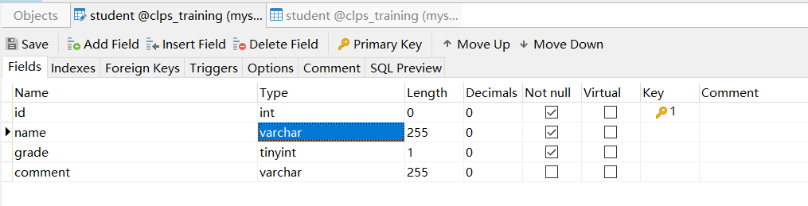
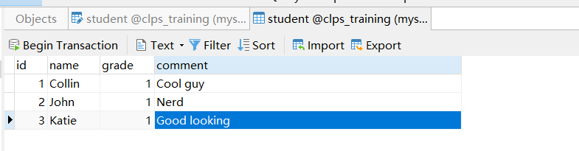
Mysql backgroud

Slide 12

Q&A

