Slide 1

E-mail Writing Workshop
Jasmine

Slide 2
E-mail Writing Workshop
Part 4
Basic terminology
Part 3
The tone of the mail,
formal or informal
Part 2
Composition of the E-mail
Part 1
Why are business writing skills important?

Slide 3
Why are business writing skills important？
1.Customers see your writing more than see you
Causes
2. Good writing skills show you are really care
3. Good writing skills boost argument/persuasion/selling

Slide 4




Composition of E-mail
Format
The format of business English Email
Body
Key expressions commonly used in the body of Email
Attachment
When attaching files to your Email, it’s necessary to make reference to it in the context of your mail
Openings and closings
Salutations/beginning/
closing regards/ending

Slide 5
Part 1：Format

Slide 6
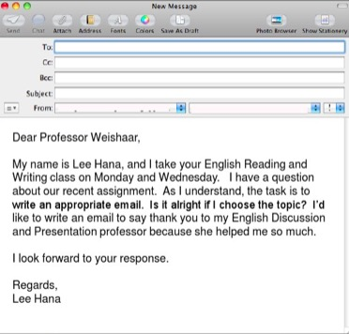
Format
Carbon copy表示这封邮件也将寄给其他收件人
Content:
Writer’s address, recipient’s address, CC,BCC
Subject
Salutations, beginning ,body , ending
Complimentary close
Writers full name. titles and department, address, tel, fax …
Blind carbon copy 密件副本
Subject line 主题，告知内容
salutation称呼
Close regarding结尾

Slide 7
1）抄送别人怎么说？
中国人喜欢说cc，美国人直接说copy. cc是carbon copy（复写纸）的简称，以前还没有电子邮件时候，用复写纸抄送，所以本质上还是copy.
I have put John on copy. (记住put on copy的固定搭配）
You can copy Steven going forward.
如果是分别抄送给某些人，但是又不想让他们互相知道对方的联系方式，可以用暗送(BCC也就是blind cc),比如同时发给几个供应商，邮件开头直接写: BCC vendors
2）群发邮件增加联系人怎么说？
Looping in Steven.
Adding/Added Steven.
甚至直接用“+”都可以+ Steven
把某个人删除（涉及到保密的信息）,用remove Removed Mike from this email
3)转发邮件怎么说？
forward the email to someone(大部分中国人只会用这种)
pass me the email(老外也经常用这种)

Slide 8
Part 2：Openings and closings

Slide 9
Salutations
Mr., Ms. or Dr., it must be followed by a person's last name or full name
The standard way to begin a formal e-mail is by using “Dear/Hi/Hello + (person‘s name)：”
right | wrong
Ms./Mrs./Dr. Bolton or Ms./Mrs./Dr. Dorothy Bolton | Ms/ Mrs/ Dr.Dorothy
Dorothy | Bolton
Using just a person's first name provides a sense of seriousness

Slide 10
Staring /Ending sentences
The reason/purpose I’m writing to you is to…
State your reasons
I‘m writing with reference to /in regard to /with regard to
Thank you very much for…
Respond with thanks
It was great to get your email…
I am looking forward to …
If you have any questions, please don’t hesitate to …
Wrap up the contents
Please let me know if…
Thanks all for now.
Regarding closings
Sincerely 、 Yours truly、Best regards 、Regards 、 Yours faithfully 、Kind regards

Slide 11
Key Expressions Commonly used in the body
1.Giving good and bad news
I am pleased to inform you that…
You will be pleased to know that…
We regret to inform you that…
I am sorry to tell you that…
2.Making Request
I was wondering if…?
Is it possible to …?
I would be grateful if..
3.Offering help
Would you like me/us to …?
I/we can do this if you like.
4.Indicating if you can comply or not
Yes ,we are able to …
Unfortunately , we are unable to ..

Slide 12
How to deal with attachments?
1. I have attached something to this email…
phrases
2. Please find (something) attached
3. Please see the attachment.

Slide 13
Part 3. Formal or informal?

Slide 14
Compare these sentences:
Semi-formal/informal | Formal
Hi John | Dear sir/madam
Thank you for your email ,it was great to hear from you. | Thank you for your email of 25th June regarding the sale of…
I want to let you know that… | I am writing with regard to the sale of....
Please let me know if you can ... | Could you please tell me if you can attend…?
Would you mind to come early…? | I would appreciate it if you can come early…...
II am sorry to say that… | We regret to inform you that….
I am write to complain about… | I am writing to express my dissatisfaction with…
How about I come and help you? | Should you need any further assistance, please don’t hesitate to contact us.

Slide 15
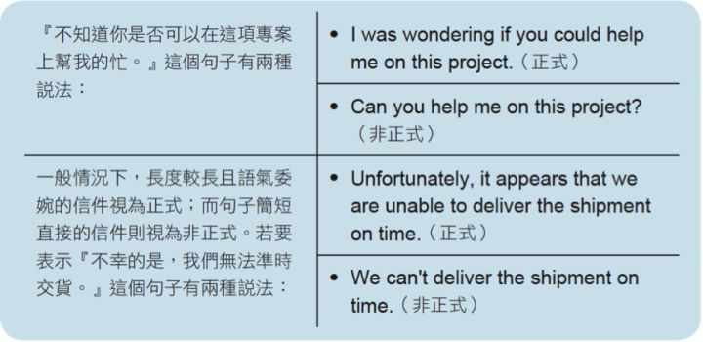

Compare these sentences:

Slide 16
Part 4.E-mail Terminology

Slide 17

抄送别人 | Cc(carbon copy)/BCC(blind cc)
群发邮件增加联系人 | Looping in Steven. Adding/Added Steven.(开头处加）
转发邮件 | forward the email to someone pass me the email
回复邮件 | get back， reply（ I will get back to you tomorrow)
附件 | Attached / Enclosed
文件 | Document.(excel可以说spreadsheet, ppt可以说presentation) ,file

Slide 18

Email etiquette

Slide 19
1）感谢acknowledge
中文邮件不喜欢太多客套话，废话少说，直入正题，但是美国人写邮件，哪怕是和熟悉的人，回邮件第一句话，都要感谢，所以他们的邮件都是thank来thank去的，中文邮件没这种习惯。开头，感谢别人回复自己的邮件（也可以用thank you，用在稍微正式场合，比如和陌生人发邮件）
Thanks for the quick reply.
Thanks for getting back to me.
Thanks for the update on the situation.
Thanks for the updated information.
Thanks for gathering the information this week on this issue.
别人发邮件提供信息给你，中文邮件是懒得回的，英文邮件也习惯感谢，简单回复一个。
Thank you.
Well noted.
Noted/Received with thanks.
Good information.

Slide 20
2）道歉
如果是回邮件回得晚了，先道歉，貌似中文很少有这个习惯(以下sorry也可以替换成apologize，更正式一点，发给重要的人或者群发）
Sorry for the late reply.（中国人普遍用这一种，也有老外用，不过下面两种更多）
Sorry I haven’t got back to you sooner .
Sorry for the delay getting back to you.
如果是临时通知别人是什么事情: Apologies for the late/short notice.
如果是上一封邮件没写清楚导致收件人误解了: I apologize if this was not made clear
提前给别人预警如果自己的措辞过于强硬:
I apologize if this may make you feel uncomfortable/bad.I apologize if this may sound a little harsh.

Slide 21
3）收尾套路
最后收尾的套路，一般都是问别人意下如何。(不要用please tell me ...这种句式，从来没见过老外用的）
Please let me know what you think.
Please let me know your thoughts.
Let me know if you have any questions or concerns. (最常见）
Please let me know if there are questions.
Looking forward to your input/insight(用insight/input代替opinion)
That's my idea, what's your idea?(也有直接这样说的）
Please review the lengthy e-mail and provide feedback on how we can proceed.(如果邮件太长了）或者，干脆下面的话结尾:
I'll let you know more tomorrow(表示今天没说完，明天再说更多)
Please call me if you like.(有什么事打我电话）

Slide 22
Salutation
Dear Mr/Mrs/Ms/Miss...
Opening
Background + Purpose
Facts
Reader's Information
Action
Reader's Response
Remarks
Polite Closing

Slide 23
To: All Staff | Date: 20 July 200X
From: General Manager | Reference
Subject: Dress Code
background
As you know, we have always enforced a strict dress code. We have now revised this code.
I would like to inform you of the changes.
The code for branch staff and office staff is different. As I'm sure you will appreciate, there are no changes for branch staff. All branch staff must wear the correct uniform at all times. On the other hand, if you work in the office, you may wear 'smart-casual' wear. However, on any day that you do meet people from outside the company, please ensure you are dressed in a business-like manner.
Please adopt the new dress code from 1 September. If you have any questions, please call Annie Wong on 2344 7765.
purpose
Reader‘s information
Reader‘s respond

Slide 24
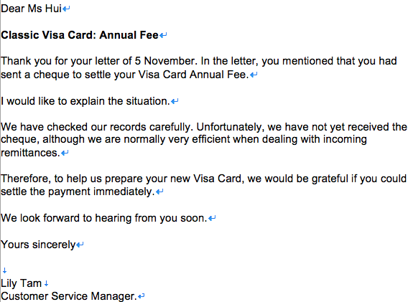
background
purpose
Reader‘s information
Reader‘s respond
Polite closing

Slide 25
Happy New Year—I hope you and your family had a great holiday and enjoyed some well-deserved time off. Thank you again for a terrific effort and a strong result last year!

