Slide 1

SISTEM PENGELOLAAN
KEBUTUHAN AIR PADA
TANAMAN MENGGUNAKAN
WIRELESS SENSOR NETWORK
Isbat Uzzin Nadhori S.Kom, MT [ 1974050520031210021 ]
M. Udin Harun Al Rasyid, S.Kom, Ph.D [ 198108082005011001 ]
Bintang Refani Mauludi [ 2103161052 ]
Notes:
Assalammualaikum wr wb.
Introduce :
My final project the title :
Thanks for the time.

Slide 2




Background
Management of water requirements in plants is one of the most important factors in plant growth
But in general the management of water is only based on soil moisture without adapt to the watering schedule and weather forecast.
This situations water is wasted because watering when it rains
Notes:
Management of water requirements in plants is one of the most important factors in plant growth. But in general the management of water is only based on soil moisture without adapt to the watering schedule and weather forecast. So that in some situations water is wasted due to watering when it rains

Slide 3



Solution
Current Environmental Conditions
watering schedules
compared
watering plants
weather forecast
weather forecast
Notes:
Salah satu faktor iklim yang mempengaruhi kebutuhan air tanaman adalah kelembaban dan suhu yang menyebabkan transpirasi serta evaporasi (James, 1988). Suhu dan kelembaban yang tinggi akan menyebabkan kebutuhan air tanaman meningkat. Selain itu pemberian air tanaman juga dipengaruhi oleh curah hujan. Sehingga diharapkan dapat memberikan makanan yang teapt dengan jumlah yang tepat dari dosis berdasarkan data yang diperoleh

Slide 4

Related Work
1
Modern Irrigation based on Web Weather Forecast
2
Weather based Smart watering system using soil sensor and GSM
Sistem Pengelolaan Kebutuhan Air Pada Tanaman Menggunakan Wireless Sensor Network
3
Penerapan Logika Fuzzy Pada Sistem Penyiraman Tanaman Otomatis Berbasis Mikrkontroller
4
Penerapan Fuzzy Logic Pada Sistem Pengaturan Jumlah Air berdasarkan suhu dan kelembaban

Slide 5
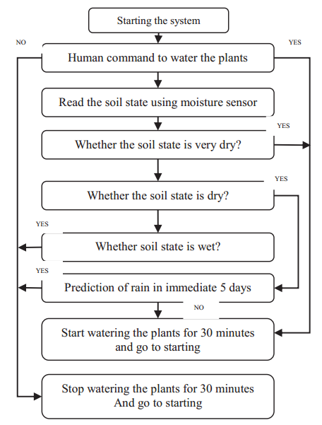

Specification :
Modern Irrigation based on Web Weather Forecast [ 1 ]
Sensor Soil Moisture
weather Forecast
Cek soil moisture every 30 minute
Notes:
1. Open the serial port monitor and set the baud rate to 9600
2. Record the sensor value when the probe is exposed to the air as "Value 1". This is the boundary value of dry soil “Humidity: 0%RH”
Jika semakin besar maka semakin kering “520”
3. Take a cup of water and insert the probe into it no further than the red line in the diagram
4. Record the sensor value when the probe is exposed to the water as "Value 2". This is the boundary value of moist soil “Humidity: 100%RH”
Jika semakin kecil maka semakin lembab “260”
The final output value is affected by probe insertion depth and how tight the soil packed around it is. We regard "value_1" as dry soil and "value_2" as soaked soil. This is the sensor detection range. For example: Value_1 = 520; Value_2 = 260. The range will be divided into three sections: dry, wet, water. Their related values are:
Dry: (520 430]
Wet: (430 350]
Water: (350 260]

Slide 6
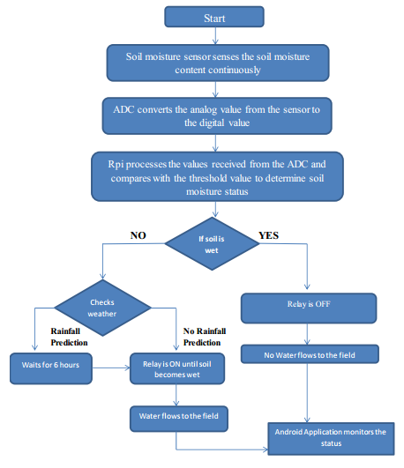
Specification :
Weather based Smart watering system using soil sensor and GSM [ 2 ]
Soil Moisture Sensor
Raspberry pi
Weather Forecast
Notes:
1. Open the serial port monitor and set the baud rate to 9600
2. Record the sensor value when the probe is exposed to the air as "Value 1". This is the boundary value of dry soil “Humidity: 0%RH”
Jika semakin besar maka semakin kering “520”
3. Take a cup of water and insert the probe into it no further than the red line in the diagram
4. Record the sensor value when the probe is exposed to the water as "Value 2". This is the boundary value of moist soil “Humidity: 100%RH”
Jika semakin kecil maka semakin lembab “260”
The final output value is affected by probe insertion depth and how tight the soil packed around it is. We regard "value_1" as dry soil and "value_2" as soaked soil. This is the sensor detection range. For example: Value_1 = 520; Value_2 = 260. The range will be divided into three sections: dry, wet, water. Their related values are:
Dry: (520 430]
Wet: (430 350]
Water: (350 260]

Slide 7
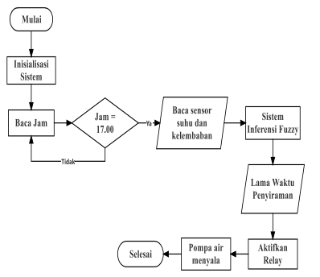
Specification :
Penerapan Logika Fuzzy Pada Sistem Penyiraman Tanaman Otomatis Berbasis Mikrkontroller [ 3 ]
Soil moisture sensor
Sensor realtime clock
(For Schedule Watering)
Sensor temperature LM35
Metode fuzzy
Notes:
1. Open the serial port monitor and set the baud rate to 9600
2. Record the sensor value when the probe is exposed to the air as "Value 1". This is the boundary value of dry soil “Humidity: 0%RH”
Jika semakin besar maka semakin kering “520”
3. Take a cup of water and insert the probe into it no further than the red line in the diagram
4. Record the sensor value when the probe is exposed to the water as "Value 2". This is the boundary value of moist soil “Humidity: 100%RH”
Jika semakin kecil maka semakin lembab “260”
The final output value is affected by probe insertion depth and how tight the soil packed around it is. We regard "value_1" as dry soil and "value_2" as soaked soil. This is the sensor detection range. For example: Value_1 = 520; Value_2 = 260. The range will be divided into three sections: dry, wet, water. Their related values are:
Dry: (520 430]
Wet: (430 350]
Water: (350 260]

Slide 8
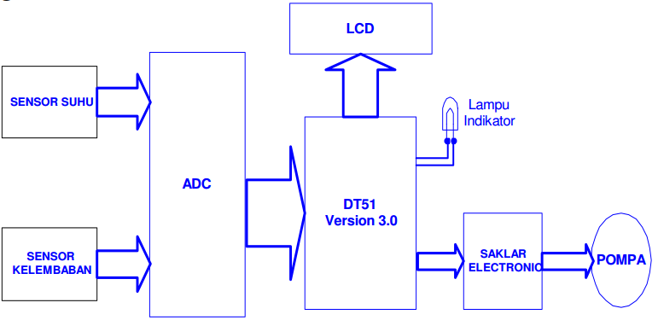
Specification :
Penerapan Fuzzy Logic Pada Sistem Pengaturan Jumlah Air berdasarkan suhu dan kelembaban [ 4 ]
Sensor LM35
Sensor soil moisture
Metode fuzzy
Notes:
1. Open the serial port monitor and set the baud rate to 9600
2. Record the sensor value when the probe is exposed to the air as "Value 1". This is the boundary value of dry soil “Humidity: 0%RH”
Jika semakin besar maka semakin kering “520”
3. Take a cup of water and insert the probe into it no further than the red line in the diagram
4. Record the sensor value when the probe is exposed to the water as "Value 2". This is the boundary value of moist soil “Humidity: 100%RH”
Jika semakin kecil maka semakin lembab “260”
The final output value is affected by probe insertion depth and how tight the soil packed around it is. We regard "value_1" as dry soil and "value_2" as soaked soil. This is the sensor detection range. For example: Value_1 = 520; Value_2 = 260. The range will be divided into three sections: dry, wet, water. Their related values are:
Dry: (520 430]
Wet: (430 350]
Water: (350 260]

Slide 9

Uniqness
 | Hardware | Metode | Weather Forecast | Schedule Watering | Realtime monitoring
[ 1 ] | Sensor Soil Mositure | - | v | - | v
[ 2 ] | Sensor Soil Mositure, | - | v | - | v
[ 3 ] | Sensor Soil moisture , Sensor realtime clock, Sensor temperature LM35 | Fuzzy | - | v | v
[ 4 ] | Sensor LM35, Sensor soil moisture | Fuzzy | - | - | v
[ 5 ] | Sensor Soil Moisture, Sensor DHT11 | Fuzzy | v | v | v

Slide 10

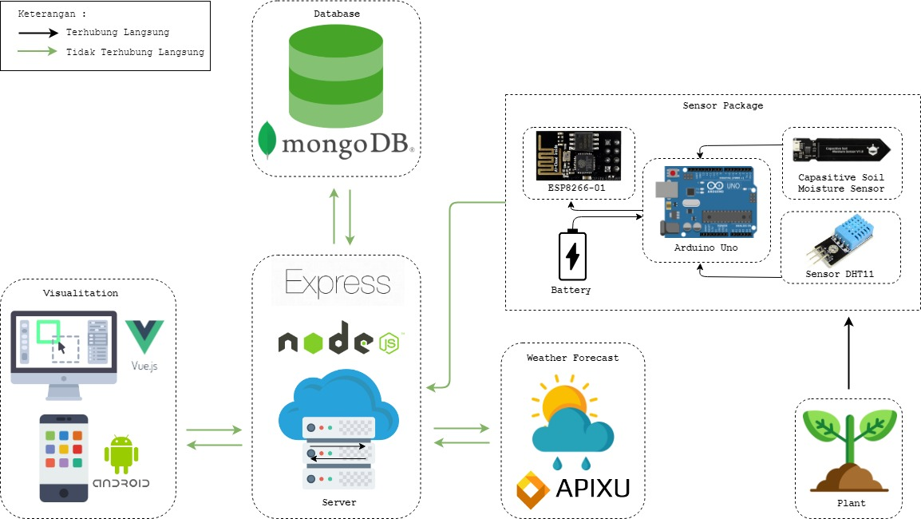
Desain System

Slide 11
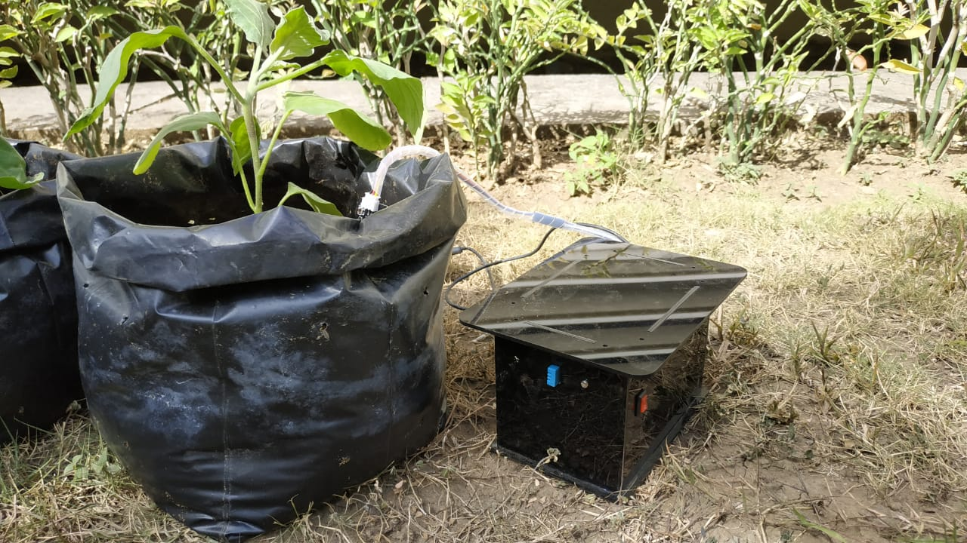
Implementation
Prepare plant for this trials
Put the sensor around the plant
the system has been set up to do watering twice a day if the weather is sunny, the system has been set up to do watering once a day if rainfall is low and then the system has been set not to do watering if the rainfall is high
If the watering time, farmer will get notifications how much volume of water

Slide 12
Implementation

Slide 13
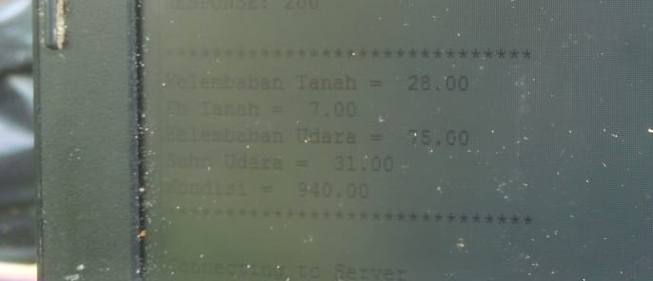
Cek current condition

Slide 14
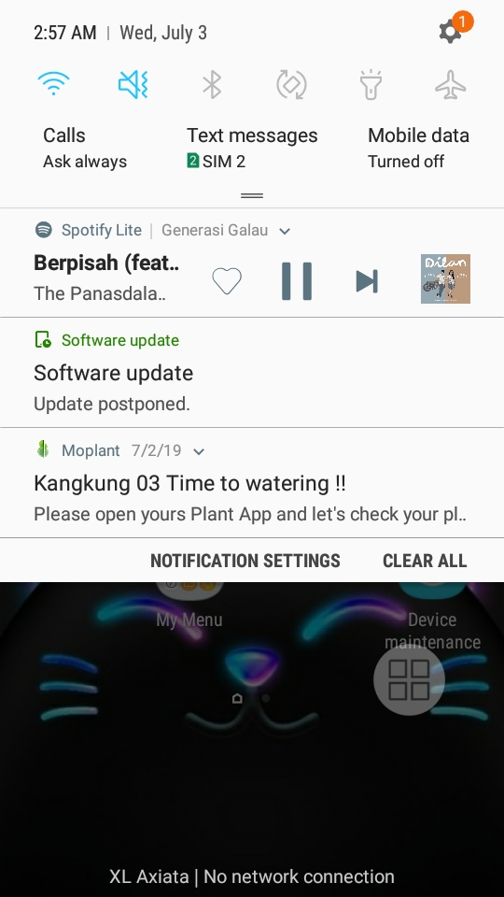
Get Notification

Slide 15
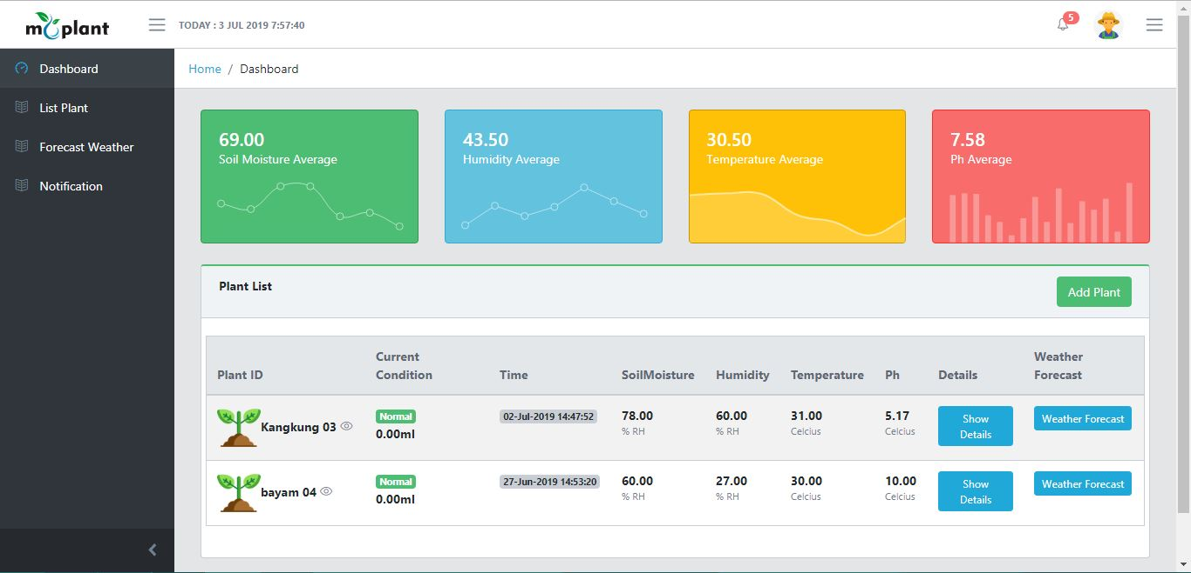
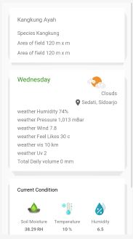
UI

Slide 16
Result
The Result of this research we can monitoir current condition of soil moisture, temperature and humidity
the system will do watering twice a day if the weather is sunny, the system will do watering once a day if rainfall is low and then the system do not watering if the rainfall is high
If the watering time, farmer will get notifications how much volume of water

Slide 17
Terimakasih

Slide 18
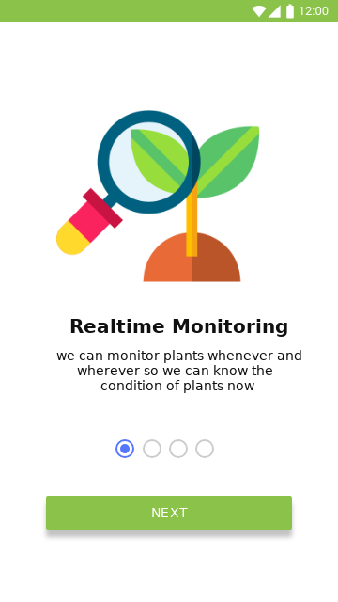

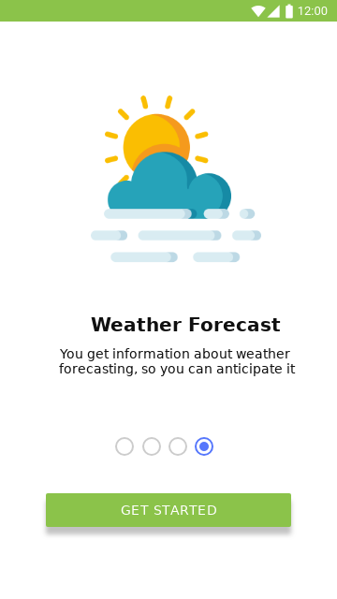
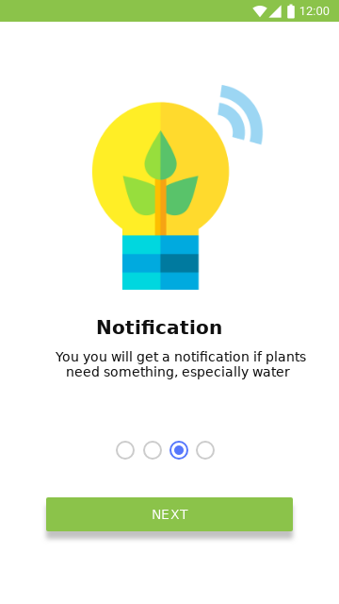
Uji Coba

Slide 19
Mobile

Slide 20
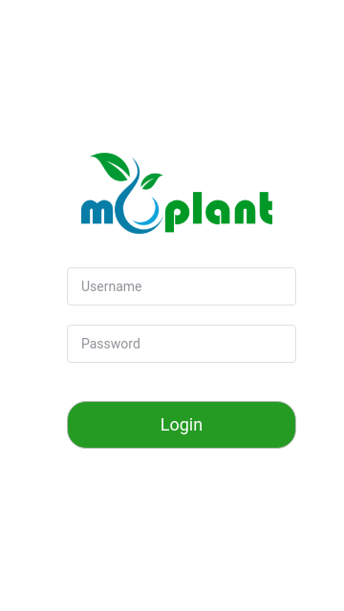
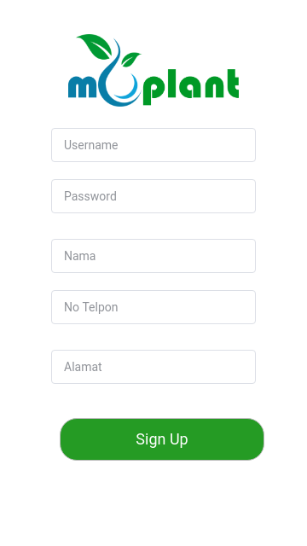
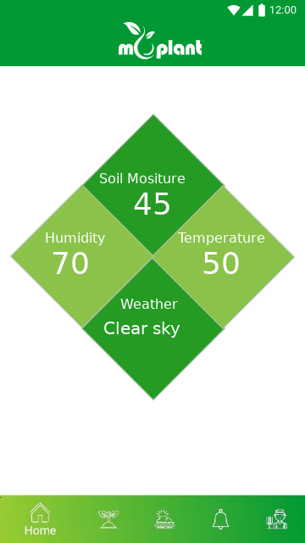
Mobile

Slide 21
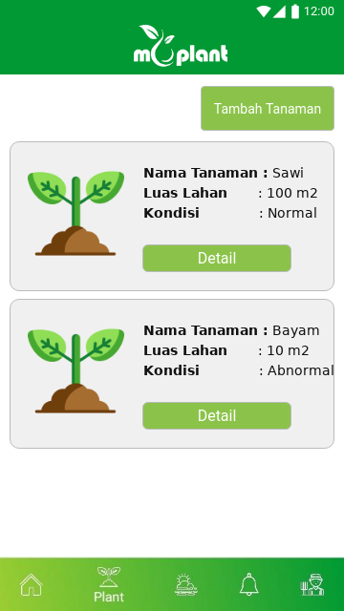
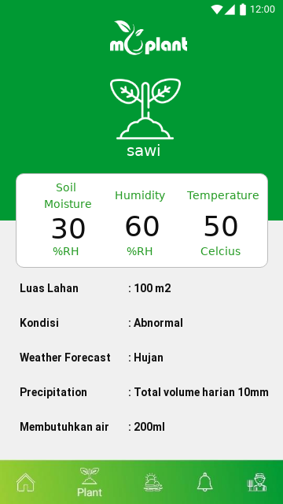
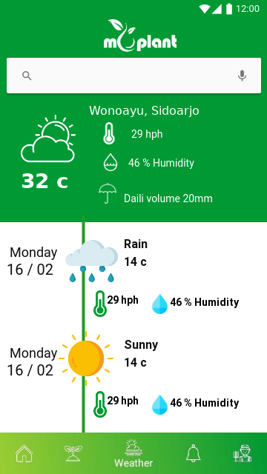
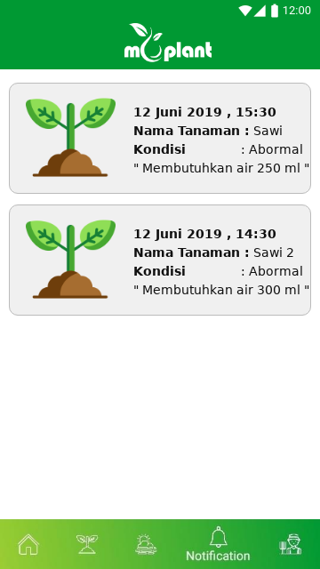
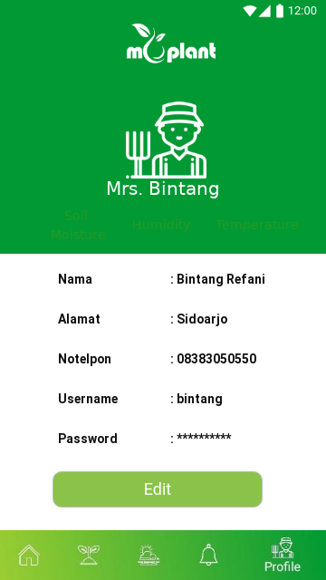
Mobile

Slide 22
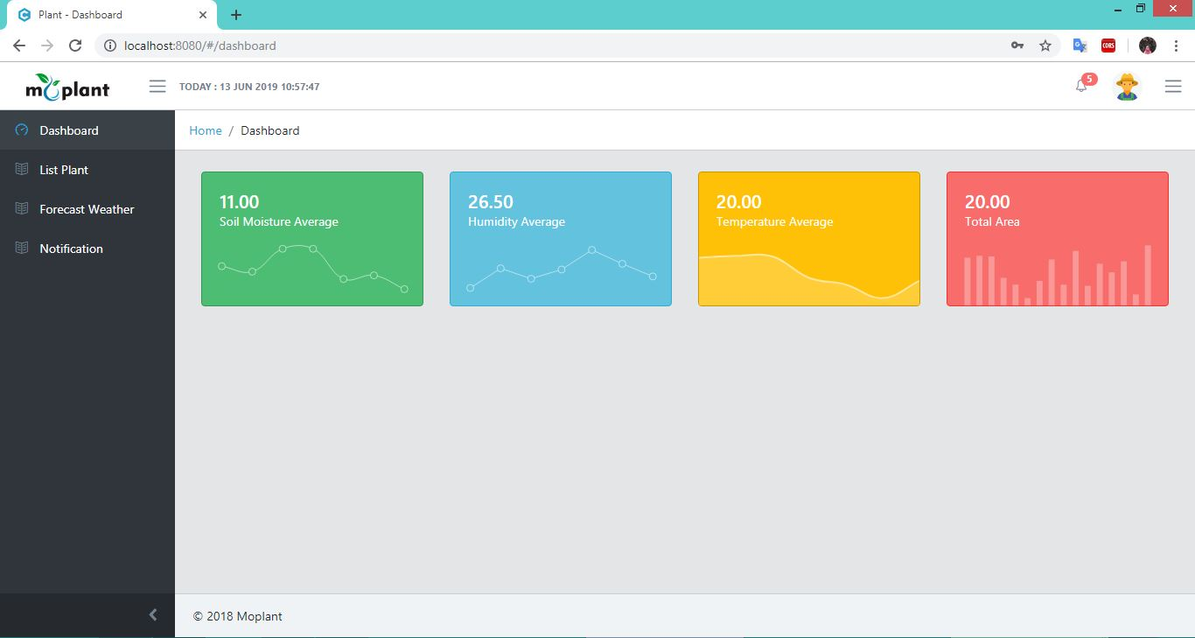
web

Slide 23
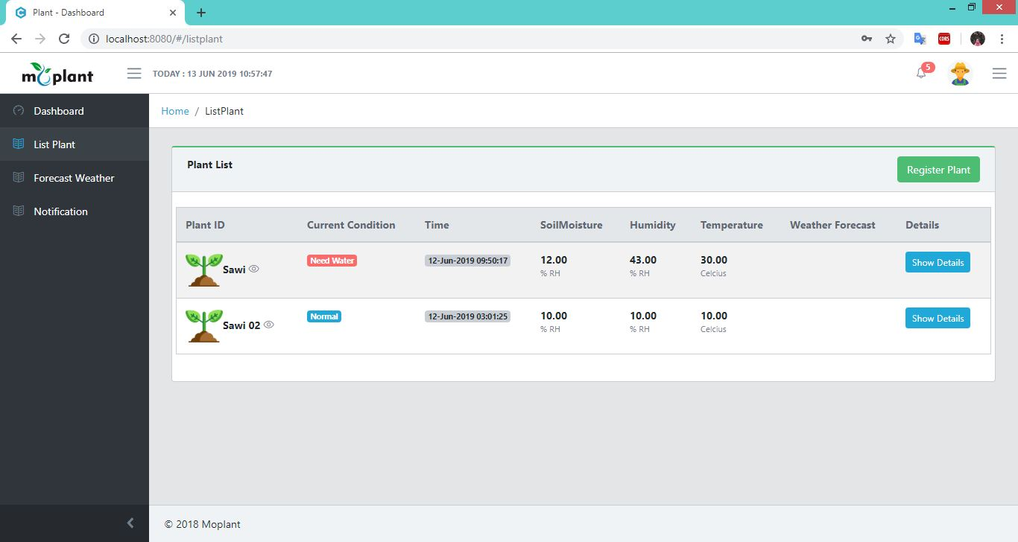
web

Slide 25

Memunculkan data sensor melalui aplikasi arduino IDE
Membuat api Login register petani [Node js]
Membuat tampilan web dengan vue [On progress]
Menentukan api cuaca yang digunakan
Progress

Slide 26


Slide 28
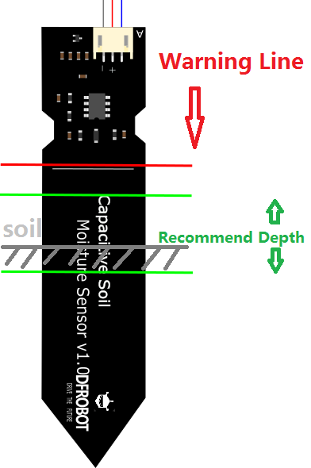
Specification :
Soil Moisture Sensor
Operating Voltage: 3.3 ~ 5.5 VDC
Output Voltage: 0 ~ 3.0 VDC
Operating Current: 5mA
Interface: PH2.0-3P
Dimensions: 3.86 x 0.905 inches (L x W)
Satuan : RH ->Example 20%RH
Weight: 15g
Notes:
1. Open the serial port monitor and set the baud rate to 9600
2. Record the sensor value when the probe is exposed to the air as "Value 1". This is the boundary value of dry soil “Humidity: 0%RH”
Jika semakin besar maka semakin kering “520”
3. Take a cup of water and insert the probe into it no further than the red line in the diagram
4. Record the sensor value when the probe is exposed to the water as "Value 2". This is the boundary value of moist soil “Humidity: 100%RH”
Jika semakin kecil maka semakin lembab “260”
The final output value is affected by probe insertion depth and how tight the soil packed around it is. We regard "value_1" as dry soil and "value_2" as soaked soil. This is the sensor detection range. For example: Value_1 = 520; Value_2 = 260. The range will be divided into three sections: dry, wet, water. Their related values are:
Dry: (520 430]
Wet: (430 350]
Water: (350 260]

