Slide 1

Mathematical Modeling Seminar
Farkas Illés
Modern Portfolio Theory
& Capital Asset Pricing Model
(Introduction)
Illes Farkas
September 10, 2024
BMETE15MF78
github.com/fij/btup
Information classification: Public

Slide 2

About Citi
About Citi
CEO
Jane Fraser
220 000+ colleagues globally
Managing Director,
Citi Country Officer, and Banking Head for Hungary
Veronika Spanarova
3 000+ in Budapest

Slide 3
About myself
About myself
2004 Physics PhD at Eotvos University, Advisor: Tamas Vicsek
– 2017 Eotvos Univ. / Hung. Acad. of Sci.
Habilitation, DSc
2017 – Citi HU MQA (Markets Quantitative Analysis)

Slide 4
Agenda
Intro
A brief introduction to
return, risk, and portfolios
Modern Portfolio
Theory (MPT)
Capital Asset
Pricing Model (CAPM)
Return
Efficient Portfolios
Risk

Slide 5
Introduction
Intro
Intro
Alice
Return
Payments
1
1 + q
q : 1-year simple rate
Bob
Time ( in years )
0
1

Slide 6
Introduction
Intro
Asset
Alice
something that has value
Payments
1
1 + q
q : 1-year simple rate
Usually at both payments an asset is transferred in the opposite direction
Bob
Time
0
1

Slide 7
Introduction
Intro
Portfolio
A linear combination of assets
For example, 1 unit of MSFT and 1 unit of AAPL
Normalization to sum of weights = 1 gives : 0.5 MSFT + 0.5 AAPL
In this presentation : only positive weights

Slide 8

Introduction
Any contract contains numbers
that will be known only in the future
Risk
( for a single asset )
Risk quantifies the uncertainty of a future value,
for example, the future price of an asset
We don’t know the future, but we can forecast
A simple forecast for the uncertainty of an asset’s future price is the same asset’s past volatility

Slide 9
Introduction
Modern Portfolio Theory (MPT)
Why forecast the return ?
q can be used for discounting
discounting can be applied to – for example – bond pricing

Slide 10
Modern Portfolio Theory (MPT)
Modern Portfolio Theory (MPT)
N risky assets :
Variable weights w_{i} w
Fixed yearly returns r_{i} r
and covariance w_{i j} c
Return
row
vectors
A
example
portfolios
matrix
B
What is the max q ?
( q does have a max, for example, q ≤ max r_{i} )
Portfolio Risk ( σ ² = w c w ^{T} )
Equivalently : What is the min σ ² ?

Slide 11
Modern Portfolio Theory (MPT)
Modern Portfolio Theory (MPT)
What is the min σ ² ?
Fixed: covariance matrix and return. Variable: weight vector.
Find min σ ² with 2 constraints : sum of weights is 1 , portfolio return is q.
Lagrange method
Add risk-free asset
σ ² ( q )
q ( σ ² )
q ( σ )
Variable transformation
Risky assets only

Slide 12
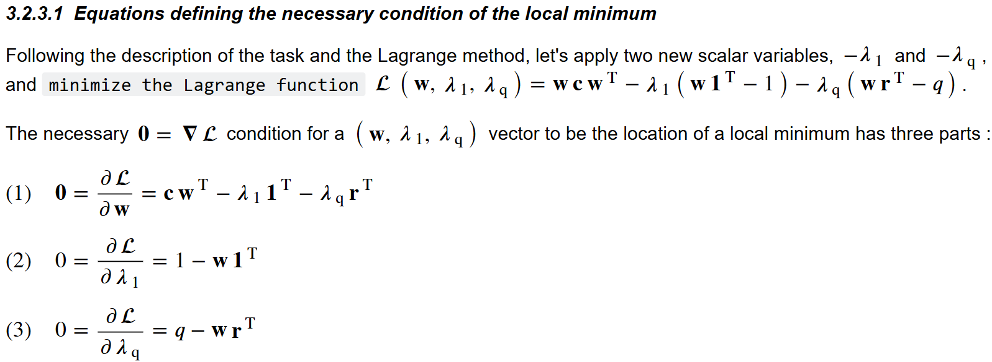
Modern Portfolio Theory (MPT)
Modern Portfolio Theory (MPT)
What is the min σ ² ?

Slide 13




Modern Portfolio Theory (MPT)
Modern Portfolio Theory (MPT)
What is the min σ ² ? Equivalently : max q ?
Numerical issues
c ^{– 1}
A ^{– 1}
Efficient Frontier (EF) of the risky assets only

Slide 14
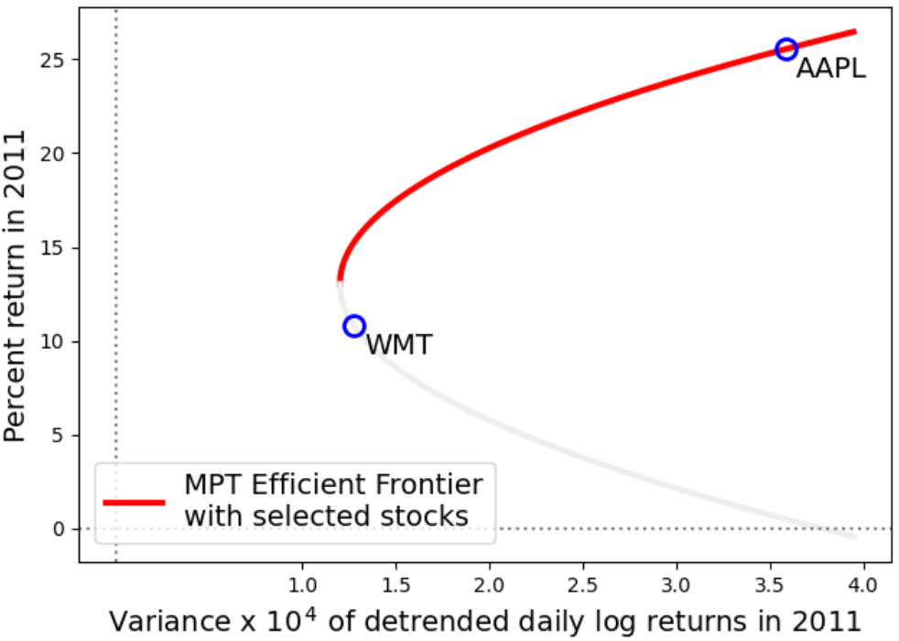
Modern Portfolio Theory (MPT)
Modern Portfolio Theory (MPT)
Example :
Efficient Frontier
of 2 risky assets
Data source:
kaggle.com/dgawlik/nyse

Slide 15
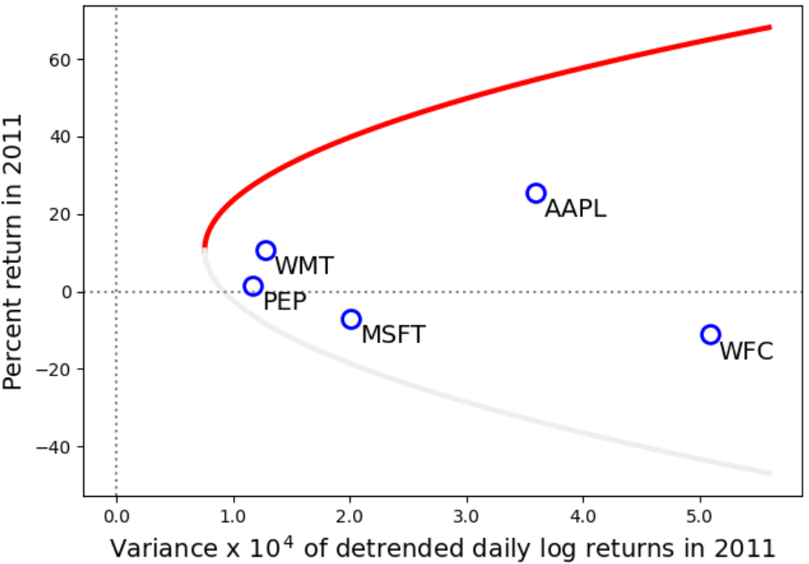
Modern Portfolio Theory (MPT)
Modern Portfolio Theory (MPT)
Example :
Efficient Frontier
of 5 risky assets

Slide 16
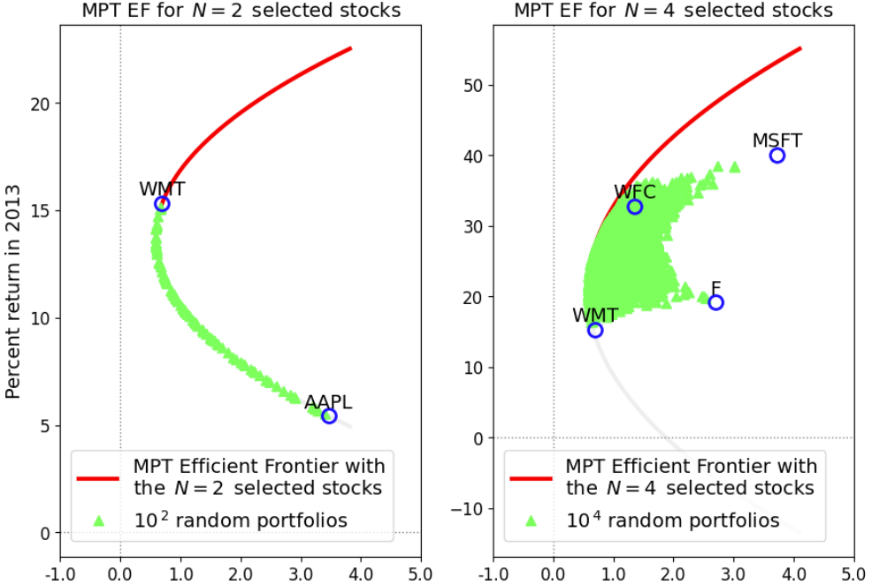
Modern Portfolio Theory (MPT)
Modern Portfolio Theory (MPT)
Example :
Rnd portfolios
of risky assets

Slide 17


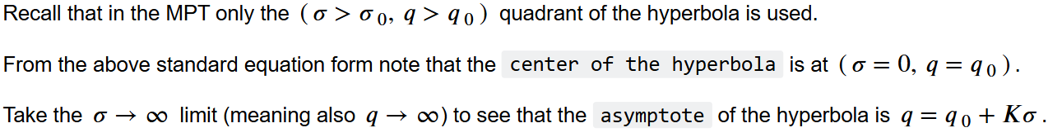
Modern Portfolio Theory (MPT)
Modern Portfolio Theory (MPT)
Variable change : σ ² → σ

Slide 18
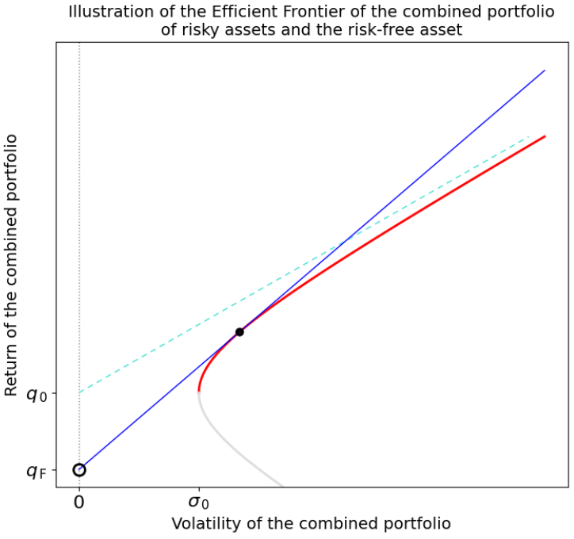
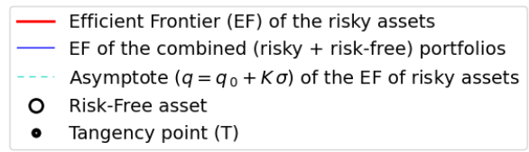
Modern Portfolio Theory (MPT)
Modern Portfolio Theory (MPT)
Efficient Frontier (EF)
of N risky assets
plus 1 risk-free asset :
Line containing the Risk-Free point and tangent to the Risky EF

Slide 19
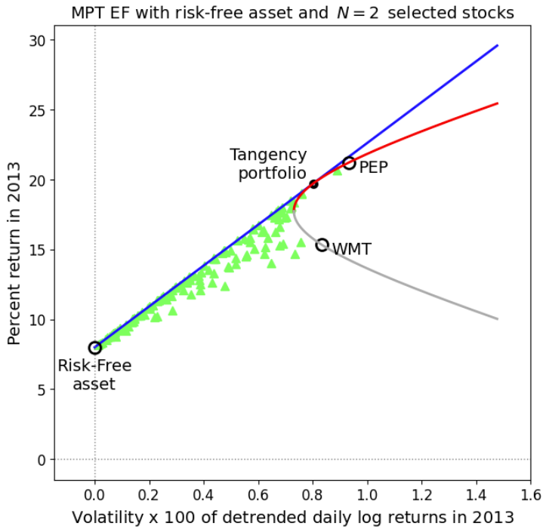
Modern Portfolio Theory (MPT)
Modern Portfolio Theory (MPT)
Example:
risk-free asset + 2 risky assets
Efficient Frontier
Random portfolios

Slide 20
Capital Asset Pricing Model (CAPM)
Capital Asset Pricing Model (CAPM)
MPT σ full risk
CAPM ϐ non-diversifiable risk

Slide 21
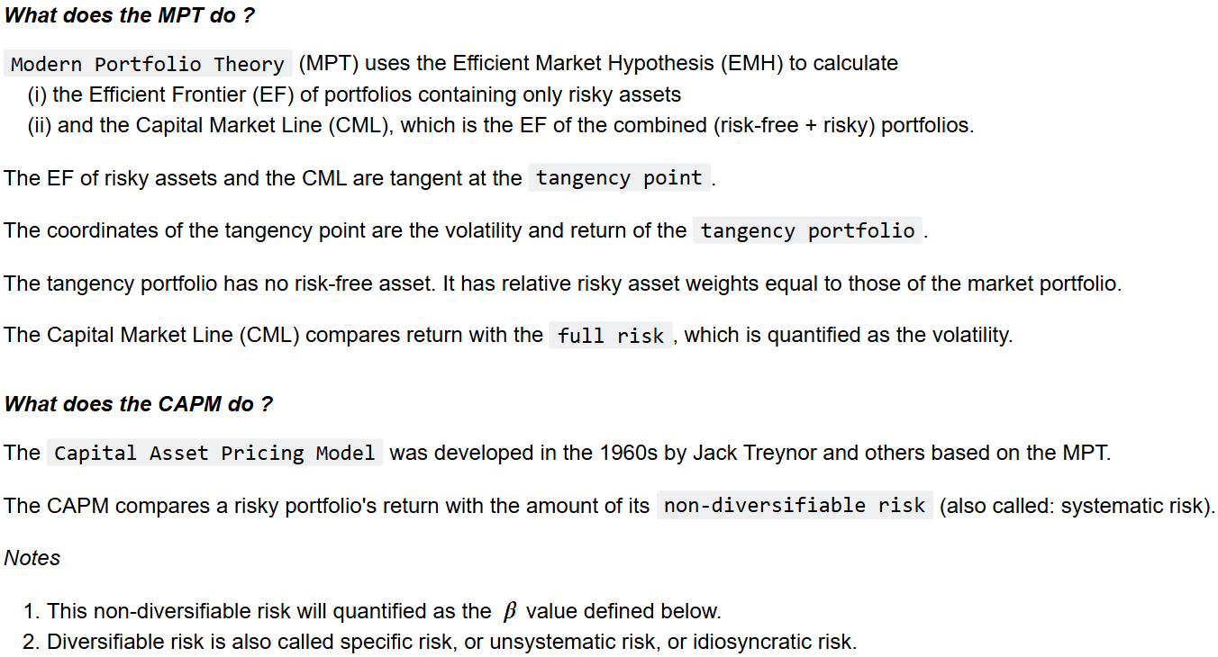
Capital Asset Pricing Model (CAPM)
Capital Asset Pricing Model (CAPM)

Slide 22

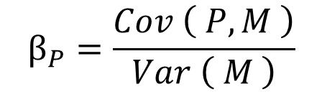

Capital Asset Pricing Model (CAPM)
Capital Asset Pricing Model (CAPM)
ϐ of a portfolio P
(P can be a single asset)
Equivalent definitions
(M is the market portfolio)
$$β_{P}=\frac{Cov \left( P, M \right)}{Var \left( M \right)}$$
is the slope of the linear fit to the scatter plot displaying P (vertical coordinate) vs M (horizontal)
$$β_{P}$$
is the non-diversifiable (also called: systematic) risk of the portfolio P
$$β_{P}$$

Slide 23
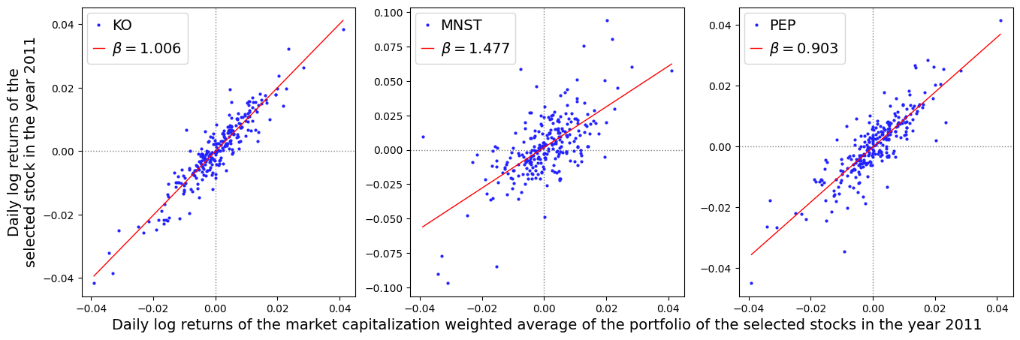
Capital Asset Pricing Model (CAPM)
Capital Asset Pricing Model (CAPM)
Example: Market is 3 stocks
Pepsi, Coke, Monster Beverages

Slide 24
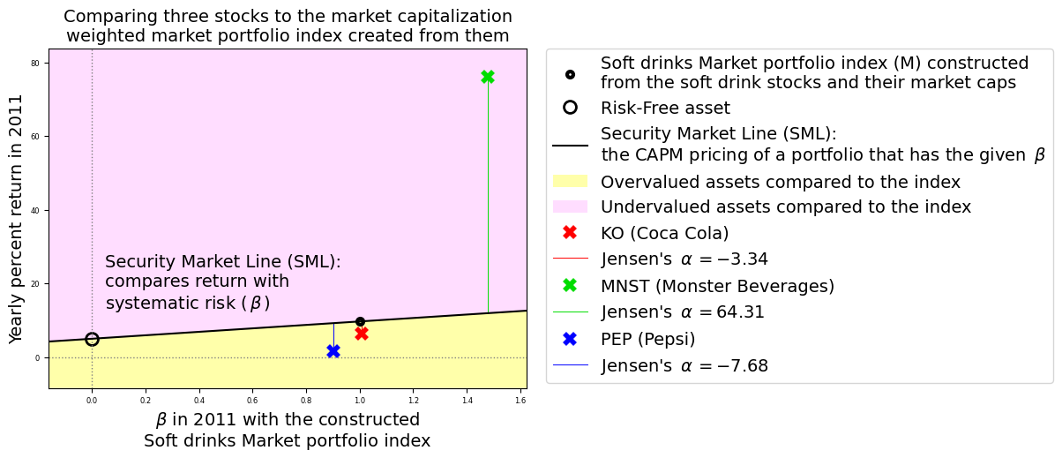
Capital Asset Pricing Model (CAPM)
Capital Asset Pricing Model (CAPM)
Example: Market is 3 stocks

Slide 25
Thank you
Questions

