Slide 1

Farkas Illés
Modern Portfolio Theory
&
Capital Asset Pricing Model
See also: BMETE15MF78

Slide 2
About myself
2004 Physics PhD at Eotvos University, Advisor: Tamas Vicsek
– 2017 Eotvos Univ. / Hung. Acad. of Sci.
Habilitation, DSc
2017 – Citi HU MQA (Markets Quantitative Analysis)

Slide 3
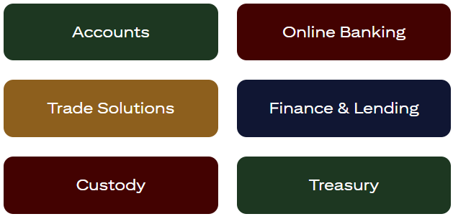
About Citi
CEO
Jane Fraser
229 000 colleagues globally
Managing Director and Country Officer in HU
Veronika Spanarova
3 000+ in Budapest

Slide 4
Intro
Return
Portfolios
Risk

Slide 5
Intro
Alice
Return
Payments
1
1 + q
q : 1-year simple rate
Bob
Time ( in years )
0
1

Slide 6
Intro
Alice
Asset
Payments
1
1 + q
q : 1-year simple rate
Often the exact same thing (asset) is transferred twice in the opposite direction
asset : something that has value
Bob
Time
0
1

Slide 7

Intro
Risk
( for a single asset )
All contracts contain (sometimes just implicitly) numbers that will be known only in the future
Risk quantifies the uncertainty of a future value,
for example, the future price of an asset
We don’t know the future, but we can forecast
A simple forecast for the uncertainty of an asset’s future price is the same asset’s past volatility

Slide 8
Intro
Portfolio
A linear combination of (financial) assets
In math: sum of weights is 1
Start notations here !!!

Slide 9
Intro
What ?
What’s the goal here ?

Slide 10
Intro
How ?
Lagrange mult, Variable changes, Numerical points

Slide 11
Intro
Why ?
q allows discounting, eg, bond pricing

