Slide 1
Farkas Illés Citibank HU MQA
Modern Portfolio Theory
&
Capital Asset Pricing Model
Source: BMETE15MF78

Slide 2
About myself
2004 PhD Eotvos University Advisor: Tamas Vicsek
– 2017 Eotvos Univ., Hung. Acad. of Sci.
Habilitation, DSc
2017 – Citibank HU MQA (Markets Quantitative Analysis)

Slide 3
About Citi
CEO
Jane Fraser
240 000 colleagues globally
HU SSC
Head
Veronika Spanarova
3100 in Budapest
Arena Corner (M2 Stadionok)
Promenade Gardens (M3 Dózsa György út)

Slide 4
Intro
Return
Portfolios
Risk

Slide 5
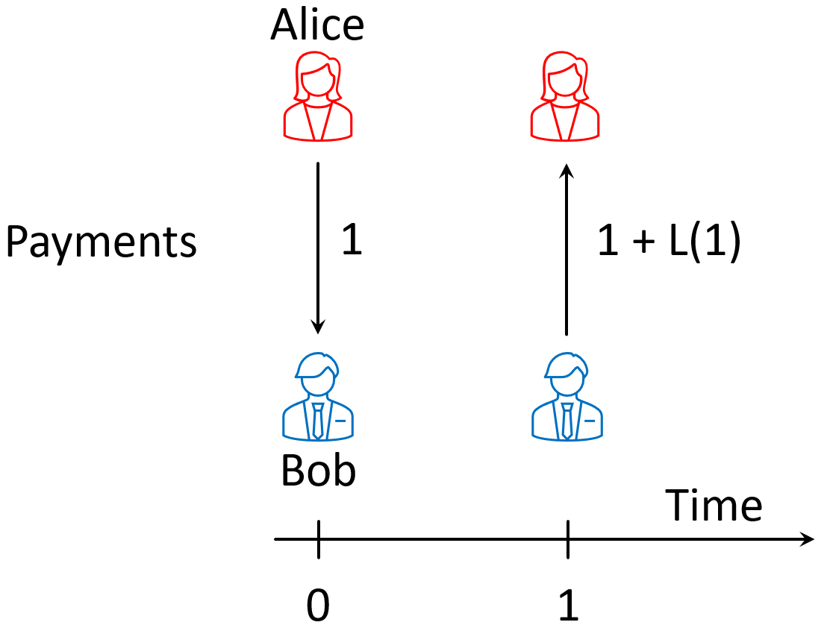
Intro
Return

Slide 6
Intro
Risk

Slide 7
Intro
Portfolios

