Slide 1
Farkas Illés Citibank HU MQA
Modern Portfolio Theory
&
Capital Asset Pricing Model

Slide 2
Farkas Illés Citibank HU MQA
1960s / 1970s
Modern Portfolio Theory
&
Capital Asset Pricing Model

Slide 3
Farkas Illés Citibank HU MQA
1960s / 1970s
Modern Portfolio Theory
&
Capital Asset Pricing Model
Source: BMETE15MF78

Slide 4
Topic
Return
Portfolios
Risk

Slide 5
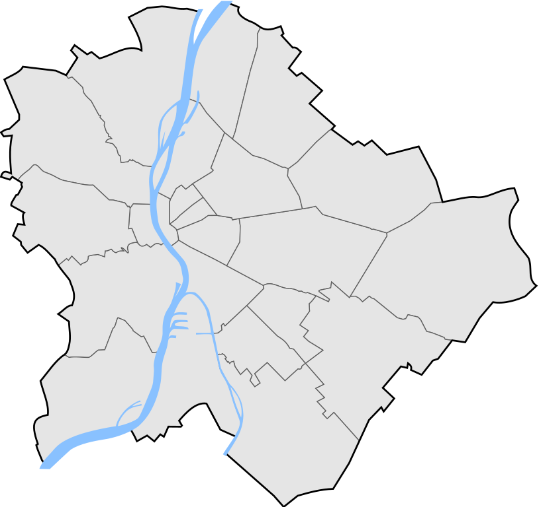
Topic | Citi
CEO
Jane Fraser
200k+ people
HU SSC Head
Veronika Spanarova
3 000

