Slide 1
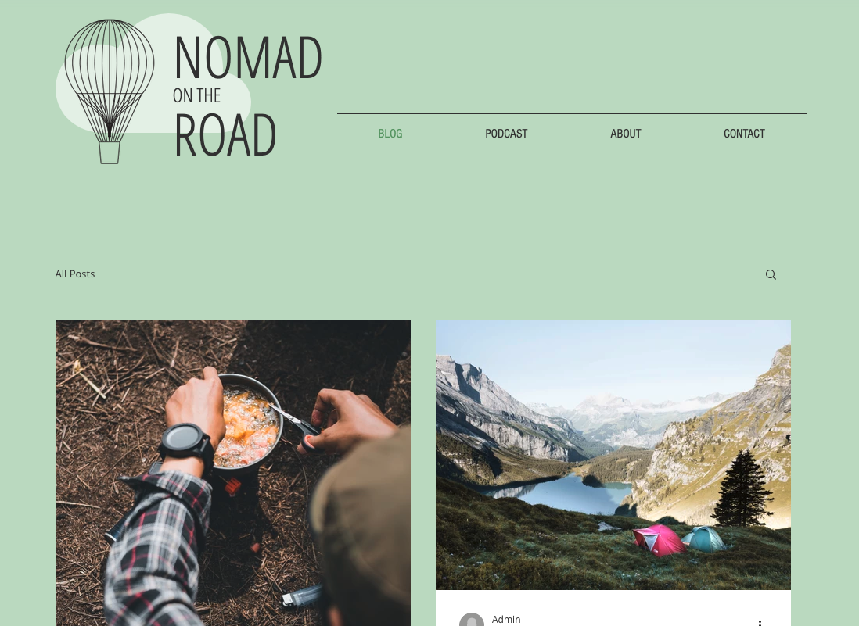

Slide 2
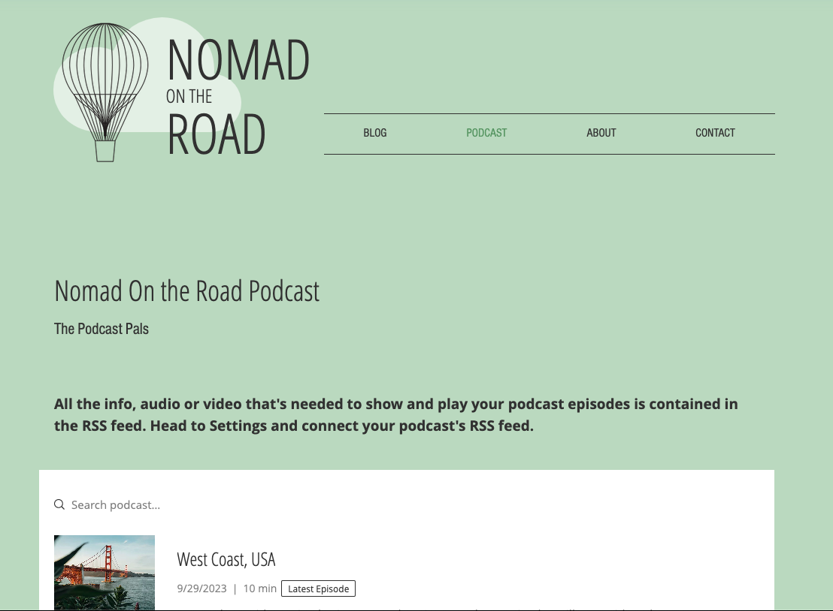

Slide 3
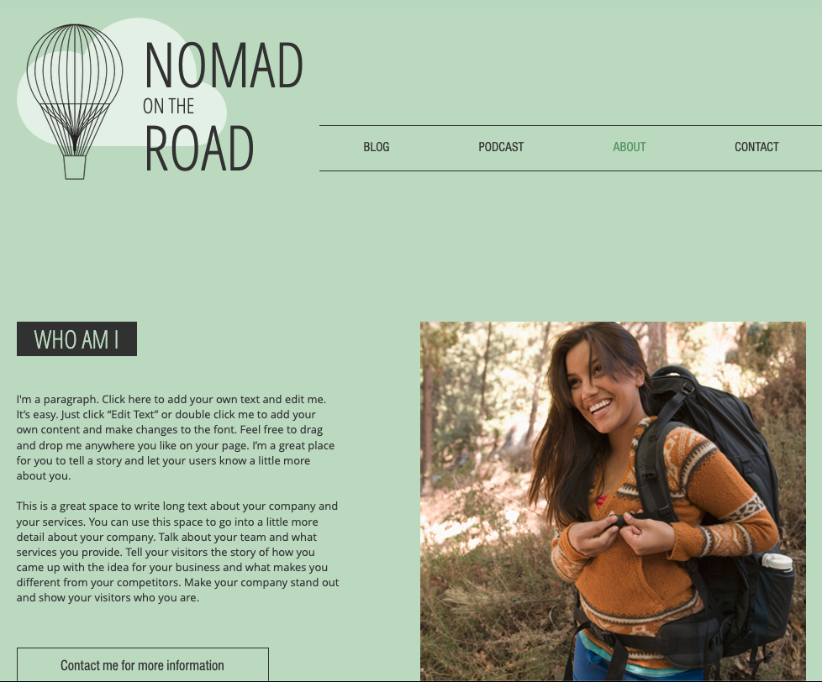

Slide 4
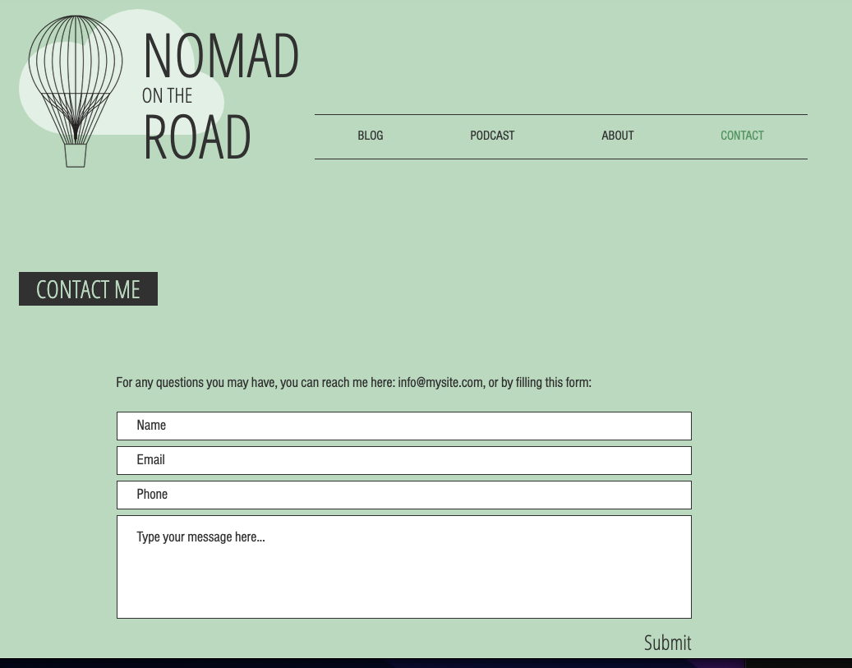

Slide 5
Font
https://www.dafont.com/heavy-trip.font
Background:
https://www.reddit.com/r/HeartstopperNetflix/comments/uc0y1v/some_minimalist_heartstopper_leaves_wallpapers/

Slide 6
Use hover
Use visited

