Slide 1

Documentation for Assessment
Mini_Account_Service

Slide 2
Overview of the Assessment
I have tried to develop and Implement the small system ,based on the Requirement.
What I Understood is The Payer can pay for the users , and That user should be registered in the DB.
In order to pay or add points to the user , the Payer account should not have less point in DB.
And the payer can call deduct API But to deduct the point, the payer account couldn’t be Negative.And the payer can see all available point.
Finally I add one API which is findALL Payer points , to see all Payer available points.

Slide 3
Database, TABLES And Technology Framework
To store the Data I use H2 in memory database
No password and No username.
It has 3 tables which are Account, User and payer. And The Account table has user_Id and payer_Id.
For simplicity purpose I use generated Sql file for user and Payer. Which store username and payer Information.
IDE IntelliJ ,Spring Boot framework and the required Dependencies, Spring data JPA, H2 DB ,Devops tool and web.

Slide 4
Implemented API
POST /api/account/{userid}/{payerid}
Patch /api/payer/{payerid}
Get/api/payer/{payerid}
GET/api/payer/

Slide 5
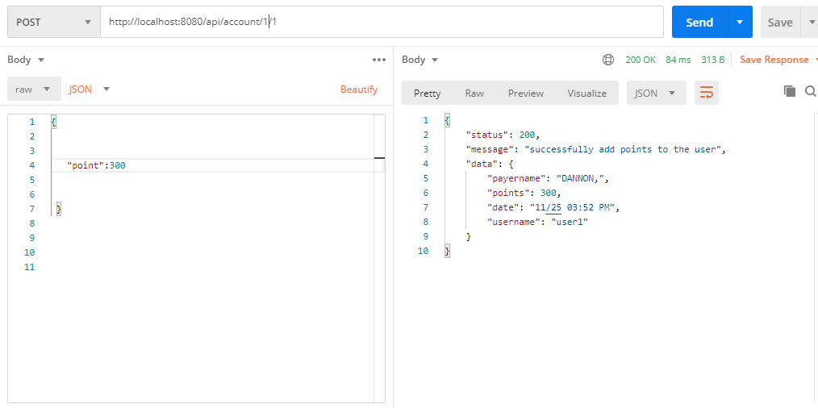
Testing document sample

Slide 6
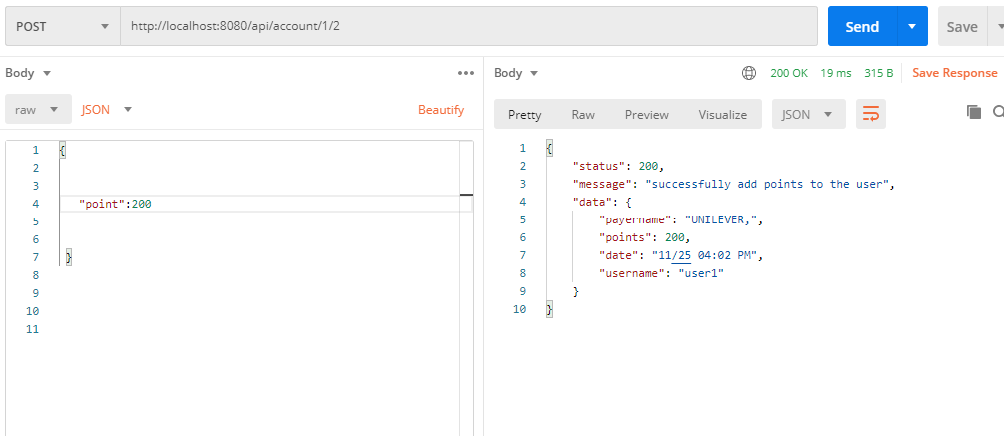
Cont…

Slide 7
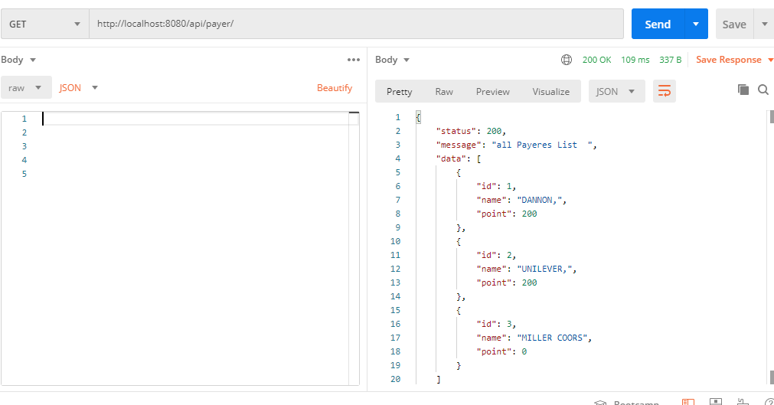
Cont…

Slide 8
Thank You
Please reach me ,if you have any questions

