Slide 1
Beers & Breweries
An analysis of US craft beer and US brewery offerings:
Geography, Alcohol Content, and Bitterness
Samuel Kadyebo
Faiz Ikramulla
SMU DS6306
October 15, 2018
https://github.com/fikramulla/6306-TeamStars-B-B.git

Slide 2
Introduction
Number of breweries per state
Median ABV/IBU per state
State with highest ABV beer offering
State with highest IBU beer offering
Summary statistics for ABV
Correlation in ABV & IBU
Provided raw market data, we will provide an analysis of:
Breweries
Geography
Craft beers
Types
Alcohol Content (ABV)
Bitterness (IBU)

Slide 3

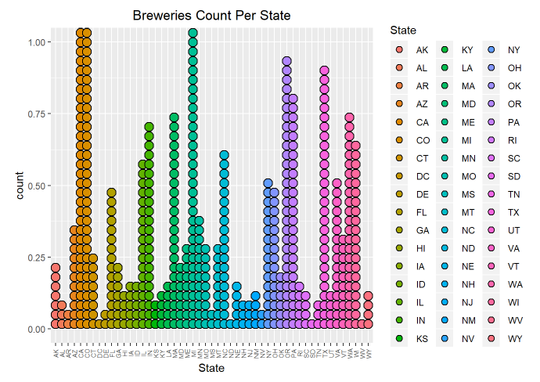
Breweries: Top 10 States
Colorado (47)
California (39)
Michigan (32)
Oregon (29)
Texas (28)
Pennsylvania (25)
Massachusetts (23)
Washington (23)
Indiana (22)
Wisconsin (22)

Slide 4
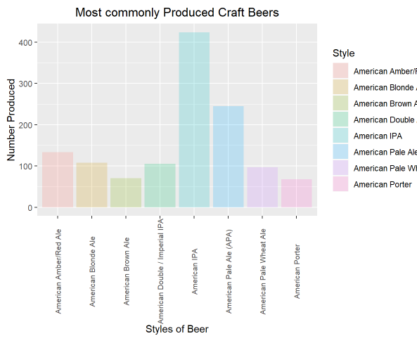
Types of Beers
Most common beers:
American IPAs
American APAs
ABV Stats:
Mean – 0.060
Median – 0.056
 – 0.014
IBU Stats:
Mean – 55
Median – 55
 – 26

Slide 5
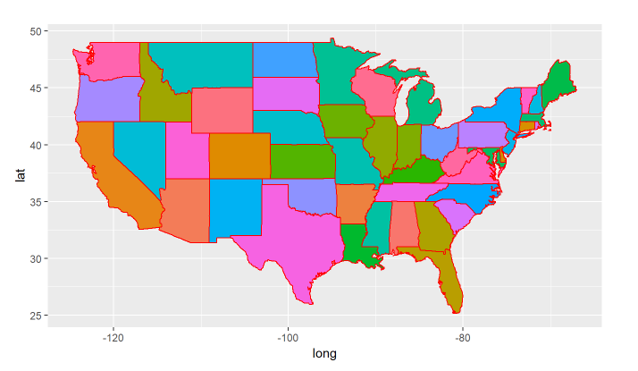
State ABV/IBU Ratings
Highest ABV Beer – Colorado
“Lee Hill Series V5” – 0.128
Highest IBU Beer – Oregon
“Bitter IPA” - 138

Slide 6
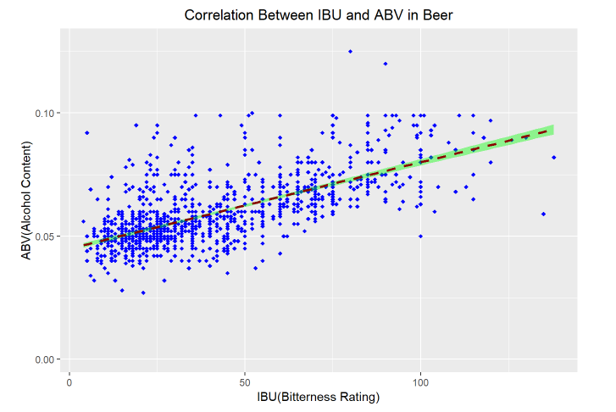
Correlation Analysis
ABV vs. IBU
Scatter Plot
Local polynomial regression fitting
“line-of-best-fit” approach
There appears to be an overall linear correlation between ABV and IBU.
Too much variance across the range to conclude a “direction correlation”
Cluster near low end

Slide 7
Conclusions
The Pacific Northwest has a high concentration of breweries.
The Upper Midwest has a high concentration of breweries.
Colorado – “The State of Craft Beer”
https://coloradobeer.org/why-colorado-is-a-breeding-ground-for-craft-beer/
Americans tend to prefer lower levels of bitterness and alcohol content.
ABV and IBU are apparently linearly, but not directly, correlated.
Americans love beer!
Provided raw market data, we provided an analysis of:
Breweries per state
Median ABV/IBU per state
State with highest ABV beer - Colorado
State with highest IBU beer - Oregon
Summary statistics for ABV
Mean – 0.060
Median – 0.056
Correlation in ABV & IBU
Linearly correlated
High variance

