Slide 1

errorfaktor
spatial machine learning information error mitigation (ML-IEM)
faiz ikramulla
mano ramireddy
Maryville University Data Science, September 2020

Slide 2
Influence – neither good nor bad
Fundamental concept in organization behavior
”the power or capacity of causing an effect in indirect or intangible ways” (mw)
-Is social media influence spatially random?
-Is social media influence spatially unbiased?
-Is social media influence spatially proprietary? – NO!
Social media data is MASSIVE, yet (some?) is free and open source !
We can model and locate the “error”, and optimize or “fix” it

Slide 3
Machine Learning
FAST(ER) computation of MASSIVE information to achieve explainable human & machine usable solutions
-”all models are wrong, some models are useful”
-error modeling - global and local optimizations possible
-quantization, discretization, transformation
-3D (lat,lon,z) – possible for spatial
-4D (x,y,z + t) (time-series) – good for temporal spatial
Patterns of “error” in space and time in dimensions not perceivable by humans alone

Slide 4
Machine Learning
Indirect to direct
Intangible to tangible
Invisible to visible…
… Influence to neutrality
-SORT , FILTER , SELECT , JOIN , REMOVE
-NLP (Text, Audio, Locational, Other Behaviors)
-Clustering / Vector Machines

Slide 5
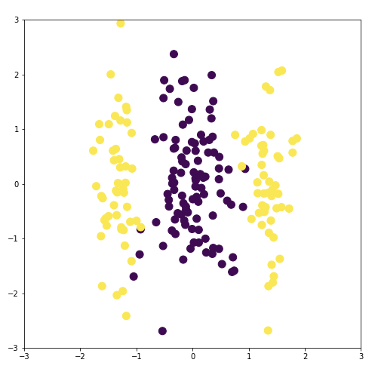
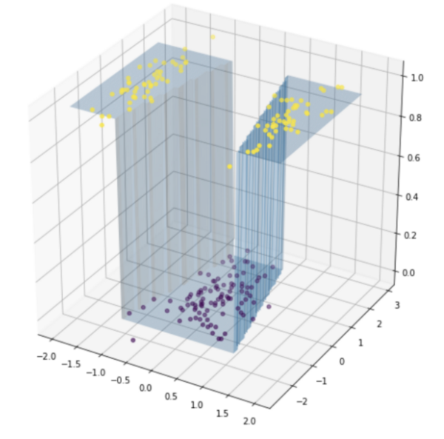
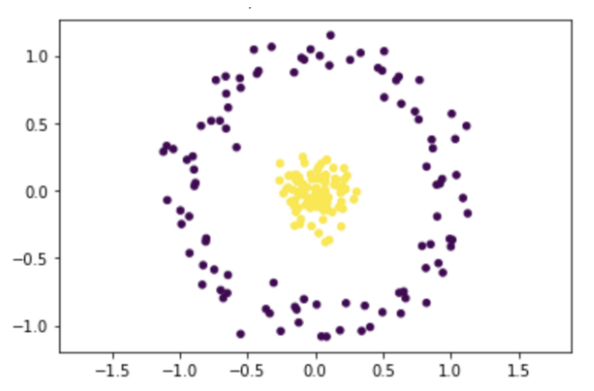
Machine Learning – Ex. https://towardsdatascience.com/animations-of-neural-networks-transforming-data-42005e8fffd9

Slide 6
Machine Learning – Feature Engineering
Word source (original, re-post, human generated, machine generated)
Word stats (static) – min, max, mean, standard deviation, histos
Word stats (dynamic) – time series min, max, mean, std.
Word association per time or per location or per time&location
Same as above for emoji / symbols / digital images / digital video / etc.
ESTIMATION: only about 10-20% of the social media has an original source. The rest is reposts or “shares”.

Slide 7
Machine Learning – Label Determination
Word association to other words or other events
Unsupervised Learning – we are agnostic on influence – based on our features, we just want the machine to differentiate in ways we can not (easily) perceive
We can then look for correlations between the differentiators (or their transformations) and apply optimization methods to reduce the error

Slide 8
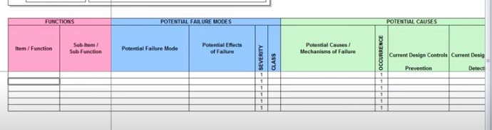
Solution Proposal (ML-IEM)
Like an FMEA
Mode – normal, abnormal, incorrect
Severity – catastrophic, critical, marginal, negligible
Likelihood – frequent, probable, occasional, remote, improbable

Slide 9
Dataset - Twitter Hydroxychloroquine https://digital.library.unt.edu/ark:/67531/metadc1706013/
Twitter Hydroxychloroquine (UNT)
Mode – normal, abnormal, incorrect
Severity – catastrophic, critical, marginal, negligible
Likelihood – frequent, probable, occasional, remote, improbable
FACT: only 13-14% of this tweet data consisted of original posts.

Slide 10
Machine Learning – Algo Development
Main Flow:
STEP 1: Model with all tweets
STEP 2: Model with retweets/reposts FILTERed OUT / REMOVEd
STEP 3: Compare - Are the differentiators now more or less or similarly evident?
REPEAT 1-3 (SORT , FILTER , REMOVE , etc.):
Repetitive twitter handle sources, repetitive associate words
Human vs. machine source
Paid vs. unpaid source – need independent data set

Slide 11
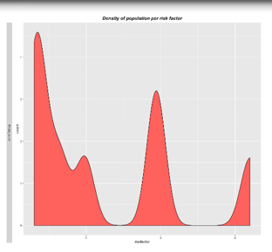
Machine Learning + Geospatial
Example:
Probability Dist. Function of model “error” computation based on geocoded input data
Not normalized / not random
3 possible anomalies
Where AND when are they?
Events in that timeframe / location?
How to normalize / reduce?

Slide 12
Solution Proposal - reduce “error”
Identify factors that when removed trend towards normalization.
Spatially correlate these to specific locations – with statistical power
Highlight these as geocoded “influencers” to users
-words, handles, expressions, linguistics, behaviors + correlations
-make non-personal
Present space-time alternative view “FMEA dashboard” - per metro region
-as-is
-with “influencers” removed
-with alternate “influencer” weighting (frequency* + TBD, pending model)

Slide 13
Workflow
!!! “An ounce of SQL is a worth a pound of python” !!!
SQL - Query / aggregate / filter / sort / combine / join / transform geocoded data with built-in integrity @Quality
R/Python – tidy, transform, process, analyze, model, visualize with automated math, stats, and logic @Speed
General – structured data, ethical data @Performance
Operation/Deployment – anywhere you like! @Interoperable
~70% of the time should be spent on preparing data to ensure reliable results.

Slide 14
Open Source Geospatial Tools
PostgreSQL (PostGIS)
R (rgdal, raster, sf, sp, leaflet)
Python (gdal, rasterio)
OSM
Open data everywhere!
Many other applications… election, census,

Slide 15
References
https://en.wikipedia.org/wiki/Failure_mode,_effects,_and_criticality_analysis
https://github.com/mona-kay/odsc-sql-for-data-science
https://www.merriam-webster.com/
https://towardsdatascience.com/animations-of-neural-networks-transforming-data-42005e8fffd9
https://digital.library.unt.edu/ark:/67531/metadc1706013/

