Slide 1
Computer Security: Principles and Practice
Chapter 1: Overview
EECS710: Information Security
Professor Hossein Saiedian
Fall 2014
Notes:
Lecture slides prepared by Dr Lawrie Brown (UNSW@ADFA) for “Computer Security: Principles and Practice”, 1/e, by William Stallings and Lawrie Brown, Chapter 1 “Overview”.

Slide 2
Chapter 1 overview
Computer Security Concepts
Threats, Attacks, and Assets
Security Functional Requirements
Fundamental Security Design Principles
Attack Surfaces and Attack Trees
Computer Security Strategy

Slide 3
Learning objectives
Describe the key security requirements of confidentiality, integrity and availability
Discuss the types security threats and attacks that must be dealt with
Summarize the functional requirements for computer security
Explain the fundamental security design principles
Discuss the use of attack surfaces and attack trees
Understand the principle aspects of a comprehensive security strategy

Slide 4
A definition of computer security
Computer security: The protection afforded to an automated information system in order to attain the applicable objectives of preserving the integrity, availability and confidentiality of information system resources (includes hardware, software, firmware, information/data, and telecommunications)
NIST 1995
Notes:
This chapter provides an overview of computer security. We begin with a discussion of what we mean by computer security. The NIST Computer Security Handbook [NIST95] defines the term computer security as shown. This definition introduces three key objectives that are at the heart of computer security as we see on the next slide.

Slide 5
Three key objectives (the CIA triad)
Confidentiality
Data confidentiality: Assures that confidential information is not disclosed to unauthorized individuals
Privacy: Assures that individual control or influence what information may be collected and stored
Integrity
Data integrity: assures that information and programs are changed only in a specified and authorized manner
System integrity: Assures that a system performs its operations in unimpaired manner
Availability: assure that systems works promptly and service is not denied to authorized users

Slide 6
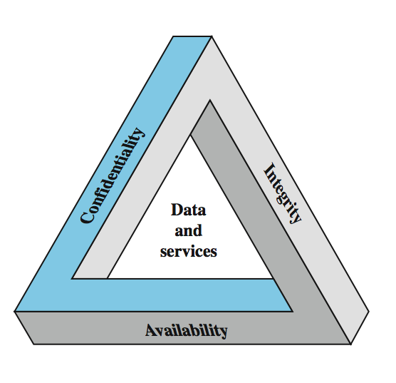
Key Security Concepts
Notes:
These three concepts form what is often referred to as the CIA triad (Figure 1.1). The three concepts embody the fundamental security objectives for both data and for information and computing services. FIPS PUB 199 provides a useful characterization of these three objectives in terms of requirements and the definition of a loss of security in each category:
• Confidentiality: Preserving authorized restrictions on information access and disclosure, including means for protecting personal privacy and proprietary information. A loss of confidentiality is the unauthorized disclosure of information.
• Integrity: Guarding against improper information modification or destruction, and includes ensuring information non-repudiation and authenticity. A loss of integrity is the unauthorized modification or destruction of information.
• Availability: Ensuring timely and reliable access to and use of information. A loss of availability is the disruption of access to or use of information or an information system.
Although the use of the CIA triad to define security objectives is well established, some in the security field feel that additional concepts are needed to present a complete picture. Two of the most commonly mentioned are:
• Authenticity: The property of being genuine and being able to be verified and trusted; confidence in the validity of a transmission, a message, or message originator. • Accountability: The security goal that generates the requirement for actions of an entity to be traced uniquely to that entity.

Slide 7
Other concepts to a complete security picture
Authenticity: the property of being genuine and being able to be verified and trusted; confident in the validity of a transmission, or a message, or its originator
Accountability: generates the requirement for actions of an entity to be traced uniquely to that individual to support nonrepudiation, deference, fault isolation, etc

Slide 8
Levels of security breach impact
Low: the loss will have a limited impact, e.g., a degradation in mission or minor damage or minor financial loss or minor harm
Moderate: the loss has a serious effect, e.g., significance degradation on mission or significant harm to individuals but no loss of life or threatening injuries
High: the loss has severe or catastrophic adverse effect on operations, organizational assets or on individuals (e.g., loss of life)

Slide 9
Examples of security requirements: Confidentiality
Student grade information is an asset whose confidentiality is considered to be very high
The US FERPA Act: grades should only be available to students, their parents, and their employers (when required for the job)
Student enrollment information: may have moderate confidentiality rating; less damage if enclosed
Directory information: low confidentiality rating; often available publicly
Notes:
FERPA: Family Education Right and Privacy Act

Slide 10
Examples of security requirements: Integrity
A hospital patient’s allergy information (high integrity data): a doctor should be able to trust that the info is correct and current
If a nurse deliberately falsifies the data, the database should be restored to a trusted basis and the falsified information traced back to the person who did it
An online newsgroup registration data: moderate level of integrity
An example of low integrity requirement: anonymous online poll (inaccuracy is well understood)
Notes:
FERPA: Family Education Right and Privacy Act

Slide 11
Examples of security requirements: Availability
A system that provides authentication: high availability requirement
If customers cannot access resources, the loss of services could result in financial loss
A public website for a university: a moderate availably requirement; not critical but causes embarrassment
An online telephone directory lookup: a low availability requirement because unavailability is mostly annoyance (there are alternative sources)
Notes:
FERPA: Family Education Right and Privacy Act

Slide 12
Challenges of computer security
Computer security is not simple
One must consider potential (unexpected) attacks
Procedures used are often counter-intuitive
Must decide where to deploy mechanisms
Involve algorithms and secret info (keys)
A battle of wits between attacker / admin
It is not perceived on benefit until fails
Requires constant monitoring
Too often an after-thought (not integral)
Regarded as impediment to using system
Notes:
Computer security is both fascinating and complex. Some of the reasons follow:
1. Computer security is not as simple as it might first appear to the novice. The requirements seem to be straightforward, but the mechanisms used to meet those requirements can be quite complex and subtle.
2. In developing a particular security mechanism or algorithm, one must always consider potential attacks (often unexpected) on those security features.
3. Hence procedures used to provide particular services are often counterintuitive.
4. Having designed various security mechanisms, it is necessary to decide where to use them.
5. Security mechanisms typically involve more than a particular algorithm or protocol, but also require participants to have secret information, leading to issues of creation, distribution, and protection of that secret information.
6. Computer security is essentially a battle of wits between a perpetrator who tries to find holes and the designer or administrator who tries to close them.
7. There is a natural tendency on the part of users and system managers to perceive little benefit from security investment until a security failure occurs.
8. Security requires regular monitoring, difficult in today's short-term environment.
9. Security is still too often an afterthought - incorporated after the design is complete.
10. Many users / security administrators view strong security as an impediment to efficient and user-friendly operation of an information system or use of information.

Slide 13
A model for computer security
Table 1.1 and Figure 1.1 show the relationship
Systems resources
Hardware, software (OS, apps), data (users, system, database), communication facilities and network (LAN, bridges, routers, …)
Our concern: vulnerability of these resources (corrupted, unavailable, leaky)
Threats exploit vulnerabilities
Attack is a threat that is accrued out
Active or passive; from inside or from outside
Countermeasures: actions taken to prevent, detect, recover and minimize risks

Slide 14
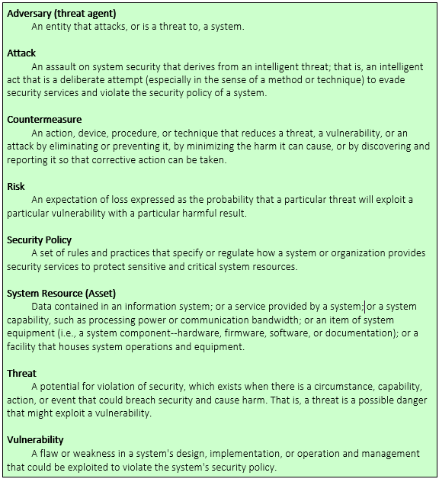
Computer security terminology

Slide 15
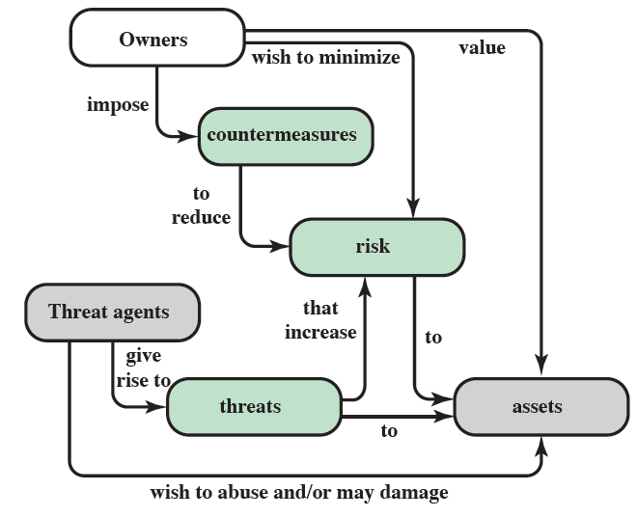
Security concepts and relationships

Slide 16
Threat consequences
Unauthorized disclosure: threat to confidentiality
Exposure (release data), interception, inference, intrusion
Deception: threat to integrity
Masquerade, falsification (alter data), repudiation
Disruption: threat to integrity and availability
Incapacitation (destruction), corruption (backdoor logic), obstruction (infer with communication, overload a line)
Usurpation: threat to integrity
Misappropriation (theft of service), misuse (hacker gaining unauthorized access)
Notes:
RFC 2828 describes four kinds of threat consequences and kinds of attacks that result:
Unauthorized disclosure is a threat to confidentiality:
Exposure: Sensitive data is directly released to an unauthorized entity.
Interception: An unauthorized entity directly accesses sensitive data in transit.
Inference: an unauthorized entity indirectly accesses sensitive data by reasoning from characteristics or byproducts of communications.
Intrusion: An unauthorized entity circumvents system's security protections.
Deception is a threat to either system integrity or data integrity:
Masquerade: An unauthorized entity poses as an authorized entity.
Falsification: False data deceives an authorized entity.
Repudiation: An entity deceives another by falsely denying responsibility for an act.
Disruption is a threat to availability or system integrity:
Incapacitation: Prevent/interrupt system operation by disabling a system component
Corruption: adversely modifying system functions or data
Obstruction: interrupts delivery of system services by hindering system operation.
Usurpation is a threat to system integrity:
Misappropriation: unauthorized logical or physical control of a system resource.
Misuse: Causes system to perform a function or service detrimental to security.

Slide 17
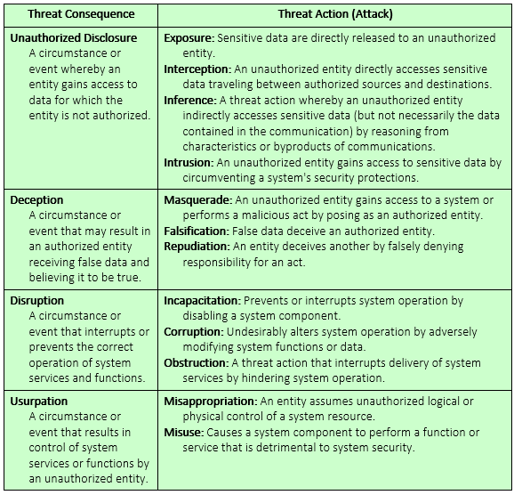
Threat consequences (tabular form)

Slide 18
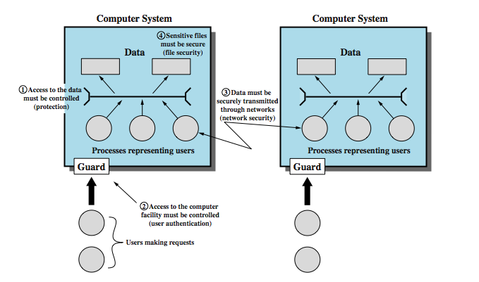
The scope of computer security
Notes:
As mentioned, the assets of a computer system can be categorized as hardware, software, data, and communication lines and networks. We briefly describe these four categories and relate these to the concepts of integrity, confidentiality, and availability, as illustrated here in Figure 1.3.
Hardware - A major threat = is the threat to availability. Hardware is the most vulnerable to attack and the least susceptible to automated controls. Threats include accidental and deliberate damage to equipment as well as theft. Theft of CDROMs and DVDs can lead to loss of confidentiality. Physical and administrative security measures are needed to deal with these threats.
Software - includes the operating system, utilities, and application programs. A key threat is an attack on availability. Software is often easy to delete. Software can also be altered or damaged to render it useless. Careful software configuration management can maintain high availability. A more difficult problem is software modification (e.g. from virus/worm) that results in a program that still functions but that behaves differently than before, which is a threat to integrity/authenticity.
Data - involves files and other forms of data controlled by individuals, groups, and business organizations. Security concerns with respect to data are broad, encompassing availability, secrecy, and integrity. In the case of availability, the concern is with the destruction of data files, which can occur either accidentally or maliciously. The obvious concern with secrecy is the unauthorized reading of data files or databases. A less obvious secrecy threat involves the analysis of data and manifests itself in the use of so-called statistical databases, which provide summary or aggregate information. Finally, data integrity is a major concern in most installations. Modifications to data files can have consequences ranging from minor to disastrous.

Slide 19
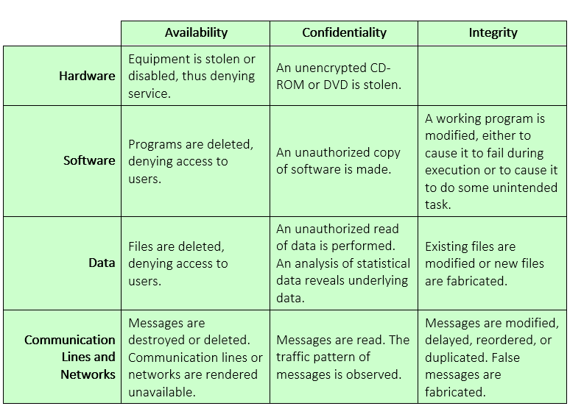
Examples of threats

Slide 20
Security functional requirements (FIPS 200)
Technical measures
Access control; identification & authentication; system & communication protection; system & information integrity
Management controls and procedures
Awareness & training; audit & accountability; certification, accreditation, & security assessments; contingency planning; maintenance; physical & environmental protection; planning; personnel security; risk assessment; systems & services acquisition
Overlapping technical and management
Configuration management; incident response; media protection
Notes:
Here we view countermeasures in terms of functional requirements, and we follow the classification defined in FIPS PUB 200 (Minimum Security Requirements for Federal Information and Information Systems). This standard enumerates seventeen security-related areas, and are defined in Table 1.4 in the text. The requirements listed in FIP PUB 200 encompass a wide range of countermeasures to security vulnerabilities and threats. Each of the functional areas may involve both computer security technical measures and management measures. Functional areas that are primarily require computer security technical measures include access control; identification and authentication; system and communication protection; and system and information integrity. Functional areas that primarily involve management controls and procedures include awareness and training; audit and accountability; certification, accreditation, and security assessments; contingency planning; maintenance; physical and environmental protection; planning; personnel security; risk assessment; and systems and services acquisition. Functional areas that overlap computer security technical measures and management controls include configuration management; incident response; and media protection.

Slide 21
X.800 Security Architecture
X.800, Security Architecture for OSI
systematic way of defining requirements for security and characterizing approaches to satisfying them
defines:
security attacks - compromise security
security mechanism - act to detect, prevent, recover from attack
security service - counter security attacks
Notes:
ITU-T Recommendation X.800, Security Architecture for OSI, defines a systematic way of defining the requirements for security and characterizing the approaches to satisfying those requirements. The OSI security architecture is useful to managers as a way of organizing the task of providing security. The OSI security architecture focuses on security attacks, mechanisms, and services. These can be defined briefly as:
• Security attack: Any action that compromises the security of information owned by an organization. cf. network security attacks slide earlier
• Security mechanism: A mechanism that is designed to detect, prevent, or recover from a security attack. cf. functional requirements from previous slide or Table 1.6 in text.
• Security service: A service that enhances the security of the data processing systems and the information transfers of an organization. The services are intended to counter security attacks, and they make use of one or more security mechanisms to provide the service. cf CIA security concepts earlier, or Table 1.5 in text.

Slide 22
Fundamental security design principles [1/4]
Despite years of research, it is still difficult to design systems that comprehensively prevent security flaws
But good practices for good design have been documented (analogous to software engineering)
Economy of mechanism, fail-safe defaults, complete mediation, open design, separation of privileges, lease privilege, least common mechanism, psychological accountability, isolation, encapsulation, modularity, layering, least astonishment

Slide 23
Fundamental security design principles [2/4]
Economy of mechanism: the design of security measures should be as simple as possible
Simpler to implement and to verify
Fewer vulnerabilities
Fail-safe default: access decisions should be based on permissions; i.e., the default is lack of access
Complete mediation: every access should checked against an access control system
Open design: the design should be open rather than secret (e.g., encryption algorithms)

Slide 24
Fundamental security design principles [3/4]
Isolation
Public access should be isolated from critical resources (no connection between public and critical information)
Users files should be isolated from one another (except when desired)
Security mechanism should be isolated (i.e., preventing access to those mechanisms)
Encapsulation: similar to object concepts (hide internal structures)
Modularity: modular structure

Slide 25
Fundamental security design principles [4/4]
Layering (defense in depth): use of multiple, overlapping protection approaches
Least astonishment: a program or interface should always respond in a way that is least likely to astonish a user

Slide 26
Fundamental security design principles
Separation of privilege: multiple privileges should be needed to do achieve access (or complete a task)
Least privilege: every user (process) should have the least privilege to perform a task
Least common mechanism: a design should minimize the function shared by different users (providing mutual security; reduce deadlock)
Psychological acceptability: security mechanisms should not interfere unduly with the work of users

Slide 27
Attack surfaces
Attack surface: the reachable and exploitable vulnerabilities in a system
Open ports
Services outside a firewall
An employee with access to sensitive info
…
Three categories
Network attack surface (i.e., network vulnerability)
Software attack surface (i.e., software vulnerabilities)
Human attack surface (e.g., social engineering)
Attack analysis: assessing the scale and severity of threats

Slide 28
Attack trees
A branching, hierarchical data structure that represents a set of potential vulnerabilities
Objective: to effectively exploit the info available on attack patterns
published on CERT or similar forums
Security analysts can use the tree to guide design and strengthen coiuntermeasures

Slide 29
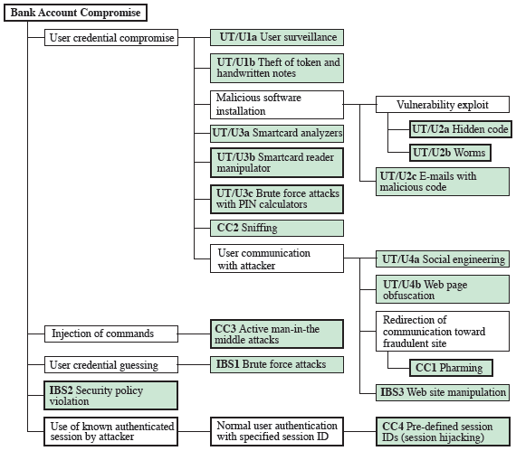
An attack tree

Slide 30
Computer security strategy
An overall strategy for providing security
Policy (specs): what security schemes are supposed to do
Assets and their values
Potential threats
Ease of use vs security
Cost of security vs cost of failure/recovery
Implementation/mechanism: how to enforce
Prevention
Detection
Response
Recovery
Correctness/assurance: does it really work (validation/review)

Slide 31
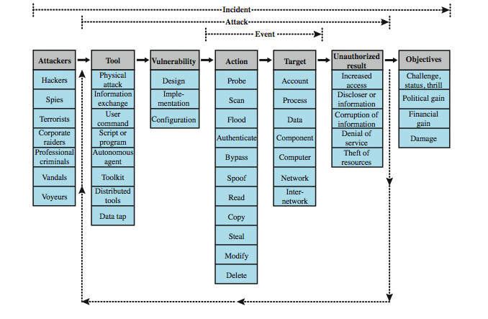
Security Taxonomy
Notes:
There is one generally agreed-upon approach used by the CERT and other organizations concerned with computer security, the computer and network security incident taxonomy. Figure 1.4 from the text depicts the overall scope of computer security using this taxonomy. At a top level of detail, an attacker, or group of attackers, achieves their objectives by performing attacks. An incident may be comprised of a single or multiple attacks, as illustrated by the return loop . The key elements are:
• Action: A step taken by a user or process in order to achieve a result
• Target: A computer or network logical entity or physical entity
• Event: An action directed at a target that is intended to result in a change of state, or status, of the target
• Tool: A means of exploiting a computer or network vulnerability
• Vulnerability: A weakness in a system allowing unauthorized action
• Unauthorized result: An unauthorized consequence of an event
• Attack: A series of steps taken by an attacker to achieve an unauthorized result
• Attacker: An individual who attempts one or more attacks in order to achieve an objective
• Objectives: The purpose or end goal of an incident
• Incident: a group of attacks that can be distinguished from other attacks because of the distinctiveness of the attackers, attacks, objectives, sites, and timing

Slide 32
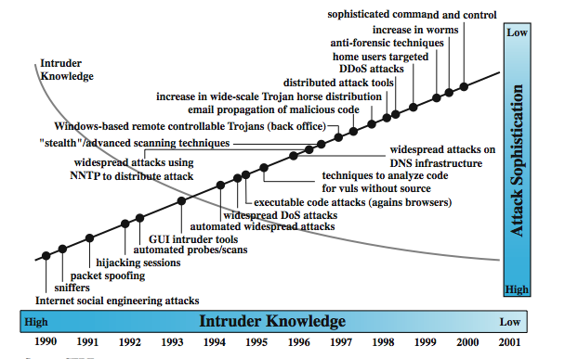
Security Trends
Notes:
The trends reported by the Computer Emergency Response Team (CERT) Coordination Center, as shown in the text in Figure 1.5, have an increasing trend in Internet-related vulnerabilities and incidents reported to CERT over a 10-year period.
Over time, the attacks on the Internet and Internet-attached systems have grown more sophisticated while the amount of skill and knowledge required to mount an attack has declined, as shown here in Figure 1.6 from the text. Attacks have become more automated and can cause greater amounts of damage. This increase in attacks coincides with an increased use of the Internet and with increases in the complexity of protocols, applications, and the Internet itself. Critical infrastructures increasingly rely on the Internet for operations. Individual users rely on the security of the Internet, email, the Web, and Web-based applications to a greater extent than ever. Thus, a wide range of technologies and tools are needed to counter the growing threat.

Slide 33
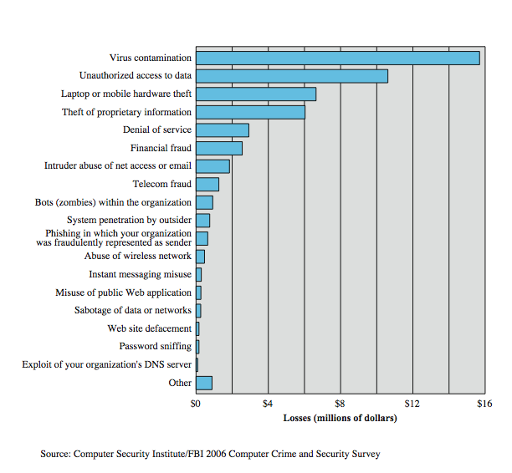
Computer Security Losses
Notes:
Another useful view of trends in computer security is provided by the CSI/FBI Computer Crime and Security Survey for 2006, conducted by the Computer Security Institute, a private organization, and the U.S. Federal Bureau of Investigation (FBI). Figure 1.7 here shows the estimated losses caused by various types of computer security incidents. The top four categories of losses (viruses, unauthorized access, laptop or mobile hardware theft, and theft of proprietary information) accounted for nearly three-quarters of the total loss. Note that these attacks need to be countered by technical measures (in the case of viruses and unauthorized access); physical security measures (laptop or mobile hardware theft); or a combination (theft of proprietary information, which could include electronic as well as paper assets). Other management controls would also come into play.

Slide 34
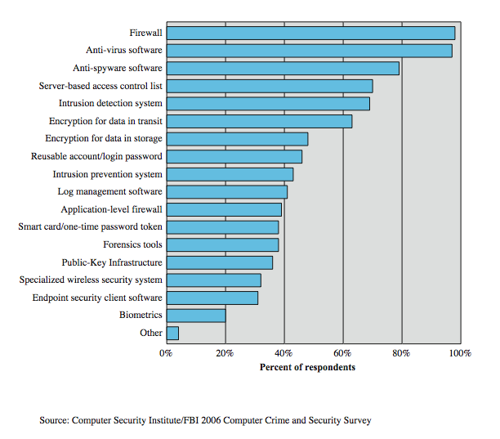
Security Technologies Used
Notes:
Figure 1.8here, also from the CSI/FBI Computer Crime and Security Survey for 2006, indicates the types of security technology used by organizations to counter threats. Both firewalls and anti-virus software are used almost universally. This popularity reflects a number of factors:
• The maturity of these technologies means that security administrators are very familiar with the products and are confident of their effectiveness.
• Because these technologies are mature and there are a number of vendors, costs tend to be quite reasonable and user-friendly interfaces are available
• The threats countered by these technologies are among the most significant facing security administrators.

Slide 35
Summary
Security concepts
Terminology
Functional requirements
Security design principles
Security strategy
Notes:
Chapter 1 summary.

